Slide 1

Project Details
Velocity Subwords : Emphasizes speed and the subword nature for Multimedia operation on simple processor
Project Number: 3173
Student Names: Tom Berenshtain, Amit Rachmiel
Mentor Name: Oren Ganon
Project Location: Tel Aviv University
Mentor Approval:
חתימה __________________

Slide 2
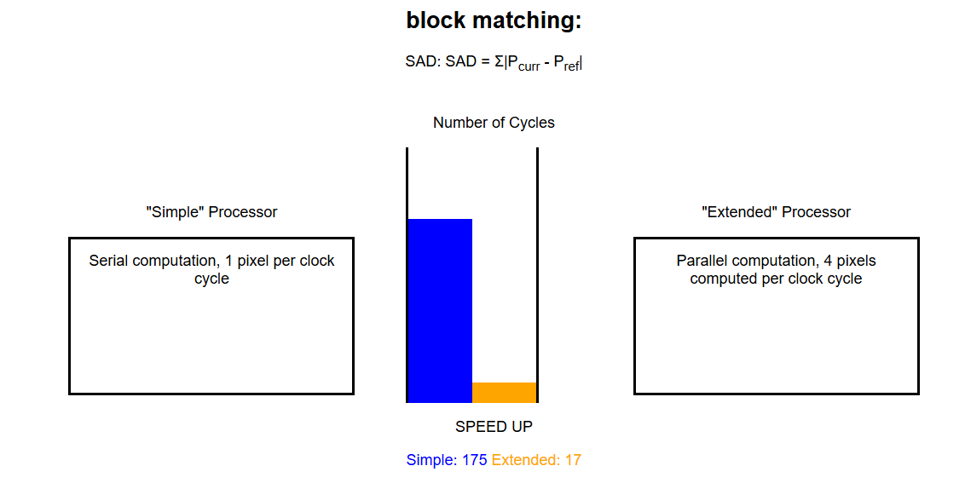
Motivation

Slide 3
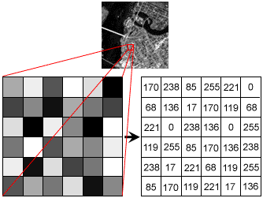
Introduction to Image Processing & Parallel Computation
Pixels and Image Representation:
A pixel is the smallest unit of a digital image.
Images are represented as 2D matrices of pixel values.
Parallel Processing in Image Computation:
Many image processing tasks require applying the same operation to multiple pixels simultaneously.
Examples: Brightness adjustment, contrast enhancement, edge detection and filtering.
SIMD allows performing these operations on multiple pixels at once, significantly reducing computation time.
Matrix Transpose: Turns an image sideways or rearranges pixels for easier processing.
Image Sharpening: Makes an image clearer by making edges stand out.
Block Matching: Finds movement between pictures by checking groups of pixels, helping with video operation

Slide 4
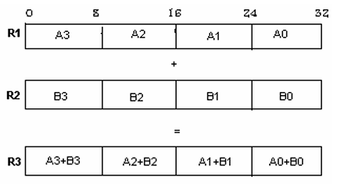
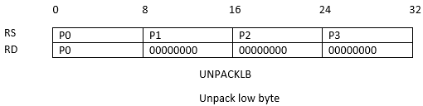
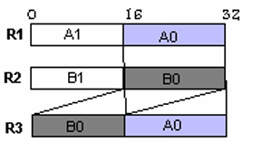
Motivation
parallel processing unit processes 4 pixels (8-bit each) simultaneously instead of processing one pixel per clock cycle in the basic processor.
For example in block matching:
Why is it slow on a basic processor? PADDB
The formula for SAD: SAD= ∑|P_curr – P_ref|, each pixel must be processed separately(Extracting each pixel for processing took about 37 cycles.),requiring subtraction(1 cycle), absolute value(2-3 cycle), and summation(1 cycle).
Total for one pixel:42 cycles
For a 2x2 block (4 pixels):4×42+7=175 cycles.
Performance Calculation with SIMD
Use PABSSUBB to compute 4 differences and absolute values in one instruction → 1 cycle for 4 pixel
Extract 1 pixel using PERMUTEB and UNPACKLB-> 2 cycles
summation→ 1 cycle per pixel
Total for 4 pixels: 13 cycles per 4 pixels + 4 = 17 cycles
Speed up = 175/17 = 10.29 PACKLH(PACK LOW HALF WORD)
help for matrix transpose

Slide 5
Project Goal and Methods
Project Goal:
Improve processing speed for multimedia applications.
Reduce dynamic power consumption compared to existing simple DLX processor.
Implementation Methods:
Using Xilinx and RESA simulators for hardware design and verification.
Implementing a SIMD instruction set for parallel processing
creating a new OPCODE for these operations
generating new control signals and modifying the processor's control unit
adjusting the DATAPATH to support parallel processing.
Implementation of assembly code before extensions for operations: block matching, matrix transpose, image sharpening
implementation of assembly code after parallel extension
performance comparison

Slide 6
Project Requirements
Beyond the basic DLX processor, the system must include:
Support for 39 parallel subword operations (8-bit or 16-bit) per clock cycle using SIMD instructions.
Performance at least 300% faster than the basic DLX processor in multimedia tasks.
Processor area not exceeding 130% of the basic DLX processor.
10-15% reduced power consumption in multimedia applications.
Project outputs:
FPGA Prototype:
Fully functional DLX-based RISC processor with subword parallel multimedia extension implemented on FPGA.
Extended Instruction Set:
New SIMD instructions (e.g., PADDUB, PSUBUH) optimized for parallel multimedia processing.
Performance Benchmarking:
Results comparing basic DLX vs. extended architecture across multimedia tasks
(e.g., Block Matching, Matrix Transpose, Image Sharpening).

Slide 7
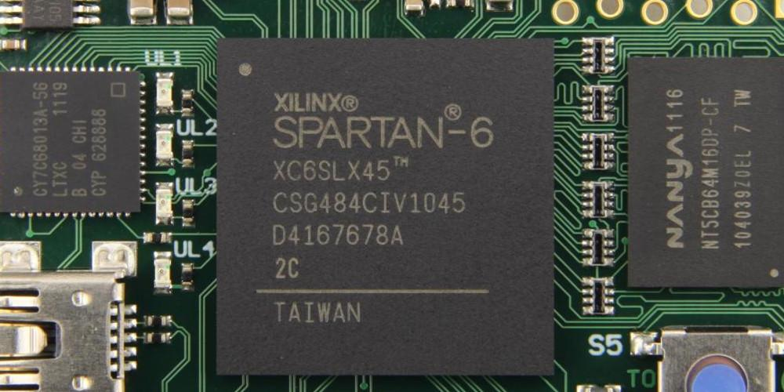
Block Diagram
Existing Components (Pre-Built at ACSL Lab):
Basic DLX Processor: The initial processor is already available and serves as the starting point for developing the enhanced system.
FPGA-DLX Interface (RESA): This unit is provided and ensures seamless communication via a bus between the FPGA and the personal computer.
Newly Designed Components (Created from the Ground Up in Verilog):
Parallel Image Processing Unit: Designed from the ground up to support high-speed image processing operations,
such as image sharpening and matrix transpose, through parallel pixel computations.
DLX PROCESSOR ON FPGA
memory
Main ALU
I/O Control
PC master
Parallel ALU Extension
memory
Monitor slave

Slide 8
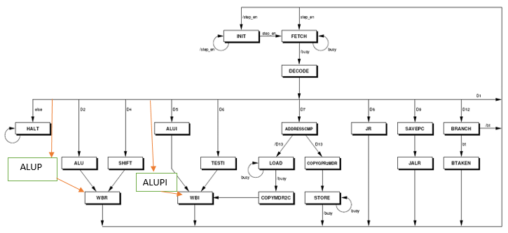

Implementation
Modifications to the Control Unit :
Control Unit Upgrade: The control unit redesigned to incorporate new states supporting SIMD instructions for parallel data processing.
Created efficient opcode coding for new instructions.
Modified Instruction Register (IR) for reading and decoding parallel instructions(ALUFP).
Added two new states (ALUP and ALUPI) to the state machine for parallel processing.
Introduced a new control signal (MUXALU_SEL) to switch between basic and parallel ALU.
Coordinated the other control signals to support new states.
R- type instruction

Slide 9
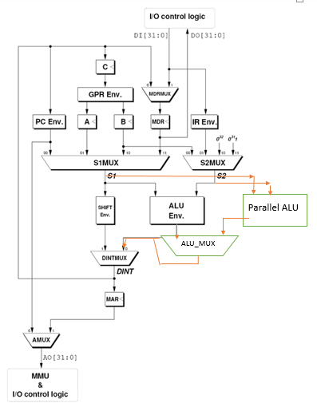
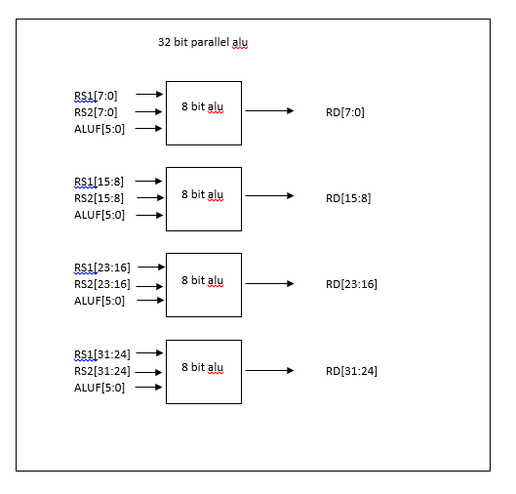
Implementation
Modifications to the Datapath:
Datapath Modification:
A parallel ALU supporting 39 new instructions
Added a new MUX to select between basic and parallel processor operations.

Slide 10
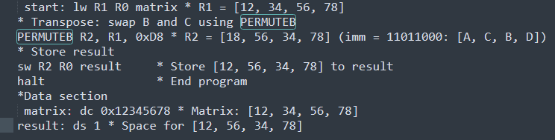
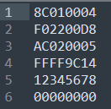
Implementation
Why We Developed an Assembler
Made assembler to convert assembly code to .DATA files for logic simulation in Xilinx.
.DATA files from assembler were input for simulator to test parallel commands.
How the Assembler Works – General Algorithm Idea
Assembler reads assembly code as input and turns it into a .DATA file with binary machine code.
Splits code into lines and identifies command types (e.g., R-type, I-type, or SIMD).
Breaks each line into parts: command name, registers, immediate values, or labels.
Maps parts to binary code using DLX instruction format.
Writes binary code to .DATA file for Xilinx simulator to test processor behavior.

Slide 11
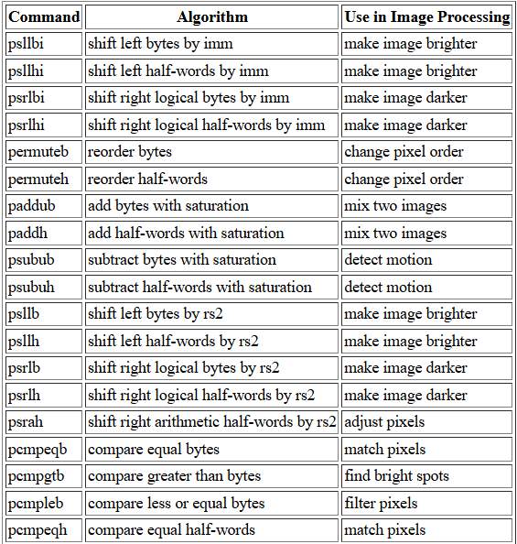
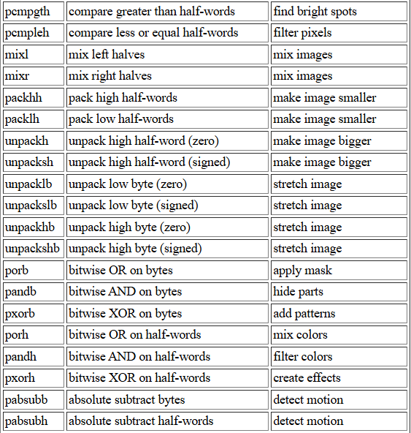
SIMD Instructions
A parallel ALU supporting 39 new instructions.

Slide 12
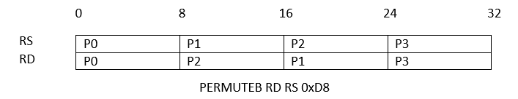
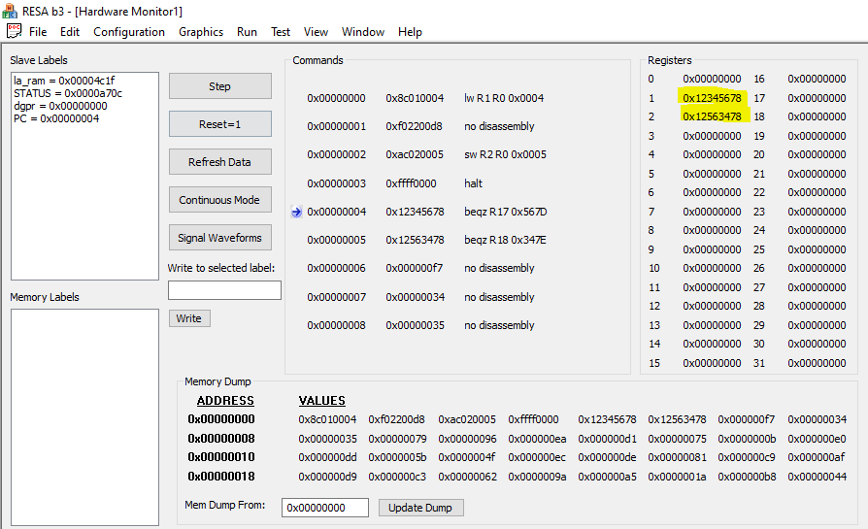
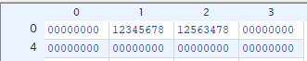
Demonstration – matrix transpose
Matrix transpose is used in image processing to rotate or flip an image by swapping its rows and columns, helping with tasks like image transformation, feature extraction, and data reorganization.
A matrix transpose for a 2x2 matrix (4 pixels of 8 bits each) is performed by swapping the values B and C within a single 32-bit word, so that [A, B, C, D] becomes [A, C, B, D].
Example result:
Input: 0x12345678 -> [A=12, B=34, C=56, D=78]
Output: 0x12563478 -> [A=12, C=56, B=34, D=78]
Example for logical test of Matrix Transpose operation
ModelSim environment (Xilinx)
for an extended processor that supports parallel operations.
An illustration of the processor's register memory is attached.
R1 is used for input, and R2 is used for output
Example of a hardware test for the Matrix Transpose operation
extended processor that supports parallel operations in the RESA environment.
The input and output are shown in yellow.

Slide 13
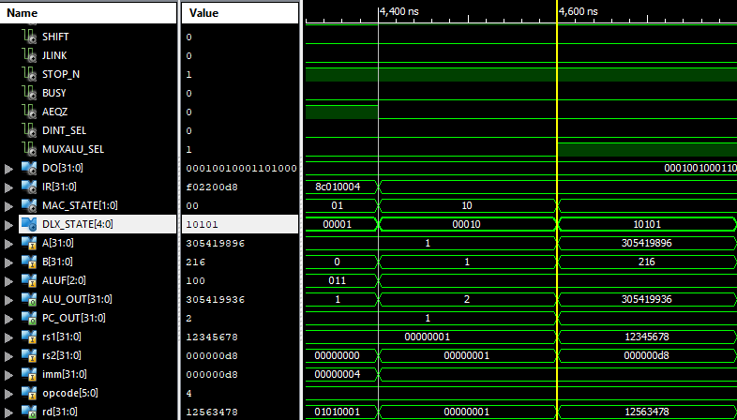
Demonstration – matrix transpose
At time 4600 ns, we can see that the control signal MUXALU_SEL is activated, which tells us that the processor is in parallel processing mode. We can also see that the processor state (DLX_STATE) is in binary 10101, which is decimal 21. This indicates the ALUPI state, since PERMUTEB a parallel instruction and an I-type instruction. The operation swaps the 8 bits in positions 8–15 with the 8 bits in positions 16–23 of a 32-bit word, as shown in the diagram (rs1 as input and rd as output).

Slide 14
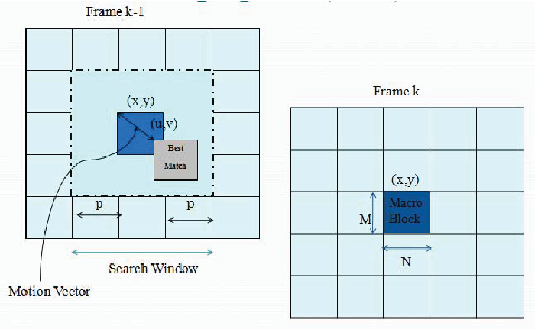
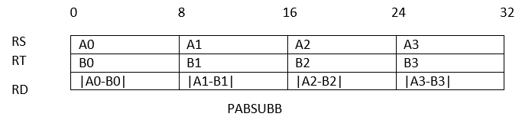
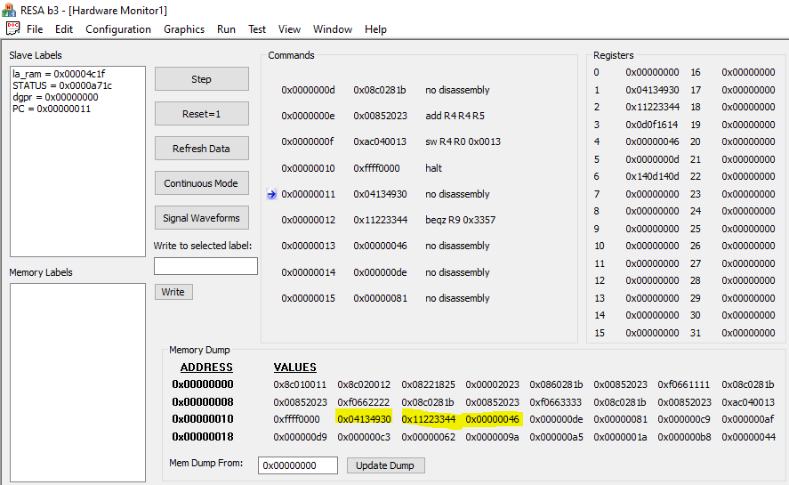
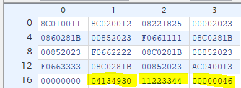
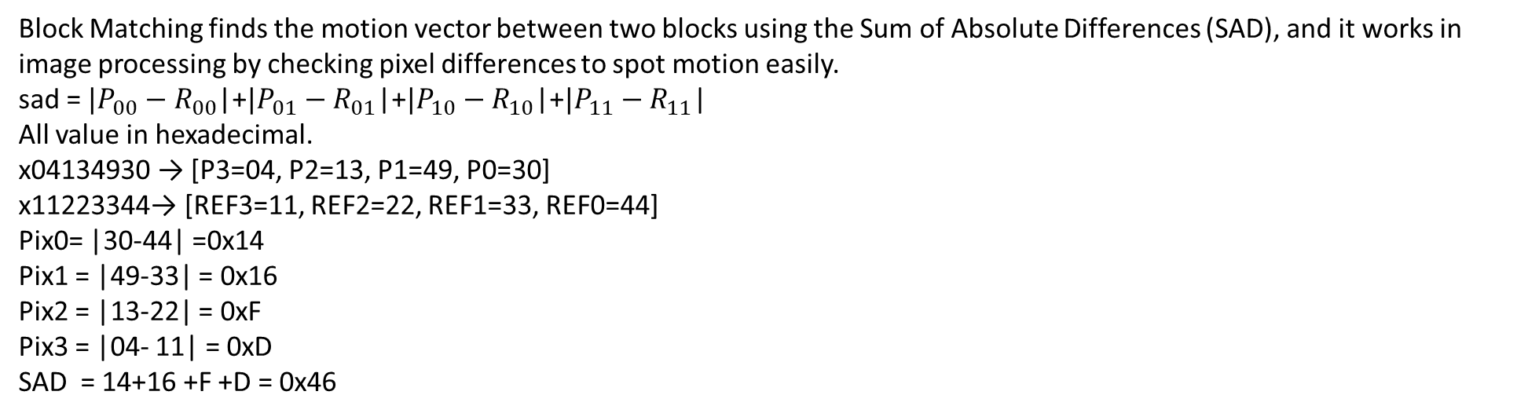
Demonstration – block matching
Block Matching finds the motion vector between two blocks using the Sum of Absolute Differences (SAD), and it works in image processing by checking pixel differences to spot motion easily.
sad = ${|P}_{00}−R_{00}$|+${|P}_{01}−R_{01}$|+${|P}_{10}−R_{10}$|+${|P}_{11}−R_{11}$|
All value in hexadecimal.
x04134930 → [P3=04, P2=13, P1=49, P0=30]
x11223344→ [REF3=11, REF2=22, REF1=33, REF0=44]
Pix0= |30-44| =0x14
Pix1 = |49-33| = 0x16
Pix2 = |13-22| = 0xF
Pix3 = |04- 11| = 0xD
SAD = 14+16 +F +D = 0x46
Example of a hardware test for the Block Matching operation
extended processor that supports parallel operations in the RESA environment.
The input and output are shown in yellow.
Example for logical test of Block Matching operation
ModelSim environment (Xilinx)
for an extended processor that supports parallel operations.
An illustration of the processor's external memory is attached.
Inputs and output are mark in yellow

Slide 15
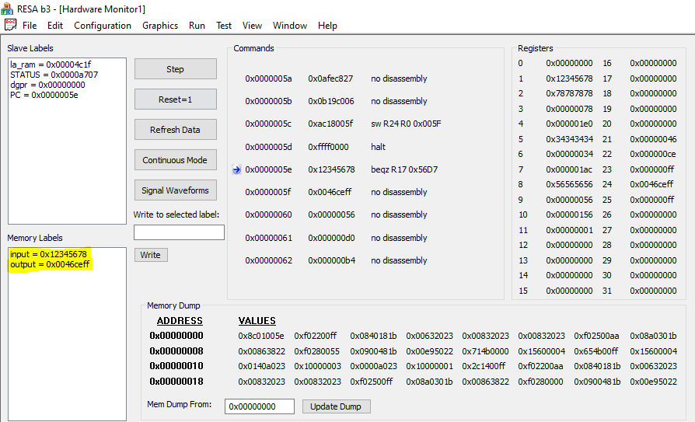
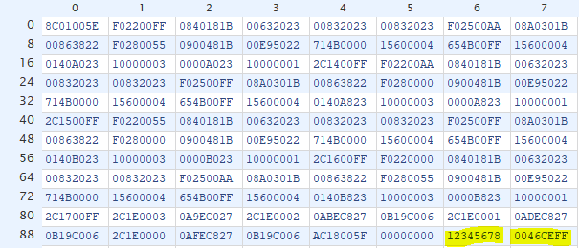
Demonstration – Image Sharpening
Image Sharpening: Sharpens images by increasing edge contrast, making details clearer, using filters like Laplacian to find sharp pixel changes.
Input Block: Stored in a 32-bit word 0x12345678 → [P00 = 18, P01 = 52, P10 = 86, P11 = 120]
(Hex values converted to decimal)
Laplacian Formula: Laplacian = 3 × pixel - neighbor1 - neighbor2
S = pixel + LaplacianCalculations (in decimal):
S00: 3×18 - 52 - 86 = -84 → 18 + (-84) = -66 → clipped to 0
S01: 3×52 - 18 - 120 = 18 → 52 + 18 = 70
S10: 3×86 - 18 - 120 = 120 → 86 + 120 = 206
S11: 3×120 - 52 - 86 = 222 → 120 + 222 = 342 → clipped to 255
Output: [S00 = 0, S01 = 70, S10 = 206, S11 = 255]→ 0x0046CEFF (in hex)
Example for logical test of Image Sharpening operation
ModelSim environment (Xilinx)
for an extended processor that supports parallel operations.
An illustration of the processor's external memory is attached.
Inputs and output are mark in yellow
Example of a hardware test for the Image Sharpening operation
extended processor that supports parallel operations in the RESA environment.
The input and output are shown in yellow.

Slide 16
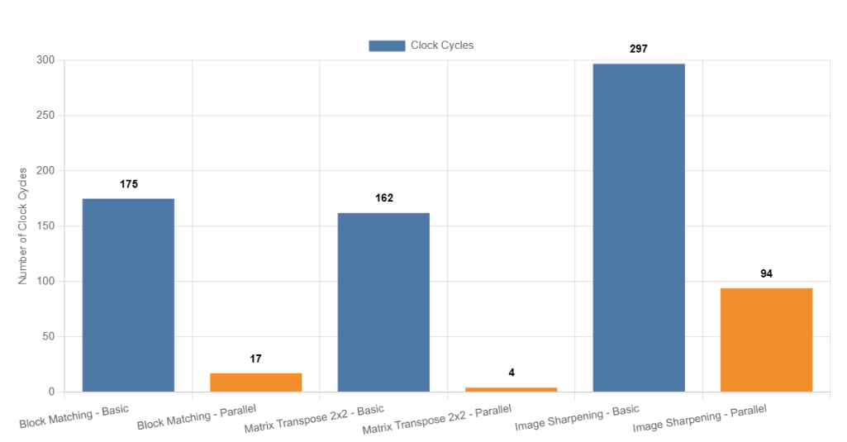
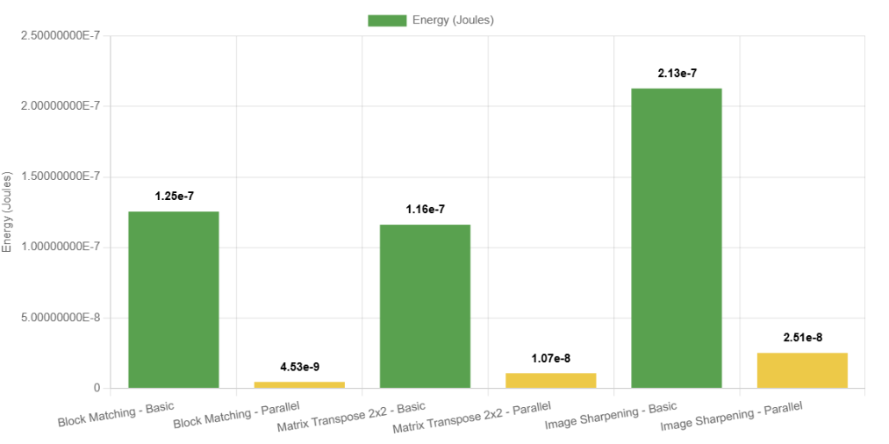
PROJECT PRODUCTS
This part looks at results from simulations and hardware tests of the basic and enhanced DLX processor with 39 SIMD instructions.
Focuses on comparing performance between the basic and parallel processors for three image tasks: Block Matching, Matrix Transpose 2x2, and Image Sharpening.
Checks cycle count, power use, and FPGA area, measured in Xilinx simulations and on Xilinx Spartan-6 FPGA hardware.
Both processors were fully built and tested.
The parallel processor shows big improvements: 3.2-15.5 times fewer cycles and 88.22-99.08% less power, but uses 128.57% more FPGA space.

Slide 17
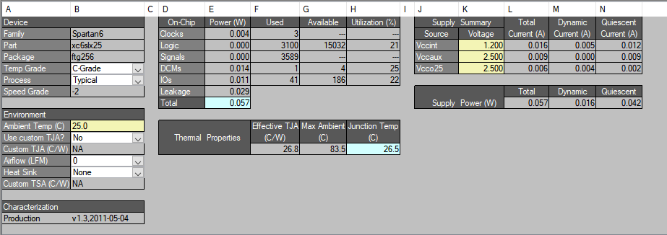
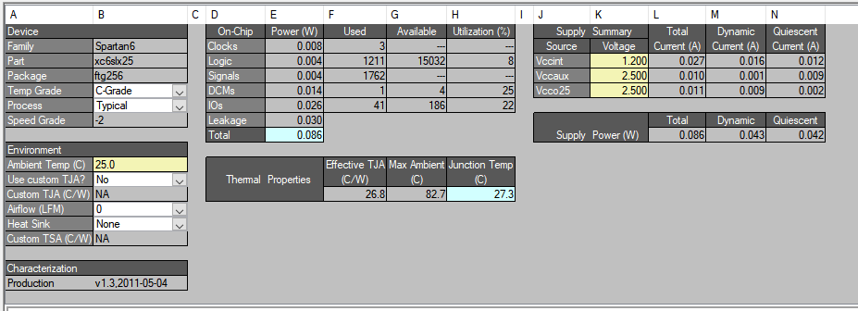
power consumption
Power calculations for image tasks used dynamic power of basic processor (0.043 W) and parallel processor (0.016 W) from power reports.
The parallel processor uses less dynamic power (0.016 W) than the basic processor (0.043 W) because it finishes tasks faster with fewer cycles (e.g., 17 vs. 175 in Block Matching), reducing active time. It processes data in parallel with SIMD, so it does more work in each cycle, lowering power use even though it takes more space (128.57% more Slices) for extra units like the parallel ALU and wider data path.
Parallel processor basic processor

Slide 18
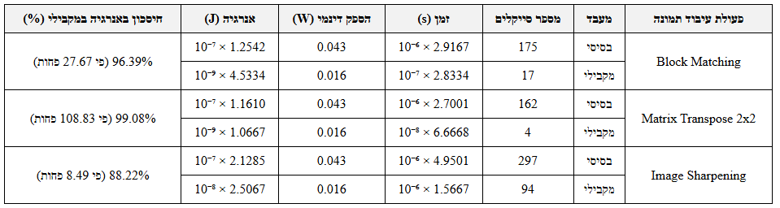
power consumption
Power calculations for image tasks used dynamic power of basic processor (0.043 W) and parallel processor (0.016 W) from power reports.
Energy for each task was figured out with the formula: Energy (J) = Dynamic Power (W) × Time (s).
Time comes from cycle count multiplied by cycle time of 16.667 ns (based on 60 MHz frequency).
Energy difference shows big savings with the parallel processor (88.22% to 99.08%), thanks to fewer cycles and lower dynamic power, even with more space used.

Slide 19
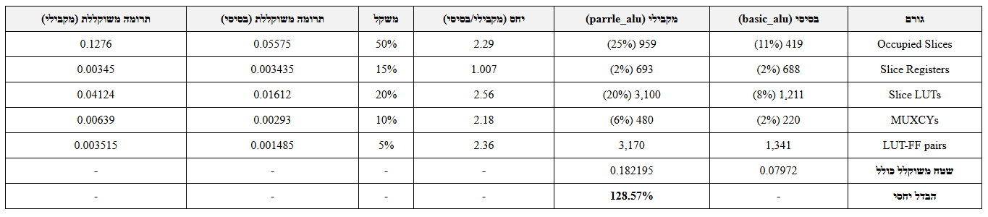
area
Area calculations for the basic processor (basic_alu) and the parallel processor (parallel_alu) were done using Place and Route reports for a Xilinx Spartan-6 FPGA (xc6slx25).
The focus was on key metrics such as :
Number of Slices (419 vs. 959) ,Slice LUTs (1,211 vs. 3,100) ,Slice Registers (688 vs. 693), MUXCYs (220 vs. 480) ,LUT-FF pairs (1,341 vs. 3,170).
The overall area was calculated using relative weights (as shown in the table below), by normalizing usage compared to the maximum available.
The results show that the parallel processor is 128.57% larger than the basic one, mainly because of the big increase in Slices and LUTs.

Slide 20
Conclusions
The parallel processor is efficient for multimedia tasks, thanks to:
Sub-word parallelism (8-bit and 16-bit SIMD)
Lower power came from:
Fewer active cycles (faster execution)
Lower dynamic power (only 37% of the basic)
However, the larger area can be a limitation for systems with limited resources.
Simulation results matched hardware results, showing design reliability.
The assembler made testing and development of new SIMD instructions much easier.

Slide 21
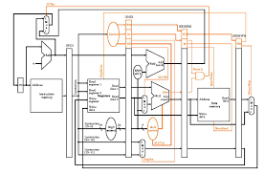
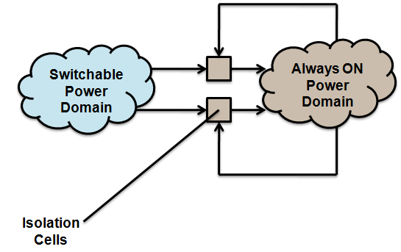
Suggestions to Improve Performance
Optimize area by reducing the number of Slice LUTs and LUT-FF pairs, using advanced synthesis techniques in Xilinx (e.g., logic remapping for shared logic).
Add pipelining to the parallel processor, which will allow multiple instructions to be processed at the same time and will further reduce clock cycles.
Improve static power efficiency (leakage) by using power gating, which turns off unused parts of the processor to save energy.

Slide 22

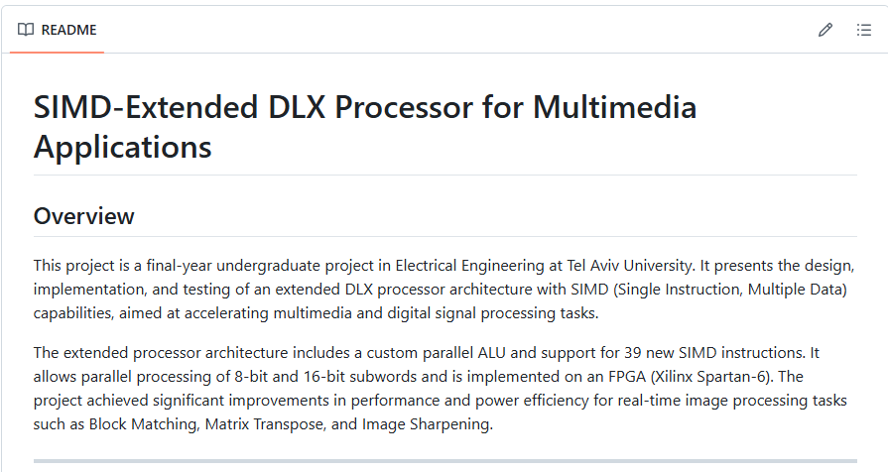
Documentation
https://github.com/amitrachmiel/simd-dlx-project

