Slide 1
Neural_FCA
By: Amit Raj

Slide 2
Dataset Overview
Contains Information about Individuals in India, including their Location, Gender, Experience, Education, and Position.
Salary information used as the target variable to classify whether they earn a "good salary" or not.
Key Features:
Location: 20+ cities across India.
Gender: Male/Female.
Education: Various educational qualifications.
Experience: Number of years in the job.
Salary: Target variable, classified as a good or bad salary.

Slide 3
Binarization Strategy:
Target Label (Salary): A salary threshold of ₹1,000,000 used to classify
a "Good Salary" or "Bad Salary.“
Features:
Experience: Binarized into categories (e.g., 5+ years, 10+ years, etc.).
Gender: Male/Female as binary.
Education: Various educational qualifications converted to binary.
Location: Cities converted into binary columns.

Slide 4
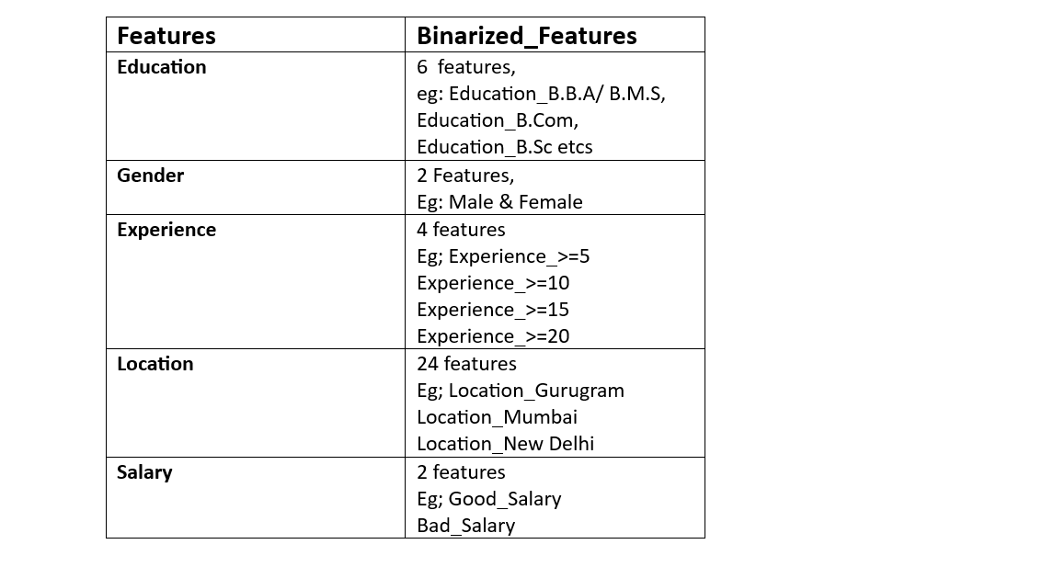
Data Preprocessing and Setup

Slide 5
Model Selection
Machine Learning Models Used:
Neural FCA
Decision Tree
Random Forest
Naive Bayes
Logistic Regression
K-Nearest Neighbours (KNN)

Slide 6
Neural FCA Model
F1-Score: 0.6
Precision: 0.86,
Recall: 0.46
Interpretation: Neural FCA provided moderate results, with a good precision but low recall.

Slide 7
Decision Tree Model
Accuracy: 64.3%
Precision: 1.0
Recall: 0.62
F1-Score: 0.76
Interpretation: The decision tree showed solid results with high precision but could be improved for recall.

Slide 8
Random Forest Model
Accuracy: 71.4%
Precision: 1.0
Recall: 0.69
F1-Score: 0.82
Interpretation: Random Forest provided the best performance in terms of overall accuracy and F1-score.

Slide 9
Naive Bayes Model
Accuracy: 28.6%
Precision: 1.0
Recall: 0.23
F1-Score: 0.38
Interpretation: Naive Bayes performed poorly, showing very low recall and F1-score, despite perfect precision.

Slide 10
Logistic Regression Model
Accuracy: 85.7%
Precision: 1.0
Recall: 0.85
F1-Score: 0.92
Interpretation: Logistic Regression was the top-performing model, with a very high F1-score and precision.

Slide 11
KNN Model
Accuracy: 78.6%
Precision: 0.92
Recall: 0.85
F1-Score: 0.88
Interpretation: KNN performed well with high precision and recall but slightly lower accuracy than other models.

Slide 12
Conclusion:
The Logistic Regression model outperformed others in terms of accuracy and F1-score.
Random Forest and KNN also performed well, with high precision.
Naive Bayes had the worst performance with low recall.

