Slide 1
Data Structures and Algorithms
N Radhakrishnan
Assistant Professor
Anna University, Chennai

Slide 2
Topics
Revision of Previous Session Contents
Cursor-based Implementation of Lists
Stacks
Queues
Applications of Stacks and Queues
Doubly Linked Lists

Slide 3
Cursor Implementation
Problems with linked list implementation:
Same language do not support pointers!
  Then how can you use linked lists ?
new and free operations are slow
  Actually not constant time
SOLUTION: Implement linked list on an array - called CURSOR

Slide 4
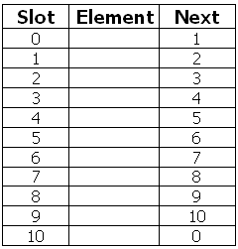
Cursor Implementation - Diagram

Slide 5
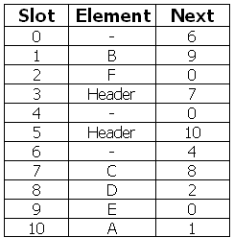
Cursor Implementation
If L = 5, then L represents list (A, B, E)
If M = 3, then M represents list (C, D, F)

Slide 6
Arrays - Pros and Cons
Pros
  Directly supported by C
  Provides random access
Cons
  Size determined at compile time
  Inserting and deleting elements is time consuming

Slide 7
Linked Lists - Pros and Cons
Pros
  Size determined during runtime
  Inserting and deleting elements is quick
Cons
  No random access
  User must provide programming support

Slide 8
Application of Lists
Lists can be used
To store the records sequentially
For creation of stacks and queues
For polynomial handling
To maintain the sequence of operations for do / undo in software
To keep track of the history of web sites visited

Slide 9
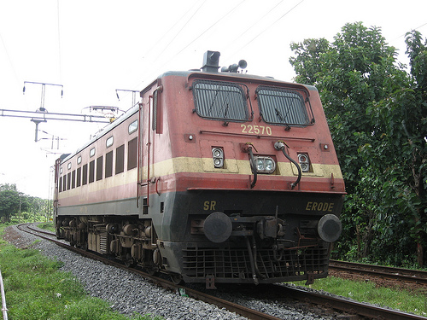
How to change the direction ?

Slide 10
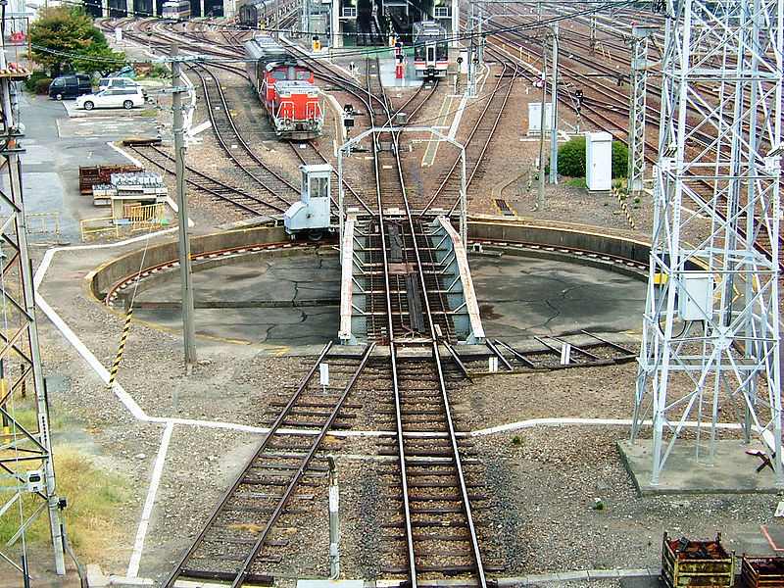
Turntable

Slide 11
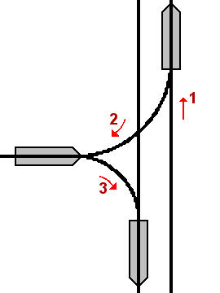
Another Method

Slide 12
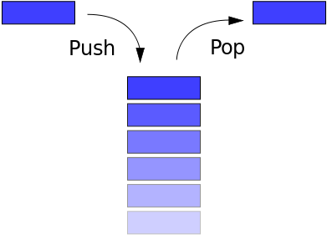
Stack

Slide 13
What is a Stack ?
a stack is a particular kind of abstract data type or collection in which the fundamental (or only) operations on the collection are the addition of an entity to the collection, known as push and removal of an entity, known as pop.

Slide 14
Basic Principle
The relation between the push and pop operations is such that the stack is a Last-In-First-Out (LIFO) data structure.
In a LIFO data structure, the last element added to the structure must be the first one to be removed.

Slide 15
Operations on Stack
This is equivalent to the requirement that, considered as a linear data structure, or more abstractly a sequential collection, the push and pop operations occur only at one end of the structure, referred to as the top of the stack.
Often a peek or top operation is also implemented, returning the value of the top element without removing it.

Slide 16
Implementation
A stack may be implemented to have a bounded capacity. If the stack is full and does not contain enough space to accept an entity to be pushed, the stack is then considered to be in an overflow state. The pop operation removes an item from the top of the stack. A pop either reveals previously concealed items or results in an empty stack, but, if the stack is empty, it goes into underflow state, which means no items are present in stack to be removed.

Slide 17
Restricted Data Structure
A stack is a restricted data structure, because only a small number of operations are performed on it. The nature of the pop and push operations also means that stack elements have a natural order. Elements are removed from the stack in the reverse order to the order of their addition. Therefore, the lower elements are those that have been on the stack the longest.

Slide 18
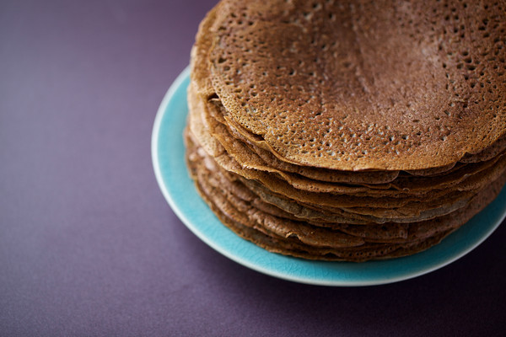

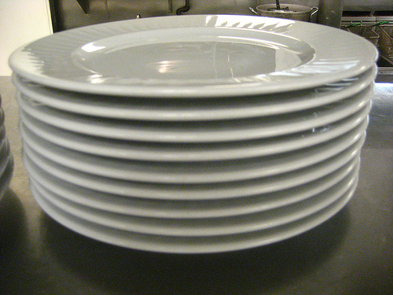

Examples

Slide 19
In Simple Words
A stack
  Last-in, first-out (LIFO) property
    The last item placed on the stack will be the first item removed
  Analogy
    A stack of dishes in a cafeteria
    A stack of Books
    A stack of Dosa
    A stack of Money

Slide 20
ADT Stack
ADT stack operations
  Create an empty stack
  Destroy a stack
  Determine whether a stack is empty
  Add a new item
  Remove the item that was added most recently
  Retrieve the item that was added most recently
A program can use a stack independently of the stack’s implementation

Slide 21
Stack Operations
bool isEmpty() const;
// Determines whether a stack is empty.
// Precondition: None.
// Postcondition: Returns true if the
// stack is empty; otherwise returns
// false.

Slide 22
Stack Operations
bool push(StackItemType newItem);
// Adds an item to the top of a stack.
// Precondition: newItem is the item to
// be added.
// Postcondition: If the insertion is
// successful, newItem is on the top of
// the stack.

Slide 23
Stack Operations
bool pop(StackItemType& stackTop);
// Retrieves and removes the top of a stack
// Precondition: None.
// Postcondition: If the stack is not empty,
// stackTop contains the item that was added
// most recently and the item is removed.
// However, if the stack is empty, deletion
// is impossible and stackTop is unchanged.

Slide 24
Stack Operations
bool getTop(StackItemType& stackTop) const;
// Retrieves the top of a stack.
// Precondition: None.
// Postcondition: If the stack is not empty,
// stackTop contains the item that was added
// most recently. However, if the stack is
// empty, the operation fails and stackTop
// is unchanged. The stack is unchanged.

Slide 25
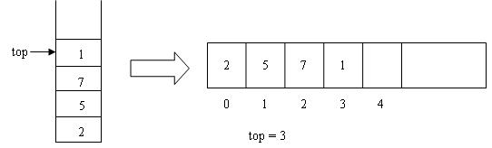
Implementation Using Arrays

Slide 26
The Stack Class - Public Contents
class Stack
{
public:
Stack() { size = 10; current = -1;}
int pop(){ return A[current--];}
void push(int x){A[++current] = x;}
int top(){ return A[current];}
int isEmpty(){return ( current == -1 );}
int isFull(){ return ( current == size-1);}

Slide 27
The Stack Class - Private Contents
private:
int object; // The data element
int current; // Index of the array
int size; // max size of the array
int A[10]; // Array of 10 elements
};

Slide 28
Stack - a Very Simple Application
The simplest application of a stack is to reverse a word.
You push a given word to stack - letter by letter - and then pop letters from the stack.

Slide 29
Applications of Stack
Recursion
Decimal to Binary Conversion
Infix to Postfix Conversion and Evaluation of Postfix Expressions
Rearranging Railroad Cars
Quick Sort
Function Calls
Undo button in various software.

Slide 30
outputInBinary - Algorithm
function outputInBinary(Integer n)
Stack s = new Stack
while n > 0 do
Integer bit = n modulo 2
s.push(bit)
if s is full then
return error
end if
n = floor(n / 2)
end while
while s is not empty do
output(s.pop())
end while
end function

Slide 31
Algebraic Expressions
Infix expressions
  An operator appears between its operands
    Example: a + b
Prefix expressions
  An operator appears before its operands
    Example: + a b
Postfix expressions
  An operator appears after its operands
    Example: a b +

Slide 32
A complicated example
Infix expressions:
  a + b * c + ( d * e + f ) * g
Postfix expressions:
  a b c * + d e * f + g * +
Prefix expressions:
  + + a * b c * + * d e f g

Slide 33
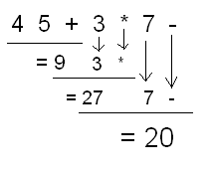
Evaluation of Postfix Expression

Slide 34
Evaluation of Postfix Expression
The calculation: 1 + 2 * 4 + 3 can be written down like this in postfix notation with the advantage of no precedence rules and parentheses needed
1 2 4 * + 3 +
The expression is evaluated from the left to right using a stack:
  when encountering an operand: push it
  when encountering an operator: pop two operands, evaluate the result and push it.

Slide 35
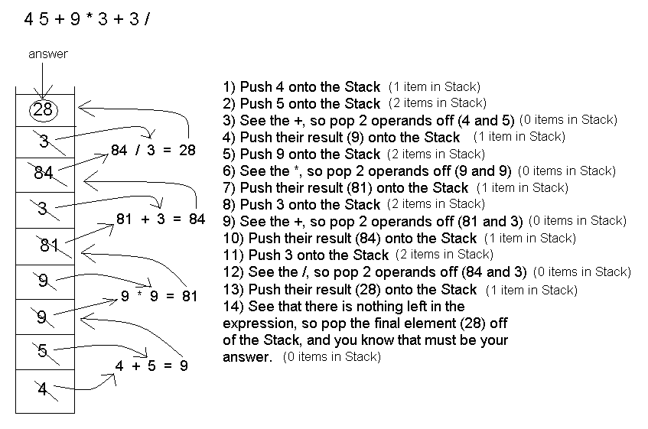

Slide 36
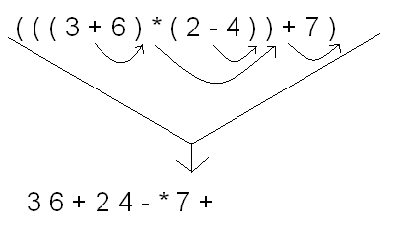
Infix to Postfix Conversion

Slide 37

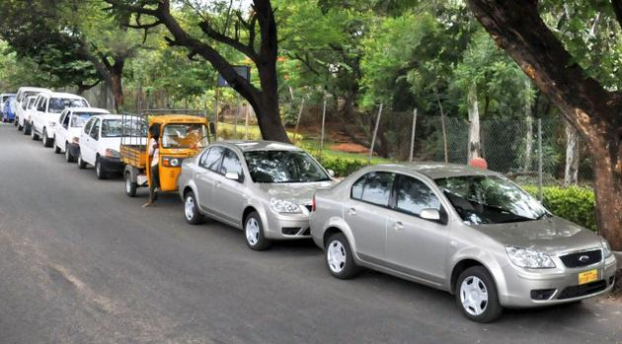
What’s this ?

Slide 38
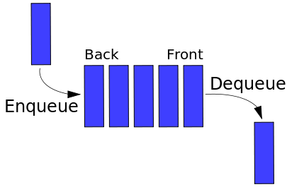
Queue

Slide 39
Queue
A stack is LIFO (Last-In First Out) structure. In contrast, a queue is a FIFO (First-In First-Out ) structure.
In a FIFO data structure, the first element added to the queue will be the first one to be removed.
A queue is a linear structure for which items can be only inserted at one end and removed at another end.

Slide 40
Operations on Queue
We will dedicate once again six operations on the Queue.
  You can add a person to the queue (enque),
  Look who is the first person to be serviced (front)
  Rremove the first person (dequeue) and
  Check whether the queue is empty (isEmpty).
  Also there are two more operations to create and to destroy the queue.

Slide 41
Operations
Queue create()
  Creates an empty queue
boolean isEmpty(Queue q)
  Tells whether the queue q is empty
enqueue(Queue q, Item e)
  Place e at the rear of the queue q
destroy(Queue q)
  destroys queue q

Slide 42
Operations Continued
Item front(Queue q)
  returns the front element in Queue q without removing it
  Precondition: q is not empty
dequeue(Queue q)
  removes front element from the queue q
  Precondition: q is not empty

Slide 43
Implementation Using Arrays
If we use an array to hold queue elements, dequeue operation at the front (start) of the array is expensive.
This is because we may have to shift up to “n” elements.
For the stack, we needed only one end; for queue we need both.
To get around this, we will not shift upon removal of an element.

Slide 44
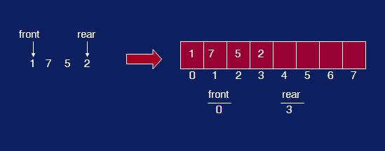
Snapshot of a Queue

Slide 45
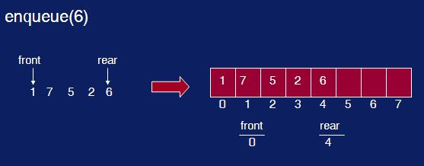
enqueue()

Slide 46
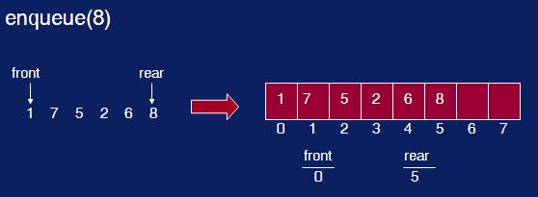
enqueue() again

Slide 47
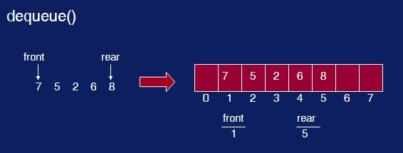
dequeue()

Slide 48
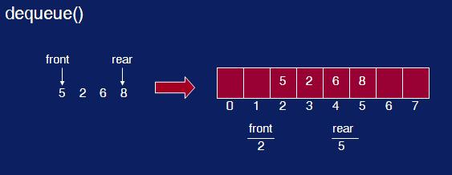
dequeue() again

Slide 49
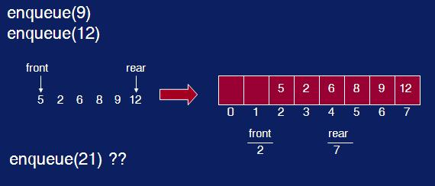
Two more enqueue()

Slide 50
What’s Wrong ?
We have inserts and removal running in constant time but we created a new problem.
We cannot insert new elements even though there are two places available at the start of the array.
Solution: allow the queue to “wrap around”. Basic idea is to picture the array as a circular array as show below.

Slide 51
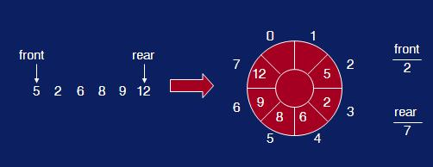
Queue array wrap-around

Slide 52
enqueue(element)
void enqueue(int x)
{
rear = (rear+1)%size;
array[rear] = x;
noElements = noElements+1;
}

Slide 53
dequeue()
int dequeue()
{
int x = array[front];
front = (front+1)%size;
noElements = noElements-1;
return x;
}

Slide 54
isEmpty() and isFull()
int isFull()
{
return noElements == size;
}
int isEmpty()
{
return noElements == 0;
}

Slide 55
Pointer Based Implementation
Possible implementations of a pointer-based queue
  A linear linked list with two external references
    A reference to the front
    A reference to the back
  A circular linked list with one external reference
    A reference to the back

Slide 56
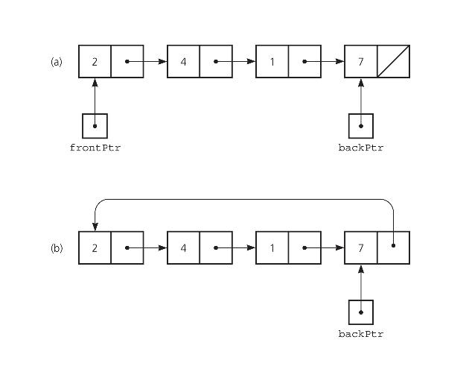
Queue - Linear and Circular List

Slide 57
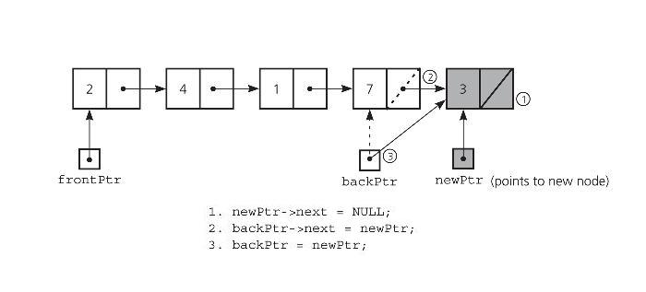
Non-empty Queue - Insertion

Slide 58
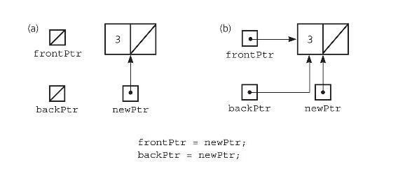
Empty Queue - Insertion

Slide 59
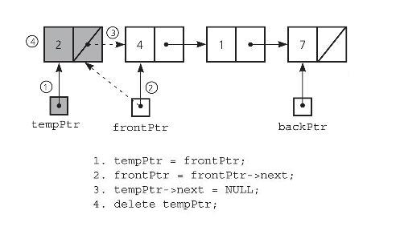
Queue with more than 1 element - Deletion

Slide 60
Applications of Queues
Queue is used when things don’t have to be processed immediatly, but have to be processed in First In First Out order like Breadth First Search.
This property of Queue makes it also useful in following kind of scenarios.

Slide 61
Applications of Queues
When a resource is shared among multiple consumers. Examples include CPU scheduling, Disk Scheduling.
When data is transferred asynchronously (data not necessarily received at same rate as sent) between two processes. Examples include IO Buffers, pipes, file IO, etc.
Operating systems often maintain a queue of processes that are ready to execute or that are waiting for a particular event to occur.

Slide 62
Applications of Queues
Computer systems must often provide a “holding area” for messages between two processes, two programs, or even two systems. This holding area is usually called a “buffer” and is often implemented as a queue.
Call center phone systems will use a queue to hold people in line until a service representative is free.

Slide 63
Applications of Queues
Buffers on MP3 players and portable CD players, iPod playlist. Playlist for jukebox - add songs to the end, play from the front of the list.
Round Robin (RR) algorithm is an important scheduling algorithm. It is used especially for the time-sharing system. The circular queue is used to implement such algorithms.

Slide 64
Why Doubly Linked List ?
given only the pointer location, we cannot access its predecessor in the list.
Another task that is difficult to perform on a linear linked list is traversing the list in reverse.
Doubly linked list A linked list in which each node is linked to both its successor and its predecessor
In such a case, where we need to access the node that precedes a given node, a doubly linked list is useful.

Slide 65
Doubly Linked List
In a doubly linked list, the nodes are linked in both directions. Each node of a doubly linked list contains three parts:
  Info: the data stored in the node
  Next: the pointer to the following node
  Back: the pointer to the preceding node

Slide 66
Operations on Doubly Linked Lists
The algorithms for the insertion and deletion operations on a doubly linked list are somewhat more complicated than the corresponding operations on a singly linked list.
The reason is clear: There are more pointers to keep track of in a doubly linked list.

Slide 67
Inserting Item
As an example, consider the Inserting an item.
To link the new node, after a given node, in a singly linked list, we need to change two pointers:
  newNode->next and
  location->next.
The same operation on a doubly linked list requires four pointer changes.

Slide 68
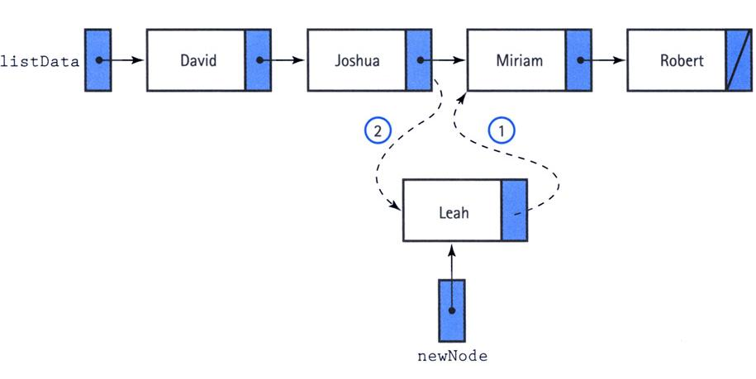
Singly Linked List Insertion

Slide 69
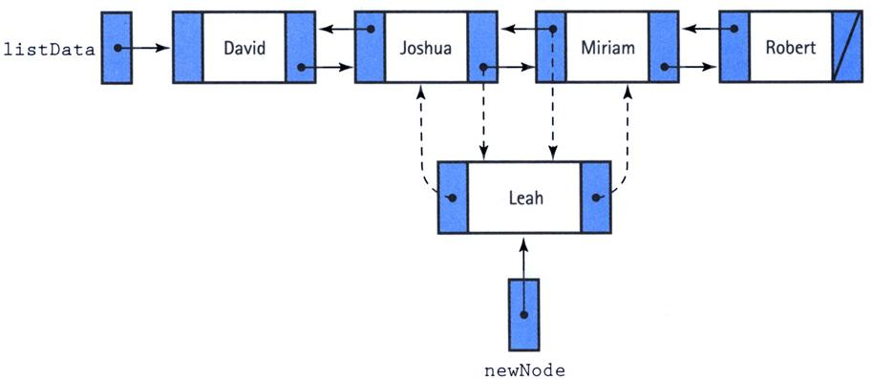
Doubly Linked List Insertion

Slide 70
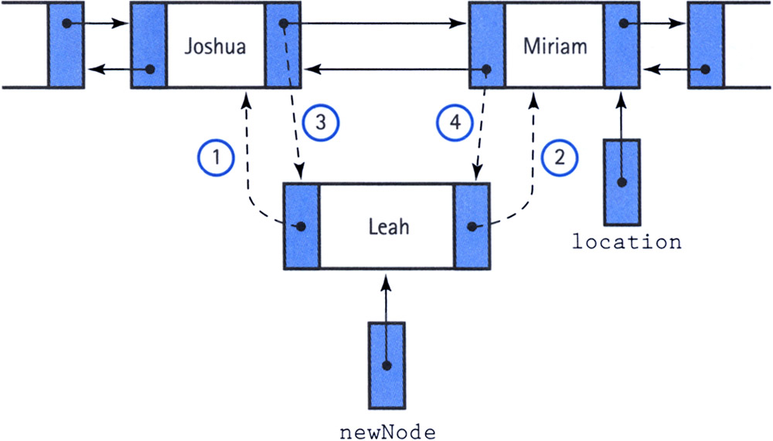
The Order is Important

Slide 71
Doubly Linked List - Deletion
One useful feature of a doubly linked list is its elimination of the need for a pointer to a node's predecessor to delete the node.
Through the back member, we can alter the next member of the preceding node to make it jump over the unwanted node.
Then we make the back pointer of the succeeding node point to the preceding node.

Slide 72
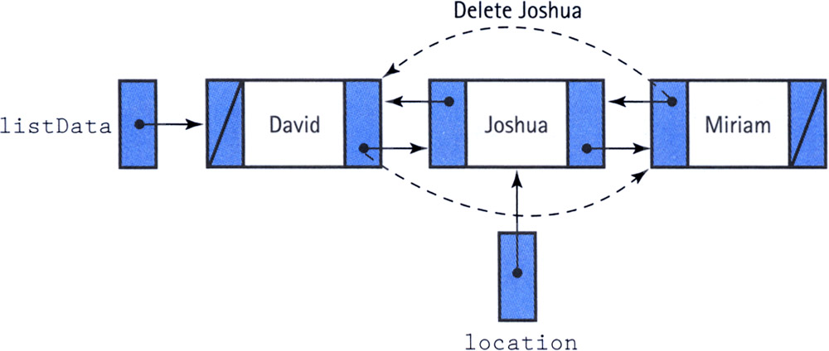
Doubly Linked List - Deletion

Slide 73
Special Cases of Deletion
We do, however, have to be careful about the end cases:
  If location->back is NULL, we are deleting the first node
  if location->next is NULL, we are deleting the last node.
  If both location->back and location->next are NULL, we are deleting the only node.

Slide 74

Interaction

