Slide 1
RELATIONAL TERM WEIGHING METRIC FOR EVENT DETECTION
Project Guide:
Prof. Arka Prokash Mazumdar
Dept. of Computer Science and Engineering
Presented By:
Bhawika Agarwal 2015UCP1559
Sakshi Yadav 2015UCP1683
Amit K Yadav 2015UCP1549

Slide 2
Outline
Terminology
Problem Statement
Existing Metrics
Proposed Metric
Results
Future Scope
References

Slide 3
Terminology
Event : A real-world occurrence that takes place in a certain geographical location over a certain time period. Weight Metric : A metric that assigns each term in a document a weight according to an underlying scheme. Need for a new weight metric for event detection ?

Slide 4
Problem statement
To propose an improved relational weight metric that can be used to compute similarity amongst microblog posts, by considering the relationship between co-occurring words in an online incremental clustering framework.

Slide 5
TF-IDF
TF - measures how frequently a term occurs in a document.
IDF - measure rarity of a term.
tf[term] = 1 + log(count(term,Tweet))
idf[term] = log(total_clusters / cluster_freq[term])
Cosine Similarity (d1, d2) = Dot product(d1, d2) / ||d1|| * ||d2||

Slide 6
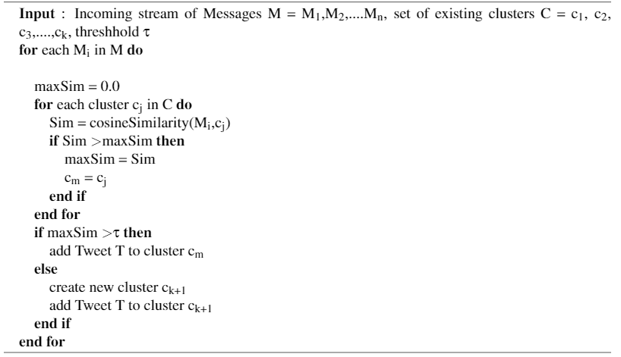
General Incremental Clustering Algorithm

Slide 7
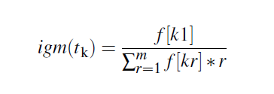
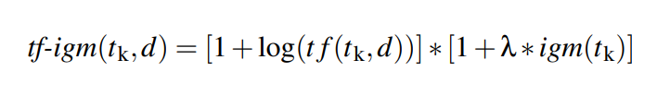
TF-IGM
IGM (Inverse Gravity Moment) - assigns weight by term’s class distinguishing power.
Notes:
An improvement over tf-idf was proposed by kewen Chen in his paper in 2016. A new IGM(Inverse Gravity Moment) measure was introduced, to measure the importance of a term in document.

Slide 8
Limitations
Twitter messages, by design, contain little textual information, and often exhibit low quality, resulting in noisy estimation of term frequency metric.
They assume that the counts of different words provide independent evidence of similarity.
Makes no use of semantic similarities between words.

Slide 9

RELATIONAL WEIGHT METRIC: TF-ACR
Exploits word co-occurrences rather than considering them independently.
Word co-occurs with few distinct words - rare - higher weight.
We define for each term,

Slide 10
Bloomfilter
A probabilistic data structure, returns either "possibly in set" or "definitely not in set".
PROS :
provides fast searching and space-efficient
CONS
Possibility of false positives.

Slide 11
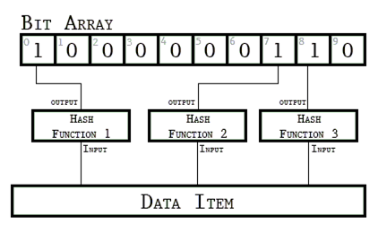
Example of Bloomfilter

Slide 12


TF-ACR (contd.)
Using bloom filter , we can re-write ACR(t) as :
Final metric can be given as:

Slide 13
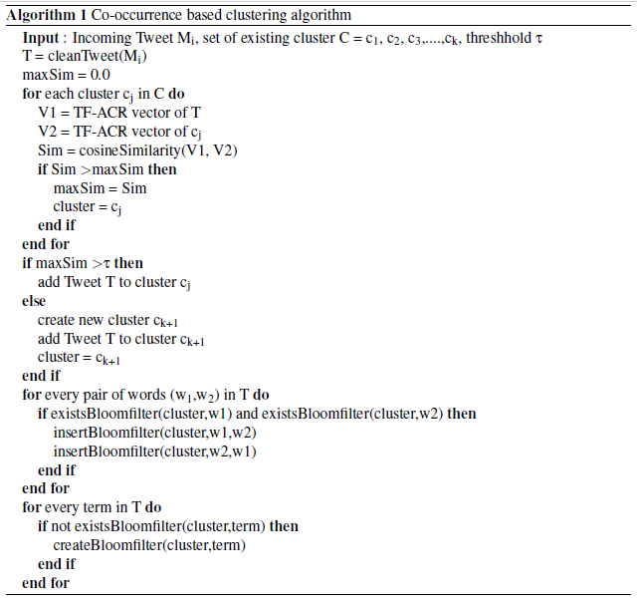
Co-occurrence based Incremental Clustering Algorithm

Slide 14


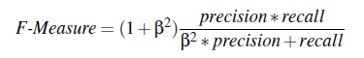
Experimental Set-Up
Dataset and ground truth creation.
Evaluation Metrics - Precision, Recall, F-Measure.
We have taken β = 1

Slide 15
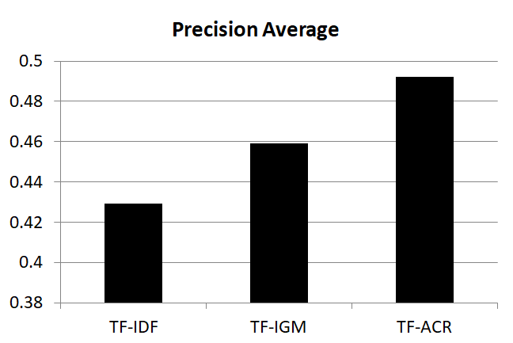
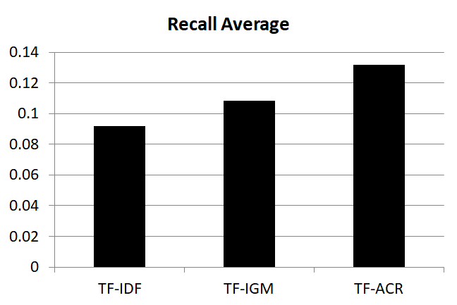
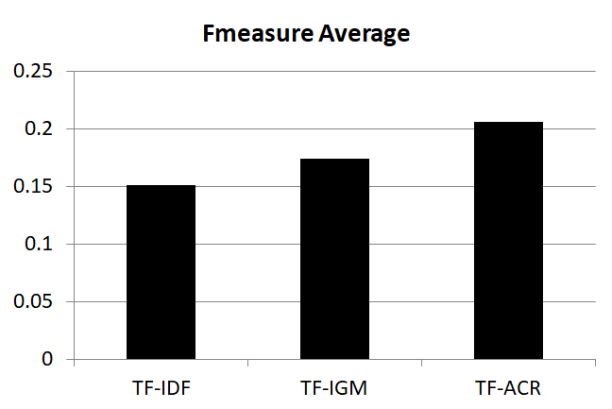
Results

Slide 16
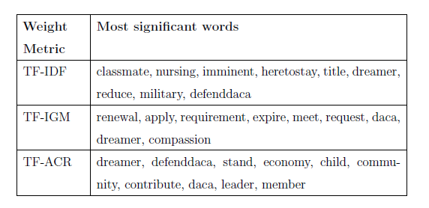
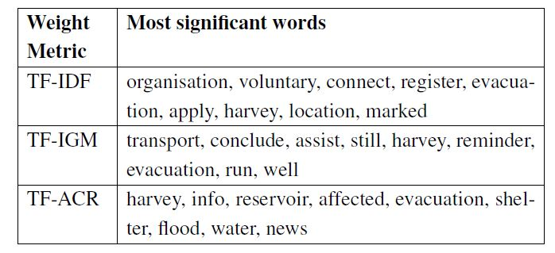
Results
Table showing Most significant words describing event related to hurricane harvey floods and daca for each of the three metric, respectively.

Slide 17
Future scope
Use an efficient and adaptive threshold function, rather than computing it empirically.
This approach is currently efficient for clustering small independent posts, but can be extended for use with retrospective documents.
We can add a cluster summarization component to the existing methodology so that the approach can be more useful to end users

Slide 18
References
Allan, J., Carbonell, J. G., Doddington, G., Yamron, J.; Yang, Y., (2003): Topic Detection and Tracking Pilot Study Final Report.
Becker, H., Naaman, M., & Gravano, L. (2011). Beyond Trending Topics Real-World Event Identification on Twitter. Icwsm, 438-441.
Chen, K., Zhang, Z., Long, J., & Zhan, H. (2016). Turning from TF-IDF to TF-IGM for term weighting in text classification, 245-260.
[online] Bloom filter - Wikipedia. Available at: https://en.wikipedia.org/wiki/Bloom_filter
[online] Bloom filter - Github. Available at: https://llimllib.github.io/bloomfilter-tutorial/
[online] Clustering Algorithms and Evaluations. Available at: https://www.ims.uni-stuttgart.de/institut/mitarbeiter/schulte/theses/phd/algorithm.pdf

