Slide 1
How to use AI Code Assistant
“How to leverage AI Code Assistants with Agent.md, SpecKit, Skills”
Authors: Amit with Wai team

Slide 2
How is this doc organized
Topic: Working effectively with AI Code Assistants with Agent, Specs, Skills
white-labelled experiment = git@github.com:amitrajpurkar/sprboot_api_cktBrkr.git
Sequence
Background on AI Agents, IDEs … pages 3-5… 10%
About Speckit … pages 6-9 … 20%
About Skills… pages 10-11 … 10%
About Agents.md … pages 12-13 .. 10%
SDLC Roles with AI Agents … pages 14-16 .. 20%
Ending thoughts … pages 17-18 … 20%
Journey of one experiment … pages 19-33 … 10%
(100% == 60 minutes)

Slide 3
Background on AI Code Assistants
AI does not replace a task; it augments and helps with automation; work is still done by the developer
Developer is responsible for the code generated by the AI Assistant based on prompts provided
Large number of Coding Assistants are available; all are fairly similar; its a developers choice to pick one as per their style and need
These code assistants can provide in-line suggestions while the developer is writing code or they allow developers to chat with it “ask-mode”, or use “plan-mode” to design an action plan before doing changes or use “code-mode” allowing AI to write code. (These modes are Windsurf specific; every Assistant provides similar modes)
SpecKit is one tool that works with Code Assistants to generate the specifications using slash-commands; The developer uses a structured interaction with AI to reach the final outcome — No adhoc prompting
This does not end at Specs.. Coding along with AI Agents is changing Software development cycle itself; to retain + enrich software engineer practices, “detailing-requirements”, “developing-clear-unambiguous specifications” is now at the heart of the process
Estimate talk time: 3-5 minutes ?
Notes:
Note on IDE differences and also how different LLMS
https://www.demandlab.com/resources/blog/5-takeaways-report-on-the-state-of-ai-in-business/
https://www.aigl.blog/state-of-ai-in-business-2025/

Slide 4
Which IDE to use?
Large number of IDEs available with similar capabilities
All AI Code Assistants have similar capabilities— it is developers choice which one to use
Each one is similarly priced… around $20 per month
At the moment Claude Code (Anthropic) is most feature reach; but you ideally need “Max-version” priced at $100-$200 per month to use it to full extent
To name a few: Copilot, AWS CodeWhisperer, Tabnine, Cursor, Replit Ghostwriter, Codeium, Windsurf, Cody
Each of these IDEs connect with different LLMs: Claude Sonnet, Claude Opus, GPT-5, Grok, o3, SWE to name a few— this depends on your token usage or your subscription
Notes:
I am personally using Windsurf; purchased Professional license

Slide 5
LLM models
Which ones to use? And when? — Its developers choice/ taste — try different models — below is one example
How much control do you want?
I want to control: Kind of tasks?
Simple / directed changes
Priority 1 — SWE-1.5; Claude Haiku 4.5
Priority 2: GPT 5.2 (low reasoning)
Larger/ Complex changes
Priority 1: Claude Sonnent 4.5
Priority 2: GPT 5.2 (medium)
Priority 3: Claude Opus 4.5
AI should take control: Task Complexity?
Scoped/ routine tasks
Priority 1: Claude Sonnet 4.5
Priority 2: SWE-1.5, Gemini 3 Pro
Priority 3: Claude Opus 4.5
Very Complex
Priority 1: Claude Sonnet 4.5 (thinking)
Priority 2: GPT 5.2 (high), GPT 5.1 Codex-Max
Priority 3: Claude Opus 4.5

Slide 6
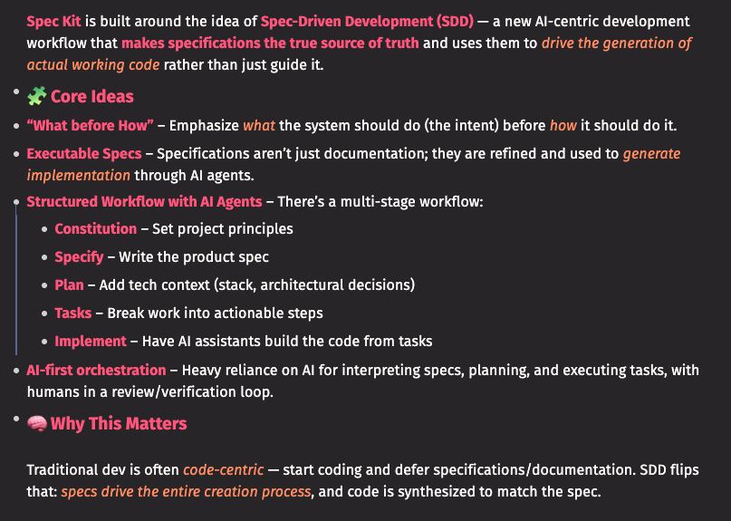
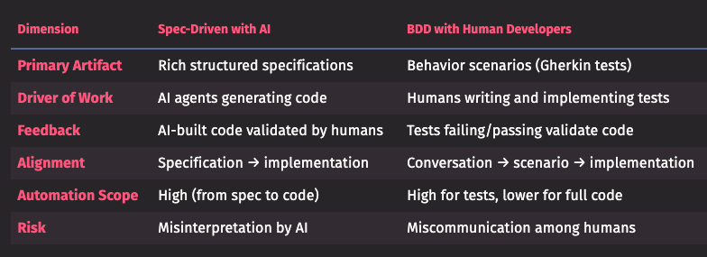
Background for SpecKit
SpecKit provides set of templates for AI Code Assistants (pull the latest).. use CLI to configure these templates for your Code Assistant or setup manually
Philosophy: document the specification, plan, tasks very well before making code changes
What this means for a developer: “document accurately before you code”
Estimate talk time: 3-5 minutes ?
Notes:
https://github.com/github/spec-kit
Though this information is pulled from ChatGPT and Poe, these snippets are valuable.
I am experimenting with SpecKit on a couple of apps.. so far so good.

Slide 7
Resources on Speckit
Handy links to documentation, explanation
From the creators:
https://github.com/github/spec-kit
Youtube videos:
https://www.youtube.com/watch?v=a9eR1xsfvHg. ; https://www.youtube.com/watch?v=SGHIQTsPzuY. ; https://www.youtube.com/watch?v=8jtIXRyGMQU
Windsurf links:
https://docs.windsurf.com/windsurf/cascade/workflows
Similar alternative
https://github.com/Fission-AI/OpenSpec

Slide 8
Comparing with OpenSpec
Two similar toolkits
Aspect | Speckit | OpenSpec
Purpose and Focus | Framework for writing and managing specifications | Open-source collaboration for specification-driven development
Integration with AI | Direct integrations with AI coding assistants | Similar integrations
Usability | Polished user interface for enhanced productivity | May require more technical knowledge; customizable
Community and Support | Typically backed by commercial support | Relies on community support; responsiveness varies
Flexibility and Extension | Structured extensibility for easy build-on | Encourages flexibility; open-source allows custom tweaks
Documentation, Learning Curve | Comprehensive documentation lowers learning curve | Depends on community contributions; may vary in quality
Notes:
Know more: Speckit only shows us one way to introduce specifications into our development workflow. As you mature into this process, you can evolve your own specification template or even hand-craft your own specifications for the application or project
https://github.com/johnpeterman72/CursorRIPER. —> RIPER = Research-Innovate-Plan-Execute-Review loop
https://www.kzsoftworks.com/blog/windsurf-workflows-from-prompt-chaos-to-productive-focus
https://github.com/kzsoftworks/windsurf-workflows

Slide 9
Command Workflow
Basic: constitution —> specify —> plan —> tasks —> implement
Alternate: constitution -> specify -> clarify -> plan -> tasks -> analyze -> implement
/constitution project principles, standards
/specify define what you need (no tech info)
/clarify follow up questions
/plan implementation plan
/tasks break plan into actionable steps
/analyze validate documents
/implement execute tasks, text
Commit: pull request, merge
Notes:
More commands are being released as time progresses; Above was true as of Nov 2025; as of 2026-02-08 I am seeing newer commands: “checklist”, “taskstoissues”;

Slide 10
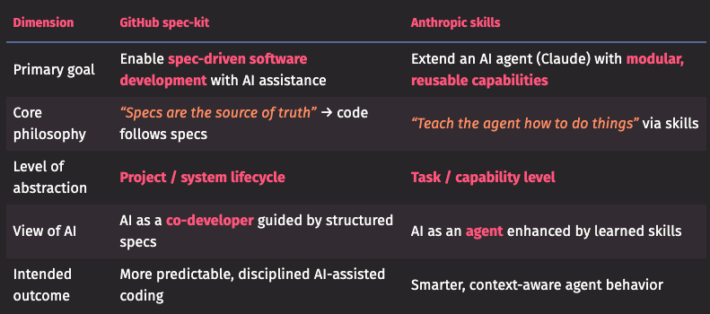
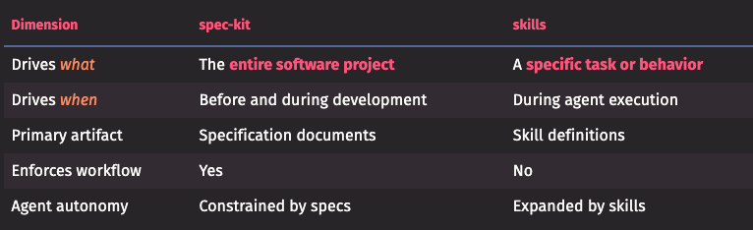
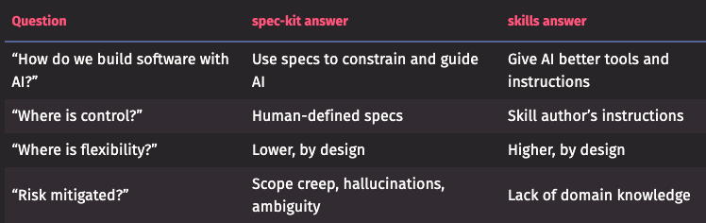
Things to know: Skills
When working with AI Coding Assistants
spec-kit = “what good looks like”
skills = “how good work is done”
spec-kit is a process framework for AI-assisted software engineering
skills is a capability framework for AI agents
spec-kit defines what should be built; skills define what the AI knows how to do.
Notes:
https://github.com/anthropics/skills
Experimentation on Skills is yet to start. Collect samples of Skills, experiment, tweak.
Try using Skills with Speckit.. need to understand how it works
And then revise here, what are the benefits I see plus any other feedback
https://docs.windsurf.com/windsurf/cascade/skills

Slide 11
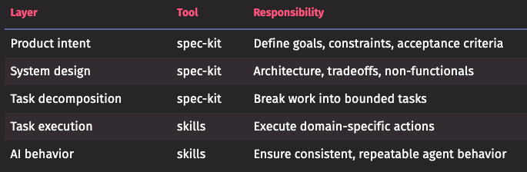
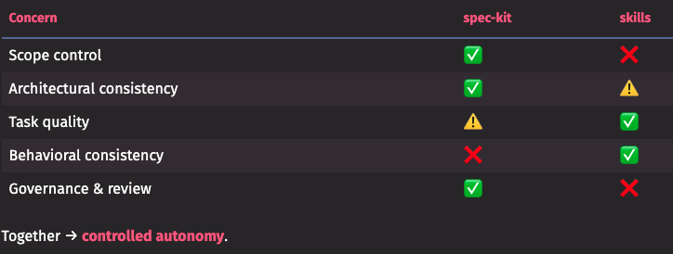
SpecKit with Skills
These two can co-exist and complement each other
spec-kit governs what should be built and why
skills govern how the AI performs specific actions
Think of spec-kit as the contract and skills as the toolbox.
Personally I have found Specs very useful, valuable; but I have been an architect for a long time, producing large amount of documentation myself
When I interview developers , most complain that Specs are too “process-heavy” .. lots of documentation before they can write code
This is where the tech-lead, principle developer should work with Business Analysts, Project manager, Quality Analyst to “write specs.md, run-clarify, write plan.md and tasks.md”

Slide 12
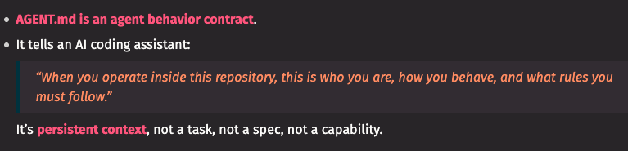
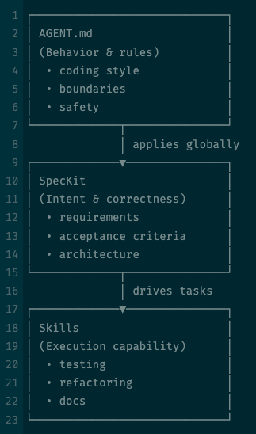
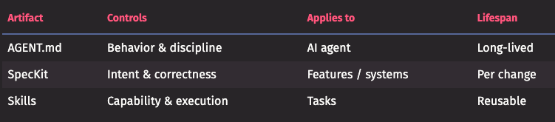
Agent.md
One more markdown you will hear
AGENT.md defines how the AI behaves
Specs define what is being built
Skills define what the AI can do
AGENT.md is the constitution
Specs are the laws
Skills are the tools
They’re complementary — not redundant
Notes:
https://agents.md/
Need to Experiment Agent.md … need to explicitly invoke this alongside Speckit
Capture a bunch of samples for Agent files… for different roles in SDLC and different types of Developers/ architects; Java, Python, React and Frontend expert, etc
https://www.scriptbyai.com/best-agent-skills/#google_vignette
https://github.com/obra/superpowers/tree/main/skills
https://github.com/vercel-labs/agent-skills
https://github.com/OthmanAdi/planning-with-files
https://github.com/muratcankoylan/Agent-Skills-for-Context-Engineering
https://github.com/K-Dense-AI/claude-scientific-skills

Slide 13
AGENTS.md vs SPECS vs SKILLS
Which one fits where ??
Dimensions | Agents.md | Specs | Skills
 | Define how the AI behaves | Define what is being built | Define what the AI can do
Primary purpose | Control AI Agents behavior consistently | Control the development process | Control specific type of task
Scope | Across projects, teams | Feature-based or for-a-system | For a task-type
Role | always-on | lifecycle-based | Task-based
Changes often? | rarely | Frequently, per feature/ project | Stays same for task-type
Audience | AI Agent | AI + Human | AI Agent
Enforces | Style, rules, discipline | Scope, intent, acceptance | How that type of task is done
Notes:
NOTE: a developer typically builds his toolkit, evolve/ maintain AGENTS.md for java-developer, one for python-developer, react-developer, etc; build up Skills library: code-review, CI-CD, deployment; request-validations; etc;
https://github.com/ComposioHQ/awesome-claude-skills

Slide 14
So… the Developers part in this ??
“If AI is doing more of the typing, what must I still be good at so the system doesn’t collapse?”
Non-negotiable: AI amplifies skills; it does not replace Developer’s skills
Architectural thinking: decompose the system, decide which component, library or design pattern suites best for the problem at hand; think about transaction boundaries; interface contracts
Specify the problem: translate business needs into technical intent; what should be the constraints; what should be the acceptance criteria
Review, Verification: Because AI codes fast, you must validate faster; spot complexity; identify security holes; spot clever but wrong solutions; iterate through each step (its not fire-and-forget)
Most imp — your core development skills: if you are a Java developer, you must know Java thoroughly; you should not work with half-baked-knowledge
Notes:
NOTE: Racing to code / touching delivery-finish-line is not the goal — breaking down the specification; getting requirements right; understanding domain knowledge that’s the key, before you touch or start coding; this is not a one-man-job; a small team can ideally make the engineering practice a reality
https://forum.cursor.com/t/i-created-an-amazing-mode-called-riper-5-mode-fixes-claude-3-7-drastically/65516

Slide 15
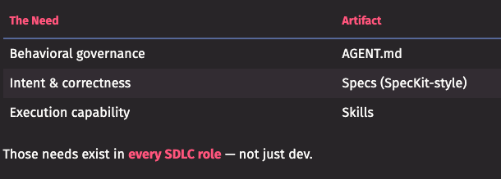
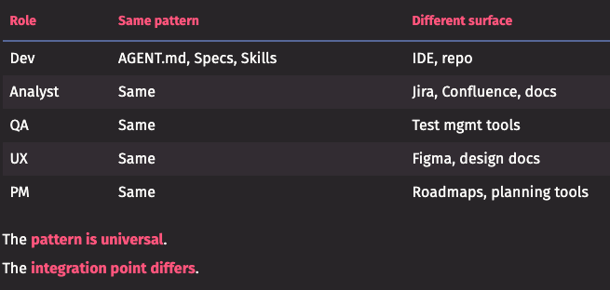
For other roles in SDLC
Analysts, Testers, Project Managers, Architects…
Agent.md, Specs and Skills each generate good amount of documentation; though it appears to be dev-centric
These three are not developer-only concepts; any role that works through structured artifacts and repeatable process can benefit
Non-Developer roles can benefit more; their work is already text-heavy; many times artifacts are ambiguous
A shared-intent, Spec between all roles is valuable; structured intent writing is important
Standardize the intent, encode behavior, automate execution across all roles.
Notes:
Get samples for different roles.. for both Agent and Skills

Slide 16
Planning to work with AI
How I planned/ broke-down migration effort into phases and steps for making changes
Sequencing and prioritization of the phases and steps
Making the AI analyze the current codebase itself and match its analysis with my own experience creating the original app
Getting the ground ready to let AI start making changes
Key point —> we don’t start coding directly when using AI.. we need to plan, document and be very specific on what we need to do.
Notes:
https://amitrajpurkar.github.io/
I started experimenting with speckit since October 2025; I am still a novice at SPECs at Feb 2026, after about 6 experiment apps; getting maturity with SPECS, AGENTS, SKILLS will take time and effort.
https://github.com/wesreisz-tw/icsaet-demo —> check “specifications” folder to see what high-maturity-level specs look like

Slide 17
Ending thoughts
AI is still evolving at a very rapid pace.. standardization in coding practice using AI is in its infancy
Developers need to try the tools and experiment with different approaches as they surface.
SpecKit is providing one such path; Claude Code is also using a very similar approach using “skills, scripts, templates, workflows” (comparing to memory, scripts, templates, workflows in SpecKit)
If you don’t use concepts like Agent.md, Specs, Skills, the developer will need to babysit with AI for a long time and no consistency can be reached; we need to bring repeatability, predictability into software engineering to make production code reliable; Feeding the AI Agents with these three will help get us there

Slide 18
From other developers
Provide references to what other developers are researching
Follow podcasts/ spotify/ YouTube from leading developer organizations: Thoughtworks, MartinFowler, Info-Q, ChangeLog, Software Engineering podcast; — plus the key sources: Anthropic, OpenAI, Google, Microsoft
https://podcasts.apple.com/us/podcast/how-ai-will-change-software-engineering-with-martin-fowler/id1769051199?i=1000737446931
https://martinfowler.com/articles/legacy-modernization-gen-ai.html
https://www.thoughtworks.com/en-in/insights/podcasts/technology-podcasts/using-generative-ai-legacy-modernization
https://youtu.be/6aD4c_izpnE?si=visMMXLY5mkJrQ8j
https://youtu.be/yNH52oDpIKw?si=TFH8X0ErUW6E7-_O
https://www.deeplearning.ai/. …. https://www.anthropic.com/learn
Worth watching —> https://youtu.be/wVyQn6QRcT4?feature=shared
Notes:
Do check the last link, an insightful session from Thoughtworks
https://www.infoq.com/presentations/chop-rag-llm-qcon/

Slide 19
Experiment:
… migrate sample application from old to new stack

Slide 20
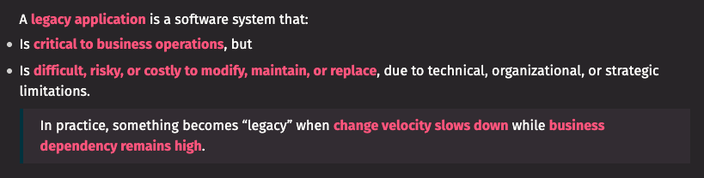
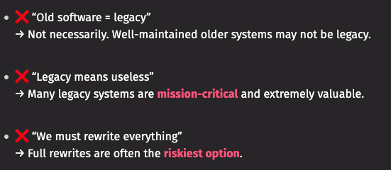
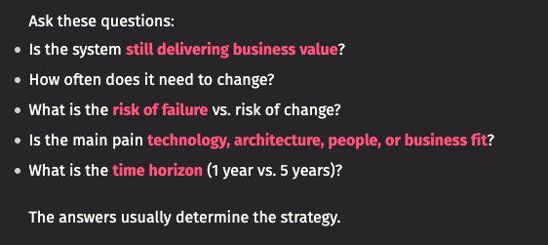
How can AI address Legacy App??
Qualities of Legacy application
Technical Characteristics: outdated tech, tight coupling, poor architecture/ design, low testability
Human factors: loss of institutional knowledge; skill scarcity
Operational Characteristics: high risk of change, costly maintenance
Business & Strategic factors: misaligned with current business needs, compliance/ security risks
Different ways to address Legacy application
Leave as is
Refactor/ Modernize
Re-platform
Rewrite/ Replace
Strangler pattern
Observation:
Investigate both code as well as business requirements; get latest business requirements; use AI to analyze -> document -> get specs; AI for wrap-around testing; tackle one feature at a time;
Estimate talk time: 3-5 minutes ?
Notes:
2026/01/13:

Slide 21
About the Experiment
Migrating a sample application from old tech stack to new
Why is this app legacy? a working application written in 2020 on older tech stack; newer versions of Java, Gradle do not support that stack; one of the key libraries is no longer supported today; a demo app with rest APIs which are expected to run 24/7 with a high transaction volume of up to 3,000 transactions per minute.
This experiment was started before I knew about SpecKit; hence it used AI Assistant following a plan and set sequence of instructions
Refactoring and modernization technique was used
Key points:
Initial app was developed by myself in 2017; so the entire codebase as well as business requirements were well known; this was not a black-box
Target tech stack after upgrade was also known before hand
Experiment was with sequencing instructions to the AI Assistant and testing each step of the way

Slide 22
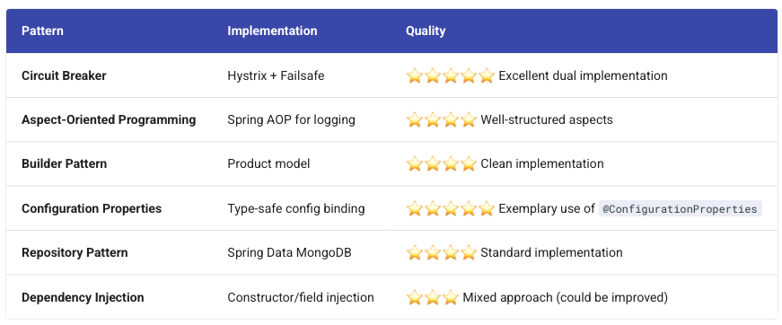
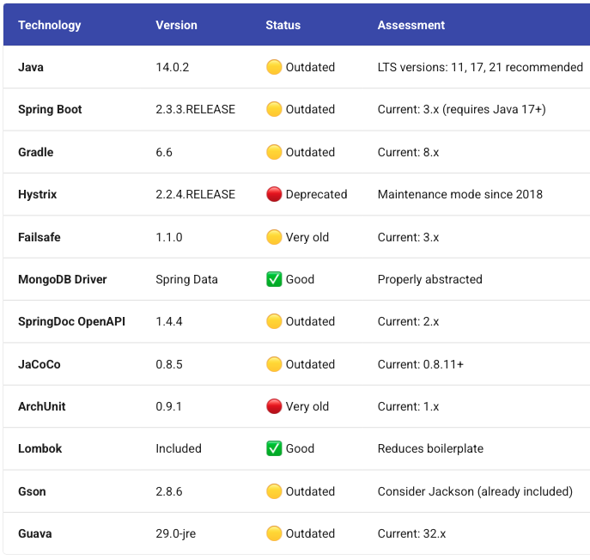
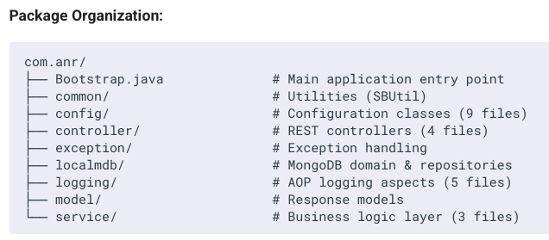
Glimpse of First Analysis
AI reviews, shows findings, Developer verifies
Ask AI Code Assistant to analyze the codebase
As a developer, verify the findings documented by AI
In my case, being the original developer of this application written in 2020, I was able to verify accuracy of the analysis

Slide 23
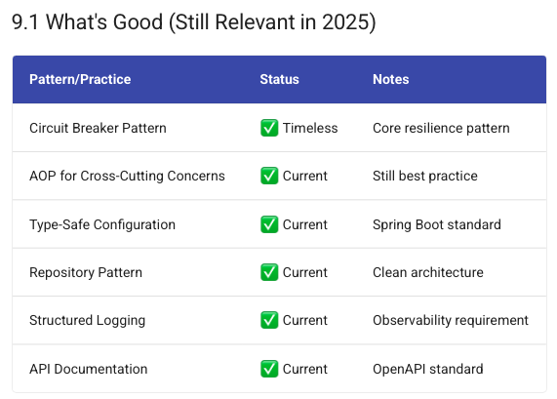
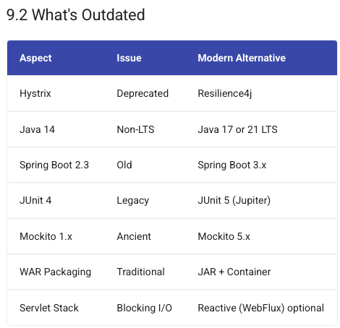
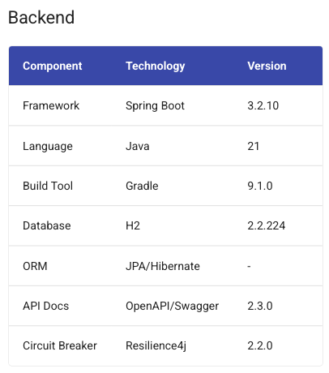
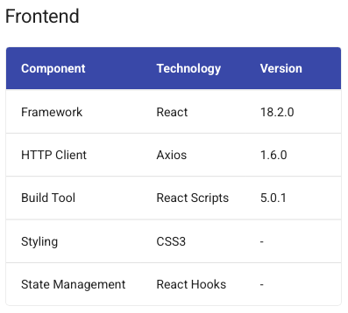
First Analysis continued
Even before I showed AI my plan for migration, it had listed correctly which features were good and which outdated.
This also helped me update my own plan for migration
After migration was completed

Slide 24
Drafting the plan
Step 1: ask AI to analyze codebase; describe what this application is and what key features it has (NOTE: this later part is because I was the original developer)
Step 2: ask AI to create a step by step plan for migrating this application to latest stack and document this plan in a markdown file. Give it a hint to use gradle 9, java 21
Step 3: ask AI to create separate migration plan for circuit breaker migration and save that in another markdown; give hint to use resilience4j (Here as well I had researched this lib before hand)
Step 4: ask AI to create another plan for changing backend from mongodb to H2
NOTE: separate research was done beforehand on steps 2, 3, 4; experiment was observing how AI was addressing these tasks

Slide 25
Journey of changes
Comparing my approach with speckit
Further experimenting on other greenfield projects using speckit; the sequential plan I used here was in line with speckits’ specify, clarify, plan commands
The features or changes needed were called out in steps 2, 3, 4
Also fair amount of interaction went behind each steps to get it to a desired level: java/springboot-upgrade; circuit-breaker-upgrade; database-upgrade;
One important distinction; in this experiment I was having AI implement each step fully at a time; unlike executing “task-command” followed by “implement”;
Also for each code change AI was making, I was verifying those changes, testing with unit tests and then committing changes that looked good.

Slide 26
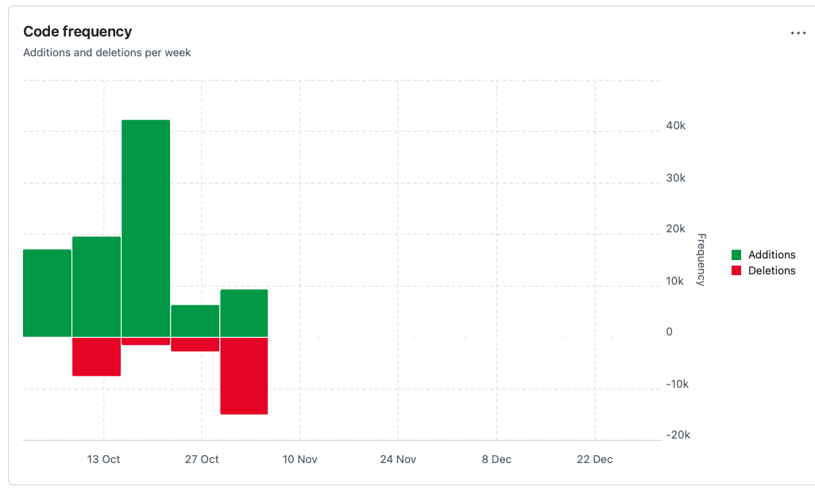
Backend working with new stack
Compare with speckit
In the migration experiment I had fair amount of interaction with AI to reach on a good enough upgrade; later experiments using speckit proved that if specification and plan is build with careful details, these iterations can be controlled
It took me 3-4 weeks to complete steps 2, 3, 4 as outlined before. — speckit can help reduce this time
Verifying changes made by AI using test cases was also important; on some occasions I also had AI generate more test cases. I was manually checking these in the Windsurf to see how these tests ran.

Slide 27
Increase testability
My initial test cases in the original application were only checking on the service layer, repository layer, and Aspects
With code changes made by AI I started adding more tests around utilities, service layer and even controller
Next I used AI to increase my test coverage to a higher level than before
Classifying test cases per feature using BDD style test cases is helpful for pair programming with AI; more so as you are detailing fine-grain specifications; so its better to test is the code is satisfying those specifications.

Slide 28
Adding new feature
This app was not having a client for the API — either a web-frontend or a CLI; so next came feature additions now that the essential upgrade was done.
I asked AI to add a frontend UI in ReactJS and that it should be a single page application
This also ran through numerous iterations till desirable frontend UI was working

Slide 29
Adding documentation for the app
Over the 5 week period working with AI to migrate the legacy application to new tech stack, I had been making my notes each day. After both backend and frontend were working as desired, now was a good time to capture all notes in the repository itself
I had AI generate documentation, of my journey — project summary, architecture, migration guides for gradle, resilience4j, H2; implementation guides, test summaries, code review, quick start guides, etc

Slide 30
Re-arrange docs to Mkdocs
For my experiment, I hand crafted the mkdocs for this application using documentation generated by AI
I arranged the pages, the navigation, wrote my own index page and few others to organize documentation in certain way
With thoughtful planning this could be achieved by asking AI generate documents in this layout and structure.

Slide 31
Summarizing this experiment
As my first experiment playing with AI Code Assistant, this did give me insight on how I should be interacting with AI
I experimented with SpecKit separately on simple example projects from scratch
If I need to experiment on a large legacy system and also make use of SpecKit; my personal approach will be to isolate one feature or aspect of that legacy app and work with AI using SpecKit to understand and document the behavior of that feature; verify with business partners before making any changes.

Slide 32
Appendix
… extra pages

Slide 33
Old advice is still relevant
“Working effectively with Legacy Code” by Michael Feathers (2004)
First add tests and then do your changes
Identify places to alter program behavior without changing code (“seams”)
Create tests that characterizes behavior of the piece of code
Use sprout and wrap techniques
Sprout: create code in separate module/ package; test it; identify insertion point; call it from legacy code
Wrap: rename old method you want to wrap; create a new method with same signature as old; call old method from new; put logic before & after call; like AOP

