Slide 1
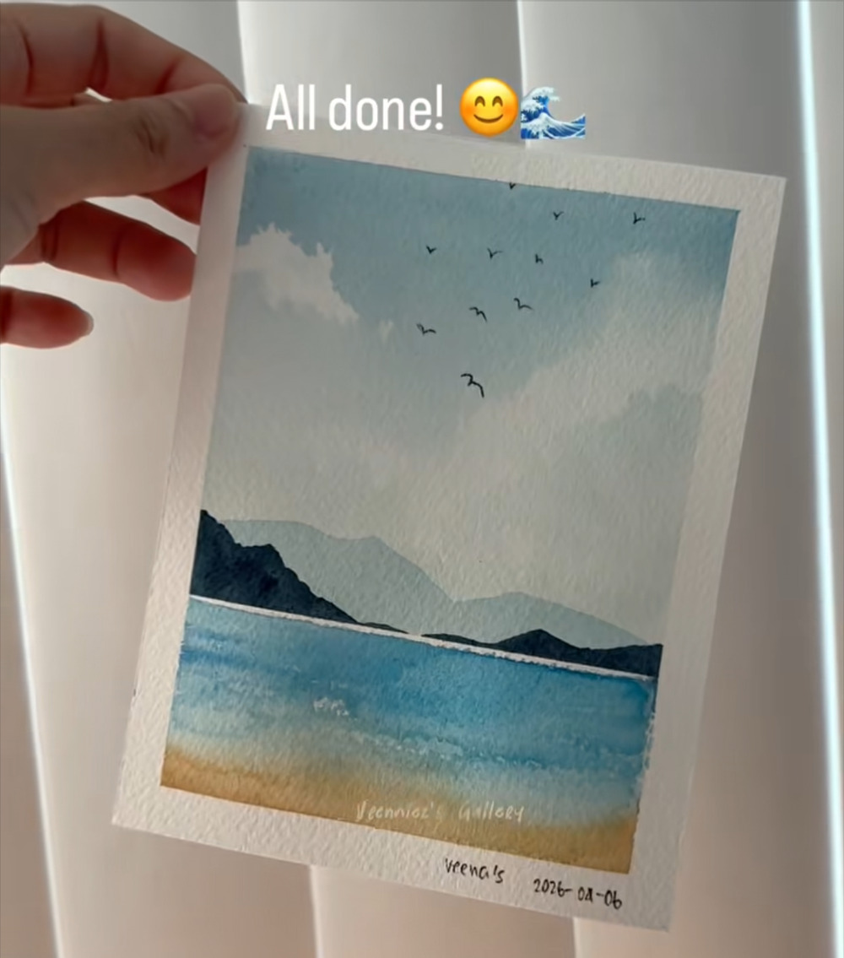
Watercolor Seascape
A step-by-step guide for beginners: sky, mountains, sea and beach in loose, layered washes
60 steps from wet paper to finished painting
Built from screenshots of a Facebook reel by Veenniez's Gallery (“3-minute seascape process”). Colors are kept as they appear in the reel.
Notes:
Title slide. The finished painting is shown on the right (screenshot IMG_4528.PNG).

Slide 2
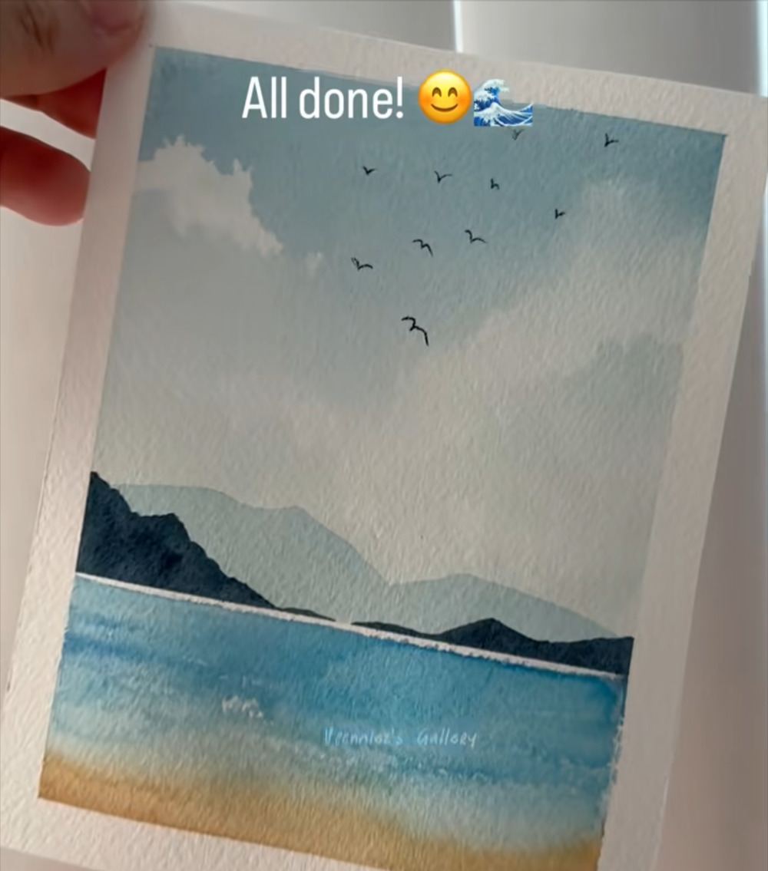
What you will paint
1
Light to dark, far to near
The pale sky and far mountains go in first. The darkest shapes (the near mountains) come next, then the sea and sand.
2
Let each layer dry
The artist starts wet-on-wet, then twice writes “Let it dry..” before adding the next layer. Waiting keeps edges crisp.
3
Save the whites
Clouds are lifted out with a tissue, waves are flecks of unpainted paper, and a thin white line marks the horizon.
The artist's on-screen captions stay visible in every frame, and the step titles in this guide follow them.
Notes:
Overview of the finished painting (screenshot IMG_4527.PNG).

Slide 3
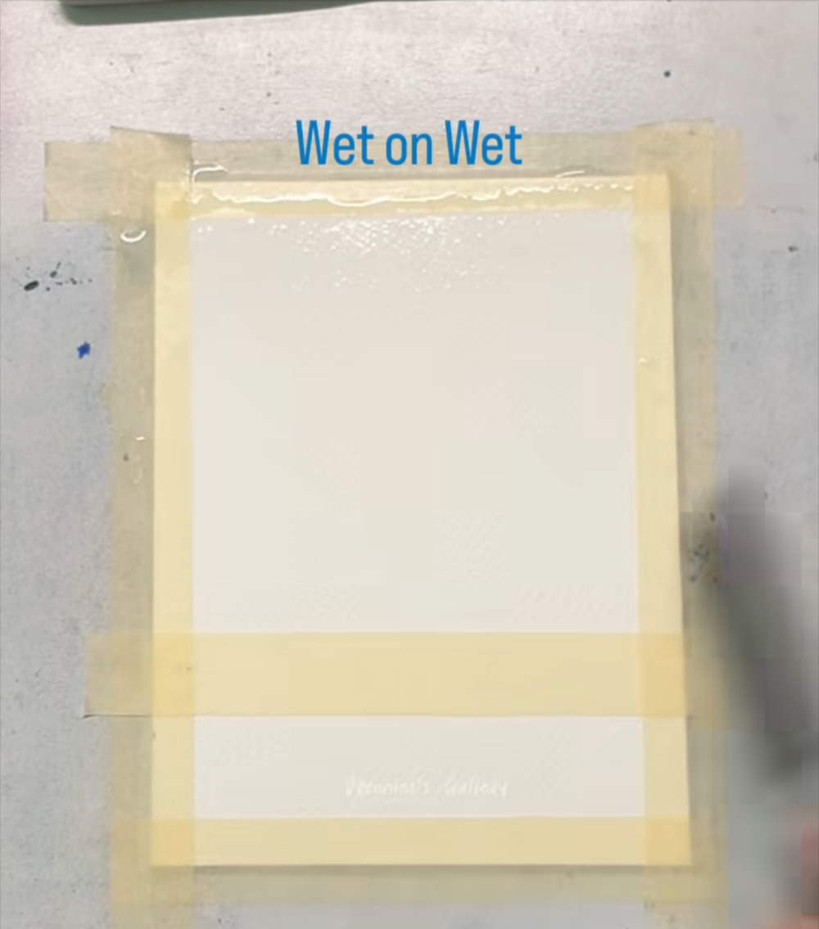
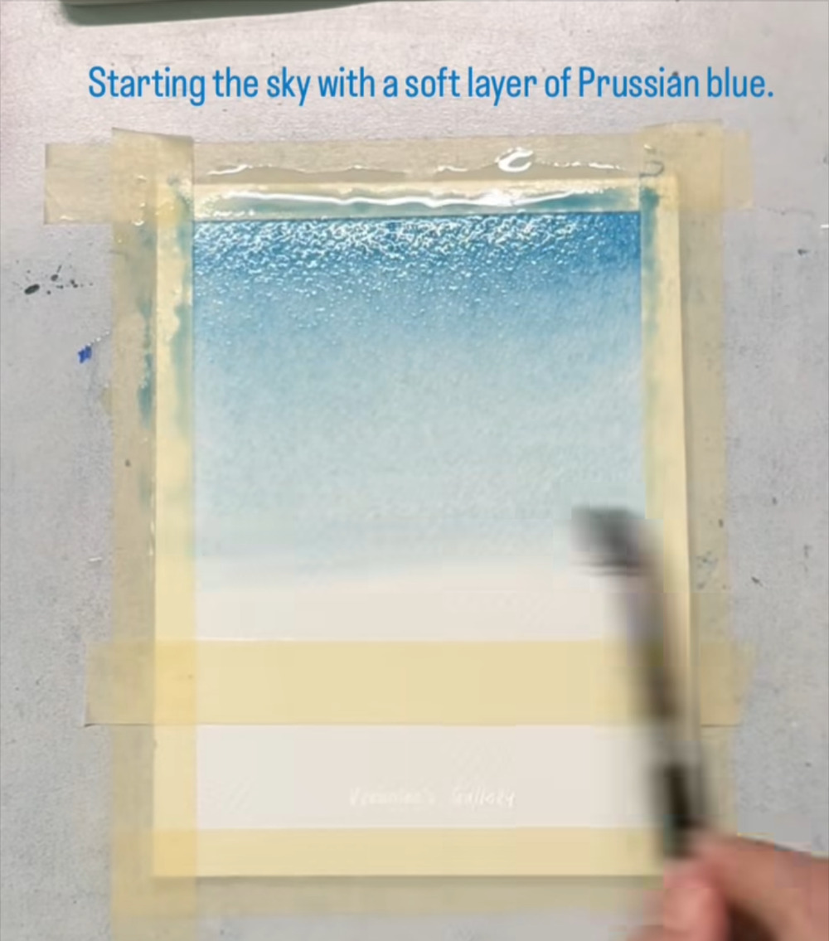
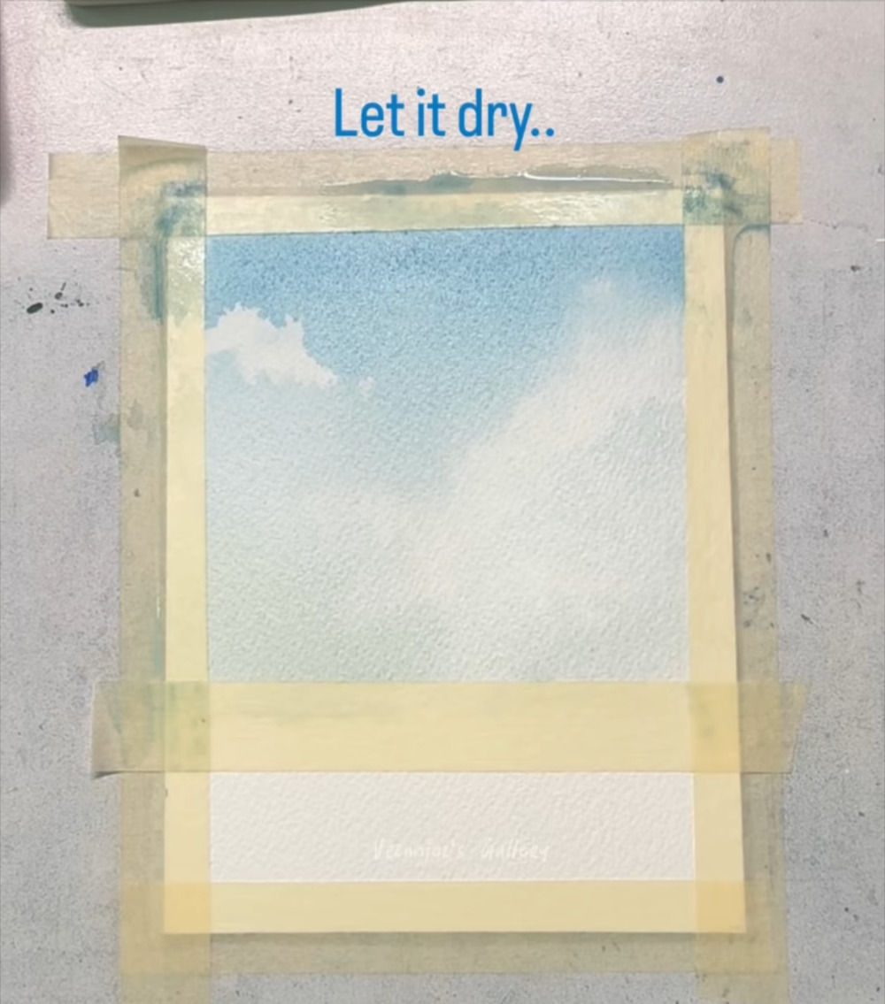
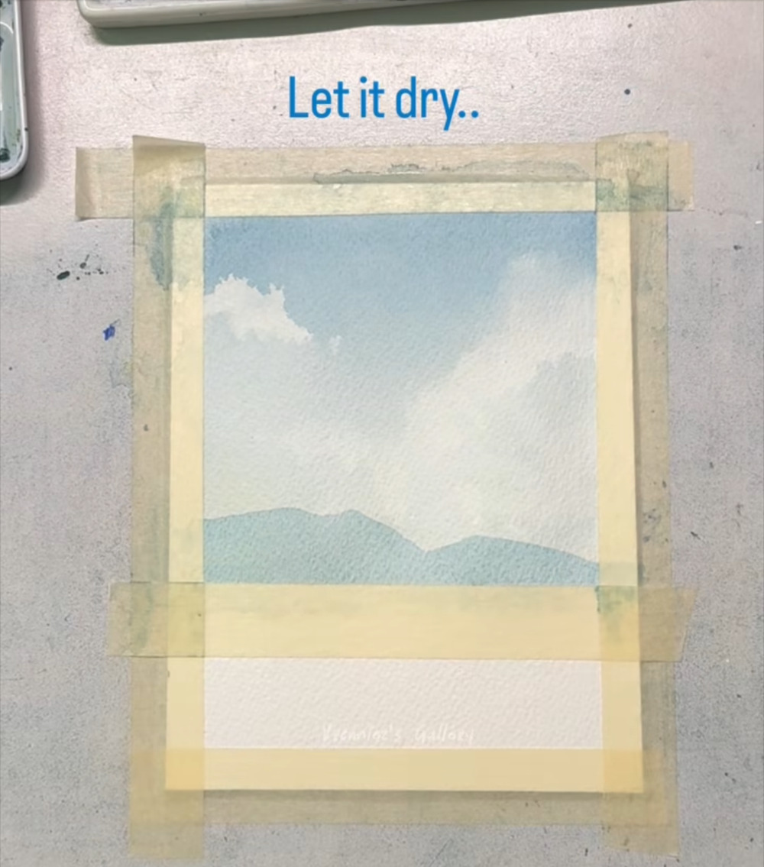
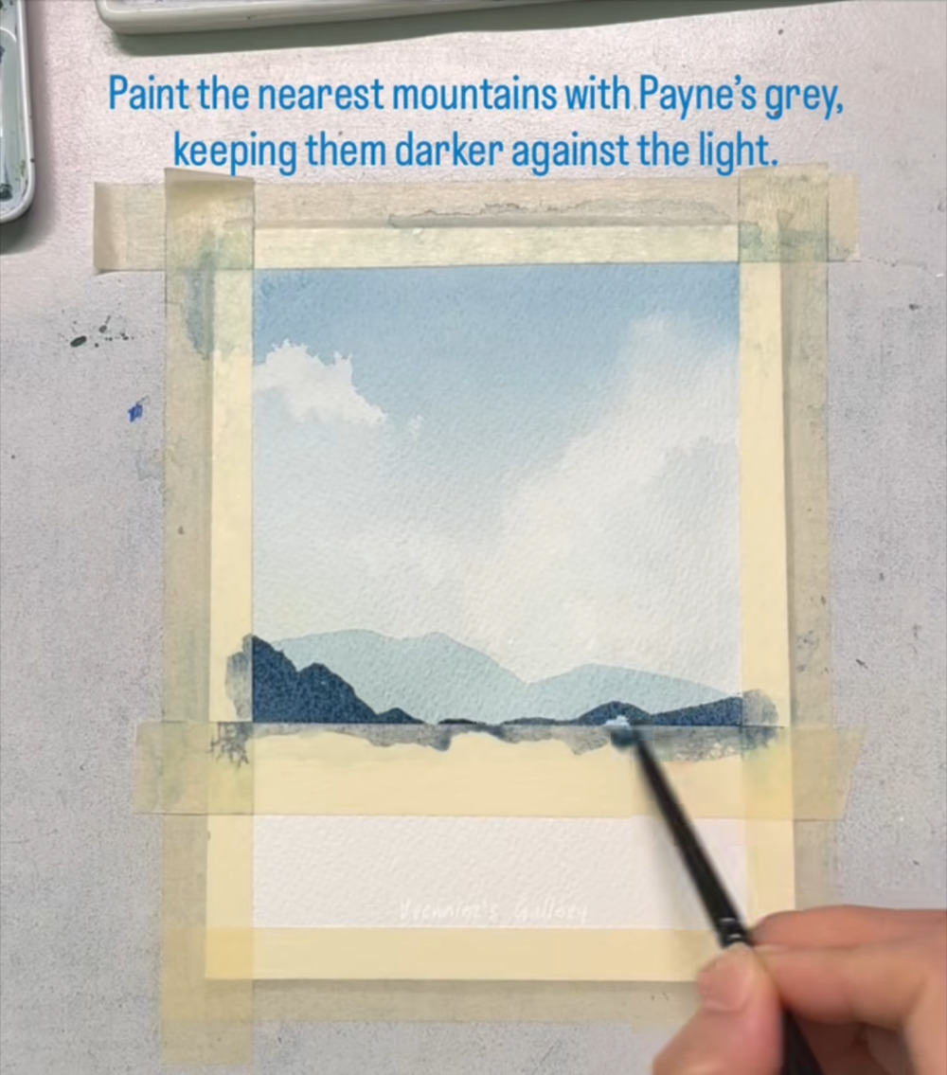
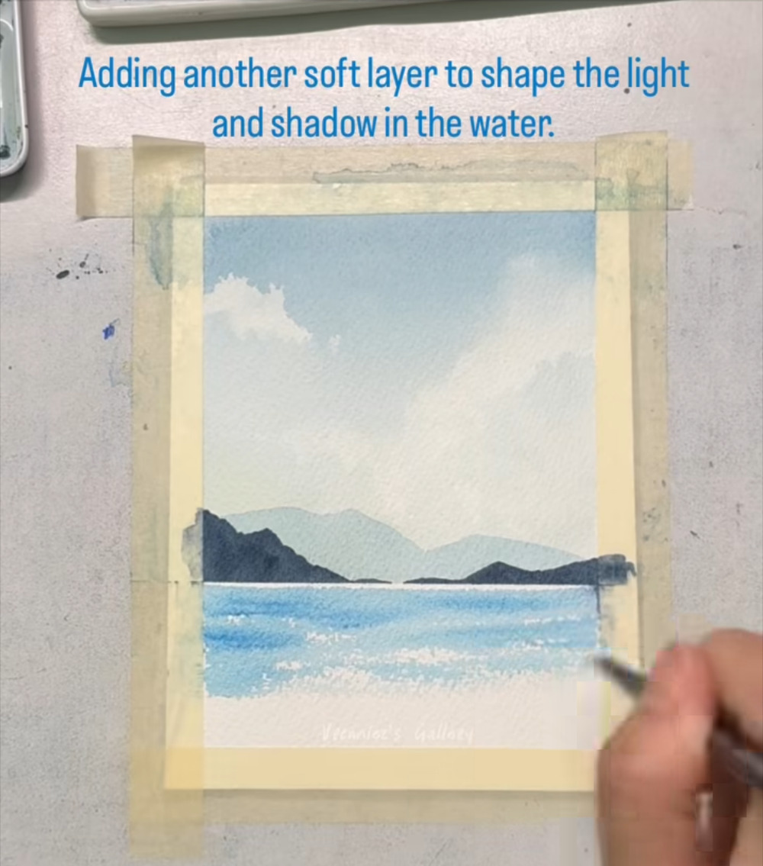
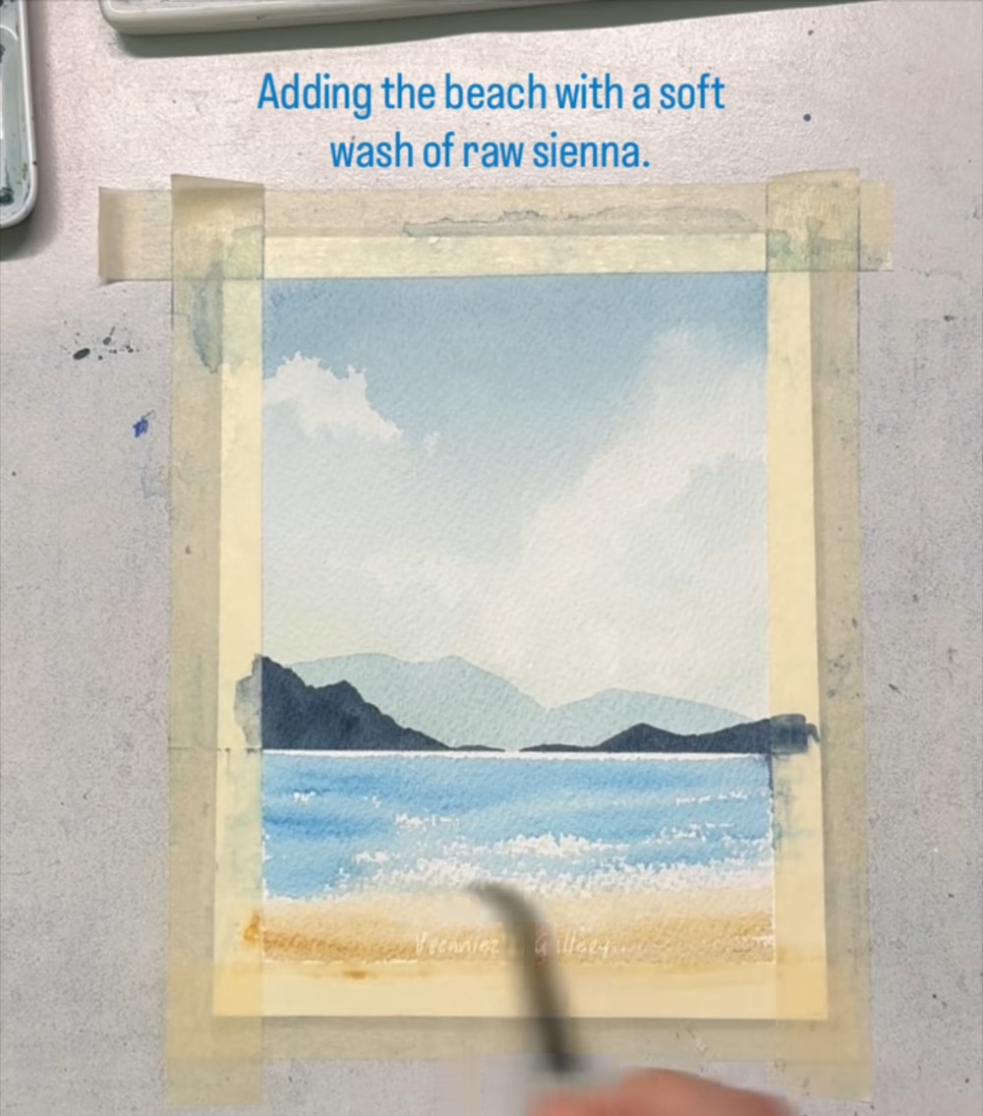
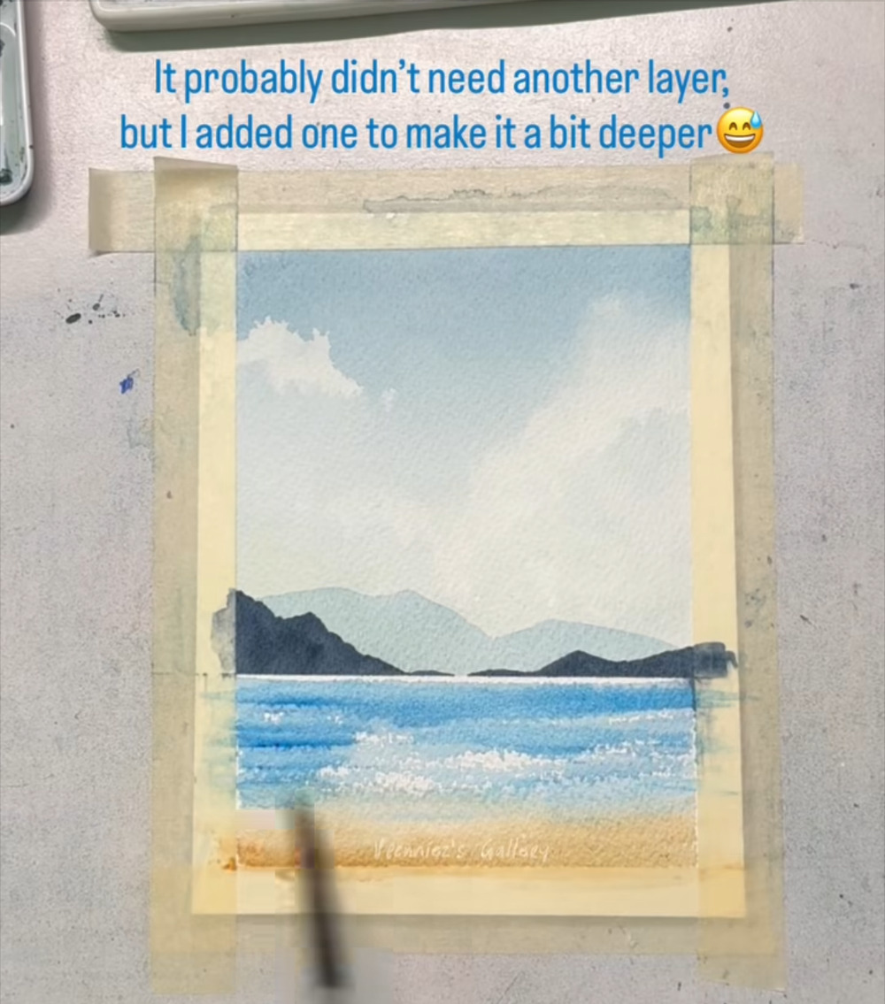
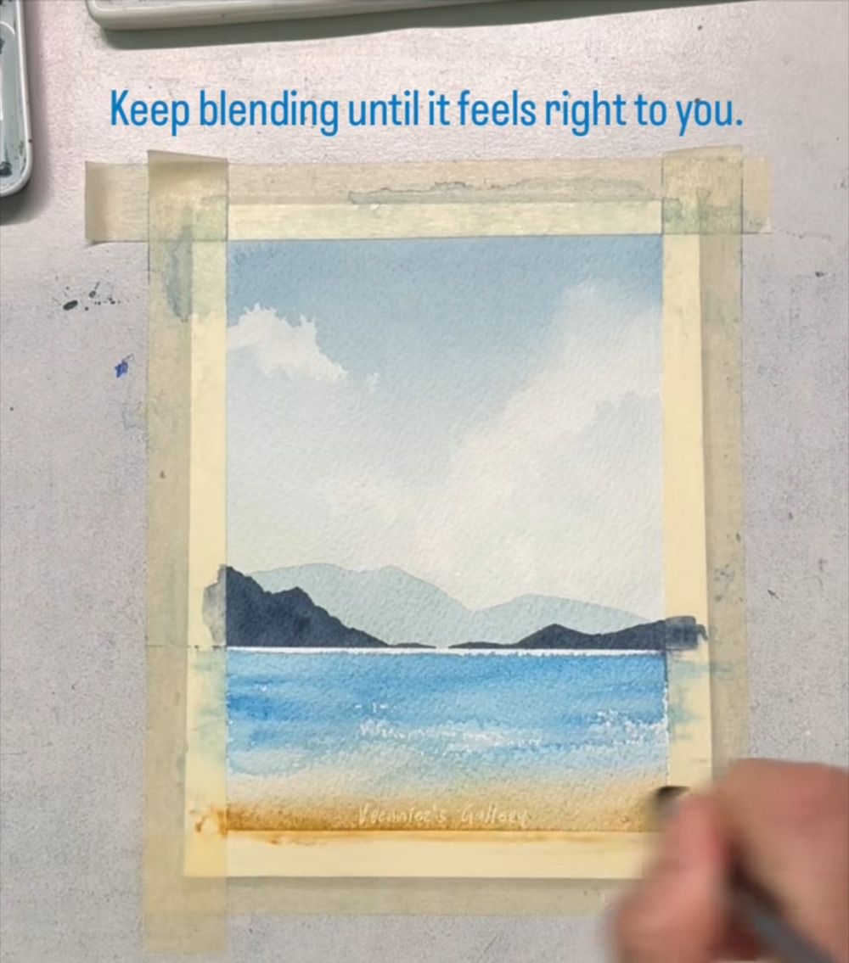
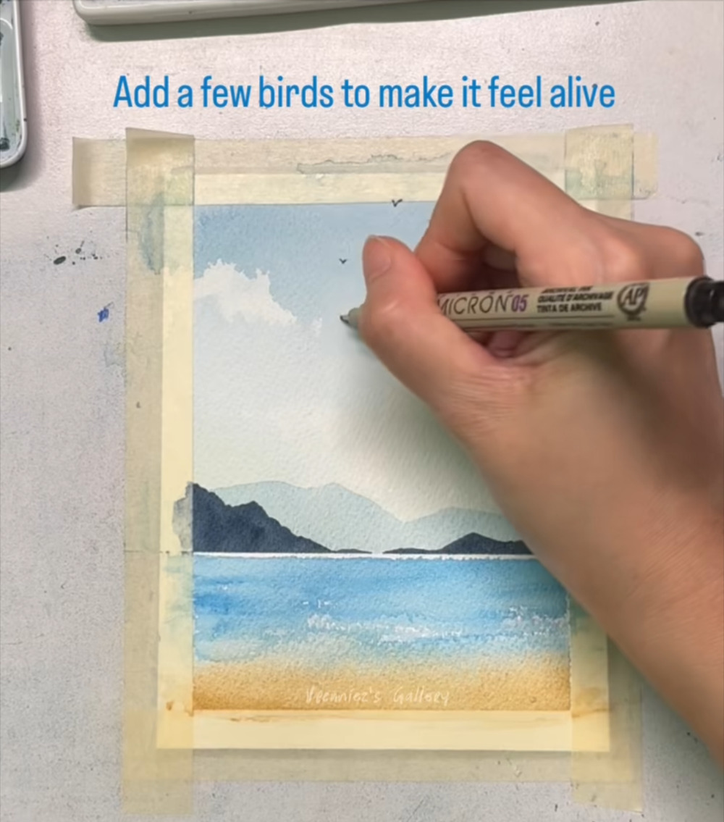
The painting in eleven stages
1. Wet the paper
2. Sky
3. Clouds
4. Far mountains
5. Near mountains
6. Sea
Steps 1–2
Steps 3–6
Steps 7–17
Steps 18–23
Steps 24–27
Steps 28–33
A wet-on-wet start
Prussian blue, deep to pale
Lift with tissue, add shadows, dry
Pale, diluted blue
Dark Payne's grey
Phthalo blue with light wave flecks
7. Beach
8. Deepen the color
9. Blend
10. Birds
11. Finished painting
Steps 34–40
Steps 41–47
Steps 48–50
Steps 51–57
Steps 58–60
A soft raw sienna wash
An optional extra layer
Soften until it feels right
Tiny birds in black ink
Reveal and compare
Notes:
Roadmap of the eleven stages and which steps belong to each. Thumbnails come from the screenshot that ends each stage.

Slide 4
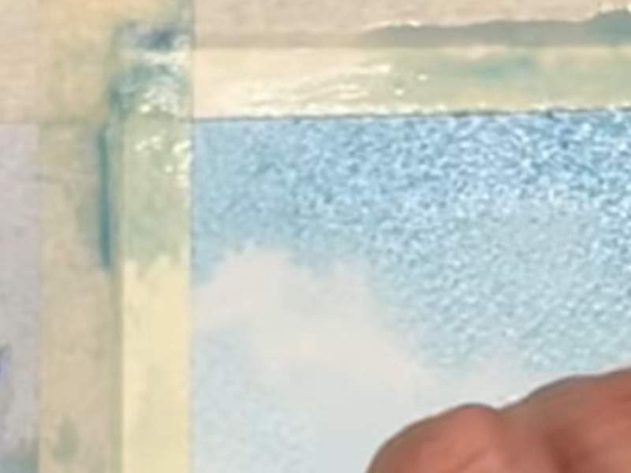
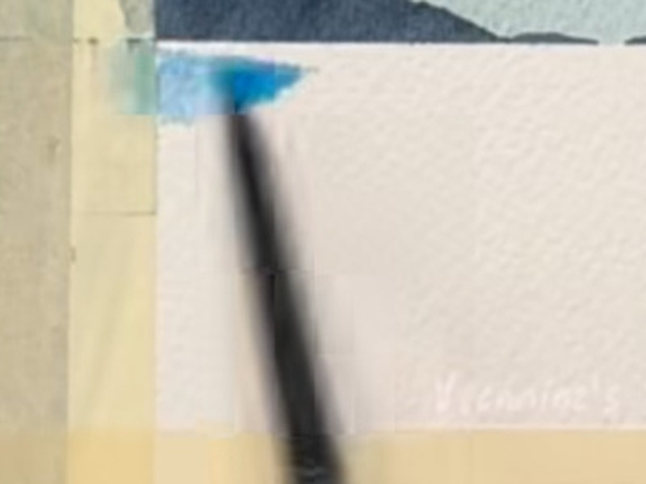
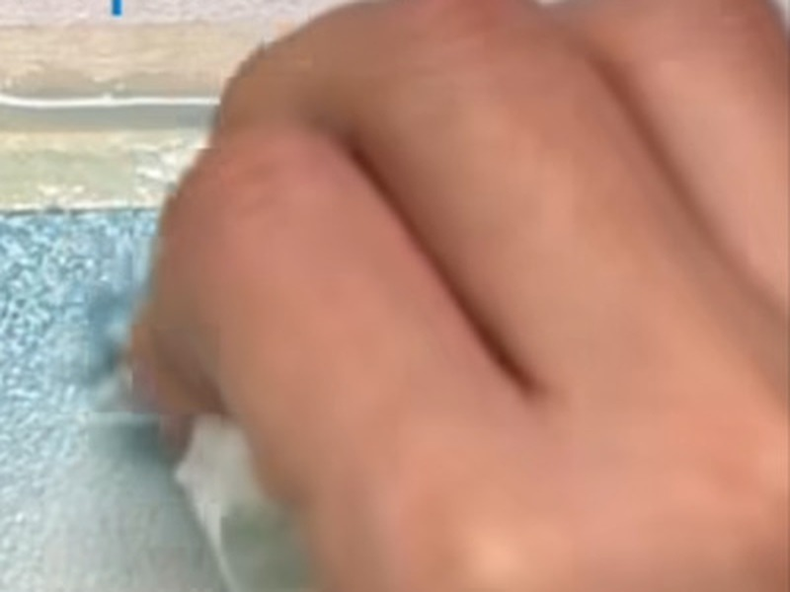
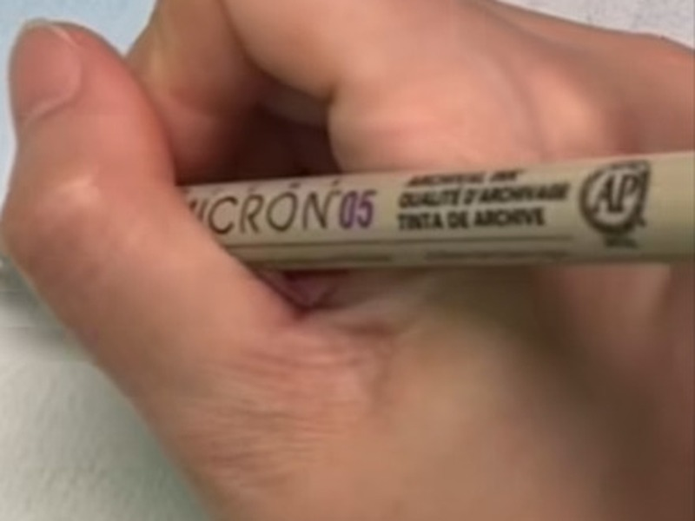
Tools and materials seen in the reel
Masking tape
Round brush, black handle
Tissue
Fine black pen
Steps 1–27
Most paint steps
Steps 7–13
Steps 51–57
Taped on all four sides, plus a strip across the lower paper that masks the sea area until the mountains are done.
A small round brush for the mountains, sea and beach. Sizes are not stated.
A crumpled tissue pressed onto the wet blue lifts paint and leaves soft cloud shapes.
A fine-tip pen labeled Micron 05 draws the birds in black ink.
Also visible: watercolor paper with a visible grain (the texture that makes light brushing leave tiny white flecks), a small palette of paint, and a work surface. The artist names four pigments in the captions: Prussian blue, Payne's grey, phthalo blue and raw sienna.
Notes:
Tools are identified by eye from the screenshots. The pen's label reads Micron 05. Brush sizes and paper brand are not stated in the reel.

Slide 5
Your color palette
Prussian blue
Named in the artist's captions
#5E95AE · Steps 3–16
Sky wash, cloud shadows
Prussian blue, diluted
Named in the artist's captions
#BFCBC7 · Steps 18–22
Pale background mountains
Payne's grey
Named in the artist's captions
#344556 · Steps 24–27, 46
Dark near mountains
Phthalo blue
Named in the artist's captions
#67A6CC · Steps 28–33, 38, 41–50
The sea
How to read these
Hex values were sampled from the screenshots, so they will look a little different on your screen and paper. Use them to match by eye, and test on scrap paper first.
Raw sienna
Named in the artist's captions
#D7B47C · Steps 34–41, 47, 49–50
The beach
Black fine-tip pen
Not a paint
#314343 · Steps 51–57
The birds (ink, not paint)
Paper white
Not a paint
#DEDED6 · Unpainted paper
Clouds, wave flecks, horizon line
Notes:
Palette sampled from painted areas of the screenshots (median of paint pixels in each region). The four pigment names come from the artist's own on-screen captions; the hex values are approximations of how they appear in the video.

Slide 6
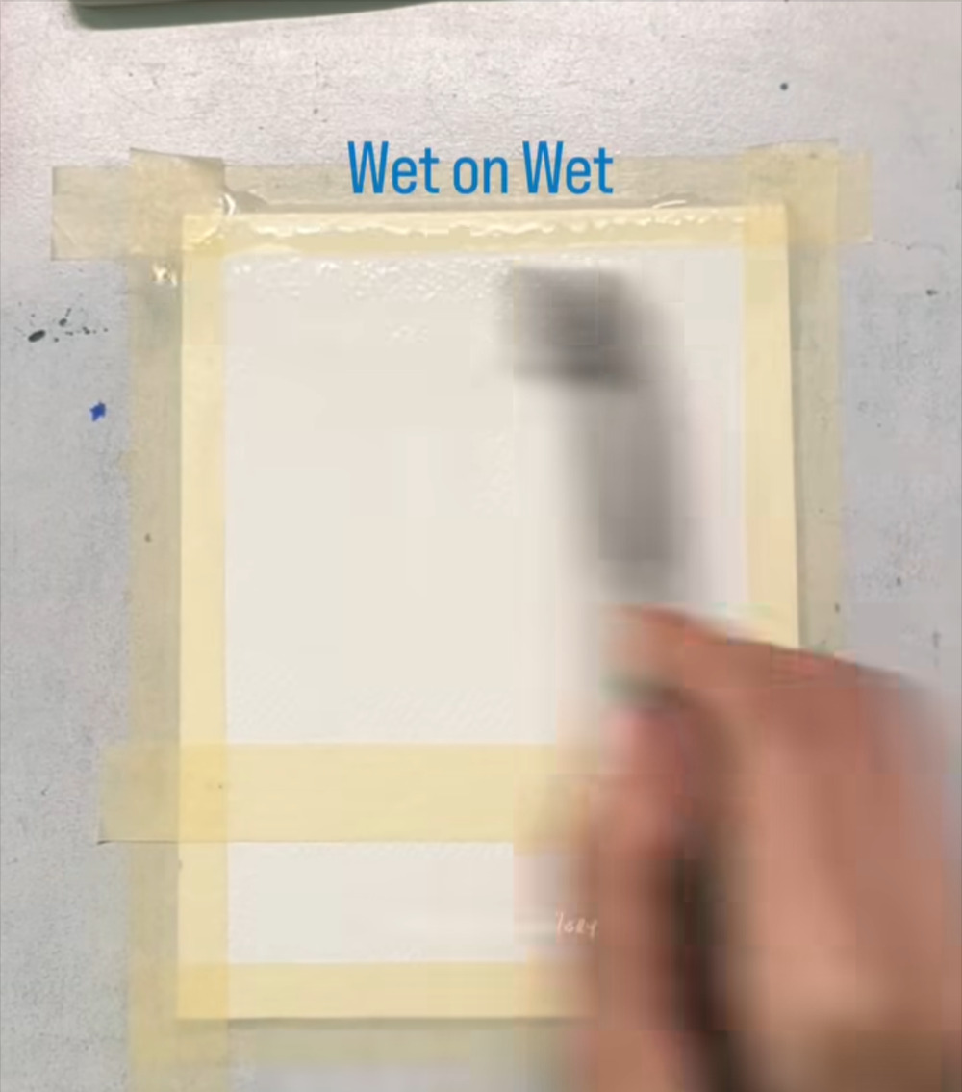
Wet the whole painting area first
STAGE 1 · WET THE PAPER
STEP 1 OF 60
WHAT TO DO
Tape the paper flat on all four sides. In the reel it is already taped down.
With a large, soft brush, spread clean water evenly over the area you will paint.
WATCH FOR
The caption is “Wet on Wet”: color will spread softly only where the paper is damp.
NO PAINT YET: CLEAN WATER ONLY
Notes:
Step 1 of 60. Source screenshot: IMG_4469.PNG. Stage: Wet the paper.
Artist's on-screen caption: “Wet on Wet”
What to do: Tape the paper flat on all four sides. In the reel it is already taped down. With a large, soft brush, spread clean water evenly over the area you will paint.
Watch for: The caption is “Wet on Wet”: color will spread softly only where the paper is damp.

Slide 7
Brush out puddles for an even sheen
STAGE 1 · WET THE PAPER
STEP 2 OF 60
WHAT TO DO
Keep brushing until the whole area looks glossy and evenly damp.
Smooth out any puddles so water is not pooling in one spot.
WATCH FOR
Damp and shiny is right. Running water means too wet; a dull surface means it is drying.
NO PAINT YET: CLEAN WATER ONLY
Notes:
Step 2 of 60. Source screenshot: IMG_4470.PNG. Stage: Wet the paper.
Artist's on-screen caption: “Wet on Wet”
What to do: Keep brushing until the whole area looks glossy and evenly damp. Smooth out any puddles so water is not pooling in one spot.
Watch for: Damp and shiny is right. Running water means too wet; a dull surface means it is drying.

Slide 8
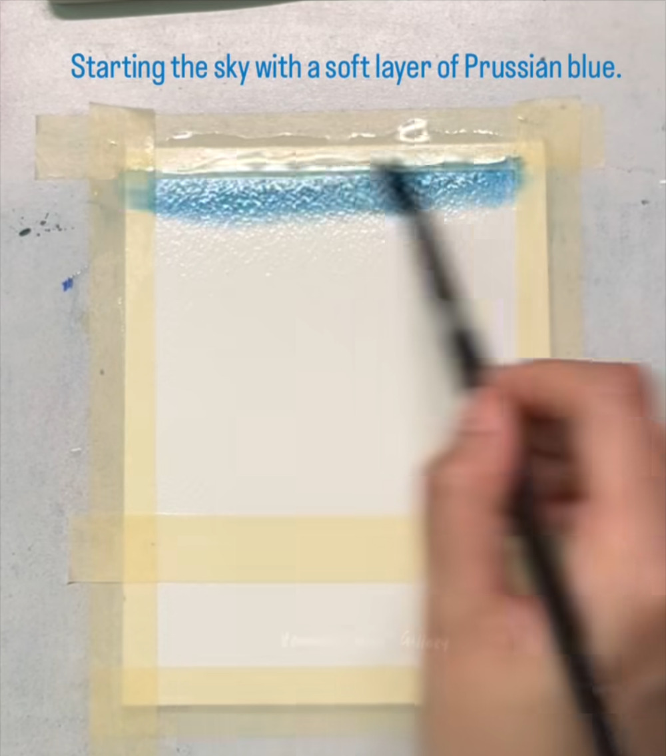
First stripe of Prussian blue
STAGE 2 · SKY
STEP 3 OF 60
WHAT TO DO
Load a brush with Prussian blue mixed with plenty of water.
Lay one stripe along the top edge of the wet paper and let it start to spread.
WATCH FOR
Start at the very top. The sky should be deepest there and fade as it comes down.
COLORS IN THIS STEP
Prussian blue
#5E95AE
Notes:
Step 3 of 60. Source screenshot: IMG_4471.PNG. Stage: Sky.
Artist's on-screen caption: “Starting the sky with a soft layer of Prussian blue.”
What to do: Load a brush with Prussian blue mixed with plenty of water. Lay one stripe along the top edge of the wet paper and let it start to spread.
Watch for: Start at the very top. The sky should be deepest there and fade as it comes down.

Slide 9
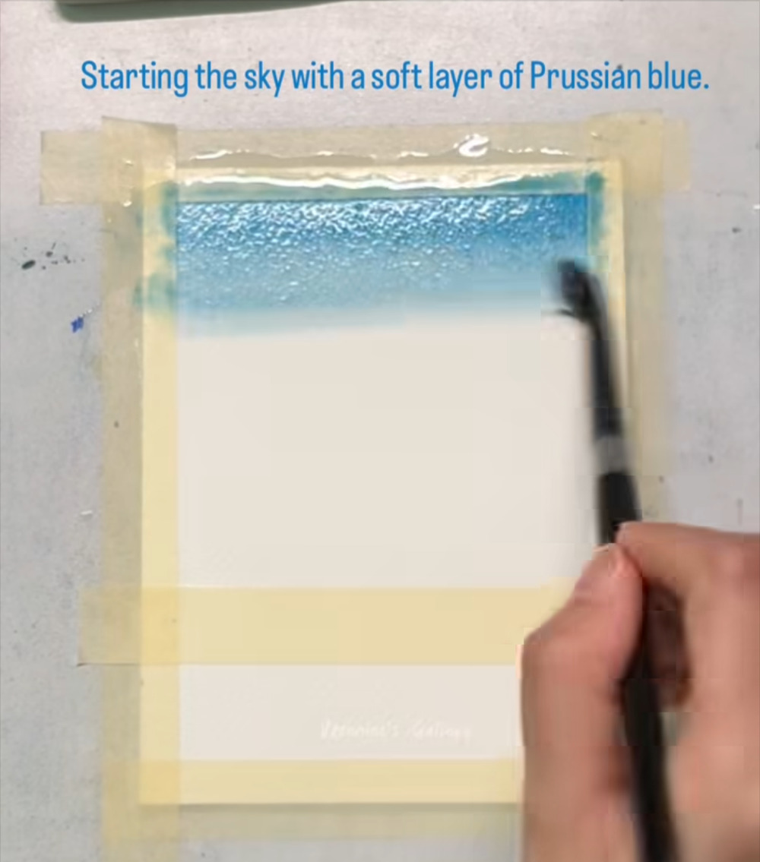
Pull the blue down the page
STAGE 2 · SKY
STEP 4 OF 60
WHAT TO DO
Drag the color downward with broad, loose strokes.
Let the wet paper carry the blue; it softens by itself.
WATCH FOR
Don't scrub. A few confident strokes keep the wash smooth.
COLORS IN THIS STEP
Prussian blue
#5E95AE
Notes:
Step 4 of 60. Source screenshot: IMG_4472.PNG. Stage: Sky.
Artist's on-screen caption: “Starting the sky with a soft layer of Prussian blue.”
What to do: Drag the color downward with broad, loose strokes. Let the wet paper carry the blue; it softens by itself.
Watch for: Don't scrub. A few confident strokes keep the wash smooth.

Slide 10
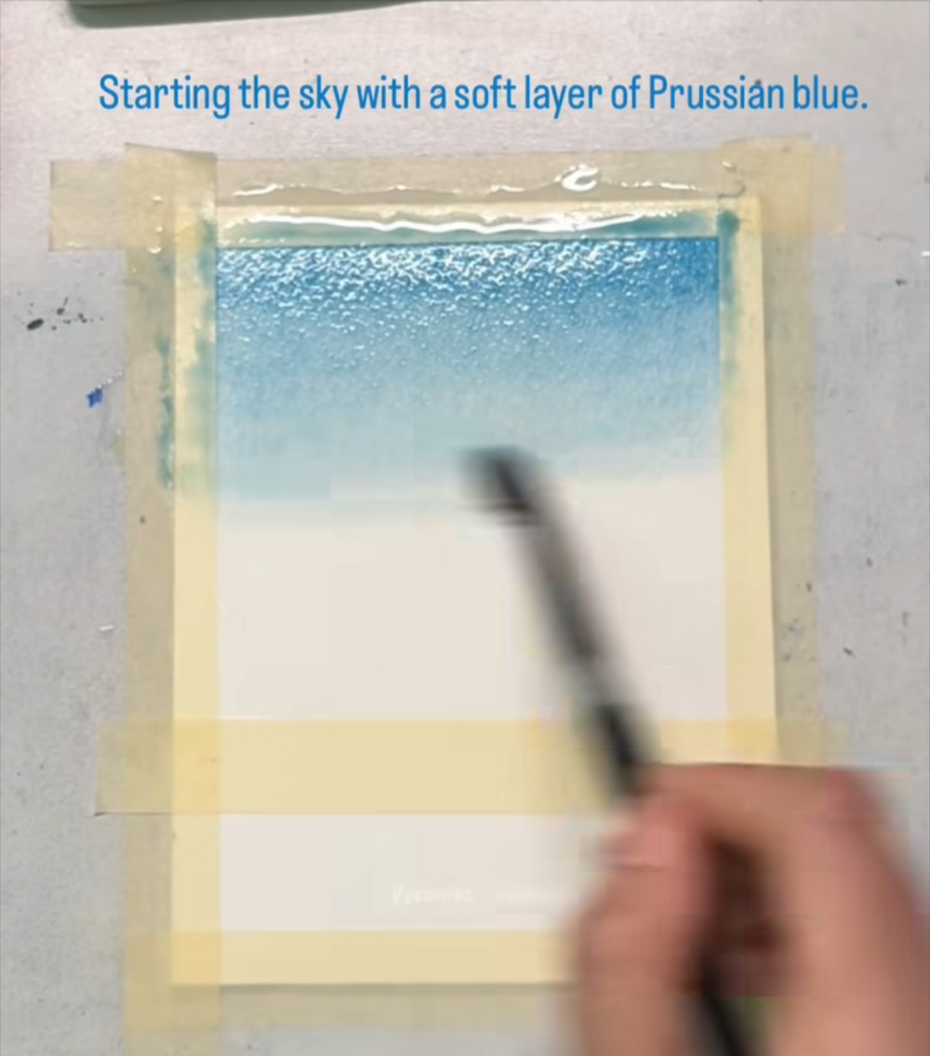
Fade the blue toward the middle
STAGE 2 · SKY
STEP 5 OF 60
WHAT TO DO
Add a little more blue near the top, then use a lightly loaded brush to pull it down.
Let the color thin out into the white of the paper.
WATCH FOR
The lower half of the sky stays very pale, which leaves room for clouds.
COLORS IN THIS STEP
Prussian blue
#5E95AE
Notes:
Step 5 of 60. Source screenshot: IMG_4473.PNG. Stage: Sky.
Artist's on-screen caption: “Starting the sky with a soft layer of Prussian blue.”
What to do: Add a little more blue near the top, then use a lightly loaded brush to pull it down. Let the color thin out into the white of the paper.
Watch for: The lower half of the sky stays very pale, which leaves room for clouds.

Slide 11
Smooth the transition
STAGE 2 · SKY
STEP 6 OF 60
WHAT TO DO
Soften the lower edge of the blue so there is no hard line.
Stop while the paper is still damp, because the next step lifts wet paint.
WATCH FOR
Don't wait for the sky to dry yet. The tissue only lifts paint that is still wet.
COLORS IN THIS STEP
Prussian blue
#5E95AE
Notes:
Step 6 of 60. Source screenshot: IMG_4474.PNG. Stage: Sky.
Artist's on-screen caption: “Starting the sky with a soft layer of Prussian blue.”
What to do: Soften the lower edge of the blue so there is no hard line. Stop while the paper is still damp, because the next step lifts wet paint.
Watch for: Don't wait for the sky to dry yet. The tissue only lifts paint that is still wet.

Slide 12
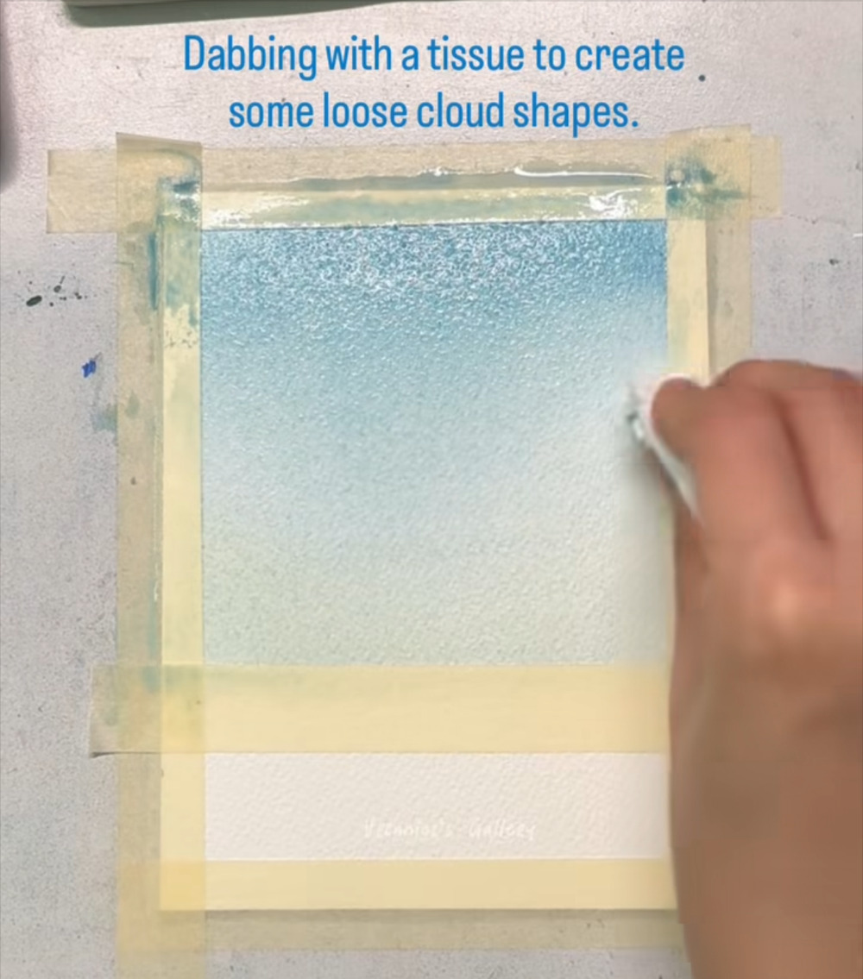
Dab the first cloud with a tissue
STAGE 3 · CLOUDS
STEP 7 OF 60
WHAT TO DO
Crumple a clean tissue and press it onto the wet blue, starting at the right edge.
Lift straight up. The tissue removes paint and leaves a soft, pale cloud shape.
WATCH FOR
Press and lift. Rubbing would smear the color instead of lifting it.
COLORS IN THIS STEP
Prussian blue
#5E95AE
Notes:
Step 7 of 60. Source screenshot: IMG_4475.PNG. Stage: Clouds.
Artist's on-screen caption: “Dabbing with a tissue to create some loose cloud shapes.”
What to do: Crumple a clean tissue and press it onto the wet blue, starting at the right edge. Lift straight up. The tissue removes paint and leaves a soft, pale cloud shape.
Watch for: Press and lift. Rubbing would smear the color instead of lifting it.

Slide 13
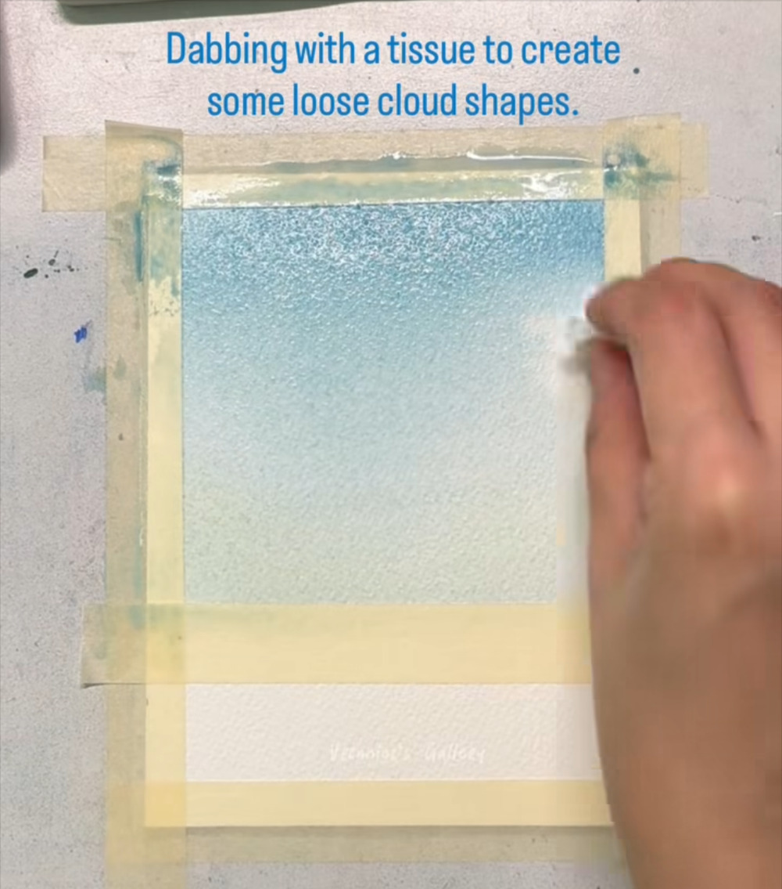
Keep lifting paint along the right side
STAGE 3 · CLOUDS
STEP 8 OF 60
WHAT TO DO
Dab the tissue in several spots along the edge of the sky.
Vary the size and spacing of the dabs so the clouds look natural.
WATCH FOR
Clouds are loose shapes with soft edges, not outlines.
COLORS IN THIS STEP
Prussian blue
#5E95AE
Notes:
Step 8 of 60. Source screenshot: IMG_4476.PNG. Stage: Clouds.
Artist's on-screen caption: “Dabbing with a tissue to create some loose cloud shapes.”
What to do: Dab the tissue in several spots along the edge of the sky. Vary the size and spacing of the dabs so the clouds look natural.
Watch for: Clouds are loose shapes with soft edges, not outlines.

Slide 14
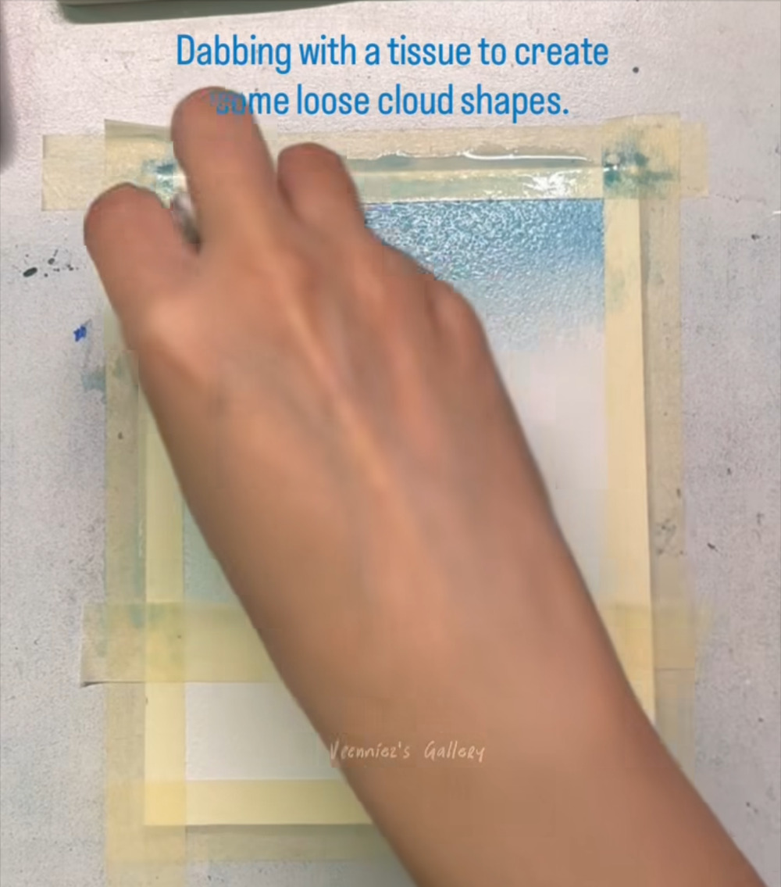
Dab across the middle of the sky
STAGE 3 · CLOUDS
STEP 9 OF 60
WHAT TO DO
Move your hand across the paper and dab clouds in the middle.
Press flatter for wide clouds and with a corner for small ones.
WATCH FOR
Your hand may hide the paper while you work. Check the result after you lift.
COLORS IN THIS STEP
Prussian blue
#5E95AE
Notes:
Step 9 of 60. Source screenshot: IMG_4477.PNG. Stage: Clouds.
Artist's on-screen caption: “Dabbing with a tissue to create some loose cloud shapes.”
What to do: Move your hand across the paper and dab clouds in the middle. Press flatter for wide clouds and with a corner for small ones.
Watch for: Your hand may hide the paper while you work. Check the result after you lift.

Slide 15
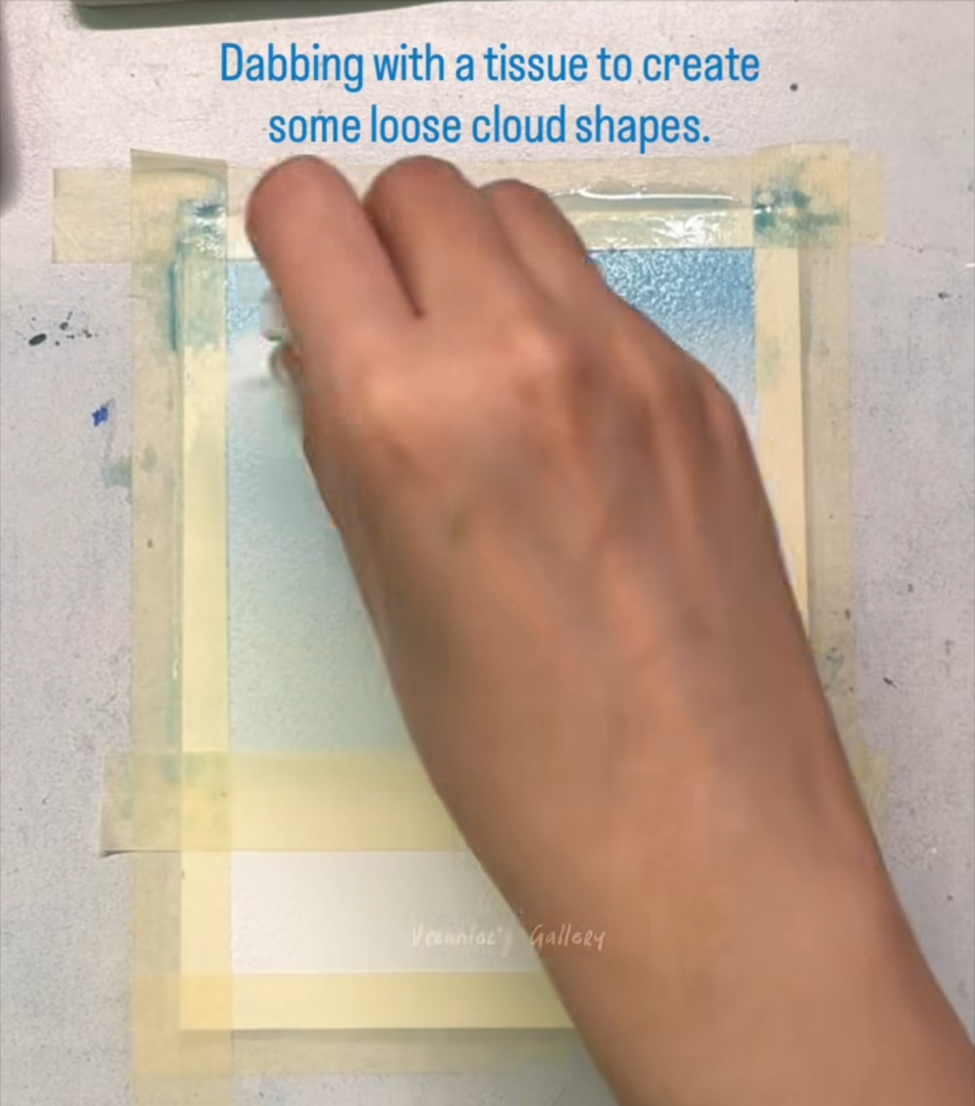
Continue the clouds across the sky
STAGE 3 · CLOUDS
STEP 10 OF 60
WHAT TO DO
Keep dabbing from left to right, overlapping some of the shapes.
Switch to a clean part of the tissue as it picks up blue.
WATCH FOR
A tissue full of blue will put paint back. Use a fresh area often.
COLORS IN THIS STEP
Prussian blue
#5E95AE
Notes:
Step 10 of 60. Source screenshot: IMG_4478.PNG. Stage: Clouds.
Artist's on-screen caption: “Dabbing with a tissue to create some loose cloud shapes.”
What to do: Keep dabbing from left to right, overlapping some of the shapes. Switch to a clean part of the tissue as it picks up blue.
Watch for: A tissue full of blue will put paint back. Use a fresh area often.

Slide 16
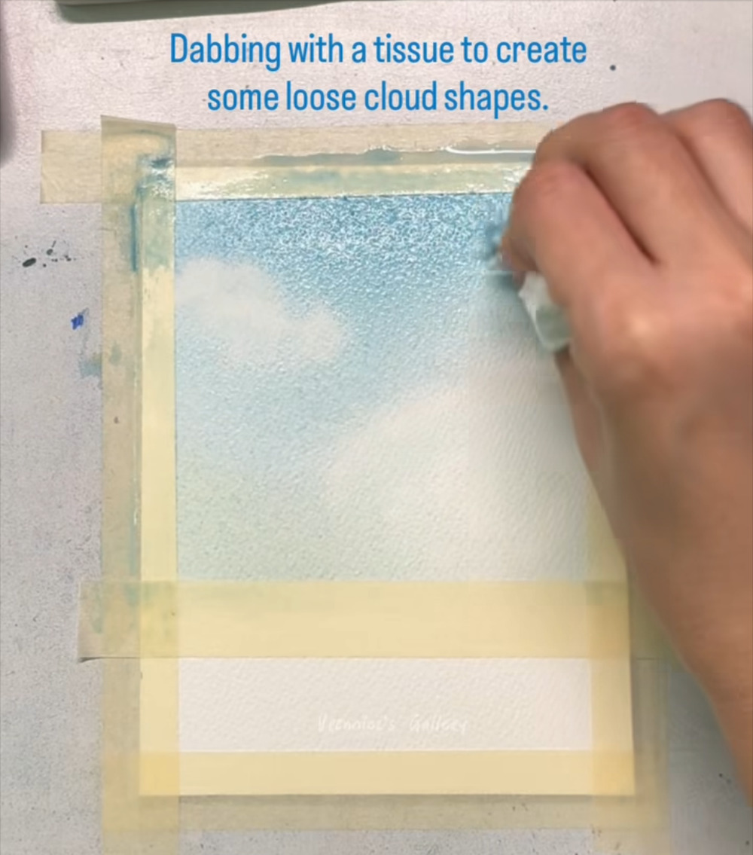
Cloud shapes start to appear
STAGE 3 · CLOUDS
STEP 11 OF 60
WHAT TO DO
Look for pale cloud shapes against the blue: one near the top left and a larger one at the right.
Dab around their edges to widen them and blur the outlines.
WATCH FOR
Soft edges make the sky feel airy.
COLORS IN THIS STEP
Prussian blue
#5E95AE
Notes:
Step 11 of 60. Source screenshot: IMG_4479.PNG. Stage: Clouds.
Artist's on-screen caption: “Dabbing with a tissue to create some loose cloud shapes.”
What to do: Look for pale cloud shapes against the blue: one near the top left and a larger one at the right. Dab around their edges to widen them and blur the outlines.
Watch for: Soft edges make the sky feel airy.

Slide 17
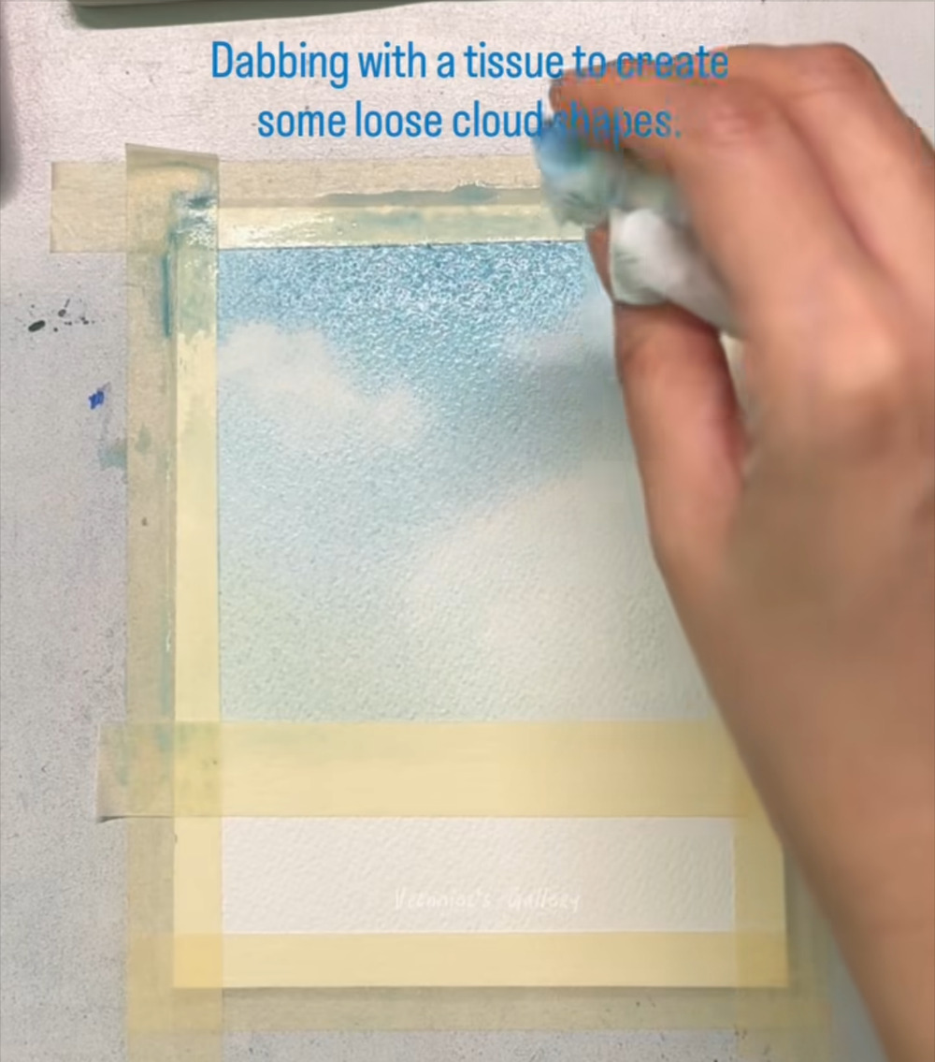
Lift paint near the top left
STAGE 3 · CLOUDS
STEP 12 OF 60
WHAT TO DO
Dab a few more cloud shapes closer to the top, where the sky is darkest.
Keep them smaller and softer than the clouds lower down.
WATCH FOR
Hold the tissue by its edge so your fingers don't touch the wet paper.
COLORS IN THIS STEP
Prussian blue
#5E95AE
Notes:
Step 12 of 60. Source screenshot: IMG_4480.PNG. Stage: Clouds.
Artist's on-screen caption: “Dabbing with a tissue to create some loose cloud shapes.”
What to do: Dab a few more cloud shapes closer to the top, where the sky is darkest. Keep them smaller and softer than the clouds lower down.
Watch for: Hold the tissue by its edge so your fingers don't touch the wet paper.

Slide 18
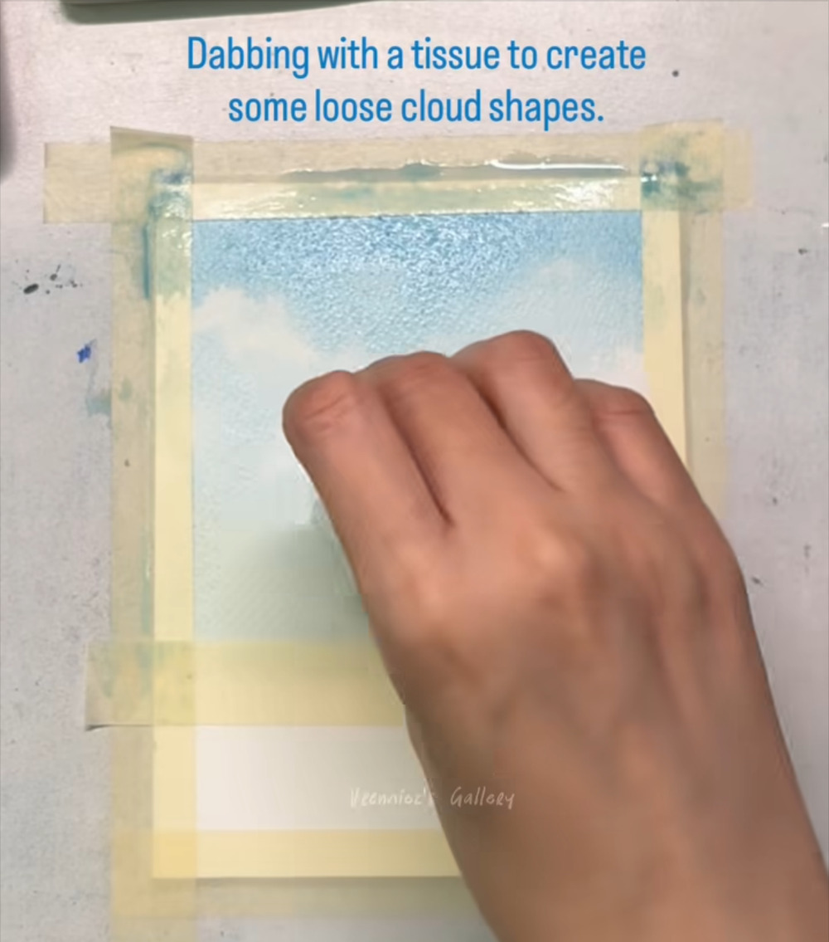
Lift a bigger cloud lower down
STAGE 3 · CLOUDS
STEP 13 OF 60
WHAT TO DO
Press the tissue flat to lift a large, soft cloud in the lower half of the sky.
Leave the deep blue at the very top untouched.
WATCH FOR
Big, pale clouds low in the sky and small ones up high give a sense of depth.
COLORS IN THIS STEP
Prussian blue
#5E95AE
Notes:
Step 13 of 60. Source screenshot: IMG_4481.PNG. Stage: Clouds.
Artist's on-screen caption: “Dabbing with a tissue to create some loose cloud shapes.”
What to do: Press the tissue flat to lift a large, soft cloud in the lower half of the sky. Leave the deep blue at the very top untouched.
Watch for: Big, pale clouds low in the sky and small ones up high give a sense of depth.

Slide 19
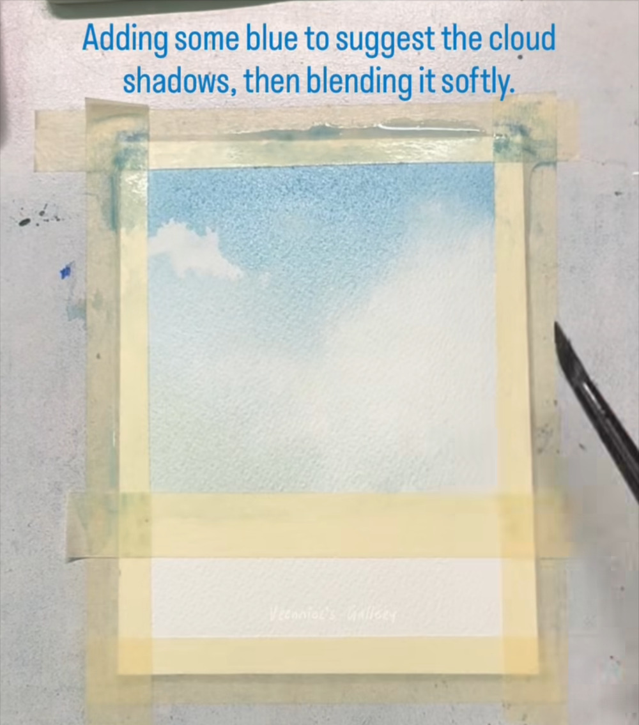
Add blue shadows under the clouds
STAGE 3 · CLOUDS
STEP 14 OF 60
WHAT TO DO
Pick up a small amount of Prussian blue on a round brush.
Touch it along the bottom edges of the clouds to suggest shadow.
WATCH FOR
Keep the paint thin so it only tints the underside of each cloud.
COLORS IN THIS STEP
Prussian blue
#5E95AE
Notes:
Step 14 of 60. Source screenshot: IMG_4482.PNG. Stage: Clouds.
Artist's on-screen caption: “Adding some blue to suggest the cloud shadows, then blending it softly.”
What to do: Pick up a small amount of Prussian blue on a round brush. Touch it along the bottom edges of the clouds to suggest shadow.
Watch for: Keep the paint thin so it only tints the underside of each cloud.

Slide 20
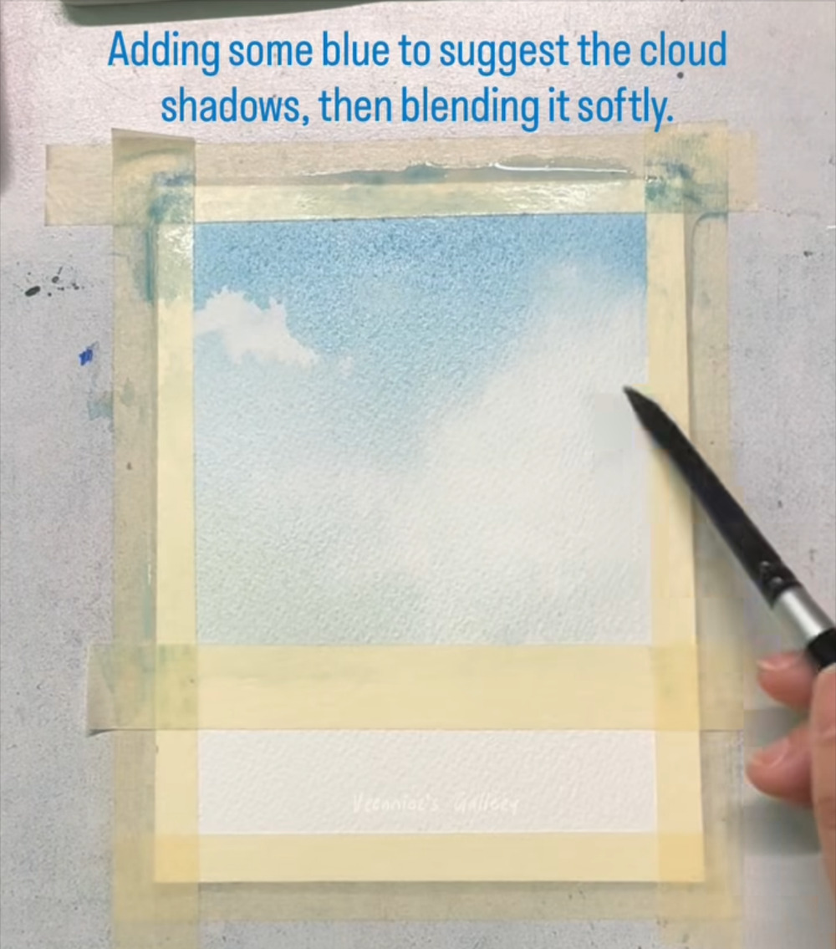
Blend the shadows softly
STAGE 3 · CLOUDS
STEP 15 OF 60
WHAT TO DO
Stroke the new blue gently into the cloud with a clean, damp brush.
Blend until the shadow fades smoothly into the white.
WATCH FOR
No hard edges on the lower sides of the clouds.
COLORS IN THIS STEP
Prussian blue
#5E95AE
Notes:
Step 15 of 60. Source screenshot: IMG_4483.PNG. Stage: Clouds.
Artist's on-screen caption: “Adding some blue to suggest the cloud shadows, then blending it softly.”
What to do: Stroke the new blue gently into the cloud with a clean, damp brush. Blend until the shadow fades smoothly into the white.
Watch for: No hard edges on the lower sides of the clouds.

Slide 21
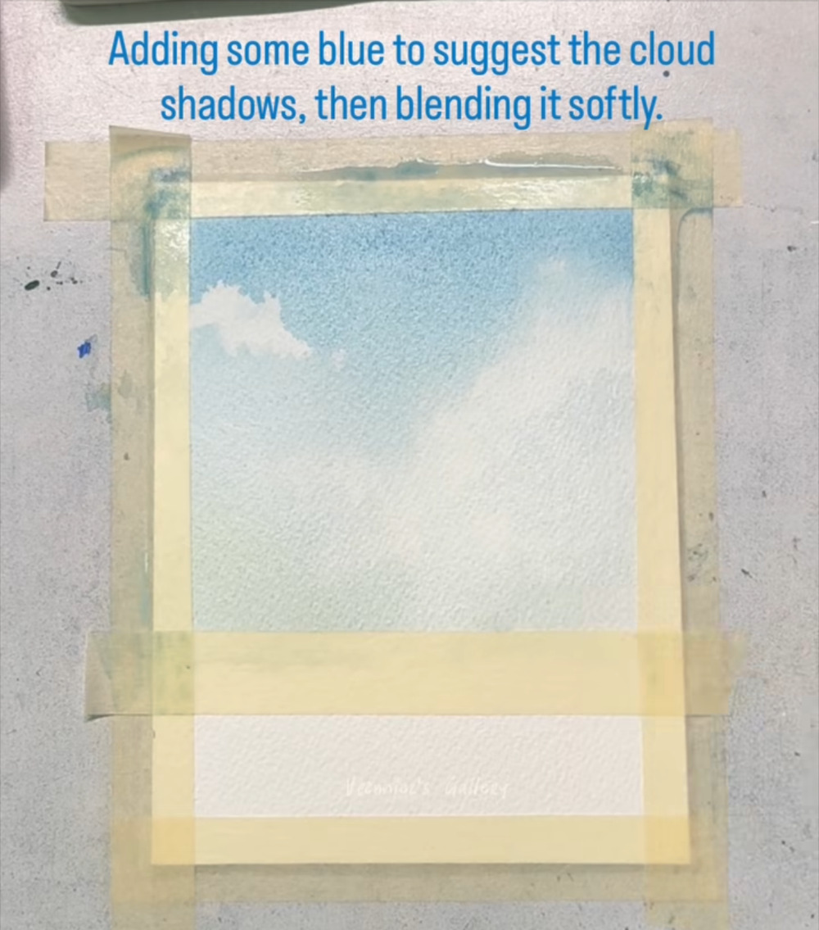
Repeat on the remaining clouds
STAGE 3 · CLOUDS
STEP 16 OF 60
WHAT TO DO
Add and blend shadows under the other clouds in the same way.
Put every shadow on the same side so the light looks consistent.
WATCH FOR
A few soft shadows look better than many strong ones.
COLORS IN THIS STEP
Prussian blue
#5E95AE
Notes:
Step 16 of 60. Source screenshot: IMG_4484.PNG. Stage: Clouds.
Artist's on-screen caption: “Adding some blue to suggest the cloud shadows, then blending it softly.”
What to do: Add and blend shadows under the other clouds in the same way. Put every shadow on the same side so the light looks consistent.
Watch for: A few soft shadows look better than many strong ones.

Slide 22
Let the sky dry completely
STAGE 3 · CLOUDS
STEP 17 OF 60
WHAT TO DO
Put the brush down and wait until the paper has lost all its shine.
Check that the sky is fully dry before you continue.
WATCH FOR
Painting mountains onto damp paper would blur them. Patience keeps the edges crisp.
NO PAINT IN THIS STEP: WAIT FOR IT TO DRY
Notes:
Step 17 of 60. Source screenshot: IMG_4485.PNG. Stage: Clouds.
Artist's on-screen caption: “Let it dry..”
What to do: Put the brush down and wait until the paper has lost all its shine. Check that the sky is fully dry before you continue.
Watch for: Painting mountains onto damp paper would blur them. Patience keeps the edges crisp.

Slide 23
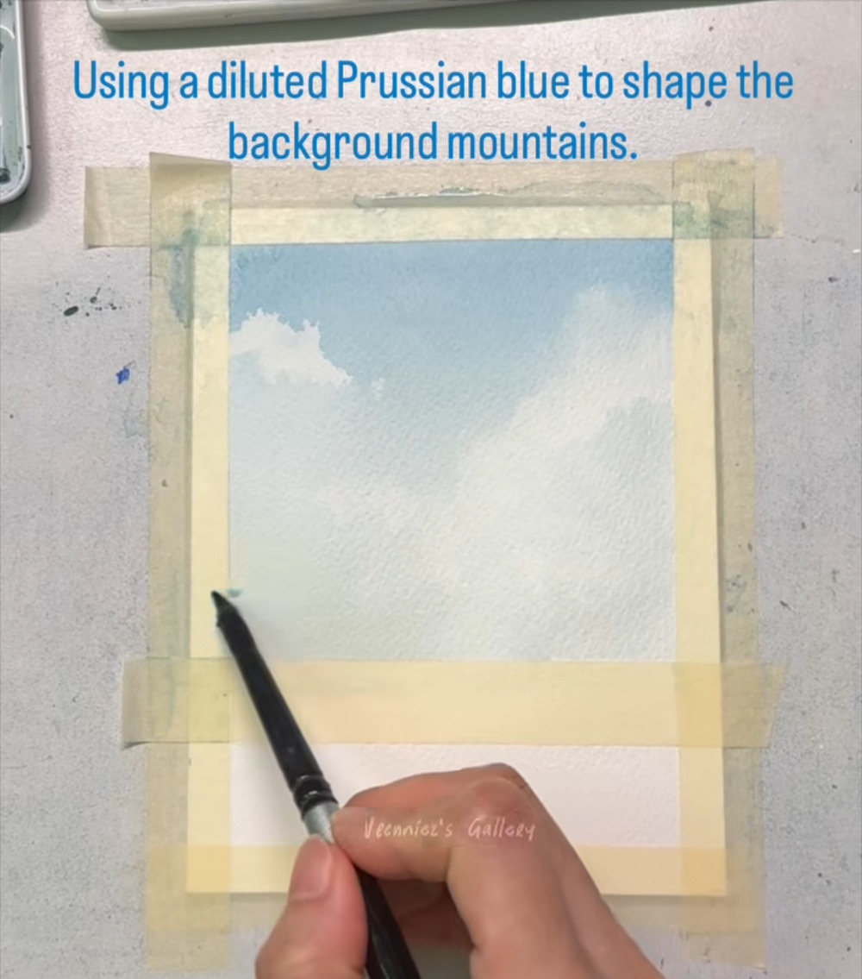
Mix a pale, diluted blue
STAGE 4 · FAR MOUNTAINS
STEP 18 OF 60
WHAT TO DO
Dilute Prussian blue with plenty of water to a pale blue-gray.
Take a small round brush and set it at the left edge, just above the strip of tape across the paper.
WATCH FOR
The tape strip masks the sea area and gives the mountains a clean, level horizon.
COLORS IN THIS STEP
Prussian blue, diluted
#BFCBC7
Notes:
Step 18 of 60. Source screenshot: IMG_4486.PNG. Stage: Far mountains.
Artist's on-screen caption: “Using a diluted Prussian blue to shape the background mountains.”
What to do: Dilute Prussian blue with plenty of water to a pale blue-gray. Take a small round brush and set it at the left edge, just above the strip of tape across the paper.
Watch for: The tape strip masks the sea area and gives the mountains a clean, level horizon.

Slide 24
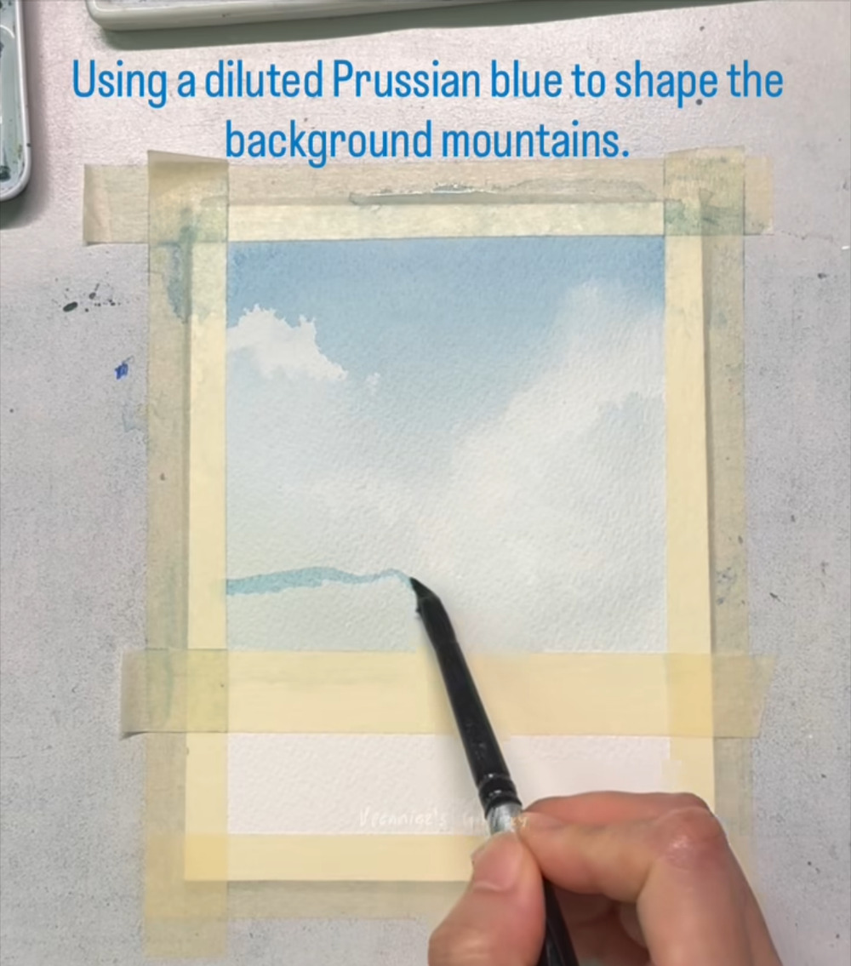
Draw the far ridge line
STAGE 4 · FAR MOUNTAINS
STEP 19 OF 60
WHAT TO DO
Draw a gently wavy ridge line from the left edge with the pale blue.
Let it rise and dip in soft peaks.
WATCH FOR
Keep it pale. Distant mountains look faint and hazy.
COLORS IN THIS STEP
Prussian blue, diluted
#BFCBC7
Notes:
Step 19 of 60. Source screenshot: IMG_4487.PNG. Stage: Far mountains.
Artist's on-screen caption: “Using a diluted Prussian blue to shape the background mountains.”
What to do: Draw a gently wavy ridge line from the left edge with the pale blue. Let it rise and dip in soft peaks.
Watch for: Keep it pale. Distant mountains look faint and hazy.

Slide 25
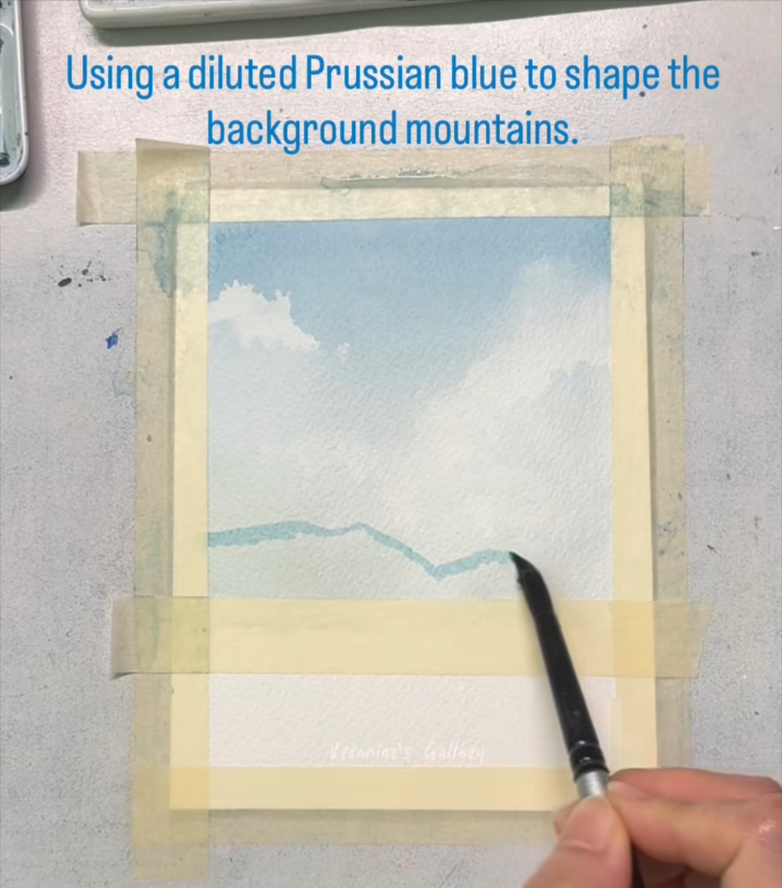
Carry the ridge to the right edge
STAGE 4 · FAR MOUNTAINS
STEP 20 OF 60
WHAT TO DO
Continue the line across the paper, adding a few broad peaks.
Keep the shape simple: you are suggesting mountains, not drawing every rock.
WATCH FOR
Gentle slopes look farther away than sharp, spiky peaks.
COLORS IN THIS STEP
Prussian blue, diluted
#BFCBC7
Notes:
Step 20 of 60. Source screenshot: IMG_4488.PNG. Stage: Far mountains.
Artist's on-screen caption: “Using a diluted Prussian blue to shape the background mountains.”
What to do: Continue the line across the paper, adding a few broad peaks. Keep the shape simple: you are suggesting mountains, not drawing every rock.
Watch for: Gentle slopes look farther away than sharp, spiky peaks.

Slide 26
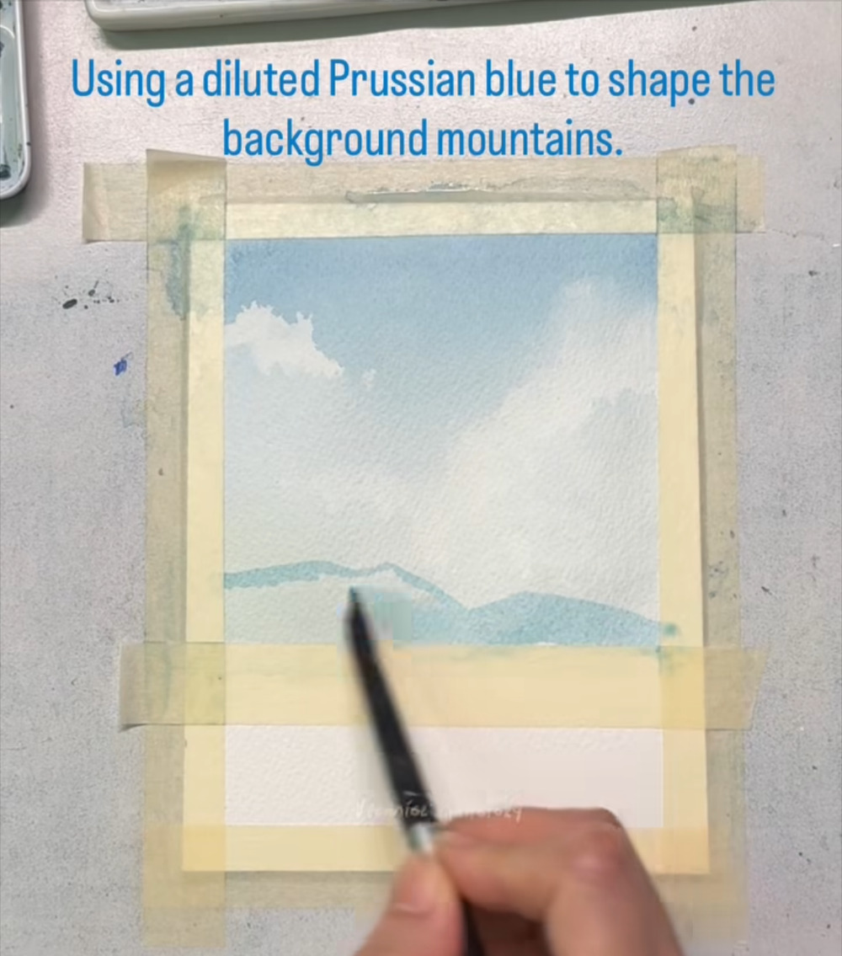
Fill in below the ridge line
STAGE 4 · FAR MOUNTAINS
STEP 21 OF 60
WHAT TO DO
Fill the area under the ridge with the same pale blue, down to the tape edge.
Keep the color even and avoid heavy blotches.
WATCH FOR
Work steadily so the wash dries evenly.
COLORS IN THIS STEP
Prussian blue, diluted
#BFCBC7
Notes:
Step 21 of 60. Source screenshot: IMG_4489.PNG. Stage: Far mountains.
Artist's on-screen caption: “Using a diluted Prussian blue to shape the background mountains.”
What to do: Fill the area under the ridge with the same pale blue, down to the tape edge. Keep the color even and avoid heavy blotches.
Watch for: Work steadily so the wash dries evenly.

Slide 27
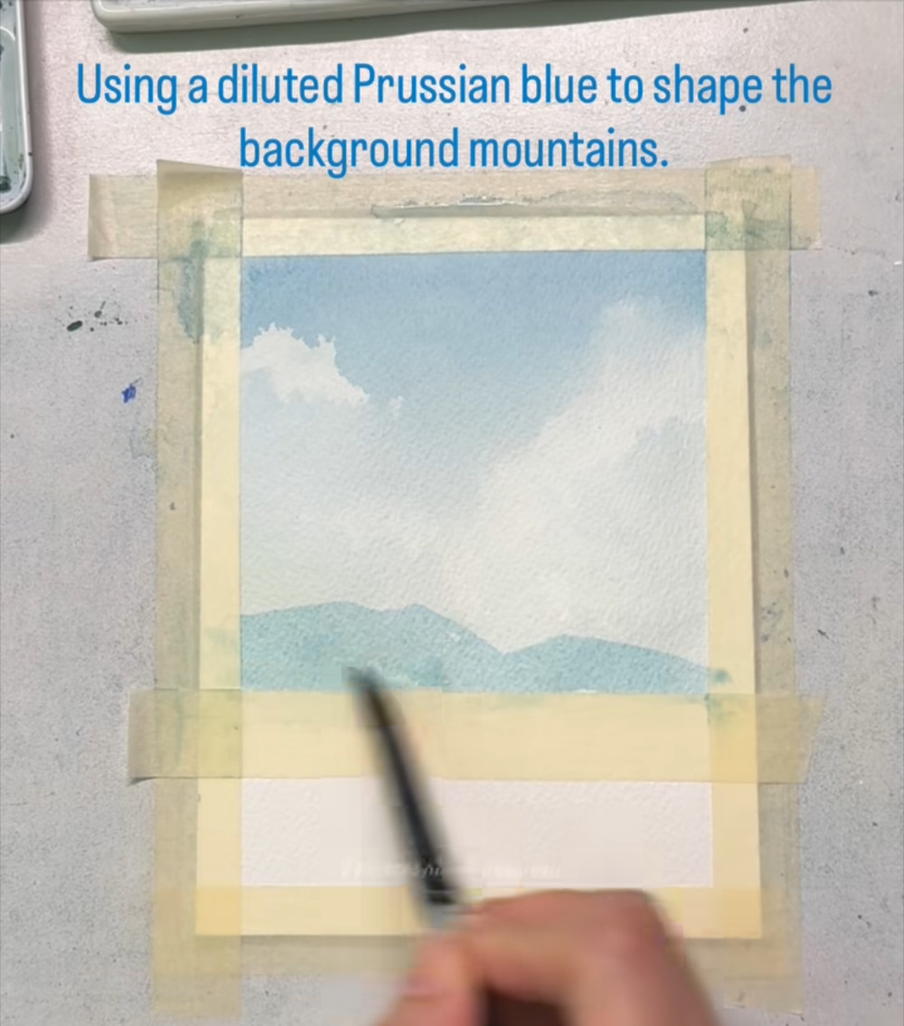
Finish the far mountain range
STAGE 4 · FAR MOUNTAINS
STEP 22 OF 60
WHAT TO DO
Complete the fill so the range has two or three gentle peaks.
Check the bottom edge sits flat against the tape.
WATCH FOR
The pale range should stay faint so the darker mountains in front will stand out.
COLORS IN THIS STEP
Prussian blue, diluted
#BFCBC7
Notes:
Step 22 of 60. Source screenshot: IMG_4490.PNG. Stage: Far mountains.
Artist's on-screen caption: “Using a diluted Prussian blue to shape the background mountains.”
What to do: Complete the fill so the range has two or three gentle peaks. Check the bottom edge sits flat against the tape.
Watch for: The pale range should stay faint so the darker mountains in front will stand out.

Slide 28
Let the far mountains dry
STAGE 4 · FAR MOUNTAINS
STEP 23 OF 60
WHAT TO DO
Wait until the mountains are completely dry.
They should look pale blue-gray, sitting low under the clouds.
WATCH FOR
The next layer is dark and will bleed into any damp areas.
NO PAINT IN THIS STEP: WAIT FOR IT TO DRY
Notes:
Step 23 of 60. Source screenshot: IMG_4491.PNG. Stage: Far mountains.
Artist's on-screen caption: “Let it dry..”
What to do: Wait until the mountains are completely dry. They should look pale blue-gray, sitting low under the clouds.
Watch for: The next layer is dark and will bleed into any damp areas.

Slide 29
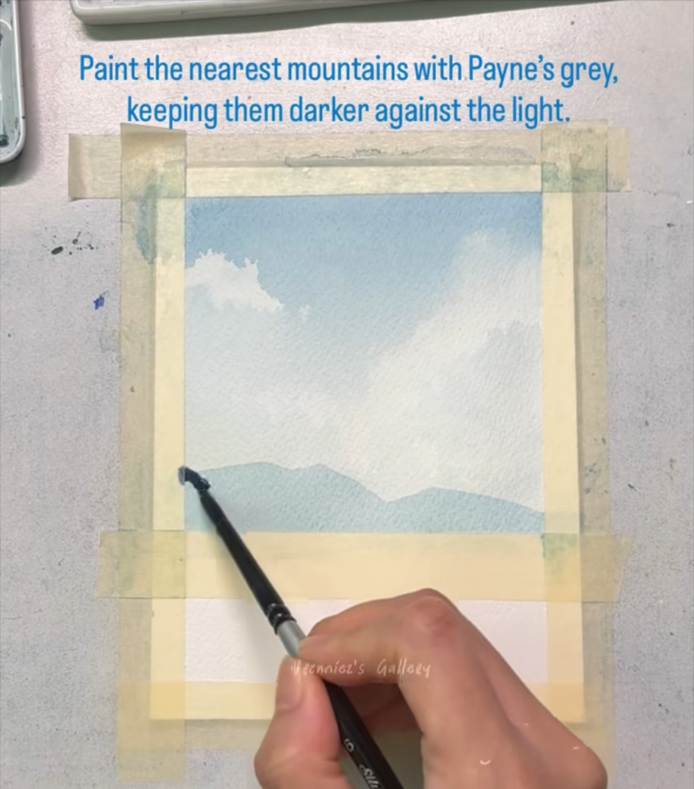
Start the dark near mountain with Payne's grey
STAGE 5 · NEAR MOUNTAINS
STEP 24 OF 60
WHAT TO DO
Mix Payne's grey, thicker and darker than the pale blue.
Start at the left edge, just below the pale mountains, and use the tape edge as the horizon.
WATCH FOR
Dark in front, light behind: that difference in value is what creates distance.
COLORS IN THIS STEP
Payne's grey
#344556
Notes:
Step 24 of 60. Source screenshot: IMG_4492.PNG. Stage: Near mountains.
Artist's on-screen caption: “Paint the nearest mountains with Payne's grey, keeping them darker against the light.”
What to do: Mix Payne's grey, thicker and darker than the pale blue. Start at the left edge, just below the pale mountains, and use the tape edge as the horizon.
Watch for: Dark in front, light behind: that difference in value is what creates distance.

Slide 30
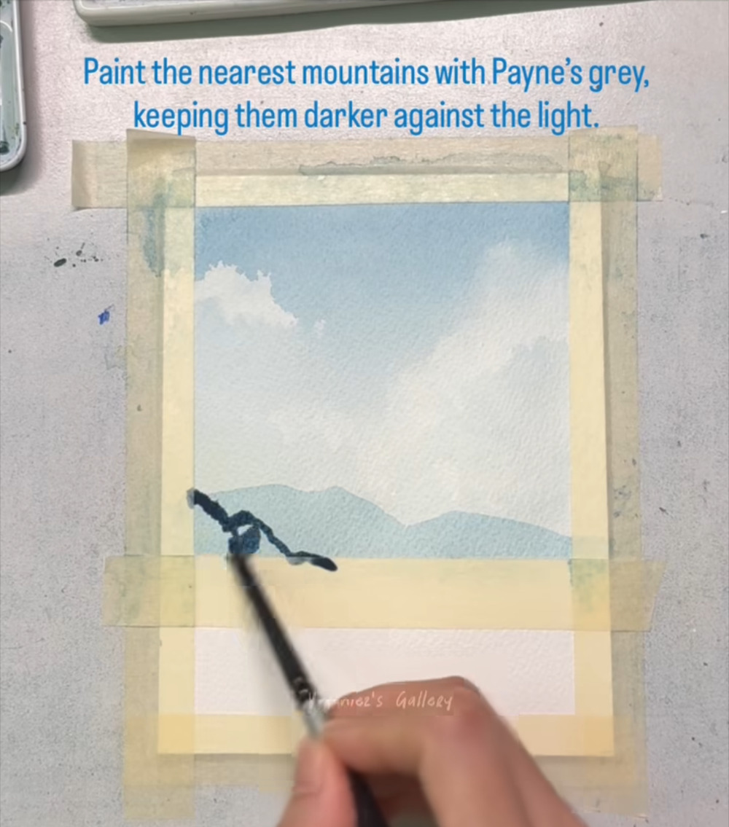
Outline the nearest mountain
STAGE 5 · NEAR MOUNTAINS
STEP 25 OF 60
WHAT TO DO
Trace the top edge of the near mountain with a thin, slightly wobbly line.
Let the line slope down toward the horizon.
WATCH FOR
A little wobble looks natural. A ruler-straight edge would look fake.
COLORS IN THIS STEP
Payne's grey
#344556
Notes:
Step 25 of 60. Source screenshot: IMG_4493.PNG. Stage: Near mountains.
Artist's on-screen caption: “Paint the nearest mountains with Payne's grey, keeping them darker against the light.”
What to do: Trace the top edge of the near mountain with a thin, slightly wobbly line. Let the line slope down toward the horizon.
Watch for: A little wobble looks natural. A ruler-straight edge would look fake.

Slide 31
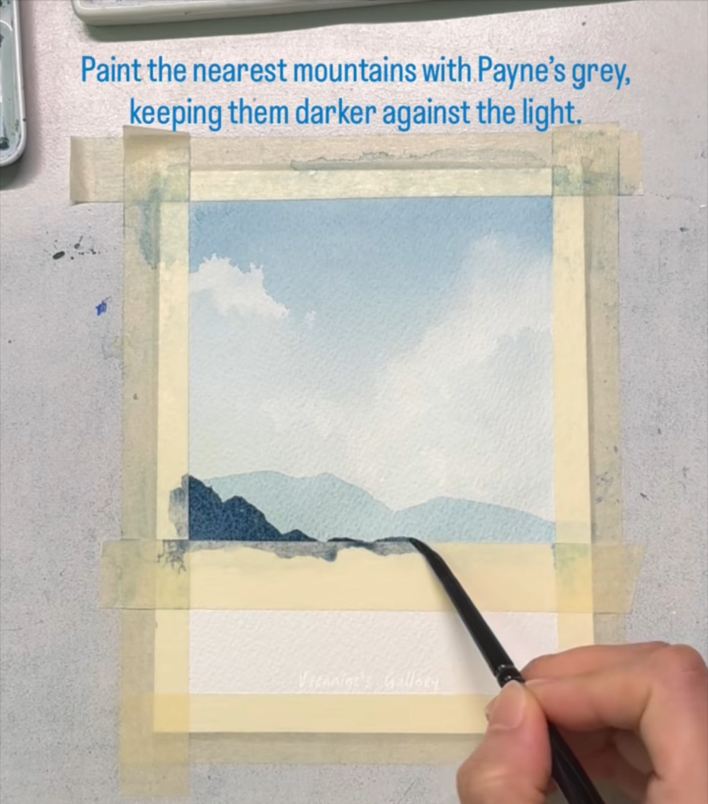
Fill the dark mass and run the shoreline
STAGE 5 · NEAR MOUNTAINS
STEP 26 OF 60
WHAT TO DO
Fill the shape in solid Payne's grey.
Then run a thin dark line along the tape edge toward the right to form the shoreline.
WATCH FOR
Rough, uneven edges at the base can read as rocks and trees.
COLORS IN THIS STEP
Payne's grey
#344556
Notes:
Step 26 of 60. Source screenshot: IMG_4494.PNG. Stage: Near mountains.
Artist's on-screen caption: “Paint the nearest mountains with Payne's grey, keeping them darker against the light.”
What to do: Fill the shape in solid Payne's grey. Then run a thin dark line along the tape edge toward the right to form the shoreline.
Watch for: Rough, uneven edges at the base can read as rocks and trees.

Slide 32
Extend the dark shoreline to the right
STAGE 5 · NEAR MOUNTAINS
STEP 27 OF 60
WHAT TO DO
Add a smaller dark hill on the right and connect it to the left mass with the shoreline.
Let the pale mountains show through the gap between the two dark hills.
WATCH FOR
Next the tape strip comes off. The reel cuts here, and the strip is gone by the next step.
COLORS IN THIS STEP
Payne's grey
#344556
Notes:
Step 27 of 60. Source screenshot: IMG_4495.PNG. Stage: Near mountains.
Artist's on-screen caption: “Paint the nearest mountains with Payne's grey, keeping them darker against the light.”
What to do: Add a smaller dark hill on the right and connect it to the left mass with the shoreline. Let the pale mountains show through the gap between the two dark hills.
Watch for: Next the tape strip comes off. The reel cuts here, and the strip is gone by the next step.

Slide 33
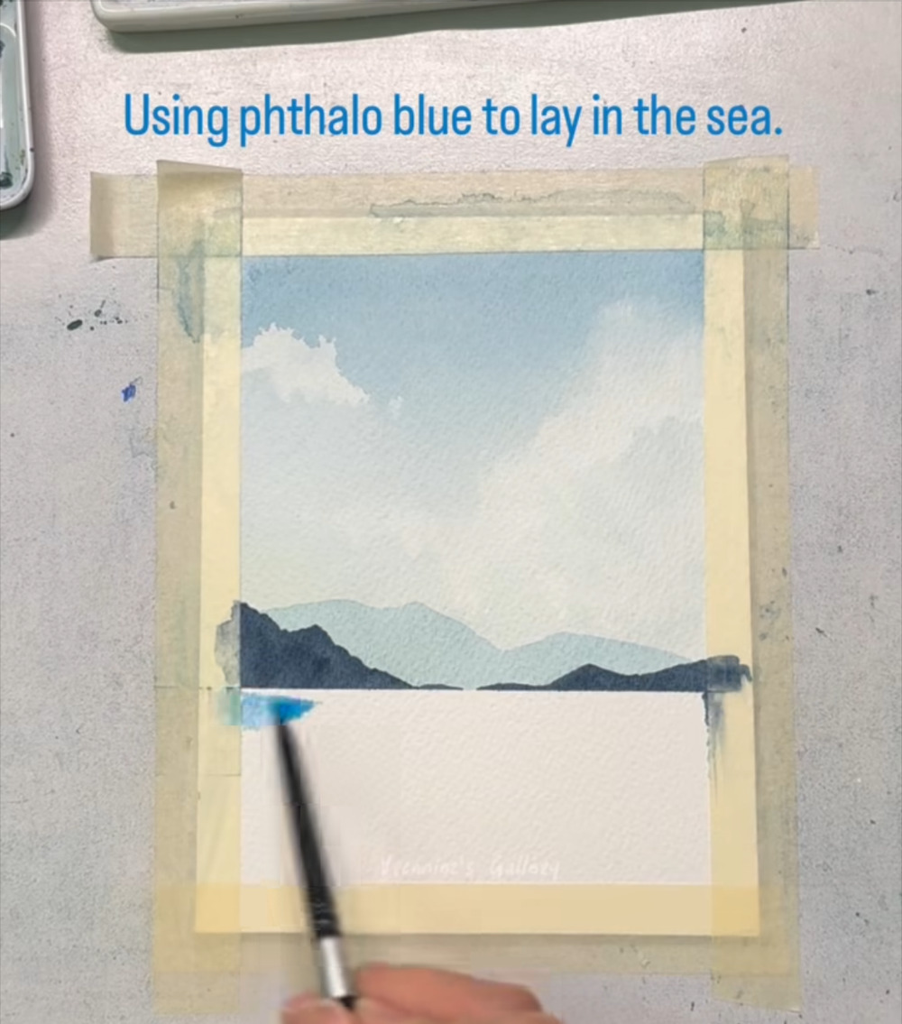
Lay in the sea with phthalo blue
STAGE 6 · SEA
STEP 28 OF 60
WHAT TO DO
With the tape strip removed, pick up phthalo blue (a vivid blue) and touch it to the left end of the horizon.
Leave a thin line of bare paper between the dark mountains and the sea.
WATCH FOR
That thin white line will make the horizon sparkle. Keep your brush just below it.
COLORS IN THIS STEP
Phthalo blue
#67A6CC
Notes:
Step 28 of 60. Source screenshot: IMG_4496.PNG. Stage: Sea.
Artist's on-screen caption: “Using phthalo blue to lay in the sea.”
What to do: With the tape strip removed, pick up phthalo blue (a vivid blue) and touch it to the left end of the horizon. Leave a thin line of bare paper between the dark mountains and the sea.
Watch for: That thin white line will make the horizon sparkle. Keep your brush just below it.

Slide 34
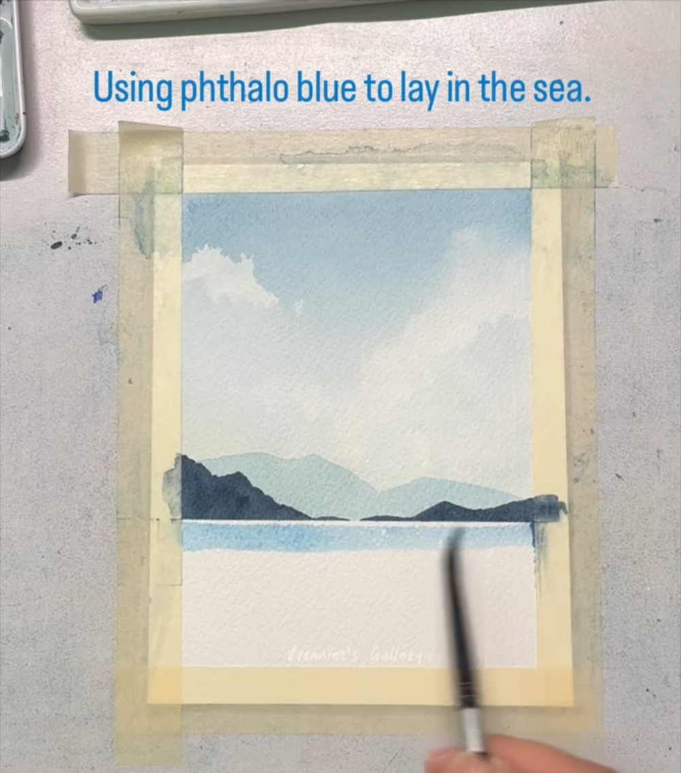
Pull the blue across the horizon
STAGE 6 · SEA
STEP 29 OF 60
WHAT TO DO
Drag the blue in one steady stroke from left to right.
Keep the stroke straight and level.
WATCH FOR
A level horizon matters. Slanting it will make the sea look like it is tipping.
COLORS IN THIS STEP
Phthalo blue
#67A6CC
Notes:
Step 29 of 60. Source screenshot: IMG_4497.PNG. Stage: Sea.
Artist's on-screen caption: “Using phthalo blue to lay in the sea.”
What to do: Drag the blue in one steady stroke from left to right. Keep the stroke straight and level.
Watch for: A level horizon matters. Slanting it will make the sea look like it is tipping.

Slide 35
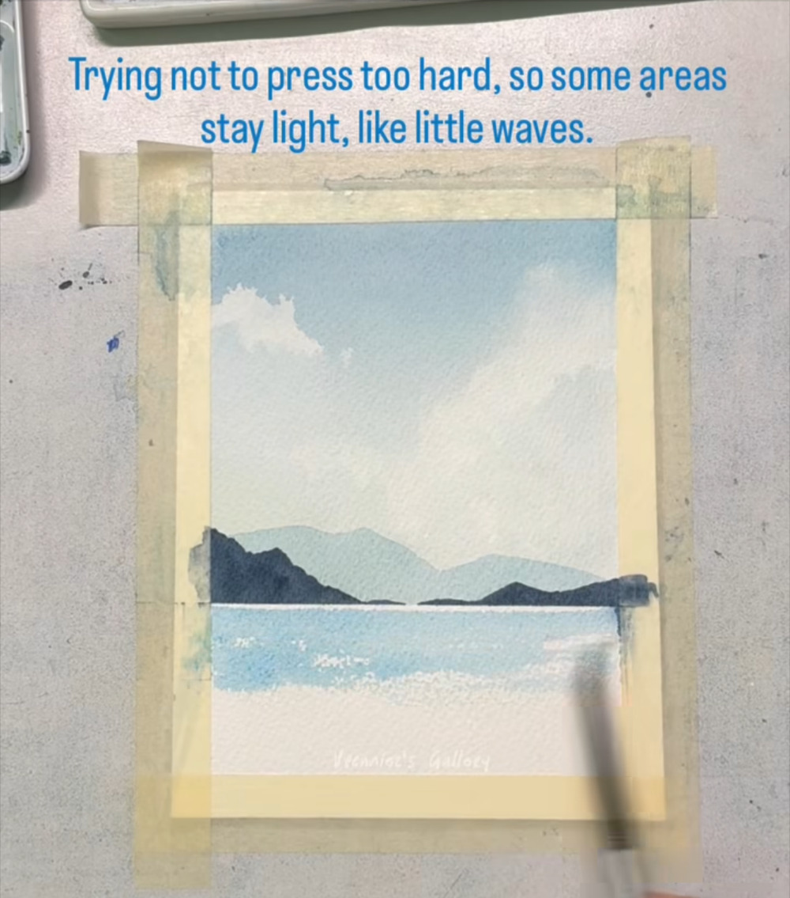
Work downward, leaving white wave flecks
STAGE 6 · SEA
STEP 30 OF 60
WHAT TO DO
Brush lighter blue below the horizon band, pressing very lightly.
Let the brush skip over the paper's grain so small white flecks stay unpainted.
WATCH FOR
Light pressure skips across the texture of the paper. Those flecks become little waves.
COLORS IN THIS STEP
Phthalo blue
#67A6CC
Notes:
Step 30 of 60. Source screenshot: IMG_4498.PNG. Stage: Sea.
Artist's on-screen caption: “Trying not to press too hard, so some areas stay light, like little waves.”
What to do: Brush lighter blue below the horizon band, pressing very lightly. Let the brush skip over the paper's grain so small white flecks stay unpainted.
Watch for: Light pressure skips across the texture of the paper. Those flecks become little waves.

Slide 36
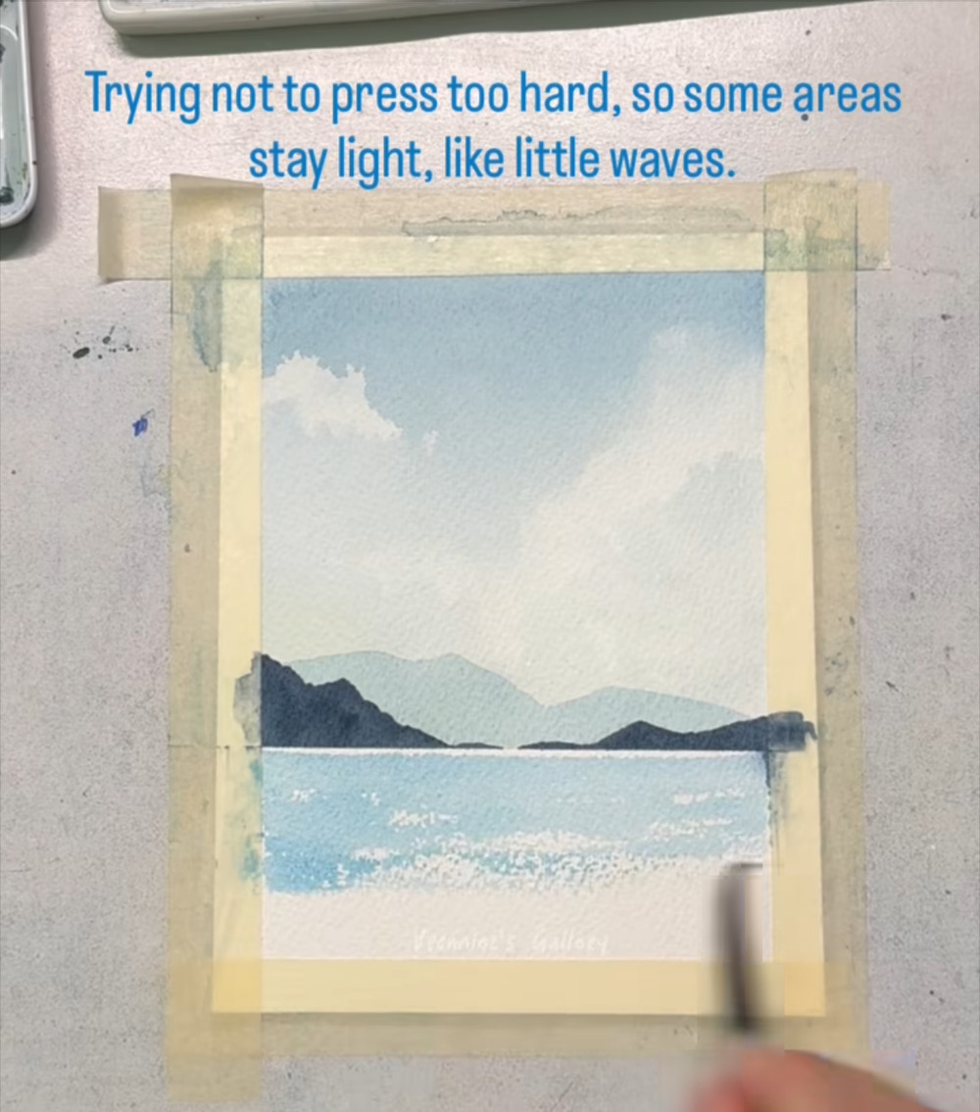
Add more broken wave flecks
STAGE 6 · SEA
STEP 31 OF 60
WHAT TO DO
Keep working down the sea with light, horizontal strokes.
Leave more gaps toward the bottom, where waves are closer to us.
WATCH FOR
Bigger, brighter flecks in front and smaller ones near the horizon look natural.
COLORS IN THIS STEP
Phthalo blue
#67A6CC
Notes:
Step 31 of 60. Source screenshot: IMG_4499.PNG. Stage: Sea.
Artist's on-screen caption: “Trying not to press too hard, so some areas stay light, like little waves.”
What to do: Keep working down the sea with light, horizontal strokes. Leave more gaps toward the bottom, where waves are closer to us.
Watch for: Bigger, brighter flecks in front and smaller ones near the horizon look natural.

Slide 37
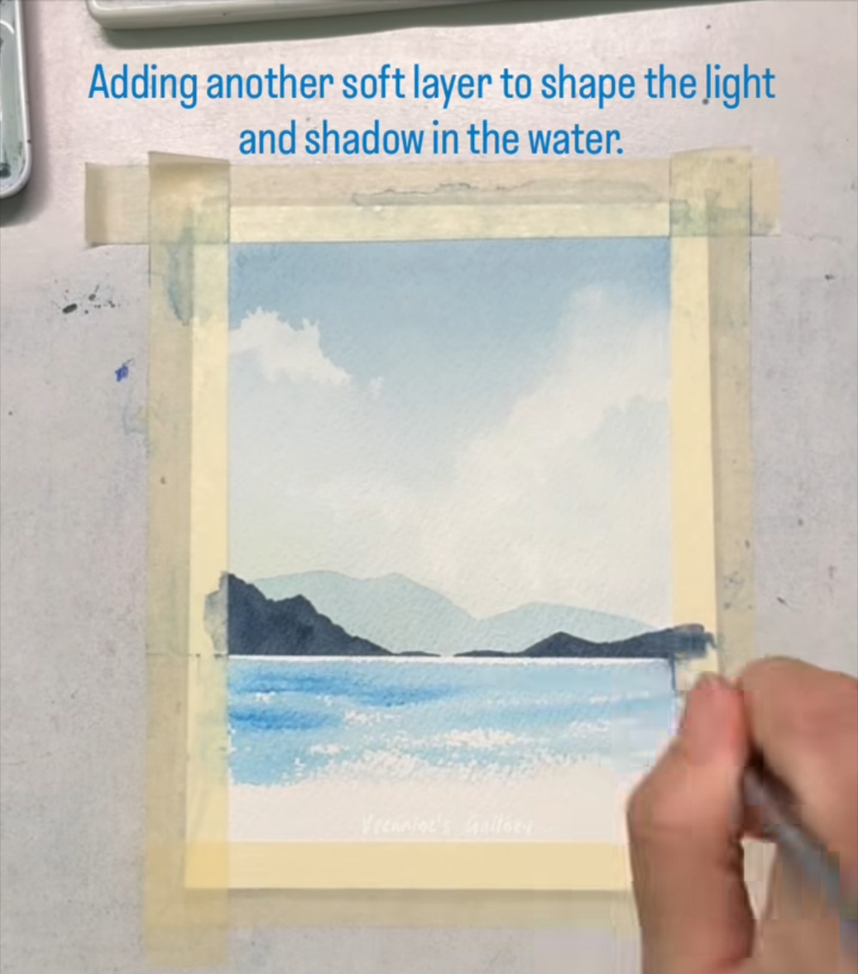
Add a second soft layer of blue
STAGE 6 · SEA
STEP 32 OF 60
WHAT TO DO
Brush a slightly deeper blue in horizontal bands, strongest near the horizon.
Let each band fade as it comes toward you.
WATCH FOR
Keep the strokes horizontal: that keeps the water looking flat and calm.
COLORS IN THIS STEP
Phthalo blue
#67A6CC
Notes:
Step 32 of 60. Source screenshot: IMG_4500.PNG. Stage: Sea.
Artist's on-screen caption: “Adding another soft layer to shape the light and shadow in the water.”
What to do: Brush a slightly deeper blue in horizontal bands, strongest near the horizon. Let each band fade as it comes toward you.
Watch for: Keep the strokes horizontal: that keeps the water looking flat and calm.

Slide 38
Shape the light and shadow in the water
STAGE 6 · SEA
STEP 33 OF 60
WHAT TO DO
Keep laying darker bands next to lighter ones across the sea.
Leave the white flecks showing between them.
WATCH FOR
Look for the contrast between deeper bands and bright flecks: that is the sparkle of water.
COLORS IN THIS STEP
Phthalo blue
#67A6CC
Notes:
Step 33 of 60. Source screenshot: IMG_4501.PNG. Stage: Sea.
Artist's on-screen caption: “Adding another soft layer to shape the light and shadow in the water.”
What to do: Keep laying darker bands next to lighter ones across the sea. Leave the white flecks showing between them.
Watch for: Look for the contrast between deeper bands and bright flecks: that is the sparkle of water.

Slide 39
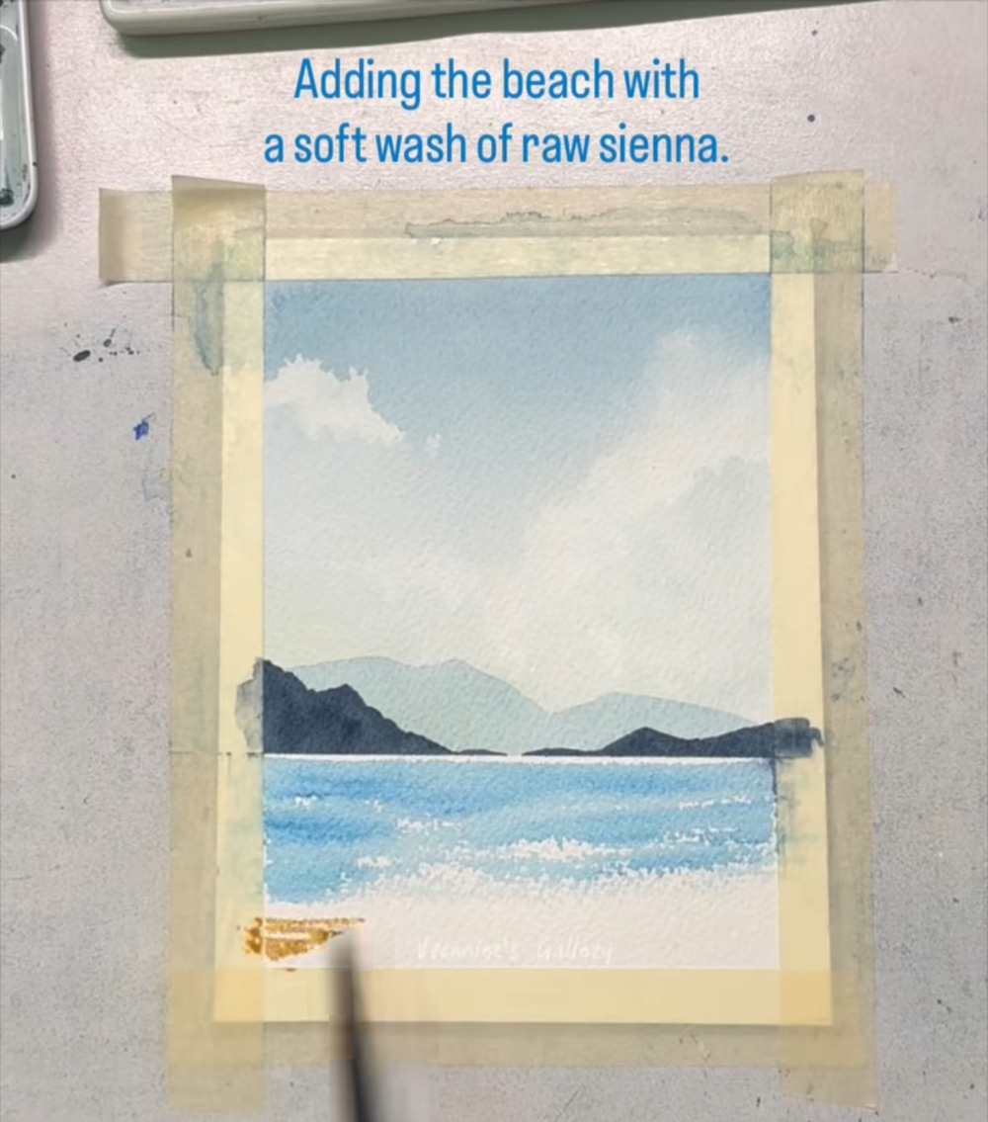
Start the beach at the bottom left
STAGE 7 · BEACH
STEP 34 OF 60
WHAT TO DO
Load a brush with raw sienna, a warm golden tan.
Stroke it along the bottom of the painting, starting at the left.
WATCH FOR
Warm sand against cool blue water makes the shoreline pop.
COLORS IN THIS STEP
Raw sienna
#D7B47C
Notes:
Step 34 of 60. Source screenshot: IMG_4502.PNG. Stage: Beach.
Artist's on-screen caption: “Adding the beach with a soft wash of raw sienna.”
What to do: Load a brush with raw sienna, a warm golden tan. Stroke it along the bottom of the painting, starting at the left.
Watch for: Warm sand against cool blue water makes the shoreline pop.

Slide 40
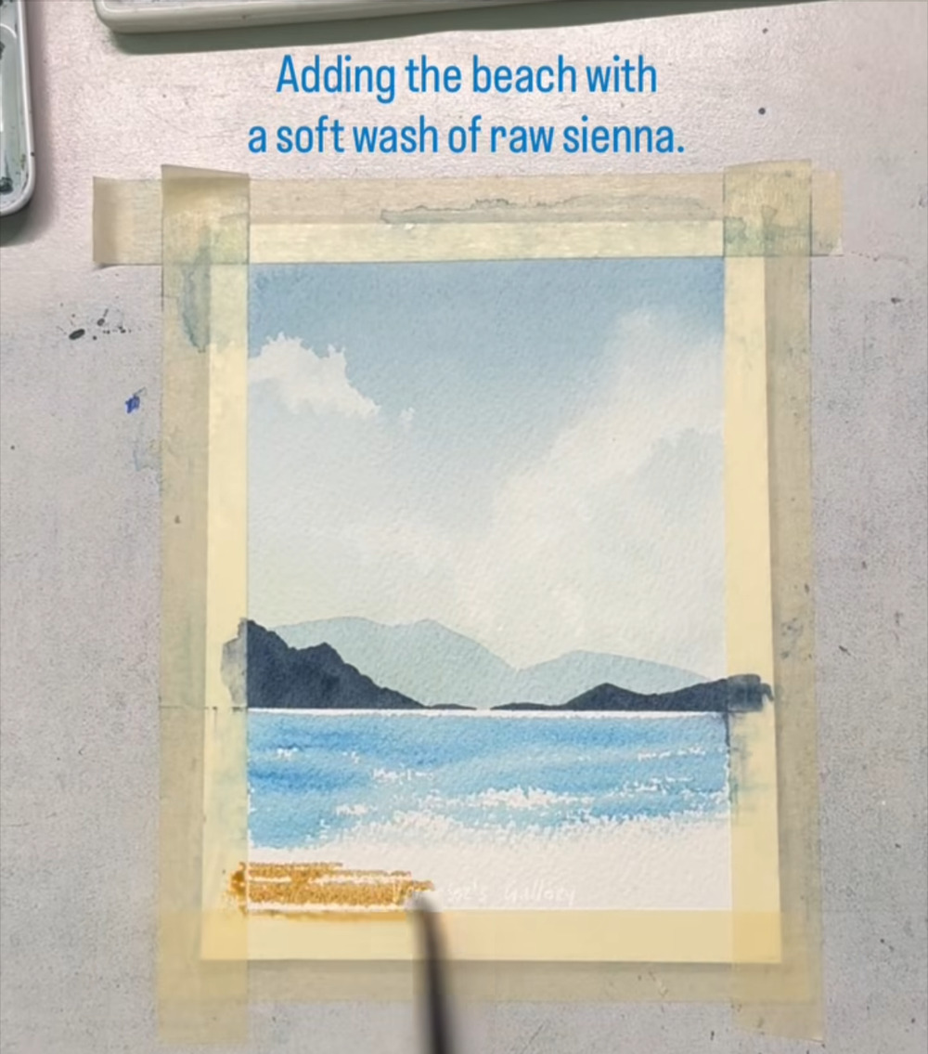
Extend the sand stripe across
STAGE 7 · BEACH
STEP 35 OF 60
WHAT TO DO
Carry the raw sienna across to the right in a steady stroke.
Keep the top edge of the stripe slightly uneven, like a shoreline.
WATCH FOR
Don't paint the shoreline as a hard, straight line.
COLORS IN THIS STEP
Raw sienna
#D7B47C
Notes:
Step 35 of 60. Source screenshot: IMG_4503.PNG. Stage: Beach.
Artist's on-screen caption: “Adding the beach with a soft wash of raw sienna.”
What to do: Carry the raw sienna across to the right in a steady stroke. Keep the top edge of the stripe slightly uneven, like a shoreline.
Watch for: Don't paint the shoreline as a hard, straight line.

Slide 41
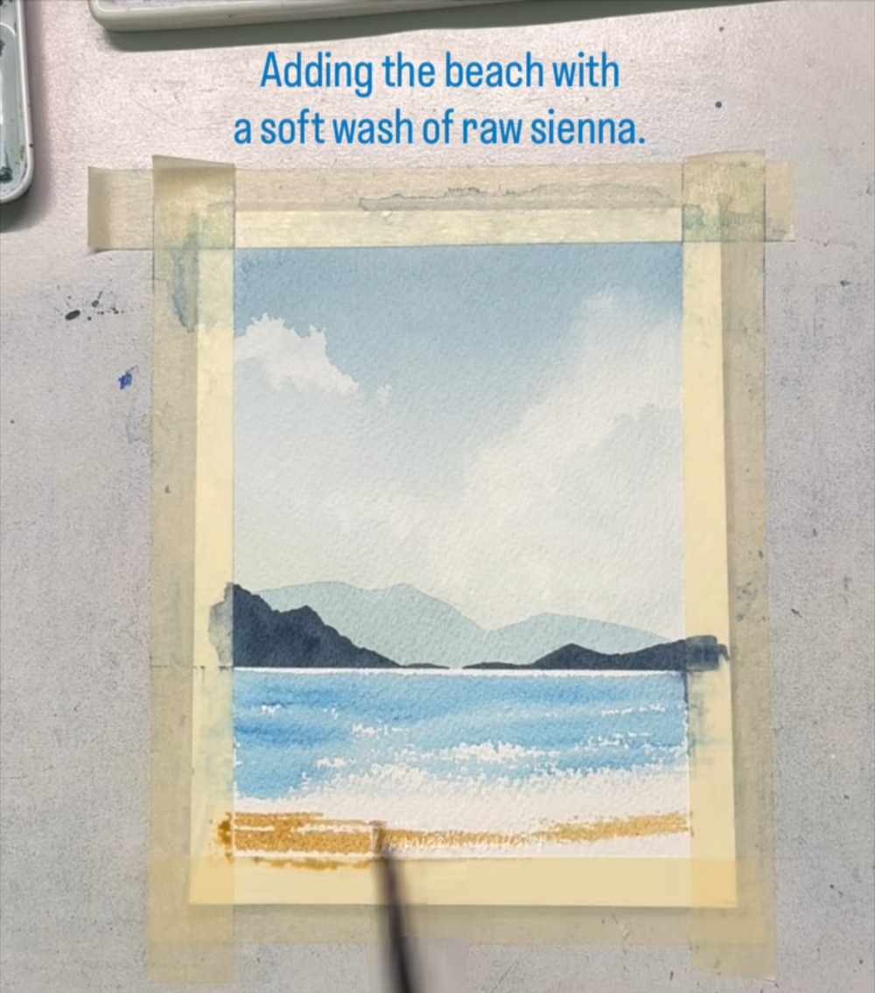
Widen the sand band
STAGE 7 · BEACH
STEP 36 OF 60
WHAT TO DO
Add a second stroke above the first to make the sand band deeper.
Let the strokes overlap slightly.
WATCH FOR
Overlapping strokes give the sand a natural, uneven look.
COLORS IN THIS STEP
Raw sienna
#D7B47C
Notes:
Step 36 of 60. Source screenshot: IMG_4504.PNG. Stage: Beach.
Artist's on-screen caption: “Adding the beach with a soft wash of raw sienna.”
What to do: Add a second stroke above the first to make the sand band deeper. Let the strokes overlap slightly.
Watch for: Overlapping strokes give the sand a natural, uneven look.

Slide 42
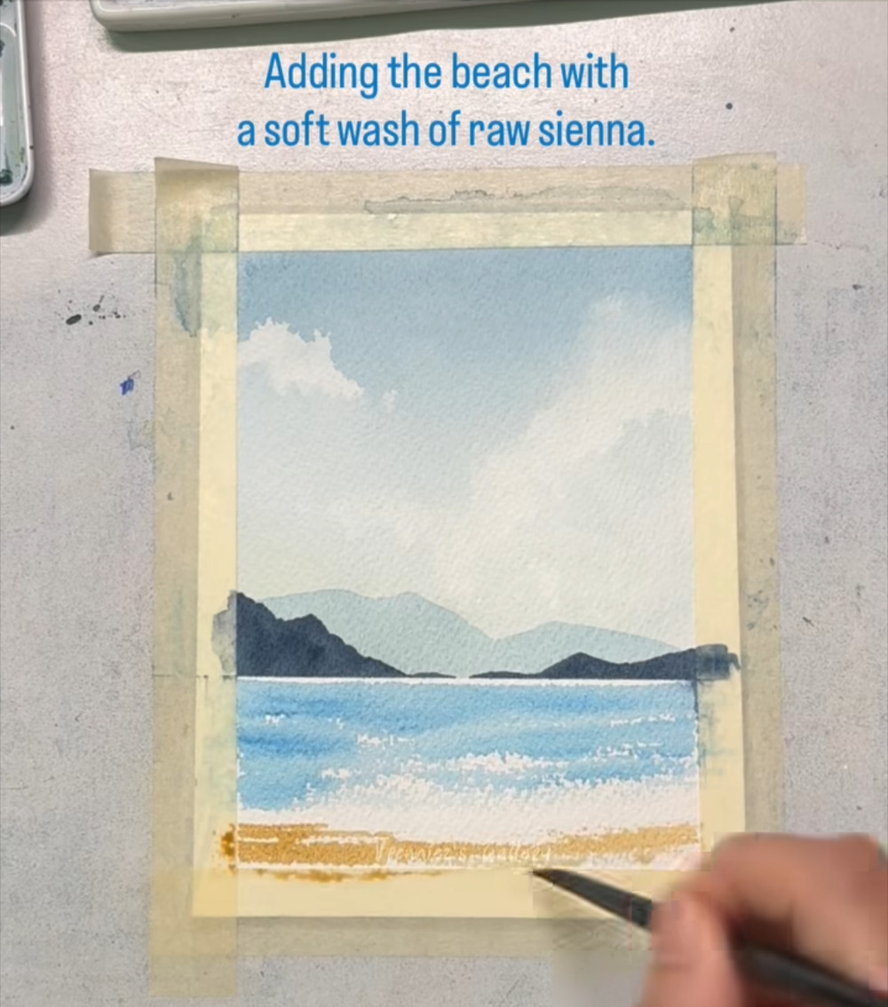
Keep building the sand
STAGE 7 · BEACH
STEP 37 OF 60
WHAT TO DO
Continue to fill the lower part of the painting with raw sienna.
Use more water as you move upward so the color gets paler.
WATCH FOR
The sand is deepest at the bottom and fades toward the water.
COLORS IN THIS STEP
Raw sienna
#D7B47C
Notes:
Step 37 of 60. Source screenshot: IMG_4505.PNG. Stage: Beach.
Artist's on-screen caption: “Adding the beach with a soft wash of raw sienna.”
What to do: Continue to fill the lower part of the painting with raw sienna. Use more water as you move upward so the color gets paler.
Watch for: The sand is deepest at the bottom and fades toward the water.

Slide 43
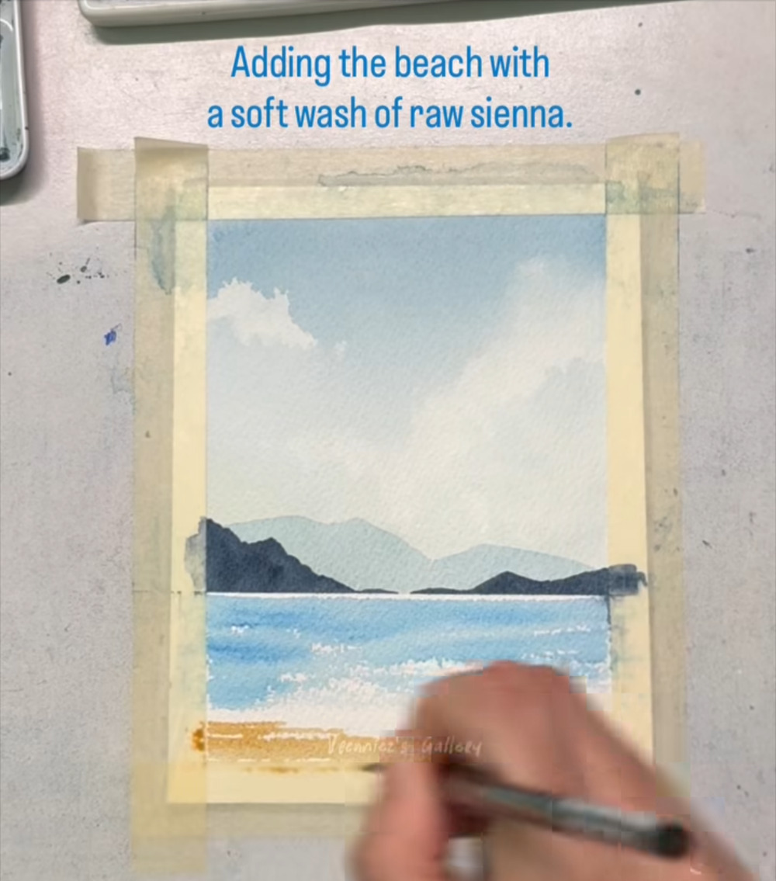
Soften where sand meets sea
STAGE 7 · BEACH
STEP 38 OF 60
WHAT TO DO
Use a damp brush to blend the top edge of the sand into the blue.
Keep the blend small. A little overlap is enough.
WATCH FOR
Too much blending can turn the meeting point muddy green. Stop early.
COLORS IN THIS STEP
Raw sienna
#D7B47C
Phthalo blue
#67A6CC
Notes:
Step 38 of 60. Source screenshot: IMG_4506.PNG. Stage: Beach.
Artist's on-screen caption: “Adding the beach with a soft wash of raw sienna.”
What to do: Use a damp brush to blend the top edge of the sand into the blue. Keep the blend small. A little overlap is enough.
Watch for: Too much blending can turn the meeting point muddy green. Stop early.

Slide 44
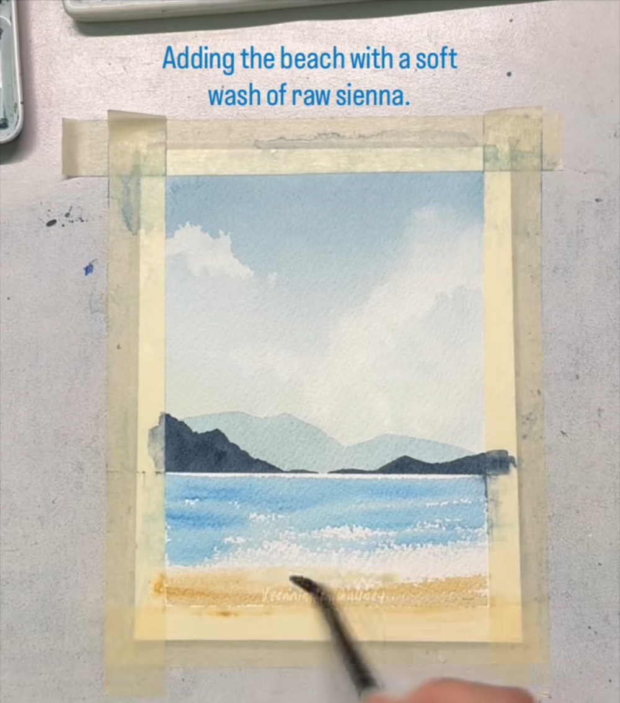
Lighten the sand toward the water
STAGE 7 · BEACH
STEP 39 OF 60
WHAT TO DO
Thin the raw sienna with water and brush upward so the sand fades toward the sea.
Keep the stroke direction consistent.
WATCH FOR
Pale sand near the waterline reads as wet sand catching the light.
COLORS IN THIS STEP
Raw sienna
#D7B47C
Notes:
Step 39 of 60. Source screenshot: IMG_4507.PNG. Stage: Beach.
Artist's on-screen caption: “Adding the beach with a soft wash of raw sienna.”
What to do: Thin the raw sienna with water and brush upward so the sand fades toward the sea. Keep the stroke direction consistent.
Watch for: Pale sand near the waterline reads as wet sand catching the light.

Slide 45
Even out the beach
STAGE 7 · BEACH
STEP 40 OF 60
WHAT TO DO
Step back and look: the sand should be a smooth, golden band across the bottom.
Touch up any streaks with a slightly damp brush.
WATCH FOR
Fix only what bothers you. Overworking watercolor often does more harm than good.
COLORS IN THIS STEP
Raw sienna
#D7B47C
Notes:
Step 40 of 60. Source screenshot: IMG_4508.PNG. Stage: Beach.
Artist's on-screen caption: “Adding the beach with a soft wash of raw sienna.”
What to do: Step back and look: the sand should be a smooth, golden band across the bottom. Touch up any streaks with a slightly damp brush.
Watch for: Fix only what bothers you. Overworking watercolor often does more harm than good.

Slide 46
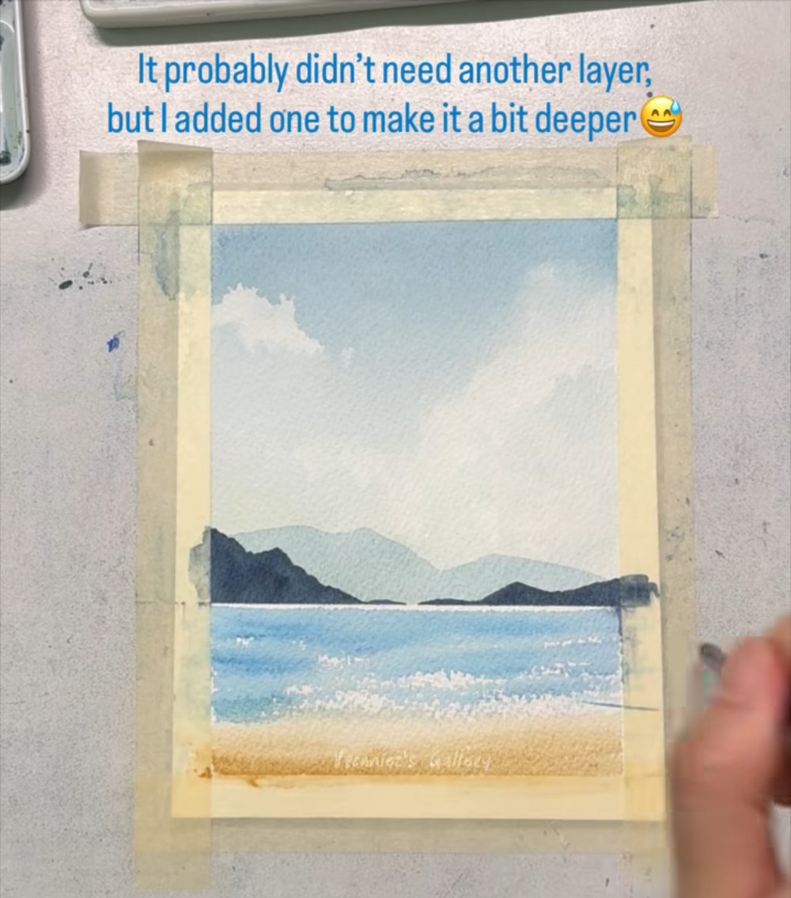
Decide whether to deepen the color
STAGE 8 · DEEPEN THE COLOR
STEP 41 OF 60
WHAT TO DO
Look at the sea and sand. If they look too pale, plan one more thin layer.
The artist jokes in the caption that this layer probably wasn't needed.
WATCH FOR
A second layer works best over paint that has already dried.
COLORS IN THIS STEP
Phthalo blue
#67A6CC
Raw sienna
#D7B47C
Notes:
Step 41 of 60. Source screenshot: IMG_4509.PNG. Stage: Deepen the color.
Artist's on-screen caption: “It probably didn't need another layer, but I added one to make it a bit deeper.”
What to do: Look at the sea and sand. If they look too pale, plan one more thin layer. The artist jokes in the caption that this layer probably wasn't needed.
Watch for: A second layer works best over paint that has already dried.

Slide 47

Add a deeper blue at the left of the sea
STAGE 8 · DEEPEN THE COLOR
STEP 42 OF 60
WHAT TO DO
Take a thin brush with phthalo blue and glaze a darker band along the left of the horizon.
Keep the stroke thin and even.
WATCH FOR
A glaze is a transparent layer, so the white flecks underneath can still show.
COLORS IN THIS STEP
Phthalo blue
#67A6CC
Notes:
Step 42 of 60. Source screenshot: IMG_4510.PNG. Stage: Deepen the color.
Artist's on-screen caption: “It probably didn't need another layer, but I added one to make it a bit deeper.”
What to do: Take a thin brush with phthalo blue and glaze a darker band along the left of the horizon. Keep the stroke thin and even.
Watch for: A glaze is a transparent layer, so the white flecks underneath can still show.

Slide 48

Carry the deeper blue across the water
STAGE 8 · DEEPEN THE COLOR
STEP 43 OF 60
WHAT TO DO
Continue the glaze toward the right in horizontal strokes.
Skip over the brightest wave flecks.
WATCH FOR
You don't need to cover everything. Leave some of the first layer showing.
COLORS IN THIS STEP
Phthalo blue
#67A6CC
Notes:
Step 43 of 60. Source screenshot: IMG_4511.PNG. Stage: Deepen the color.
Artist's on-screen caption: “It probably didn't need another layer, but I added one to make it a bit deeper.”
What to do: Continue the glaze toward the right in horizontal strokes. Skip over the brightest wave flecks.
Watch for: You don't need to cover everything. Leave some of the first layer showing.

Slide 49

Keep layering across the middle
STAGE 8 · DEEPEN THE COLOR
STEP 44 OF 60
WHAT TO DO
Work across the middle of the sea, again in horizontal strokes.
Let the glaze overlap the edges of the first layer.
WATCH FOR
Your hand may hide the water here. Check the result when you lift it.
COLORS IN THIS STEP
Phthalo blue
#67A6CC
Notes:
Step 44 of 60. Source screenshot: IMG_4512.PNG. Stage: Deepen the color.
Artist's on-screen caption: “It probably didn't need another layer, but I added one to make it a bit deeper.”
What to do: Work across the middle of the sea, again in horizontal strokes. Let the glaze overlap the edges of the first layer.
Watch for: Your hand may hide the water here. Check the result when you lift it.

Slide 50

Check the deeper sea
STAGE 8 · DEEPEN THE COLOR
STEP 45 OF 60
WHAT TO DO
Look at the sea: it should now be a richer blue, with bright wave flecks still visible.
Stop adding color if it already looks right.
WATCH FOR
More layers are not always better. It is easy to lose the white flecks.
COLORS IN THIS STEP
Phthalo blue
#67A6CC
Notes:
Step 45 of 60. Source screenshot: IMG_4513.PNG. Stage: Deepen the color.
Artist's on-screen caption: “It probably didn't need another layer, but I added one to make it a bit deeper.”
What to do: Look at the sea: it should now be a richer blue, with bright wave flecks still visible. Stop adding color if it already looks right.
Watch for: More layers are not always better. It is easy to lose the white flecks.

Slide 51

Judge the balance of light and dark
STAGE 8 · DEEPEN THE COLOR
STEP 46 OF 60
WHAT TO DO
Compare the sea with the sky and the mountains.
The darkest darks should be the near mountains, with the sea a step lighter.
WATCH FOR
If the sea is darker than the near mountains, the picture can look top-heavy.
COLORS IN THIS STEP
Phthalo blue
#67A6CC
Payne's grey
#344556
Notes:
Step 46 of 60. Source screenshot: IMG_4514.PNG. Stage: Deepen the color.
Artist's on-screen caption: “It probably didn't need another layer, but I added one to make it a bit deeper.”
What to do: Compare the sea with the sky and the mountains. The darkest darks should be the near mountains, with the sea a step lighter.
Watch for: If the sea is darker than the near mountains, the picture can look top-heavy.

Slide 52
Small touch-ups near the shore
STAGE 8 · DEEPEN THE COLOR
STEP 47 OF 60
WHAT TO DO
Use a thin brush to tidy any rough spots where the sea meets the sand.
Add a hint of deeper blue just above the waterline if needed.
WATCH FOR
Small touches only. The big shapes are already in place.
COLORS IN THIS STEP
Phthalo blue
#67A6CC
Raw sienna
#D7B47C
Notes:
Step 47 of 60. Source screenshot: IMG_4515.PNG. Stage: Deepen the color.
Artist's on-screen caption: “It probably didn't need another layer, but I added one to make it a bit deeper.”
What to do: Use a thin brush to tidy any rough spots where the sea meets the sand. Add a hint of deeper blue just above the waterline if needed.
Watch for: Small touches only. The big shapes are already in place.

Slide 53

Blend the sea edges
STAGE 9 · BLEND
STEP 48 OF 60
WHAT TO DO
Use a damp brush to soften any hard edges in the water.
Work gently with short strokes.
WATCH FOR
The caption says to keep blending until it feels right to you. Trust your eye.
COLORS IN THIS STEP
Phthalo blue
#67A6CC
Notes:
Step 48 of 60. Source screenshot: IMG_4516.PNG. Stage: Blend.
Artist's on-screen caption: “Keep blending until it feels right to you.”
What to do: Use a damp brush to soften any hard edges in the water. Work gently with short strokes.
Watch for: The caption says to keep blending until it feels right to you. Trust your eye.

Slide 54

Soften where sand meets water
STAGE 9 · BLEND
STEP 49 OF 60
WHAT TO DO
Blend the lower edge of the sea into the sand a little more.
Keep a soft, wavy edge rather than a ruled line.
WATCH FOR
A soft shoreline looks natural. A hard line looks painted on.
COLORS IN THIS STEP
Phthalo blue
#67A6CC
Raw sienna
#D7B47C
Notes:
Step 49 of 60. Source screenshot: IMG_4517.PNG. Stage: Blend.
Artist's on-screen caption: “Keep blending until it feels right to you.”
What to do: Blend the lower edge of the sea into the sand a little more. Keep a soft, wavy edge rather than a ruled line.
Watch for: A soft shoreline looks natural. A hard line looks painted on.

Slide 55
Stop when it feels right
STAGE 9 · BLEND
STEP 50 OF 60
WHAT TO DO
Look at the whole painting: sea smoother, beach slightly deeper at the bottom edge.
Let everything dry before you add the finishing details.
WATCH FOR
Knowing when to stop is a skill. Put the brush down once the color feels balanced.
COLORS IN THIS STEP
Phthalo blue
#67A6CC
Raw sienna
#D7B47C
Notes:
Step 50 of 60. Source screenshot: IMG_4518.PNG. Stage: Blend.
Artist's on-screen caption: “Keep blending until it feels right to you.”
What to do: Look at the whole painting: sea smoother, beach slightly deeper at the bottom edge. Let everything dry before you add the finishing details.
Watch for: Knowing when to stop is a skill. Put the brush down once the color feels balanced.

Slide 56

Switch to a fine black pen
STAGE 10 · BIRDS
STEP 51 OF 60
WHAT TO DO
Pick up a fine-tip black pen. The one in the reel is labeled Micron 05.
Hover it over the sky, deciding where the first bird should go.
WATCH FOR
Waterproof ink won't smear over dry paint. Make sure the sky is dry first.
COLORS IN THIS STEP
Black fine-tip pen
#314343
Notes:
Step 51 of 60. Source screenshot: IMG_4519.PNG. Stage: Birds.
Artist's on-screen caption: “Add a few birds to make it feel alive.”
What to do: Pick up a fine-tip black pen. The one in the reel is labeled Micron 05. Hover it over the sky, deciding where the first bird should go.
Watch for: Waterproof ink won't smear over dry paint. Make sure the sky is dry first.

Slide 57

Draw the first bird
STAGE 10 · BIRDS
STEP 52 OF 60
WHAT TO DO
Draw a tiny bird as two quick, curved strokes that meet in a small “v”.
Place it in the upper right of the sky.
WATCH FOR
Birds are just two small curves. Don't add detail.
COLORS IN THIS STEP
Black fine-tip pen
#314343
Notes:
Step 52 of 60. Source screenshot: IMG_4520.PNG. Stage: Birds.
Artist's on-screen caption: “Add a few birds to make it feel alive.”
What to do: Draw a tiny bird as two quick, curved strokes that meet in a small “v”. Place it in the upper right of the sky.
Watch for: Birds are just two small curves. Don't add detail.

Slide 58

Add a few more small birds
STAGE 10 · BIRDS
STEP 53 OF 60
WHAT TO DO
Add several more birds nearby, each at a slightly different angle.
Keep them small and loosely grouped.
WATCH FOR
A loose cluster looks like a flock. Even spacing looks like wallpaper.
COLORS IN THIS STEP
Black fine-tip pen
#314343
Notes:
Step 53 of 60. Source screenshot: IMG_4521.PNG. Stage: Birds.
Artist's on-screen caption: “Add a few birds to make it feel alive.”
What to do: Add several more birds nearby, each at a slightly different angle. Keep them small and loosely grouped.
Watch for: A loose cluster looks like a flock. Even spacing looks like wallpaper.

Slide 59

Vary the birds' size
STAGE 10 · BIRDS
STEP 54 OF 60
WHAT TO DO
Make some birds slightly bigger and some smaller.
Tilt the wings differently so they look like they are in motion.
WATCH FOR
Smaller birds look farther away, bigger ones look closer.
COLORS IN THIS STEP
Black fine-tip pen
#314343
Notes:
Step 54 of 60. Source screenshot: IMG_4522.PNG. Stage: Birds.
Artist's on-screen caption: “Add a few birds to make it feel alive.”
What to do: Make some birds slightly bigger and some smaller. Tilt the wings differently so they look like they are in motion.
Watch for: Smaller birds look farther away, bigger ones look closer.

Slide 60

Spread the flock
STAGE 10 · BIRDS
STEP 55 OF 60
WHAT TO DO
Add a few birds a little farther from the group.
Aim to guide the eye from the flock toward the mountains.
WATCH FOR
Stray birds make the flock feel natural.
COLORS IN THIS STEP
Black fine-tip pen
#314343
Notes:
Step 55 of 60. Source screenshot: IMG_4523.PNG. Stage: Birds.
Artist's on-screen caption: “Add a few birds to make it feel alive.”
What to do: Add a few birds a little farther from the group. Aim to guide the eye from the flock toward the mountains.
Watch for: Stray birds make the flock feel natural.

Slide 61

Place a few birds higher in the sky
STAGE 10 · BIRDS
STEP 56 OF 60
WHAT TO DO
Add one or two birds near the top of the sky.
Keep them very small.
WATCH FOR
Don't overdo it. Eight to twelve birds is plenty.
COLORS IN THIS STEP
Black fine-tip pen
#314343
Notes:
Step 56 of 60. Source screenshot: IMG_4524.PNG. Stage: Birds.
Artist's on-screen caption: “Add a few birds to make it feel alive.”
What to do: Add one or two birds near the top of the sky. Keep them very small.
Watch for: Don't overdo it. Eight to twelve birds is plenty.

Slide 62
A last bird or two
STAGE 10 · BIRDS
STEP 57 OF 60
WHAT TO DO
Add one final bird on the left to balance the flock on the right.
Lift the pen and look before you add another.
WATCH FOR
Stop while the sky still has plenty of open space.
COLORS IN THIS STEP
Black fine-tip pen
#314343
Notes:
Step 57 of 60. Source screenshot: IMG_4525.PNG. Stage: Birds.
Artist's on-screen caption: “Add a few birds to make it feel alive.”
What to do: Add one final bird on the left to balance the flock on the right. Lift the pen and look before you add another.
Watch for: Stop while the sky still has plenty of open space.

Slide 63

Close-up on the finished sky and sea
STAGE 11 · FINISHED PAINTING
STEP 58 OF 60
WHAT TO DO
The reel zooms in to show the finished details: soft clouds, pale mountains and a white horizon line.
Notice the small birds and the layered tones of blue.
WATCH FOR
Zoom in on your own painting like this to judge it. Details show up that you miss at arm's length.
FULL PALETTE ON SLIDE 5
Notes:
Step 58 of 60. Source screenshot: IMG_4526.PNG. Stage: Finished painting.
Artist's on-screen caption: “All done!”
What to do: The reel zooms in to show the finished details: soft clouds, pale mountains and a white horizon line. Notice the small birds and the layered tones of blue.
Watch for: Zoom in on your own painting like this to judge it. Details show up that you miss at arm's length.

Slide 64
Peel the tape and reveal the painting
STAGE 11 · FINISHED PAINTING
STEP 59 OF 60
WHAT TO DO
Once everything is fully dry, peel the tape away slowly, pulling it back over itself and away from the paint.
A clean white border is left around the picture. The artist also signs and dates the corner.
WATCH FOR
Peeling slowly keeps the paper from tearing. This is a general tip; the reel shows only the result.
FULL PALETTE ON SLIDE 5
Notes:
Step 59 of 60. Source screenshot: IMG_4527.PNG. Stage: Finished painting.
Artist's on-screen caption: “All done!”
What to do: Once everything is fully dry, peel the tape away slowly, pulling it back over itself and away from the paint. A clean white border is left around the picture. The artist also signs and dates the corner.
Watch for: Peeling slowly keeps the paper from tearing. This is a general tip; the reel shows only the result.

Slide 65
The finished seascape
STAGE 11 · FINISHED PAINTING
STEP 60 OF 60
WHAT TO DO
Is the sky pale at the horizon and deepest at the top?
Are the near mountains the darkest shapes, with the horizon kept level?
Does the sea sparkle with white flecks, and the sand glow warm?
WATCH FOR
Use this view as your reference when you check your own painting.
FULL PALETTE ON SLIDE 5
Notes:
Step 60 of 60. Source screenshot: IMG_4528.PNG. Stage: Finished painting.
Artist's on-screen caption: “All done!”
What to do: Is the sky pale at the horizon and deepest at the top? Are the near mountains the darkest shapes, with the horizon kept level? Does the sea sparkle with white flecks, and the sand glow warm?
Watch for: Use this view as your reference when you check your own painting.

Slide 66
Tips for your first seascape
1
Practice the tissue lift
2
Wait when it says wait
3
Keep your brush light
Wet a scrap of paper with blue and practice lifting clouds. Timing matters: the paint has to still be wet.
The artist writes “Let it dry..” twice. Both times it protects crisp edges for the next layer.
Light pressure skips across the paper's grain and leaves the white flecks that read as waves.
4
Keep the horizon level
5
Don't over-layer
6
Aim for the feel, not a copy
A tilted horizon makes the whole sea look like it is sliding. Check it with the tape edge as your guide.
The artist admits the extra layer “probably wasn't needed.” Stop when the painting looks balanced.
Your clouds, waves and birds will not match the reel exactly, and they don't need to.
Tips draw on the reel's captions plus general watercolor practice.
Notes:
Closing tips. Tips 2 and 5 quote the artist's own captions; the rest are general beginner watercolor advice.

