Slide 1
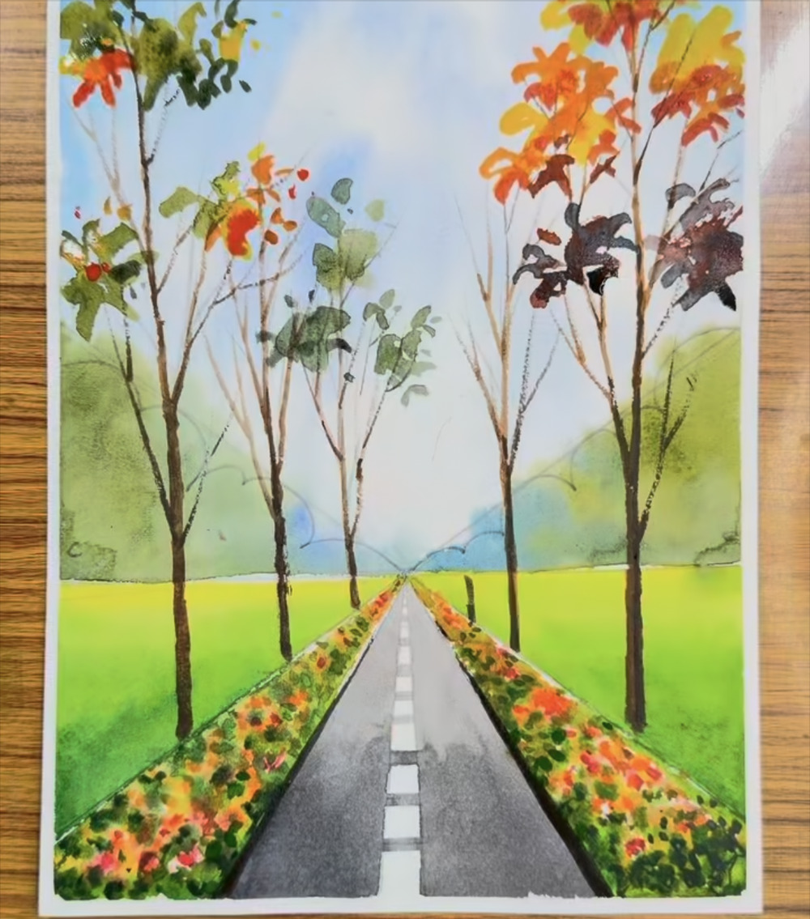
Watercolor Perspective Painting
A step-by-step guide for beginners: a tree-lined road with autumn flower beds
34 steps from first pencil line to finished painting
Built from screenshots of a Facebook reel by themohiart. Colors are kept as they appear in the reel.
Notes:
Title slide. Final painting shown on the right (screenshot IMG_4457.PNG).

Slide 2
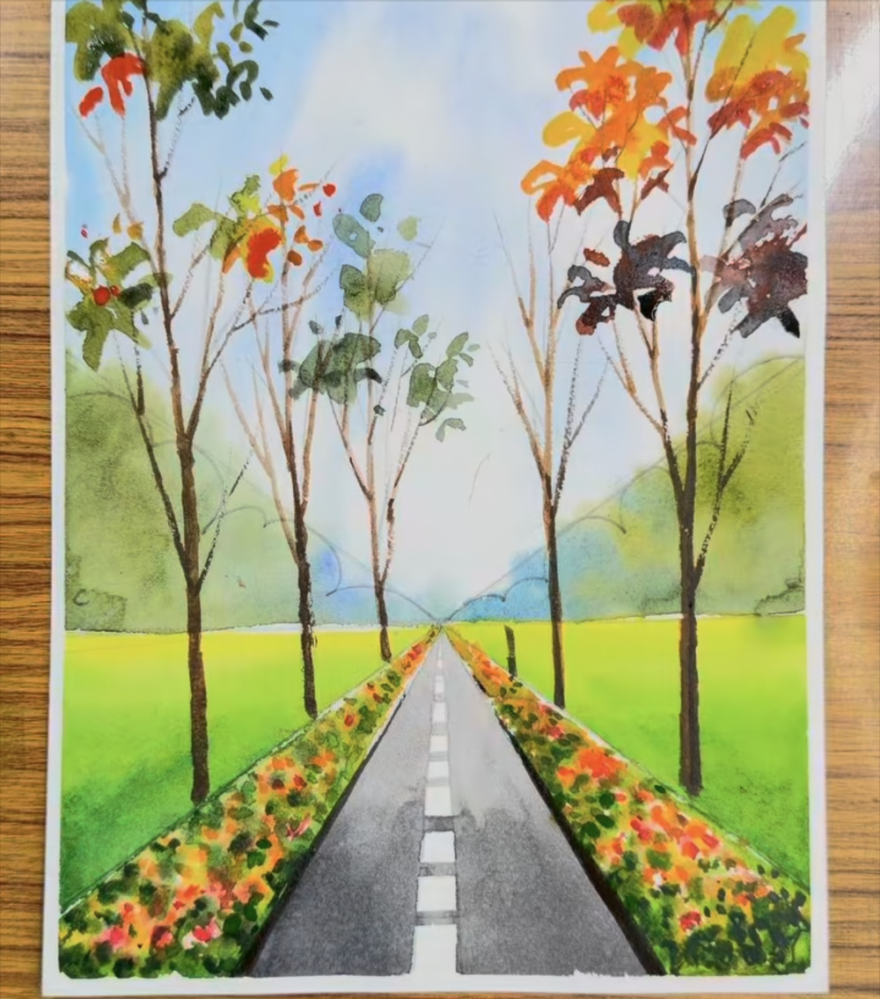
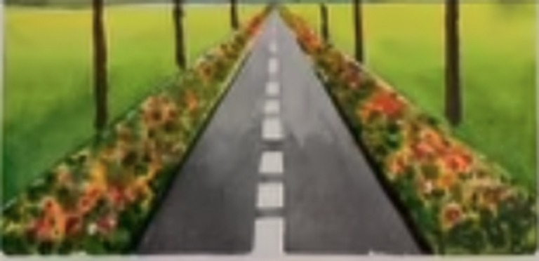
What you will paint
1
One-point perspective
Every line of the road, flower beds and treeline runs to a single vanishing point on the horizon. That one idea creates the sense of depth.
2
Light to dark, far to near
The sky and distant trees go in first, then the meadow, flower beds, trunks, road and finally the bright autumn leaves.
3
Loose, layered brushwork
Flowers, foliage and clouds are dabs and overlaps, not careful outlines. Expect imperfect edges and let them stay.
The reel opens with this small reference photo in the corner:
Notes:
Overview of the finished painting (screenshot IMG_4456.PNG). The reference photo is cropped from the corner of the first screenshots.

Slide 3
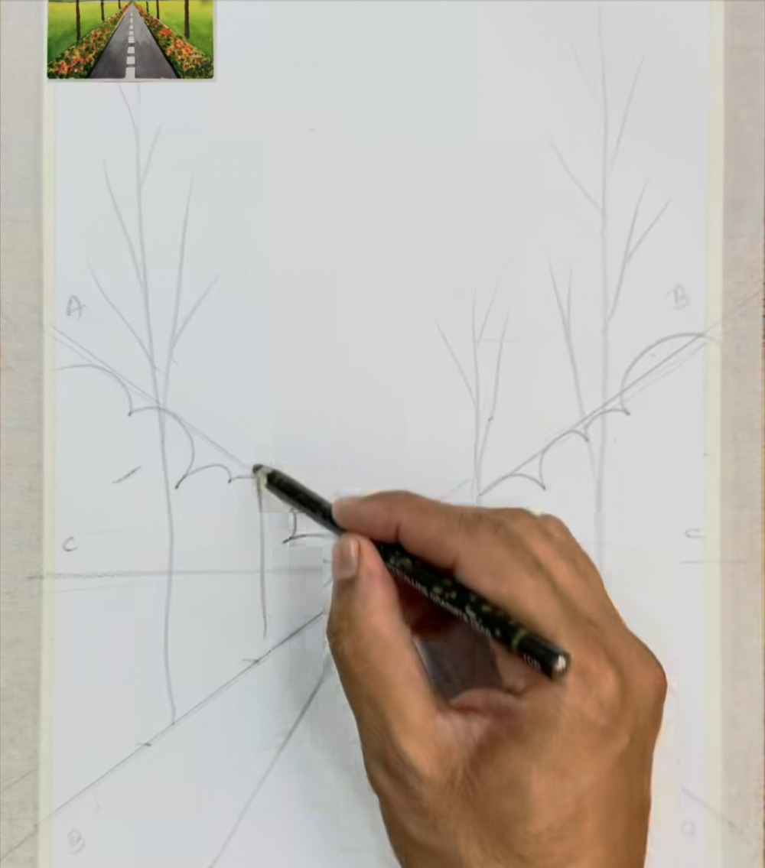
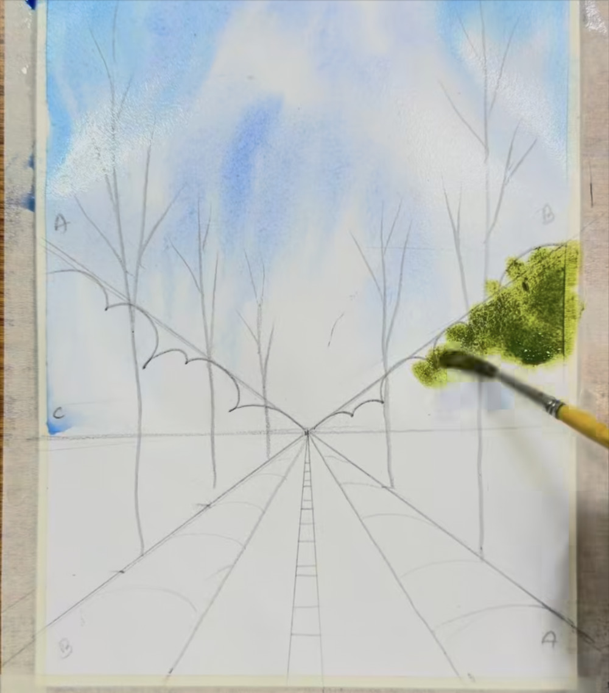
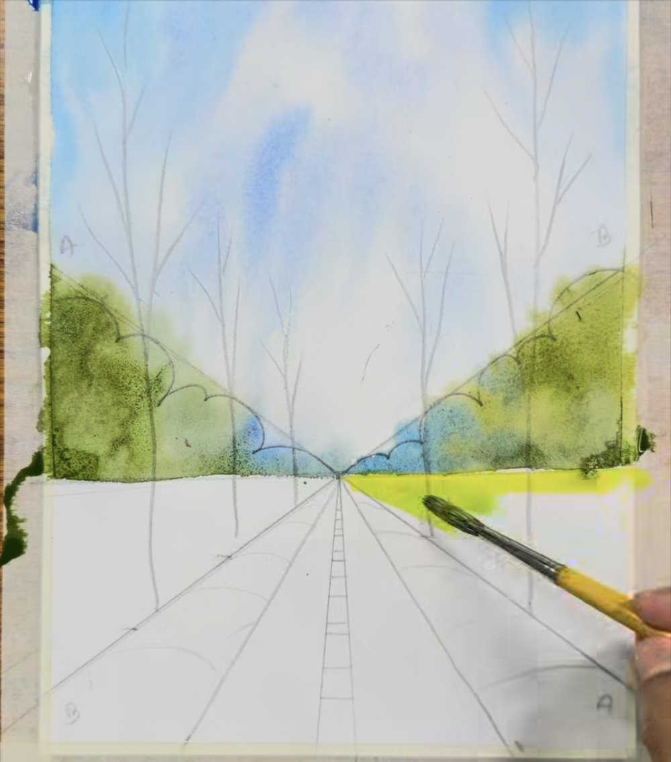
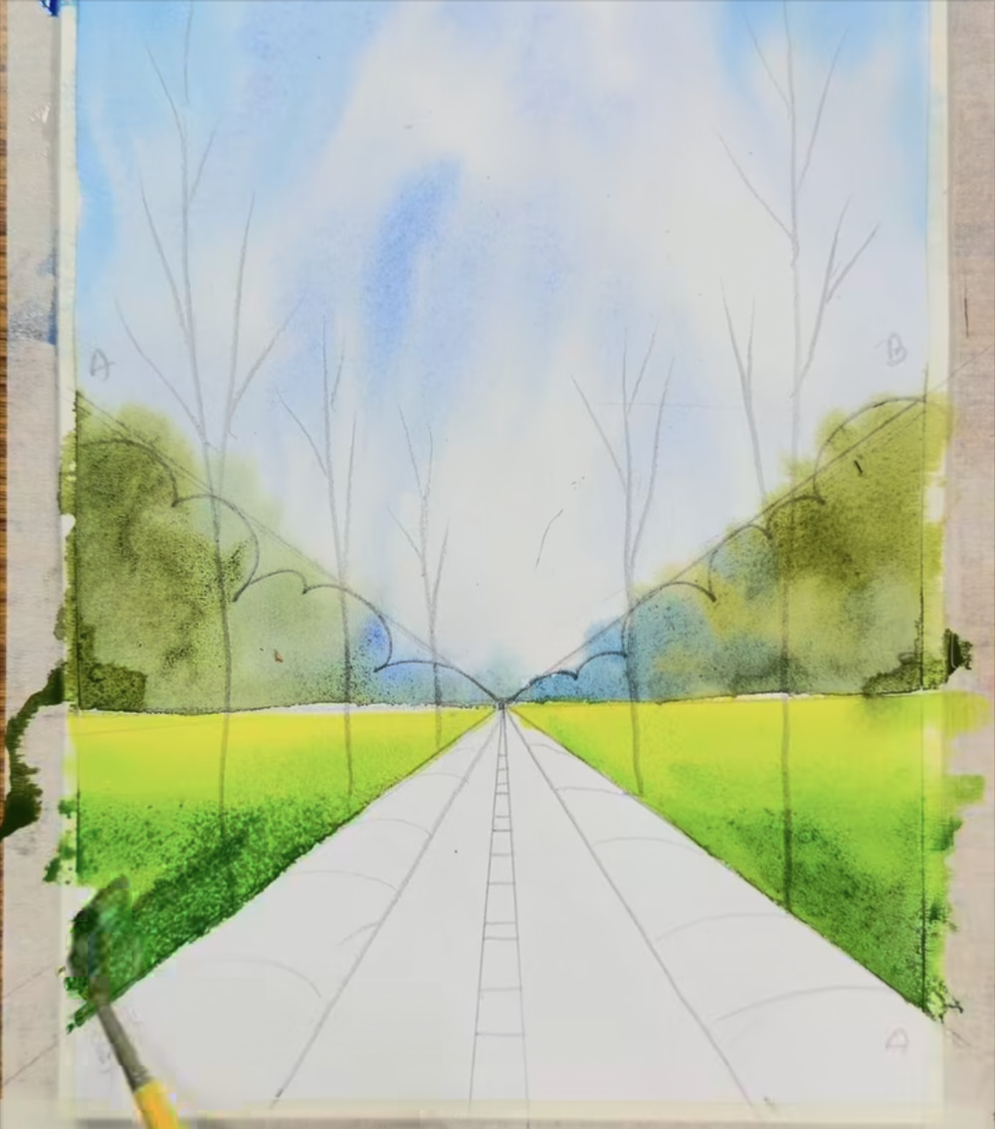
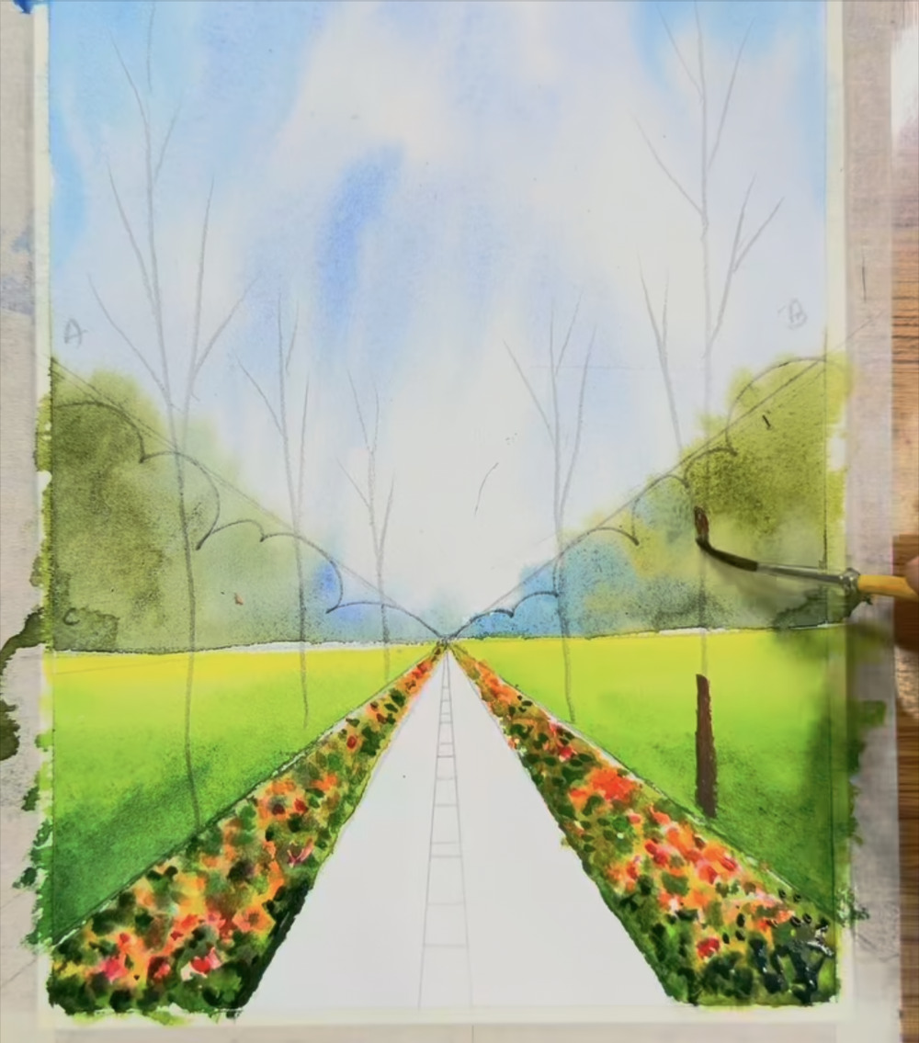
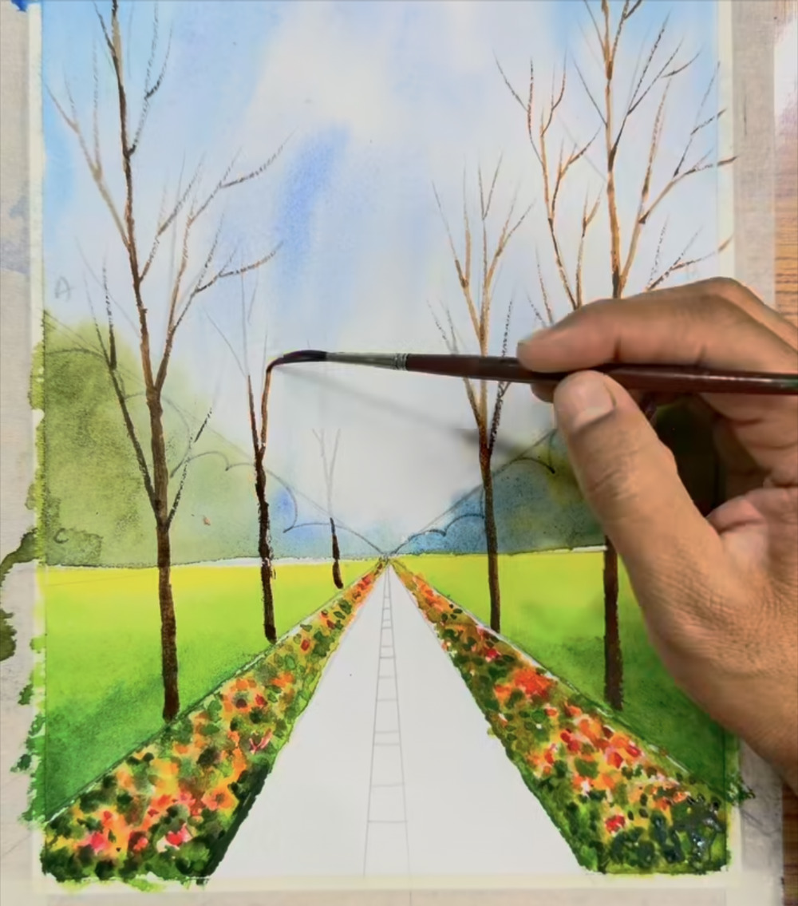
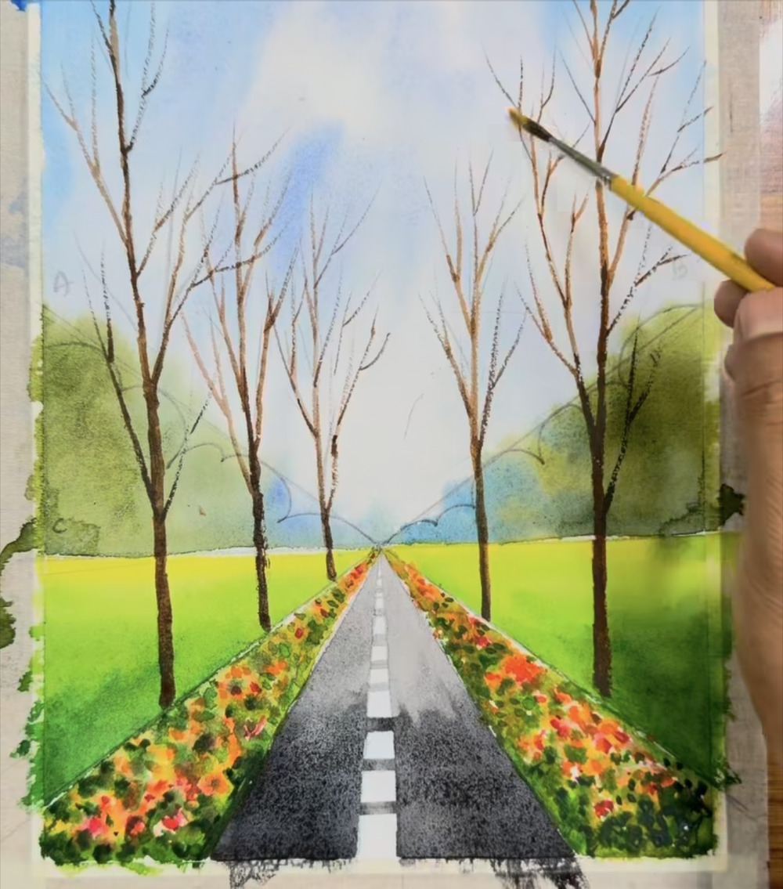
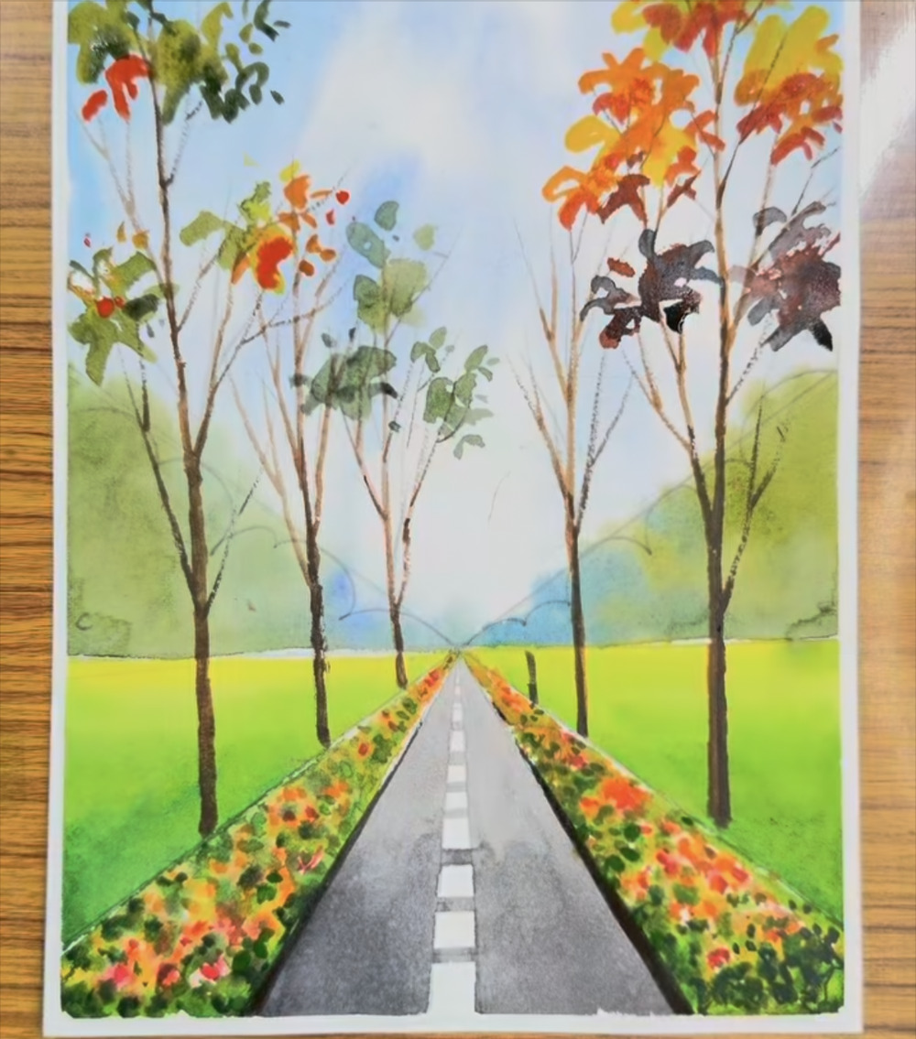
The painting in nine stages
1. Pencil drawing
2. Sky
3. Distant trees
Steps 1–3
Steps 4–7
Steps 8–12
Build the one-point perspective frame, treeline and trunks in light pencil.
Loose blue washes and dabbed clouds, with white paper left between.
Olive-green masses on both sides, with a blue-green haze at the base.
4. Meadow
5. Flower beds
6. Tree trunks
Steps 13–14
Steps 15–21
Steps 22–25
Yellow-green fields that darken toward the foreground.
Loose dabs of red, orange and yellow, then dark green leaves.
Thin brown trunks and forked twigs, small and fine near the horizon.
7. Road
8. Autumn leaves
9. Finished painting
Steps 26–27
Steps 28–32
Steps 33–34
Gray road from the vanishing point down, white dashes left bare.
Yellow, orange and maroon clusters on the right; gray-green on the left.
Step back, compare and study the details.
Notes:
Roadmap of the nine stages and which steps belong to each. Thumbnails are from the screenshot that ends each stage.

Slide 4
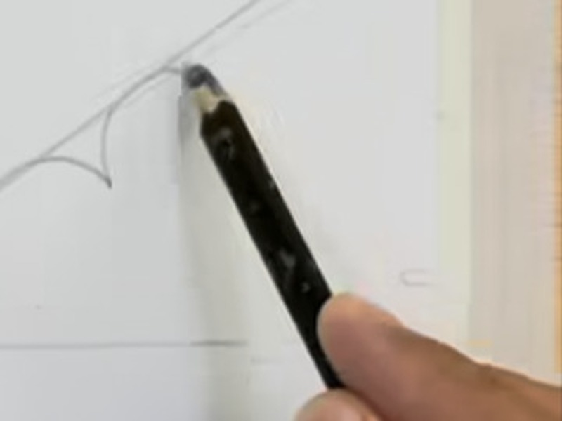
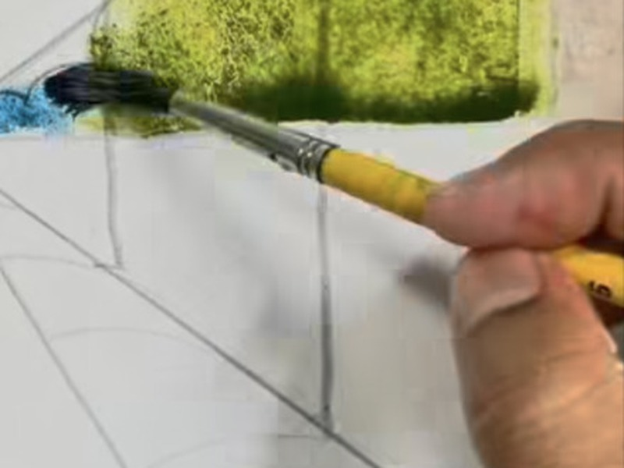
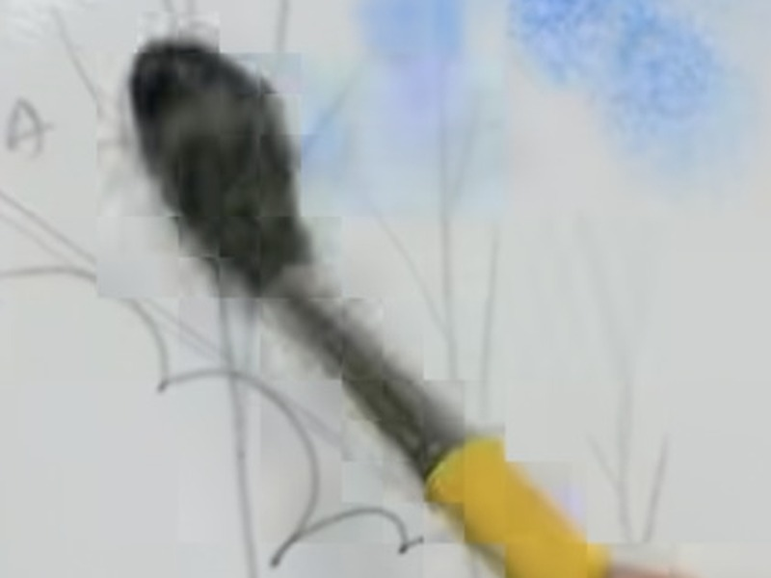
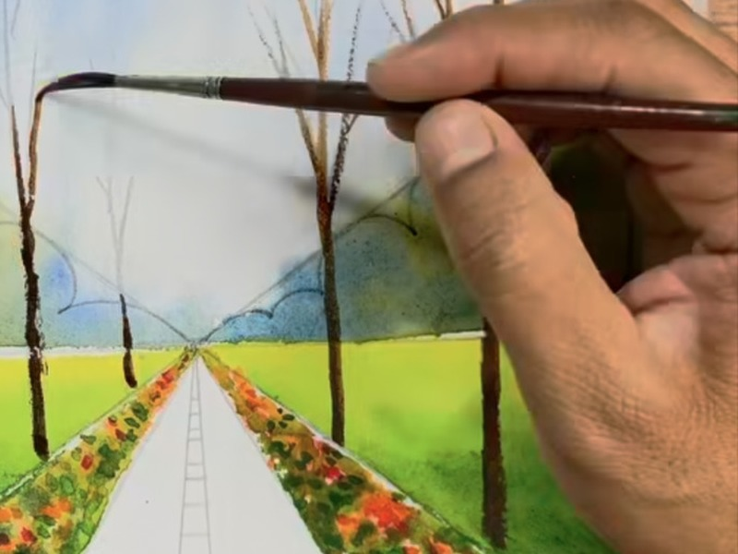
Tools seen in the reel
Graphite pencil
Round brush, yellow handle
Soft brush for dabbing
Fine liner brush
Steps 1–4
Most paint steps
Steps 6–7
Step 25
Light drawing of the perspective lines, treeline and trunks.
The main brush for the trees, meadow, flowers, road and leaves.
A fluffy, dark-bristled tip dabbed on the sky to make soft cloud edges.
A thin, long-bristled brush for trunks and twigs.
Also visible: watercolor paper held flat with its edges taped down (a clean white border shows at the end), a jar of water for rinsing, and a wooden table. Brush sizes are not stated, so use what you have: a medium round brush for most steps and a fine liner for the twigs.
Notes:
Tools are identified by eye from the screenshots; the reel does not name brands or sizes.

Slide 5
Your color palette
Deep sky blue
#4E7EEB · Steps 4–5
Try: Ultramarine or cobalt blue
Soft sky blue
#98B5DD · Steps 5–7
Try: The same blue, thinned with plenty of water
Blue-green haze
#7AA2AF · Steps 9–11
Try: Cerulean or turquoise, plus a little green
Olive green
#79832D · Steps 8–11
Try: Sap green plus a touch of yellow ochre
Muted olive
#848D4B · Step 12
Try: Olive green, thinned
Yellow-green
#C0D246 · Steps 12–14
Try: Lemon yellow plus a touch of green
Grass green
#52832E · Step 14
Try: Sap green plus a little blue
Dark leaf green
#2D4216 · Steps 19–21
Try: Sap green plus a touch of burnt umber
Coral red
#E3665D · Steps 15–18, 21, 32
Try: Scarlet or permanent red
Orange
#E8853E · Steps 18, 20–21, 29–32
Try: Orange or yellow-orange
Golden yellow
#E1AE42 · Steps 18, 28–30
Try: A warm, bright yellow
Dark brown
#4B432B · Steps 22–25
Try: Burnt umber or sepia
Road gray
#6D7072 · Steps 26–27
Try: Neutral tint or Payne's gray, thinned
Maroon
#4B3632 · Step 31
Try: Red plus brown, or a dark red-brown
Gray-green
#555E44 · Steps 31–32
Try: Sap green plus a little gray
Hex values were sampled from the screenshots, so they will look a little different on your screen and paper. The reel does not name pigments: the “Try” lines are suggestions only, so match by eye.
Notes:
Palette sampled from the painted areas of the screenshots (median of paint pixels in each region). Pigment suggestions are the author's, not from the reel.

Slide 6
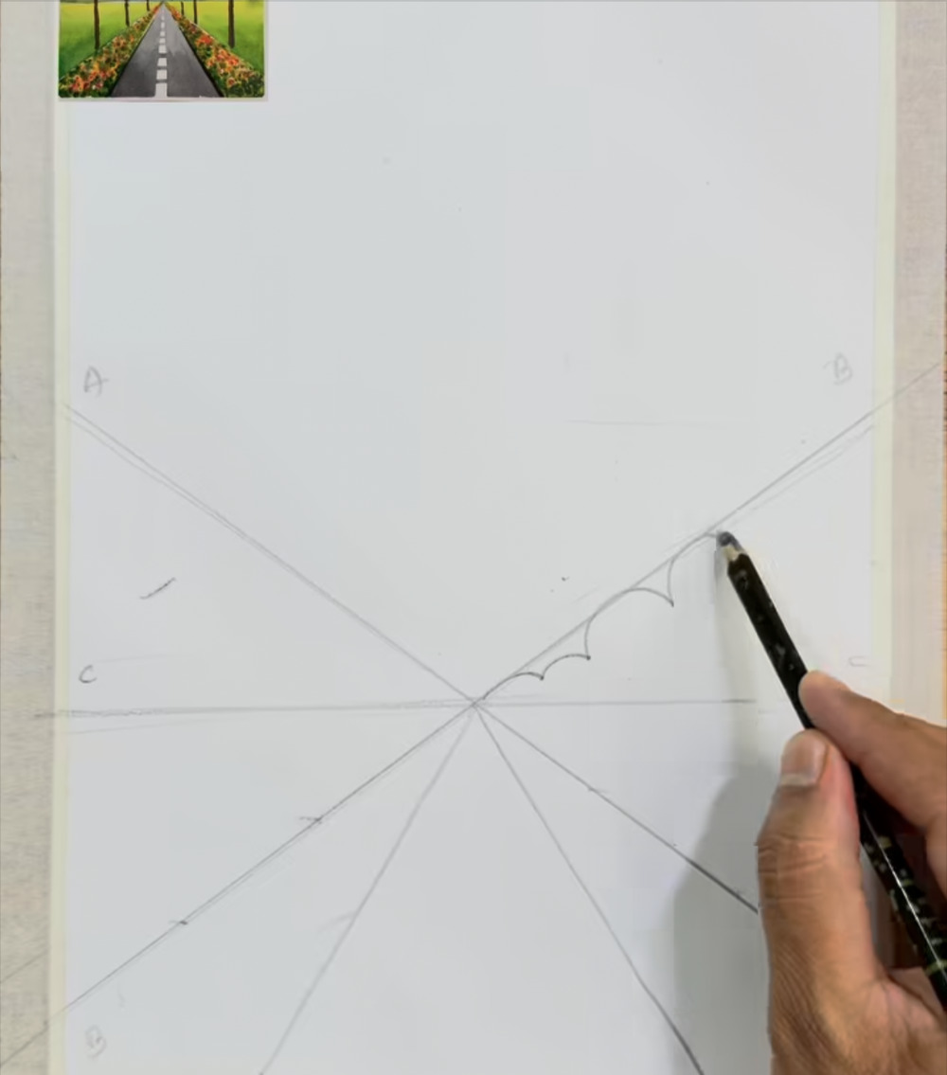
Draw the perspective frame
STAGE 1 · PENCIL DRAWING
STEP 1 OF 34
WHAT TO DO
Lightly draw a horizontal horizon line about 60% of the way down the page.
Mark one vanishing point on it. Draw two long crossing diagonals through that point, plus a fan of straight lines down to the bottom edge.
Start the bumpy treeline (small scallops) along the right-hand diagonal.
WATCH FOR
Press very lightly. The small A, B and C letters in the margins are the artist's own guide marks; you don't need to copy them.
NO PAINT YET: PENCIL ONLY
Notes:
Step 1 of 34. Source screenshot: IMG_4424.PNG. Stage: Pencil drawing.
What to do: Lightly draw a horizontal horizon line about 60% of the way down the page. Mark one vanishing point on it. Draw two long crossing diagonals through that point, plus a fan of straight lines down to the bottom edge. Start the bumpy treeline (small scallops) along the right-hand diagonal.
Watch for: Press very lightly. The small A, B and C letters in the margins are the artist's own guide marks; you don't need to copy them.

Slide 7
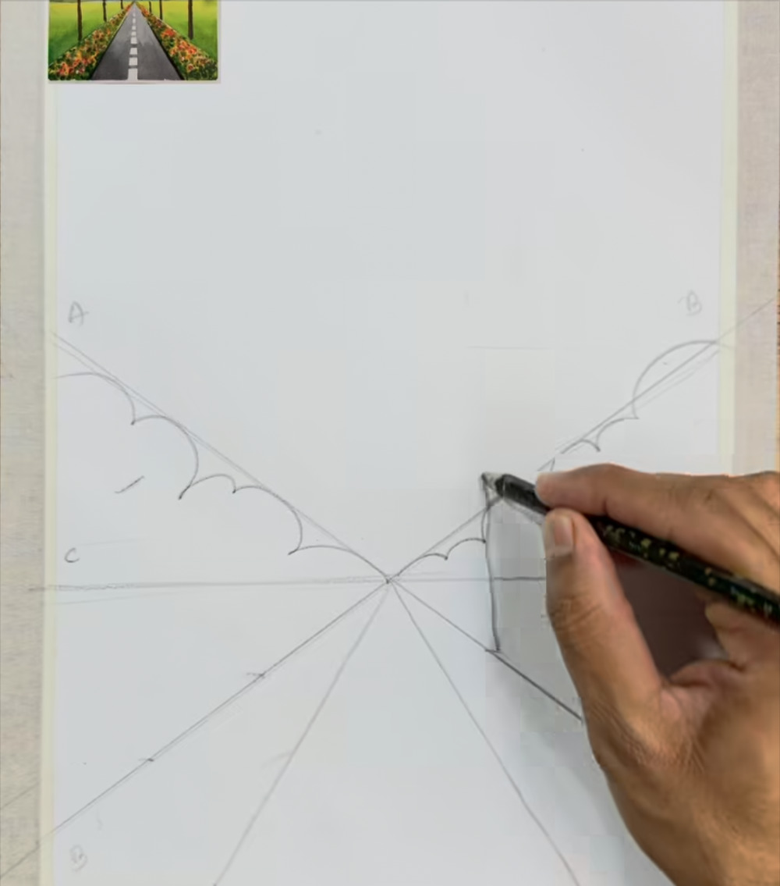
Mirror the treeline on the left
STAGE 1 · PENCIL DRAWING
STEP 2 OF 34
WHAT TO DO
Draw the same scalloped treeline along the left diagonal so both sides match.
Keep the bumps small near the vanishing point and larger toward the edges.
Extend the right treeline out to the paper's edge and begin the first vertical trunk line.
WATCH FOR
Big shapes in front, small shapes far away: that is what makes the scene look deep.
NO PAINT YET: PENCIL ONLY
Notes:
Step 2 of 34. Source screenshot: IMG_4425.PNG. Stage: Pencil drawing.
What to do: Draw the same scalloped treeline along the left diagonal so both sides match. Keep the bumps small near the vanishing point and larger toward the edges. Extend the right treeline out to the paper's edge and begin the first vertical trunk line.
Watch for: Big shapes in front, small shapes far away: that is what makes the scene look deep.

Slide 8
Sketch the tree trunks
STAGE 1 · PENCIL DRAWING
STEP 3 OF 34
WHAT TO DO
Draw tall, thin trunks on both sides, each splitting into a few forked twigs near the top.
Add shorter, thinner trunks in between, standing along the treeline.
WATCH FOR
Trunks shrink toward the vanishing point, so the row of trees seems to recede.
NO PAINT YET: PENCIL ONLY
Notes:
Step 3 of 34. Source screenshot: IMG_4426.PNG. Stage: Pencil drawing.
What to do: Draw tall, thin trunks on both sides, each splitting into a few forked twigs near the top. Add shorter, thinner trunks in between, standing along the treeline.
Watch for: Trunks shrink toward the vanishing point, so the row of trees seems to recede.

Slide 9
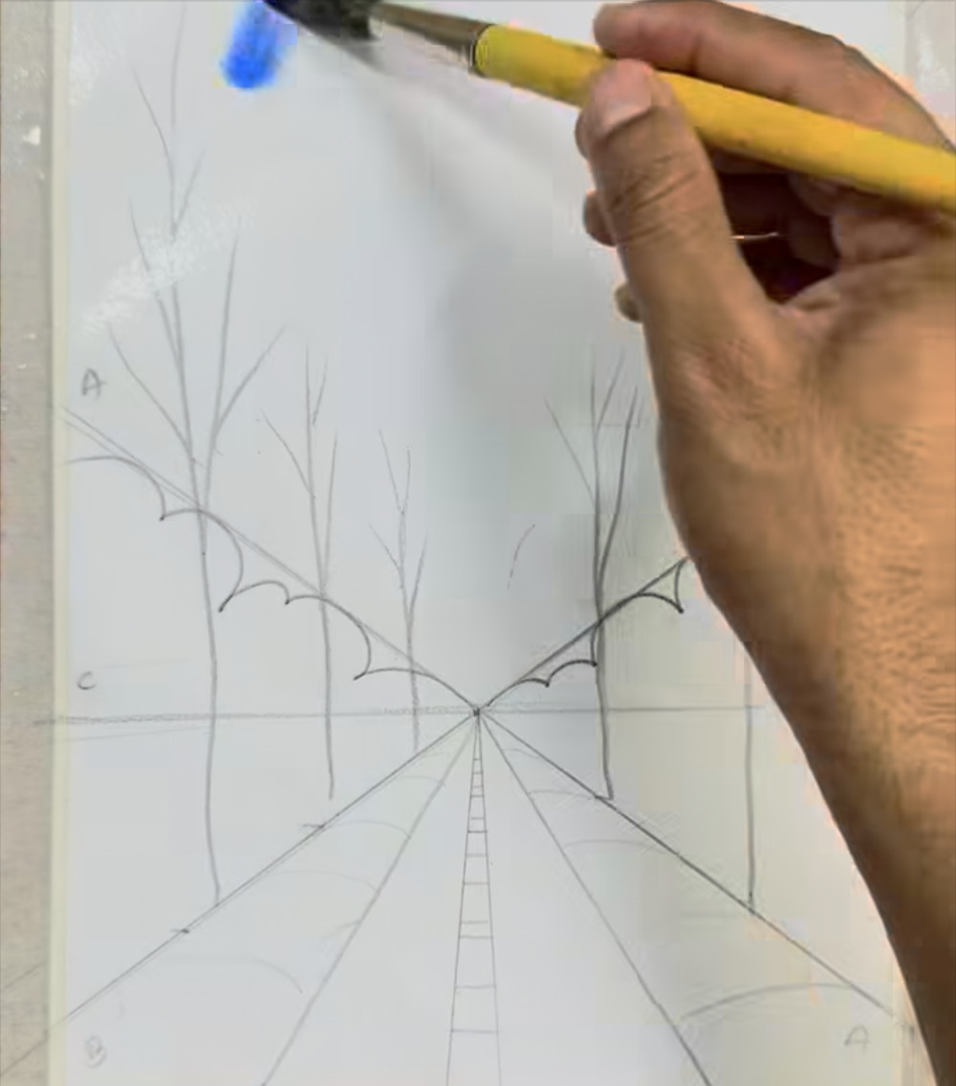
Pencil done: first blue at the top
STAGE 2 · SKY
STEP 4 OF 34
WHAT TO DO
Finish the drawing: the faint ladder-like marks down the middle of the road become the dashed center line.
Load a round brush with sky blue and touch it to the top edge of the paper.
WATCH FOR
Start high on the page and keep your strokes loose. The sky does not need to be even.
COLORS IN THIS STEP
Deep sky blue
#4E7EEB
Notes:
Step 4 of 34. Source screenshot: IMG_4427.PNG. Stage: Sky.
What to do: Finish the drawing: the faint ladder-like marks down the middle of the road become the dashed center line. Load a round brush with sky blue and touch it to the top edge of the paper.
Watch for: Start high on the page and keep your strokes loose. The sky does not need to be even.

Slide 10
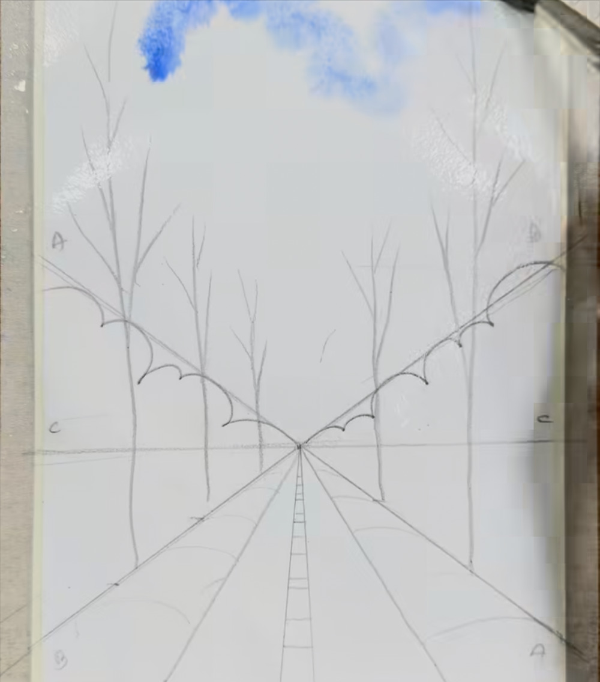
Spread the blue across the top
STAGE 2 · SKY
STEP 5 OF 34
WHAT TO DO
Pull the blue sideways into soft, streaky patches along the top of the sky.
Leave gaps of bare white paper between the patches.
WATCH FOR
The white gaps become your clouds, so don't fill them in.
COLORS IN THIS STEP
Deep sky blue
#4E7EEB
Soft sky blue
#98B5DD
Notes:
Step 5 of 34. Source screenshot: IMG_4428.PNG. Stage: Sky.
What to do: Pull the blue sideways into soft, streaky patches along the top of the sky. Leave gaps of bare white paper between the patches.
Watch for: The white gaps become your clouds, so don't fill them in.

Slide 11
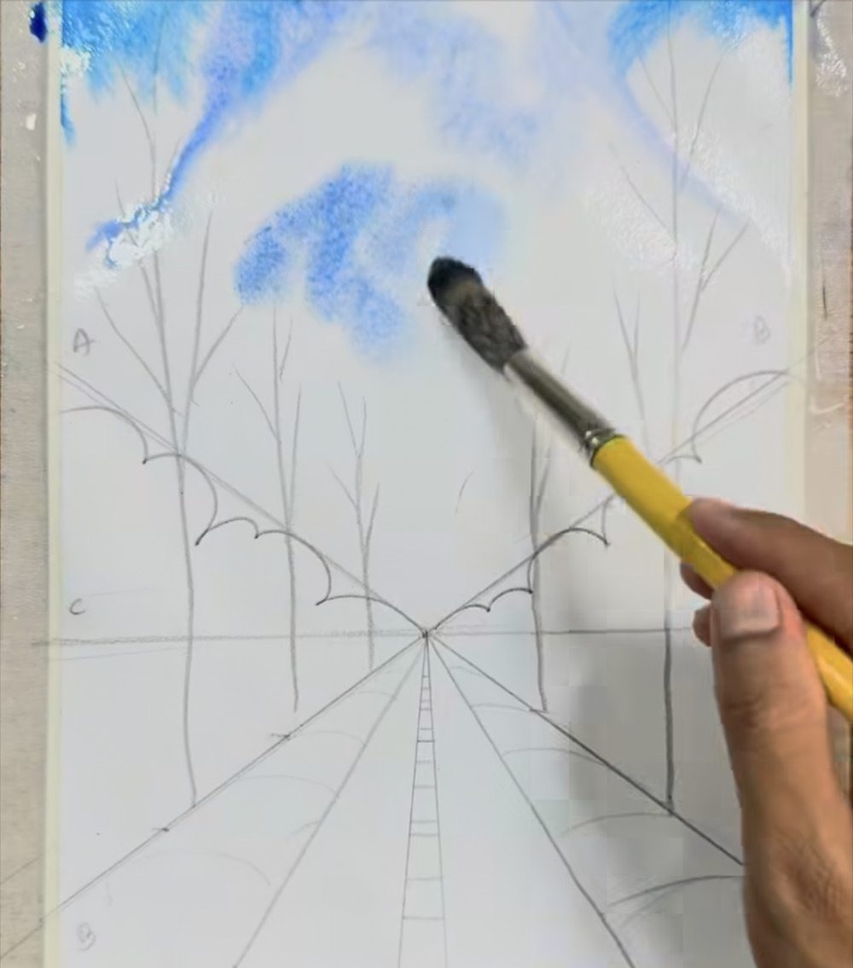
Dab cloud patches lower in the sky
STAGE 2 · SKY
STEP 6 OF 34
WHAT TO DO
Switch to a soft, dark-bristled brush and dab (don't stroke) a blue patch below the top band.
Keep the edges uneven and leave white around each patch.
WATCH FOR
Dabbing with the tip leaves a soft, speckled edge that looks like cloud.
COLORS IN THIS STEP
Soft sky blue
#98B5DD
Notes:
Step 6 of 34. Source screenshot: IMG_4429.PNG. Stage: Sky.
What to do: Switch to a soft, dark-bristled brush and dab (don't stroke) a blue patch below the top band. Keep the edges uneven and leave white around each patch.
Watch for: Dabbing with the tip leaves a soft, speckled edge that looks like cloud.

Slide 12
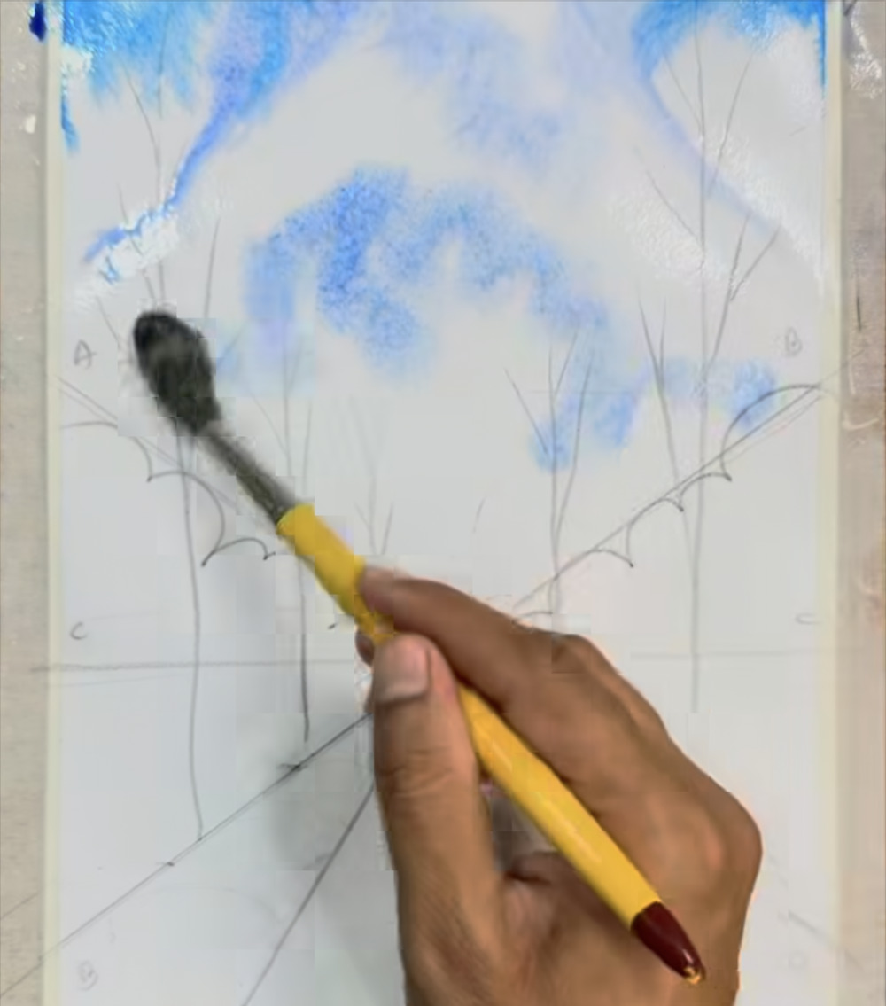
Keep dabbing to soften the sky
STAGE 2 · SKY
STEP 7 OF 34
WHAT TO DO
Add one or two more dabbed patches and blend their edges into the white.
Let the blue fade out gradually toward the horizon.
WATCH FOR
Deeper blue at the top, paler near the horizon. Stop before the sky gets busy.
COLORS IN THIS STEP
Soft sky blue
#98B5DD
Notes:
Step 7 of 34. Source screenshot: IMG_4430.PNG. Stage: Sky.
What to do: Add one or two more dabbed patches and blend their edges into the white. Let the blue fade out gradually toward the horizon.
Watch for: Deeper blue at the top, paler near the horizon. Stop before the sky gets busy.

Slide 13
Sky done: start the right-hand trees
STAGE 3 · DISTANT TREES
STEP 8 OF 34
WHAT TO DO
Switch to olive green and fill the triangle above the right-hand scalloped line, following its edge.
Dab so the green looks mottled, not flat.
WATCH FOR
Uneven, speckled paint reads as leaves. Don't smooth it out.
COLORS IN THIS STEP
Olive green
#79832D
Notes:
Step 8 of 34. Source screenshot: IMG_4431.PNG. Stage: Distant trees.
What to do: Switch to olive green and fill the triangle above the right-hand scalloped line, following its edge. Dab so the green looks mottled, not flat.
Watch for: Uneven, speckled paint reads as leaves. Don't smooth it out.

Slide 14
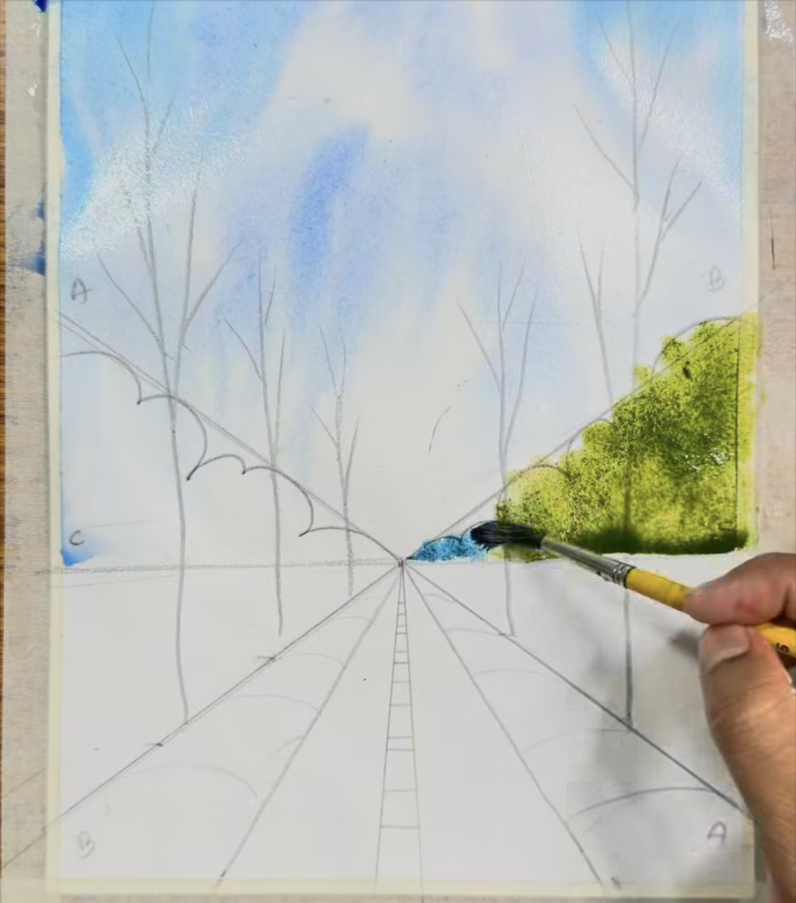
Deepen the right trees, add blue at the base
STAGE 3 · DISTANT TREES
STEP 9 OF 34
WHAT TO DO
Build the green up toward the horizon so the mass looks fuller.
At the base, beside the vanishing point, start a band of blue-green.
WATCH FOR
A cooler, bluer color at the base makes the trees look farther away.
COLORS IN THIS STEP
Olive green
#79832D
Blue-green haze
#7AA2AF
Notes:
Step 9 of 34. Source screenshot: IMG_4432.PNG. Stage: Distant trees.
What to do: Build the green up toward the horizon so the mass looks fuller. At the base, beside the vanishing point, start a band of blue-green.
Watch for: A cooler, bluer color at the base makes the trees look farther away.

Slide 15
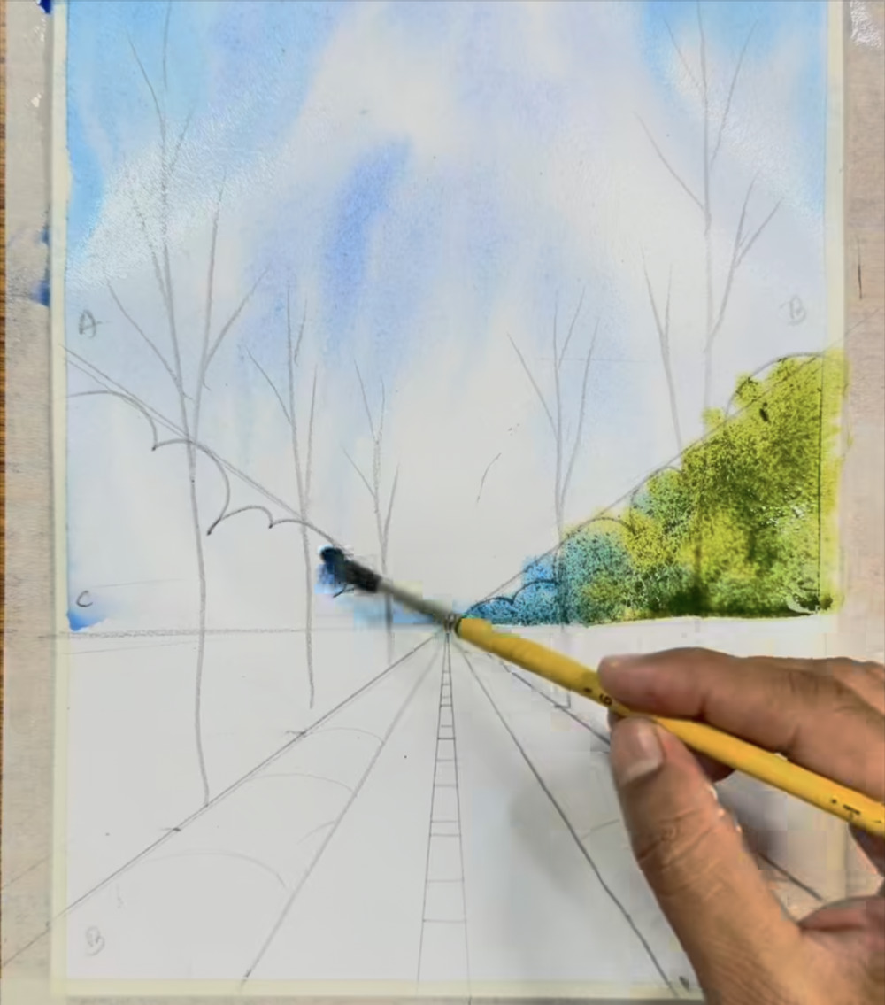
Run the blue-green haze along the horizon
STAGE 3 · DISTANT TREES
STEP 10 OF 34
WHAT TO DO
Continue the blue-green band along the base of the right treeline, all the way to the vanishing point.
Let it blend slightly into the green above.
WATCH FOR
Follow the scalloped pencil line so the haze keeps its bumpy edge.
COLORS IN THIS STEP
Blue-green haze
#7AA2AF
Olive green
#79832D
Notes:
Step 10 of 34. Source screenshot: IMG_4433.PNG. Stage: Distant trees.
What to do: Continue the blue-green band along the base of the right treeline, all the way to the vanishing point. Let it blend slightly into the green above.
Watch for: Follow the scalloped pencil line so the haze keeps its bumpy edge.

Slide 16
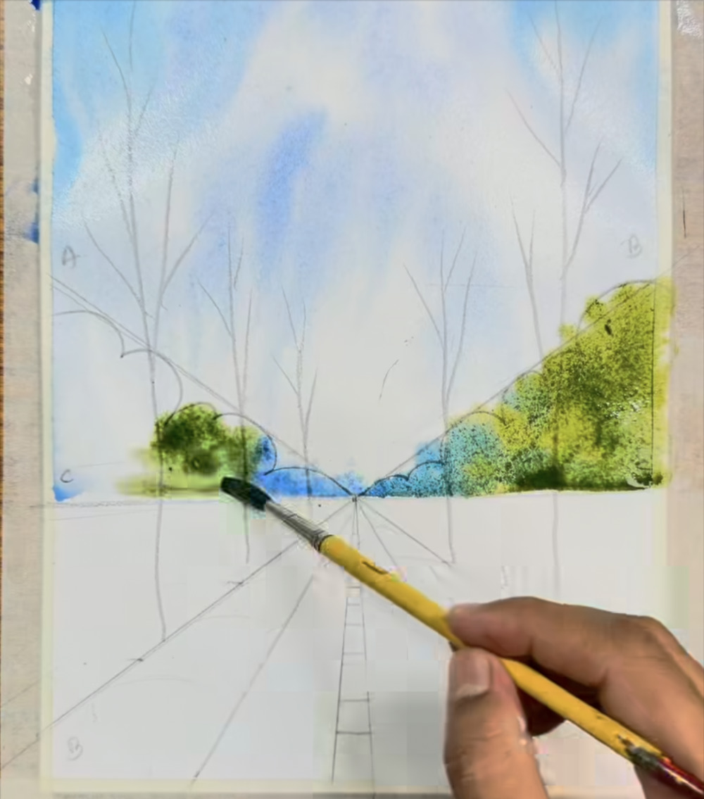
Begin the left-hand trees
STAGE 3 · DISTANT TREES
STEP 11 OF 34
WHAT TO DO
Dab dark green clumps on the left, mirroring the right-hand trees.
Add the blue-green strip at the base, running from the vanishing point toward the left.
WATCH FOR
Work in small clumps and leave the bumpy outline visible.
COLORS IN THIS STEP
Olive green
#79832D
Blue-green haze
#7AA2AF
Notes:
Step 11 of 34. Source screenshot: IMG_4434.PNG. Stage: Distant trees.
What to do: Dab dark green clumps on the left, mirroring the right-hand trees. Add the blue-green strip at the base, running from the vanishing point toward the left.
Watch for: Work in small clumps and leave the bumpy outline visible.

Slide 17
Fill the left trees, first meadow stripe
STAGE 3 · DISTANT TREES
STEP 12 OF 34
WHAT TO DO
Fill the left treeline so it balances the right one, using some darker and some lighter patches.
Switch to bright yellow-green and paint a strip just under the horizon on the right.
WATCH FOR
Varied tones keep the trees from looking flat.
COLORS IN THIS STEP
Muted olive
#848D4B
Yellow-green
#C0D246
Notes:
Step 12 of 34. Source screenshot: IMG_4435.PNG. Stage: Distant trees.
What to do: Fill the left treeline so it balances the right one, using some darker and some lighter patches. Switch to bright yellow-green and paint a strip just under the horizon on the right.
Watch for: Varied tones keep the trees from looking flat.

Slide 18
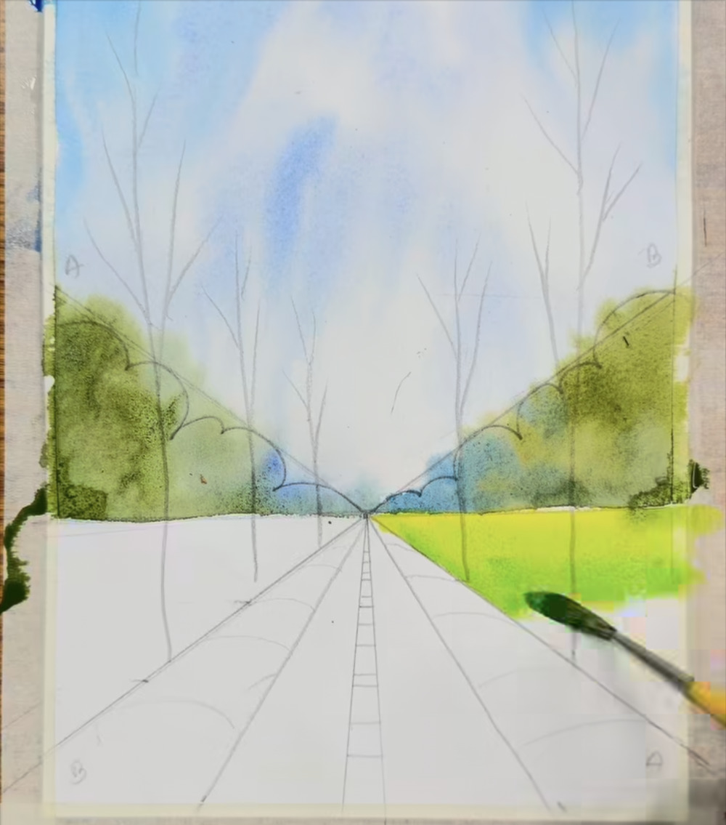
Fill the right meadow
STAGE 4 · MEADOW
STEP 13 OF 34
WHAT TO DO
Paint the wedge between the horizon and the outer pencil line on the right in yellow-green.
Leave the narrow strip next to the road and the road itself unpainted.
WATCH FOR
The narrow strips beside the road stay white for now: they are for the flowers.
COLORS IN THIS STEP
Yellow-green
#C0D246
Notes:
Step 13 of 34. Source screenshot: IMG_4436.PNG. Stage: Meadow.
What to do: Paint the wedge between the horizon and the outer pencil line on the right in yellow-green. Leave the narrow strip next to the road and the road itself unpainted.
Watch for: The narrow strips beside the road stay white for now: they are for the flowers.

Slide 19
Left meadow, then darken the foreground
STAGE 4 · MEADOW
STEP 14 OF 34
WHAT TO DO
Paint the left meadow wedge in yellow-green, matching the right.
Add darker green along the bottom and outer edge of both meadows and blend it upward into the lighter green.
WATCH FOR
Light in the distance, dark up close: this deepens the sense of space.
COLORS IN THIS STEP
Yellow-green
#C0D246
Grass green
#52832E
Notes:
Step 14 of 34. Source screenshot: IMG_4437.PNG. Stage: Meadow.
What to do: Paint the left meadow wedge in yellow-green, matching the right. Add darker green along the bottom and outer edge of both meadows and blend it upward into the lighter green.
Watch for: Light in the distance, dark up close: this deepens the sense of space.

Slide 20
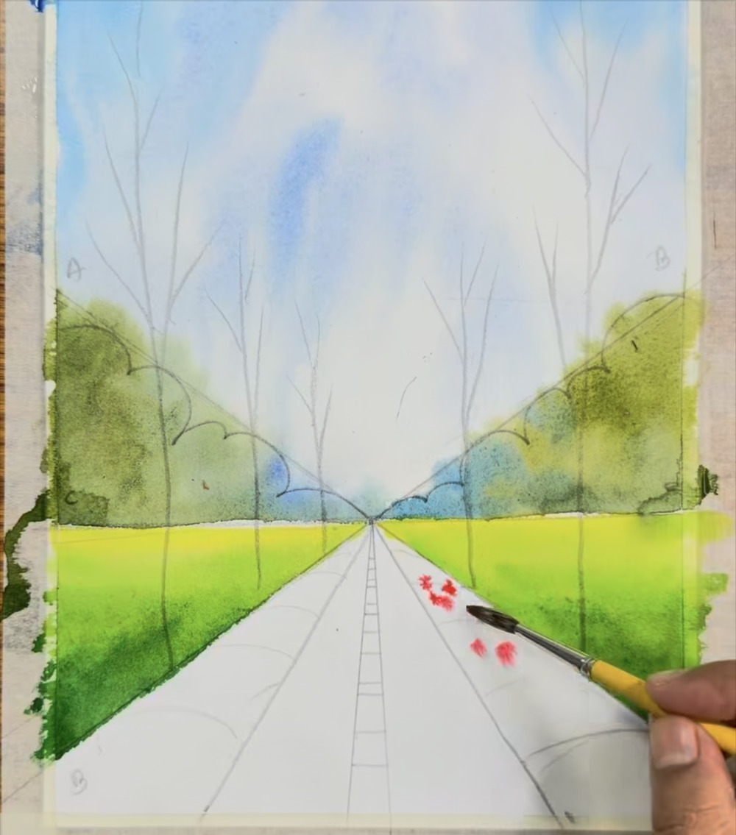
First red dabs for the flower beds
STAGE 5 · FLOWER BEDS
STEP 15 OF 34
WHAT TO DO
Load a small round brush with red and dab spots along the right flower-bed strip.
Keep the dabs random and uneven in size.
WATCH FOR
Don't paint individual flowers. Loose dabs read as a bed of blooms.
COLORS IN THIS STEP
Coral red
#E3665D
Notes:
Step 15 of 34. Source screenshot: IMG_4438.PNG. Stage: Flower beds.
What to do: Load a small round brush with red and dab spots along the right flower-bed strip. Keep the dabs random and uneven in size.
Watch for: Don't paint individual flowers. Loose dabs read as a bed of blooms.

Slide 21
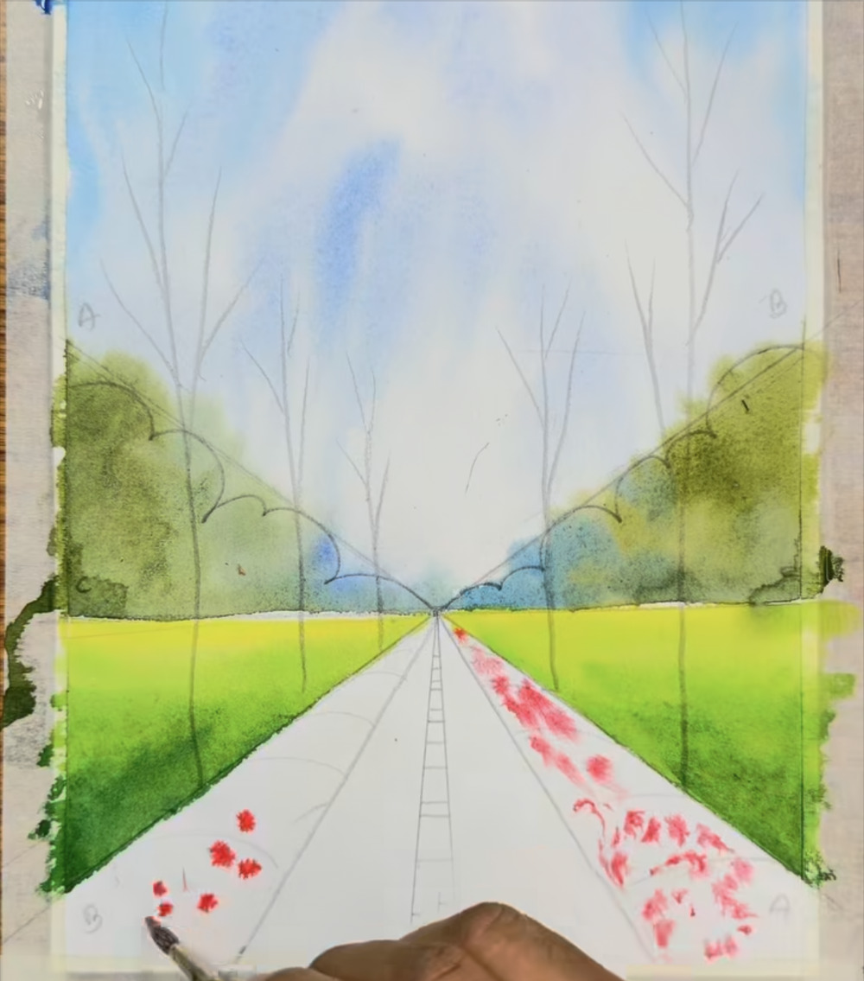
Spread the red along both beds
STAGE 5 · FLOWER BEDS
STEP 16 OF 34
WHAT TO DO
Continue the red dabs up the right strip toward the vanishing point, smaller and paler as you go.
Start dabbing red on the left strip, near the bottom.
WATCH FOR
Larger, stronger dabs near the bottom edge (close); small, pale dabs far away.
COLORS IN THIS STEP
Coral red
#E3665D
Notes:
Step 16 of 34. Source screenshot: IMG_4439.PNG. Stage: Flower beds.
What to do: Continue the red dabs up the right strip toward the vanishing point, smaller and paler as you go. Start dabbing red on the left strip, near the bottom.
Watch for: Larger, stronger dabs near the bottom edge (close); small, pale dabs far away.

Slide 22
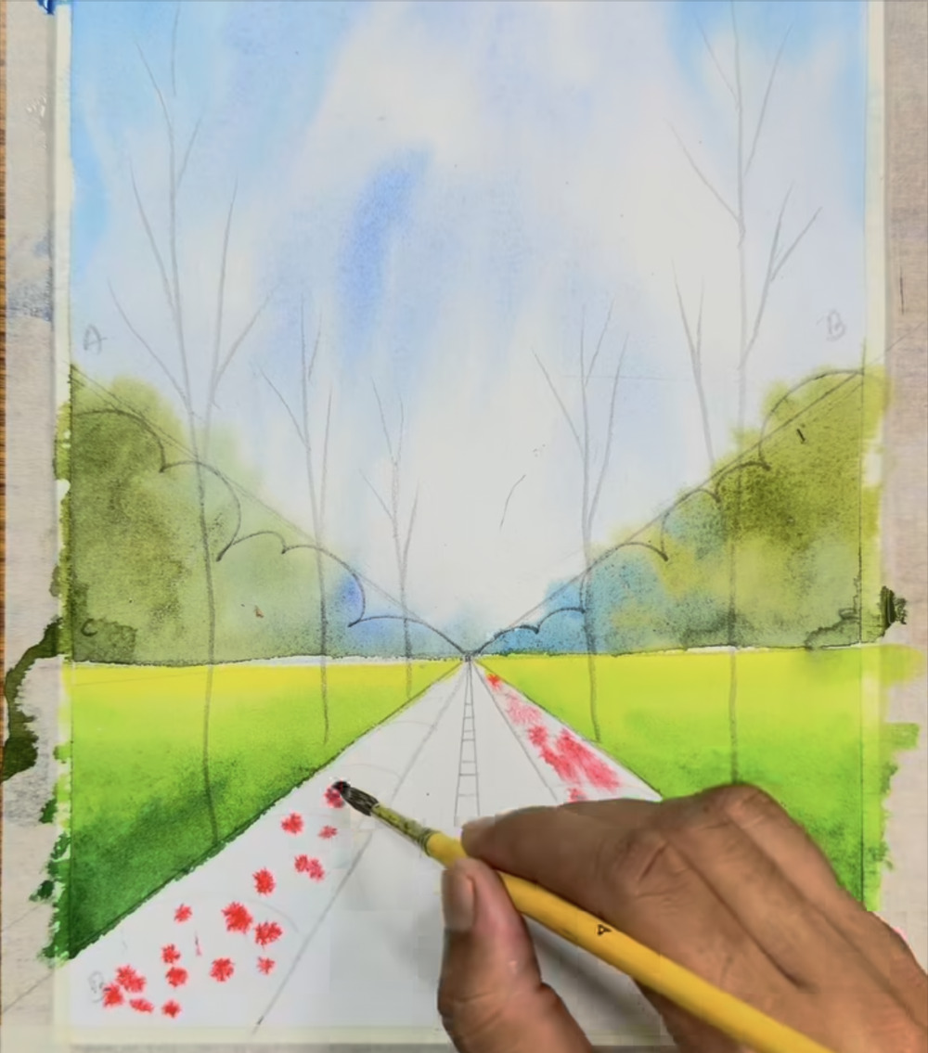
Finish the red on the left bed
STAGE 5 · FLOWER BEDS
STEP 17 OF 34
WHAT TO DO
Work up the left strip with the same loose dabs.
Match the size and spacing to the right bed so both sides feel balanced.
WATCH FOR
Leave gaps between the dabs. Orange and yellow fill them next.
COLORS IN THIS STEP
Coral red
#E3665D
Notes:
Step 17 of 34. Source screenshot: IMG_4440.PNG. Stage: Flower beds.
What to do: Work up the left strip with the same loose dabs. Match the size and spacing to the right bed so both sides feel balanced.
Watch for: Leave gaps between the dabs. Orange and yellow fill them next.

Slide 23
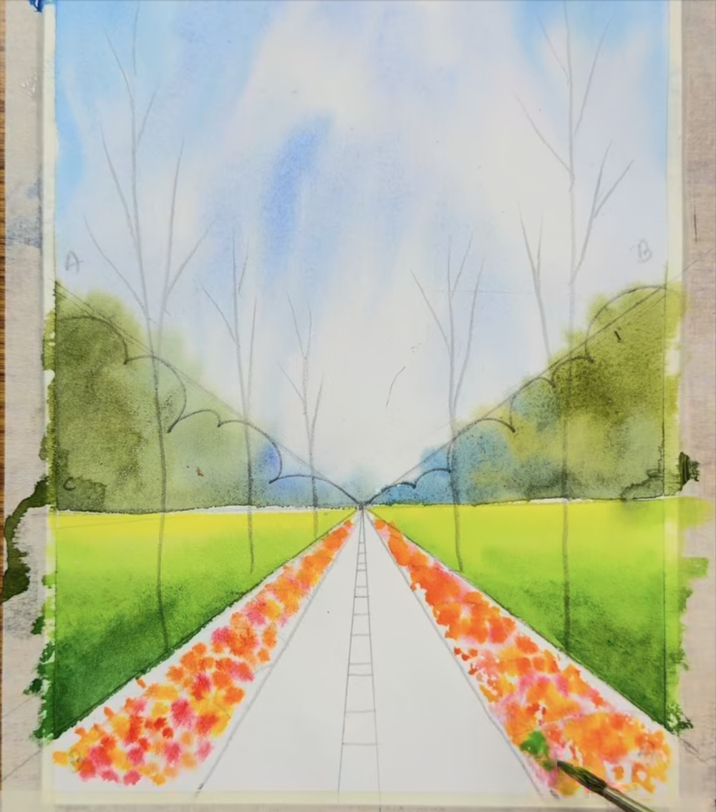
Fill the gaps with orange and yellow
STAGE 5 · FLOWER BEDS
STEP 18 OF 34
WHAT TO DO
Switch to orange, then yellow-orange, and dab between and over the red spots.
Let the colors overlap so they mix on the paper.
WATCH FOR
Overlapping, see-through dabs create a warm, glowing mass of flowers.
COLORS IN THIS STEP
Orange
#E8853E
Golden yellow
#E1AE42
Coral red
#E3665D
Notes:
Step 18 of 34. Source screenshot: IMG_4441.PNG. Stage: Flower beds.
What to do: Switch to orange, then yellow-orange, and dab between and over the red spots. Let the colors overlap so they mix on the paper.
Watch for: Overlapping, see-through dabs create a warm, glowing mass of flowers.

Slide 24
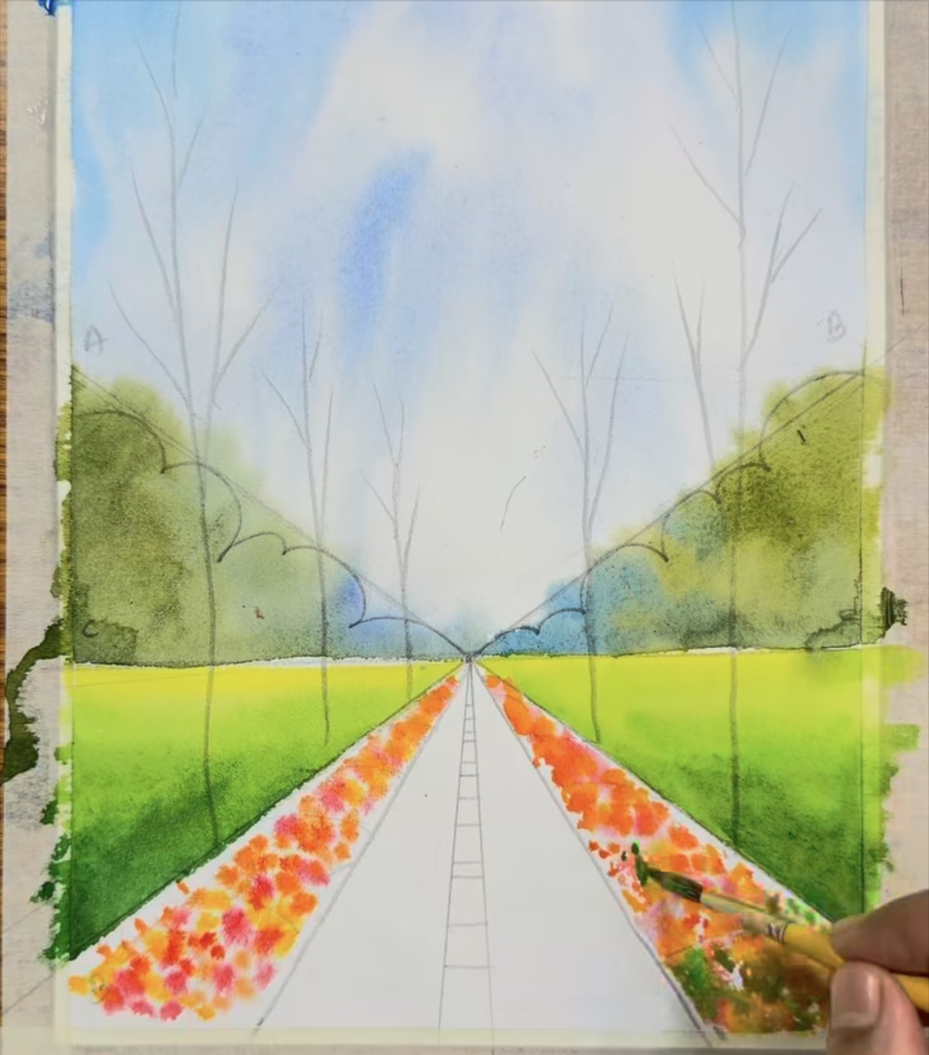
Add leaf-green touches to the beds
STAGE 5 · FLOWER BEDS
STEP 19 OF 34
WHAT TO DO
Pick up dark green and dab small leaf shapes among the flowers, starting at the bottom of the right bed.
Keep plenty of orange showing.
WATCH FOR
Go easy with the dark green at first. It is easy to add more and hard to take away.
COLORS IN THIS STEP
Dark leaf green
#2D4216
Notes:
Step 19 of 34. Source screenshot: IMG_4442.PNG. Stage: Flower beds.
What to do: Pick up dark green and dab small leaf shapes among the flowers, starting at the bottom of the right bed. Keep plenty of orange showing.
Watch for: Go easy with the dark green at first. It is easy to add more and hard to take away.

Slide 25
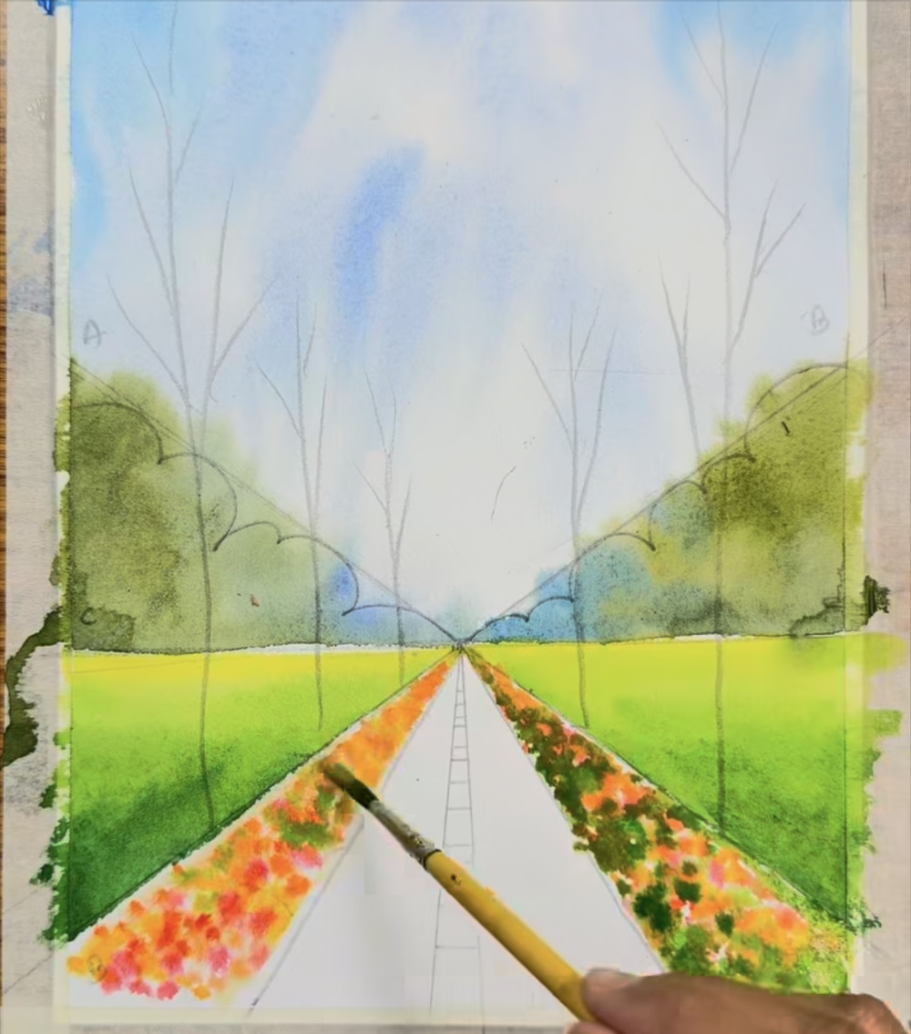
Keep adding green along the beds
STAGE 5 · FLOWER BEDS
STEP 20 OF 34
WHAT TO DO
Continue the green dabs up the right bed.
Move to the left bed and repeat, keeping the pattern random.
WATCH FOR
Vary the size of the dabs. Even spacing looks mechanical.
COLORS IN THIS STEP
Dark leaf green
#2D4216
Orange
#E8853E
Notes:
Step 20 of 34. Source screenshot: IMG_4443.PNG. Stage: Flower beds.
What to do: Continue the green dabs up the right bed. Move to the left bed and repeat, keeping the pattern random.
Watch for: Vary the size of the dabs. Even spacing looks mechanical.

Slide 26
Finish the beds and define their edges
STAGE 5 · FLOWER BEDS
STEP 21 OF 34
WHAT TO DO
Add dark green along the outer and bottom edges of each bed to define its shape.
Check that both beds look balanced: flowers in the middle, leaf-green around them.
WATCH FOR
A short brown stroke for the first tree trunk appears at the right here. That is the next step.
COLORS IN THIS STEP
Dark leaf green
#2D4216
Orange
#E8853E
Coral red
#E3665D
Notes:
Step 21 of 34. Source screenshot: IMG_4444.PNG. Stage: Flower beds.
What to do: Add dark green along the outer and bottom edges of each bed to define its shape. Check that both beds look balanced: flowers in the middle, leaf-green around them.
Watch for: A short brown stroke for the first tree trunk appears at the right here. That is the next step.

Slide 27
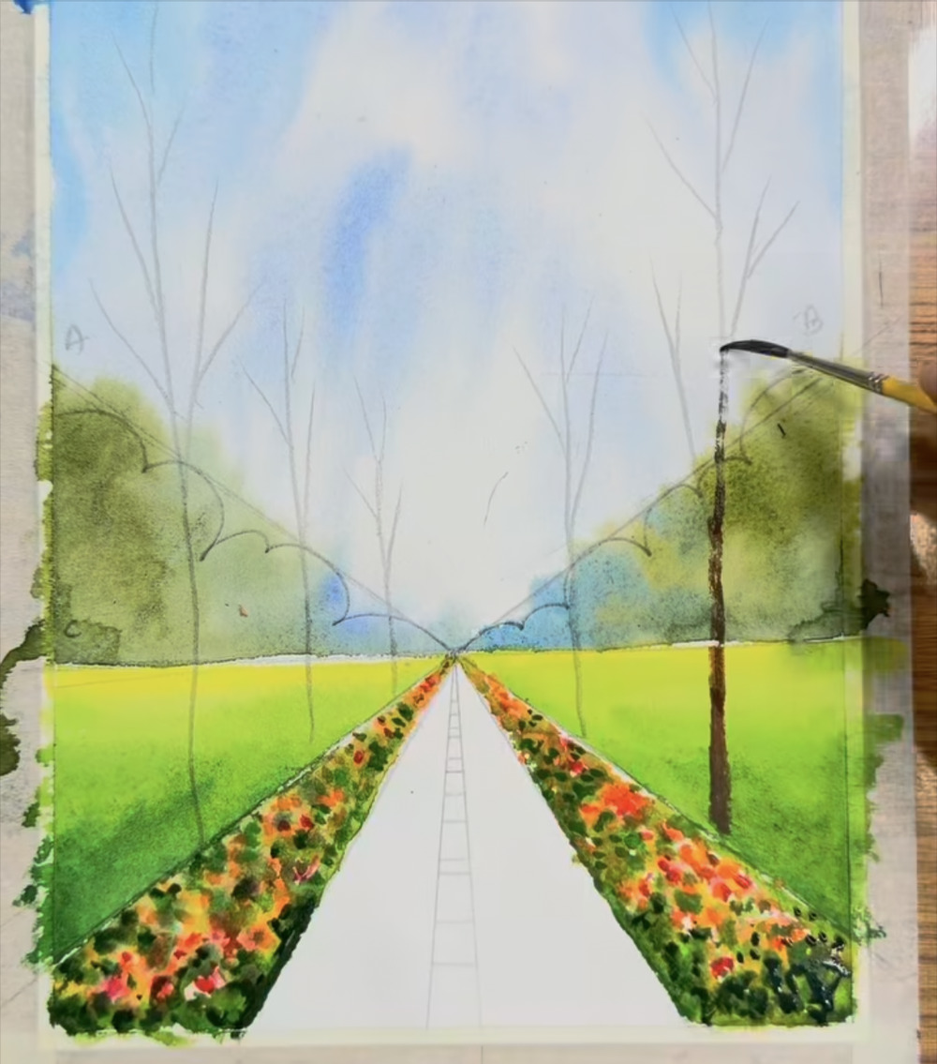
Paint the first tree trunk
STAGE 6 · TREE TRUNKS
STEP 22 OF 34
WHAT TO DO
With brown on a thin round brush, pull a line up from the meadow edge on the right.
Trace the pencil trunk and let the line thin out as you go up.
WATCH FOR
Real trunks are not ruler-straight. A slightly wavy line looks natural.
COLORS IN THIS STEP
Dark brown
#4B432B
Notes:
Step 22 of 34. Source screenshot: IMG_4445.PNG. Stage: Tree trunks.
What to do: With brown on a thin round brush, pull a line up from the meadow edge on the right. Trace the pencil trunk and let the line thin out as you go up.
Watch for: Real trunks are not ruler-straight. A slightly wavy line looks natural.

Slide 28
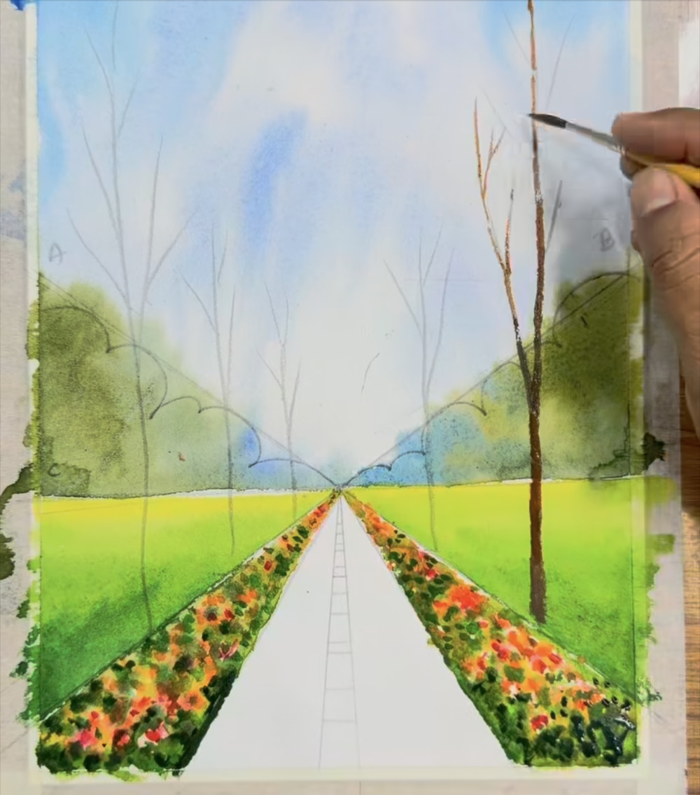
Take the trunk to the top, start the twigs
STAGE 6 · TREE TRUNKS
STEP 23 OF 34
WHAT TO DO
Carry the trunk up to the top edge of the paper.
Near the top, start thin, forking twigs using just the tip of the brush.
WATCH FOR
Branches split into smaller and smaller twigs. A lighter touch makes a thinner line.
COLORS IN THIS STEP
Dark brown
#4B432B
Notes:
Step 23 of 34. Source screenshot: IMG_4446.PNG. Stage: Tree trunks.
What to do: Carry the trunk up to the top edge of the paper. Near the top, start thin, forking twigs using just the tip of the brush.
Watch for: Branches split into smaller and smaller twigs. A lighter touch makes a thinner line.

Slide 29
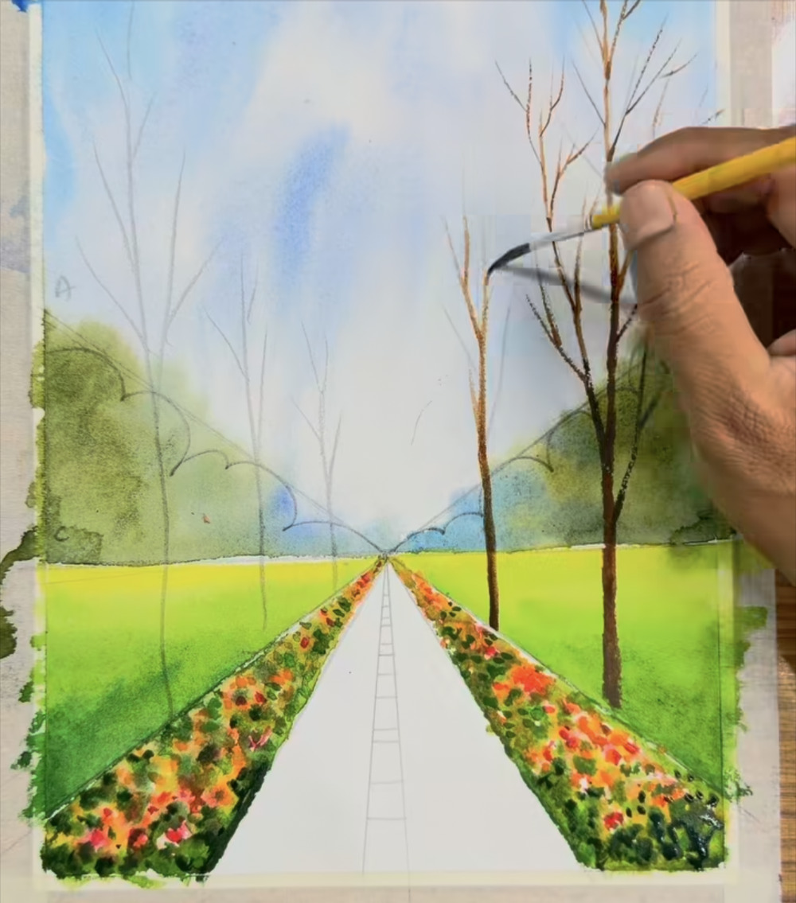
Add branches and a second trunk
STAGE 6 · TREE TRUNKS
STEP 24 OF 34
WHAT TO DO
Add forked side branches along the main trunk.
Paint a shorter second trunk to its left, with its own thin twigs.
WATCH FOR
The shorter trunk stands farther back, so keep it thinner.
COLORS IN THIS STEP
Dark brown
#4B432B
Notes:
Step 24 of 34. Source screenshot: IMG_4447.PNG. Stage: Tree trunks.
What to do: Add forked side branches along the main trunk. Paint a shorter second trunk to its left, with its own thin twigs.
Watch for: The shorter trunk stands farther back, so keep it thinner.

Slide 30
Paint the remaining trunks with a fine brush
STAGE 6 · TREE TRUNKS
STEP 25 OF 34
WHAT TO DO
Switch to a thin, long-bristled liner brush for the rest of the trunks and twigs.
Work across the left side and the middle, tracing your pencil trunks.
WATCH FOR
Trees near the vanishing point are small and thin. Keep the brush light.
COLORS IN THIS STEP
Dark brown
#4B432B
Notes:
Step 25 of 34. Source screenshot: IMG_4448.PNG. Stage: Tree trunks.
What to do: Switch to a thin, long-bristled liner brush for the rest of the trunks and twigs. Work across the left side and the middle, tracing your pencil trunks.
Watch for: Trees near the vanishing point are small and thin. Keep the brush light.

Slide 31
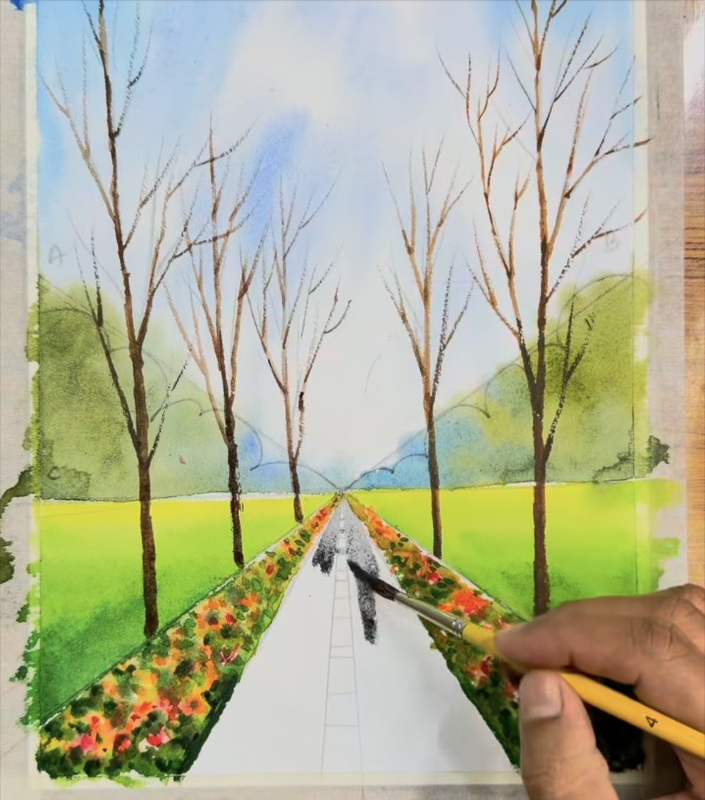
Start the road at the vanishing point
STAGE 7 · ROAD
STEP 26 OF 34
WHAT TO DO
Load a brush with dark gray and begin the road at the vanishing point.
Paint around the pencil center-line marks so they stay white.
WATCH FOR
Those unpainted rungs become the white dashed line, so avoid covering them.
COLORS IN THIS STEP
Road gray
#6D7072
Notes:
Step 26 of 34. Source screenshot: IMG_4449.PNG. Stage: Road.
What to do: Load a brush with dark gray and begin the road at the vanishing point. Paint around the pencil center-line marks so they stay white.
Watch for: Those unpainted rungs become the white dashed line, so avoid covering them.

Slide 32
Fill in the road
STAGE 7 · ROAD
STEP 27 OF 34
WHAT TO DO
Work down toward the bottom edge, filling both sides of the center line.
Keep the road a little lighter in the distance and slightly darker at the bottom.
Let the bottom edge go a bit ragged, as it does in the reel.
WATCH FOR
Leave the white dashes untouched. They shrink toward the vanishing point.
COLORS IN THIS STEP
Road gray
#6D7072
Notes:
Step 27 of 34. Source screenshot: IMG_4450.PNG. Stage: Road.
What to do: Work down toward the bottom edge, filling both sides of the center line. Keep the road a little lighter in the distance and slightly darker at the bottom. Let the bottom edge go a bit ragged, as it does in the reel.
Watch for: Leave the white dashes untouched. They shrink toward the vanishing point.

Slide 33
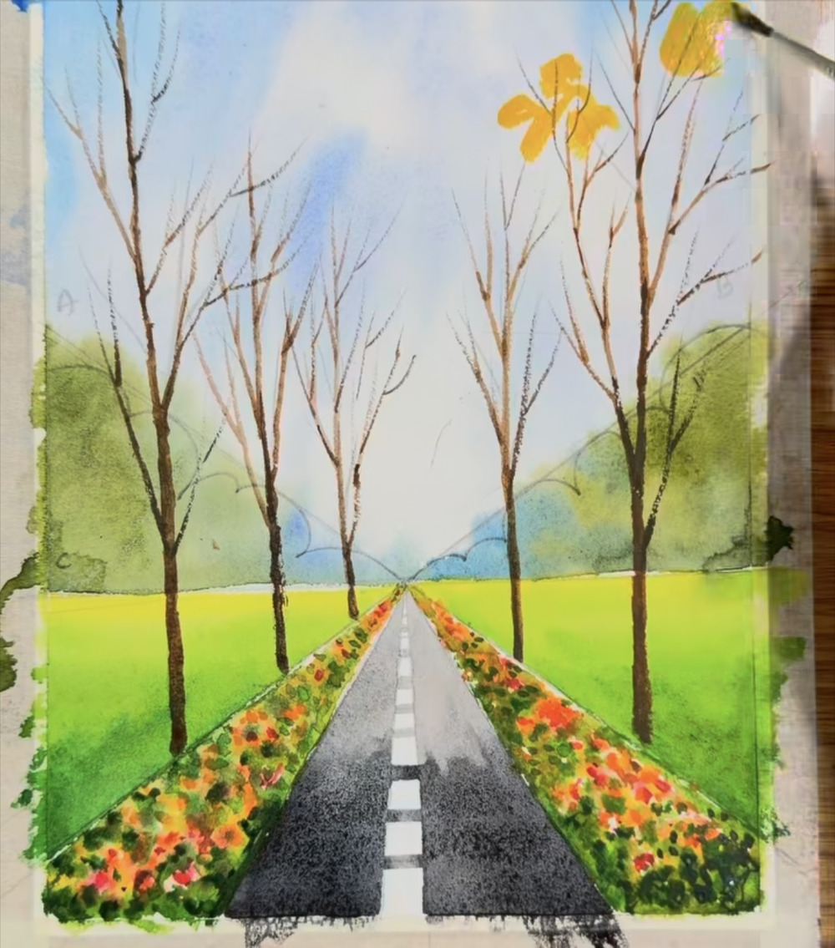
Autumn leaves: start with yellow
STAGE 8 · AUTUMN LEAVES
STEP 28 OF 34
WHAT TO DO
Pick up bright yellow and dab leaf clusters at the tips of the tall right-hand tree's branches.
Use small, irregular shapes, not perfect leaves.
WATCH FOR
Start with the lightest color. Orange and dark tones go on top.
COLORS IN THIS STEP
Golden yellow
#E1AE42
Notes:
Step 28 of 34. Source screenshot: IMG_4451.PNG. Stage: Autumn leaves.
What to do: Pick up bright yellow and dab leaf clusters at the tips of the tall right-hand tree's branches. Use small, irregular shapes, not perfect leaves.
Watch for: Start with the lightest color. Orange and dark tones go on top.

Slide 34
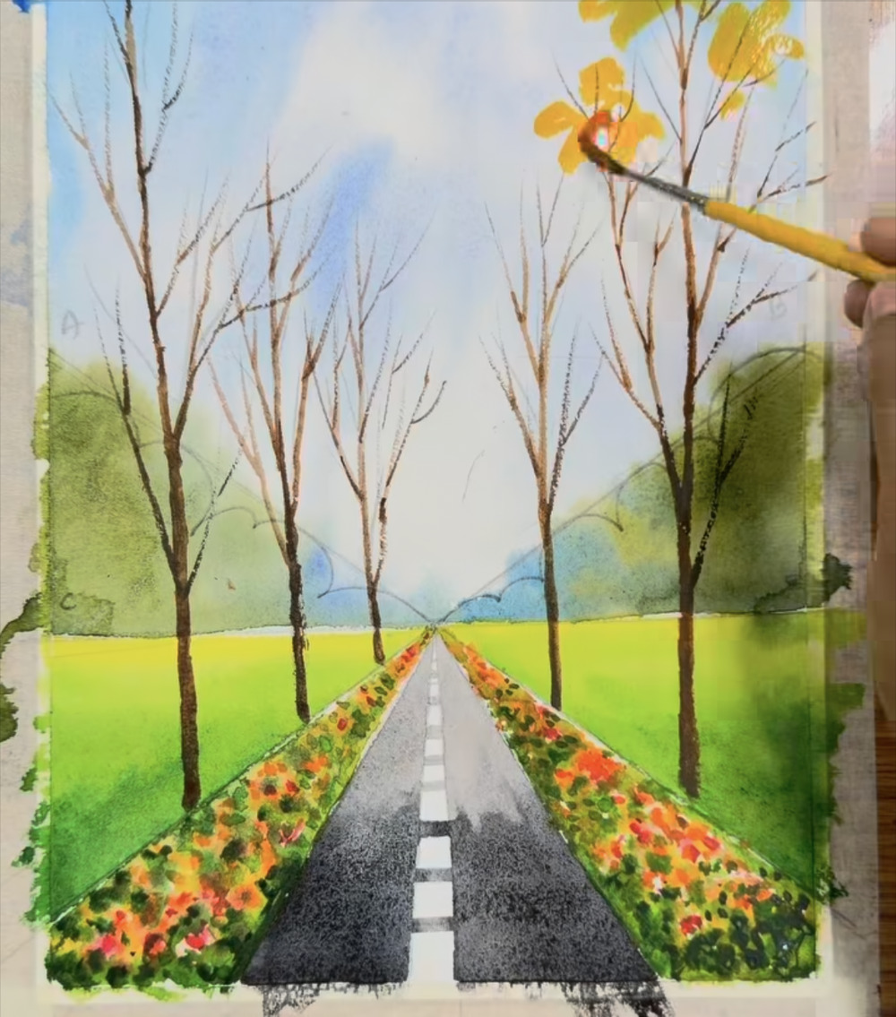
Layer orange over the yellow
STAGE 8 · AUTUMN LEAVES
STEP 29 OF 34
WHAT TO DO
Dab orange onto the clusters, partly overlapping the yellow.
Leave some of the yellow showing.
WATCH FOR
Overlaps give the foliage a glowing, layered look.
COLORS IN THIS STEP
Orange
#E8853E
Golden yellow
#E1AE42
Notes:
Step 29 of 34. Source screenshot: IMG_4452.PNG. Stage: Autumn leaves.
What to do: Dab orange onto the clusters, partly overlapping the yellow. Leave some of the yellow showing.
Watch for: Overlaps give the foliage a glowing, layered look.

Slide 35
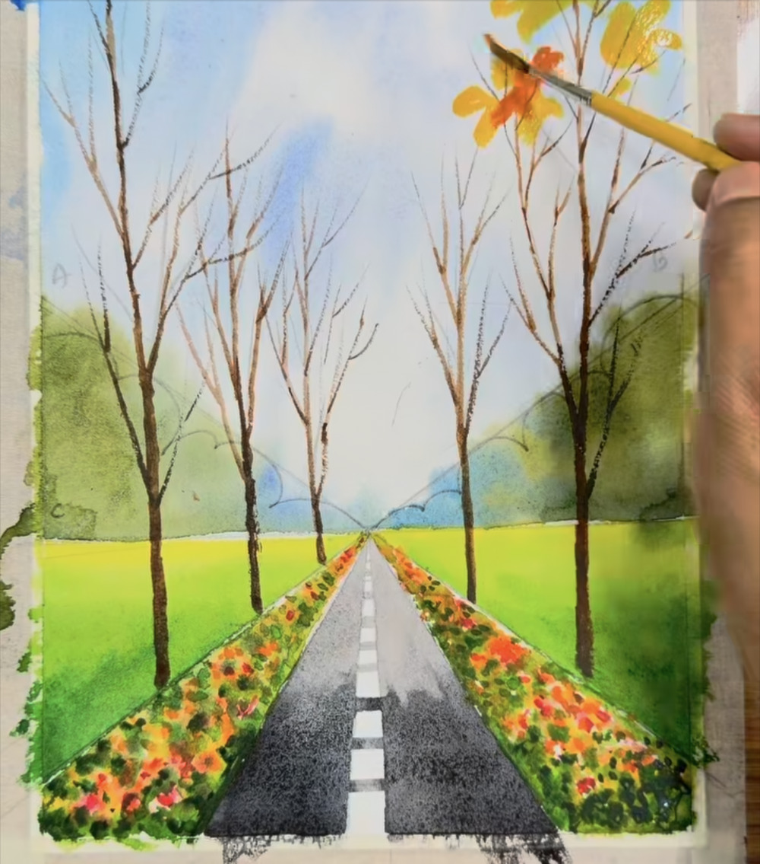
Build up the leaf clusters
STAGE 8 · AUTUMN LEAVES
STEP 30 OF 34
WHAT TO DO
Keep adding orange and yellow clusters along the upper branches.
Vary the size of the clusters.
WATCH FOR
Leave some sky showing between clusters so the tree stays airy.
COLORS IN THIS STEP
Orange
#E8853E
Golden yellow
#E1AE42
Notes:
Step 30 of 34. Source screenshot: IMG_4453.PNG. Stage: Autumn leaves.
What to do: Keep adding orange and yellow clusters along the upper branches. Vary the size of the clusters.
Watch for: Leave some sky showing between clusters so the tree stays airy.

Slide 36
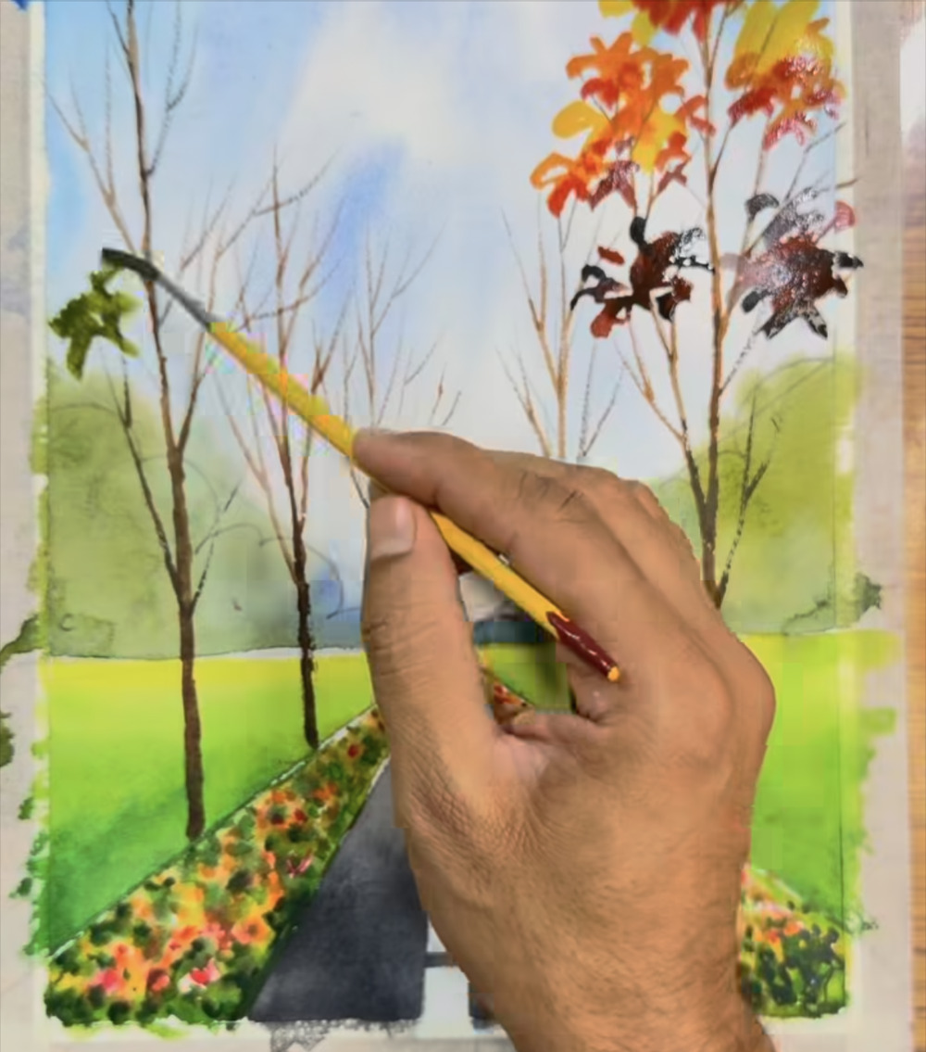
Add dark leaves, then green on the left
STAGE 8 · AUTUMN LEAVES
STEP 31 OF 34
WHAT TO DO
Dab a few maroon (dark red-brown) clusters among the orange on the right tree for contrast.
Switch to gray-green and start leaf clusters on the left-hand trees.
WATCH FOR
A few dark clusters make the bright oranges pop.
COLORS IN THIS STEP
Maroon
#4B3632
Gray-green
#555E44
Orange
#E8853E
Notes:
Step 31 of 34. Source screenshot: IMG_4454.PNG. Stage: Autumn leaves.
What to do: Dab a few maroon (dark red-brown) clusters among the orange on the right tree for contrast. Switch to gray-green and start leaf clusters on the left-hand trees.
Watch for: A few dark clusters make the bright oranges pop.

Slide 37
Finishing touches
STAGE 8 · AUTUMN LEAVES
STEP 32 OF 34
WHAT TO DO
Add gray-green and orange-red leaf clusters across the left and middle trees.
Add a thin dark line where the road meets the flower beds.
Once everything is dry, peel off any tape to reveal a clean white border (general tip).
WATCH FOR
The painting is now complete. The reel pulls back to show the whole sheet on the table.
COLORS IN THIS STEP
Gray-green
#555E44
Orange
#E8853E
Coral red
#E3665D
Notes:
Step 32 of 34. Source screenshot: IMG_4455.PNG. Stage: Autumn leaves.
What to do: Add gray-green and orange-red leaf clusters across the left and middle trees. Add a thin dark line where the road meets the flower beds. Once everything is dry, peel off any tape to reveal a clean white border (general tip).
Watch for: The painting is now complete. The reel pulls back to show the whole sheet on the table.

Slide 38
The finished painting
STAGE 9 · FINISHED PAINTING
STEP 33 OF 34
WHAT TO DO
Do all the lines meet at one vanishing point?
Is it pale in the sky and distance, and deep in color up front?
Do the left and right sides echo each other without matching exactly?
WATCH FOR
Use this view as your reference when you check your own painting.
FULL PALETTE ON SLIDE 5
Notes:
Step 33 of 34. Source screenshot: IMG_4456.PNG. Stage: Finished painting.
What to do: Do all the lines meet at one vanishing point? Is it pale in the sky and distance, and deep in color up front? Do the left and right sides echo each other without matching exactly?
Watch for: Use this view as your reference when you check your own painting.

Slide 39
Close-up details to study
STAGE 9 · FINISHED PAINTING
STEP 34 OF 34
WHAT TO DO
Flower beds: loose dabs of red, orange and yellow with dark green between them.
Road: even gray, with white dashes shrinking toward the vanishing point.
Trees: thin branches against the sky, with bright leaf clusters only at the tips.
WATCH FOR
Run your eye along the road edges. Every line aims at the same point.
FULL PALETTE ON SLIDE 5
Notes:
Step 34 of 34. Source screenshot: IMG_4457.PNG. Stage: Finished painting.
What to do: Flower beds: loose dabs of red, orange and yellow with dark green between them. Road: even gray, with white dashes shrinking toward the vanishing point. Trees: thin branches against the sky, with bright leaf clusters only at the tips.
Watch for: Run your eye along the road edges. Every line aims at the same point.

Slide 40
Tips for your first attempt
1
Practice the dabs first
2
Test every color on scrap paper
3
Keep the pencil light
Try the cloud dabs, flower dabs and leaf clusters on a scrap of paper before you commit to the painting.
Watercolor dries lighter than it looks wet. A quick swatch saves a lot of guessing.
Graphite shows through pale washes, and heavy lines are hard to erase once painted over.
4
Pause and let layers dry
5
Photograph each stage
6
Aim for the feel, not a copy
Wet-on-wet blends softly. Painting beside a wet area can blur edges you wanted crisp. Wait when in doubt.
Compare your photos with the step slides to catch problems early, like a vanishing point that has drifted.
Your dabs, clouds and leaves will not match the reel exactly, and they don't need to.
These are general watercolor tips, not statements from the reel.
Notes:
General beginner tips added by the guide author; they are not taken from the reel.

