Slide 1
THE AI RESET
RETHINKING LEADERSHIP,
STRUCTURE, IMPACT

Slide 2
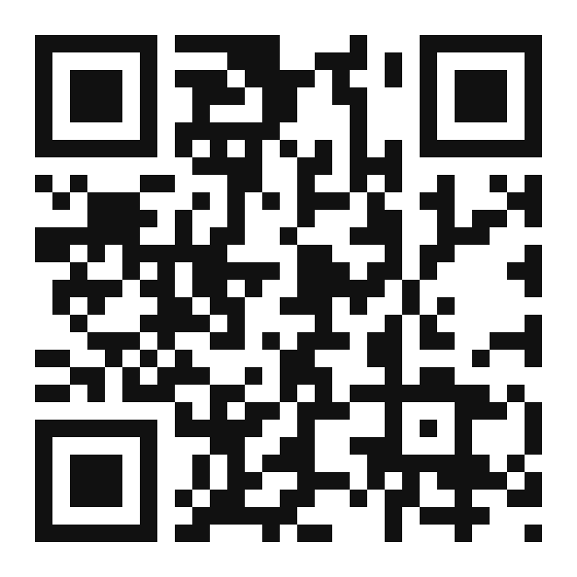
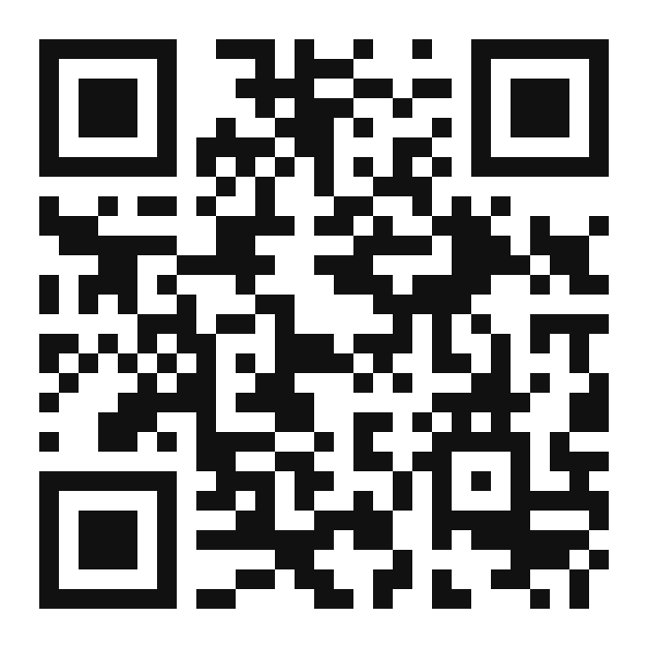
TOWN HALL | 1
JASON AVERBOOK
CO-FOUNDER, NOW TO NEXT
EMAIL jason@nowtonext.ai
LINKEDIN
SUBSTACK
linkedin.com/in/jasonaverbook
jasonaverbook.substack.com
A presentation by Jason Averbook in our Townhall session about aligning ourselves with AI in todays time

Slide 3
TOWN HALL | 2
EVERYONE IS
SOMEWHERE
NOW.
WE'RE NOT GOING
"BACK TO NORMAL."
WE'VE ENTERED THE
NEVER NORMAL.
WHERE ARE YOU
GOING NEXT?

Slide 4
TOWN HALL | 3
CONNECTED
≠
CONNECTION
A TECHNOLOGY STORY
A HUMAN STORY

Slide 5
TOWN HALL | 4
AN EXPONENTIAL
MOMENT
TIME TO REACH 100 MILLION USERS
Telephone
75 years
THE SCALE RIGHT NOW
Internet
7 years
800M
Instagram
2.5 years
weekly active ChatGPT users
TikTok
9 months
$315B
ChatGPT
2 months
OpenClaw
72 hours*
Big Tech AI investment (2025)

Slide 6
TOWN HALL | 5
THE COST OF DOING
IS GOING TO ZERO.
THE COST OF WAITING
IS GOING TO INFINITY.
SPEED IS THE STRATEGY.
NOW TO NEXT

Slide 7
TOWN HALL | 6
EVERY REVOLUTION RESETS EVERYTHING
1ST REVOLUTION
2ND REVOLUTION
3RD REVOLUTION
4TH REVOLUTION
1760s
1870s
1960s
NOW
STEAM
ELECTRICITY
COMPUTING
AI
Mechanized production,
factories, urbanization
Mass production, assembly lines,
global trade
Digital systems, automation,
the internet
Cognitive automation, agents,
intelligence on demand
The difference? Previous revolutions took decades to mature. This one moves at exponential speed.

Slide 8
TOWN HALL | 7
WE'RE TRYING TO SOLVE
2030 PROBLEMS WITH
2010 ORG CHARTS
AND 1990S THINKING.

Slide 9
TOWN HALL | 8
THE SIGNALS ARE EVERYWHERE
EDUCATION
WORK
PERSONAL LIFE
92% of students use AI tools: universities are rewriting curriculums in real time
Entry-level job postings down 35%: the way people start careers is shifting
Personal AI agents managing health, finances, and schedules: life is being redesigned
Degrees are being questioned: skills and adaptability matter more than credentials
Managers now oversee AI workflows alongside human teams: a completely new skill
Expectations are being set outside work: then carried into the office every day
Sources: HEPI Student AI Survey (2025); industry entry-level hiring data, 2025

Slide 10
TOWN HALL | 9
IT IS 2026 OUTSIDE OF WORK.
WHAT YEAR DOES IT FEEL LIKE INSIDE?
OUTSIDE OF WORK
INSIDE OF WORK
AI plans their travel, manages their health,
tutors their kids, runs their side projects
Same portals, same ticket queues, same
manual workflows they had five years ago
The future is already here.
The past is still running.

Slide 11
TOWN HALL | 10
THE FIVE WOUNDS OF CHANGE
01
FEAR OF REPLACEMENT
WHAT CHANGE
DOES TO
PEOPLE
02
LOSS OF MASTERY
03
DECISION FATIGUE
04
TRUST EROSION
Across hundreds of transformations, five patterns recur. Not predictions. Observations. What happens when technology lands on unprepared psychological ground.
05
IDENTITY DISRUPTION
NAME THEM, AND YOU CAN HEAL THEM.
SKIP THEM, AND THEY METASTASIZE.

Slide 12
TOWN HALL | 11
FEAR OF BECOMING OBSOLETE
FOBO

Slide 13
TOWN HALL | 12
2023
CURIOSITY
THE AI
CONVERSATION
HAS CHANGED
2024
EXPERIMENTATION
2025
CONSEQUENCES
2026
REALITY
UNCERTAINTY ISN'T A BUG IN THE SYSTEM.
IT'S THE RAW MATERIAL FOR OPPORTUNITY.

Slide 14
TOWN HALL | 13
MARCH 2025
WATCH THE CLIP
youtube.com/shorts/PSPLAS41aLI
@slow_developer
"But now getting to..."

Slide 15
TOWN HALL | 14
MARCH 2026
WATCH THE REEL
instagram.com/reel/DblkpJMSPtb

Slide 16
TOWN HALL | 15
COULD VS. SHOULD
COULD
SHOULD
CAPABILITY
JUDGMENT
What AI makes technically possible: automation, generation, scale. The frontier expands every month, faster than we can absorb it.
VS
What is actually worth doing: trust, values, consequences. Where we draw the line stays a human decision, not the model's.
Just because we can doesn't mean we should: capability is cheap, judgment is the job.

Slide 17
TOWN HALL | 16
THE RESET IS ALREADY HERE
EDUCATION
WORK
PERSONAL LIFE
30%
50%
56%
of 2025 grads secured a
full-time job in their field
decline in new grad hiring
at Big Tech since 2019
of 2025 seniors feel pessimistic
about their career
Down from 41% in 2024.
The career ladder's first
rung is disappearing.
Entry-level postings down 35%
since 2023. AI automates the
tasks juniors used to learn on.
52% of Class of 2023 were
underemployed a year
after graduation.
CNBC / Cengage
SignalFire / Revelio Labs
Handshake / Burning Glass
The bottom rung of career ladder is disappearing. The question is what replaces it.

Slide 18
TOWN HALL | 17
MOST
COMPANIES
TODAY
ARE HERE
★
"WE'VE REDESIGNED
WORK."
"WE KNOW
AI MATTERS."

Slide 19
TOWN HALL | 18
WE'RE NOT
AUTOMATING WORK.
WE'RE AUTOMATING
DYSFUNCTION.
NOW TO NEXT

Slide 20
TOWN HALL | 19
THE REAL
QUESTION IS NO
LONGER WHAT CAN
AI DO?
IT'S HOW DO WE
REDESIGN WORK
AROUND AI?
HUMAN + MACHINE

Slide 21
TOWN HALL | 20
THE FUTURE OF WORK IS NOT
HUMAN VS.
MACHINE
THE FUTURE OF WORK IS
HUMAN X
MACHINE

Slide 22
TOWN HALL | 21
AI DOESN'T REPLACE
HUMANS.
HUMANS WHO USE AI
REPLACE HUMANS
WHO DON'T.

Slide 23
TOWN HALL | 22
WORK MUST BE
DESIGNED ACROSS
HANDS, HEADS &
HEARTS

Slide 24
TOWN HALL | 23
HANDS, HEADS, HEARTS
FRAMEWORK
✎
🧠
♥
HANDS
HEADS
HEARTS
EXECUTION
AUTOMATE
THINKING
AUGMENT
PURPOSE
AMPLIFY
FOCUS NOT ON MVP... INSTEAD FOCUS on MLP: Most Lovable Proposition

Slide 25
TOWN HALL | 24
THE FOUR RESETS AI FORCES
MINDSET: From control to trust, from certainty to experimentation
HEARTSET: From compliance to co-creation, from fear to transparency
SKILLSET: From knowing answers to learning continuously
TOOLSET: From tools leading to humans leading (tools serve)
THE 4SET MODEL
MINDSET
HEARTSET
SKILLSET
TOOLSET

Slide 26
TOWN HALL | 25
MINDSET
SHIFT
OUTCOME
EXPERIMENTATION
ABUNDANCE

Slide 27
TOWN HALL | 26
5 MINDSET SHIFTS
CONTROL
→
TRUST
PROCESS
→
OUTCOME
CERTAINTY
→
EXPERIMENTATION
SCARCITY
→
ABUNDANCE
INDIVIDUAL EXPERTISE
→
COLLECTIVE INTELLIGENCE
THE OLD PLAYBOOK WON'T WORK IN A NEW WORLD

Slide 28
TOWN HALL | 27
HEARTSET
SHIFT
TRUST
TRANSPARENCY
CO-CREATION
COLLABORATION IN PROGRESS
NOW TO NEXT

Slide 29
TOWN HALL | 28
CHANGE ISN'T
THE ENEMY
IT'S THE STRATEGY
NOW TO NEXT

Slide 30
TOWN HALL | 29
THE MINDSET SHIFT · 2026+
Two mindsets for constant change
Episodic
Continuous
Top-down
Everyone's job
Time-boxed
CHANGE
MANAGEMENT
CHANGEFULNESS
Always-on
→
Run by a project team
Built into culture
Resistance to overcome
Never "done"
Organizations don't need better change programs: they need to become changeful.

Slide 31
TOWN HALL | 30
SKILLSET
SHIFT
PROMPTING IS NOT THE SKILL
THE SKILL IS WORKFLOW REDESIGN

Slide 32
TOWN HALL | 31
THE FEAR WE DON'T NAME
FOBO IS REAL
52%
37%
79%
of U.S. workers are worried about
AI's long-term career impact
of business leaders expect to
replace workers with AI by end of 2026
of people express low trust in
businesses to use AI responsibly
FOBO isn't a weakness. It's a signal. Leaders who acknowledge it earn trust. Leaders who dismiss it lose their people.

Slide 33
TOWN HALL | 32
THE KNOWLEDGE WORKER
Skills that make a knowledge
worker
essential in an AI-first world
01
02
03
Contextual judgment
Process fluency
Prompt craft & iteration
Know when to override the machine.
See how work really flows.
Refine, constrain, pressure-test.
04
05
06
Change translation
Data storytelling
Relationship-led influence
Turn shifts into language people adopt.
Make insight actionable, not just pretty.
Trust and influence AI can't replace.

Slide 34
TOWN HALL | 33
TOOLSET
SHIFT
TECHNOLOGY COMES LAST,
NOT FIRST

Slide 35
TOWN HALL | 34
TOOLSET: USE CASES
01
CONVERSATIONAL AI
EMPLOYEE SELF-SERVICE, POLICY Q&A, MANAGER COACHING
02
GENERATIVE AI
JOB DESCRIPTIONS, INTERNAL COMMS, TRAINING CONTENT
03
ANALYTICAL AI
WORKFORCE PLANNING, ATTRITION PREDICTION, ENGAGEMENT
04
APPLICATION AI
NO-CODE APPS, CHATBOTS, WORKFLOW AUTOMATION, INTERNAL TOOLS

Slide 36
TOWN HALL | 35
YESTERDAY
NOW
CHATBOT
AGENT
– You ask, it answers
– You delegate, it executes
– Single turn, no memory
– Persistent memory
– Generates text only
– Takes action across apps
– Lives in a browser tab
– Works autonomously 24/7
Every role becomes a manager of AI agents.

Slide 37
TOWN HALL | 36
AI CAN DRAFT
THE WORK.
THE LAST MILE
IS OURS.

Slide 38
TOWN HALL | 37
AI ISN'T COMING. IT'S HERE.
THE QUESTION ISN'T
WHETHER TO CHANGE.
IT'S WHERE YOU'RE
GOING NEXT,
AS AN ORGANIZATION
AND AS AN INDIVIDUAL.

Slide 39
TOWN HALL | 38
CONNECT ON
JASON AVERBOOK
LINKEDIN/SUBSTACK
CO-FOUNDER, NOW TO NEXT

