Slide 1
Prep work for podcast
“how can SpecKit be applied to legacy application”
Authors: Amit with Wai team

Slide 2
Planning for the conversation
Topic: how can SpecKit be applied to legacy application
Demonstrate one application with talking points
white-labelled experiment = git@github.com:amitrajpurkar/sprboot_api_cktBrkr.git
Sequence
Context/ background : xxx minutes
Where and how this experiment fits : xxx minutes
Journey of this experiment : xxx minutes
Summary and other observations : xxx minutes
Ending thoughts : xxx minutes

Slide 3
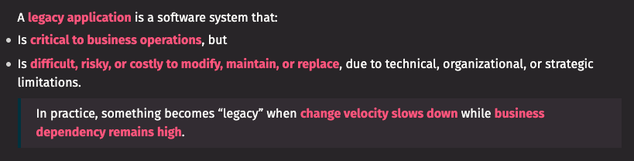
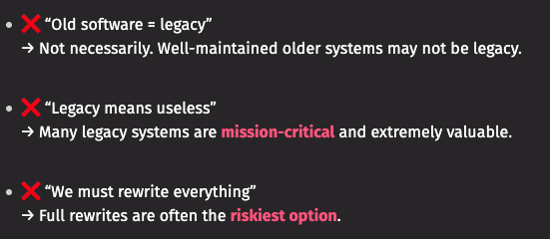
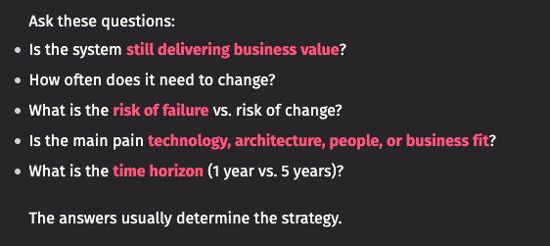
Context for Legacy Application
Qualities of Legacy application
Technical Characteristics: outdated tech, tight coupling, poor architecture/ design, low testability
Human factors: loss of institutional knowledge; skill scarcity
Operational Characteristics: high risk of change, costly maintenance
Business & Strategic factors: misaligned with current business needs, compliance/ security risks
Different ways to address Legacy application
Leave as is
Refactor/ Modernize
Re-platform
Rewrite/ Replace
Strangler pattern
Observation:
Investigate both code as well as business requirements; get latest business requirements; use AI to analyze -> document -> get specs; AI for wrap-around testing; tackle one feature at a time;
Estimate talk time: 3-5 minutes ?

Slide 4
Context for AI Code Assistants
AI does not replace a task; it augments and helps with automation; work is still done by the developer
Developer is responsible for the code generated by the AI Assistant based on prompts provided
Large number of Assistants are available; all are fairly similar; its a developers choice to pick one as per their style and need
These code assistants can provide in-line suggestions while the developer is writing code or they allow developers to chat with it allowing AI to write code.
SpecKit works with the chatbot option to generate the specifications; The developer along the way will need to use both styles of interaction with AI to reach the final outcome
Estimate talk time: 3-5 minutes ?

Slide 5
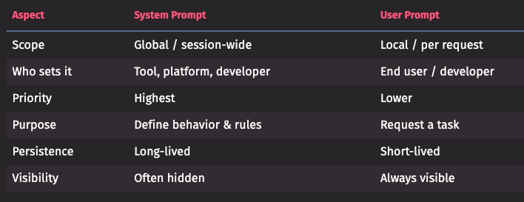
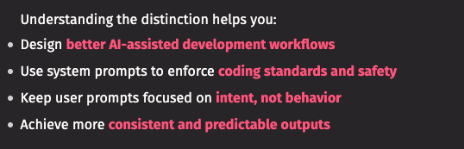
System prompt vs User prompt
System prompts establish how the AI Assistant should behave; provides global context, sets priorities; remains consistent across many user prompts
User prompts describe what task to perform right now, the context, inputs, constraints for that task
In a way, SpecKit helps provide system prompts in a stan
Estimate talk time: 3-5 minutes ?

Slide 6
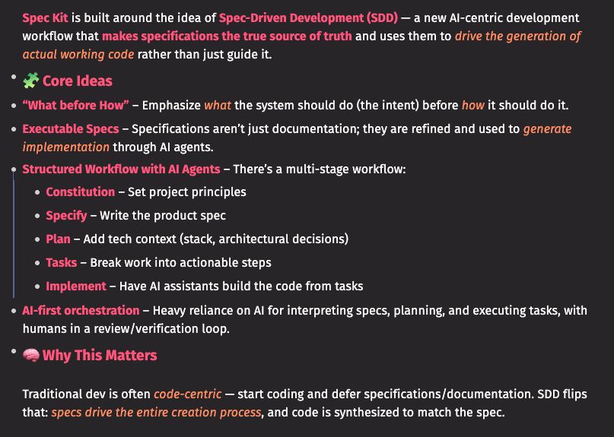
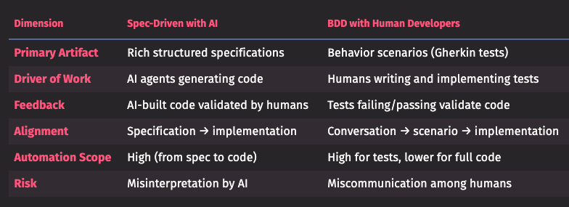
Context for SpecKit
SpecKit provides set of templates for AI Code Assistants (pull the latest).. use CLI to configure these templates for your Code Assistant or setup manually
Philosophy: document the specification, plan, tasks very well before making code changes
What this means for a developer: “document accurately before you code”
Estimate talk time: 3-5 minutes ?

Slide 7
About the Experiment
Migrating a sample application from old tech stack to new
Why is this app legacy? a working application written in 2017 on older tech stack; newer versions of Java, Gradle do not support that stack; one of the key libraries is no longer supported today; the app provides rest API which are expected to run 24/7 with a high transaction volume of up to 3,000 transactions per minute.
This experiment was started before I knew about SpecKit; hence it used AI Assistant following a plan and set sequence of instructions
Refactoring and modernization technique was used
Key points:
Initial app was developed by myself in 2017; so the entire codebase as well as business requirements were well known; this was not a black-box
Target tech stack after upgrade was also known before hand
Experiment was with sequencing instructions to the AI Assistant and testing each step of the way

Slide 8
Planning to work with AI
To-be-documented
How I planned/ broke-down migration effort into phases and steps for making changes
Sequencing and prioritization of the phases and steps
Making the AI analyze the current codebase itself and match its analysis with my own experience creating the original app
Getting the ground ready to let AI start making changes

Slide 9
Glimpse of First Analysis
To-be-documented

Slide 10
Journey of changes
To-be-documented

Slide 11
Arrive at API working with new stack
To-be-documented

Slide 12
Increase testability
To-be-documented

Slide 13
Adding new feature
To-be-documented
This app was not having a client for the API — either a web-frontend or a CLI

Slide 14
Adding documentation for the app

Slide 15
Summarizing the study using Mkdocs
To-be-documented

Slide 16
Old advice is still relevant
“Working effectively with Legacy Code” by Michael Feathers (2004)
First add tests and then do your changes
Identify places to alter program behavior without changing code (“seams”)
Create tests that characterizes behavior of the piece of code
Use sprout and wrap techniques
Sprout: create code in separate module/ package; test it; identify insertion point; call it from legacy code
Wrap: rename old method you want to wrap; create a new method with same signature as old; call old method from new; put logic before & after call; like AOP

Slide 17
From other developers
Provide references to what other developers are researching
To-be-documented
https://martinfowler.com/articles/legacy-modernization-gen-ai.html
https://www.thoughtworks.com/en-in/insights/podcasts/technology-podcasts/using-generative-ai-legacy-modernization

