Slide 1
Introduction to Natural Language Processing (NLP)
UCSC Course DBDA.X418.(15)
Week #2 (Hour 3) 02/28/2020
N-grams, skip-grams, and sense2vec
Oswald Campesato
ocampesato@yahoo.com

Slide 2
List of Topics
Text Classification Algorithms
Evaluating Classifiers
What are skip grams?
What are n-grams?
What is word2vec?
What is sense2vec?
Code Samples

Slide 3
Text Classification Algorithms
Multinomial Naïve Bayes (multi-class classification)
Logistic Regression (sklearn supports multi-label)
SVMs (Support Vector Machines)
Random Forests (ensemble method)
GBM: Gradient Boosting Machine (ensemble method)

Slide 4
Evaluating Classifiers: Confusion Matrix
1) Precision and Recall
Type I error = FP and Type II error = FN
Pos | Neg
--------------
Pos |TP | FP
Neg |FP | TN
Accuracy = % of correct predictions
= (TP + TN) / total cases
Recall = % of correctly identified positive cases
= (TP / (TP + TN)
Precision = % of correct positive predictions
= (TP / (TP + FP)

Slide 5
Evaluating Classifiers
2) ROC curve ( Receiver Operating Characteristics):
ROC curve is used for visual comparison of classification models which shows the trade-off between the true positive rate and the false positive rate
The area under the ROC curve is a measure of the accuracy of the model
Models closer to the diagonal are less accurate and the models with perfect accuracy will have an area of 1.0
x-axis: FP and y-axis: TP

Slide 6
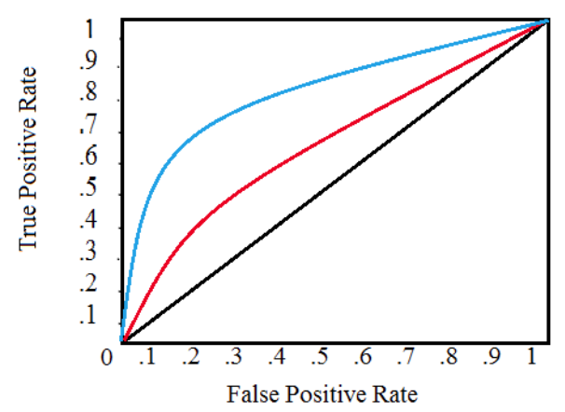
Evaluating Classifiers

Slide 7
What are N-grams?
A technique for creating a vocabulary
“groups” N adjacent words together
Hence it retains some word positions
The value of “n” specifies the size of the group
=> n-gram can be used with characters

Slide 8
What are N-grams?
EX #1: “This is a sentence” has 2-grams (bi-grams):
(this, is), (is, a), (a, sentence)
EX #2: “This is a sentence” has 3-grams (tri-grams):
(this, is, a), (is, a, sentence)
EX #3: "The cat sat on the mat” has 3-grams:
"The cat sat"
"cat sat on"
"sat on the"
"on the mat"

Slide 9
What are N-grams?
items in n-grams can be any of the following:
phonemes
syllables
letters
words/base pairs according to the app
n-grams typically are from a text or speech corpus
when items are words, n-grams may be called shingles

Slide 10
How are N-grams Used?
N-grams are fed into the Word2Vec context prediction system (=NN)
Example: input word is "cat" :
Word2Vec tries to predict the context ("the", "sat") from this supplied input word
The Word2Vec system moves through all the supplied grams and input words
and attempts to learn appropriate mapping vectors (embeddings) that produce high probabilities for the right context given the input words

Slide 11
Skip-gram and CBoW
Skip-gram: given a target word, estimate the probability of other words appearing close to that word
CBow: given some context words as input, find the single target word that has the highest probability of fitting that context
skip-gram and CBoW are 2 implementations of word2vec

Slide 12
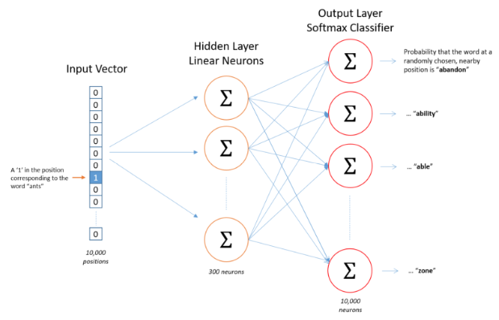
Skip-gram Neural Network

Slide 13
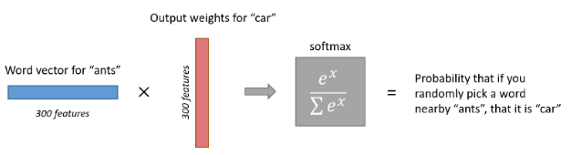
Skip-gram Neural Network

Slide 14
Skip-gram Neural Network
no activation function on the hidden layer neurons
the hidden layer weight matrix has 10,000 rows: one for each word in our vocabulary) and 300 columns (one for every hidden neuron)
the output layer uses softmax

Slide 15
Skip-gram Algorithm
Treat the target word and a neighboring context word as positive examples
Randomly sample other words in the lexicon to get negative samples
Use logistic regression to train a classifier to distinguish those two cases
Use the weights as the embeddings

Slide 16
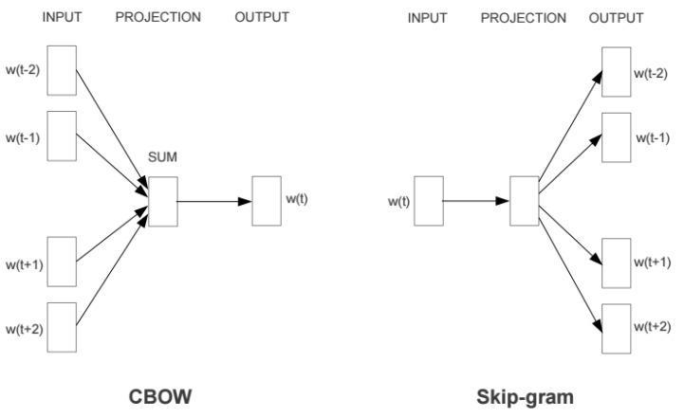
CBOW vs Skip-gram

Slide 17
What is sense2vec?
a Fast and Accurate Method
for Word Sense Disambiguation
in Neural Word Embeddings
gensim and TensorBoard:
https://github.com/ArdalanM/gensim2tensorboard

Slide 18
Distributed Representation
Suppose a vector has 1000 dimensions
Each word has a distribution of “partial” weights
NOT a 1-1 mapping from elements to words
the representation of a word is spread across all of the elements in the vector
each vector element contributes to the definition of many words

Slide 19
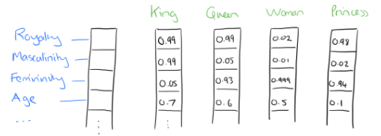
Distributed Representation

Slide 20
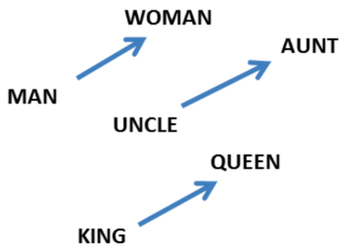
Vectors and Gender

Slide 21
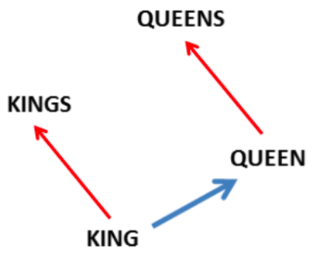
Vectors and Plurals

Slide 22
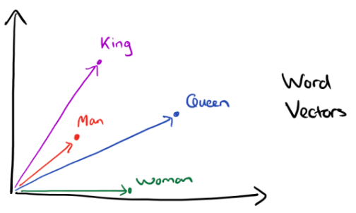
Multiple Vectors

Slide 23
Skip-gram/Word2Vec Links
https://towardsdatascience.com/word2vec-skip-gram-model-part-1-intuition-78614e4d6e0b
https://towardsdatascience.com/word2vec-skip-gram-model-part-2-implementation-in-tf-7efdf6f58a27
https://www.geeksforgeeks.org/implement-your-own-word2vecskip-gram-model-in-python/
https://github.com/mchablani/deep-learning
https://github.com/mchablani/deep-learning/blob/master/embeddings/Skip-Gram_word2vec.ipynb

Slide 24
Keras Code Samples
generate-ngrams.py
keras-skip-gram.py
keras-skip-gram2.py
nltk-ngrams.py

