Slide 1
Store Sales Prediction
Amit Ranajn Sahoo

Slide 2
Problem Statement
Nowadays, shopping malls and Big Marts keep track of individual item sales data in
order to forecast future client demand and adjust inventory management. In a data
warehouse, these data stores hold a significant amount of consumer information and particular item details. By mining the data store from the data warehouse, more anomalies and common patterns can be discovered.

Slide 3
Attribute Description
Item_Identifier: Unique product ID
Item_Weight: Weight of product
Item_Fat_Content: Whether the product is low fat or not
Item_Visibility: The % of total display area of all products in a store allocated to the
particular product
Item_Type: The category to which the product belongs
Item_MRP: Maximum Retail Price (list price) of the product
Outlet_Identifier: Unique store ID
Outlet_Establishment_Year: The year in which store was established
Outlet_Size: The size of the store in terms of ground area covered
Outlet_Location_Type: The type of city in which the store is located
Outlet_Type: Whether the outlet is just a grocery store or some sort of supermarket
Item_Outlet_Sales: Sales of the product in the particular store. This is the outcome
variable to be predicted.

Slide 4
Objective
We have to build a solution that should able to predict the sales of the
different stores of Big Mart according to the provided dataset.

Slide 5
Data sharing Agreement
Sample file name (ex- Store_Sales_Prediction_20220607_203015.csv)
Length of date stamp(8 digits)
Length of time stamp(6 digits)
Number of Columns(11)
Column names
Column data type

Slide 6
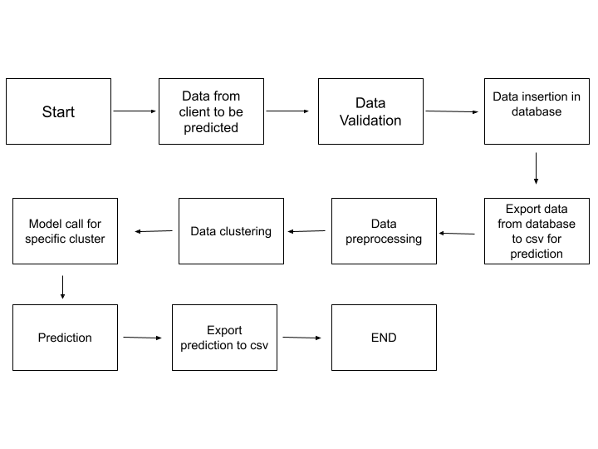
Architecture

Slide 7
Prediction Data Validation
In this step, we perform different sets of validation on the given set of prediction files.
1. Name Validation- We validate the name of the files based on the given name in the schema file. We have created a regex pattern as per the name given in the schema file to use for validation. After validating the pattern in the name, we check for the length of date in the file name as well as the length of time in the file name. If all the values are as per requirement, we move such files to "Good_Raw" else we move such files to "Bad_Raw"
2. Number of Columns - We validate the number of columns present in the files, and if it doesn't match with the value given in the schema file, then the file is moved to "Bad_Raw."
3. Name of Columns - The name of the columns is validated and should be the same as given in the schema file. If not, then the file is moved to "Bad_Raw".
4. The datatype of columns - The datatype of columns is given in the schema file. This is validated when we insert the files into Database. If the datatype is wrong, then the file is moved to "Bad_Raw".
5. Null values in columns - If any of the columns in a file have all the values as NULL or missing, we discard such a file and move it to "Bad_Raw".

Slide 8
Prediction Data Insertion in Database
1) Database Creation and connection - Create database with the given name passed. If the database is already created, open the connection to the database.
2) Collection creation in the database - Collection with name - "Good_Raw_Data", is created in the database for inserting the files in the "Good_Raw" on the basis of given column names and data type in the schema file. If collection is already present then the collection is deleted and new collection is created.
3) Insertion of files in the collection - All the files in the "Good_Raw" are inserted in the above-created table. If any file has invalid data type in any of the columns, the file is not loaded in the table and is moved to "Bad_Raw".

Slide 9
Prediction
1) Data Export from Db - The data in the stored database is exported as a CSV file to be used for prediction.
2) Data Preprocessing
a) Drop columns not useful for training the model. Such columns were selected while doing the EDA.
b) Encode the categorical values
c) Check for null values in the columns. If present, impute the null values using the KNN imputer.
3) Clustering - KMeans model created during training is loaded, and clusters for the preprocessed prediction data is predicted.
4) Prediction - Based on the cluster number, the respective model is loaded and is used to predict the data for that cluster.
5) Once the prediction is made for all the clusters, a zip file containing prediction(csv file) and bad files are sent to client.

Slide 10
Q & A
Q1) What’s the source of data?
The data for training is provided by the client in multiple batches and each batch contain multiple files
Q 2) What was the type of data?
The data was the combination of numerical and Categorical values.
Q 3) What’s the complete flow you followed in this Project?
Refer slide 6th for better Understanding
Q 4) After the File validation what you do with incompatible file or files which didn’t pass the validation?
Files like these are moved to the Archive Folder and a list of these files has been
shared with the client and we removed the bad data folder.

Slide 11
Q 5) How logs are managed?
We are using different logs as per the steps that we follow in validation and modeling like File validation log , Data Insertion ,Model Training log , prediction log etc.
Q 6) What techniques were you using for data pre-processing?
i.Removing unwanted attributes
ii.Visualizing relation of independent variables with each other and output variables
iii.Checking and changing Distribution of continuous values
iv.Cleaning data and imputing if null values are present.
v.Converting categorical data into numeric values.

Slide 12
Q 7) How training was done or what models were used?
i.Before diving the data in training and validation set we performed clustering over fit to divide the data into Clusters.
ii.As per cluster the training and validation data were divided.
iii.The scaling was performed over training and validation data
iv.Algorithms like RandomForest , XGBoost were used based on the r2_score
final model was used for each cluster and we saved that model .
Q 8) How Prediction was done?
The testing files are shared by the client .We Perform the same life cycle till the
data is clustered .Then on the basis of cluster number model is loaded and
perform prediction. In the end we get the accumulated data of predictions.

Slide 13
The End

