Slide 1
Amazon Sales Data Analysis

Slide 2
Introduction
Data analysis is a powerful tool for businesses and individuals to gain insights and make informed decisions.
This project is aimed to focuses on Amazon's vast sales data to uncover hidden patterns, explore factors driving its success, and identify potential strategies for global market leadership

Slide 3
Details of Data
From year 2010 to 2017:
Total Profit 44168198.4$
Total Cost 93180569.91$
Total Revenue 137348768.3$
Total Sales 137348768.3$
Minimum Sale in year - 2011
Maximum Sale in year - 2012
Regions of Sale - Asia, Australia and Oceania, Central America and the Caribbean, Europe, Middle East and North Africa, North America,
Sub-Saharan Africa.

Slide 4
Main KPIs
RWS - Region Wise Sales
IWS - Item Wise Sales
CWS- Country Wise Sales
Yearly_month Sales - Sales in each month of year from 2010-2017

Slide 5
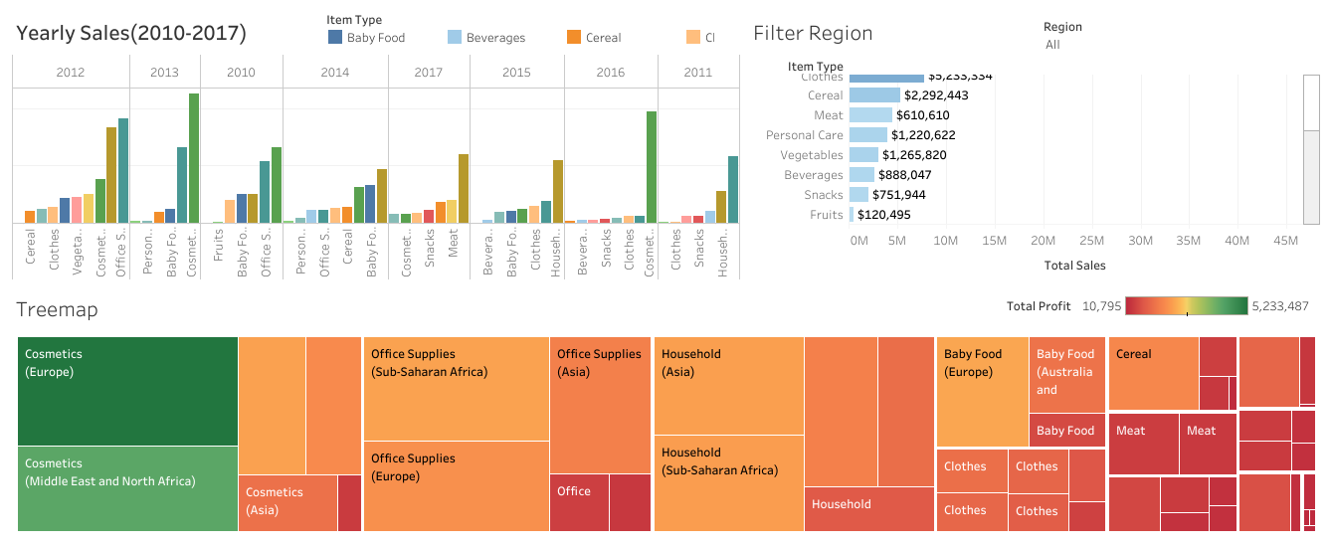
Mock–up Dashboard

Slide 6
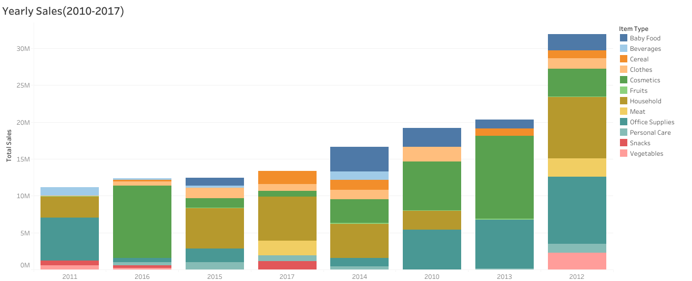
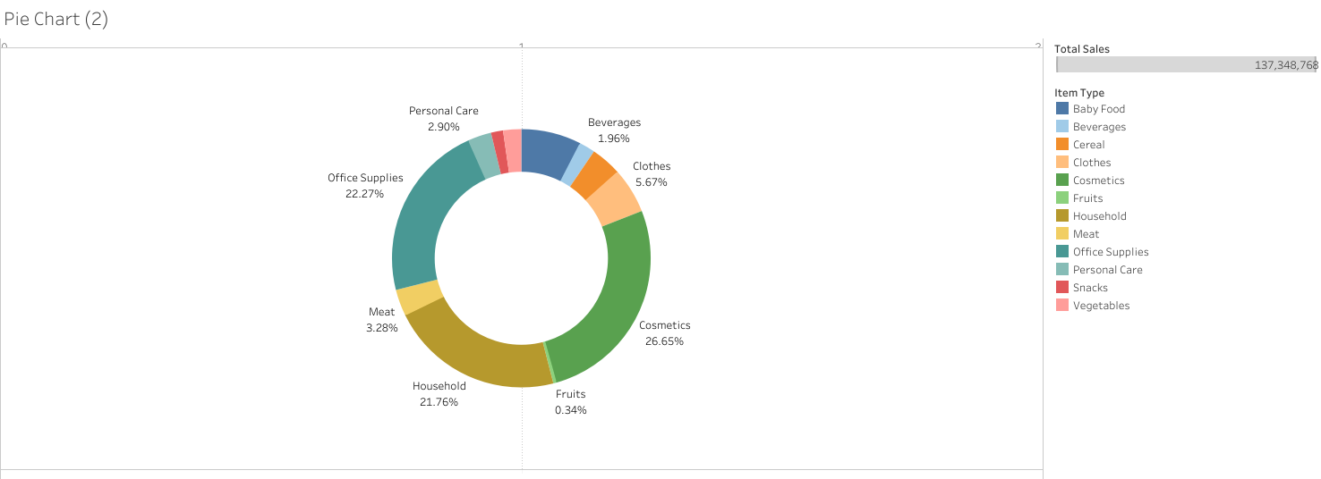
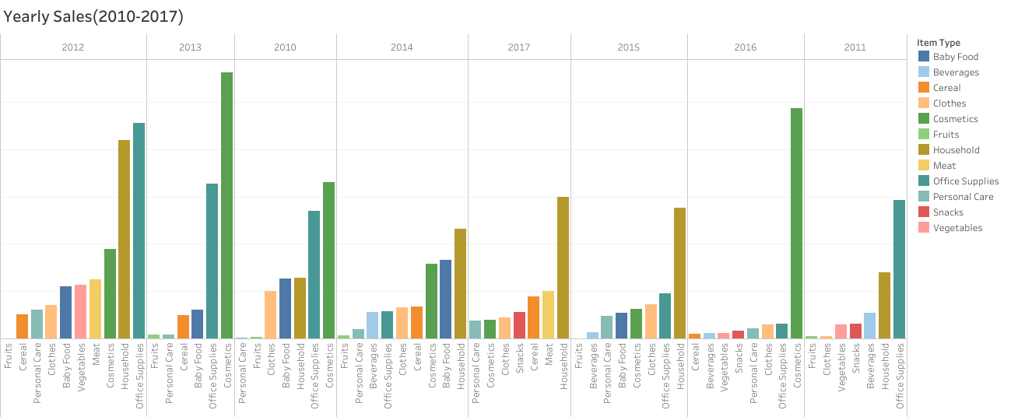
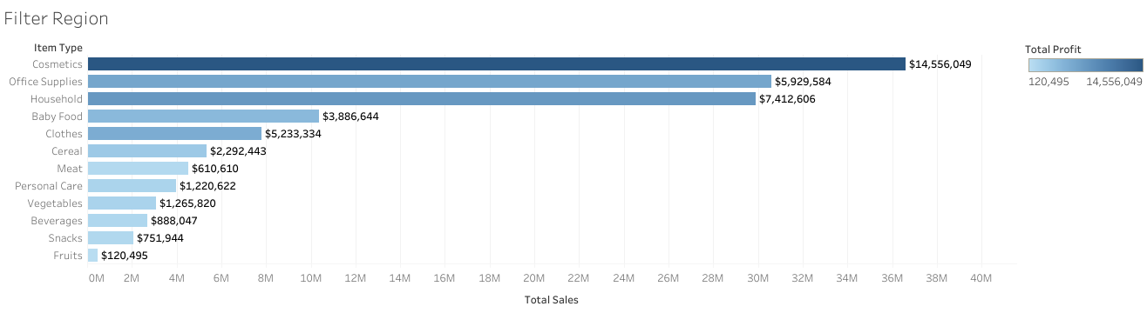
My Design

Slide 7
Tableau Link
https://public.tableau.com/views/AmazonDataSalesFinancialResult/AmazonDataSalesFinancialResult?:language=en-US&:display_count=n&:origin=viz_share_link

Slide 8
Thank you

