Slide 1
Employee Attrition Analysis

Slide 2
Introduction
Employee attrition, also known as employee turnover or employee churn, refers to the rate at which employees voluntarily leave an organization over a specific period.
Attrition can occur due to various reasons, including voluntary reasons such as employees seeking better opportunities, personal reasons, or retirement, as well as involuntary reasons such as terminations or layoffs.
In today's dynamic and competitive job market, managing and reducing employee attrition has become a top priority for businesses across industries. High attrition rates can result in numerous negative consequences for an organization

Slide 3
Details of the data
Total man - 882
Total Woman - 588
Attrition - 273
Married - 673
Single - 470
Divorced - 327
Job role- Laboratory Technician, Sales executive, Research scientist, sales representative, Human resource, manufacturing director, Healthcare representative, Manager, Research director

Slide 4
Main KPIs
Average attrition attrition count
Average Monthly Income
Average Age
Average working years
Average years at company

Slide 5
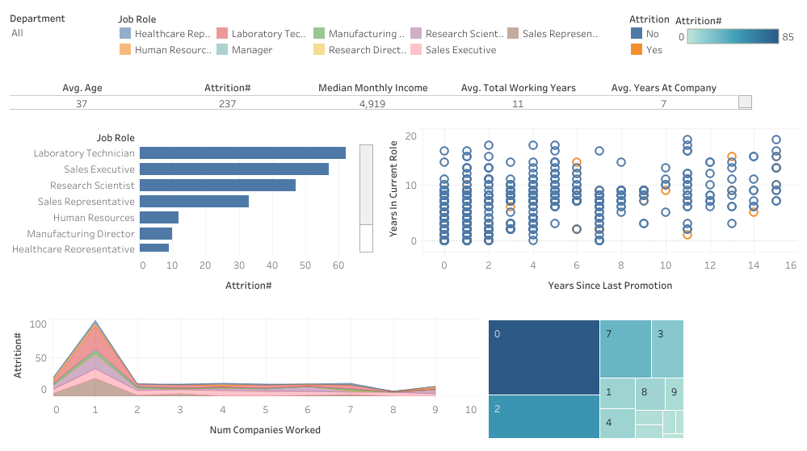
Mock–up Dashboard
t

Slide 6
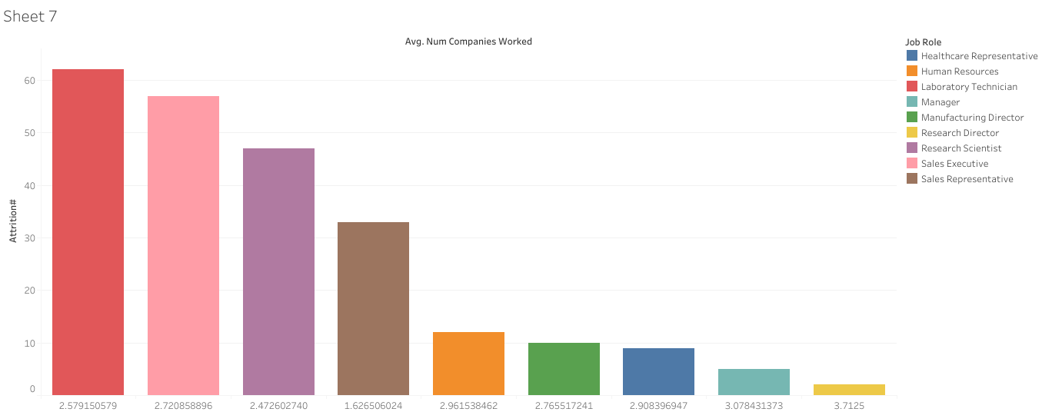
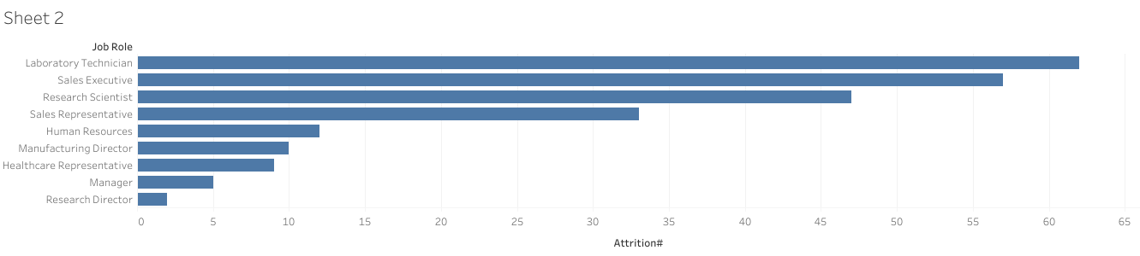
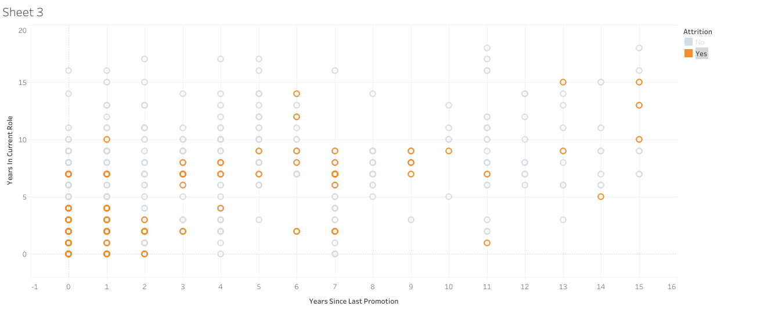
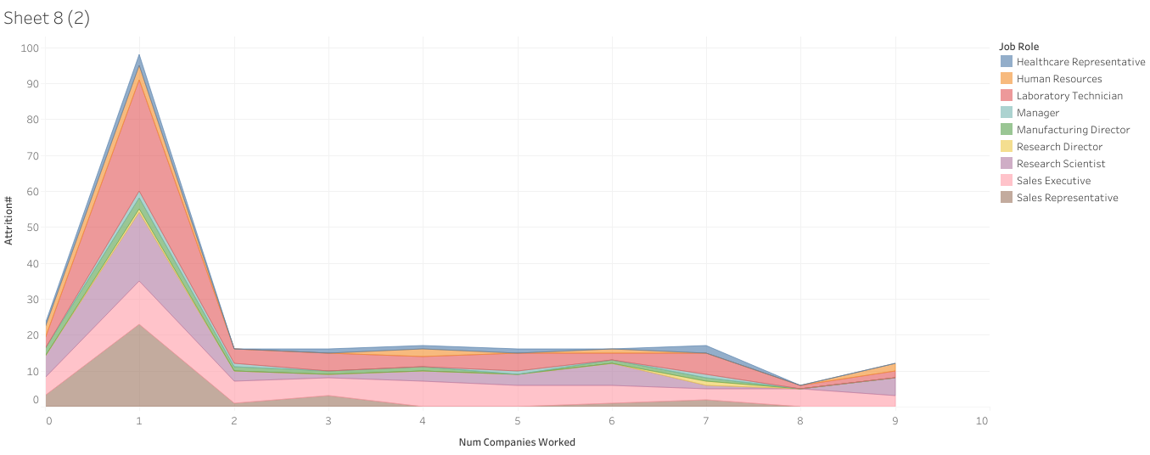
My design

Slide 7
Tableau Link
https://public.tableau.com/views/Dashboard_greendestination/Dashboard1?:language=en-US&:display_count=n&:origin=viz_share_link

Slide 8
Thank You

