Slide 1
The New Modern Application Platform Session 7: Helm Automation and Operators
“Bridging the growing chasm between developers and infra engineering”
Amit Rathod
June 2021

Slide 2
Today’s Class
What is Helm?
Helm basics
Operators
Helm Operators

Slide 3
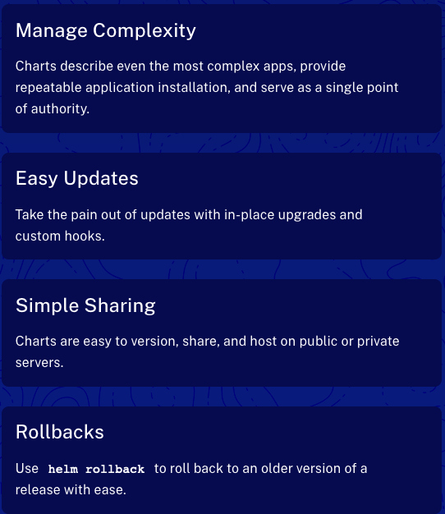
What is Helm?
Helm is THE Package Manager for Kubernetes
Helm helps you manage Kubernetes applications — Helm Charts help you define, install, and upgrade even the most complex Kubernetes application.
Charts are easy to create, version, share, and publish — so start using Helm and stop the copy-and-paste.
Helm is a graduated project in the CNCF and is maintained by the Helm community.
Notes:
https://helm.sh/
Compare helm vs deploying an application via yaml
Reference bitnami which uses helm charts

Slide 4
Helm Install and Demo
Quick demo to show you what it can do
Requires a Kubernetes cluster and kubectl (it installs on the currently configured Kube Config). Works with KinD!
Mac install: brew install helm
Add a repo using:
helm repo add bitnami https://charts.bitnami.com/bitnami
helm repo list
Search a repo using:
helm search repo kubeapps
Create the ns kubeapps and then Install a new application called as kubeapps, kubectl create ns kubeapps
helm install kubeapps --namespace kubeapps bitnami/kubeapps
Show possible values of postres chart
helm show values kubeapps
Always recommended to have an updated repo , update using
helm update repo
Notes:
https://helm.sh/docs/intro/quickstart/
https://helm.sh/docs/intro/install/

Slide 5
Helm Concepts
Chart / Repository / Release
A Chart is a Helm package. It contains all of the resource definitions necessary to run an application, tool, or service inside of a Kubernetes cluster.
A Repository is the place where charts can be collected and shared.
A Release is an instance of a chart running in a Kubernetes cluster. One chart can often be installed many times into the same cluster. And each time it is installed, a new release is created.
Notes:
https://helm.sh/docs/intro/using_helm/

Slide 6
Creating Helm Charts
Use to demonstrate Chart components
Create a default helm chart
helm create mySample
The “charts” folder is used for sub-charts
Review Chart.yaml
Name and Version are important!
Review values.yaml
Note the values that are set – especially “replicaCount”
The “templates” folder holds the yaml code to deploy the chart
Look at the deployment.yaml
Note the replicaCount substitution
Note the “includes” that are defined in _helpers.tpl
Note the “if” statement in ingress.yaml
Note the NOTES.txt which is what is displayed during the helm install
Notes:
https://helm.sh/docs/intro/using_helm/

Slide 7
Helm Chart Library
https://artifacthub.io/
Find the Velero chart
Note the Install methods
Visit the readme.md link to go to: https://github.com/vmware-tanzu/helm-charts#kubernetes-helm-charts-for-vmware-tanzu
Visit the values.yaml file here: https://github.com/vmware-tanzu/helm-charts/blob/main/charts/velero/values.yaml
Note that helm charts may exist outside of the Chart Library. i.e. https://istio.io/latest/docs/setup/install/helm/
Notes:
https://artifacthub.io/

Slide 8
Operators
What is a Kubernetes Operator?
coreOS introduced Operators in 2016 to extend Kubernetes’ capabilities to stateful applications.
The Operator Framework: https://github.com/operator-framework
What is a Kubernetes Operator?
- Used for managing stateful applications such as databases
Provides consistent pre and post provisioning steps in application deployment
Operators ”automate”” applications
Updates
Failure recovery
Scaling Up/Down
Operators wrap the logic for deploying and operating an application using Kubernetes constructs
Combine the creation of stateful sets, replicasets, services, deployments into an “Operator”
Operators provide a consistent and repeatable way of deploying a complex application
Notes:
https://enterprisersproject.com/article/2019/2/kubernetes-operators-plain-English
Example of mongo pod initialization or connection to MongoDB enterprise services

Slide 9
Operator Repo
https://operatorhub.io/
Use Istio Operator for an example: https://operatorhub.io/operator/istio
14 helm subcharts
50+ CRDs
Without the operator, what is the proper upgrade order?
Istio Operator documentation: https://github.com/banzaicloud/istio-operator/blob/release-1.1/README.md
Note the helm install method – one command
Upgrading with the Istio Operator: https://github.com/banzaicloud/istio-operator/blob/release-1.1/docs/upgrade.md
Deploy a version of the operator which supports Istio 1.1.x
Apply a Custom Resource using Istio 1.1.14 components
What happens is that once the operator discerns that the Custom Resource it's watching has changed, it reconciles all Istio-related components in order to perform a control plane upgrade.
Notes:
https://enterprisersproject.com/article/2019/2/kubernetes-operators-plain-English
Example of mongo pod initialization or connection to MongoDB enterprise services

Slide 10
Prometheus Operator Demo
https://github.com/prometheus-operator/kube-prometheus
Prometheus is the vROPs of the K8s world.
This demo installs:
Prometheus Operator
Prometheus
Alertmanager
Prometheus node-exporter
Prometheus Adapter for Kubernetes Metrics APIs
Kube-state-metrics
Grafana
Note the new ”kind” of prometheus and alertmanager
Notes:
https://enterprisersproject.com/article/2019/2/kubernetes-operators-plain-English
Example of mongo pod initialization or connection to MongoDB enterprise services

