Slide 1
Grails Services

Slide 2
Agenda
What are Services?
Where Services fit in MVC?
Role of Service Layer
How to use Services?
What happens behind the scenes?
Transactional Behaviour

Slide 3
Services
A service is a class that holds one or more methods that implement business logic.
Logically connected parts of a business logic are contained in one service.
Services are demarcated by transactions to make units of work atomic on the persistence level(like Databases).
All services are transactional by default.

Slide 4
Where Service fits in MVC
View = GSPs
Controllers = Grails Controllers
Model = Domain Only?
Model = Domain + Service

Slide 5
Role of Service Layer
Ideally, all the business logic should be written in this layer.
Logic that requires transactional behavior
Use cases which operate on multiple domain classes
Certain use cases are best encapsulated outside a domain class

Slide 6
How to create Services
grails create-service pkg.simple
It will create a service at the location grails-app/services/pkg/SimpleService.groovy
A service's name ends with the convention Service
class SimpleService {
}

Slide 7
Using Services in Controllers
Grails services can be injected by name into a controller.
class SimpleController {
def simpleService
...
}

Slide 8
Using a Service in another
Services can be injected into another service.
class AnotherService {
def simpleService
}

Slide 9
Using Services in Domain
Services can be even inject into domain classes.
class Book {
…
def bookService
def buyBook() {
bookService.buyBook(this)
}
}

Slide 10
Spring Beans
A bean is an object that is instantiated, assembled, and otherwise managed by a Spring IoC container.
These beans are created with the configuration metadata that you supply to the container.
Container refers to Spring Container which acts as a Factory Of Beans that means it supplies beans.

Slide 11
Creating Custom Beans
We can create a bean in grails in resources.groovy
customBean(com.as.CustomBean) {
name = “Ram”
}
We can inject it like
def customBean

Slide 12
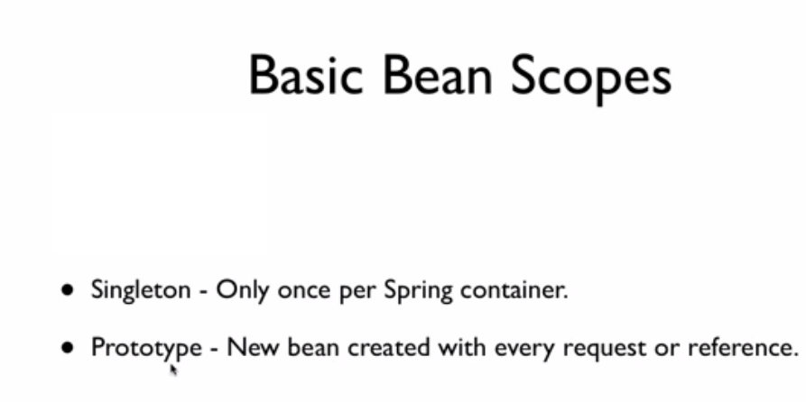
Bean Scopes

Slide 13
Bean Scopes ctd.
Singleton:
customBean(com.demo.CustomBean) { bean ->
bean.scope = 'singleton'
name = "Ram"
}
Prototype:
customBean(com.demo.CustomBean) { bean ->
bean.scope = 'prototype'
name = "Ram"
}
By default the scope is singleton. If the scope of a bean is singleton then that bean defined is going to be initialized at the time when application Context is initialized or when the spring container is loaded. In prototype if there are different beans that are referring the same bean through ref, then also a new bean will be created for each of them.

Slide 14
@Autowired
It does autowiring by type.
@Autowired Looks for type and if it finds that there is only one bean corresponding to that type it is going to autowire it even if the bean id is different from the name of dependency.
If there are multiple of the same type its going to look at the name If it finds whose bean id is same as the name of the property its going to autowire.
Otherwise it will through an exception.

Slide 15
Behind The scenes In Grails
Dependency Injection : It is a way in which you decouple dependency relationship between objects so that they are not tied to each other.
Autowiring: The Spring container can autowire relationships between collaborating beans without using <constructor-arg> and <property> elements .
byName Autowiring by property name. Spring container looks at the properties of the beans on which autowire attribute is set to byName . It then tries to match and wire its properties with the beans defined by the same names in the configuration file.
Singleton classes

Slide 16
Dependency Injection
Spring has a concept called autowiring
Dependencies are injected based on name or type
By default grails supports autowiring by name
Any spring bean in a grails application can be accessed

Slide 17
Singleton Classes
Only one instance of a service class exists
This can be overridden using
static scope = 'prototype'

Slide 18
Transactions
Atomicity
Consistency
Isolation
Durability
If an exception occurs, the events that occurred before should be rolled back

Slide 19
Declarative Transactions In Services
All services have transaction demarcation enabled by default
class SimpleService {
static transactional = true
}
To disable it, simply set the transactional property to false.
The result is that all methods are wrapped in a transaction and automatic rollback occurs if a method throws a runtime exception (i.e. one that extends RuntimeException) or an Error.
The propagation level of the transaction is by default set to PROPAGATION_REQUIRED.

Slide 20
Services and Util classes. Difference?
Service
Contain Business logic.
CreateUser() will be a method in Service
Util Classes
Type of reusable component. Provides some boiler plate work that has no
business domain meaning. Coverting userDob to certain format will be a util class.

Slide 21
Clean Code
Do all the manipulations using methods of services rather than in action itself.
Write business logic in Services.
Pass the the object rather than the whole params
Good:
List<User> filterUsers(UserSearchCO userSearchCO)
Bad:
List<User> filterUsers(Map params)

Slide 22
Clean Code ctd.
if your application need to do bootstrap it should be done by bootstrap service.
Most suitable for transactional methods (Try to make non transactional methods in domain class)
Git Repo: git@github.com:RichaIntelligrape/ServiceDemo.git

Slide 23
Questions??

