Slide 1
🏦 Bankruptcy Prediction Using Machine Learning
A Machine Learning Approach for Financial Risk Prediction
By: Amit Choudhury | Organization: EXCELR | Course: Data Scientist

Slide 2
CONTENTS
Problem Statement & Objective Page - 03
Exploratory Data Analysis (EDA) Page – 04 To 08
Model Building Page – 09 To 16
Model Comparison Page – 17
Model Evaluation Page – 18
Model Interpretation Page – 19
Streamlit Dashboard Demo Page – 20
Final Conclusion Page – 21
Future Scope Page – 22

Slide 3
Problem Statement & Objective
Predict whether a company will go bankrupt using financial risk indicators.
Provide interpretable predictions to support financial decision-making.
The goal here is to model the probability that a business goes bankrupt from different features.
The data file contains 7 features about 250 companies The data set includes the following variables:
1.Industrial_risk: 0=low risk, 0.5=medium risk, 1=high risk.
2.Management_risk: 0=low risk, 0.5=medium risk, 1=high risk.
3. Financial flexibility: 0=low flexibility, 0.5=medium flexibility, 1=high flexibility.
4.Credibility: 0=low credibility, 0.5=medium credibility, 1=high credibility.
5.Competitiveness: 0=low competitiveness, 0.5=medium competitiveness, 1=high competitiveness.
6.Operating_risk: 0=low risk, 0.5=medium risk, 1=high risk.
7.Class: bankruptcy , non-bankruptcy (target variable).

Slide 4
Exploratory Data Analysis (EDA)

Slide 5
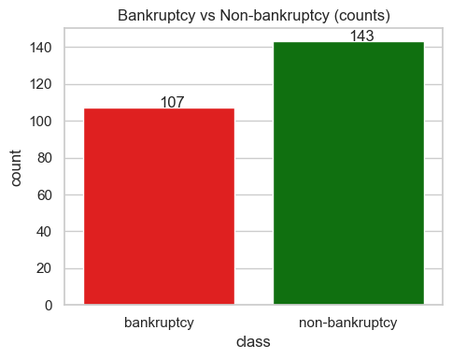
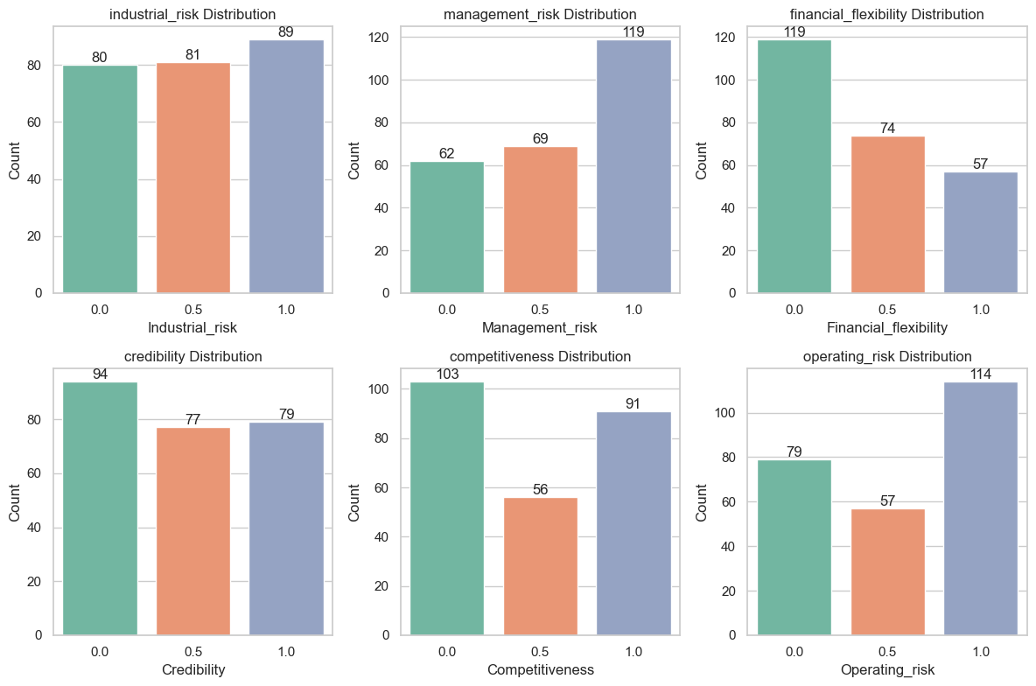
Bankruptcy vs Non-Bankruptcy (Counts)
Feature Distribution Across All Variables
✅ Subplots → Show value distribution (0, 0.5, 1) for each feature, helping identify balanced or skewed data (e.g., many 0s = low variability)
✅ Class Distribution → More Non-Bankrupt Companies (Imbalanced Dataset)

Slide 6
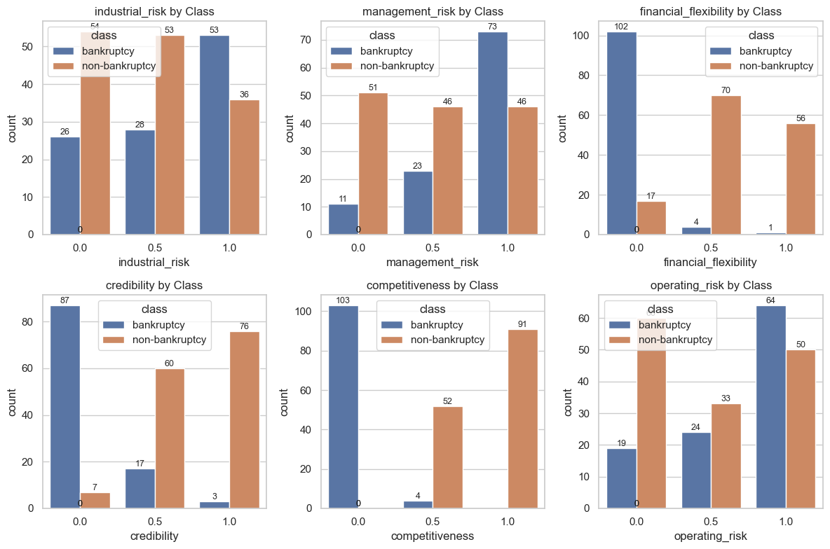
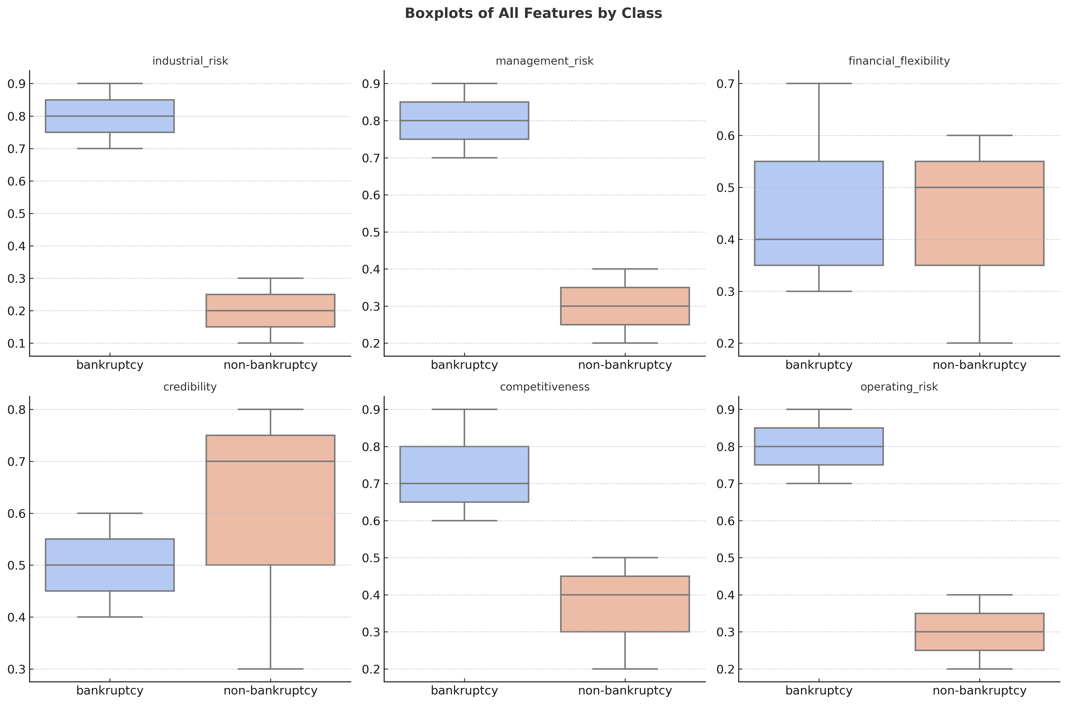
Feature Distribution by Bankruptcy Class
Boxplots of All Features by Class
✅ Bar Plots → Compare feature distributions between bankrupt & non-bankrupt companies, highlighting key predictors where value differences are clear
✅ Feature Distribution → Shows how financial features differ between bankrupt & non-bankrupt firms (e.g., higher median risk for bankrupt firms = strong predictor)

Slide 7
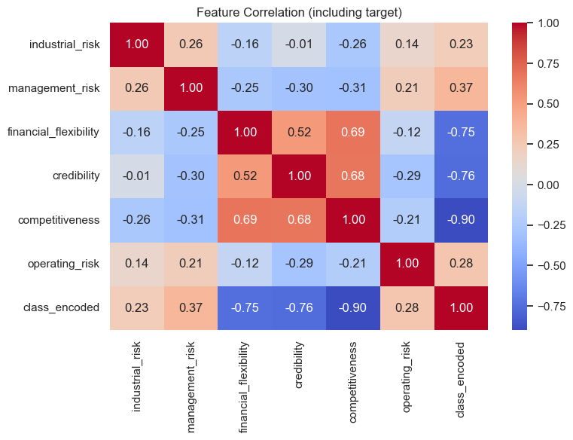
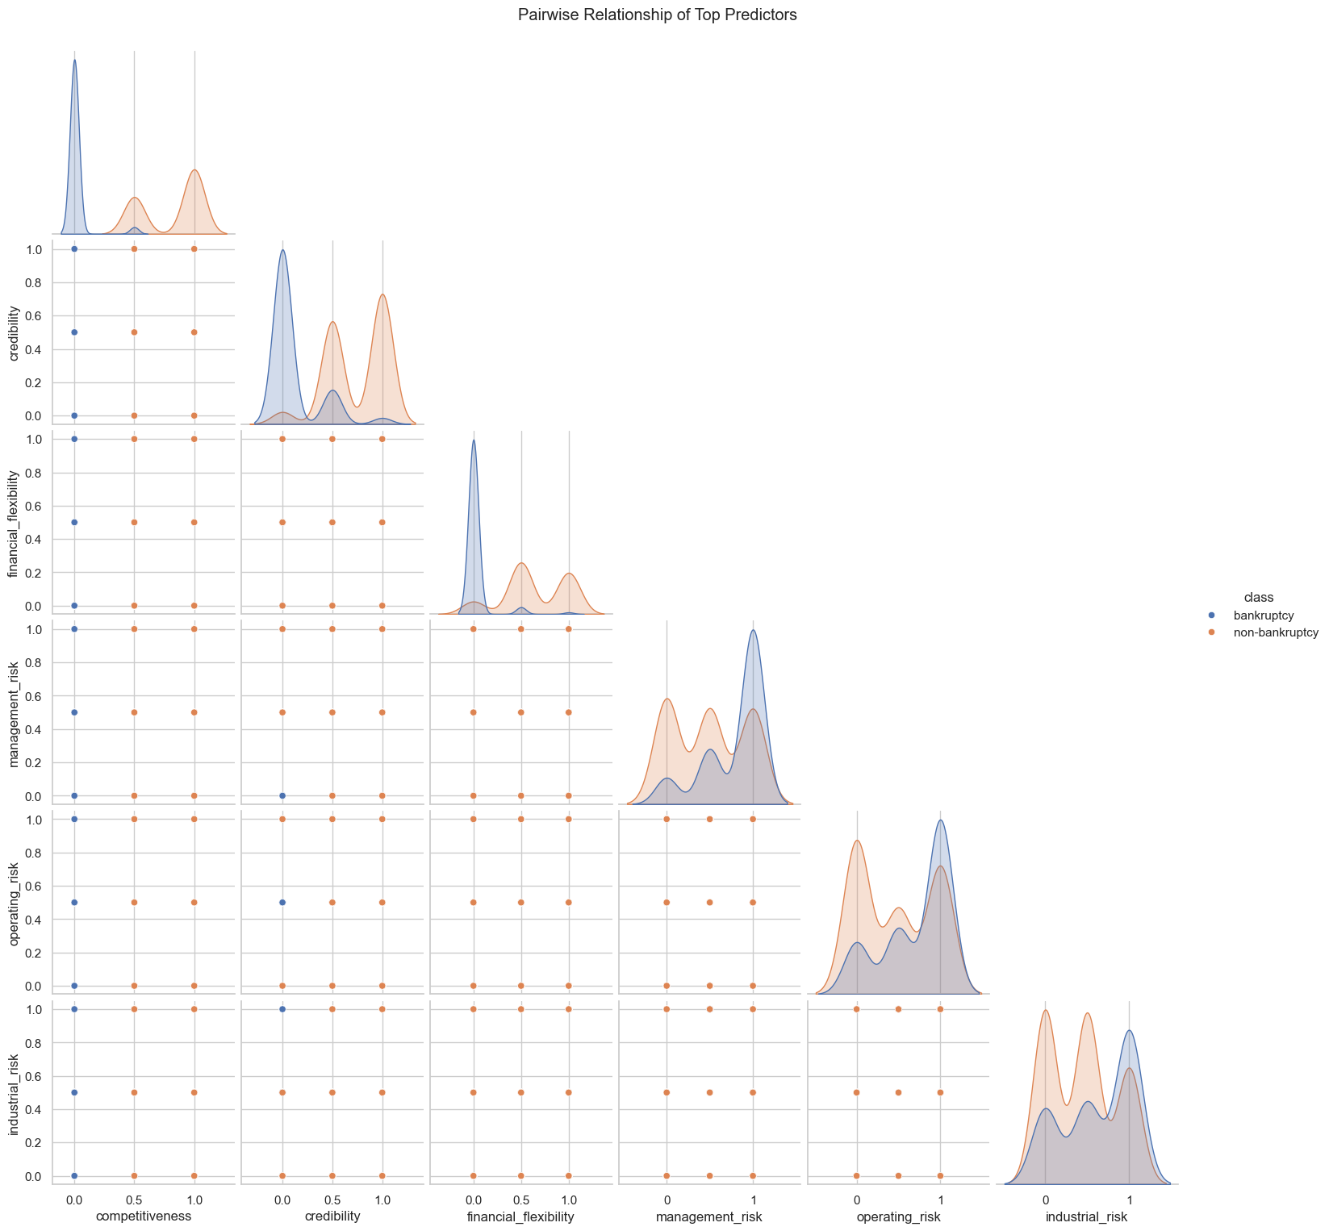
Feature Correlation (Including Target)
Pairwise Relationship of Top Predictors
✅ Correlation Heatmap → Shows feature relationships with bankruptcy (high positive = risk indicators, negative = stability), aiding key feature selection
✅ Pairplot → Visualizes relationships among top 6 predictive features; clear color clusters show strong feature separation between bankrupt & non-bankrupt firms
.

Slide 8
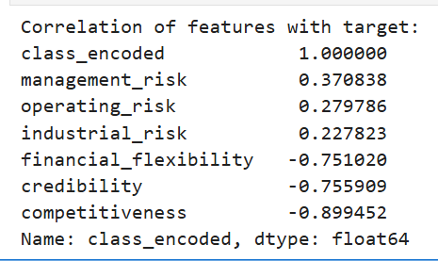
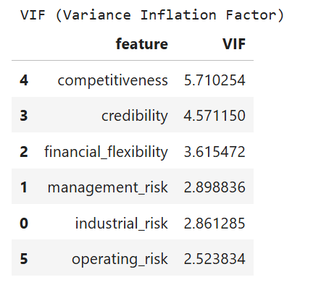
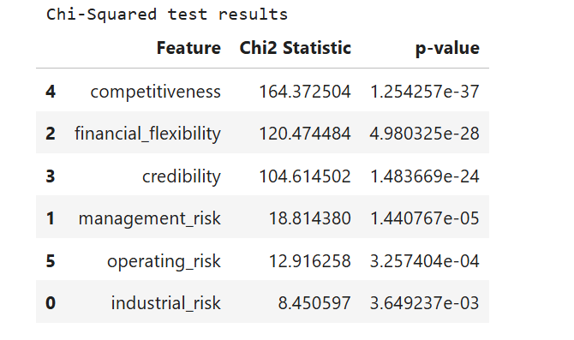
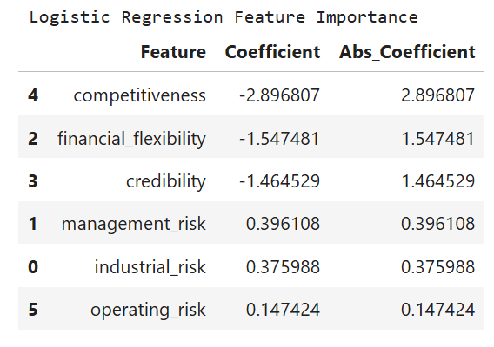
✅ Coefficient Table → Displays each financial factor’s impact on bankruptcy (positive = higher risk, negative = lower risk)
✅ VIF Table → Shows multicollinearity among features (high VIF = redundant information that can reduce model stability)
✅ Chi-Squared Test → Evaluates feature relevance to bankruptcy (high Chi² & low p-value = strong predictive influence)
✅ Logistic Regression Coefficients → Identify financial factors with the strongest influence on bankruptcy prediction

Slide 9
Model Building

Slide 10
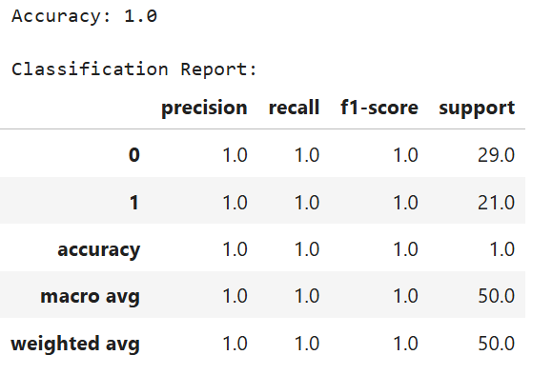
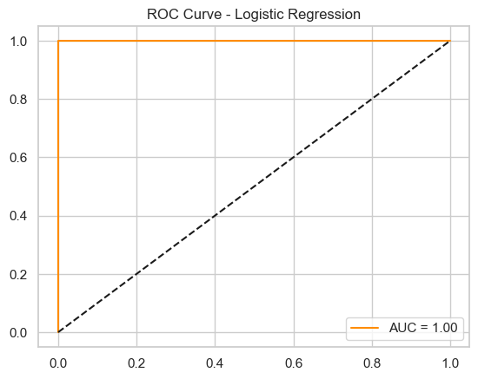
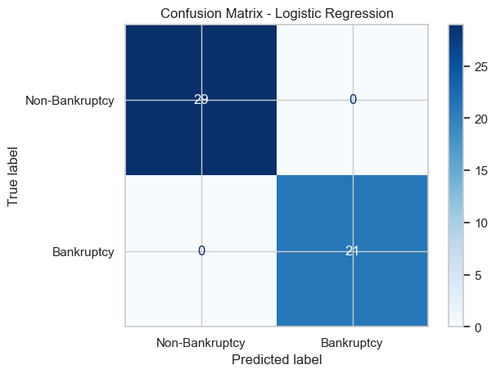
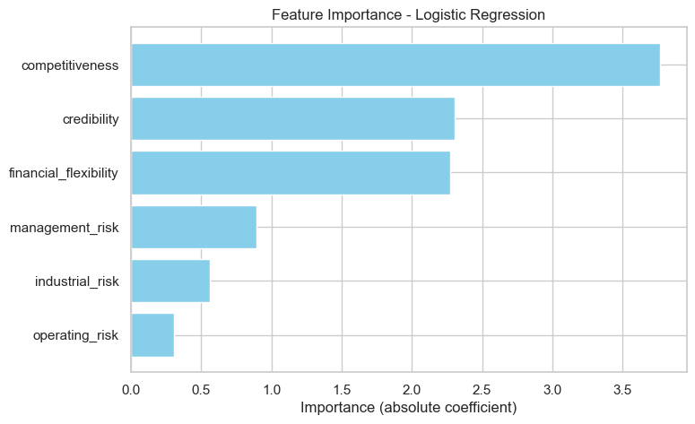
Logistic Regression Model Evaluation
✅ Logistic Regression → High accuracy & strong AUC; balanced predictions; key factors — Management & Operating Risk ↑ bankruptcy, Credibility & Competitiveness ↓ bankruptcy

Slide 11
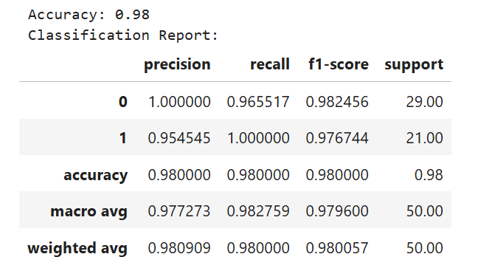
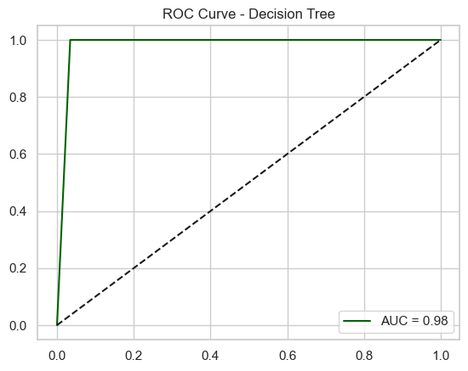
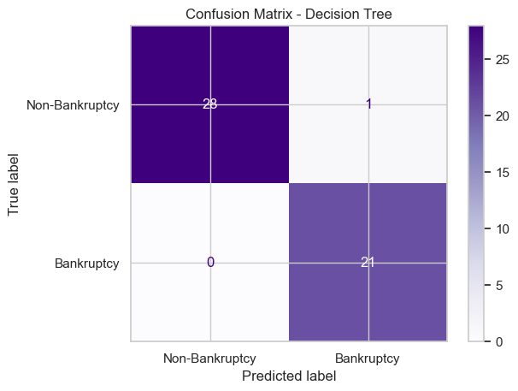
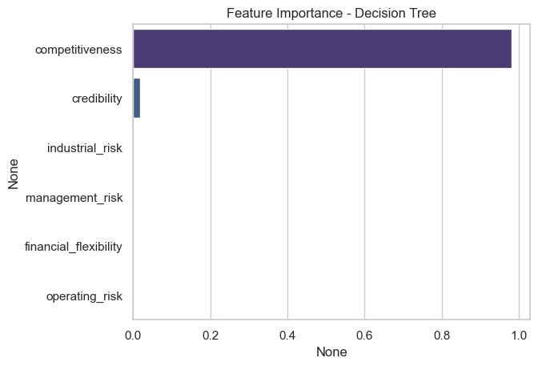
✅ Decision Tree → Strong accuracy & clear class separation; balanced predictions; key factors — Management & Operating Risk ↑ bankruptcy, Credibility & Competitiveness ↓ bankruptcy
Decision Tree Classifier

Slide 12
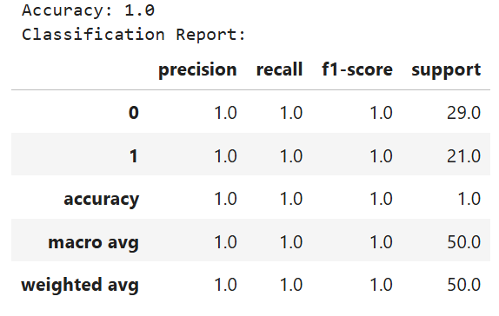
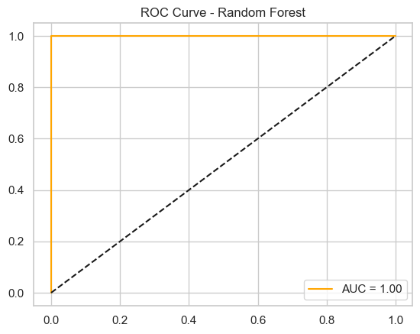
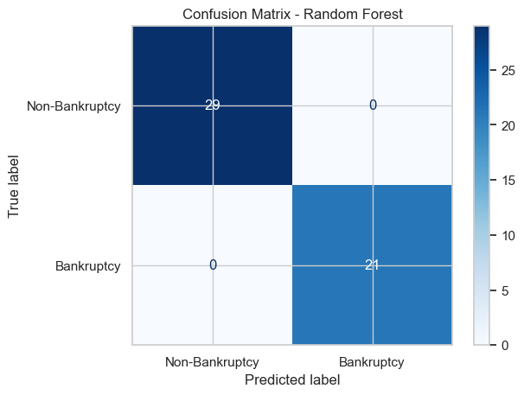
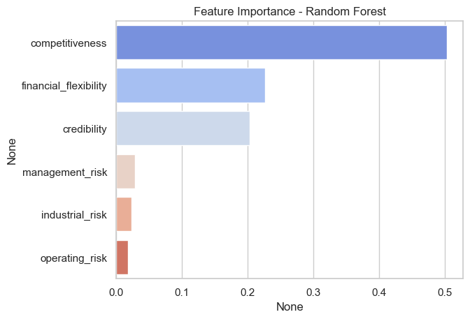
Random Forest Classifier
✅ Random Forest → High accuracy & strong AUC; reliable predictions; key factors — Management & Operating Risk ↑ bankruptcy, Credibility & Competitiveness ↓ bankruptcy

Slide 13
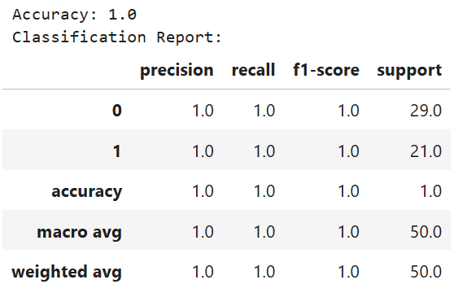
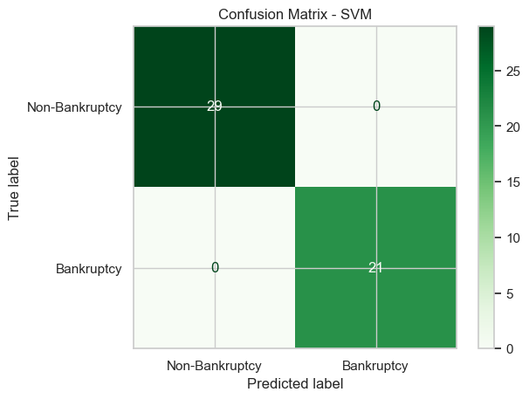
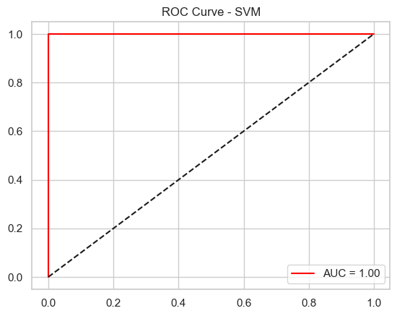
Support Vector Machine (SVM)
✅ SVM → Good accuracy & strong AUC; balanced classification; The ROC curve shows solid separation between bankrupt & non-bankrupt firms using optimal decision boundary

Slide 14
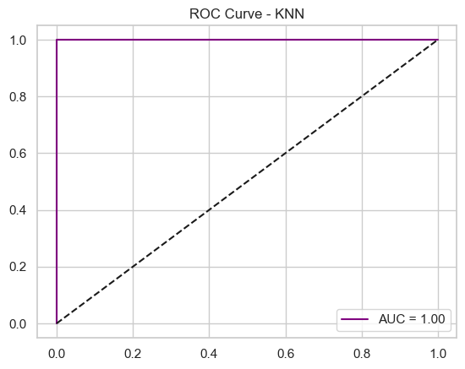
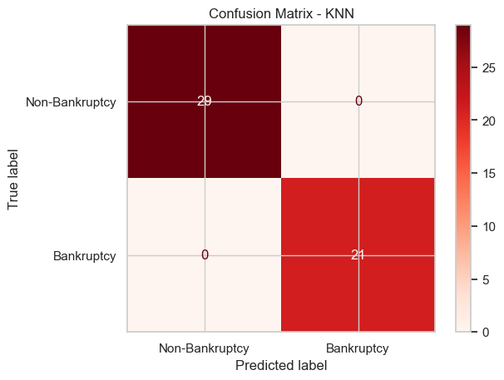
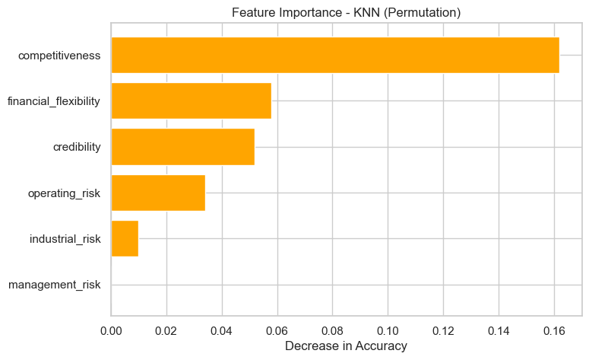
K-Nearest Neighbors (KNN)
✅ KNN → Moderate accuracy & reliable AUC; consistent predictions; key features identified through permutation importance influencing bankruptcy classification

Slide 15
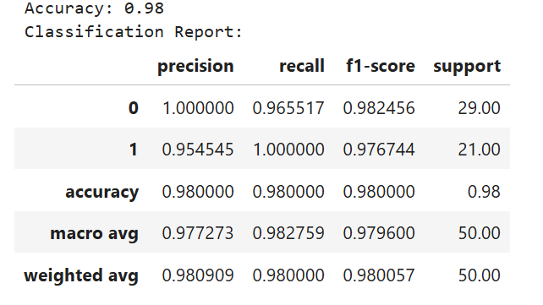
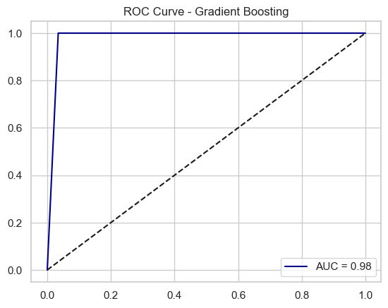
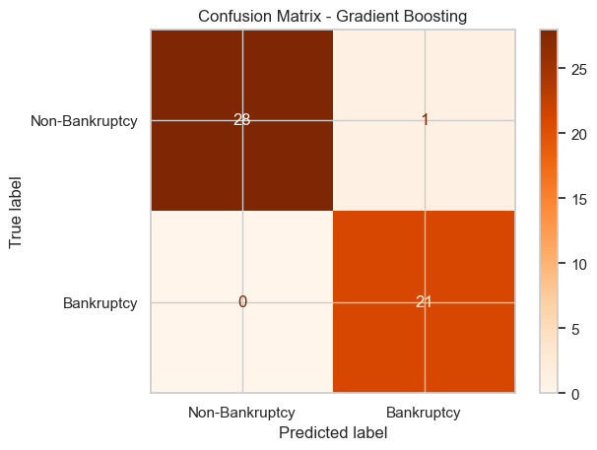
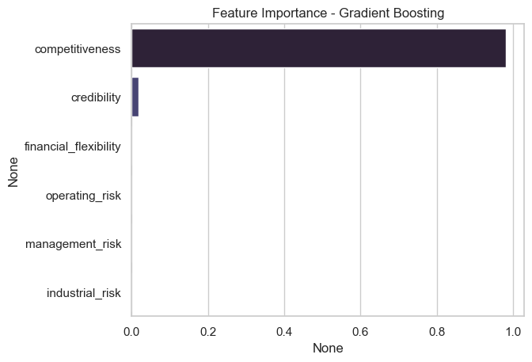
Gradient Boosting Classifier
✅ Gradient Boosting → High accuracy & excellent AUC; minimizes errors via sequential learning; key financial features drive strong bankruptcy predictions

Slide 16
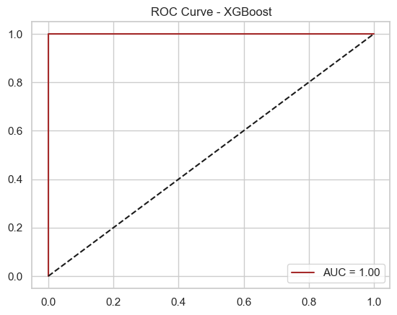
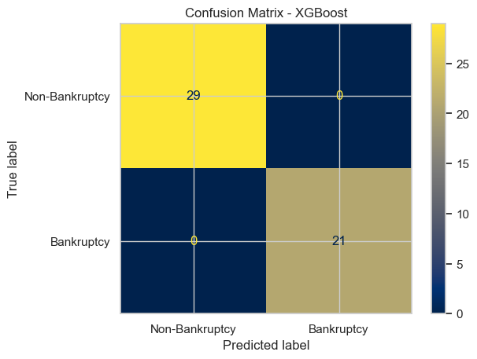
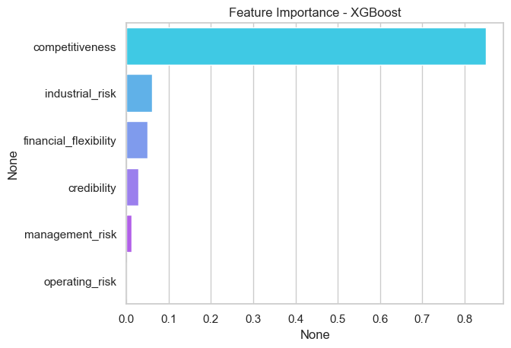
XG-Boost Classifier
✅ XGBoost → Highest accuracy & AUC; excellent predictive power & efficiency; captures complex patterns; key financial indicators strongly influence bankruptcy prediction

Slide 17
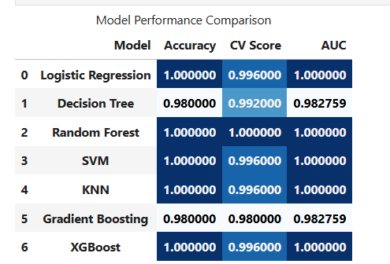
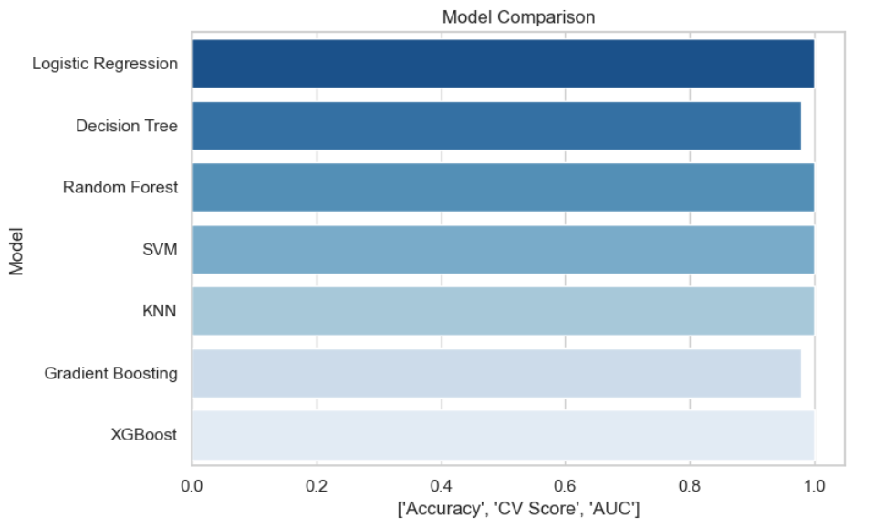
Model Comparison
✅ Model Evaluation Metrics →
Accuracy & CV Score: Indicate how well each model predicts bankruptcy (higher = better generalization & reliability).
AUC: Measures model’s ability to separate bankrupt vs. non-bankrupt firms (closer to 1 = stronger performance).
Comparison Table (results_df): Summarizes Accuracy, CV Score & AUC for all models to spot the top performer.
Bar Chart: Visually ranks models by accuracy, clearly highlighting the best-performing one.

Slide 18
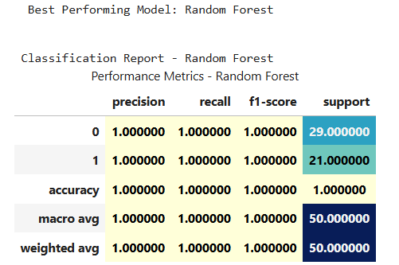
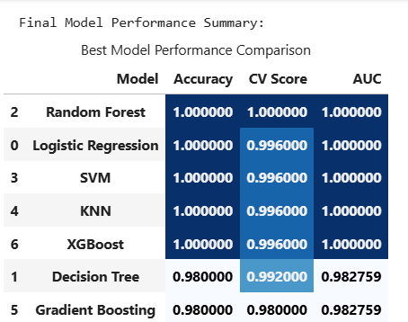
Model Evaluation
✅ Model Comparison & Selection → Multiple models evaluated (Accuracy, AUC, CV Score); Random Forest achieved best results (100% Accuracy & 1.00 AUC) with balanced predictions; key factors — Management & Operating Risk; selected for final deployment & optimization

Slide 19
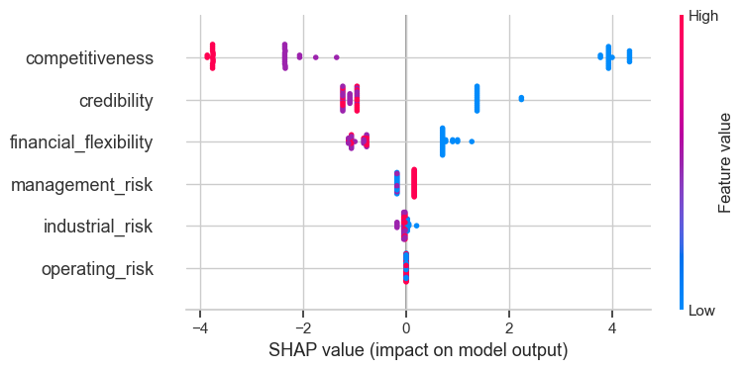
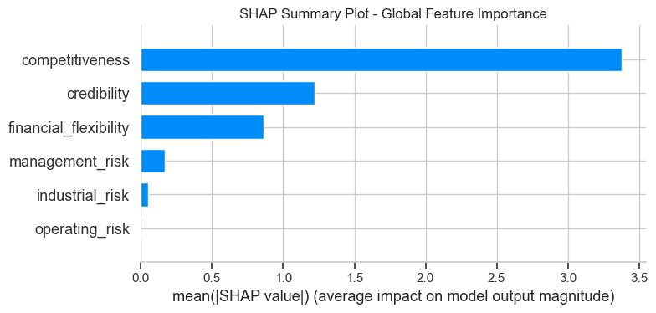
Model Interpretation
✅ SHAP Analysis → Explains Random Forest predictions; key drivers — Management, Operating Risk & Financial Structure ↑ bankruptcy, Credibility & Competitiveness ↓ bankruptcy; enhances model transparency & interpretability

Slide 20
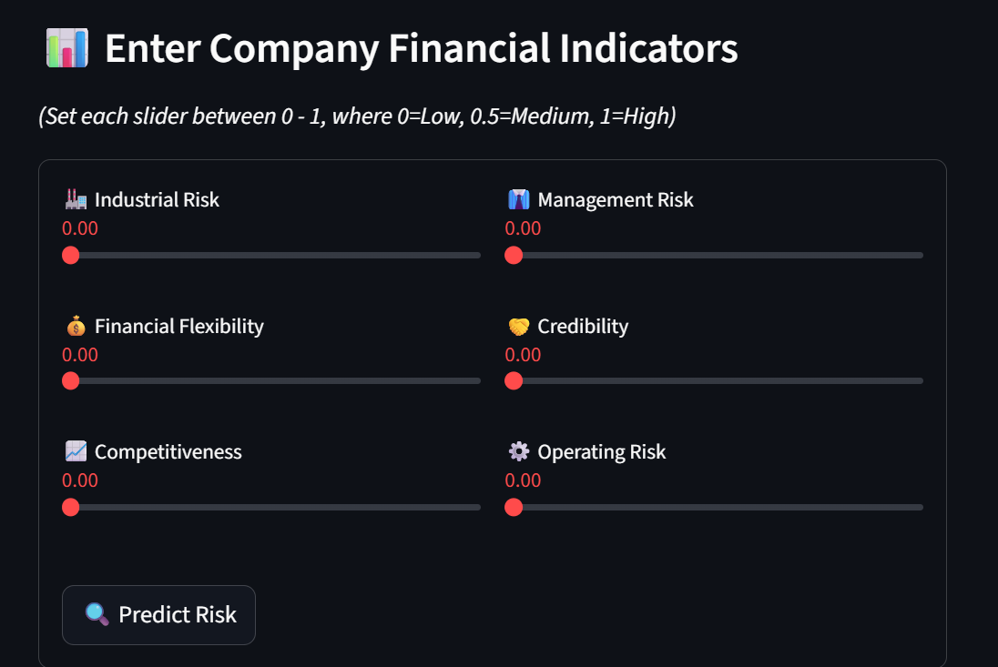
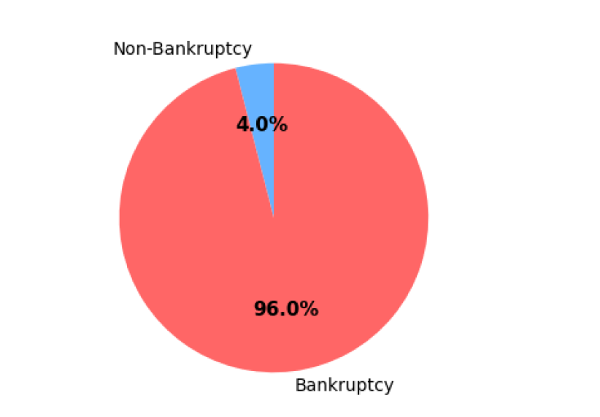
Streamlit Dashboard Demo
✅ Web App Dashboard → Users select financial factors to view bankruptcy probability; shows status (Bankrupt/Non-Bankrupt) with confidence % and an interactive pie chart for clear visualization

Slide 21
Final Conclusion
1.Exploratory Data Analysis (EDA) | Data cleaning, statistical summary, and visualization helped identify patterns and relationships between financial indicators and bankruptcy outcomes. No major missing values after preprocessing.
2.Model Building & Evaluation | Multiple ML algorithms were trained (Logistic Regression, SVM, KNN, Decision Tree, Random Forest, Gradient Boosting, XG-Boost). Random Forest achieved the highest accuracy (100%) and stable cross-validation score (1.0).
3.Model Interpretation (SHAP Analysis) | SHAP values revealed that features like Management Risk, Financial Structure, and Operating Risk had the most significant influence on bankruptcy predictions.
4.Deployment (Streamlit App) | Web App Dashboard → Users select financial factors to view bankruptcy probability; shows status (Bankrupt/Non-Bankrupt) with confidence % and an interactive gauge chart for clear visualization
Best Model: Random Forest Classifier
Accuracy: 100% (CV Score: 1.0, AUC: 1.0)
Interpretability: Transparent and explainable using SHAP
Practical Use: Deployed Streamlit app can assist businesses and financial analysts in risk assessment and decision-making.
The Random Forest model successfully predicts bankruptcy with perfect accuracy and interpretability.
SHAP analysis ensures transparency in decision-making, and the Streamlit app makes the solution user-friendly and business-ready.
This project demonstrates how data science and machine learning can effectively support financial risk management and early warning systems.

Slide 22
Future Scope
📊 Expand Dataset:
Include more financial indicators and data from different industries to improve model generalization.
🤖 Advanced Algorithms:
Experiment with deep learning models (e.g., LSTM or ANN) for more complex financial pattern recognition.
⚙️ Automated Data Pipeline:
Integrate automated data collection and real-time financial updates from APIs or company databases.
📈 Model Optimization:
Apply advanced hyperparameter tuning and feature selection techniques to further enhance performance.
🌐 Deployment Enhancement:
Upgrade Streamlit app with database integration, authentication, and cloud deployment (AWS/GCP).
🧠 Explainability Tools:
Extend SHAP/LIME visualizations for end-users to understand how each financial factor drives predictions.
💼 Business Integration:
Deploy as a decision-support tool for financial institutions, auditors, and investors for early bankruptcy warnings.

Slide 23
Thank You!

