Slide 1
🎓 Online Course Recommender
Smart course suggestions based on interests, past enrollments, and engagement.
Created By : Amit Choudhury | Organization: EXCELR | Course: Data Scientist
👥 Team Members
1.Amit Choudhury
2.Sanika S. Sharma
3.Middi Yogananda Reddy
4.CHARAN S M
5.Manjunath B. Chikkabasur
6.Varsha D V

Slide 2
CONTENTS
Problem Statement & Objective
Exploratory Data Analysis (EDA)
Feature Engineering Summary
Model Building
Streamlit Dashboard Demo
Final Conclusion
Future Scope

Slide 3
Problem Statement
The goal of this dataset is to build an online course recommendation system that suggests relevant courses to learners based on their interests, past enrollments, and engagement levels. The dataset includes course ratings, instructor information, previous learning history, study material availability, and certification offerings, making it suitable for recommendation models using collaborative filtering, content-based filtering, or hybrid approaches.

Slide 4
Exploratory Data Analysis (EDA)

Slide 5
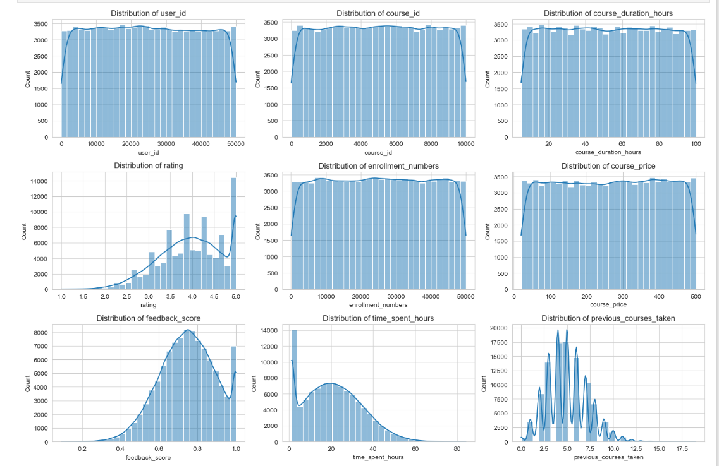
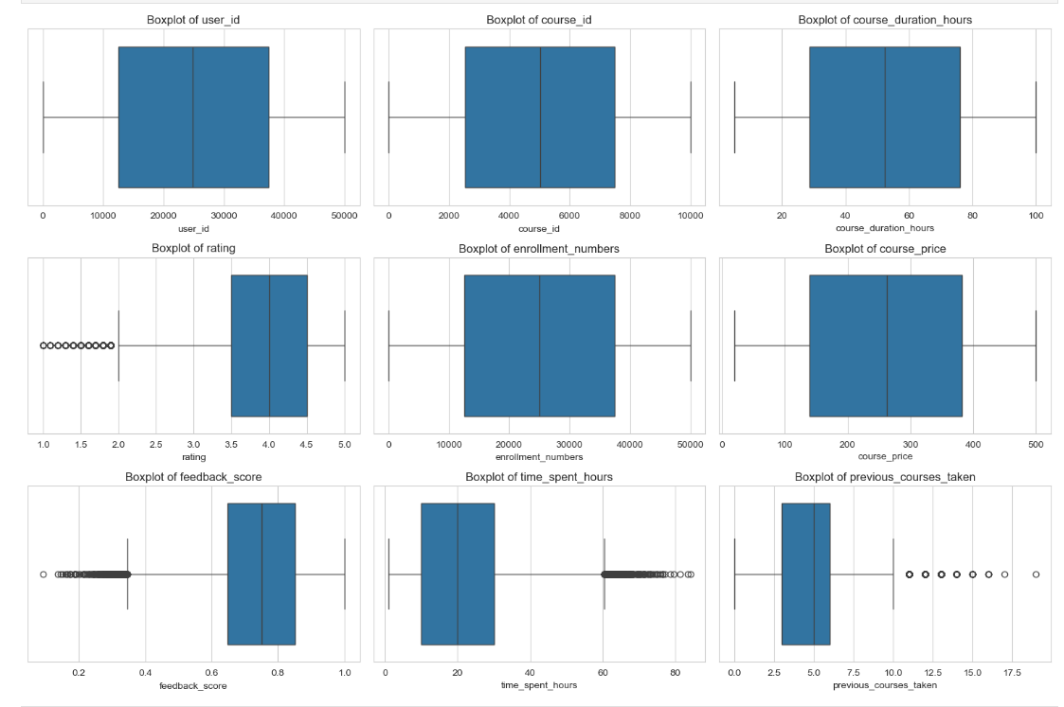
“This visualization shows the distribution of key numerical features using histograms with KDE curves, helping identify data spread, skewness, outliers, and whether features follow a normal distribution—crucial for selecting appropriate models and preprocessing techniques.”
“Boxplots were used to detect outliers and analyze the spread of numerical features, helping identify extreme values that could negatively impact model performance.”

Slide 6
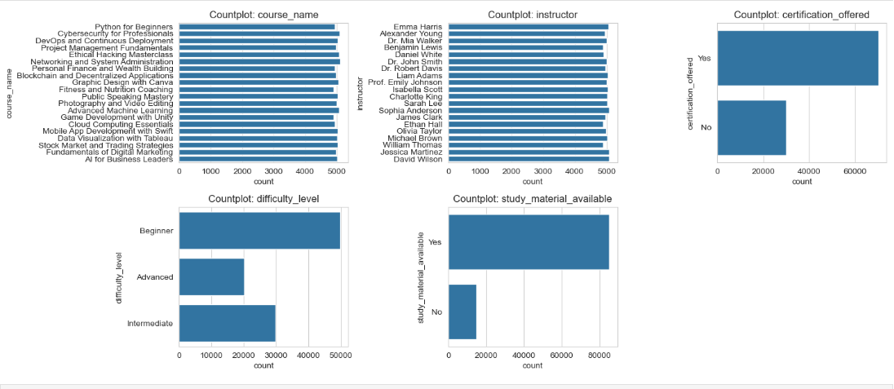
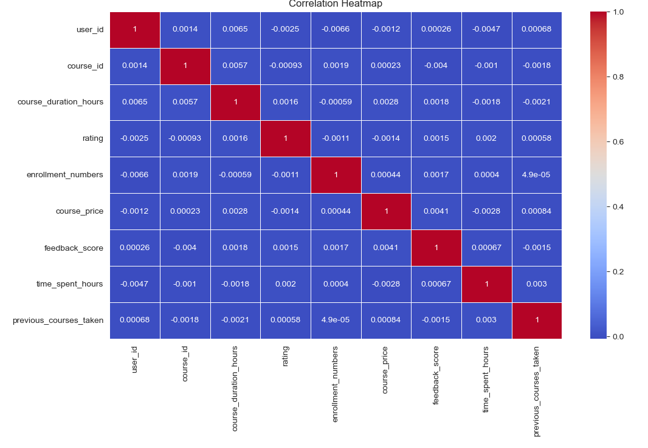
“Count plots were used to analyze the distribution of categorical features, identifying dominant categories and handling high-cardinality variables by focusing on top frequent values.”
“The correlation heatmap visualizes relationships among numerical features, helping identify strong positive and negative correlations that guide feature selection and reduce multicollinearity.”

Slide 7
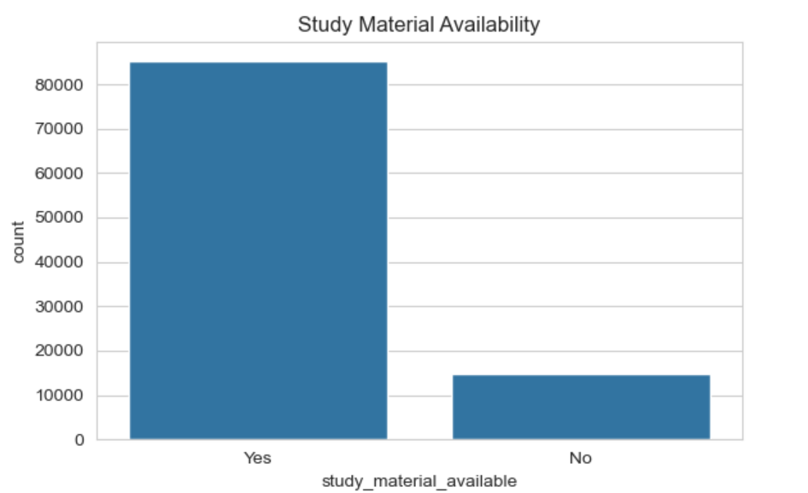
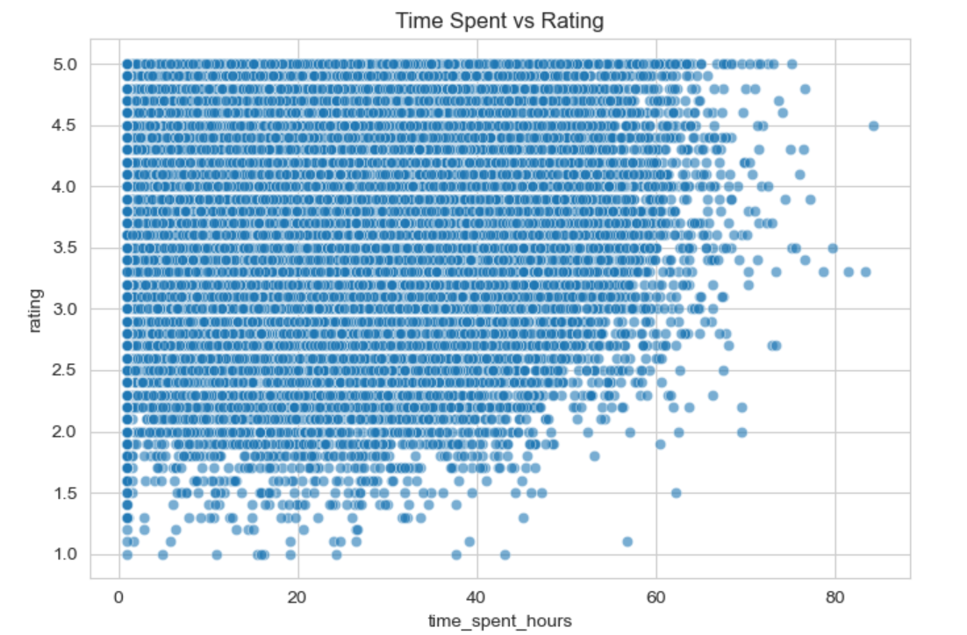
“The count plot shows that most courses provide study materials, highlighting a strong focus on learner support and content accessibility.”
“The scatter plot illustrates the relationship between learner engagement (time spent) and course ratings, showing that higher engagement generally leads to better ratings.”

Slide 8
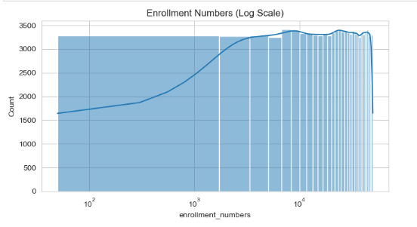
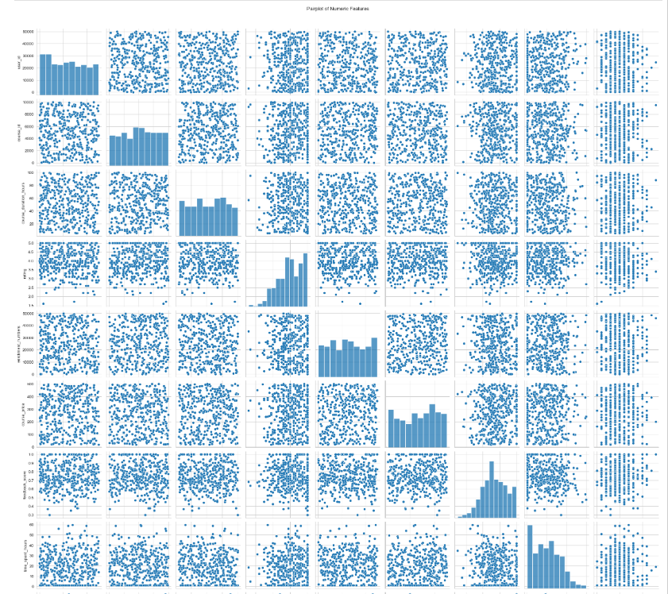
“The log-scaled histogram reveals a highly skewed enrollment distribution, where a few courses have very high enrollments while most courses attract comparatively fewer learners.”
“Pairplot visualizes pairwise relationships and distributions of numeric features, helping identify correlations, trends, and potential multicollinearity.”

Slide 9
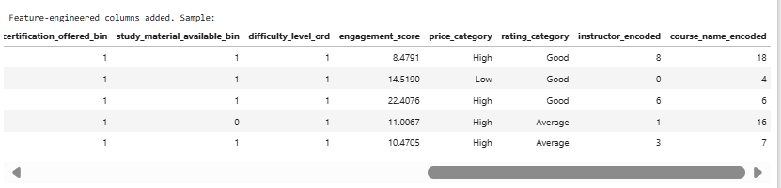
Feature Engineering Summary
Created a copy of the dataset to preserve the original data.
Converted Yes/No columns into numeric binary values (0 and 1) for modeling.
Mapped difficulty levels to ordinal numbers (Beginner=1, Intermediate=2, Advanced=3).
Developed an engagement score as a weighted sum of time spent, previous courses taken, and feedback.
Categorized course price and ratings into bins and applied label encoding to text columns for numeric representation.

Slide 10
Model Building

Slide 11
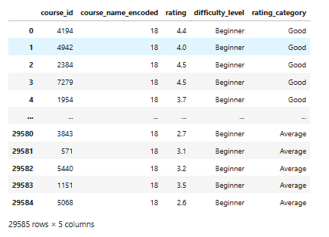
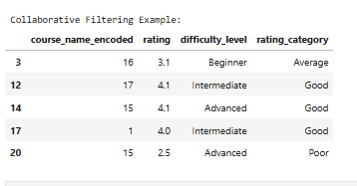
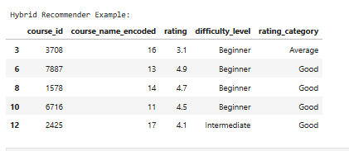
Content-Based Filtering
Combined course name, difficulty level, and rating category into a single text feature for similarity analysis.
Applied TF-IDF vectorization to convert text data into numerical feature vectors.
Used cosine similarity with K-Nearest Neighbors to find courses similar to a given course.
Indexed courses by their names for quick and interpretable lookup during recommendations.
Returned top-N similar courses based on textual similarity of course attributes.
Collaborative Filtering
Built a user-item rating matrix with users as rows and courses as columns.
Applied K-Nearest Neighbors using cosine similarity to find users with similar preferences.
Calculated weighted recommendation scores based on ratings from similar users, weighted by similarity.
Filtered out courses already rated by the target user to recommend new courses.
Returned top-N personalized course recommendations based on collaborative filtering.
Hybrid Recommender
Combines Content-Based and Collaborative Filtering recommendations for improved accuracy.
Uses a weighted approach controlled by alpha to balance content and user similarity scores.
Content-based recommendations leverage the user’s most recent course preferences.
Collaborative recommendations consider ratings from similar users via user KNN.
Aggregates and ranks scores from both methods to provide top-N personalized course recommendations.

Slide 12
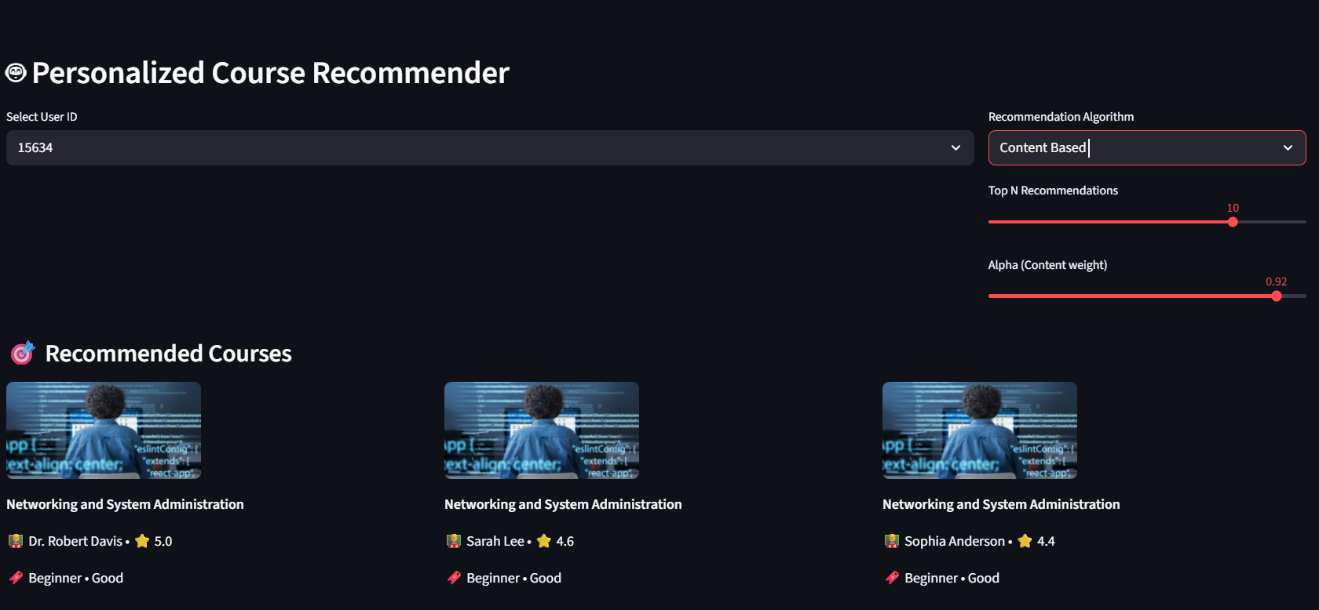
Streamlit AI Course Recommender App
🔐 Secure User Authentication & Roles Users must login with User ID (admin) and Password (admin123). Supports different roles like user and admin for controlled access.
🤖 Smart Hybrid Recommendation Engine Personalized course suggestions combining Content-Based, Collaborative, and Hybrid algorithms for best results.
🖥️ User-Friendly Multi-Page Interface Seamless navigation across Home, Recommender, Analytics, Feedback Dashboard, About, and Admin pages.
📚 Interactive Course Display & Analytics Beautiful course cards with images, instructor info, ratings, difficulty levels, plus detailed analytics on courses & instructors.
📝 User Feedback Management Collects, stores, and displays real-time feedback with ratings and comments; admins can monitor and respond efficiently.
📄 PDF Report Generation Creates downloadable, well-formatted PDF reports of personalized recommendations using reportlab or fpdf libraries.
🛠️ Robust Data Handling & Model Loading Safely loads models & data, includes defensive checks to handle missing info, ensuring smooth user experience without crashes.

Slide 13
Final Conclusion
The developed AI-driven course recommendation system demonstrates a comprehensive and effective approach to personalized learning. By seamlessly integrating content-based filtering, which leverages course features, and collaborative filtering, which utilizes user interaction and preferences, the system provides highly relevant and customized course suggestions. The hybrid model effectively balances both strategies, enhancing recommendation accuracy and user satisfaction.
The solution is strengthened by a secure user authentication system, enabling personalized experiences and protecting user data. It also incorporates a feedback mechanism, allowing continuous improvement of recommendations based on real user input. Analytics features offer valuable insights into user engagement, course popularity, and instructor performance, supporting data-driven decisions.
Through thoughtful feature engineering, the system efficiently transforms raw data into meaningful indicators such as engagement scores and rating categories, facilitating better recommendation quality. Overall, this project illustrates the power of combining data science, machine learning, and user-centric design to enhance online education platforms, driving improved learner engagement, course completion rates, and satisfaction.

Slide 14
Future Scope
📈 Incorporate Deeper User Behavior Signals Beyond basic ratings and enrollments, integrating fine-grained behavioral data such as time spent on specific course modules, clickstream patterns, pause/rewind actions, and course completion rates will enrich user profiles. This will enable more nuanced, dynamic recommendations tailored to individual learning styles and habits.
🤖 Adopt Advanced Deep Learning Architectures Employing state-of-the-art models like neural collaborative filtering, transformer-based embeddings, or graph neural networks can capture complex, non-linear relationships between users and courses. These models can uncover latent features and provide even more precise and context-aware suggestions.
🌐 Personalize with Contextual and Demographic Data Incorporating users’ demographic details, social contexts, device types, or even geographic location can improve personalization. For example, recommendations could adapt to cultural preferences, time zones, or learning goals, making suggestions more relevant and timely.
⚡ Enable Real-Time Adaptive Recommendations Integrating live user interaction tracking and feedback loops will allow the system to update recommendations in real time. This responsiveness will keep suggestions fresh, aligned with evolving user interests, and responsive to immediate needs.
🛠️ Enhance Explainability and Transparency Building explainability features that communicate why a course is recommended can significantly boost user trust and engagement. Clear, user-friendly explanations help demystify AI decisions, making learners more confident in exploring suggested content.
☁️ Cloud-Native Deployment for Scalability Migrating the platform to scalable cloud infrastructure will improve accessibility, support larger user bases, and enable faster computation and delivery of recommendations. Cloud deployment also opens doors to integrate with other services and supports continuous integration and delivery (CI/CD) pipelines.
🔄 Cross-Platform Integration and API Development Expanding the system to offer APIs would allow integration with other learning management systems (LMS), mobile apps, and educational platforms, extending its reach and utility.
🧑‍🏫 Instructor and Course Content Improvement Using analytics on course feedback and user engagement to provide actionable insights to instructors can help improve course quality, further enhancing the recommendation ecosystem.

Slide 15
Thank You!

