Slide 1
SWASTH
Making you live a healthier and longer life
AI-powered health system connecting your medical devices, your doctor, and your family

Slide 2
THE PROBLEM
India's silent health crisis — in numbers
101M
220M
47%
16.7%
diabetics in India
with hypertension
don't even know they have it
actually self-monitor their condition
ICMR-INDIAB-17 Lancet, 2023
NFHS-5, 2021
Lancet Global Health, 2023
ICMR-INDIAB-13 Lancet D&E, 2022
Those who know lose 6-8 years of life expectancy.
Those who don't know never get the chance to act.
Yet 80% of premature heart attacks and strokes are entirely preventable. — WHO
Reducing HbA1c by just 1% lowers diabetes-related death by 21%. Active BP management reduces cardiovascular death by 43%.

Slide 3
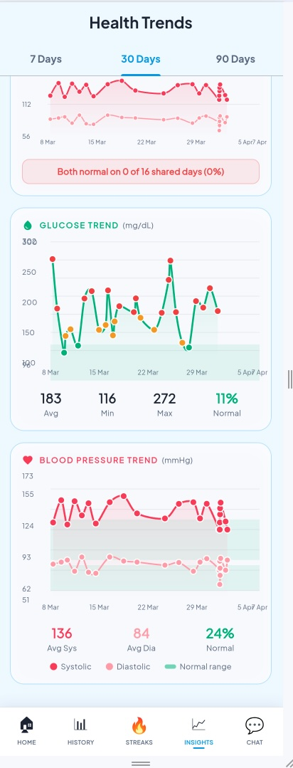
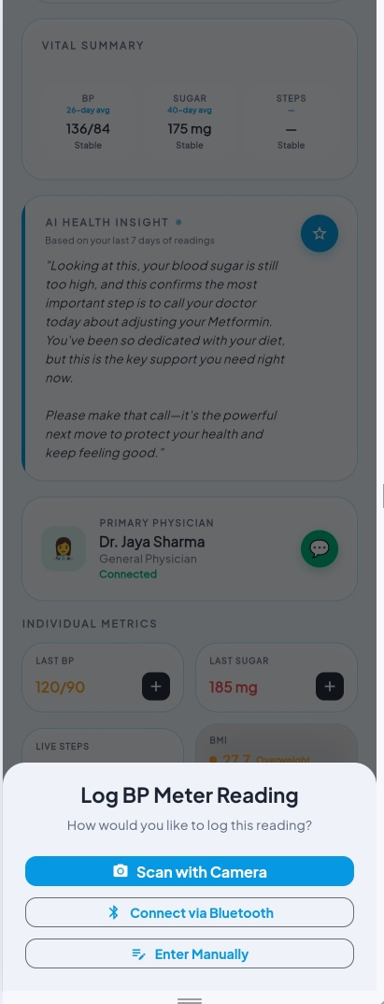
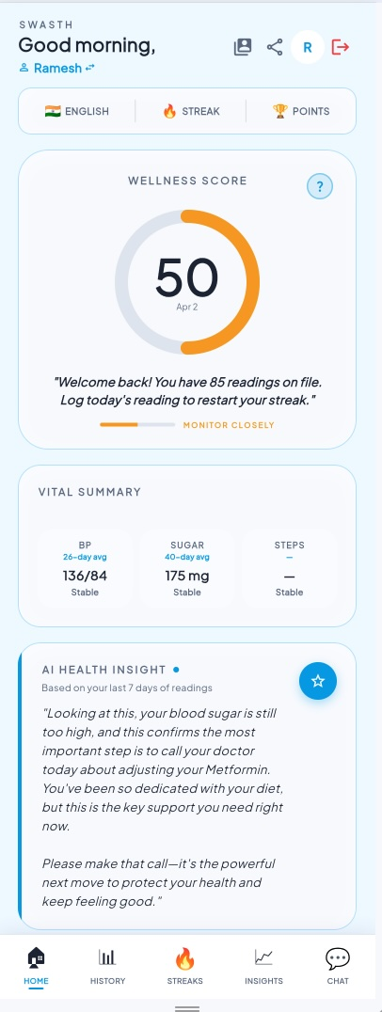
THE SOLUTION — WHAT DOCTORS GET
Real-time visibility into your patients between visits
30-Day Trend Charts
You see patients once in 3-6 months. Between visits, you're blind.
Glucose & BP trends with 7/30/90-day views. Spot an 18-day BP creep before it becomes an emergency.
Sync + Scan Any Device
Patients already own glucometers and BP monitors but readings stay on the device.
Bluetooth auto-sync OR photograph any existing meter — Camera, BLE, or Manual entry. No new hardware needed.
AI-Powered Daily Action Plan
You say 'reduce sugar' — patients don't know what that means day-to-day.
AI translates your prescription into daily plain-language actions: meal timing, walking, medication reminders.

Slide 4
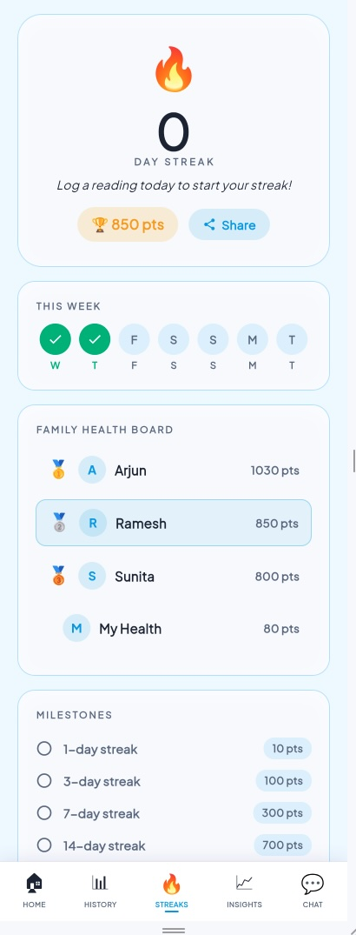
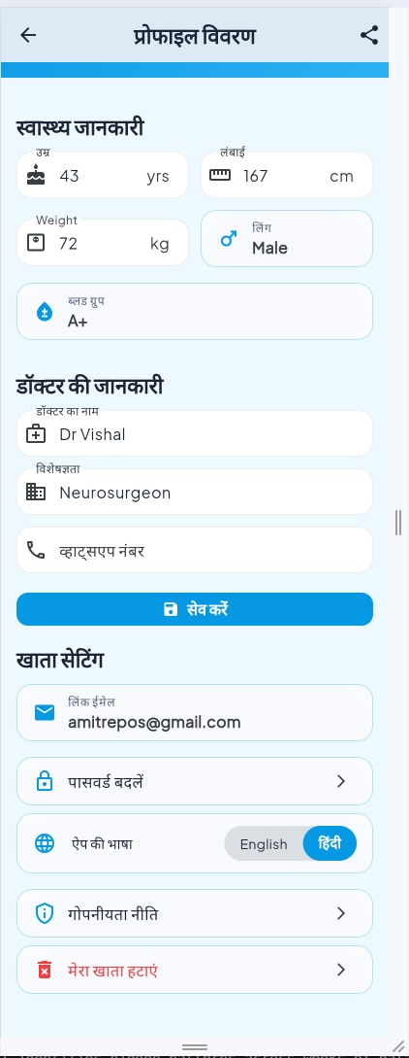
YOUR PATIENTS STAY SUPPORTED
Even when you're not there
Real-Time Family Health Dashboard
Families call, hear "I'm fine", and worry. You get emergency calls that could have been prevented.
Up to 3 family members monitor one patient from anywhere in the world.
Streak tracking and points keep patients accountable between visits.
Family involvement increases medication adherence from 34% to 69.5%.
Hindi + Elderly-Friendly Interface
Your rural and elderly patients can't navigate complex apps.
Full Hindi interface — every label, every button, every insight.
Large fonts, simple icons. Daily effort: under 3 minutes.
The person least comfortable with tech does the least.

Slide 5
THE ASK
Investor conversations are underway. We need clinical proof.
100 patients. 90 days. Real data. That's what closes this.
1
2
3
-->
-->
YOU ENROLL
PATIENTS USE
WE PROVE
Refer your diabetes & hypertension patients into the Swasth program
They track daily using their own devices or ours — Camera, Bluetooth, or Manual
90-day outcome data that brings investment to scale this nationwide
You're not just joining a pilot — you're a founding physician.
Founding team: 3 Amazon veterans | 45+ years combined experience in Technology, Product & Operations
Notes:
SPEAKER NOTES — The Ask:
- POC is free for patients and doctors during the 90 days
- Post-POC: affordable monthly subscription
- Revenue-sharing model with participating doctors
- No cost commitment from doctors at this stage
- We provide the app, they provide the patients and clinical oversight

Slide 6
WHAT'S IN IT FOR YOU
THE MISSION
THE REWARD
Help your patients live longer — beyond your clinic walls.
Your expertise today helps patients in your clinic. With Swasth, it reaches thousands.
Every protocol you help us refine saves lives you'll never meet.
Be the doctor who proved that 80% of preventable deaths can actually be prevented.
Founding Medical Advisory Board Member
Stock options — vest after 90-day commitment
Early advisors participate in long-term growth
Full platform access — free, forever
Your name on the clinical validation study
NOW
DURING THE PILOT
WHEN WE SCALE
Advisory Board seat Free platform access
Monthly patient reports Your name on the study
Stock options mature Revenue share on patients
Stock options and detailed terms governed by a formal Advisor Agreement.
Notes:
SPEAKER NOTES — What's in it for you:
- Advisory equity: ~0.2% per founding physician
- Illustrative value: if company reaches 5cr = ~1L, 50cr = ~10L, 500cr = ~1cr
- Exact terms in a formal Advisor Agreement (one-page document)
- Options vest after completing the 90-day pilot
- Revenue share model details to be finalized post-POC
- Important: compensation is NOT tied to number of patients (NMC compliance)

Slide 7
WHAT'S NEXT — PHASE 2
Expanding the ecosystem after POC validation
PHASE 1 — NOW (what we have built)
PHASE 2 — AFTER POC
✓
Bluetooth device sync (Glucose + BP)
Smart Health Band
✓
Camera OCR — scan any existing device
24/7 heart rate, SpO2, steps, sleep — fully automatic, no patient effort
✓
Manual entry for all readings
Pharmacy Integration
✓
AI-powered daily action plans
Medication delivered to patient's door through integrated pharmacy network
✓
7 / 30 / 90-day trend charts
✓
Real-time family health dashboard
Doctor Portal
✓
Hindi + English interface
Dedicated dashboard for physicians to manage all Swasth patients
✓
Streak tracking & gamification
Monthly Doctor Reports
✓
AI chat — discuss with your health data
Auto-generated health summaries delivered to the physician
✓
WhatsApp integration — patients send a photo via WhatsApp, it syncs to the app
Expanded Language Support
Regional languages beyond Hindi for pan-India coverage

Slide 8
SWASTH
Making you live a healthier and longer life
100 patients. 90 days. Let's prove this together.
[Your Name]
[Email] | [Phone]
www.swasth.health

