Slide 1
Pose2D
[geometry_msgs/Pose2D]:
float64 x
float64 y
float64 theta

Slide 2
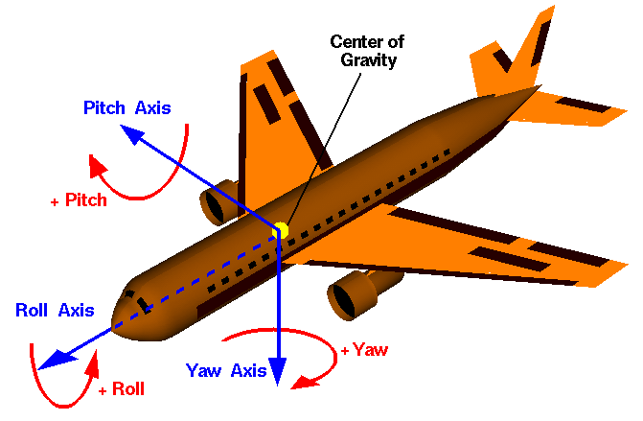
Flight Dynamics

Slide 3
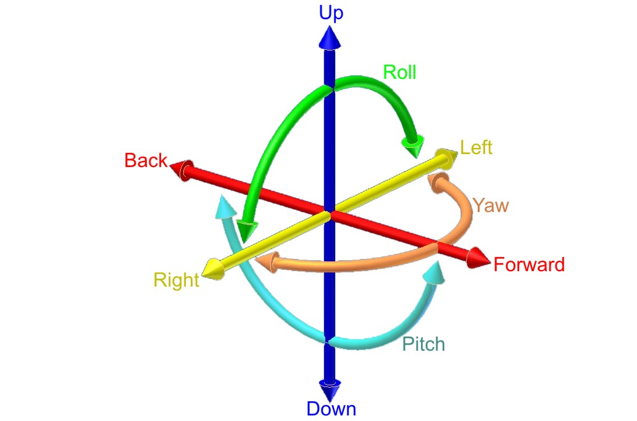
The Six Degrees of Freedom

Slide 4
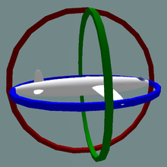
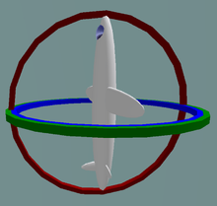
Axes of Rotation

Slide 5
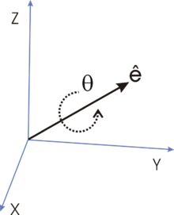
Euler's Theorem (1776)
Euler states the theorem as follows:
When a sphere is moved around its centre it is always possible to find a diameter whose direction in the displaced position is the same as in the initial position.
http://en.wikipedia.org/wiki/Euler%27s_rotation_theorem

Slide 6
Euler's Theorem
Any rotation or sequence of rotations of a rigid body or coordinate system about a fixed point is equivalent to a single rotation by a given angle θ about a fixed axis (called Euler axis) that runs through the fixed point
http://en.wikipedia.org/wiki/Quaternions_and_spatial_rotation

Slide 7
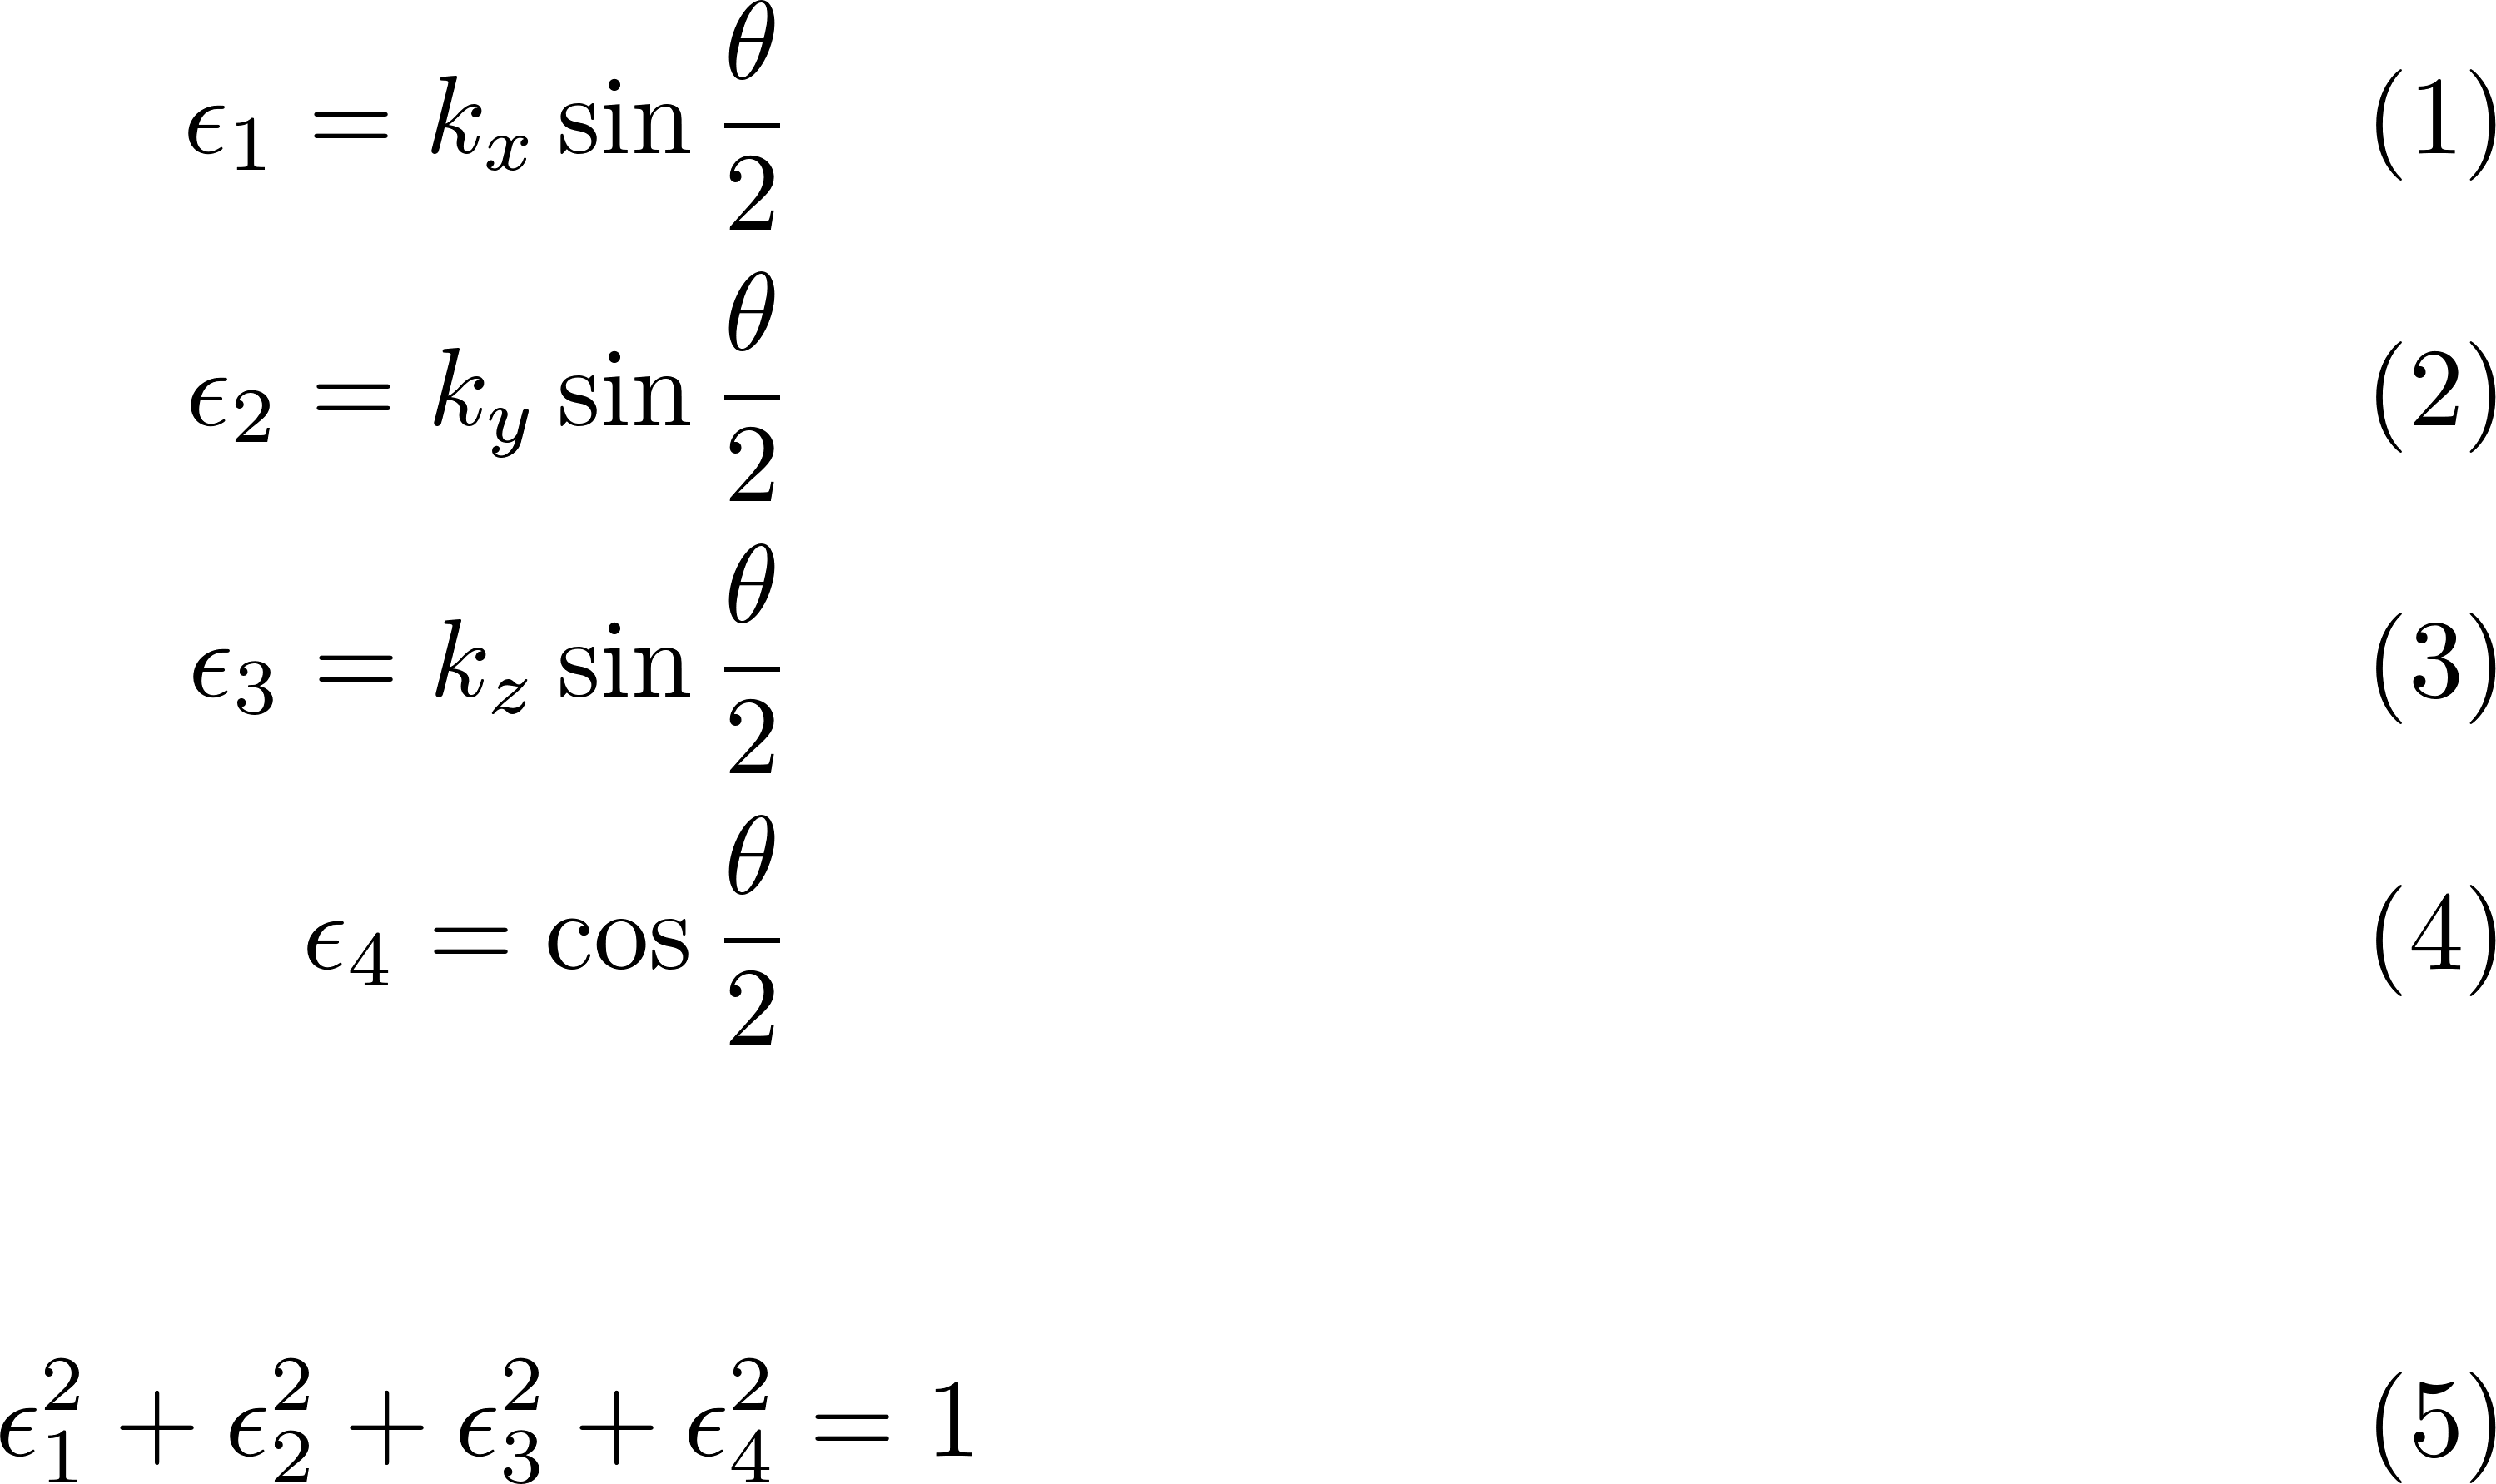
Quaternions
Given an axis K = [k_{x}, k_{y}, k_{z}] ^{T} and an angle θ, one can compute
the Euler parameters or unit quaternion:
with

Slide 8
Intuition for the vector-angle representation
Compute the eigenvectors and eigenvalues of the rotation matrix R
R v = λ v
with v the eigenvector corresponding to λ
Since R is an orthonormal matrix, it has three eigenvectors:
λ₁ = 1 λ_{2, =} cosθ + i sin θ λ_{3, =} cosθ - i sin θ
For λ = 1 the eigenvector is unchanged by the transformation R.
Thus v is the actual axis of rotation.
The angle θ can be inferred from the complex pair.

Slide 9

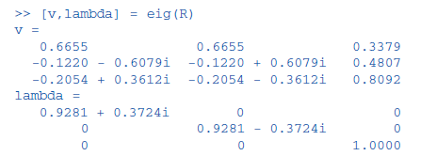

Example
r = (0.1, 0.2, 0.0.3)

Slide 10
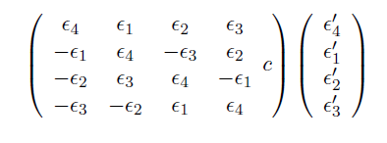
Multiplication of two rotation matrices
Two quaternions ε_{i} and ε_{i}’ are multiplied as follows:

Slide 11
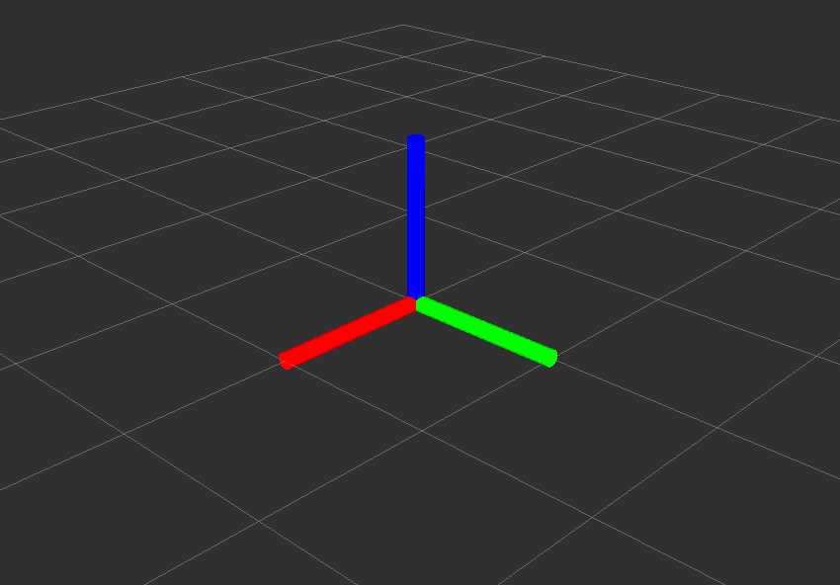
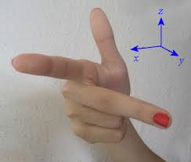
Right Hand Rule
X Y Z

Slide 12
Quaternions
x y z w
0 0 0 1

Slide 13
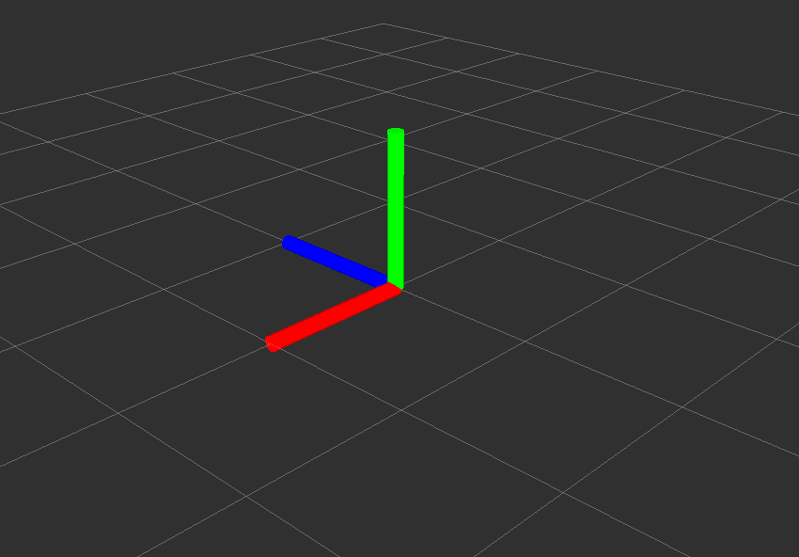
Quaternions
x y z w
1 0 0 1
.707 0 0 .707

Slide 14
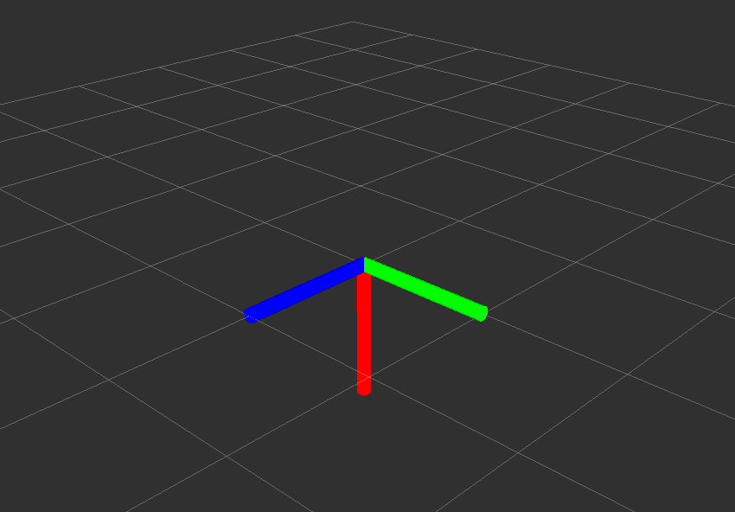
Quaternions
x y z w
0 1 0 1
0 .707 0 .707

Slide 15
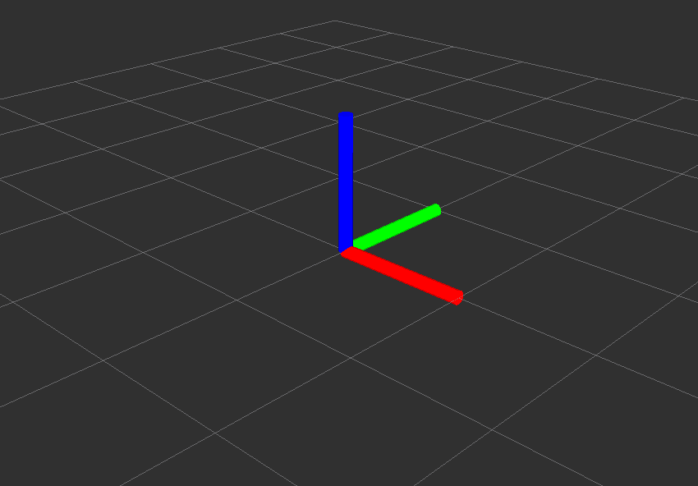
Quaternions
x y z w
0 0 1 1
0 0 .707 .707

Slide 16
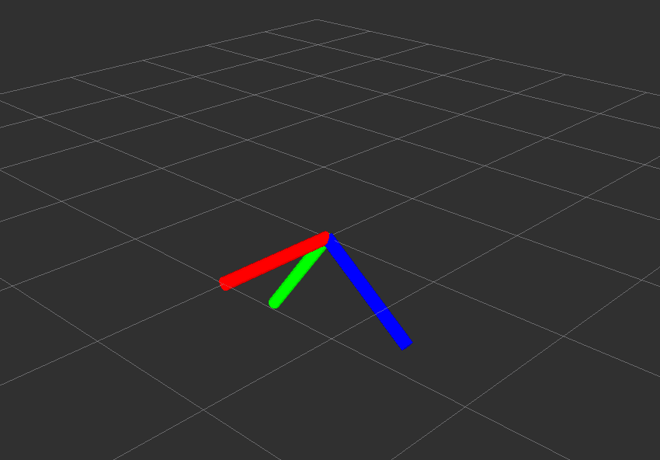
Quaternions
x y z w
1 0 0 -0.5
0.894 0.000
0.000 -0.447

Slide 17
Strike a Pose
[geometry_msgs/Pose]:
geometry_msgs/Point position
float64 x
float64 y
float64 z
geometry_msgs/Quaternion orientation
float64 x
float64 y
float64 z
float64 w

Slide 18
Translating Quaternions
from tf.transformations import *
$ print euler_from_quaternion([0.06146, 0, 0, 0.99810]
[0.123, 0, 0]
$ print quaternion_from_euler(1, 2, 3, 'ryxz')
[0.310622, -0.718287, 0.444435, 0.435953]

Slide 19
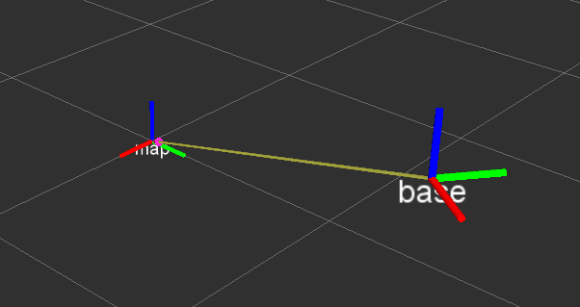
Transformations (tf)

Slide 20
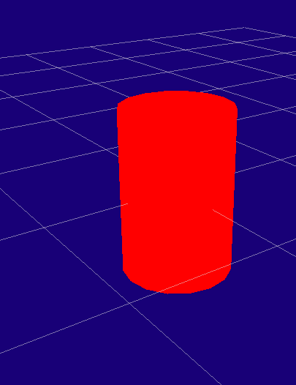
URDF
<?xml version="1.0"?> <robot name="myfirst"> <link name="base_link"> <visual> <geometry> <cylinder length="0.6" radius="0.2"/> </geometry> </visual> </link> </robot>

Slide 21

URDF
<?xml version="1.0"?> <robot name="multipleshapes"> <link name="base_link"> ... </link> <link name="right_leg"> <visual> <geometry> <box size="0.6 .2 .1"/> </geometry></visual></link> <joint name="base_to_right_leg" type="fixed"> <parent link="base_link"/> <child link="right_leg"/> </joint> </robot>

Slide 22
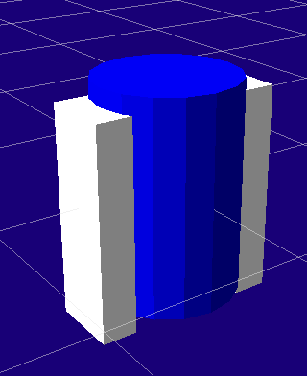
URDF
<link name="right_leg"> <visual> <geometry> <box size="0.6 .2 .1"/> </geometry> <origin rpy="0 1.57075 0" xyz="0 0 -0.3"/> </visual> </link> <joint name="base_to_right_leg" type="fixed"> <parent link="base_link"/> <child link="right_leg"/> <origin xyz="0.22 0 .25"/> </joint>

Slide 23
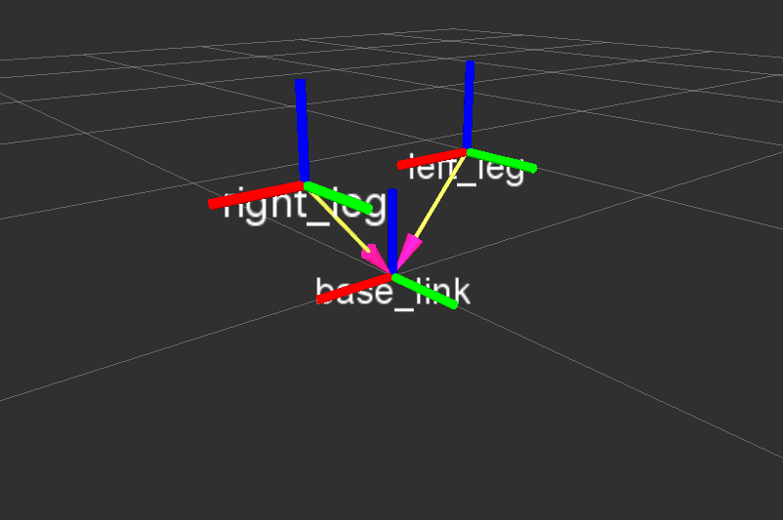
Rotation

Slide 24
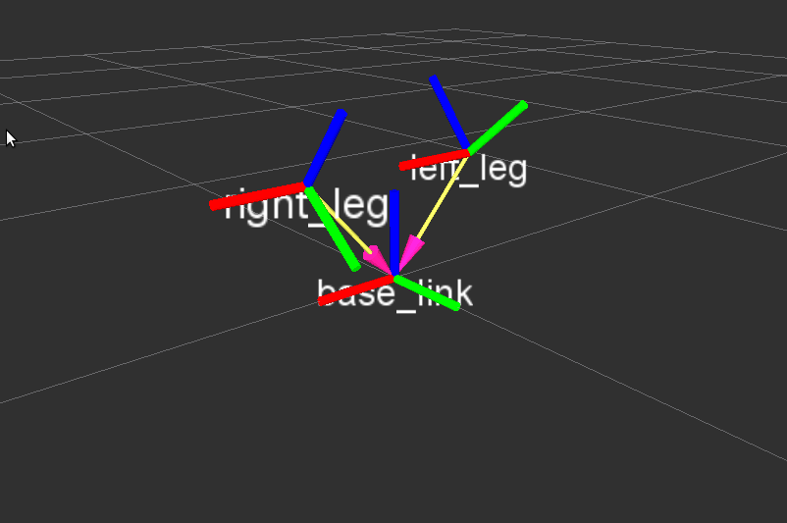
Rotation

Slide 25
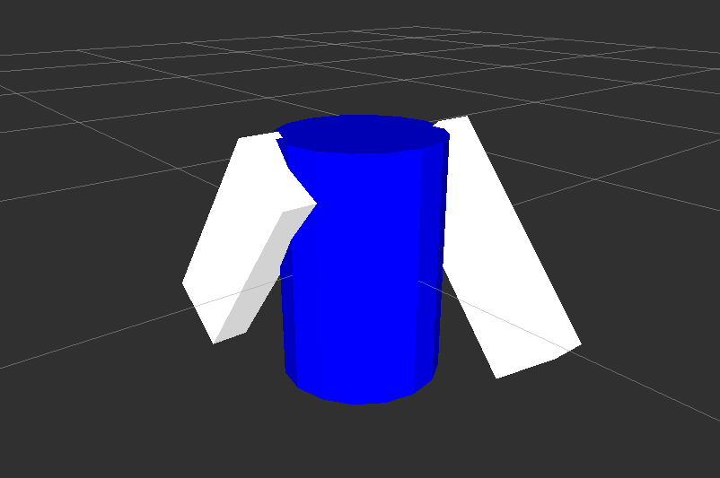
Rotation

Slide 26
Robot Geometry Pipeline
URDF
Joint
State
Publisher
Robot
State
Publisher
Joint
States
Transforms
(tf)
urdf: XML parameter /robot_description
joint states: topic sensor_msgs/JointState
TF: topic /tf

Slide 27
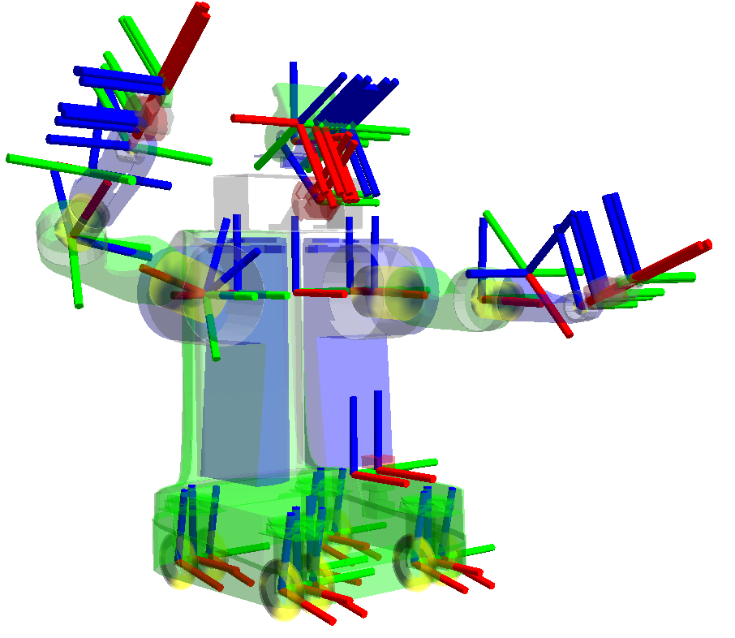
tf Library

Slide 28
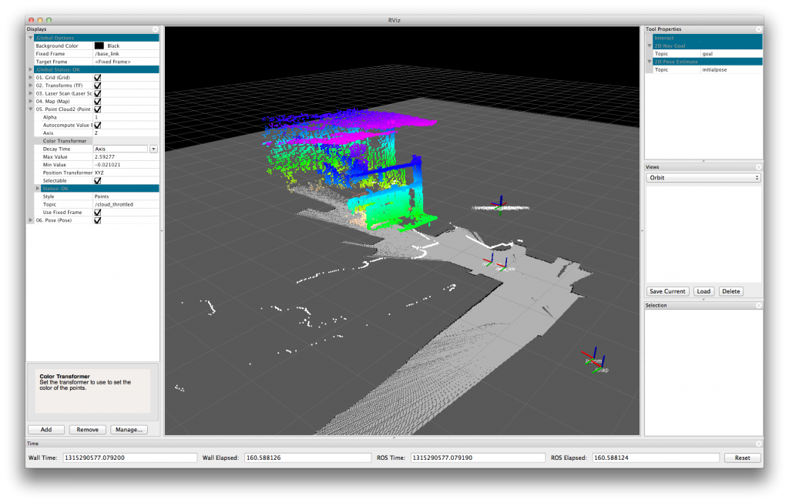
rviz

