Slide 1
Linear Algebra Review

Slide 2
Why do we need Linear Algebra?
We will associate coordinates to
  3D points in the scene
  2D points in the image
Coordinates will be used to
  Perform geometrical transformations
  Associate different coordinate systems (platform, end-effector, camera)
  Associate 3D with 2D points
Images are matrices of numbers
  We will find properties of these numbers
Octavia I. Camps

Slide 3
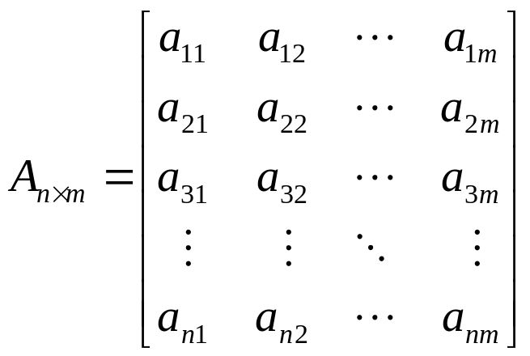
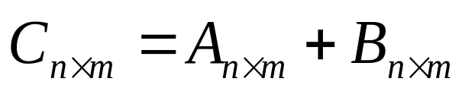
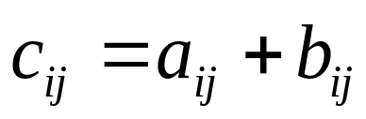
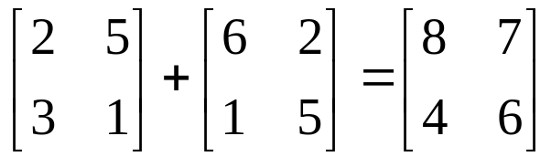
Matrices
Sum:
A and B must have the same dimensions
Example:
Octavia I. Camps

Slide 4
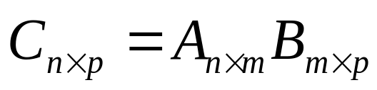
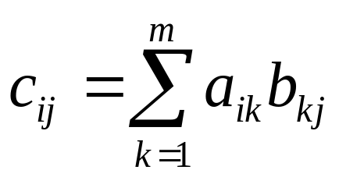
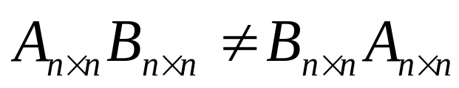
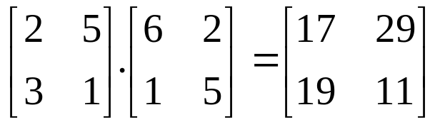
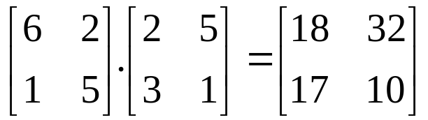
Matrices
Product:
A and B must have compatible dimensions
Examples:
Octavia I. Camps

Slide 5
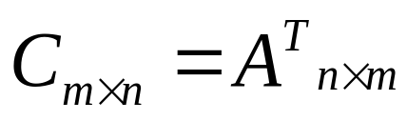
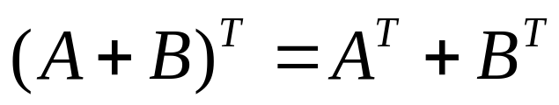
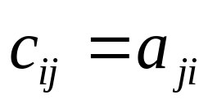
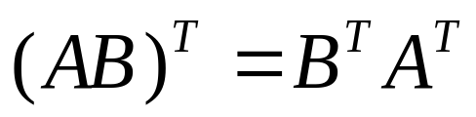
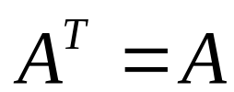
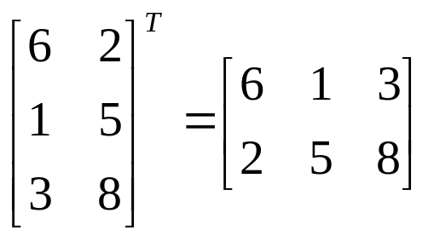
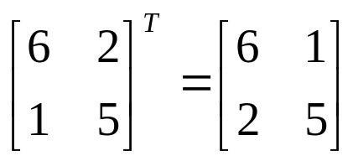
Matrices
Transpose:
If
A is symmetric
Examples:
Octavia I. Camps

Slide 6
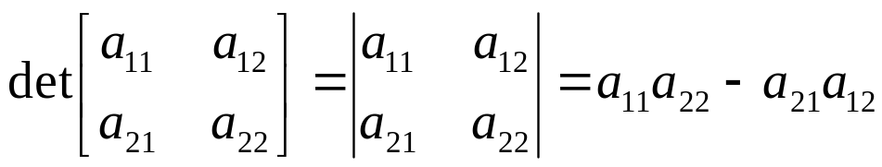
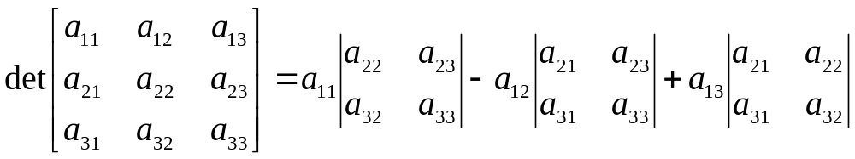
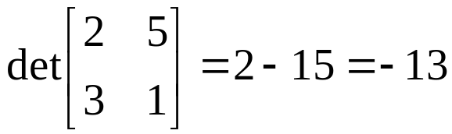
Matrices
Determinant:
A must be square
Example:
Octavia I. Camps

Slide 7
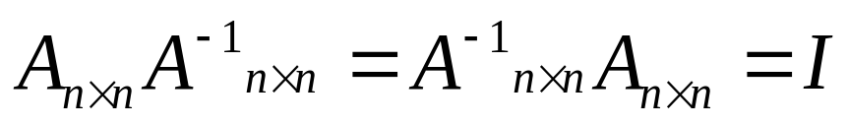
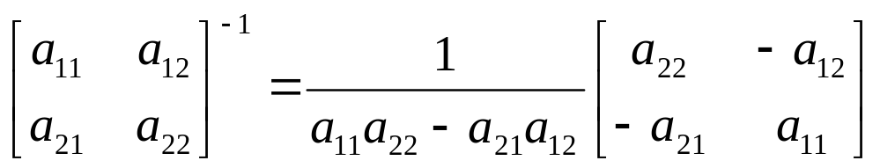
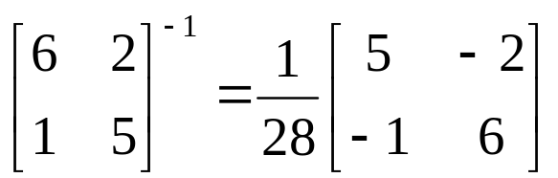
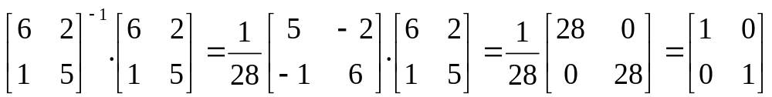
Matrices
Inverse:
A must be square
Example:
Octavia I. Camps

Slide 8
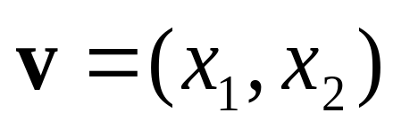
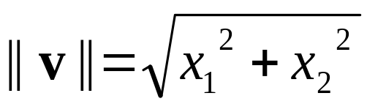


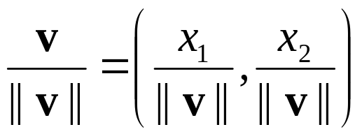
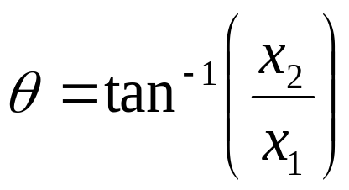
2D Vector
P
x2
v
θ
x1
Magnitude:
If
,
Is a UNIT vector
Is a unit vector
Orientation:
Octavia I. Camps

Slide 9
Vector Addition
V+w
v
w
Octavia I. Camps

Slide 10
Vector Subtraction
V-w
v
w
Octavia I. Camps

Slide 11
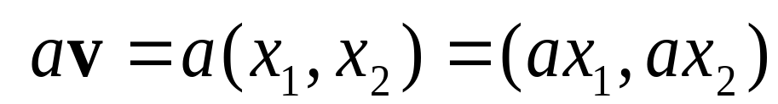
Scalar Product
av
v
Octavia I. Camps

Slide 12
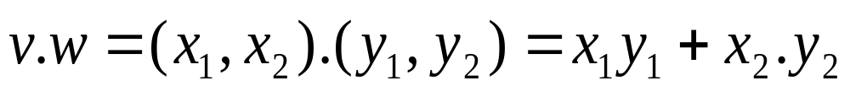
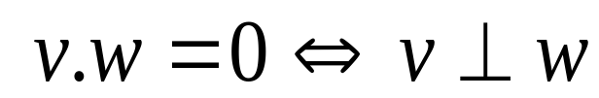
Inner (dot) Product
v
α
w
The inner product is a SCALAR!
Octavia I. Camps

Slide 13
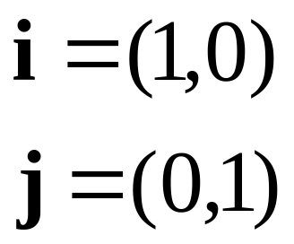
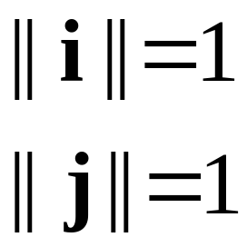
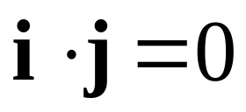
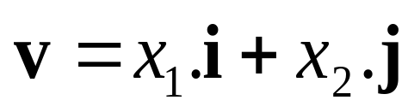
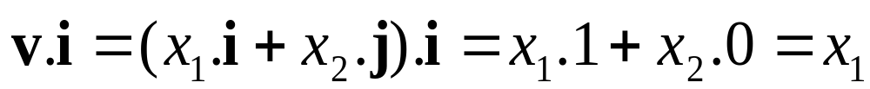
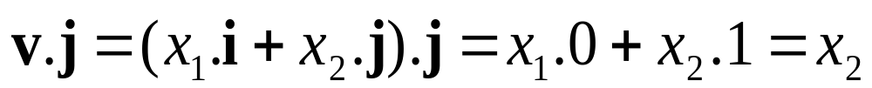
Orthonormal Basis
P
x2
v
j
θ
i
x1
Octavia I. Camps

Slide 14

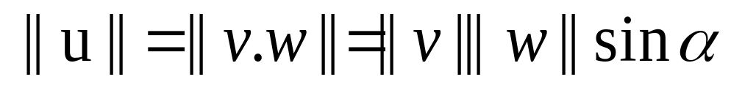
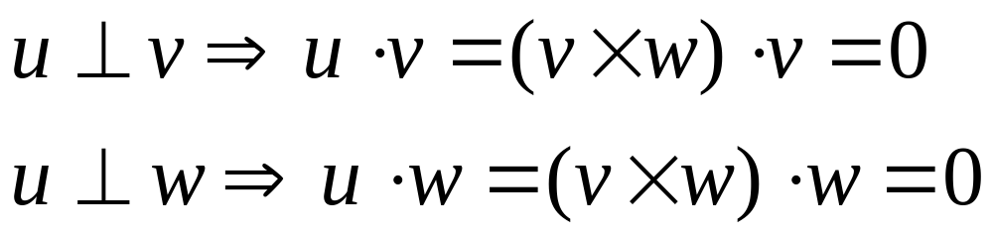
Vector (cross) Product
u
w
α
v
The cross product is a VECTOR!
Magnitude:
Orientation:
Octavia I. Camps

Slide 15
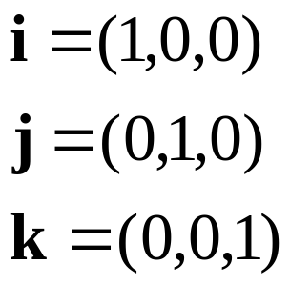
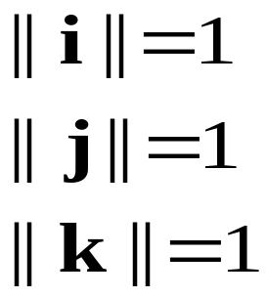

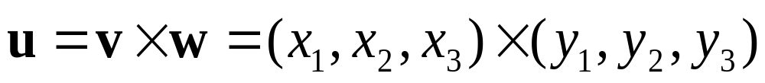
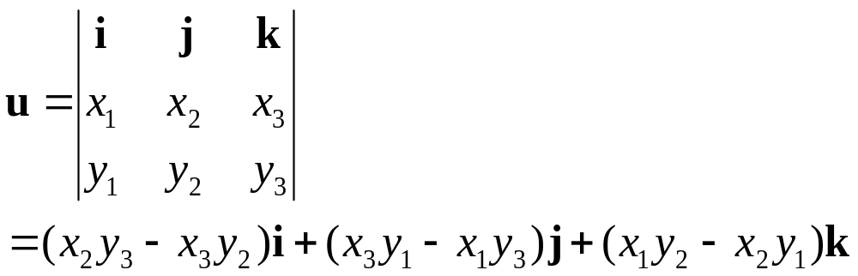
Vector Product Computation
u
w
α
v
Octavia I. Camps

Slide 16
2D Geometrical Transformations

Slide 17

2D Translation
P’
t
P
Octavia I. Camps

Slide 18
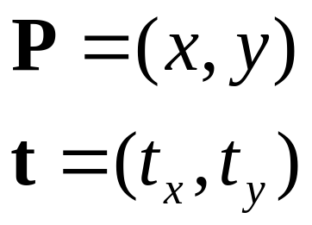
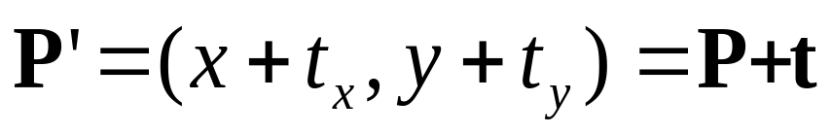
2D Translation Equation
P’
t
ty
P
y
x
tx
Octavia I. Camps

Slide 19
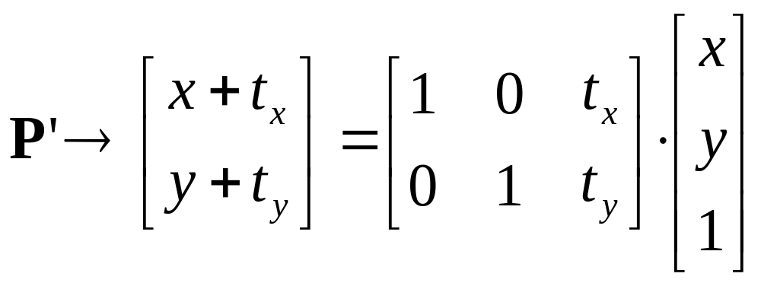
2D Translation using Matrices
P’
t
ty
P
y
t
P
x
tx
Octavia I. Camps

Slide 20
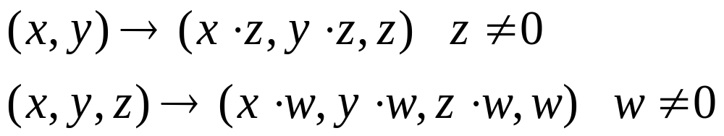
Homogeneous Coordinates
Multiply the coordinates by a non-zero scalar and add an extra coordinate equal to that scalar. For example,
NOTE: If the scalar is 1, there is no need for the multiplication!
Octavia I. Camps

Slide 21
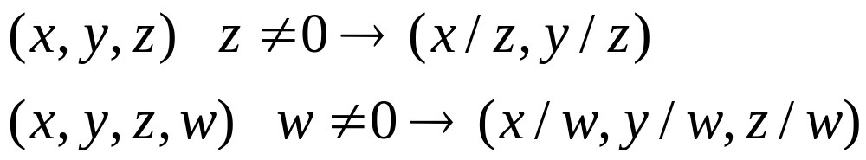
Back to Cartesian Coordinates:
Divide by the last coordinate and eliminate it. For example,
Octavia I. Camps

Slide 22
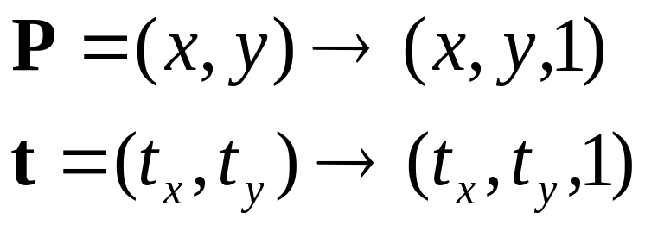
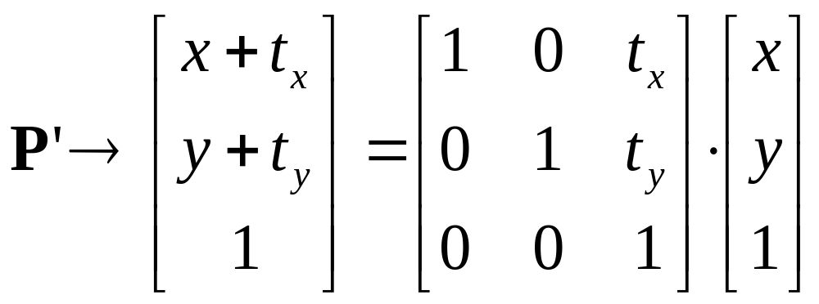


2D Translation using Homogeneous Coordinates
P’
t
t
ty
P
P
y
x
tx
Octavia I. Camps

Slide 23
Scaling
P’
P
Octavia I. Camps

Slide 24
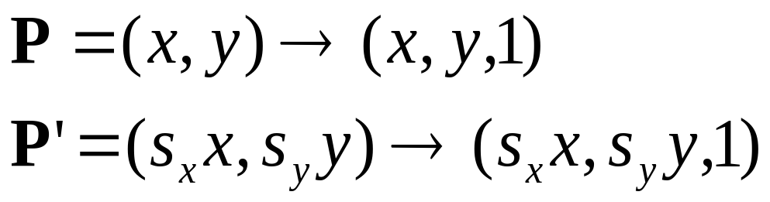



Scaling Equation
P’
Sy.y
P
y
x
Sx.x
Octavia I. Camps

Slide 25
Scaling & Translating
P’’=T.P’
S
P’=S.P
T
P
P’’=T.P’=T.(S.P)=(T.S).P
Octavia I. Camps

Slide 26

Scaling & Translating
P’’=T.P’=T.(S.P)=(T.S).P
Octavia I. Camps

Slide 27

Translating & Scaling
≠ Scaling & Translating
P’’=S.P’=S.(T.P)=(S.T).P
Octavia I. Camps

Slide 28
Rotation
P
P’
Octavia I. Camps

Slide 29


Rotation Equations
Counter-clockwise rotation by an angle θ
P’
Y’
θ
y
P
x
X’
Octavia I. Camps

Slide 30

Degrees of Freedom
R is 2x2
4 elements
BUT! There is only 1 degree of freedom: θ
The 4 elements must satisfy the following constraints:
Octavia I. Camps

Slide 31

Scaling, Translating & Rotating
Order matters!
P’ = S.P
P’’=T.P’=(T.S).P
P’’’=R.P”=R.(T.S).P=(R.T.S).P
R.T.S ≠ R.S.T ≠ T.S.R …
Octavia I. Camps

Slide 32

3D Rotation of Points
Rotation around the coordinate axes, counter-clockwise:
P’
Y’
γ
y
P
x
X’
z
Octavia I. Camps

Slide 33

3D Rotation (axis & angle)
Octavia I. Camps

Slide 34

3D Translation of Points
Translate by a vector t=(t_{x},t_{y},t_{x})^{T}:
P’
t
Y’
x
x’
P
z’
y
z
Octavia I. Camps

