Slide 1
Robotics and Perception CMSC498F
Cornelia Fermüller
AV Williams Bldg: 4459
Office hours: Tu/Th : 11:30am-12:30pm
TA: Anton Mitrokhin
AV Williams Bldg: 4470. Lab: 4468
Office hours: Mon : 11am-12pm
Wed : 11am-1pm

Slide 2
Books and Resources
Textbook:
R. Siegwart I. Nourbakhsh, and D. Scaramuzza: Autonomous Mobile Robots, Second Edition, MIT Press, 2011, First Edition: http://www.mobilerobots.org
Peter Corke: Robotics, Vision and Control, Fundamental Algorithms in Matlab: http://link.springer.com/book/10.1007%2F978-3-642-20144-8
Recommended books:
S. Thrun, W. Burghart, D. Fox: Probabilistic Robotics, http://robots.stanford.edu/probabilistic-robotics/
Online Resources :
Robot Systems Programming Course at JHU
Introduction to Autonomous Robotics by N. Correll
Planning Algorithms by S. LaValle

Slide 3
Logistics
Grading:
Projects: 65%
Exam and Homeworks: 35 %
Homeworks: Paper and pencil problems
Mid-term: March 16

Slide 4
Origins
Term ‘Robot’ due to Czech science fiction play R.U.R. (Rossum’s Universal Robots) by Karel Čapek, 1921.
(Czeck word for slave) , mechanical men on assembly line
Isaac Asimov : Russian born Science fiction writer, 1942 positive story “Runabaout”, helpful servers.
3 Laws:
Law One A robot may not injure a human being or, through inaction, allow a human being to come to harm.
Law Two A robot must obey the orders given it by human beings except where such orders would conflict with the First Law.
Law Three A robot must protect its own existence as long as such protection does not conflict with the First or Second Law.

Slide 5
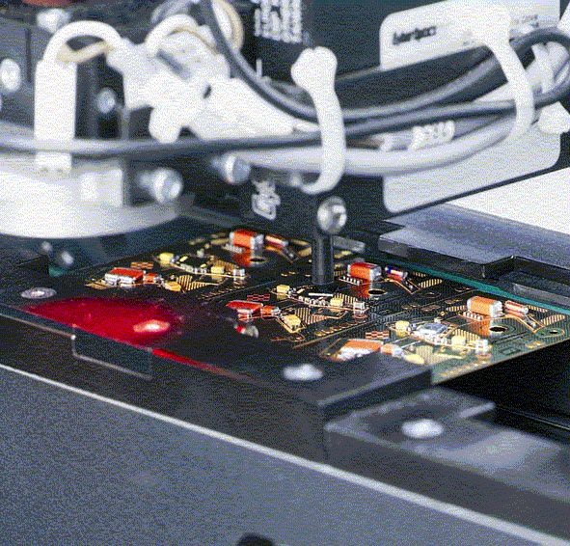
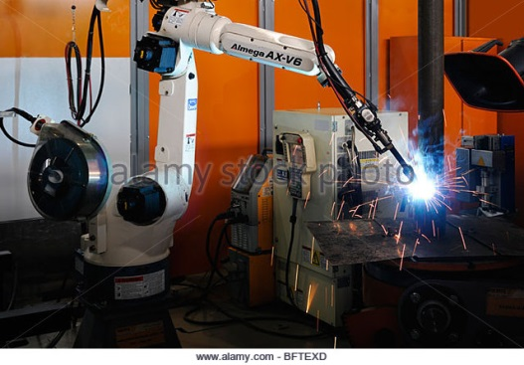
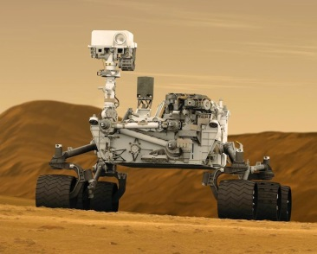
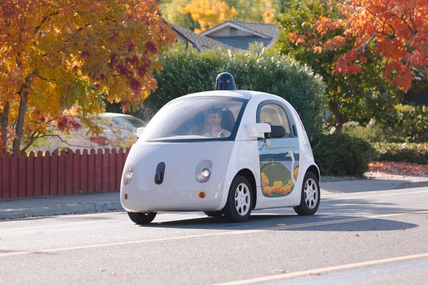
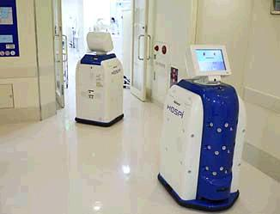
Common Robots
Manufacturing: typical manipulators, high speed and precision
Field and service Robots:
Challenges: 1.) move in complex and cluttered environments
2.) operate safely in the presence of people
Mars Rover
Google’s self driving car
Hospital delivery robot

Slide 6
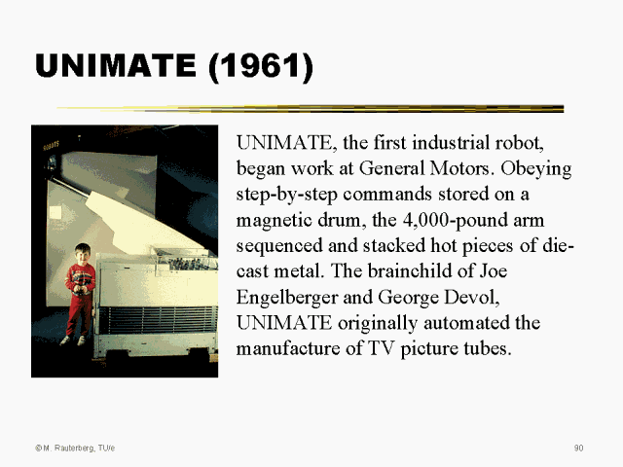
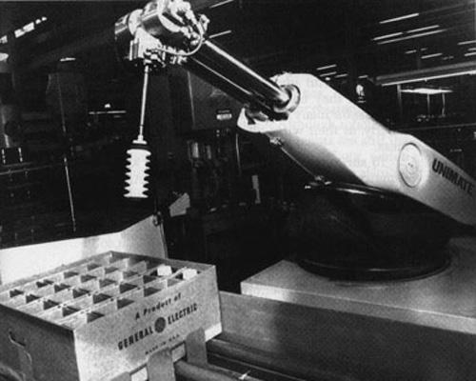
Autonomous Robots
Robots making decision in response to their environment vs. being preprogrammed (like Unimate)
George C. Devol (inventor)
Joseph F. Engelberger (business man)
Unimate was the first industrial robot, completely preprogrammed,
appeared in 1961 in a “Tonight Show”

Slide 7
Robotics involves
Mechanics
Sensors: (proprioceptive, GPS, active depth sensor such as laser or Vision)
Control
Signal processing
Planning
Artificial Intelligence
Human Computer Interaction

Slide 8
Examples
Mechanical:
Boston Dynamics:
Cheeta : http://www.bostondynamics.com/robot_cheetah.html
SandFlea: http://www.bostondynamics.com/robot_sandflea.html
Control:
Planning and Control for quadroptors
https://www.youtube.com/watch?v=5l27chpTzhg
Computation:
Bin Picking Robot from Mitsubishi
https://www.youtube.com/watch?v=G6o-ZHlbWow
Robot Human Interaction
Robot mimics social expressions: https://www.youtube.com/watch?v=dVsgJf8Kgi8
Robovie Claiming Responsibility: http://depts.washington.edu/hints/video2b.shtml

Slide 9
Topics
Introduction
Rigid Body Motion
Mobile Robot Kinematics
Mobile Robot Control
Path Planning
Sensors
Vision: visual features for recognition,
attention, segmentation, object recognition
8. Mobile Robot Localization and Mapping
RGB-D processing: mapping, aligning, 3D model building
Grasping
Visual Sevoing

Slide 10
Projects
Kinematics : forward and inverse differential drive robot in simulation and with the platform
Control of the navigating robot
Path planning in a map: potential field based control
mapping
Localization (AMCL localization)
Images: navigation + visual recognition: find objects
3D object descriptions using point clouds and picking up objects

Slide 11
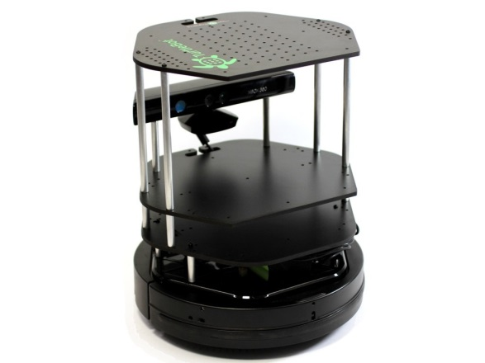
Autonomous Navigation Involves
Key Questions
Where am I ?
Where am I going ?
How do I get there ?
To answer these questions the robot has to
have a model of the environment (given or autonomously built)
perceive and analyze the environment
find its position within the environment
plan and execute the movement

Slide 12
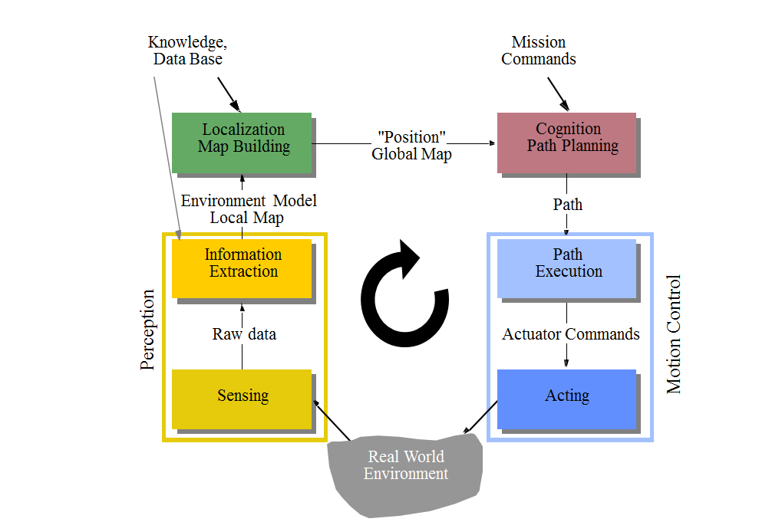
Control Scheme for Mobile Robot Systems
from R. Siegwart

Slide 13
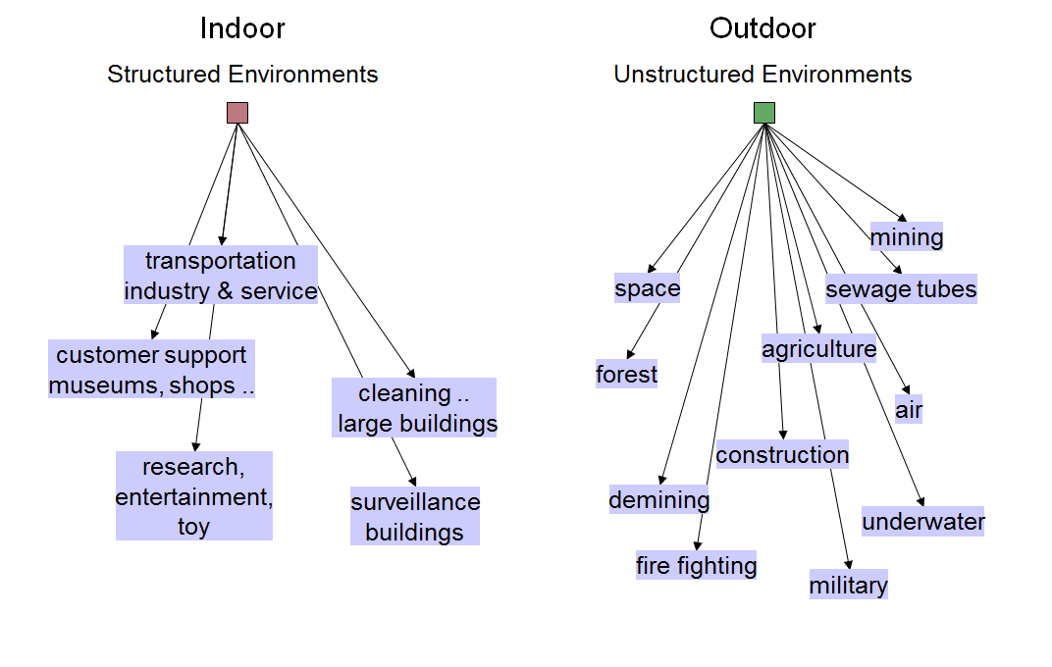
Applications of Mobile Robots

Slide 14
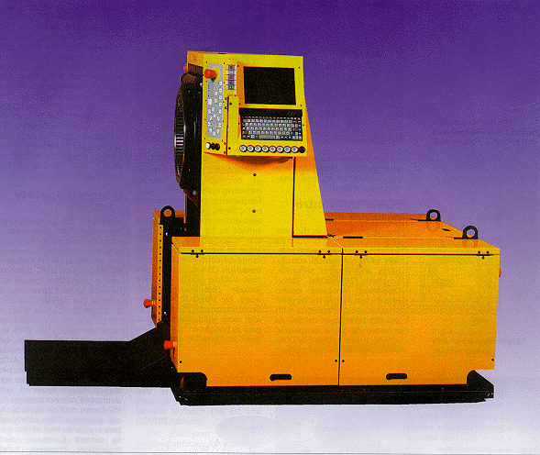
Automatic Guided Vehicles
Newest generation of Automatic Guided Vehicle of VOLVO used to transport motor blocks from one assembly station to an other. It is guided by an electrical wire installed in the floor but it is also able to leave the wire to avoid obstacles. There are over 4000 AGV only at VOLVO’s plants.

Slide 15
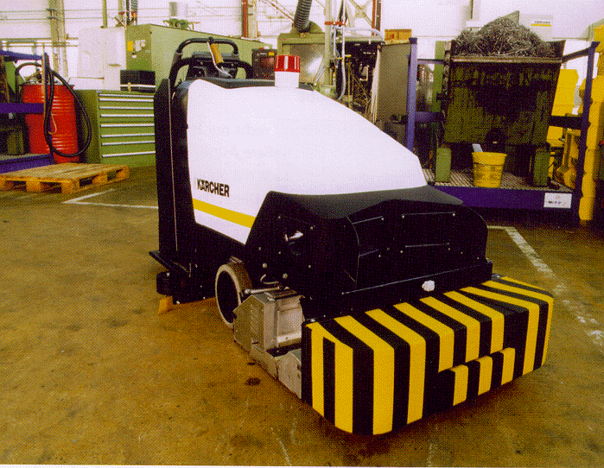
BR700 Cleaning Robot
BR 700 cleaning robot developed and sold by Kärcher Inc., Germany. Its navigation system is based on a very sophisticated sonar system and a gyro. http://www.kaercher.de

Slide 16
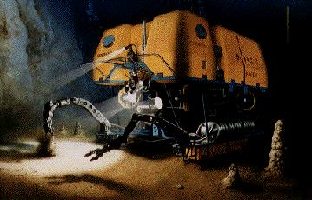
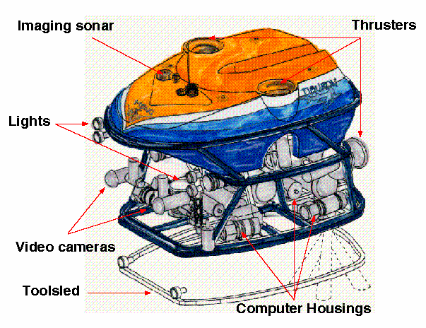
ROV Tiburon Underwater Robot
Picture of robot ROV Tiburon for underwater archaeology (teleoperated)- used by MBARI for deep-sea research, this UAV provides autonomous hovering capabilities for the human operator.

Slide 17
The Pioneer
Picture of Pioneer, the teleoperated robot that was supposed to explore the Sarcophagus at Chernobyl

Slide 18
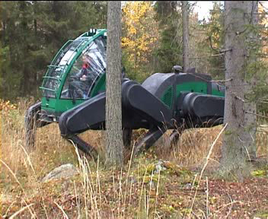
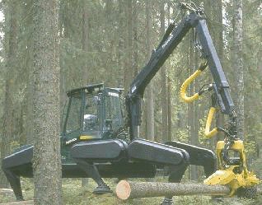
Forester Robot
Pulstech developed the first ‘industrial like’ walking robot. It is designed to move wood out of the forest. The leg coordination is automated, but navigation is still done by the human operator on the robot. http://www.plustech.fi/

Slide 19
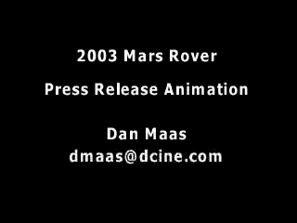
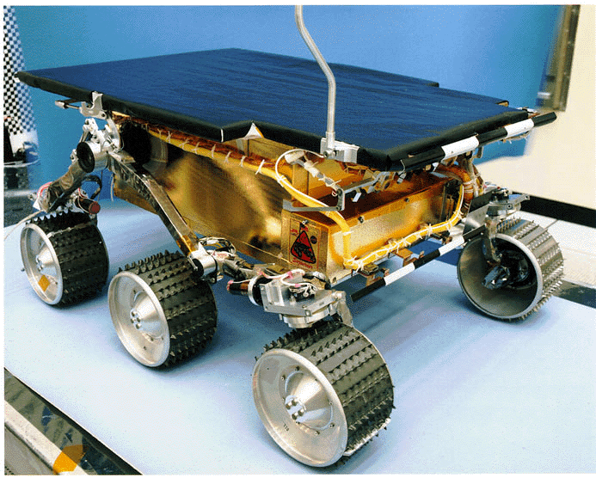
Sojourner, First Robot on Mars
The mobile robot Sojourner was used during the Pathfinder mission to explore the mars in summer 1997. It was nearly fully teleoperated from earth. However, some on board sensors allowed for obstacle detection. http://ranier.oact.hq.nasa.gov/telerobotics_page/telerobotics.shtm

Slide 20
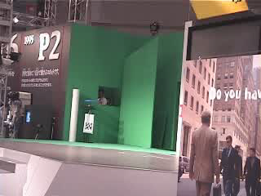
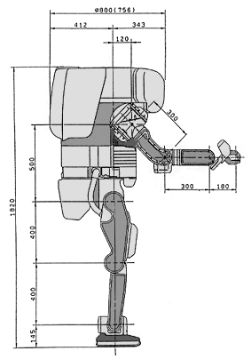
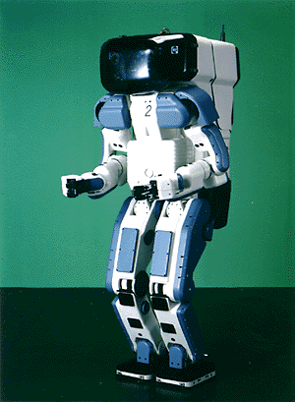
The Honda Walking Robot http://asimo.honda.com/
https://www.youtube.com/watch?v=OlDMlYHl2tU

Slide 21
Manipulation
Planning the arm trajectory
Visual Recognition and Recognition from Depth data
Reconstruction (Position, Pose and Shape of Object)
Vision based Servo Control (still research)

Slide 22
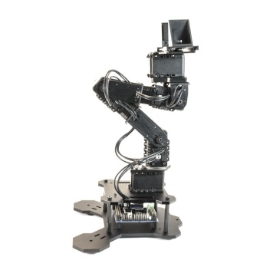
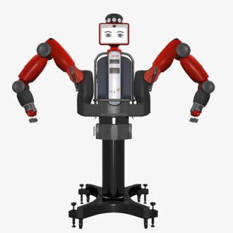
Our hardware and software
Turtlebots
Phantom Pincher Arm Kits
Baxter
ROS : http://wiki.ros.org/ROS/Introduction
Turlebot: http://wiki.ros.org/Robots/TurtleBot

Slide 23
Cognitive Robotics: ARC Lab
Learning to cook from Youtube videos:
https://www.youtube.com/watch?v=0cCFfFNyU3w&t=8s
UMD’s robot learns to make a drink by watching people :
https://www.youtube.com/watch?v=t-qEV6hTxFw&t=63s
Pointing: https://www.dropbox.com/s/qy65zg73pstj8t0/Pointing.mp4?dl=0
Microwave: https://www.dropbox.com/s/c09djd7mbbrgzvc/microwave_demo_high_resolution.mp4?dl=0

