Slide 1
Multiple View Geometry for Robotics

Slide 2
Multiple View Geometry for Robotics
Estimate 3D Motion of the Robot
Estimate the Geometry of the World (Depth of Scene and Shape)
Estimate the Movement of Independently Moving Objects
Motion Tracking
Navigation
Manipulation

Slide 3
Scenarios
The two images can arise from
A stereo rig consisting of two cameras
the two images are acquired simultaneously
or
A single moving camera (static scene)
the two images are acquired sequentially
The two scenarios are geometrically equivalent

Slide 4
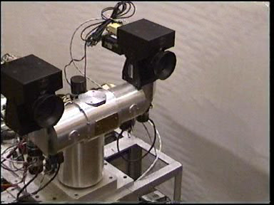
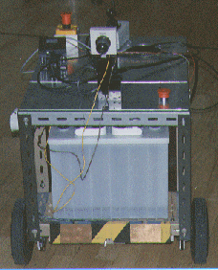
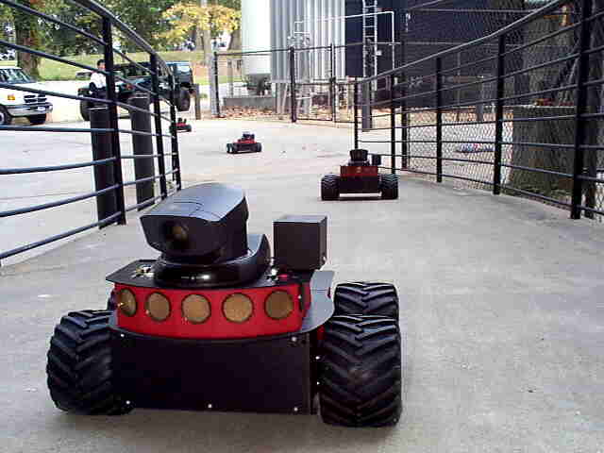

Stereo head
Camera on a mobile vehicle

Slide 5





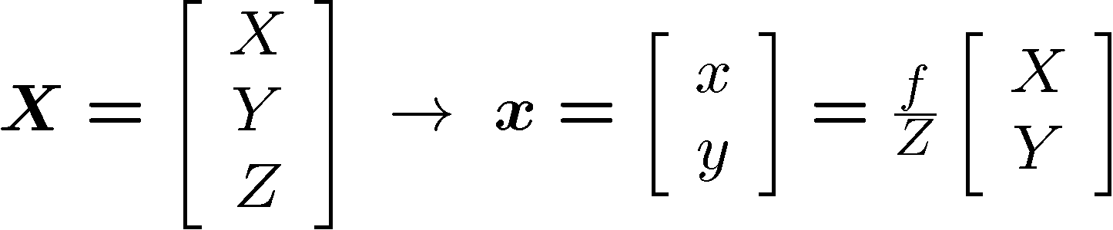
Image Formation
Pinhole
Frontal pinhole

Slide 6
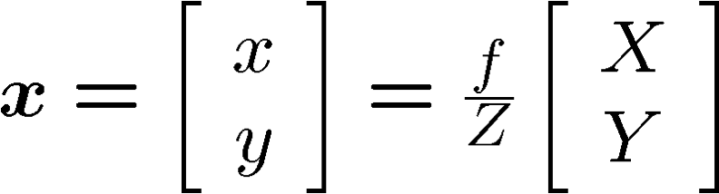
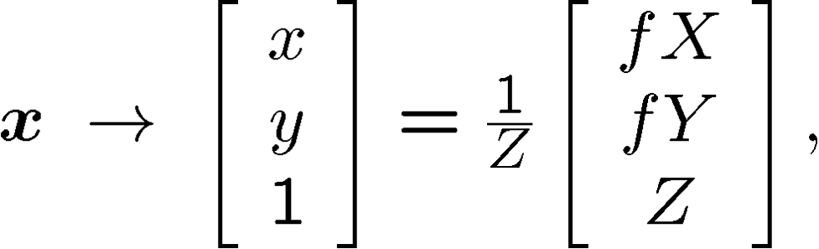
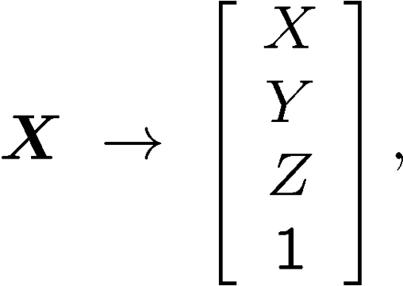
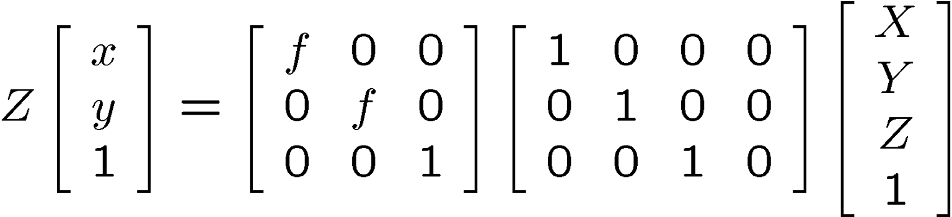


Pinhole Camera Model
Image coordinates are nonlinear function of world coordinates
Relationship between coordinates in the camera frame and sensor plane
2-D coordinates Homogeneous coordinates

Slide 7
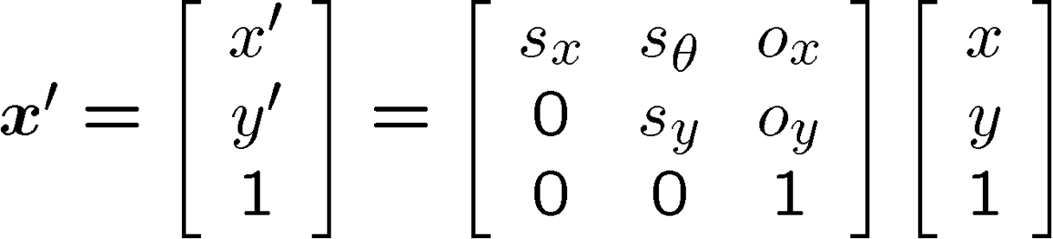









Image Coordinates
Relationship between coordinates in the sensor plane and image
metric coordinates
Linear transformation
pixel coordinates
CS482, Jana Kosecka

Slide 8


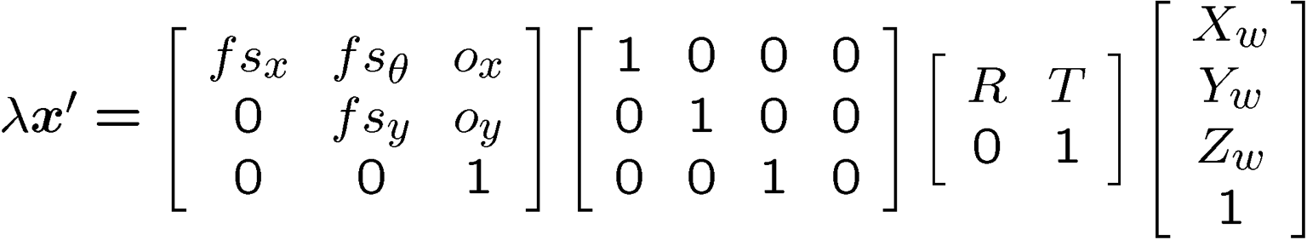

Calibration Matrix and Camera Model
Relationship between coordinates in the world frame and image
Intrinsic parameters
Pinhole camera Pixel coordinates
Adding transformation between camera coordinate systems and world coordinate system
Extrinsic Parameters

Slide 9
Transformation between 2 views Camera parameters :
Intrinsic parameters: ( Calibration parameters)
Principal point coordinates
Focal length
Pixel magnification factors
Skew (non-rectangular pixels)
Radial distortion
Extrinsic parameters
Rotation and translation relative to world coordinate system

Slide 10








Image of a Point
Homogeneous coordinates of a 3-D point
Homogeneous coordinates of its 2-D image
Projection of a 3-D point to an image plane
Kosecka, CS 685
18

Slide 11
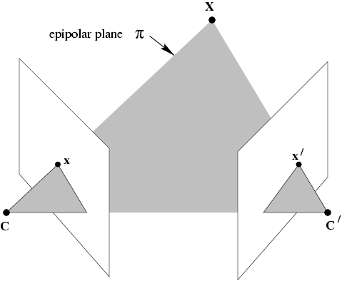
The epipolar geometry
C,C’,x,x’ and X are coplanar

Slide 12
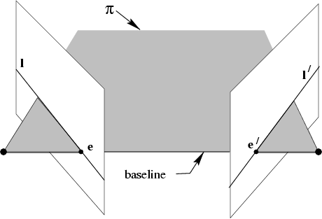
The epipolar geometry
All points on π project on l and l’

Slide 13
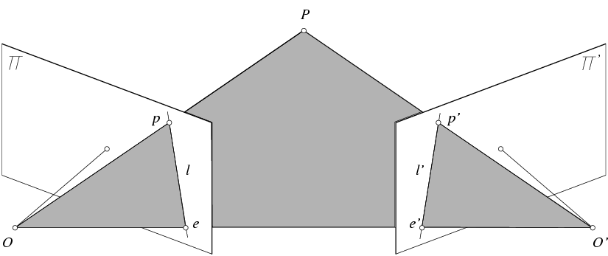
Epipolar constraint (general case)
X
= (x,1)^{T}
x
x’ = Rx+t
t
R
The vectors Rx, t, and x’ are coplanar
Notes:
X’ is X in the second camera’s coordinate system
We can identify the non-homogeneous 3D vectors X and X’ with the homogeneous coordinate vectors x and x’ of the projections of the two points into the two respective images

Slide 14
Epipolar constraint: Calibrated case
X
x
x’ = Rx+t
Essential Matrix
(Longuet-Higgins, 1981)
The vectors Rx, t, and x’ are coplanar

Slide 15
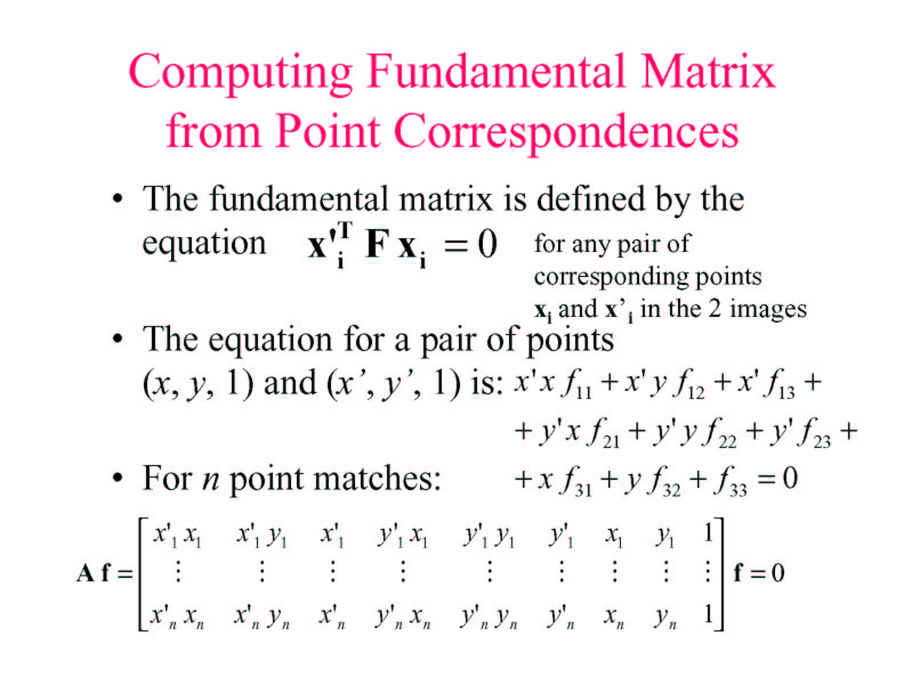

Slide 16
Two View Geometry
When a camera changes position and orientation, the scene moves rigidly relative to the camera
3-D
Scene
u’
u
Rotation + translation

Slide 17
Objective:
find formulas that links corresponding points
3-D
Scene
u’
u
Rotation + translation

Slide 18
Two View Geometry (simple cases)
In two cases this results in homography:
Camera rotates around its focal point
The scene is planar
Then:
Point correspondence forms 1:1mapping
depth cannot be recovered

Slide 19
Camera Rotation
(R is 3x3 non-singular)

Slide 20
Planar Scenes
Scene
Intuitively
A sequence of two perspectivities
Algebraically
Need to show:
Camera 2
Camera 1

Slide 21
Summary: Two Views Related by Homography
Two images are related by homography:
One to one mapping from p to p’
H contains 8 degrees of freedom
Given correspondences, each point determines 2 equations
4 points are required to recover H
Depth cannot be recovered

Slide 22
Stereo
Assumes (two) cameras.
Known positions.
Recover depth.

Slide 23
Depth from disparity
X
z
x
x’
f
B₁
B₂
f
O
Baseline B
O’
Disparity is inversely proportional to depth!

Slide 24

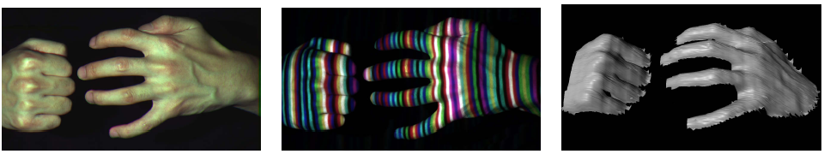
Active stereo with structured light
Project “structured” light patterns onto the object
Simplifies the correspondence problem
Allows us to use only one camera
camera
projector
L. Zhang, B. Curless, and S. M. Seitz. Rapid Shape Acquisition Using Color Structured Light and Multi-pass Dynamic Programming. 3DPVT 2002

Slide 25
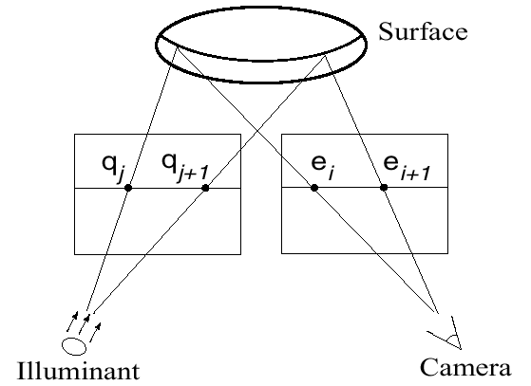
Active stereo with structured light
L. Zhang, B. Curless, and S. M. Seitz. Rapid Shape Acquisition Using Color Structured Light and Multi-pass Dynamic Programming. 3DPVT 2002

Slide 26
Active stereo with structured light
http://en.wikipedia.org/wiki/Structured-light_3D_scanner

Slide 27
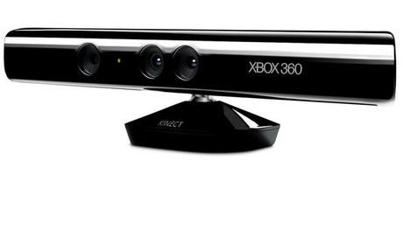
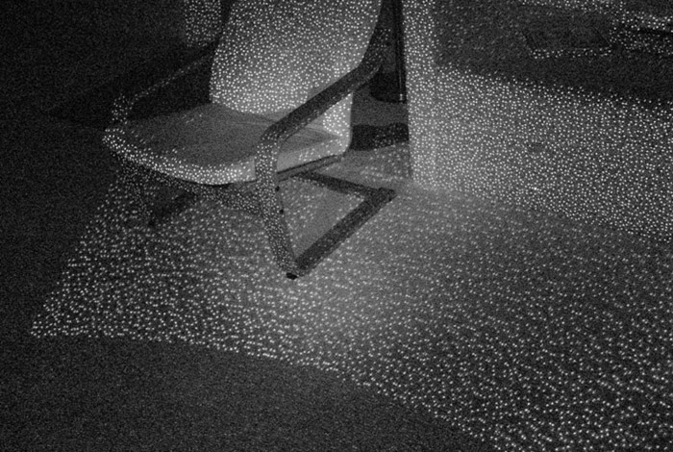
Kinect: Structured infrared light
http://bbzippo.wordpress.com/2010/11/28/kinect-in-infrared/

Slide 28
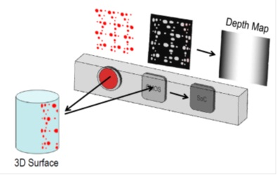
Kinect 1
Kinect uses a speckle pattern of dots that are projected onto a scene by means of an IR projector, and detected by an IR camera.
Each IR dot in the speckle pattern has a unique surrounding area and therefore allows each dot to be easily identified when projected onto a scene. The processing performed in the Kinect in order to calculate depth is essentially a stereo vision computation.

