Slide 1
Probabilistic Robotics
Bayes Filter Implementations
Gaussian filters

Slide 2
Markov ⬄ Kalman Filter Localization
Markov localization
Kalman filter localization
tracks the robot and is inherently very precise and efficient.
However, if the uncertainty of the robot becomes to large (e.g. collision with an object) the Kalman filter will fail and
localization starting from any unknown position
recovers from ambiguous situation.
However, to update the probability of all positions within the
whole state space at any time requires a discrete representation of the space (grid). The required memory and calculation power can thus become very important if a fine grid is used.
the position is definitively lost.

Slide 3
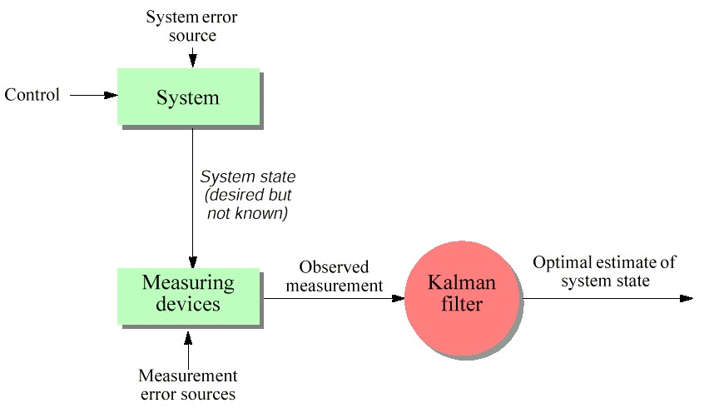
Kalman Filter Localization

Slide 4
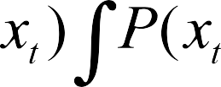

Bayes Filter Reminder
1. Algorithm Bayes_filter( Bel(x),d ):
2. η=0
If d is a perceptual data item z then
For all x do
5.
6.
7.
8.
9.
10.
11.
12.
For all x do
Else if d is an action data item u then For all x do
Return Bel’(x)
4

Slide 5
Bayes Filter Reminder
Prediction
Correction

Slide 6
Kalman Filter
Bayes filter with Gaussians
Developed in the late 1950's
Most relevant Bayes filter variant in practice
Applications range from economics, wheather forecasting, satellite navigation to robotics and many more.
The Kalman filter "algorithm" is
a couple of matrix multiplications!
6

Slide 7
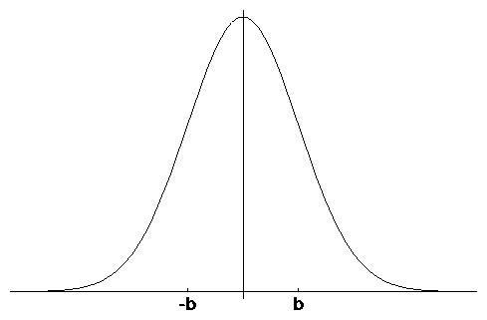
Gaussians
p(x) ~ N(μ,σ ² ) :
μ
1
−
_{e} 2
1 ( x− μ )²
p(x) =
_{σ} 2
2πσ
Univariate
-σ
σ
μ
Multivariate

Slide 8
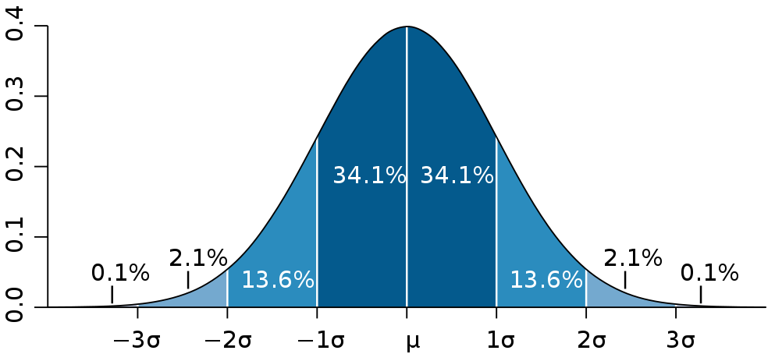
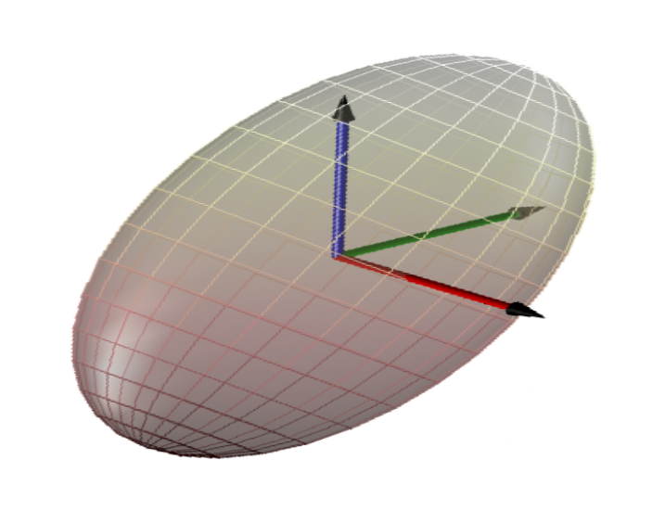
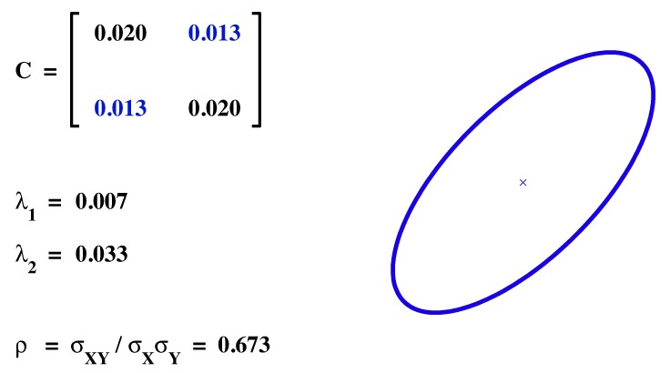
Gaussians
1D
3D
2D
Video
correlation

Slide 9
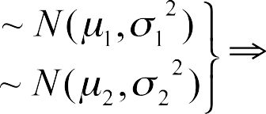
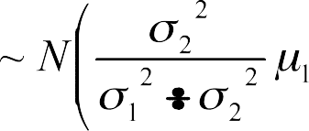
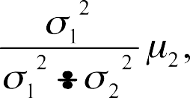

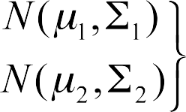

Properties of Gaussians
Univariate
Multivariate
We stay in the “Gaussian world” as long as we start with Gaussians and perform only linear transformations

Slide 10
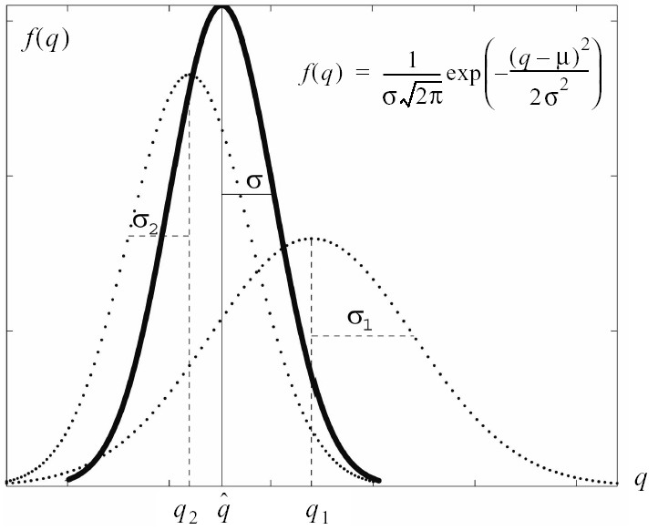


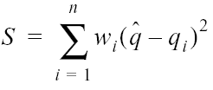
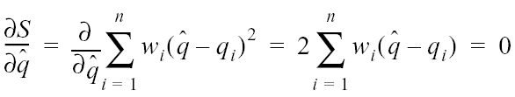
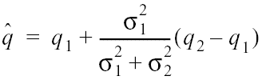
Introduction to Kalman Filter (1)
Two measurements no dynamics
Weighted least-square
Finding minimum error
After some calculation and rearrangements
Another way to look at it – weigthed mean
If w_{i} = 1/σ_{i}²

Slide 11
Discrete Kalman Filter
Estimates the state x of a discrete-time controlled process that is governed by the linear stochastic difference equation
Process dynamics
with a measurement
Observation model
Matrix (nxn) that describes how the state evolves from t -1 to t without controls or noise.
Matrix (nxl) that describes how the control u_{t} changes the state from t-1 to t.
Matrix (kxn) that describes how to map the state x_{t} to an observation z_{t}.
Random variables representing the process and measurement noise that are assumed to be independent and normally distributed with covariance R_{t} and Q_{t} respectively.
11

Slide 12
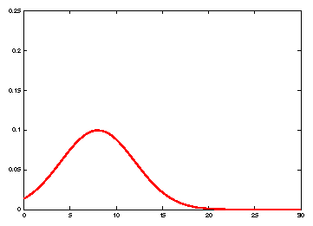
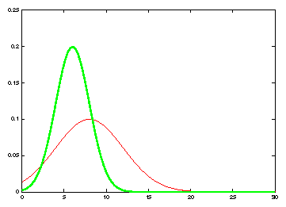
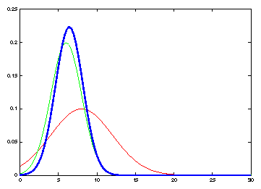

Kalman Filter Updates in 1D
prediction
measurement
correction
It's a weighted mean!

Slide 13
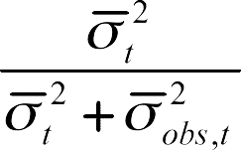

Kalman Filter Updates in 1D
gain
innovation

Slide 14
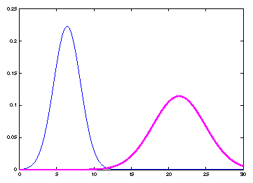
Kalman Filter Updates in 1D
1

Slide 15
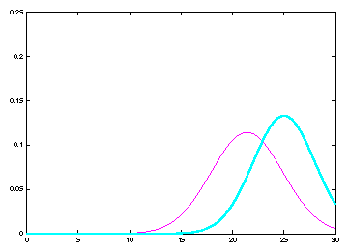
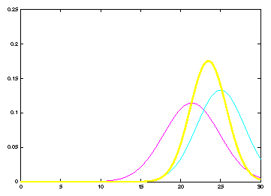
Kalman Filter Updates
1

Slide 16
Linear Gaussian Systems: Initialization
Initial belief is normally distributed:

Slide 17
Linear Gaussian Systems: Dynamics
Dynamics are linear function of state and control plus additive noise:

Slide 18


Linear Gaussian Systems: Dynamics

Slide 19
Linear Gaussian Systems: Observations
Observations are linear function of state plus additive noise:

Slide 20

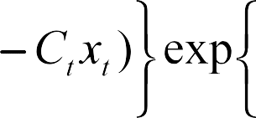

Linear Gaussian Systems: Observations

Slide 21

Kalman Filter Algorithm
Algorithm Kalman_filter( μ_{t-1}, Σ_{t-1}, u_{t}, z_{t}):
Prediction: 1.
2.
Correction: 3.
4.
5.
6.
Compute Gain
J_{t} =
Compute Innovation
Update
Return μ_{t}, Σ_{t}

Slide 22
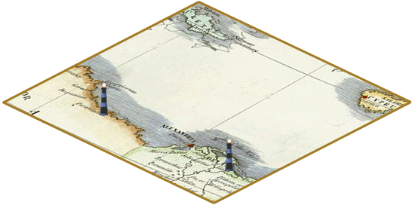
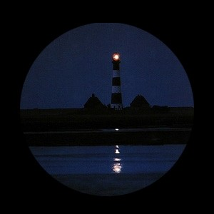
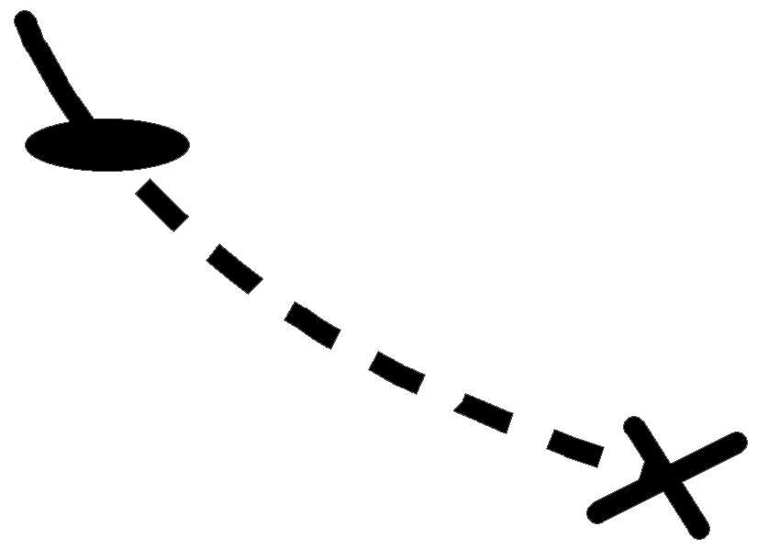




Kalman Filter Algorithm

Slide 23

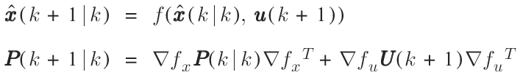

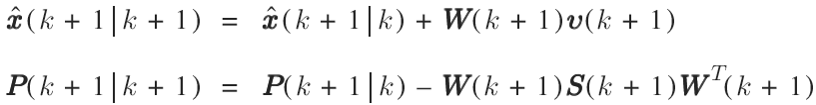
Kalman Filter Algorithm
Prediction
Observation
Matching
Correction

Slide 24
The Prediction-Correction-Cycle
Prediction

Slide 25
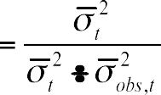
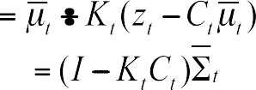

The Prediction-Correction-Cycle
Correction

Slide 26





The Prediction-Correction-Cycle
Prediction
Correction

Slide 27
Kalman Filter Summary
Highly efficient: Polynomial in measurement dimensionality k
and state dimensionality n:
_{O(k}2.376 _{+ n}2₎
Optimal for linear Gaussian systems!
Most robotics systems are nonlinear!

Slide 28
Nonlinear Dynamic Systems
Most realistic robotic problems involve nonlinear functions
x_{t} = f(u_{t} , x_{t −1} )
z_{t} = h(x_{t} )
Extended Kalman filter relaxes linearity assumption

Slide 29
EKF
x_{t} = f(x_{t-1},u_{t}) + w_{t} z_{t} = h(x_{t}) + v_{t}
x_{t} = f(μ_{t-1},u_{t}) + f'(μ_{t},u_{t})(x_{t-1}-μ_{t-1}) + w_{t}
z_{t} = h(μ_{t}) + h'(μ_{t}) (x_{t}-μ_{t})
Jacobian Matrices: f'(μ_{t},u_{t}), h'(μ_{t})

Slide 30
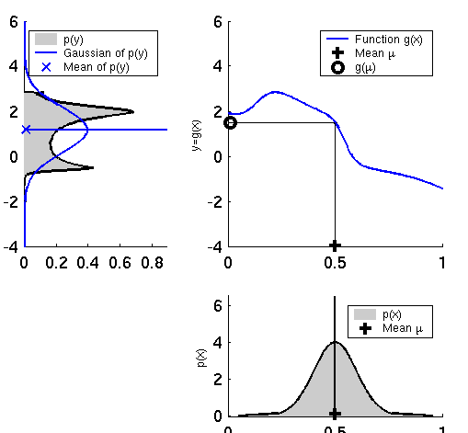
Other Error Prop. Techniques
Second-Order Error Propagation
Rarely used (complex expressions)
Monte-Carlo
Non-parametric representation of uncertainties
Sampling from p(X)
Propagation of samples
Histogramming
Normalization

Slide 31
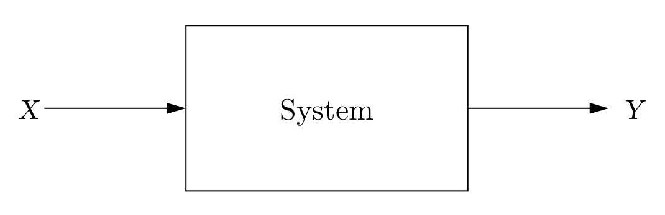
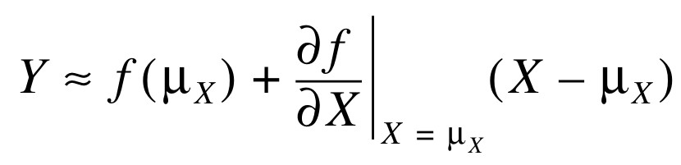


First-Order Error Propagation
X,Y assumed to be Gaussian
Y = f(X)
Taylor series expansion
Wanted:
,

Slide 32
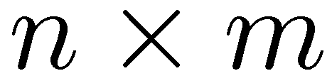
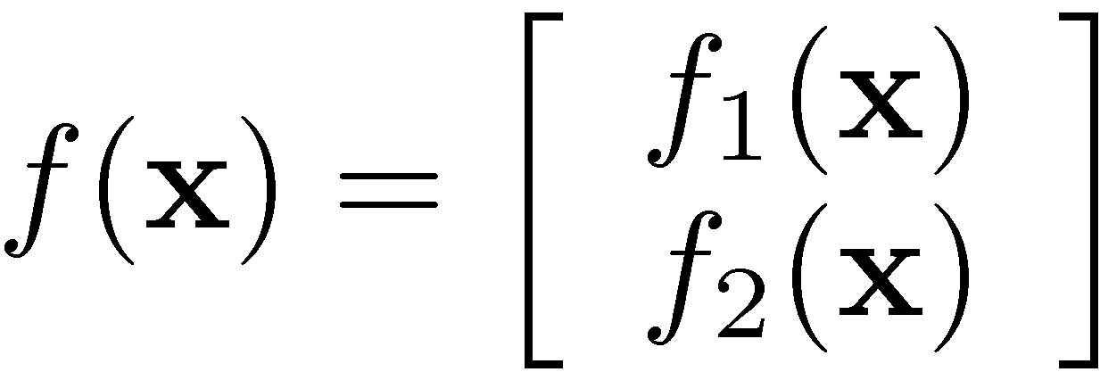
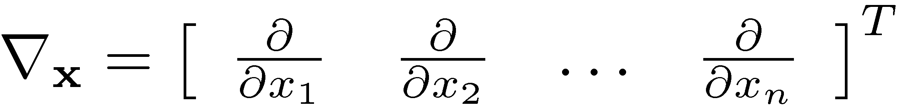
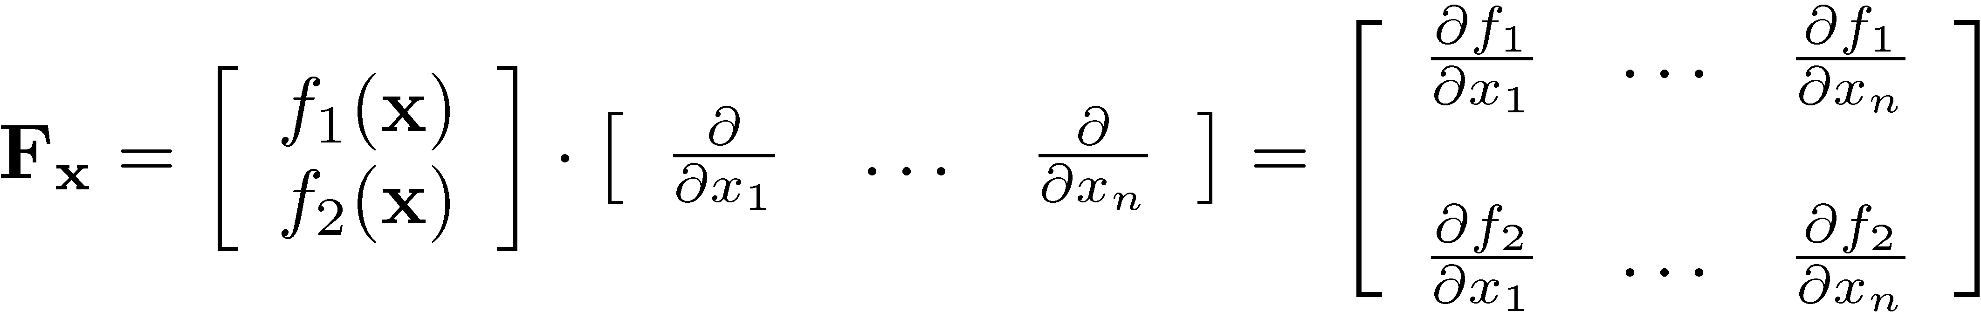
Jacobian Matrix
It’s a non-square matrix in general
Suppose you have a vector-valued function
•
Let the gradient operator be the vector of (first-order) partial derivatives
Then, the Jacobian matrix is defined as

Slide 33
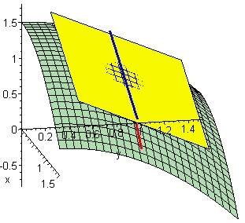
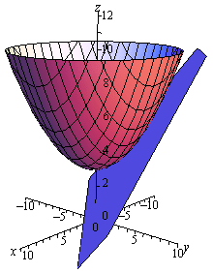
Jacobian Matrix
It’s the orientation of the tangent plane to the vector- valued function at a given point
Generalizes the gradient of a scalar valued function
Heavily used for first-order error propagation...

Slide 34
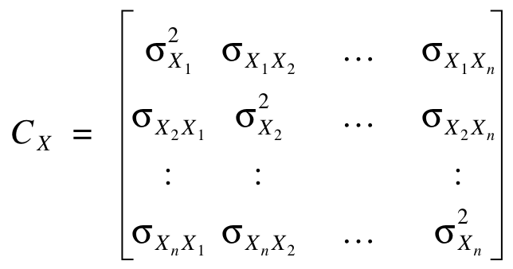
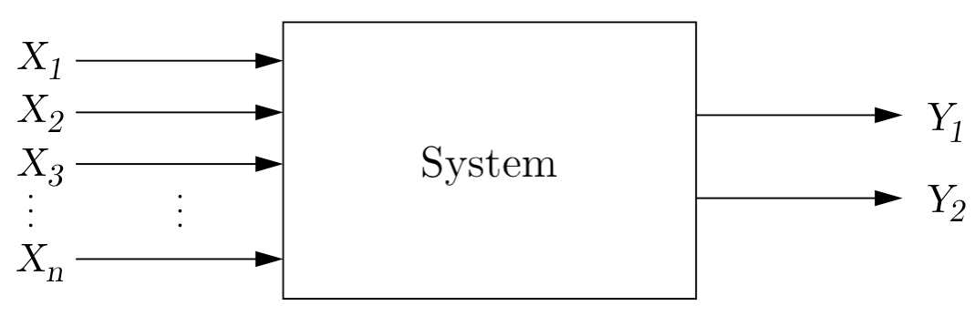
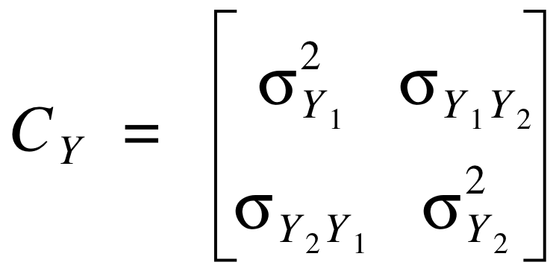
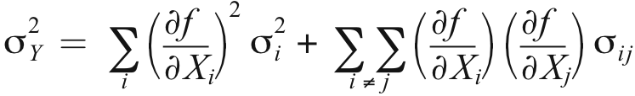
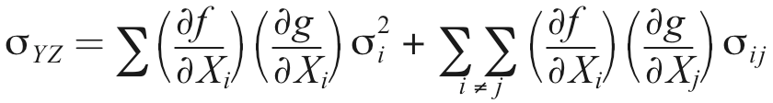
First-Order Error Propagation
Putting things together...
with
“Is there a compact form?...”

Slide 35
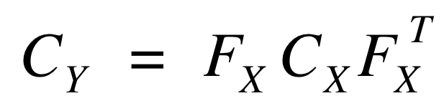
First-Order Error Propagation
...Yes! Given
Input covariance matrix C_{X}
Jacobian matrix F_{X}
the Error Propagation Law
computes the output covariance matrix C_{Y}

Slide 36
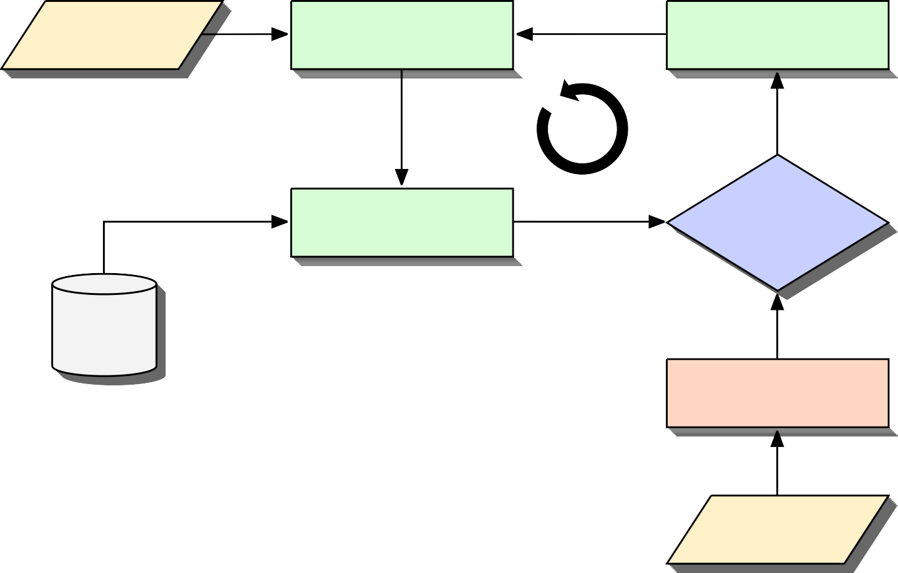
Landmark-based Localization
EKF Localization: Basic Cycle
Odometry or IMU
State Prediction
Update
Measurement Prediction
Data Association
Map
Feature/Landmark Extraction
Sensors

Slide 37
Landmark-based Localization
EKF Localization: Basic Cycle
posterior state
Update
encoder measurements
Odometry or IMU
State Prediction
predicted
state
innovation from matched landmarks
landmarks in global coordinates
Measurement Prediction
Data Association
predicted
measurements in sensor coordinates
Map
landmarks
Feature/Landmark Extraction
raw sensory data
Sensors

Slide 38



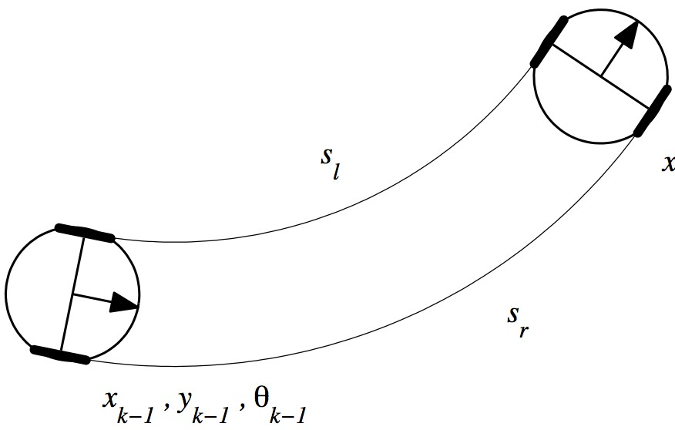

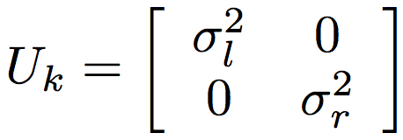
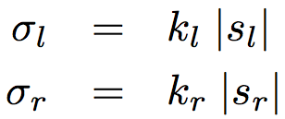
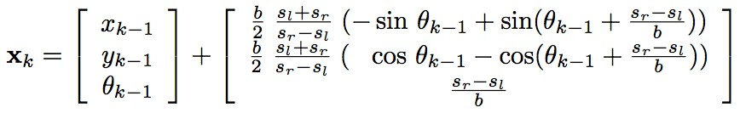
Landmark-based Localization
State Prediction (Odometry)
Control u_{k}: wheel displacements s_{l} , s_{r}
Error model: linear growth
Nonlinear process model f :

Slide 39
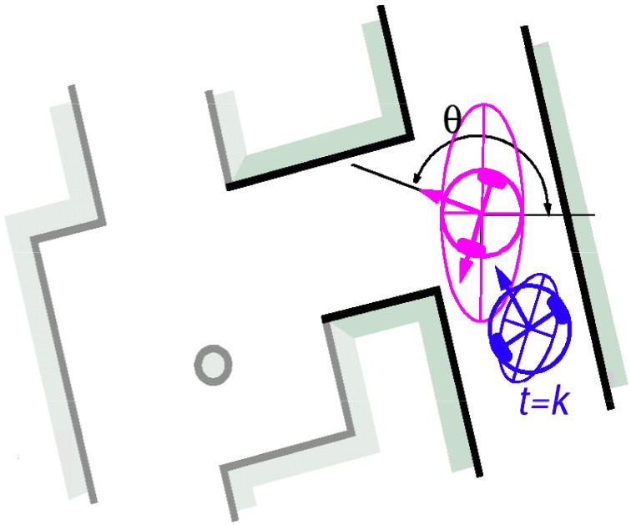
Landmark-based Localization
State Prediction (Odometry)
s_{r}
Control u_{k}: wheel displacements s_{l} ,
Error model: linear growth
Nonlinear process model f :

Slide 40



Landmark-based Localization
Landmark Extraction (Observation)
Raw laser range data
Extracted lines
Extracted lines in model space
Hessian line model

Slide 41






Landmark-based Localization
Measurement Prediction
...is a coordinate frame transform world-to-sensor
Given the predicted state (robot pose),
predicts the location uncertainty
and location of expected
model space
observations in sensor coordinates

Slide 42






Landmark-based Localization
Data Association (Matching)
Associates predicted measurements with observations
model space
Innovation and innovation covariance
Matching on significance level alpha
Green: observation Magenta: measurement prediction
62

Slide 43




Landmark-based Localization
Update
Kalman gain
State update (robot pose)
State covariance update
Red: posterior estimate
63

