Slide 1
Control

Slide 2
Motion Control (kinematic control) for mobile platform
The objective of a kinematic controller is to follow a trajectory described by its position and/or velocity profiles as function of time.
Motion control is not straight forward because mobile robots are typically non-holonomic systems.
However, it has been studied by various research groups and some adequate solutions for (kinematic) motion control of a mobile robot system are available.
Most controllers are not considering the dynamics of the system

Slide 3
Motion Control: Open Loop Control
trajectory (path) divided in motion segments of clearly defined shape:
straight lines and segments of a circle.
control problem:
pre-compute a smooth trajectory based on line and circle segments
Disadvantages:
It is not at all an easy task to pre-compute a feasible trajectory
limitations and constraints of the robots velocities and accelerations
does not adapt or correct the trajectory if dynamical changes of the environment occur.
The resulting trajectories are usually not smooth

Slide 4
Motion Control: Feedback Control!
• Set intermediate positions lying on the requested path !
• Given a goal how to compute the control commands for moving on the path !
• Linear and angular velocities to reach the desired configuration!

Slide 5
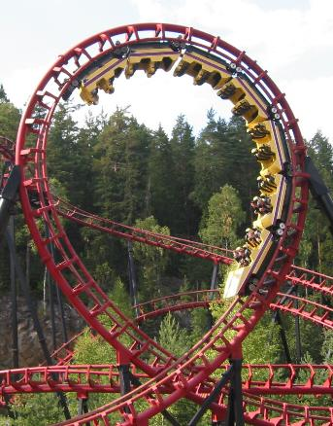
Loops
Open loop
current state + model
= resulting position
Closed loop
current state + model
feedback

Slide 6
Microwave
Cold Food
90 secs
on high
Hot Food

Slide 7
Smart Microwave
Popcorn Kernels
Apply heat
Is steam?
Yes
No
Popped
Popcorn

Slide 8
Control System
Physical System
Movement
New World
NOISE
Actuators
Sensors
Controller
NOISE
Actions
Feedback

Slide 9
A Simple System
Robot state: x
Desired state: x'
Error = (x-x')²
Action: u
Goal: Reach error =0

Slide 10
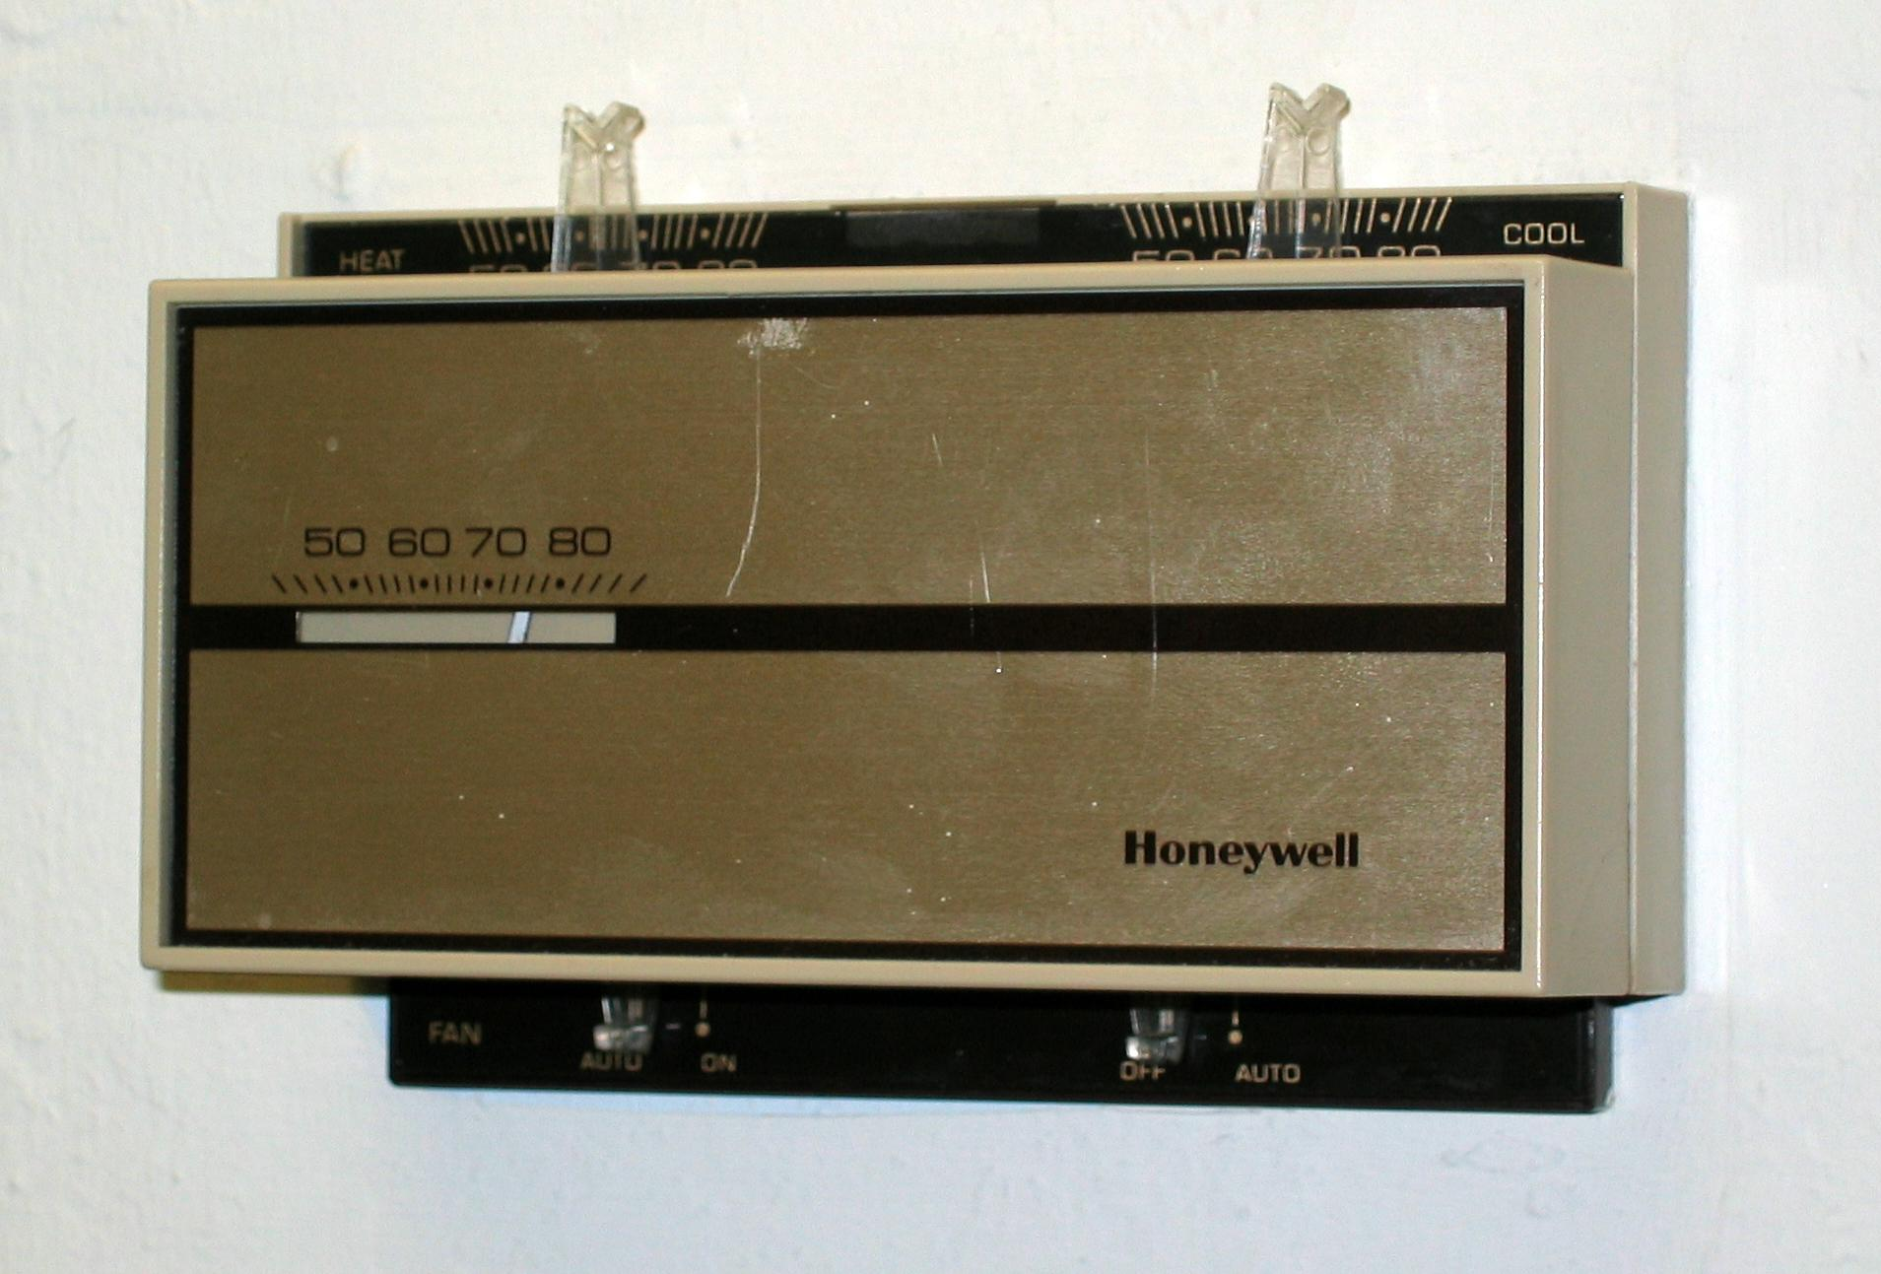
Bang Bang Controller
Action in direction of error
error = x-x'
If e<0, u=on
If e>0, u=off

Slide 11
Proportional Control
Action proportional to error
u = -K_{p}e + p₀
K_{p}=Proportional gain
p₀ = Output with zero error

Slide 12
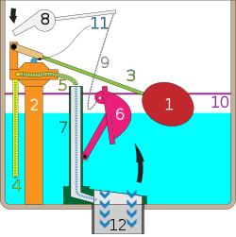
Ballcock
José Antonio de Alzate y Ramírez,
Mexican priest and scientist -1790

Slide 13
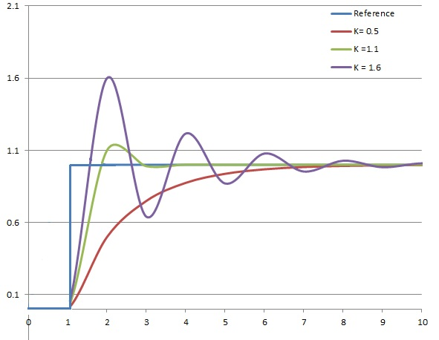
Proportional Control - K_{p}
Notes:
The proportional term produces an output value that is proportional to the current error value. Constant K_{p}, is the proportional gain constant.
High proportional gain results in a large change in the output for a given change in the error. If the proportional gain is too high, the system can become unstable
a small gain results a less responsive or less sensitive controller. If the proportional gain is too low, the control action may be too small when responding to system disturbances.
In a real system, proportional-only control will leave an offset error in the final steady-state condition. Integral action is required to eliminate this error.

Slide 14
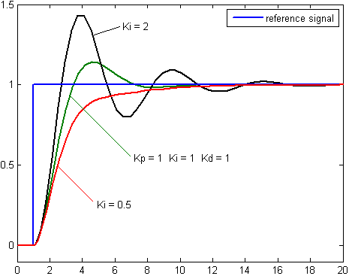
Integral Control
Actions proportional to magnitude and duration of error
K_{i} ∫e(t)dt
Notes:
The integral term accelerates the movement of the process towards the setpoint and eliminates the residual steady-state error that occurs with a pure proportional controller. However, since the integral term responds to accumulated errors from the past, it can cause the present value to overshoot the setpoint value.

Slide 15
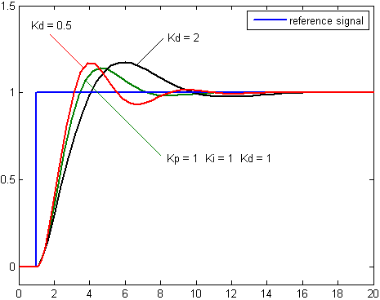
Derivative Control
Actions considering future overshooting
u = -K_{p}e(t) - K_{d} e'(t)
"Pull less when
heading in the
right direction"
Notes:
Derivative action predicts system behavior and thus improves settling time and stability of the system.

Slide 16
PID Controller
u = -K_{p}e(t) - K_{i} ∫e(t)dt - K_{d}e'(t)

Slide 17
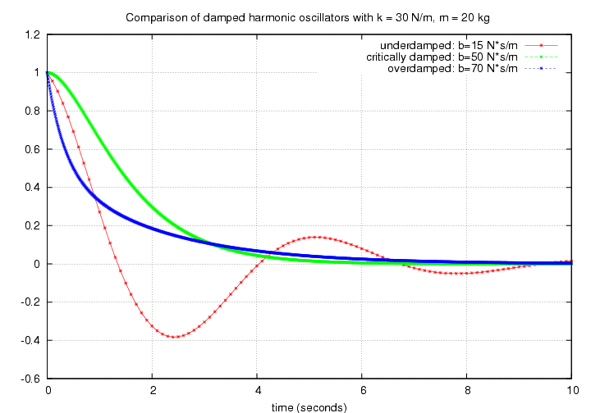
Some terminology
Damping:
Overdamped
The system returns (exponentially decays) to equilibrium without oscillating.
Critically damped
The system returns to equilibrium as quickly as possible without oscillating.
Underdamped
The system oscillates (at reduced frequency with the amplitude gradually decreasing to zero.

Slide 18
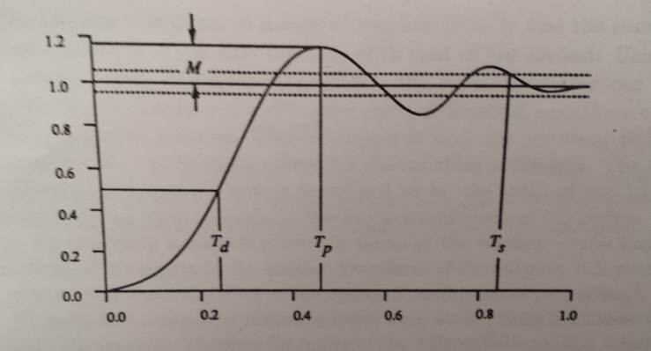
Transient response (behavior of system in response to transition of one stable state to another)
T_{d} delay time: time required to reach 50 % of target
T_{s} settling time: time required to achieve and maintain ± 5 % of the target
T_{p} peak time: time at which the largest value above target is reached
M peak overshoot : largest value above target

Slide 19
Transient response cont’ed
Steady state error: the system’s percent of error in the limit
Rise time: the time taken to change from a specified low value to a specified high value (usually 10% and 90%) of the output
A system is stable, if its response to a bounded input
is itself bounded.

Slide 20
Effects of increasing a parameter
Parameter | Rise time | Overshoot | Settling time | Steady-state error | Stability
K_{p} | Decrease | Increase | Small change | Decrease | Degrade
K_{i} | Decrease | Increase | Increase | Eliminate | Degrade
K_{d} | Minor change | Decrease | Decrease | No effect in theory | Improve if small
https://en.wikipedia.org/wiki/PID_controller
(demo of effects of varying PID parameters on the step response of a system)
http://diydrones.com/page/pid-tuning-demos

Slide 21
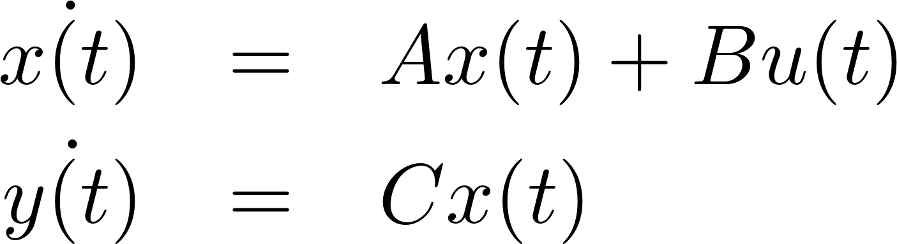
Basic issues for designing control systems
Linear dynamical system:
System state equations
Output equations
For the robot control problem y(t) = x(t)
X set of states of the system and the environment.
• Y set of outputs. Information available to the controller, since the information about the entire state is often not available to the controller.
• U set of control actions.

Slide 22
Basic issues for designing control systems
Controllability:
In set point regulation problem the objective is to achieve and obtain a particular state (or set of states) starting from any initial state.
Can we reach the target set points or any target set points from the initial state ?
Observability
Is it possible to observe state x(t₀) by observing y(t) for t₀ < t < t₁
Stability
Small changes in input or initial conditions do not result in large changes in system behavior.
Asymptotically stable: the variables of an asymptotically stable control system always decrease from their initial value and do not show permanent oscillations

Slide 23
Motion Control (kinematic control) for mobile platform
The objective of a kinematic controller is to follow a trajectory described by its position and/or velocity profiles as function of time.
Motion control is not straight forward because mobile robots are typically non-holonomic systems.
However, it has been studied by various research groups and some adequate solutions for (kinematic) motion control of a mobile robot system are available.
Most controllers are not considering the dynamics of the system

Slide 24
Motion Control: Open Loop Control
trajectory (path) divided in motion segments of clearly defined shape:
straight lines and segments of a circle.
control problem:
pre-compute a smooth trajectory based on line and circle segments
Disadvantages:
It is not at all an easy task to pre-compute a feasible trajectory
limitations and constraints of the robots velocities and accelerations
does not adapt or correct the trajectory if dynamical changes of the environment occur.
The resulting trajectories are usually not smooth

Slide 25
Motion Control: Feedback Control!
• Set intermediate positions lying on the requested path.
• Given a goal how to compute the control commands for
linear and angular velocities to reach the desired configuration!

Slide 26
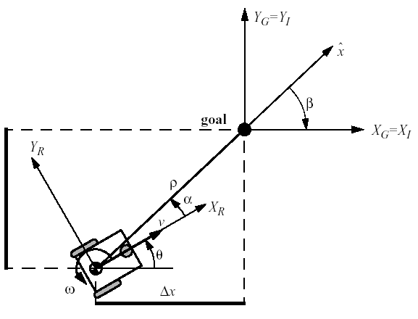
Problem statement
Given arbitrary position and orientation of the robot [x, y,θ]
how to reach desired goal orientation and position [x_{g} , y_{g},θ_{g} ]

Slide 27
Motion Control: Feedback Control, Problem Statement
Find a control matrix K, if exists with k_{ij}=k(t,e)
such that the control of v(t) and ω(t)
drives the error e to zero.

Slide 28

Motion Control: Kinematic Position Control
The kinematics of a differential drive mobile robot described in the initial frame {x_{I}, y_{I}, θ} is given by,
where and are the linear velocities in the direction of the x_{I} and y_{I} of the initial frame.
Let α denote the angle between the x_{R} axis of the robots reference frame and the vector connecting the center of the axle of the wheels with the final position.
We set the goal at the
origin of the inertial frame
Δy

Slide 29
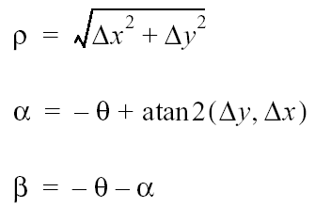
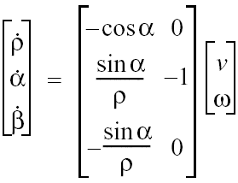
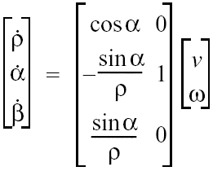


Kinematic Position Control: Coordinates Transformation
Coordinates transformation into polar coordinates with its origin at goal position:
System description in new polar coordinates
Δy
For α
for

Slide 30





Kinematic Position Control: Remarks
The coordinates transformation is not defined at x = y = 0; as in such a point the determinant of the Jacobian matrix of the transformation is not defined, i.e. it is unbounded
For the forward direction of the robot points toward the goal, for it is the backward direction.
By properly defining the forward direction of the robot at its initial configuration, it is always possible to have at t=0. However this does not mean that a remains in I₁ for all time t.
Δy

Slide 31


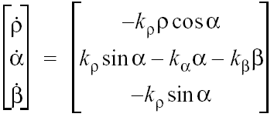
Kinematic Position Control: The Control Law
It can be shown, that with the feedback controlled system will drive the robot to
The control signal v has always constant sign,
the direction of movement is kept positive or negative during movement
parking maneuver is performed always in the most natural way and without ever inverting its motion.

Slide 32
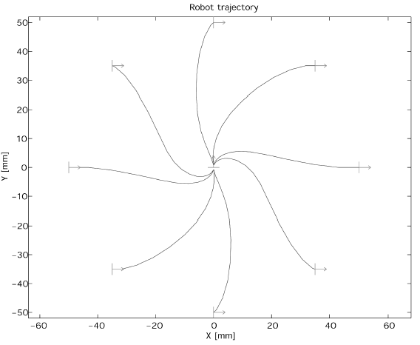
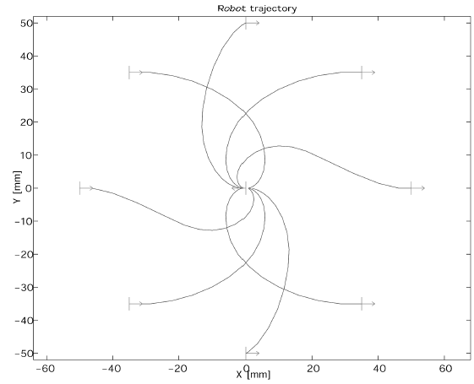
Kinematic Position Control: Resulting Path
The goal is in the center and the initial position on the circle.

Slide 33
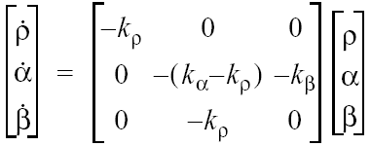
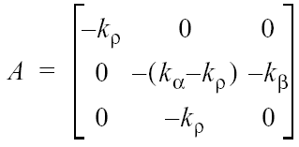

Kinematic Position Control: Stability Issue
It can further be shown, that the closed loop control system is locally exponentially stable if
Proof: linearize around the center, compute eigenvalues for small x −> cosx = 1, sinx = x
and the characteristic polynomial of the matrix A of all roots have negative real parts.

