Slide 1
SIFT
Scale-Invariant Feature Transform
David Lowe
Scale/rotation invariant
Best known feature descriptor
Applications
Object recognition, Robot localization
Distinctive image features from scale-invariant keypoints. David G. Lowe, International Journal of Computer Vision, 60, 2 (2004), pp. 91-110.

Slide 2
Feature detectors
should be invariant or at least robust
to affine changes
translation
rotation
scale change

Slide 3
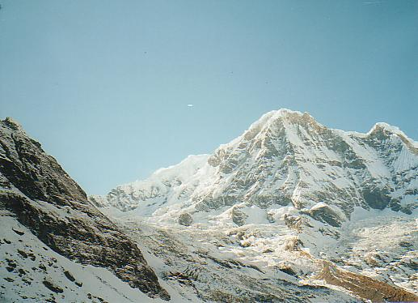
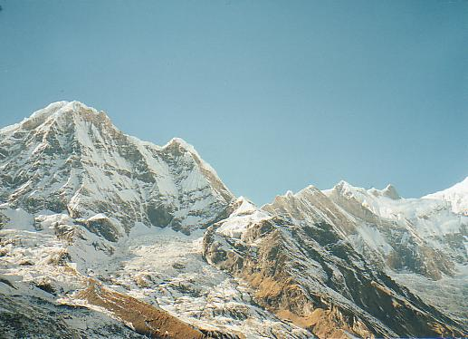
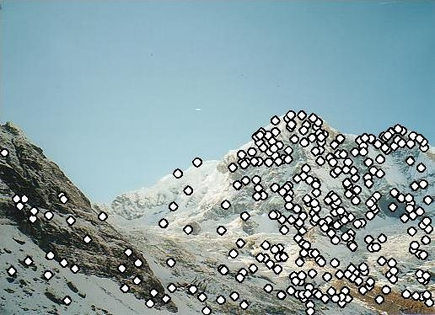
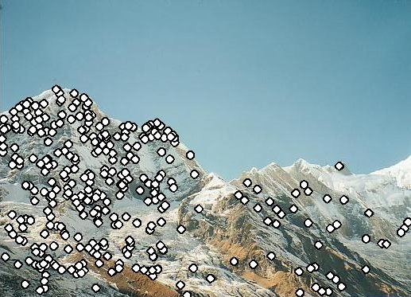
Example I: mosaicking Using SIFT features we match the different images

Slide 4
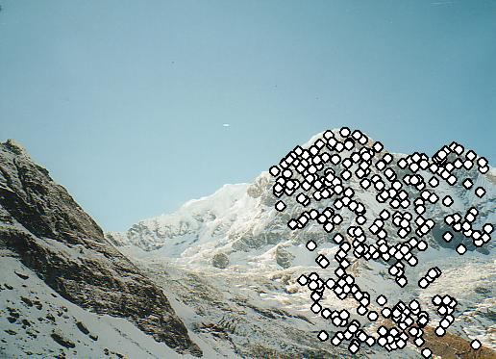
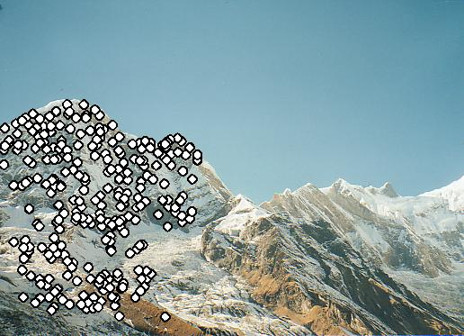
Using those matches we estimate the homography relating the two images

Slide 5
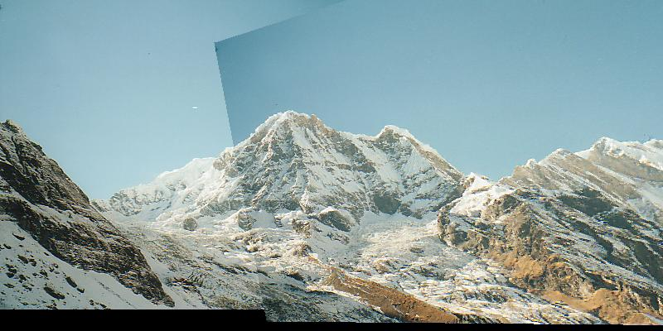
And we can “stitch” the images

Slide 6
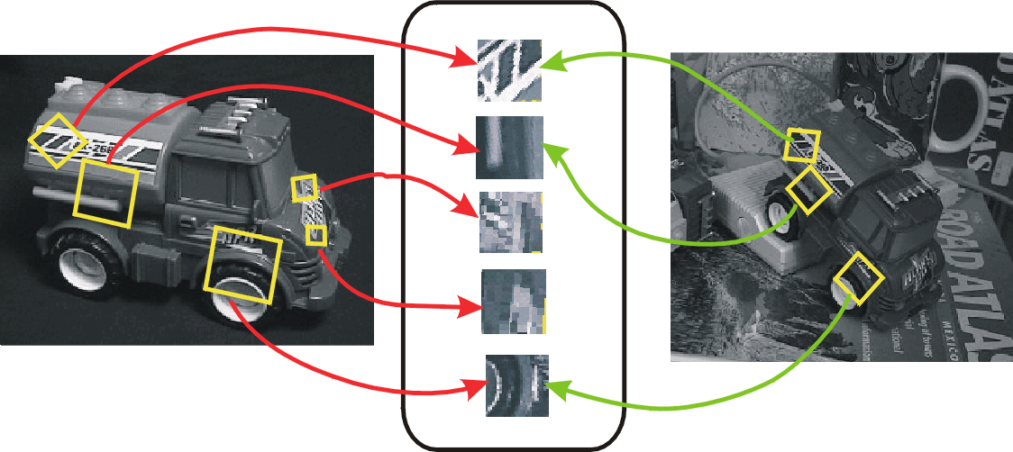
Example II: object recognition

Slide 7
SIFT Algorithm
Detection
Detect points that can be repeatably selected under location/scale change
Description
Assign orientation to detected feature points
Construct a descriptor for image patch around each feature point
Matching

Slide 8
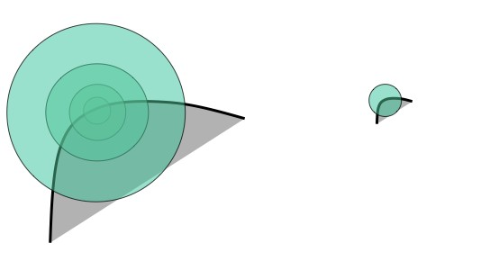
Scale Invariant Detection
Consider regions of different size
Select regions to subtend the same content

Slide 9
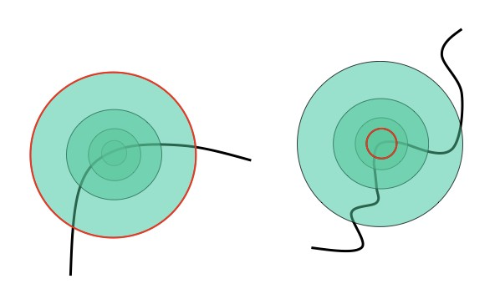
Scale Invariant detection
How to choose the size of the region independently
CS 685l

Slide 10
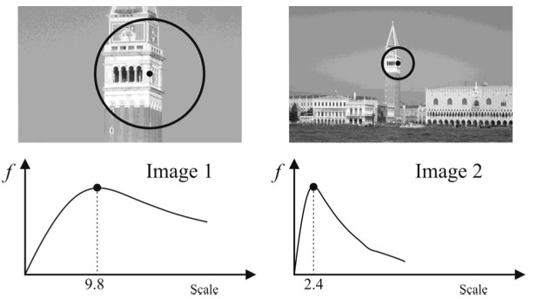
Scale Invariant detection
Sharp local intensity changes are good functions for identifying relative scale of the region
Response of Laplacian of Gaussians (LoG) at a point
CS 685l

Slide 11
1. Feature detection
This is the stage where the interest points, which are called keypoints in the SIFT framework, are detected. For this, the image is convolved with Gaussian filters at different scales, and then the difference of successive Gaussian-blurred images are taken. Keypoints are then taken as maxima/minima of the Difference of Gaussians (DoG) that occur at multiple scales.
This is done by comparing each pixel in the DoG images to its eight neighbors at the same scale and nine corresponding neighboring pixels in each of the neighboring scales. If the pixel value is the maximum or minimum among all compared pixels, it is selected as a candidate keypoint.

Slide 12
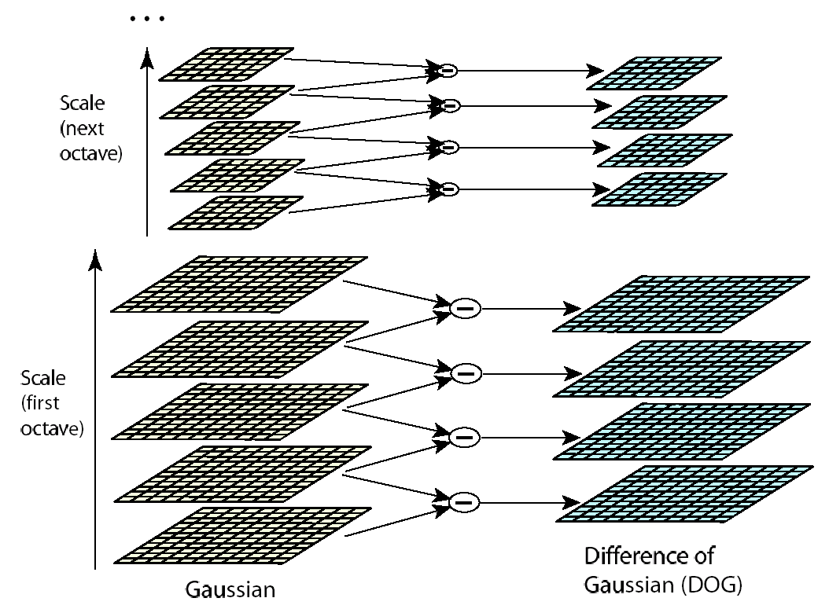
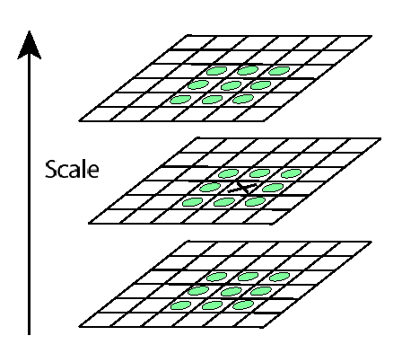
1. Feature detection

Slide 13
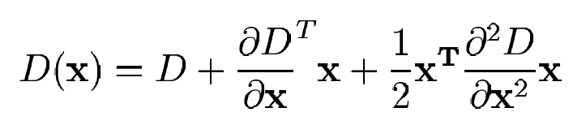
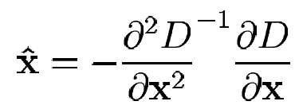
1. Feature detection
Detailed fit using data surrounding the keypoint to localize extrema by fitting a quadratic
Sub-pixel/sub-scale interpolation using Taylor expansion
Take derivative and set to zero

Slide 14
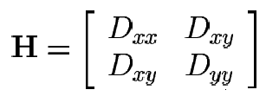
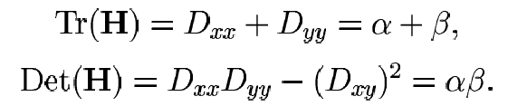
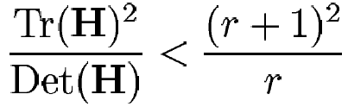
1. Feature detection
Discard low-contrast/edge points
Low contrast: discard keypoints with < threshold
Edge points: high contrast in one direction, low in the other → compute principal curvatures from eigenvalues of 2x2 Hessian matrix, and limit ratio
r is ratio of eigenvalues. Set some threshold, like r_{th} = 10

Slide 15
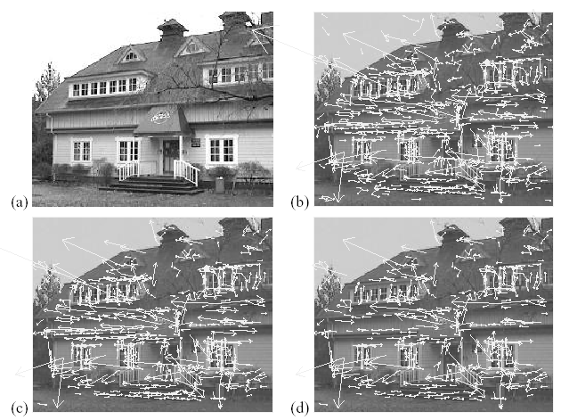
1. Feature detection
Example
(a) 233x189 image
(b) 832 DOG extrema
(c) 729 left after peak
value threshold
(d) 536 left after testing
ratio of principle
curvatures

Slide 16
2. Feature description
Assign orientation to keypoints
Create histogram of local gradient directions computed at selected scale
Assign canonical orientation at peak of smoothed histogram

Slide 17
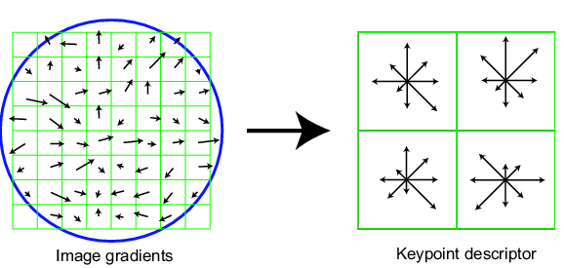
2. Feature description
Construct SIFT descriptor
Create array of orientation histograms
8 orientations x 4x4 histogram array = 128 dimensions

Slide 18
3. Feature matching
For each feature in A, find nearest neighbor in B
A
B

Slide 19
3. Feature matching
Nearest neighbor search too slow for large database of 128-dimensional data
Approximate nearest neighbor search:
Hypotheses are generated by approximate nearest neighbor matching of each feature to vectors in the database
SIFT use best-bin-first (Beis & Lowe, 97) modification to k-d tree algorithm
Use heap data structure to identify bins in order by their distance from query point
Result: Can give speedup by factor of 1000 while finding nearest neighbor (of interest) 95% of the time

Slide 20
3. Feature matching
Given feature matches…
Find an object in the scene
…

Slide 21
3. Feature matching
Example: 3D object recognition

Slide 22
3. Feature matching
3D object recognition
Assume affine transform: clusters of size >=3
Looking for 3 matches out of 3000 that agree on same object and pose: too many outliers for RANSAC or LMS
Use Hough Transform

Slide 23
3. Feature matching
3D object recognition: verify model
Discard outliers for pose solution in prev step
Perform top-down check for additional features
Evaluate probability that match is correct

Slide 24
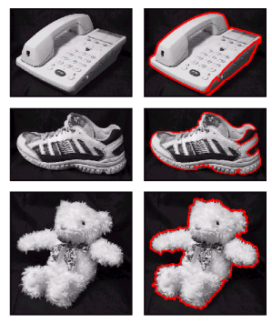
3D object recognition
Training images

Slide 25
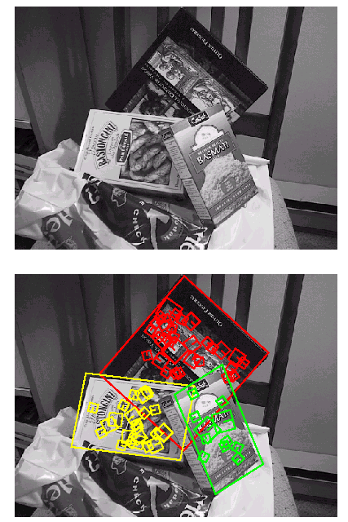
Planar recognition
Reliably recognized at a rotation of 60° away from the camera
Affine fit is an approximation of perspective projection
Only 3 points are needed for recognition

Slide 26
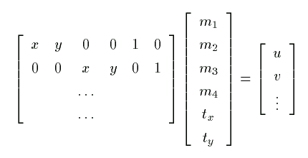

3. Feature matching
3D object recognition: solve for pose
Affine transform of [x,y] to [u,v]:
Rewrite to solve for transform parameters:

Slide 27
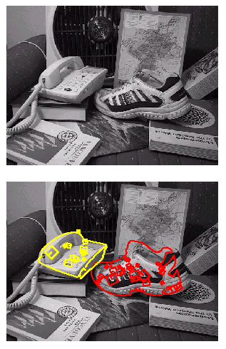
3D object recognition
Only 3 keys are needed for recognition, so extra keys provide robustness
Affine model is no longer as accurate

Slide 28
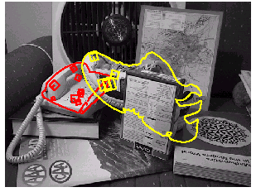
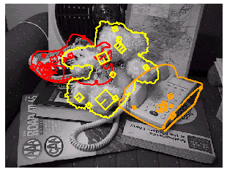
Recognition under occlusion

Slide 29
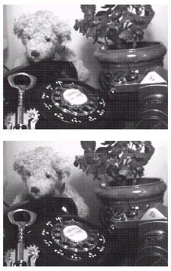
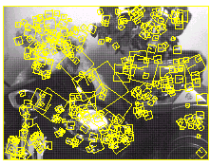
Illumination invariance

Slide 30
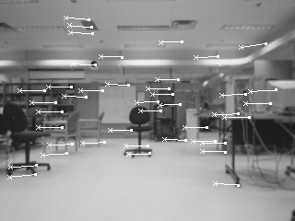
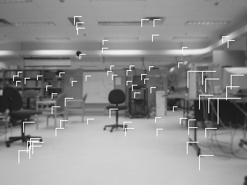

Robot Localization

