Slide 1
Kinematics
using slides from D. Lu

Slide 2
Goals of this class
Introduce Forward Kinematics of
mobile robots
How Inverse Kinematics for static and mobile robots can be derived
Concept of Holonomy
Intuition on the relationship between inverse
kinematics and path-planning.

Slide 3
Kinematics
Kinematics is the branch of classical mechanics which describes the motion of points, bodies (objects) and systems of bodies (groups of objects) without consideration of the causes of motion.^{[1][2][3]} The term is the English version of A.M. Ampère's cinématique,^{[4]} which he constructed from the Greek κίνημα kinema "movement, motion", derived from κινεῖν kinein "to move".^{[5][6]}
Kinematics is often referred to as the "geometry of motion.“ Kinematics begins with a description of the geometry of the system and the initial conditions of position, velocity and or acceleration, then from geometrical arguments it can determine the position, the velocity and the acceleration of any part of the system.
^{In contrast to}
Dynamics, is concerned with relationship between motion of bodies and its causes, the forces http://en.wikipedia.org/wiki/Kinematics
Notes:
Dynamics, is concerned with relationship between motion of bodies and its causes, the forces

Slide 4
Forward/Inverse Kinematics
Forward kinematics:
f(p, a) = p'
Given pose p and action a,
what is the resulting pose p'?
Inverse kinematics:
f(p, p') = a
Given poses p and p',
what action a will move from p to p'?
Notes:
Whereas the pose of a robotic manipulator is uniquely defined by its joint angles – which can be made available using encoders in almost real-time – this is not the case for a mobile robot. Here, the encoder values simply refer to wheel orientation and need to be integrated over time, which will be a huge source of uncertainty as we will later see.

Slide 5
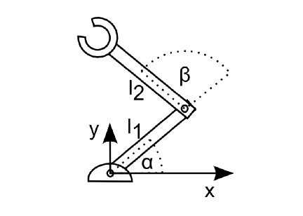
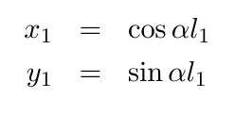
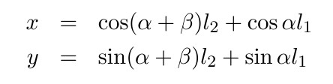
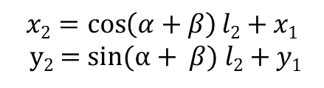
Forward kinematics of a simple arm
$$x2=\cos\left(α+β\right)l2+x1$$
y₂ = sin($α+ β) l2+y1$
Notes:
The kinematic equations of this robot relate its control parameters α and ß to the position
of its end-effector given in the local coordinate system spanned by x and z with the origin at the robot's base.
Using the right-hand rule, the direction of positive angles is defined to be counter-clockwise.

Slide 6

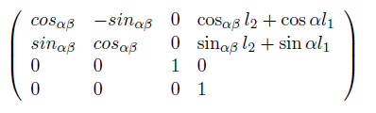

Transformation from end-effector to base
Remember
$${}_{e}^{b}{T=}$$
With cos_{αß} denoting cos(α+ ß) and sin_{αß} denoting sin(α+ ß)

Slide 7
Holonomic vs. Non-­‐Holonomic Systems
The robot's kinematic is holonomic if closed trajectories in configuration space result in closed trajectories in the workspace.
A system is non-holonomic when closed trajectories in its configuration space may not have it return to its original state.
A simple arm is holonomic, as each joint position corresponds to a unique position in space. A train is holonomic.
A car and a differential-wheel robot are non-holonomic vehicles.
Getting the robot to its initial position requires not only
to rewind both wheels by the same amount, but also getting
their relative speeds right. The speed of each wheel as a function of time matters.

Slide 8
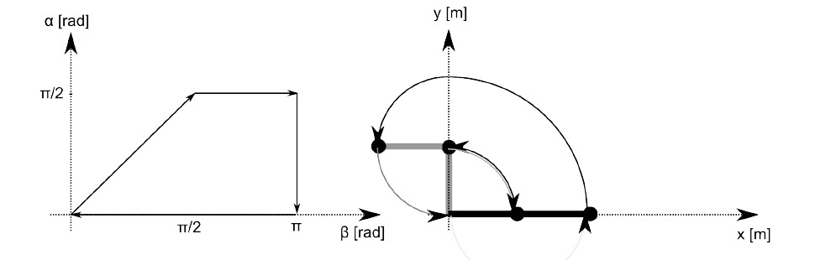
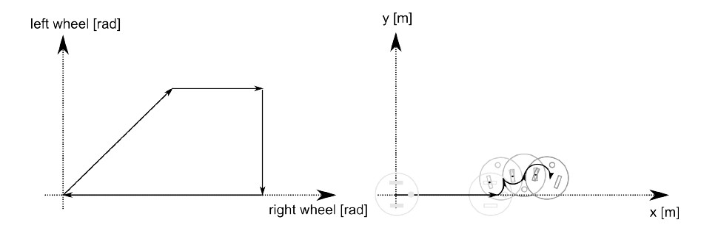
Holonomic vs. Non-­‐Holonomic
Manipulator
Diﬀ. Wheels
Conﬁguration Space
(set of angles each actuator can be set to)
Workspace
(the physical space the robot can move to )
Notes:
Here, a robot first moves on a straight line (both wheels turn an equal amount). Then the left wheel remains fixed and only the right wheel turns forward. Then the right wheel remains fixed and the left wheel turns backward. Finally, the right wheel turns backward, arriving at the initial encoder values (zero). Yet, the robot does not return to its origin. Performing a similar trajectory in the
configuration space of a two-link manipulator instead, let the robot return to its initial position.

Slide 9
Modeling Wheeled Robots
All motion models are idealized.
No wheel slippage
No axle flex
Wheels don't compress, etc.
Pose - Variables needed for state of robot
Action - Commands to send to robot

Slide 10
Simple Robot
Aligned to x-axis
One active wheel &
One passive point of contact
Pose? Action?

Slide 11
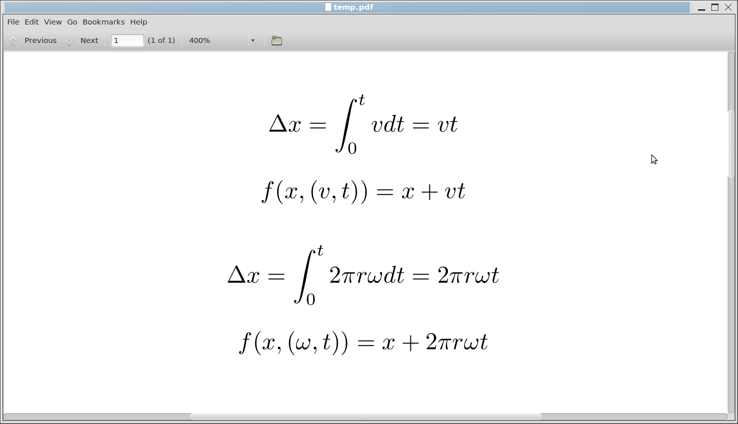
Robot Velocity
Action: Apply velocity v for t seconds
v in meters per second!

Slide 12
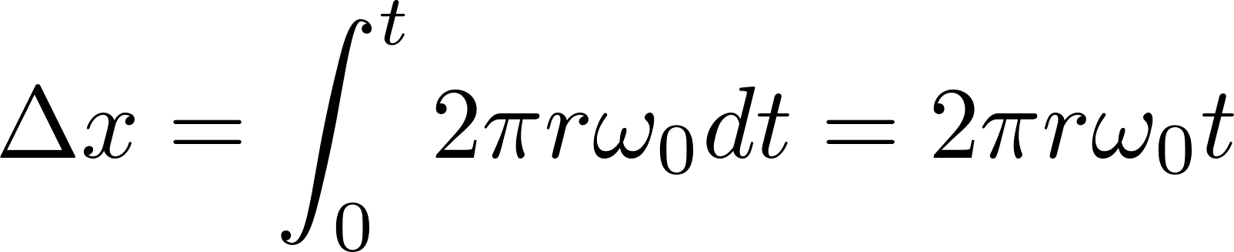
Wheel Angular Velocity
Action: Apply angular velocity ѡ for t seconds
Wheel has radius r
ѡ₀ in rotations per second!

Slide 13
Inverse Kinematic Models
Δx = tv
v = Δx/t
v = (x₂-x₁)/t
f(x₁,x₂,t) = (x₂-x₁)/t
Δx = 2𝜋rѡ₀t
ѡ₀ = Δx/(2𝜋rt)
ѡ₀ = (x₂-x₁)/(2𝜋rt)
f(x₁,x₂,t) = (x₂-x₁)/(2𝜋rt)

Slide 14
Simple Robot Observations
Models depend on action definition.
Solutions for forward model and inverse model are unique for this robot.

Slide 15
Simple Robot in 2D
Same Robot, at angle θ
Pose?
p = (x,y)
Action?
v

Slide 16
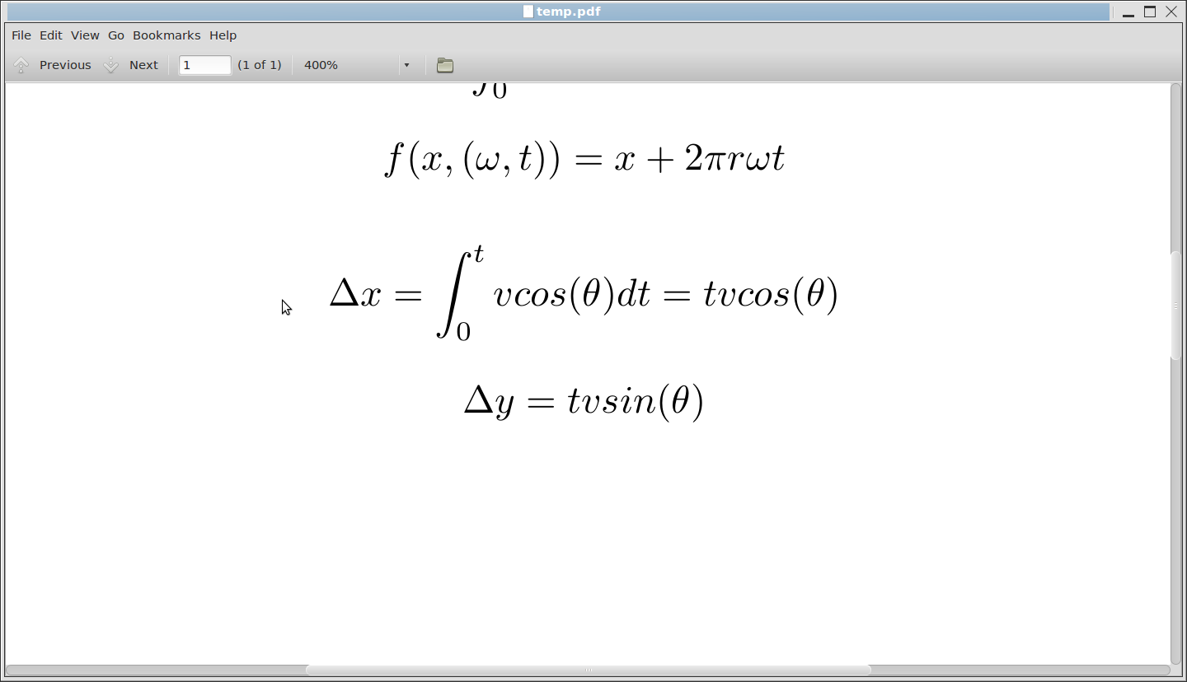
2D Kinematics

Slide 17
2D Kinematics
x + tv cos(θ) = x'
y + tv sin(θ) = y'
v = (x'-x)/(t cos(θ))
v = (y'-y)/(t sin(θ))
Observation: Inverse model has no solution in some parts of space

Slide 18
Differential Drive
Two active wheels (L & R)
Some passive supporting wheels
Pose?
p = (x,y,θ) (taken at center of axis)
Action?
a = (v_{L},v_{R})
v in meters per second!

Slide 19
v_{L} = +k, v_{R}=0

Slide 20
v_{L} = +k, v_{R}=+k'

Slide 21
v_{L} = +k, v_{R}=+k

Slide 22
v_{L} = +k, v_{R}=-k

Slide 23
Wheels Go in Circles
Wheels travel on circles of circumference
C_{L}=2𝜋(b+d)
C_{R}=2𝜋b
Axle Length d
b
ICC
Instantaneous Center of Coordinates

Slide 24
Wheels Go In Circles 2
Wheels have same angular velocity around axis of rotation
D_{L}
D_{R}

Slide 25

DD Kinematics
Traveled θ radians around circle
D_{L} = C_{L} (θ/(2𝜋) )
= 2𝜋(b+d)θ/(2𝜋)
θ = D_{L}/(b+d)
D_{R} = C_{R} (θ/(2𝜋) )
= 2𝜋bθ/(2𝜋)
θ = D_{R}/b
b = D_{R}/θ
v_{L}
v
v_{R}
θ = (D_{L}-D_{R})/d
D_{L}
D_{R}
ѡ
θ
ѡ = θ/t
= (D_{L}-D_{R})/(d t) = (v_{L}-v_{R})/d
Change of angle $\dot{θ}$

Slide 26
Observations about DD
ѡ= (v_{L}-v_{R})/d
Straight line v_{L}=v_{R} --> ѡ=0
Smaller d --> larger ѡ for constant |v_{L}-v_{R}|
v = (v_{L}+v_{R})/2

Slide 27
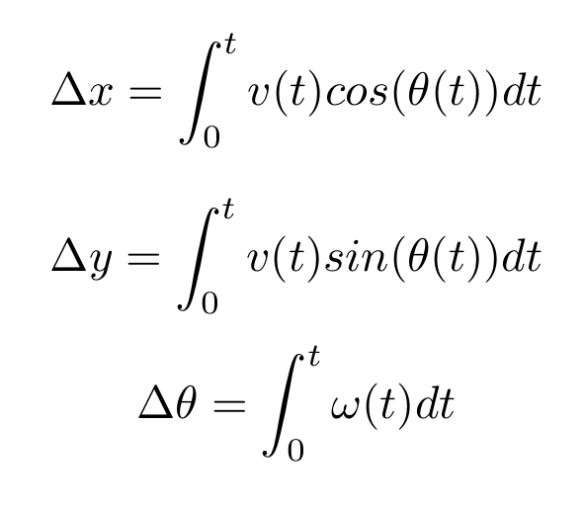
Forward Kinematics DD
y_{I}
x
y
x_{I}
D_{L}
D_{R}
θ
In general, integrals cannot be solved analytically
ω(t) and v(t) are functions of time

Slide 28
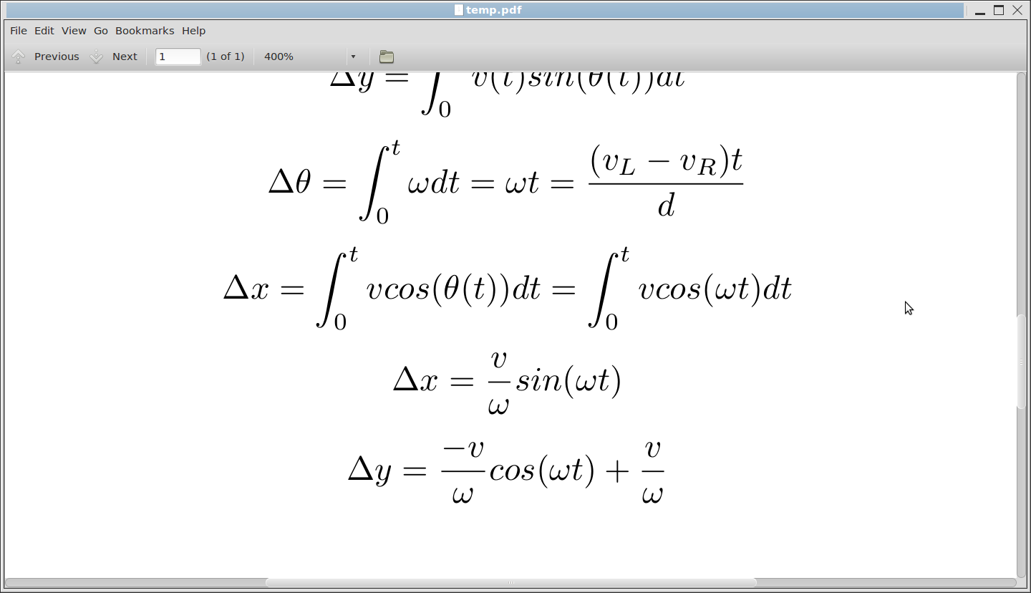
Forward Kinematics
Assume constant v, θ₀=0

Slide 29
Inverse Kinematics
Solution with constant velocities does not always exist!

Slide 30

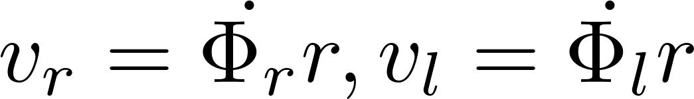
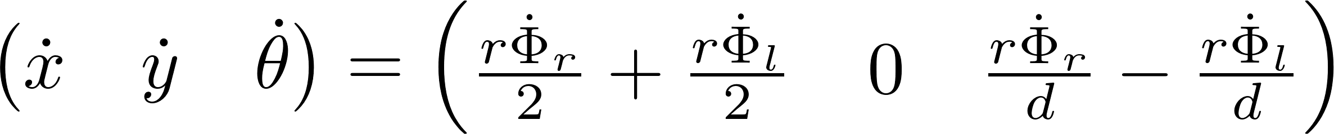
Using the notation of the books
(Siegwart et al, Correll)
We have a pose p(x,y, θ) and we are interested in their changes
We control v_{L} and v_{R} or in terms of angles on the wheels φ_{L}, φ_{R}
φ
r

Slide 31
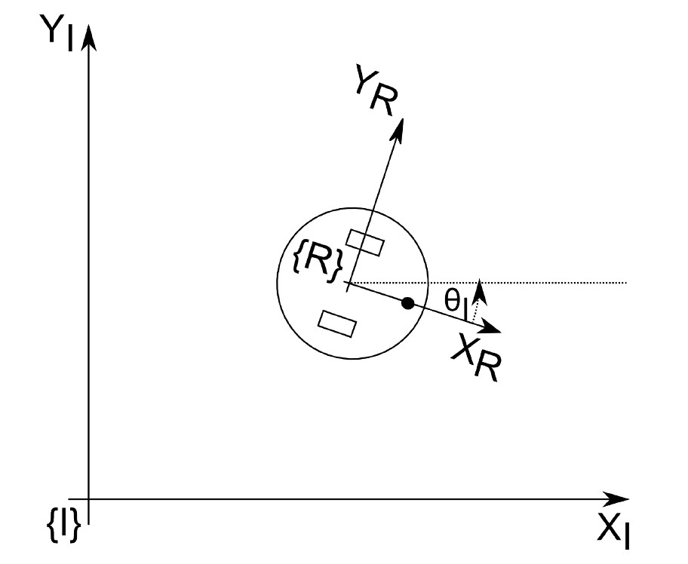







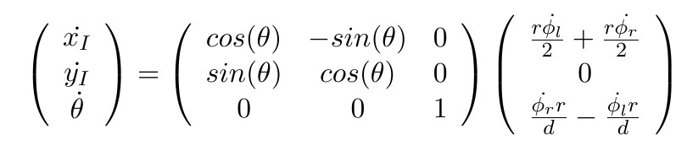
Transformation of the coordinates

Slide 32



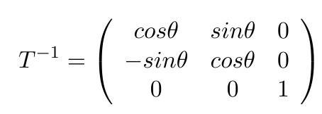



Inverse Kinematics of Mobile Robots

Slide 33
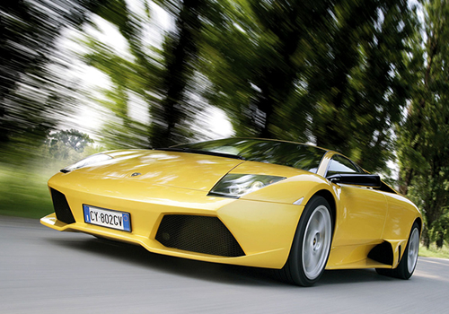
Additional Assumption
Perfect Instantaneous Activation
No inertia, no mass

Slide 34
Summary
For calculating the forward kinematics of a robot, it is easiest to establish a local coordinate frame on the robot and determine the transformation into the world coordinate first.
Forward and Inverse Kinematics of a mobile robot are performed with respect to the speed of the robot and not its position.
For calculating the effect of each wheel on the speed of the robot, you need to consider the contribution of each wheel independently.
Calculating the inverse kinematics analytically becomes quickly infeasible. You can then plan in configuration space of the robot using path-planning techniques.

