Slide 1
Probabilistic Map Based Localization
Localization
"Position"
Cognition
Global Map
Environment Model
Path
Local Map
Perception
Real World
Motion Control
Environment

Slide 2
Outline of today’s lecture
5 - Localization and Mapping
5
<number>
Definition and illustration of probabilistic map based localization
Two solutions
  Markov localization (pages 292-312 of the textbook)
  Kalman filter localization (pages 318-338)

Slide 3

The problem
5 - Localization and Mapping
5
<number>
Consider a mobile robot moving in a known environment.
As it starts to move, say from a precisely known location, it might keep track of its location using odometry.
However, after a certain movement the robot will get very uncertain about its position => update using an observation of its environment
Observation leads also to an estimate of the robot position which can then be fused with the odometric estimation to get the best possible update of the robots actual position.

Slide 4
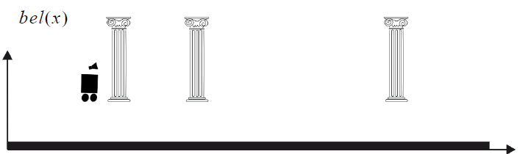
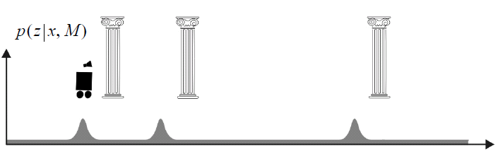

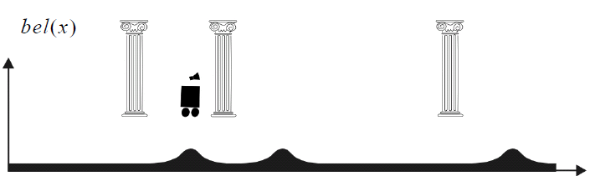
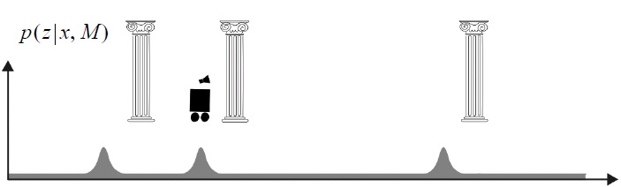
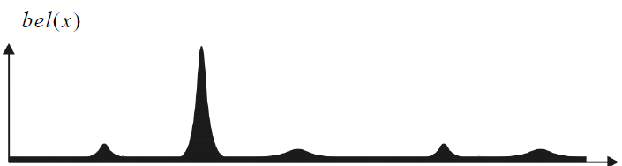
Illustration of probabilistic bap based localization:
Improving belief state by moving
5 - Localization and Mapping
5
<number>
The robot is placed somewhere in the environment but it is not told its location
The robot queries its sensors and finds it is next to a pillar
The robot moves one meter forward. To account for inherent noise in robot motion the new belief is smoother
The robot queries its sensors and again it finds itself next to a pillar
Finally, it updates its belief by combining this information with its previous belief

Slide 5
Why a probabilistic approach for mobile robot localization?
5 - Localization and Mapping
5
<number>
Because the data coming from the robot sensors are affected by measurement errors, we can only compute the probability that the robot is in a given configuration.
The key idea in probabilistic robotics is to represent uncertainty using probability theory: instead of giving a single best estimate of the current robot configuration, probabilistic robotics represents the robot configuration as a probability distribution over all possible robot poses. This probability is called belief.

Slide 6

Example probability distributions for representing robot configurations
5
<number>
In the following we consider a robot which is constrained to move along a straight rail. The problem is one dimensional.
The robot configuration is the position x along the rail.

Slide 7


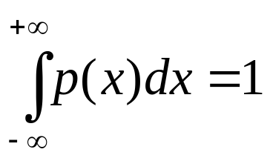
Example 1: Uniform distribution
5 - Localization and Mapping
5
<number>
This is used when the robot does not know where it is. It means that the information about the robot configuration is null.
Remember that in order to be a probability distribution a function p(x) must always satisfy the following constraint:

Slide 8
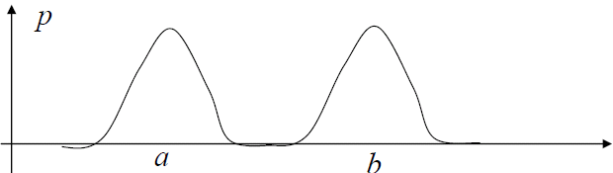
Example 2: Multimodal distribution
5 - Localization and Mapping
5
<number>
The robot is in the region around “a” or “b”.

Slide 9


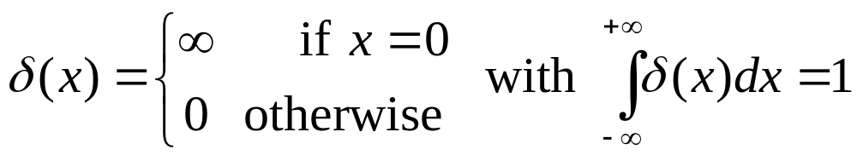
Example 3: Dirac distribution
5 - Localization and Mapping
5
<number>
The robot has a probability of 1.0 (i.e. 100%) to be at position “a”.
Note, the Dirac distribution is usually represented with an arrow.
The Dirac function is defined as:

Slide 10
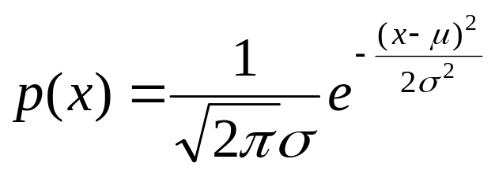
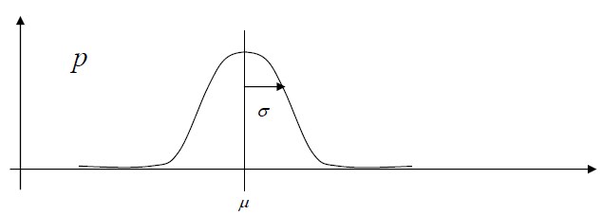
Example 4: Gaussian distribution
5 - Localization and Mapping
5
<number>
The Gaussian distribution has the shape of a bell and is defined by the following formula:
where μ is the mean value and σ is the standard deviation.
The Gaussian distribution is also called normal distribution and is usually abbreviated with N(μ ,σ ).

Slide 11
Description of the probabilistic localization problem
5 - Localization and Mapping
5
<number>
Consider a mobile robot moving in a known environment.

Slide 12
Description of the probabilistic localization problem
5 - Localization and Mapping
5
<number>
Consider a mobile robot moving in a known environment.
As it starts to move, say from a precisely known location, it can keep track of its motion using odometry.

Slide 13
Description of the probabilistic localization problem
5 - Localization and Mapping
5
<number>
Consider a mobile robot moving in a known environment.
As it starts to move, say from a precisely known location, it can keep track of its motion using odometry.
Due to odometry uncertainty, after some movement the robot will become very uncertain about its position.

Slide 14


Description of the probabilistic localization problem
5 - Localization and Mapping
5
<number>
Consider a mobile robot moving in a known environment.
As it starts to move, say from a precisely known location, it can keep track of its motion using odometry.
Due to odometry uncertainty, after some movement the robot will become very uncertain about its position.
To keep position uncertainty from growing unbounded, the robot must localize itself in relation to its environment map. To localize, the robot might use its on-board exteroceptive sensors (e.g. ultrasonic, laser, vision sensors) to make observations of its environment
Sensor reference frame

Slide 15
Description of the probabilistic localization problem
5 - Localization and Mapping
5
<number>
Consider a mobile robot moving in a known environment.
As it starts to move, say from a precisely known location, it can keep track of its motion using odometry.
Due to odometry uncertainty, after some movement the robot will become very uncertain about its position.
To keep position uncertainty from growing unbounded, the robot must localize itself in relation to its environment map. To localize, the robot might use its on-board exteroceptive sensors (e.g. ultrasonic, laser, vision sensors) to make observations of its environment
The robot updates its position based on the observation. Its uncertainty shrinks.
Sensor reference frame

Slide 16
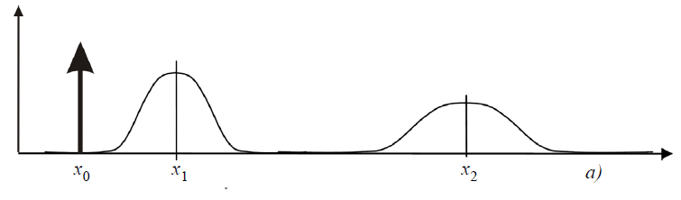
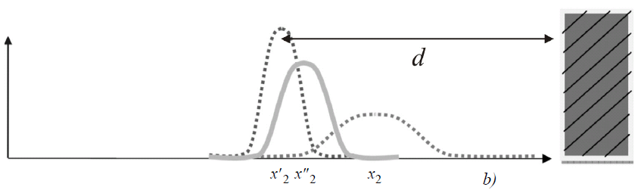
Action and perception updates
5 - Localization and Mapping
5
<number>
In robot localization, we distinguish two update steps:
  ACTION update:
    the robot moves and estimates its position through its proprioceptive sensors.
    During this step, the robot uncertainty grows.
  PERCEPTION update:
    the robot makes an observation using its exteroceptive sensors and correct its position by opportunely combining its belief before the observation with the probability of making exactly that observation.
    During this step, the robot uncertainty shrinks.
Probability of making this observation
Robot belief before the observation

Slide 17
The solution to the probabilistic localization problem
5 - Localization and Mapping
5
<number>
Solving the probabilistic localization problem
consists in solving separately the Action and Perception updates

Slide 18

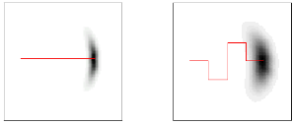
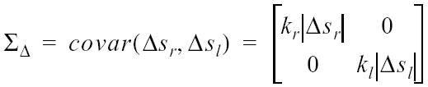
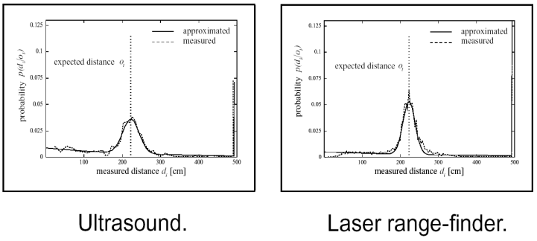
The solution to the probabilistic localization problem
5 - Localization and Mapping
5
<number>
A probabilistic approach to the mobile robot localization problem is a method able to compute the probability distribution of the robot configuration during each Action and Perception step.
The ingredients are:
The initial probability distribution
The statistical error model of the proprioceptive sensors (e.g. wheel encoders)
The statistical error model of the exteroceptive sensors (e.g. laser, sonar, camera)
Map of the environment
(If the map is not known a priori then the robots needs to build a map of the environment and then localizing in it. This is called SLAM, Simultaneous Localization And Mapping)

Slide 19
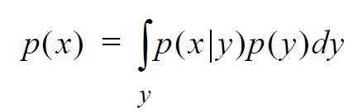
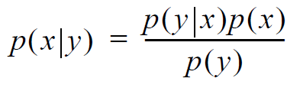
The solution to the probabilistic localization problem
5 - Localization and Mapping
5
<number>
How do we solve the Action and Perception updates?
Action update uses the Theorem of Total probability (or convolution)
Perception update uses the Bayes rule

Slide 20
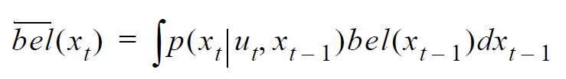

Action update
5 - Localization and Mapping
5
<number>
In this phase the robot estimates its current position based on the knowledge of the previous position and the odometric input
Using the Theorem of Total probability, we compute the robot’s belief after the motion as
which can be written as a convolution

Slide 21
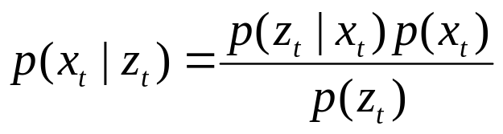
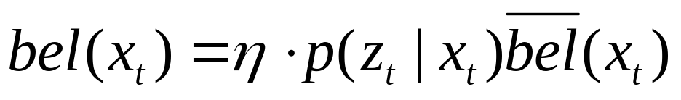
Perception update
5 - Localization and Mapping
5
<number>
In this phase the robot corrects its previous position (i.e. its former belief) by opportunely combining it with the information from its exteroceptive sensors
where η is a normalization factor which makes the probability integrate to 1.

Slide 22

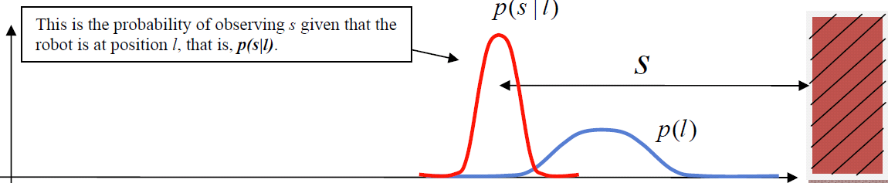

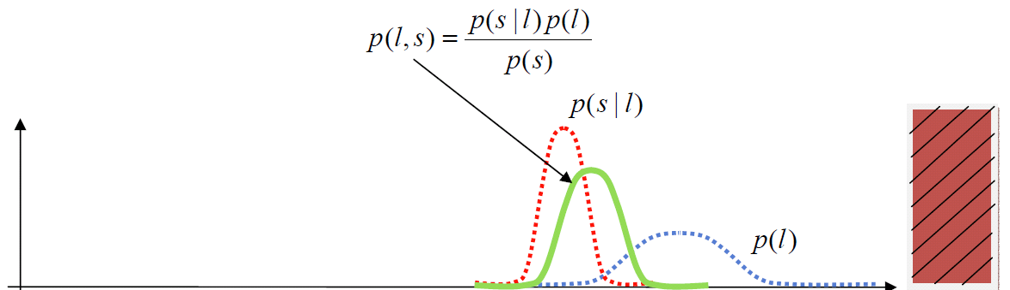
Perception update
5 - Localization and Mapping
5
<number>
Explanation of
This is the probability of observing z given that the
robot is at position x, that is:

Slide 23
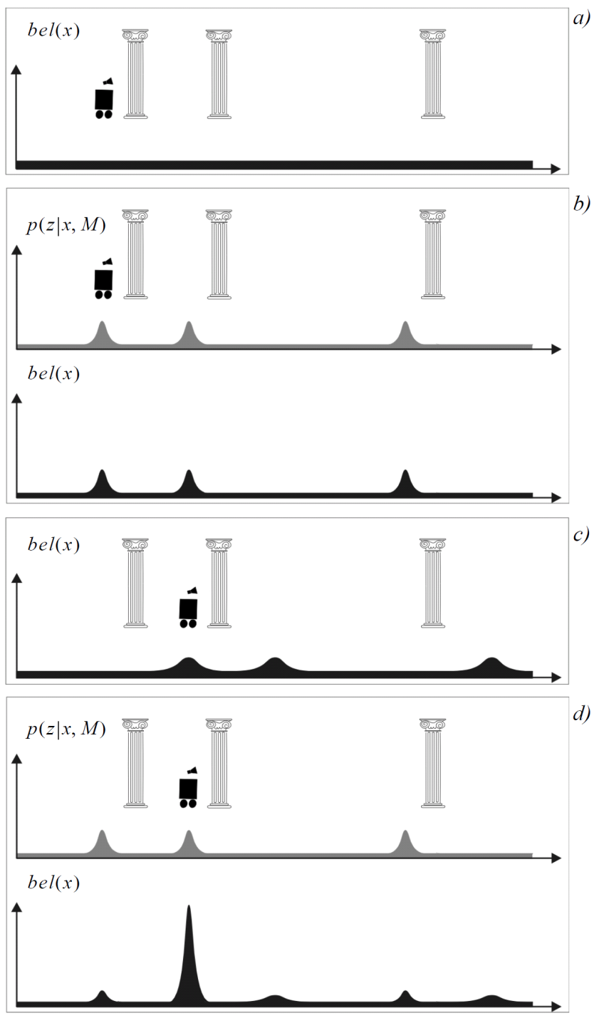

Illustration of probabilistic bap based localization
5 - Localization and Mapping
5
<number>
Initial probability distribution
Perception update
Action update
Perception update

Slide 24
Illustration of probabilistic bap based localization
5 - Localization and Mapping
5
<number>
Initial probability distribution
Perception update
Action update
Perception update

Slide 25
Illustration of probabilistic bap based localization
5 - Localization and Mapping
5
<number>
Initial probability distribution
Perception update
Action update
Perception update

Slide 26
Illustration of probabilistic bap based localization
5 - Localization and Mapping
5
<number>
Initial probability distribution
Perception update
Action update
Perception update

Slide 27
Markov versus Kalman localization
5 - Localization and Mapping
5
<number>
Two approaches exist to represent the probability distribution and to compute the convolution
and Bayes rule during the Action and Perception phases
Markov | Kalman
The configuration space is divided into many cells. The configuration space of a robot moving on a plane is 3D dimensional (x,y,θ). Each cell contains the probability of the robot to be in that cell. The probability distribution of the sensors model is also discrete. During Action and Perception, all the cells are updated | • The probability distribution of both the robot configuration and the sensor model is assumed to be continuous and Gaussian! • Since a Gaussian distribution only described through mean value μ and variance σ², we need only to update μ and Σ^{2.} Therefore the computational cost is very low!

Slide 28
Probabilistic Map Based Localization:
Markov Localization
Pages: 292-312 of the textbook
Localization
"Position"
Cognition
Global Map
Environment Model
Path
Local Map
Perception
Real World
Motion Control
Environment

Slide 29
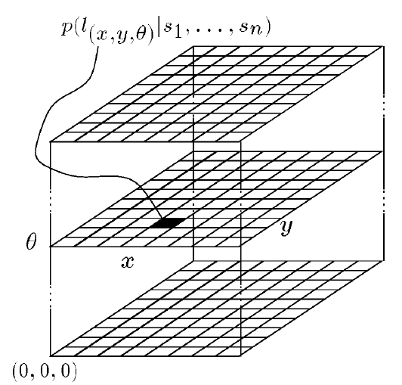

Markov localization
5 - Localization and Mapping
5
<number>
Markov localization uses a grid space representation of the robot configuration.
For sake of simplicity let us consider a robot moving in a one dimensional environment (e.g. moving on a rail). Therefore the robot configuration space can be represented through the sole variable x.
Let us discretize the configuration space into 10 cells

Slide 30
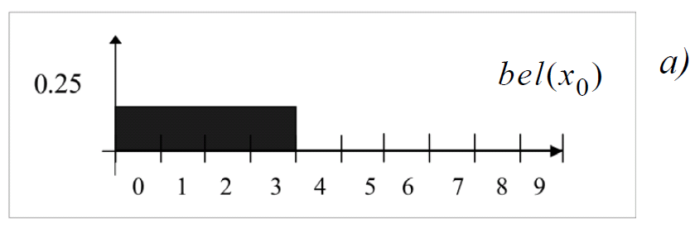
Markov localization
5 - Localization and Mapping
5
<number>
Let us discretize the configuration space into 10 cells
Suppose that the robot’s initial belief is a uniform distribution from 0 to 3. Observe that all the elements were normalized so that their sum is 1.

Slide 31
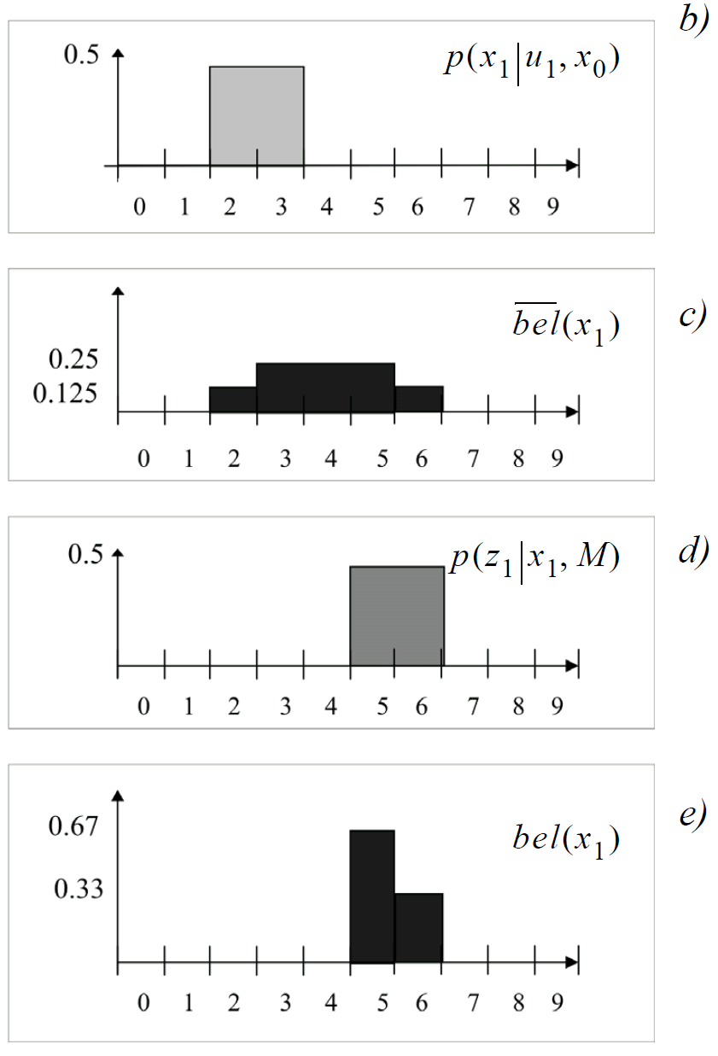
Markov localization
5 - Localization and Mapping
5
<number>
Initial belief distribution
Action phase:
Let us assume that the robot moves forward with the following statistical model
This means that we have 50% probability that the robot moved 2 or 3 cells forward.
Considering what the probability was before moving, what will the probability be after the motion?

Slide 32
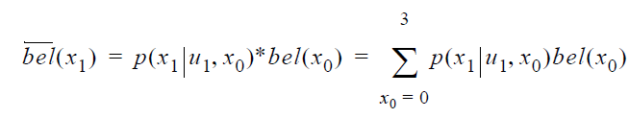

Markov localization: Action update
5 - Localization and Mapping
5
<number>
The solution is given by the convolution of the two distributions

Slide 33
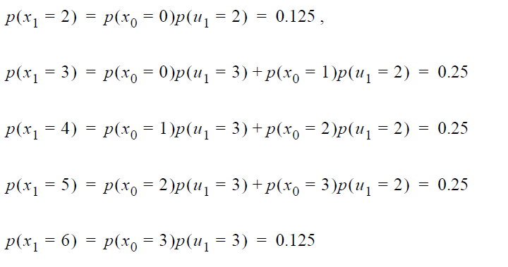
Markov localization: Action update - Explanation
5 - Localization and Mapping
5
<number>
Here, we would like to explain where this formula actually comes from. In order to compute the probability of position x₁ in the new belief state, one must sum over all the possible ways in which the robot may reach x₁ according to the potential positions expressed in the former belief state x₀ and the potential input expressed by u₁. Observe that because x₀ is limited to the range between 0 and 3, the robot can only reach the states between 2 to 6. Therefore
You can now verify that these equations are computing nothing but the convolution of the Action update:

Slide 34

Markov localization: Perception update
5 - Localization and Mapping
5
<number>
Let us now assume that the robot uses its onboard range finder and measures the distance from the origin. Assume that the statistical error model of the sensors is
This plot tells us that the distance of the robot from the origin can be 5 or 6 units.
What will the final robot belief be after this measurement? The answer is again given by the Bayes rule:

Slide 35
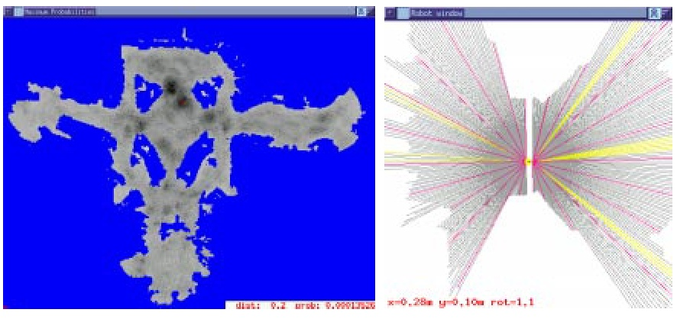
Markov Localization: Case Study 2 – Grid Map (5)
5 - Localization and Mapping
5
<number>
Example 2: Museum
  Laser scan 1
Courtesy of
W. Burgard

Slide 36
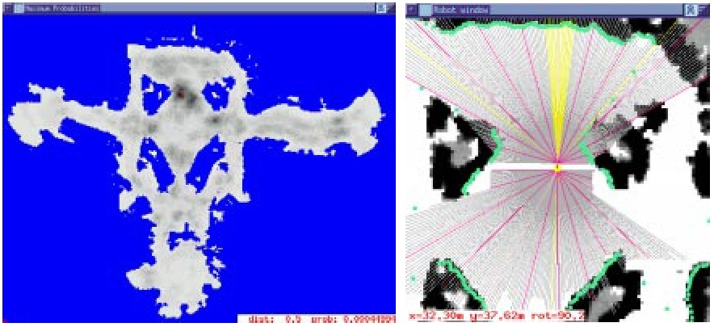
Markov Localization: Case Study 2 – Grid Map (6)
5 - Localization and Mapping
5
<number>
Example 2: Museum
  Laser scan 2
Courtesy of
W. Burgard

Slide 37
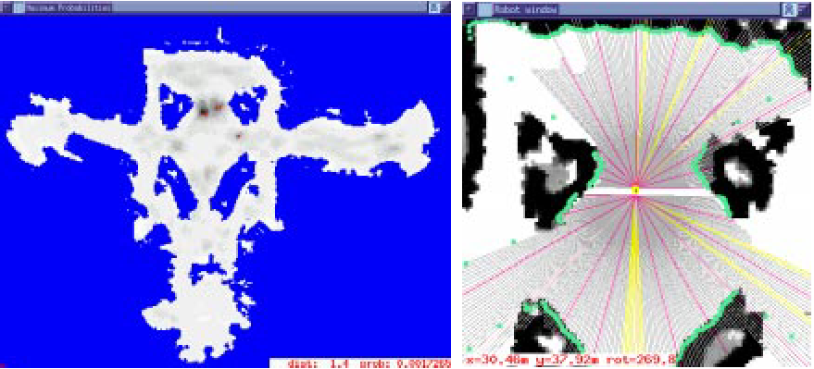
Markov Localization: Case Study 2 – Grid Map (7)
5 - Localization and Mapping
5
<number>
Example 2: Museum
  Laser scan 3
Courtesy of
W. Burgard

Slide 38
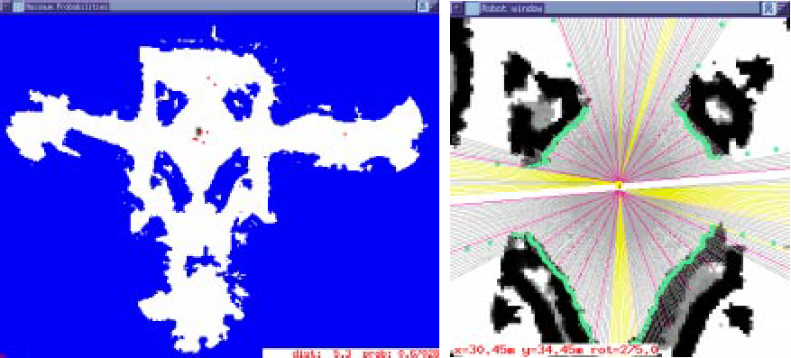
Markov Localization: Case Study 2 – Grid Map (8)
5 - Localization and Mapping
5
<number>
Example 2: Museum
  Laser scan 13
Courtesy of
W. Burgard

Slide 39
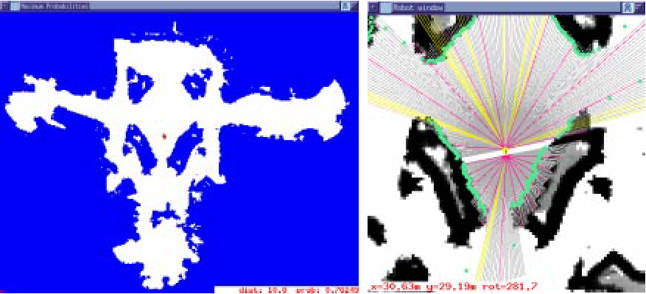
Markov Localization: Case Study 2 – Grid Map (9)
5 - Localization and Mapping
5
<number>
Example 2: Museum
  Laser scan 21
Courtesy of
W. Burgard

Slide 40
Drawbacks of Markov localization
5 - Localization and Mapping
5
<number>
In the more general planar motion case the grid-map is a three-dimensional array where each cell contains the probability of the robot to be in that cell. In this case, the cell size must be chosen carefully.
During each prediction and measurement steps, all the cells are updated. If the number of cells in the map is too large, the computation can become too heavy for real-time operations.
The convolution in a 3D space is clearly the computationally most expensive step.
As an example, consider a 30x30 m environment and a cell size of 0.1 m x 0.1 m x 1 deg. In this case, the number of cells which need to be updated at each step would be 30x30x100x360=32.4 million cells!
Fine fixed decomposition grids result in a huge state space
  Very important processing power needed
  Large memory requirement

Slide 41
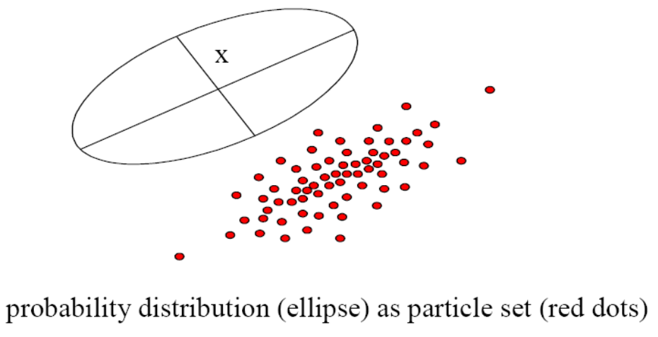
Drawbacks of Markov localization
5 - Localization and Mapping
5
<number>
Reducing complexity
  Various approached have been proposed for reducing complexity
    One possible solution would be to increase the cell size at the expense of localization accuracy.
    Another solution is to use an adaptive cell decomposition instead of a fixed cell decomposition.
Randomized Sampling / Particle Filter
  The main goal is to reduce the number of states that are updated in each step
  Approximated belief state by representing only a ‘representative’ subset of all states (possible locations)
  E.g update only 10% of all possible locations
  The sampling process is typically weighted, e.g. put more samples around the local peaks in the probability density function
  However, you have to ensure some less likely locations are still tracked, otherwise the robot might get lost

