Slide 1
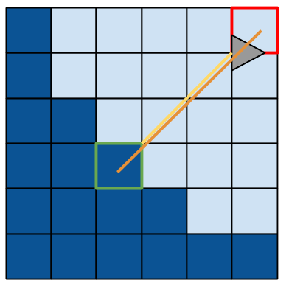
Low Resolution Maps
2.8 vs. 4.2

Slide 2
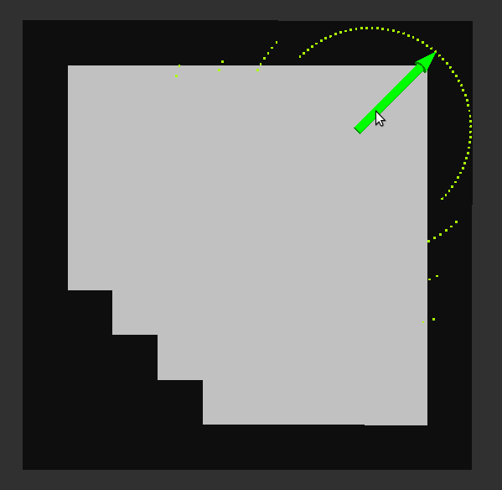

Slide 3
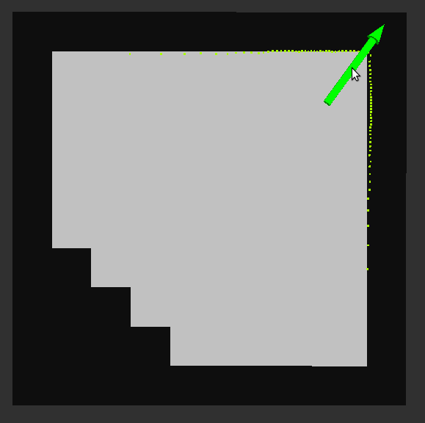

Slide 4
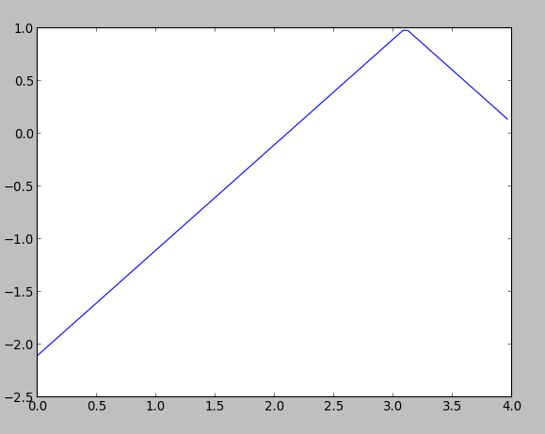
Scan Similarity
d₀,d₁
s =
1-abs(d₀-d₁)

Slide 5
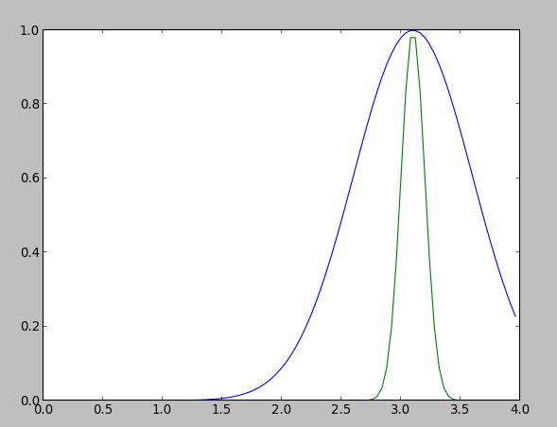
Scan Similarity
d₀,d₁
s =
exp(-(d₀-d₁)² )
2v²

Slide 6
New Particle
random.gauss(mean, variance)

Slide 7
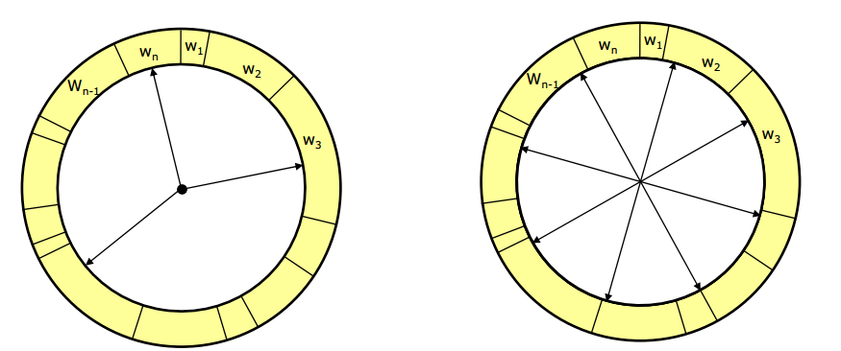
Importance Sampling

Slide 8

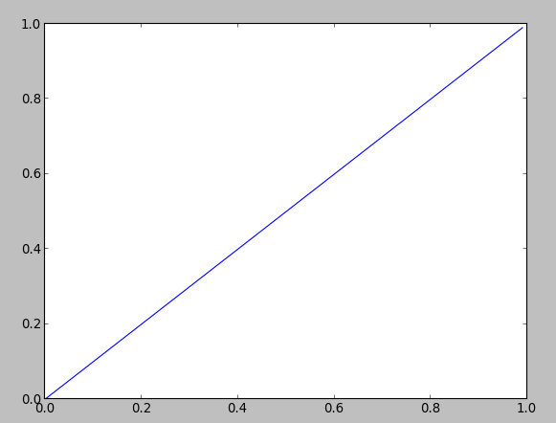
Base Case [0,1]

Slide 9

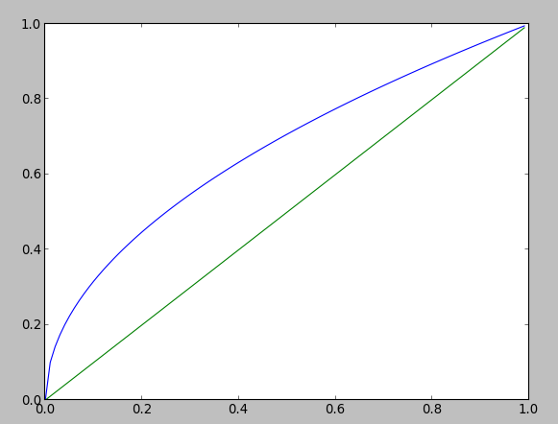
Converge Too Fast - sqrt

Slide 10

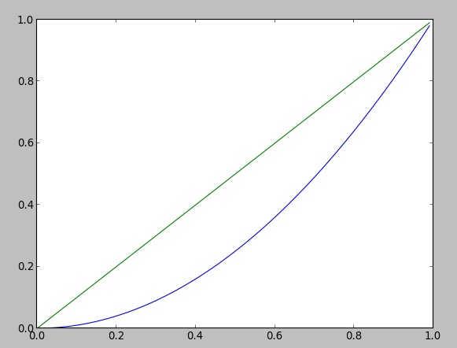
Converge Too Slow - Square

Slide 11

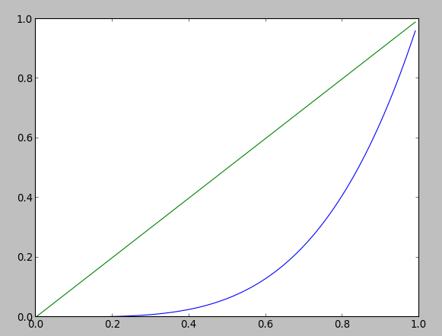
Converge Too Slow - Fourth Power

