Slide 1
Kalman Filter Example

Slide 2
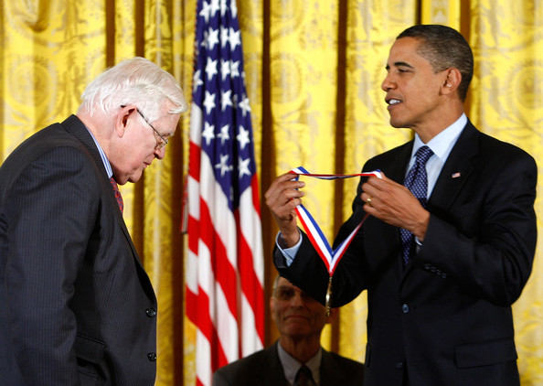
Rudolf E. Kalman
b. 1930
Hungary
Kalman Filter
NASA Ames
1960
National Medal of Science (2009)

Slide 3
Actions and Observations
Through Time
Belief(x_{t})
(using all evidence to date)
Get Measurement
Elapse Time
Belief'(x_{t})
(without latest evidence)

Slide 4
Kalman Data:
Our estimate:
x_{1..t} = x₁, x₂, x₃...x_{t}
Our measurement:
z_{1..t} = z₁, z₂, z₃...z_{t}
Our action:
u_{1..t} = u₁, u₂, u₃...u_{t}

Slide 5
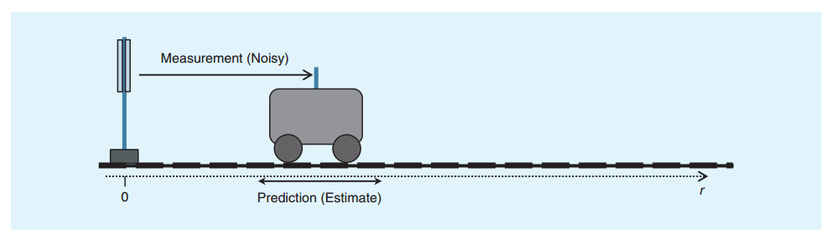
Kalman Example
"Understanding the Basis of the Kalman Filter Via a Simple and Intuitive Derivation" Ramsey Faragher
https://www.cl.cam.ac.uk/~rmf25/papers/Understanding%20the%20Basis%20of%20the%20Kalman%20Filter.pdf

Slide 6
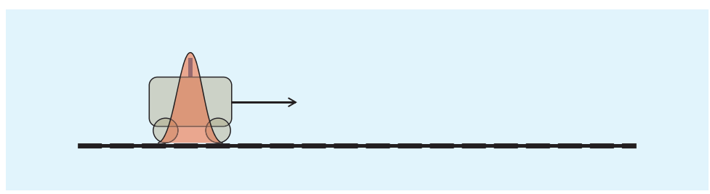
Initial Estimate

Slide 7
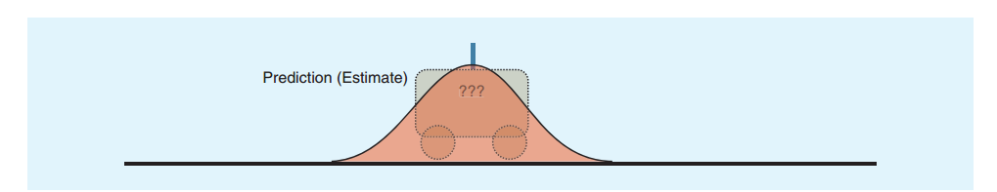
Elapse Time

Slide 8
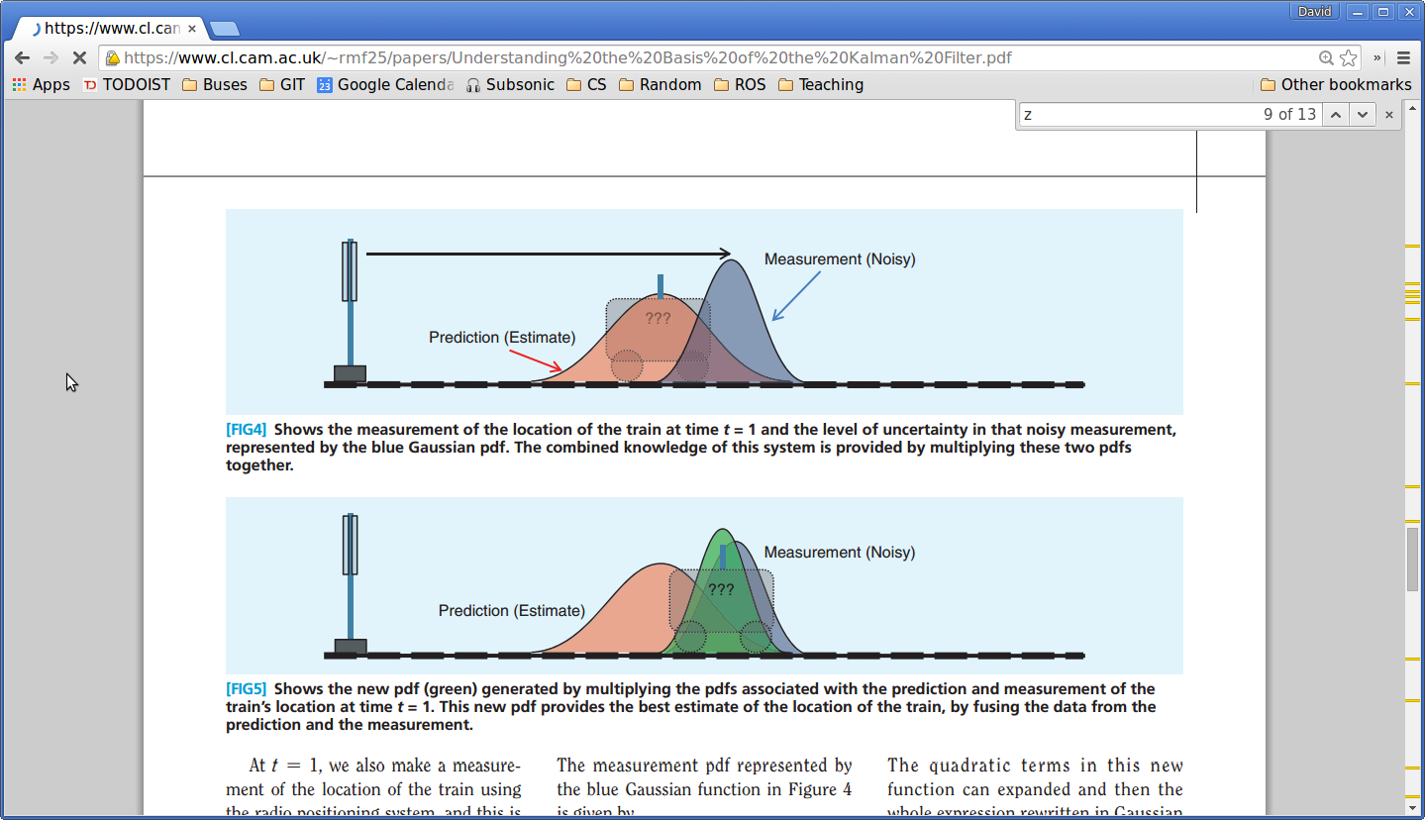
Get Measurement

Slide 9
New Belief

Slide 10
Kalman: Assume a Linear System
x_{t} = F_{t} x_{t-1} + B_{t} u_{t} + w_{t}
x_{t} = state (estimate)
u_{t} = action
F_{t} = state transition matrix
B_{t} = control input matrix
w_{t} = noise w_{t} ~ N(0,Q_{t})

Slide 11
Kalman: Measurements
z_{t} = H_{t}x_{t} + v_{t}
z_{t} = measurements
H_{t} = Transformation matrix
v_{t} = observational noise v_{t} ~ N(0, R_{t})

Slide 12
Kalman: Belief
Gaussian Distribution
x₀ = initial mean
P₀ = Variance
N(x₀, P₀)

Slide 13
Kalman Example
State:
Action:
f_{t}/m
x_{t}
v_{t}

Slide 14
Kalman Update
f_{t}/m
State:
x_{t}
v_{t}
Action:
x_{t} = x_{t-1} + v_{t-1}△t + 0.5 (f_{t}/m) * △t²
v_{t} = v_{t-1} + (f_{t}/m)△t
x'_{t}
v'_{t}
1 △t
0 1
x_{t-1}
v_{t-1}
△t²/2
△t
f_{t}/m
= +

Slide 15
Kalman: Elapse Time Update
x'_{t} = F_{t}x_{t-1} + B_{t}u_{t}
P'_{t} = F_{t}P_{t-1} F^{T}_{t} + Q_{t}

Slide 16
Kalman: Measurement Update
Kalman Gain (how much to correct estimate)
K_{t} = P'_{t}H^{T}_{t} (H_{t}P'_{t}H^{T}_{t} + R_{t})⁻¹
New Belief:
x_{t} = x'_{t} + K_{t}(z_{t}-H_{t}x'_{t})
P_{t} = P'_{t} - K_{t}H_{t}P'_{t}

Slide 17
Simple Kalman Filter Example
x_{t} = just position (meters)
u_{t} = 1 m/s
w_{t} ~ N(0,0.1)
v_{t} ~ N(0,1.0)
x₀ = 4.5 P² = 2.0
x'_{t} = x_{t-1} + u_{t} + w_{t} (F=1, B=1)
z_{t} = x_{t} + v_{t} (H=1)

Slide 18
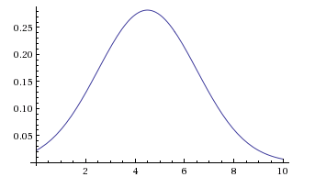
t=0
x₀=4.5
P²=2

Slide 19
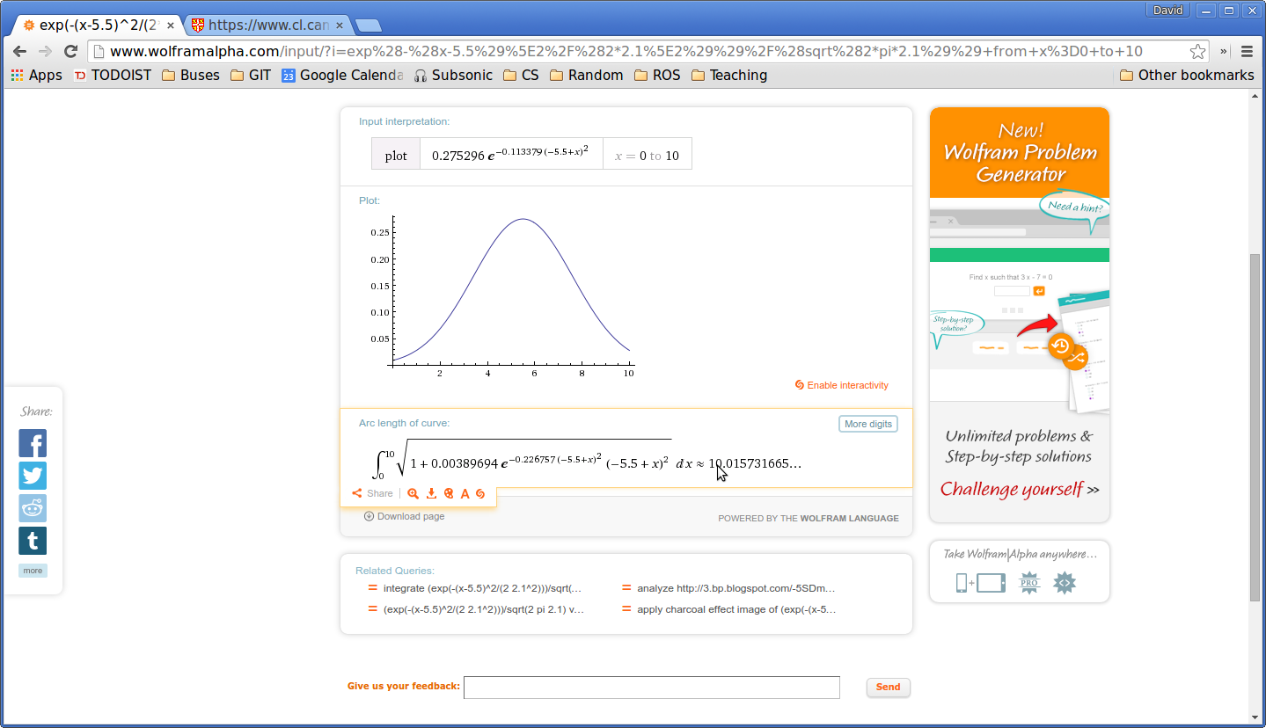
t=1
x₁ = x₀ + 1 = 5.5
P'₁ = F₀P₀ F^{T}₀ + Q₀
= 1 * 2 * 1 + 0.1
= 2.1

Slide 20
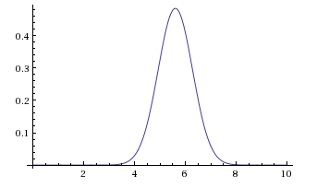
t=1 z₁=5.673
K₁ = P'_{t}H^{T}_{t} (H_{t}P'_{t}H^{T}_{t} + R_{t})⁻¹
= (2.1 * 1)/(1*2.1*1+1.0)
= .677
x₁ = x'₁ + K₁(z₁-H₁x'₁)
= 5.5 + .677 (5.673-1*5.5)
= 5.617121
P_{t} = P'_{t} - K_{t}H_{t}P'_{t}
= 2.1 - .677 * 1 * 2.1
= 0.6783

Slide 21
Kalman Filters
Must be linear system
Stored as a gaussian

