Slide 1
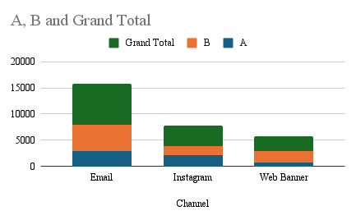
Campaign Performance Recommendation for New Customer Growth
Email Generated the Highest Overall Revenue
Campaign B Generated the Highest Total Sales
Email + Campaign A Drives New Customer Growth
Recommendation:
Email combined with Campaign A is the most effective strategy for attracting new customers. While Campaign B generated higher total revenue overall, Campaign A performed better in converting first-time buyers when delivered through the Email channel. To support the client’s goal of growing new customer sales, we recommend increasing
investment in Email + Campaign A and continuing to test variations of the message to further improve performance.

