Slide 1
Mushroom
Apriori
FP-Growth
Threshold | Time (s)
1 | 0.07779169
0.9 | 0.0987377
0.8 | 0.0997336
0.7 | 0.1276586
0.6 | 0.1176867
0.5 | 0.1276624
0.4 | 0.1555843
0.3 | 0.2862358
Threshold | Time (s)
1 | 0.06092262
0.9 | 0.05368447
0.8 | 0.07416153
0.7 | 0.1430566
0.6 | 0.157027
0.5 | 0.5739486
0.4 | 3.38636
0.3 | 60.58499

Slide 2
Chess
Apriori
FP-Growth
Threshold | Time (s)
1 | 0.02393413
0.9 | 0.05880523
0.8 | 0.2082586
0.7 | 0.9165969
0.6 | 12.23962
0.5 | 25.0869
0.4 | 485.4707
Threshold | Time (s)
1 | 0.03070951
0.9 | 2.201063
0.8 | 175.8379
0.7 | 3335.575

Slide 3
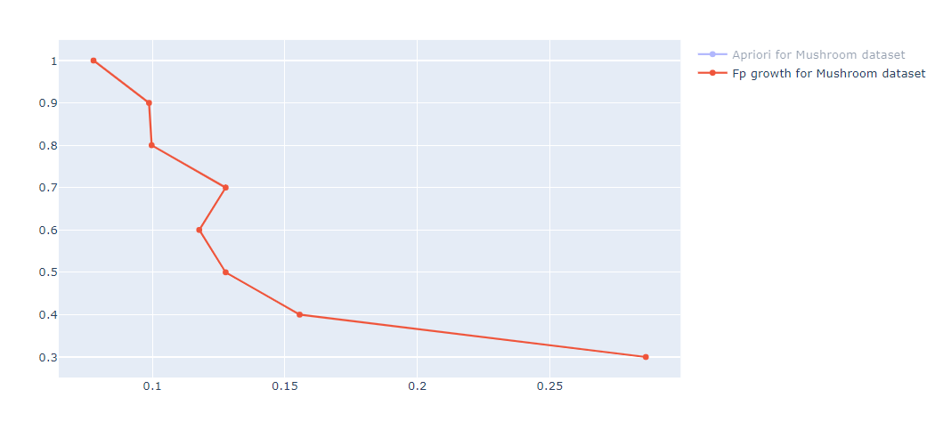
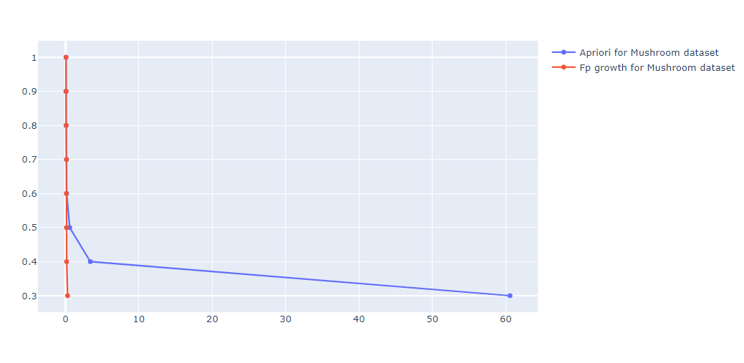
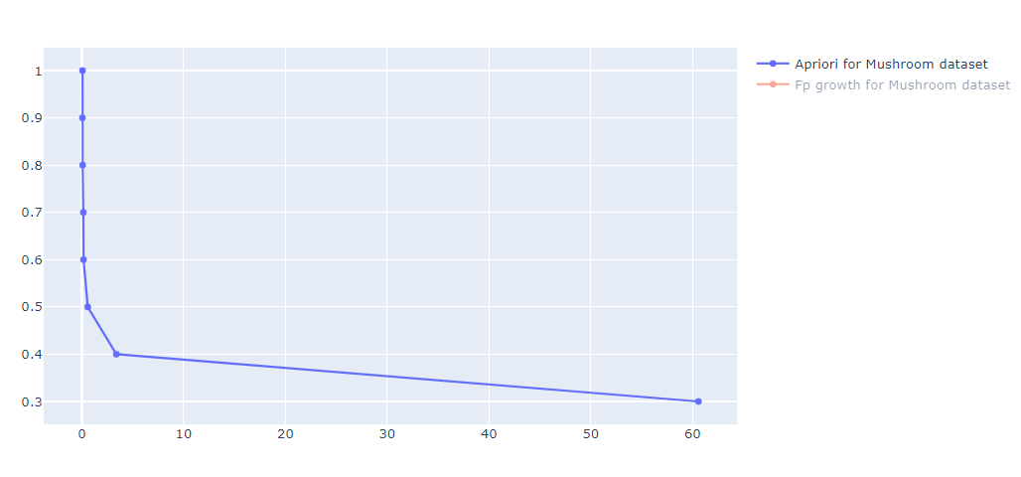

Slide 4
