Slide 1
SQL PROJECT
CAR LAUNCH ANALYSIS IN UK MARKET

Slide 2
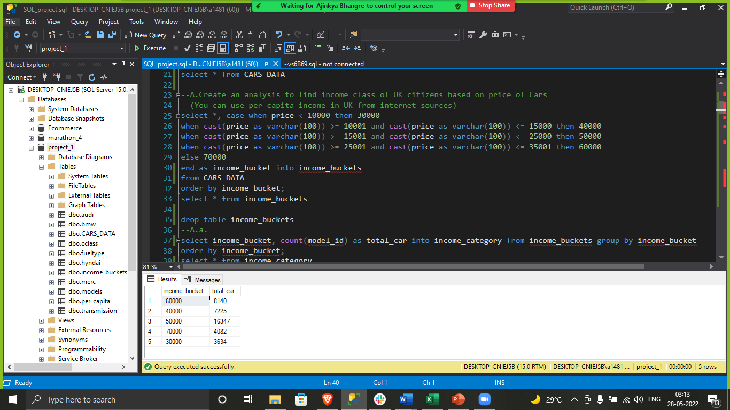
--A.Create an analysis to find income class of UK citizens based on price of Cars
--(You can use per-capita income in UK from internet sources

Slide 3
select *, case when price < 10000 then 30000
when cast(price as varchar(100)) >= 10001 and cast(price as varchar(100)) <= 15000 then 40000
when cast(price as varchar(100)) >= 15001 and cast(price as varchar(100)) <= 25000 then 50000
when cast(price as varchar(100)) >= 25001 and cast(price as varchar(100)) <= 35001 then 60000
else 70000
end as income_bucket into income_buckets
from CARS_DATA
order by income_bucket;
select * from income_buckets
drop table income_buckets
--A.a.
select income_bucket, count(model_id) as total_car into income_category from income_buckets group by income_bucket
order by income_bucket;
select * from income_category
--A.a. year_wise
select year, income_bucket, count(model_id) as total_car into yoy_income from income_buckets
group by year, income_bucket
order by year desc, income_bucket desc;
select * from yoy_income

Slide 4
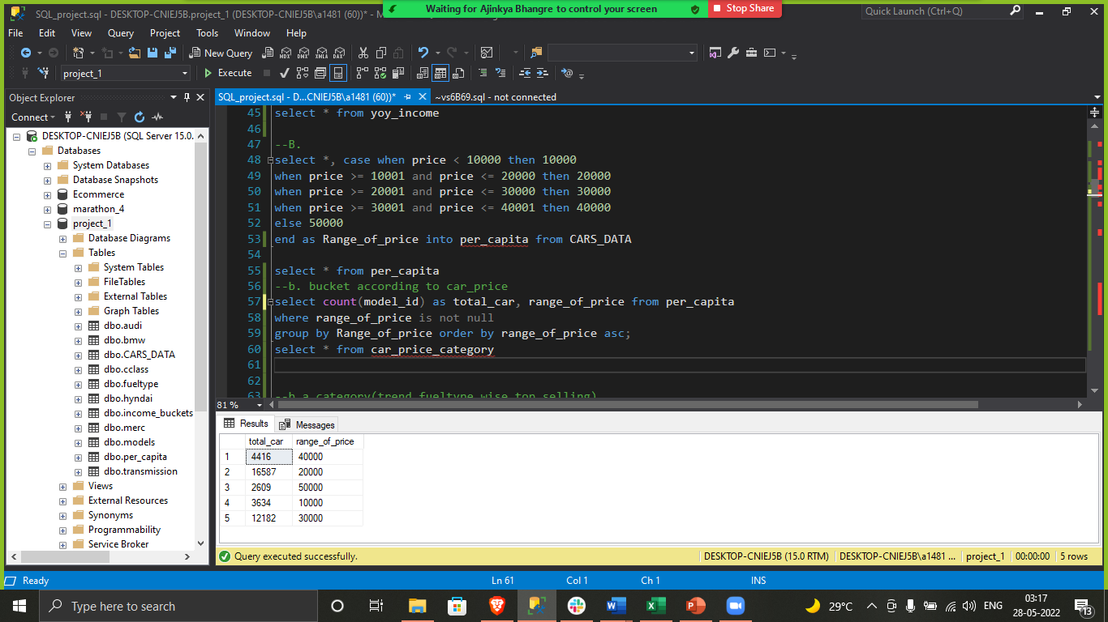
b. Categorize the cars on the basis of their price(Create as many buckets as you want as per your understanding of data) and analyze the:

Slide 5
select *, case when price < 10000 then 10000
when price >= 10001 and price <= 20000 then 20000
when price >= 20001 and price <= 30000 then 30000
when price >= 30001 and price <= 40001 then 40000
else 50000
end as Range_of_price into per_capita from CARS_DATA
select * from per_capita
--b. bucket according to car_price
select count(model_id) as total_car, range_of_price from per_capita
where range_of_price is not null
group by Range_of_price order by range_of_price asc;
select * from car_price_category

Slide 6
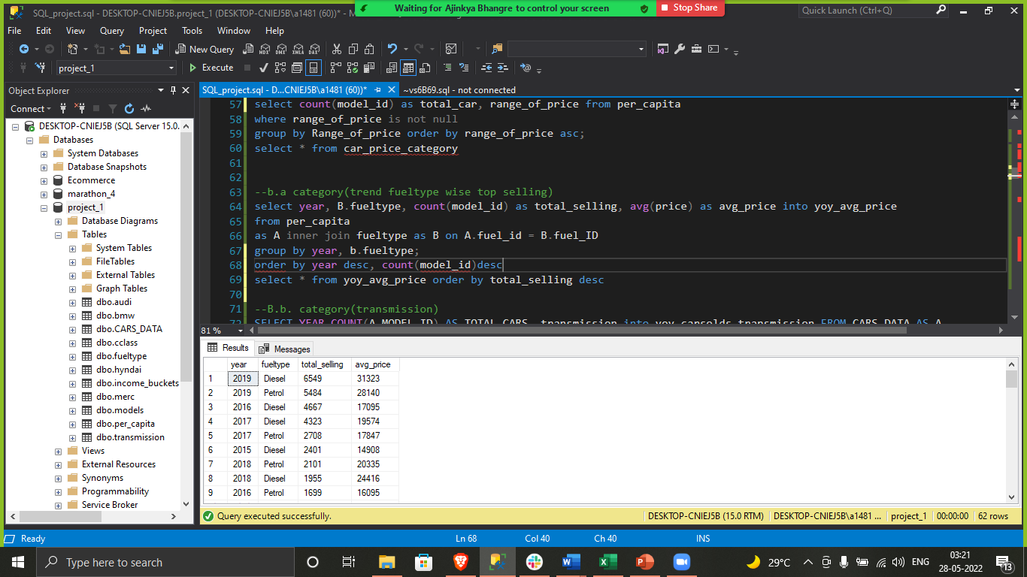
a. price changes across the years and identify the categories which has seen significant jump in its price

Slide 7
select year, B.fueltype, count(model_id) as total_selling, avg(price) as avg_price into yoy_avg_price
from per_capita
as A inner join fueltype as B on A.fuel_id = B.fuel_ID
group by year, b.fueltype;
order by year desc, count(model_id)desc
select * from yoy_avg_price order by total_selling desc

Slide 8

b. changes in no of cars sold across the years and identify the categories which has seen significant jump in its sales

Slide 9
SELECT YEAR,COUNT(A.MODEL_ID) AS TOTAL_CARS, transmission into yoy_carsolds_transmission FROM CARS_DATA AS A
INNER JOIN transmission AS B ON B.ID = A.transmission_ID
GROUP BY YEAR, transmission
ORDER BY year desc, transmission desc, COUNT(A.MODEL_ID) DESC;
select * from yoy_carsolds_transmission order by total_cars desc

Slide 10
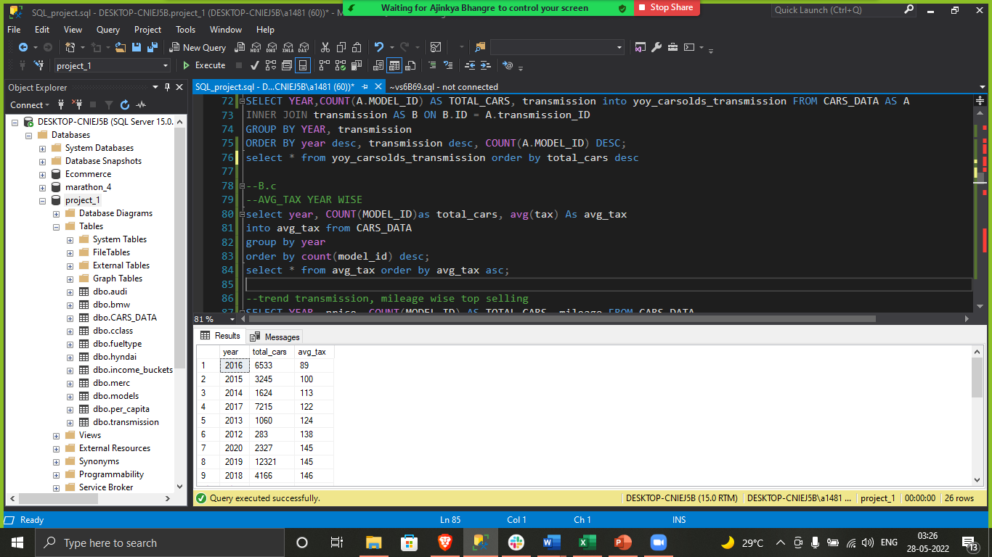
Using the above identified categories for both points (a) & (b), do a root cause analysis to identify the probable reason for their increase.

Slide 11
--AVG_TAX YEAR WISE
select year, COUNT(MODEL_ID)as total_cars, avg(tax) As avg_tax
into avg_tax from CARS_DATA
group by year
order by count(model_id) desc;
select * from avg_tax order by avg_tax asc;
Insights
The car sales has been rise because the concession in tax since year in 2012.
There is 30% to 35% improvement in tax benefit.
There is a significant improvement in a diesel car sales since 2012 because of the cost effectiveness.
The sales of diesel car is twice as compared to petrol cars.

Slide 12
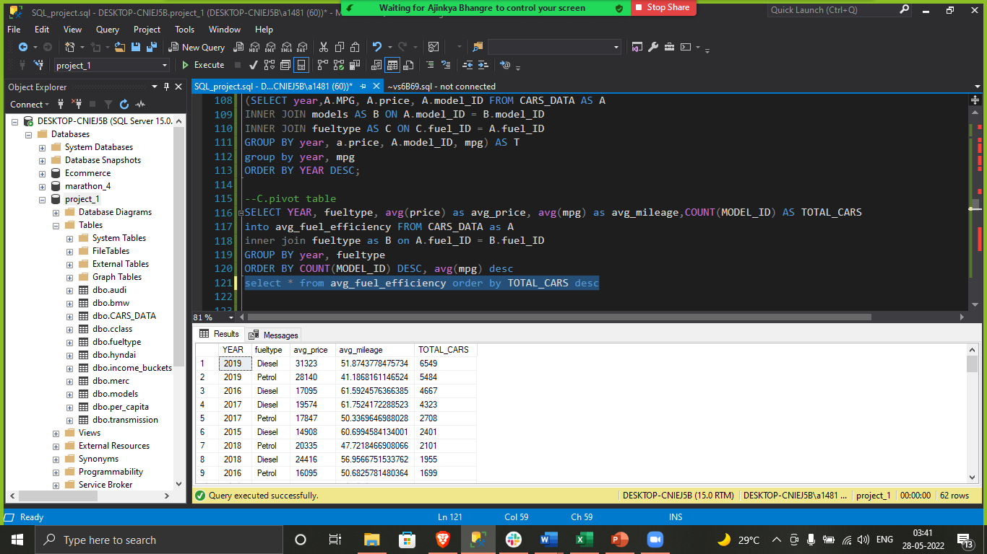
c. Find relationship between fuel efficiency & price of car/sales of car/fuel type/, etc.

Slide 13
SELECT YEAR, fueltype, avg(price) as avg_price, avg(mpg) as avg_mileage,COUNT(MODEL_ID) AS TOTAL_CARS
into avg_fuel_efficiency FROM CARS_DATA as A
inner join fueltype as B on A.fuel_ID = B.fuel_ID
GROUP BY year, fueltype
ORDER BY COUNT(MODEL_ID) DESC, avg(mpg) desc
select * from avg_fuel_efficiency order by TOTAL_CARS desc

Slide 14
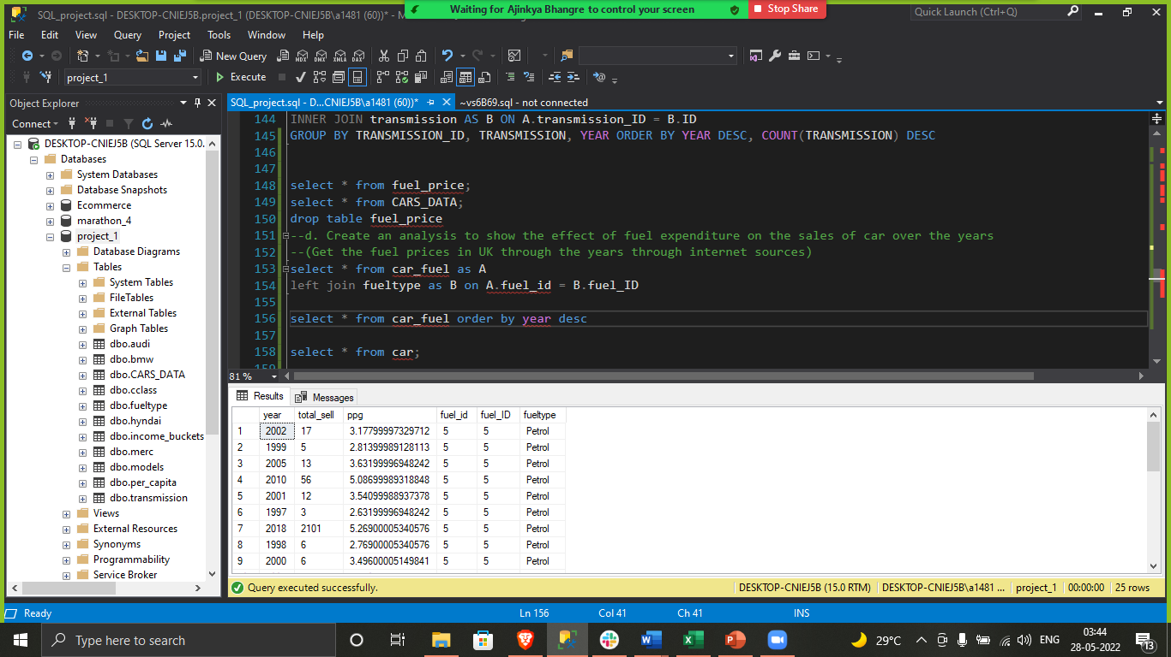
d. Create an analysis to show the effect of fuel expenditure on the sales of car over the years(Get the fuel prices in UK through the years through internet sources)

Slide 15
select * from car_fuel as A
left join fueltype as B on A.fuel_id = B.fuel_ID
select * from car_fuel order by year desc

Slide 16
Insights
The maximum sales has been observed 10000 to 20000 category.
As per the data we will suggest to launch the diesel car as we are getting maximum sale in that category.
Incase if we are able to manage tax around 120 pound it ill be additional booster.
We will suggest semiautomatic transmission as per the total sales.

Slide 17
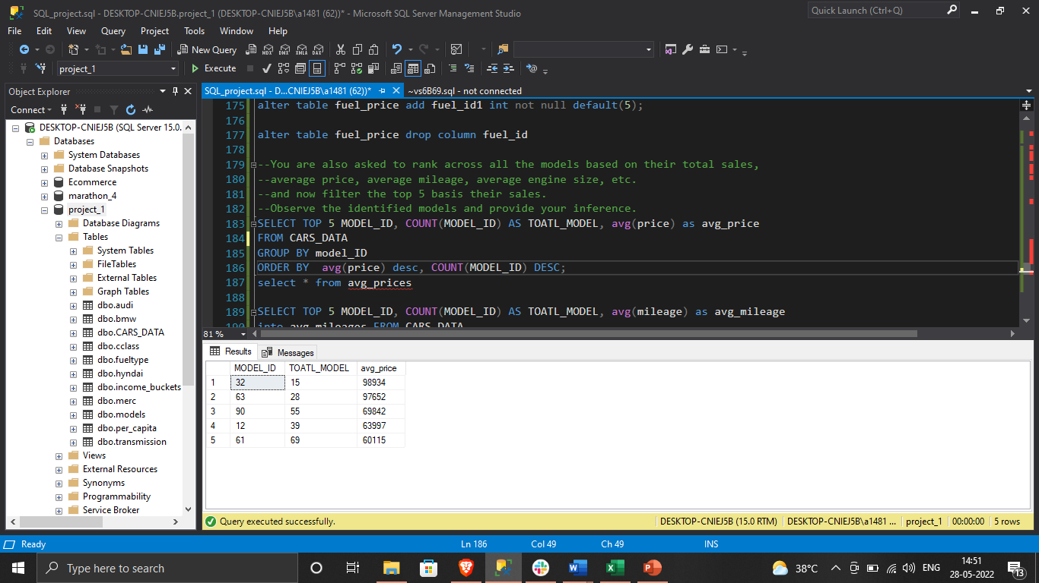
--You are also asked to rank across all the models based on their total sales,
--average price, average mileage, average engine size, etc.
--and now filter the top 5 basis their sales.
--Observe the identified models and provide your inference.

Slide 18
SELECT TOP 5 MODEL_ID, COUNT(MODEL_ID) AS TOATL_MODEL, avg(price) as avg_price
FROM CARS_DATA
GROUP BY model_ID
ORDER BY avg(price) desc, COUNT(MODEL_ID) DESC;

Slide 19
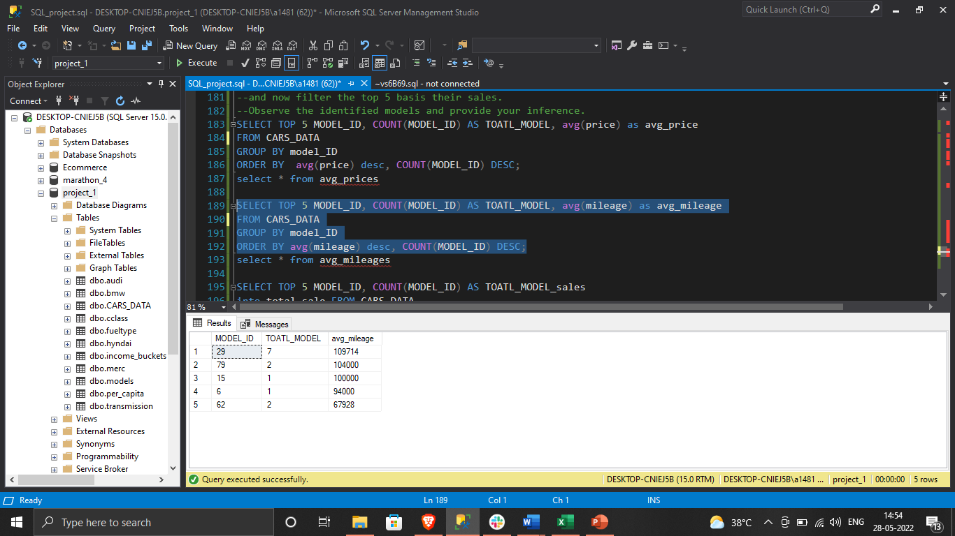

Slide 20
SELECT TOP 5 MODEL_ID, COUNT(MODEL_ID) AS TOATL_MODEL, avg(mileage) as avg_mileage
FROM CARS_DATA
GROUP BY model_ID
ORDER BY avg(mileage) desc, COUNT(MODEL_ID) DESC;

Slide 21
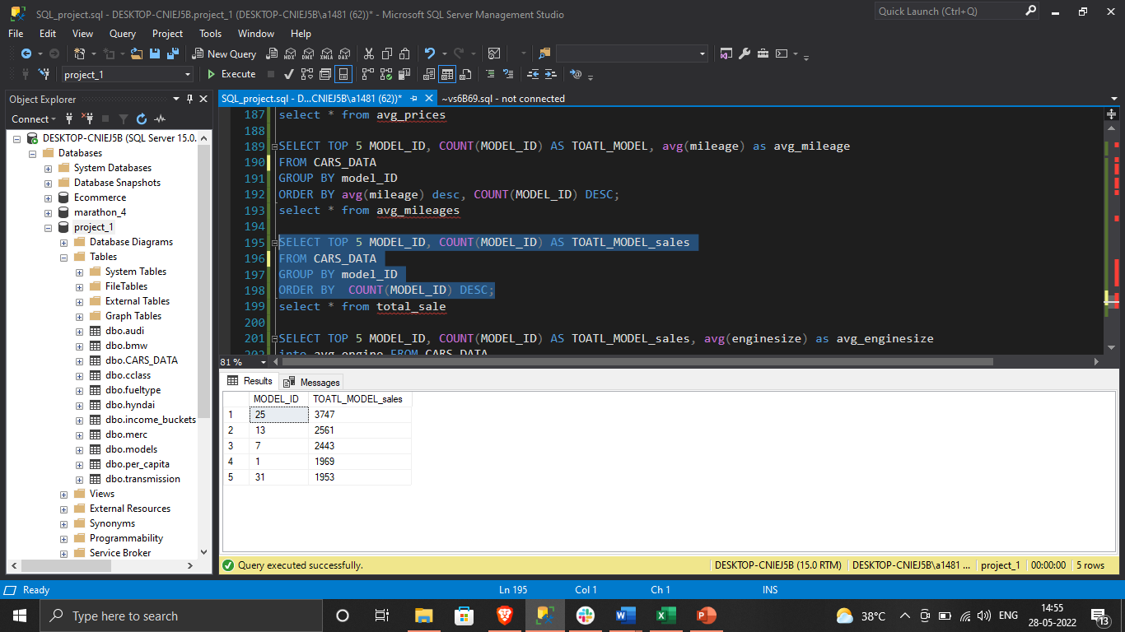

Slide 22
SELECT TOP 5 MODEL_ID, COUNT(MODEL_ID) AS TOATL_MODEL_sales
FROM CARS_DATA
GROUP BY model_ID
ORDER BY COUNT(MODEL_ID) DESC;

Slide 23


Slide 24
SELECT TOP 5 MODEL_ID, COUNT(MODEL_ID) AS TOATL_MODEL_sales, avg(enginesize) as avg_enginesize
FROM CARS_DATA
GROUP BY model_ID
ORDER BY avg(enginesize) desc, COUNT(MODEL_ID) DESC

