Slide 1

AI Chatbot Web Portal for Student Helpdesk Using NLP
Amit A. Sabnis | Sai Anudra Togati
Department of Computer Science and Engineering
GITAM University, Bengaluru

Slide 2
Problem Statement
Traditional student helpdesks struggle with scalability and consistency, creating frustration for both students and staff.
Delayed Responses
Repetitive Work
Limited Availability
Manual email and phone-based query handling causes significant delays, leaving students waiting hours or days for answers.
Staff repeatedly answer identical questions across multiple channels, wasting valuable time & resources on routine inquiries.
No support available outside working hours—students receive zero assistance during nights, weekends, or holidays.
Static Content Issues
Growing Demand
Static FAQ pages cannot understand differently phrased questions or adapt to natural language variations.
Increasing enrollments compound the problem every year, making the current system unsustainable.
"Students wait. Staff burn out. The system doesn't scale."

Slide 3





Proposed Solution Overview
An intelligent, AI-powered Chatbot Web Portal that revolutionizes student support through natural language processing and 24/7 automated assistance.
Natural Language Understanding
24/7 Instant Responses
Comprehensive Coverage
Provides immediate answers to routine questions without human intervention, eliminating response delays entirely.
Handles admissions, fees, exams, attendance, placements, and course-related queries across all domains.
Processes queries in everyday language, understanding context and intent rather than exact keyword matches.
Smart Escalation
Admin Dashboard
Automatically forwards uncertain or complex queries to human administrators when confidence thresholds aren't met.
Gives administrators powerful tools to manage knowledge bases, monitor performance, and track emerging trends.

Slide 4
System Architecture
A modular, full-stack design built with modern web technologies and machine learning frameworks.
Frontend Layer
Database Layer
Responsive web interface with intuitive chat UI, built using modern frameworks for seamless user experience.
Relational SQL database storing FAQs, conversation logs, semantic embeddings, and analytics data.
Backend Layer
NLP Engine
RESTful API handling authentication, request routing, response generation, and comprehensive logging.
Python-based processing core using Sentence-BERT transformers and Scikit-learn for intelligent query understanding.
Data Flow: Student query → Backend routing → NLP processing → Response generation or admin escalation

Slide 5












NLP Pipeline
Step-by-step query processing that transforms natural language into accurate, context-aware responses.
Preprocessing
Converts text to lowercase, removes punctuation, tokenizes words, and applies lemmatization to normalize input.
Intent Classification
Categorizes queries into predefined domains: Admissions, Fees, Exams, Attendance, Placements, or Courses.
Intent-Based Filtering
Narrows FAQ candidates to relevant domain, reducing search space and improving response accuracy.
Sentence Embedding
Encodes queries using Sentence-BERT (all-MiniLM-L6-v2), creating dense vector representations of meaning.
Hybrid Scoring
Combines semantic similarity with keyword overlap for balanced, accurate matching.
Escalation Check
Automatically forwards queries with confidence scores below 0.65 threshold to human administrators.

Slide 6

Core Algorithm: ESRIF
Enhanced Semantic Retrieval with Intent Filtering
Hybrid Score Formula
Escalation Rule
if Score < τ (0.65):
escalate to admin
where \alpha = 0.8, \beta = 0.2, and \alpha + \beta = 1
Key Innovation
Cosine Similarity
Prioritizes semantic meaning (80% weight) while using keyword overlap as reinforcement (20% weight), balancing contextual understanding with exact matches.

Slide 7
Code Implementation
Core response logic demonstrating the ESRIF algorithm in Python with clear, maintainable code structure.
def chatbot_response(query): query = preprocess(query) intent = classify_intent(query) candidate_faqs = [f for f in faqs if f["intent"] == intent] query_embedding = model.encode(query) best_score, best_answer = 0, None for faq in candidate_faqs: cosine_score = cosine_similarity( [query_embedding], [faq["embedding"]] )[0][0] keyword_score = keyword_overlap(query, faq["question"]) final_score = 0.8 * cosine_score + 0.2 * keyword_score if final_score > best_score: best_score = final_score best_answer = faq["answer"] if best_score < 0.65: return "Escalated to administration." return best_answer

Slide 8
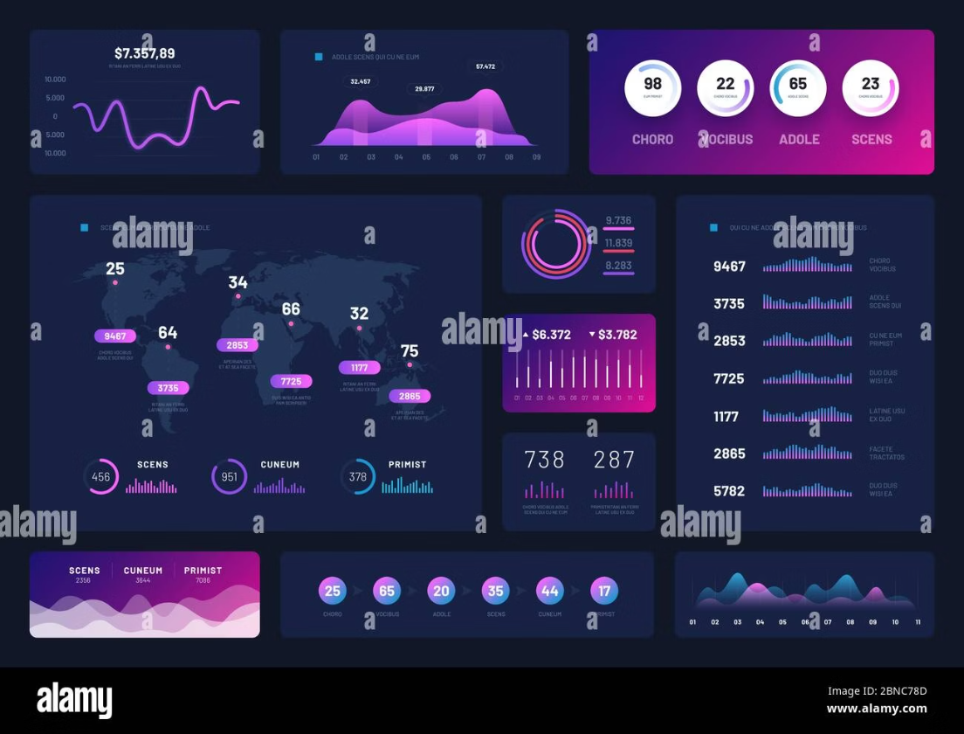
Experimental Setup & Evaluation
Dataset & Environment
Dataset: Institutional student queries across 6 domains with paraphrased variations
Environment: Python, Sentence-Transformers, Scikit-learn, SQL database, 8–16GB RAM
Metrics: Accuracy, Precision, Recall, F1-Score, Response Latency
TF-IDF + Cosine
SBERT Plain Cosine
ESRIF (Proposed)
Lower accuracy due to limited semantic understanding and keyword-only matching
Moderate improvement with semantic embeddings but no intent filtering or hybrid scoring
Highest accuracy by combining semantic depth, keyword reinforcement, and intent filtering

Slide 9
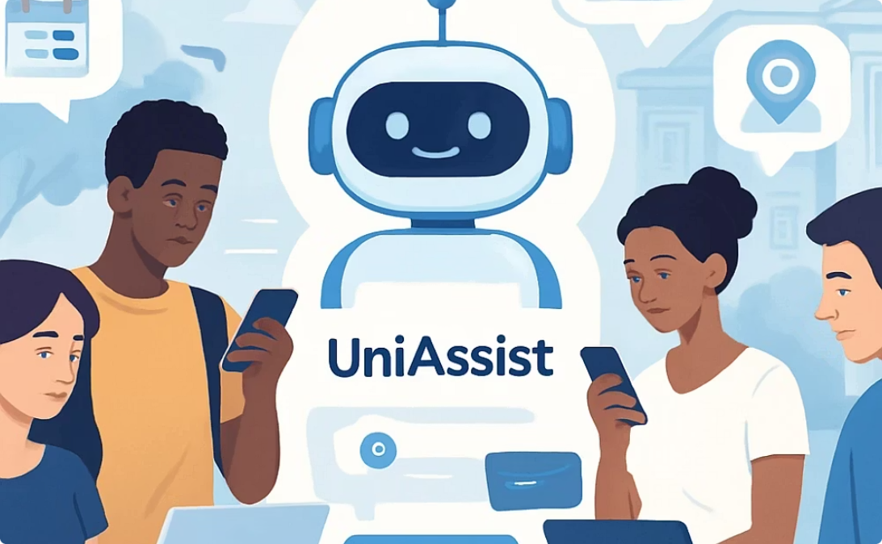
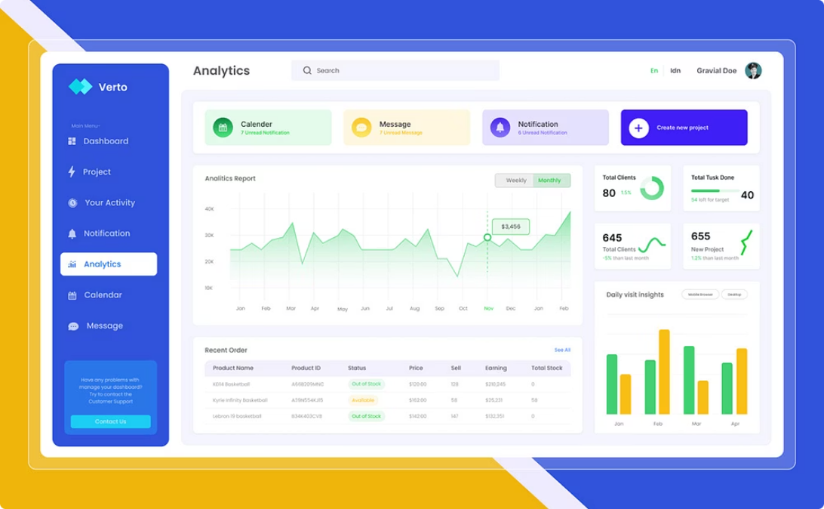
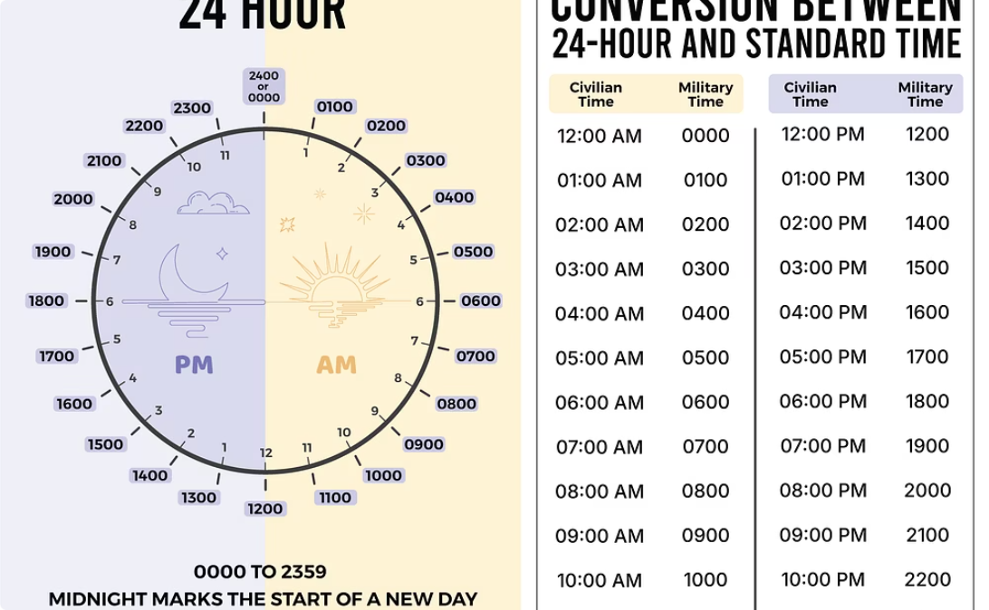
Key Features & Admin Dashboard
Student Interface
Admin Interface
System Benefits
Natural language chat experience
Conversation history tracking
Response feedback mechanism
Dynamic FAQ management
Escalated query monitoring
Usage analytics and trends
Accuracy tracking over time
24/7 availability
Low response latency
Consistent responses
Highly scalable

Slide 10






Conclusion & Future Scope
Conclusion
Successfully developed an NLP-based chatbot that automates student helpdesk operations, reduces administrative workload, and delivers real-time, semantically accurate responses across all domains.
Multilingual Support
Expand to regional languages for broader accessibility
Sentiment Analysis
Detect frustrated students and prioritize assistance
Adaptive Learning
Improve from user feedback over time
ERP Integration
Connect with attendance, fees, and results systems
Mobile App
Extend functionality to iOS and Android platforms
"A smarter helpdesk — built to scale with every student."

