Slide 1

Linux Kernel Module Programming
Anandkumar
June 5, 2021
Anandkumar

Slide 2
Introduction
Similar to Java Servlets with predefined structure and function names
Code that executes as part of the Linux kernel
Extends the capabilities and sometimes might modify the behavior of the kernel
Anandkumar

Slide 3
Introduction Cont…
Common C functions are not available to modules (such as printf, scanf, strcat, or system)
Instead you must use kernel defined functions (/proc/ksyms)
Anandkumar

Slide 4
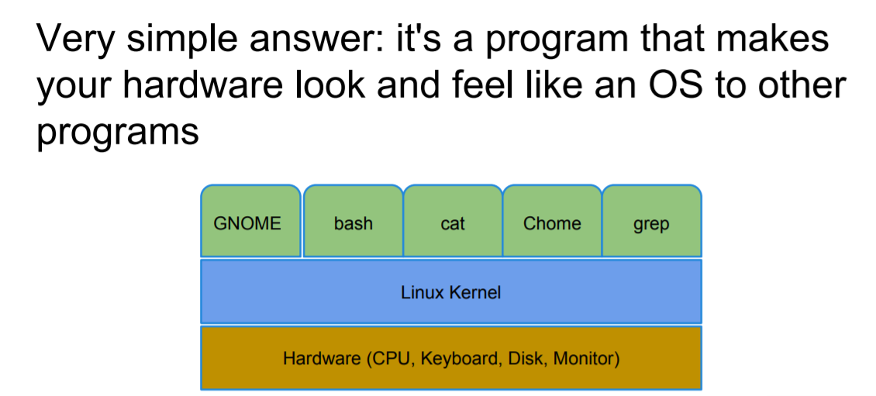
What Is the Kernel?
Anandkumar

Slide 5
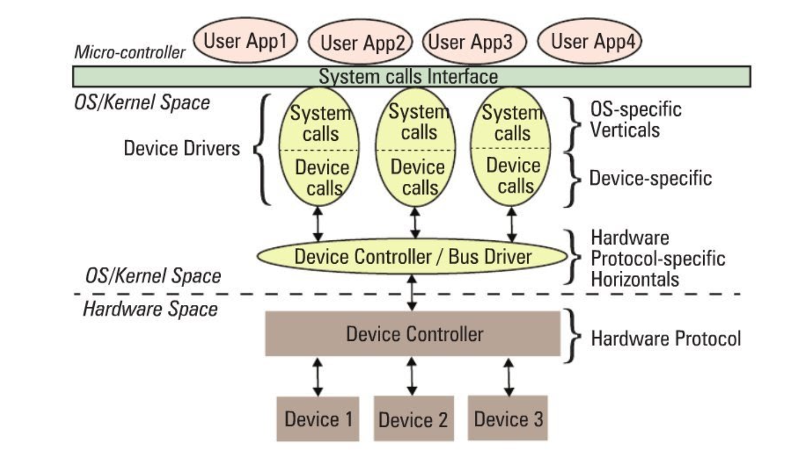
UserSpace Vs KernelSpace
  The Concept of kernel space and user space is all about memory and access rights.
  It is a feature of modern CPU, allowing it to operate either in privileged or unprivileged mode.
  One ,may consider kernel to be privileged and user apps are restricted.
Anandkumar

Slide 6
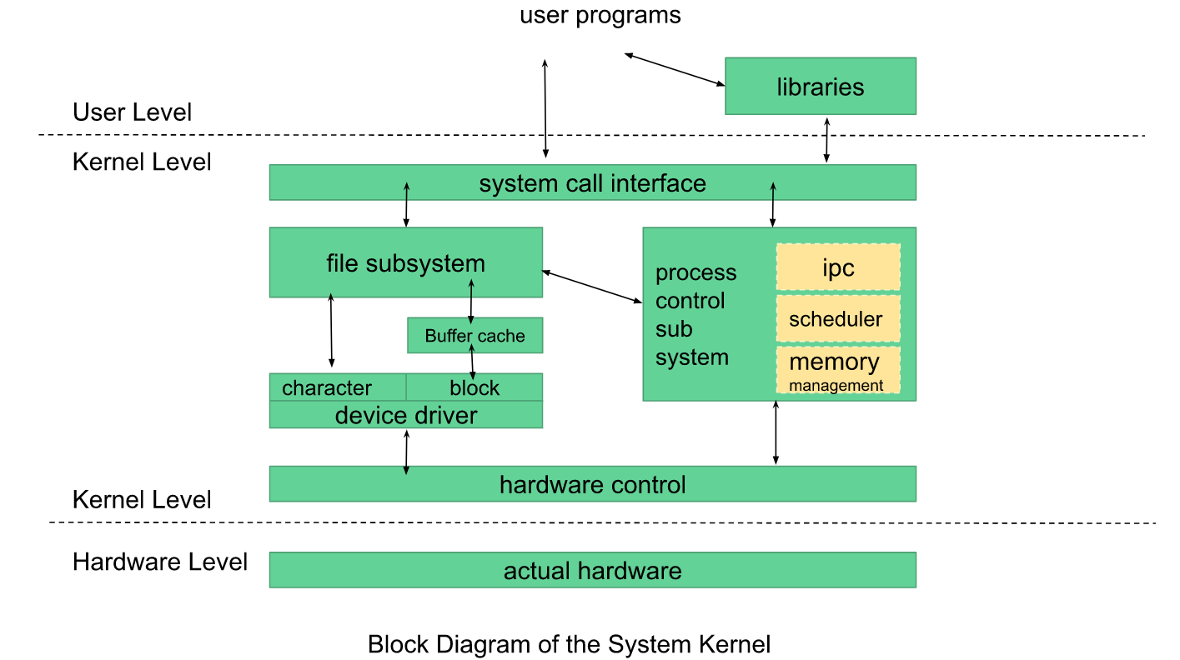
UserSpace Vs KernelSpace cont…
Anandkumar

Slide 7
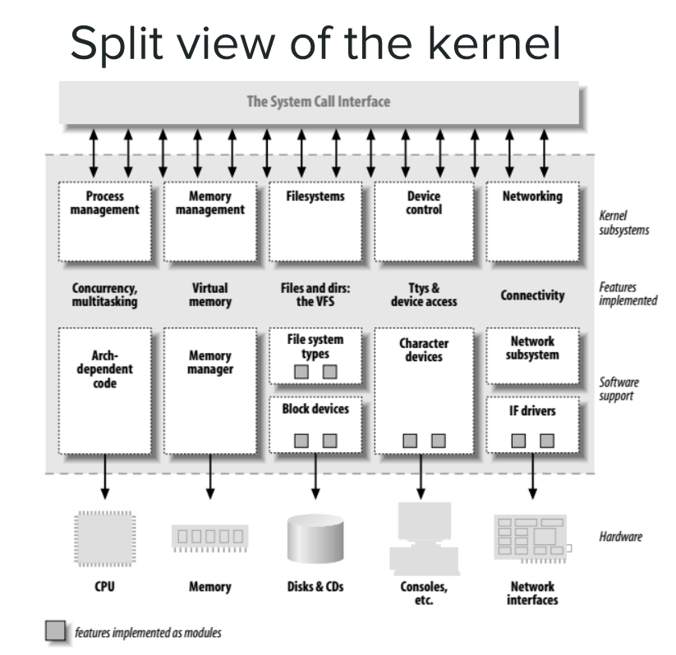
Split view of kernel…
Anandkumar

Slide 8
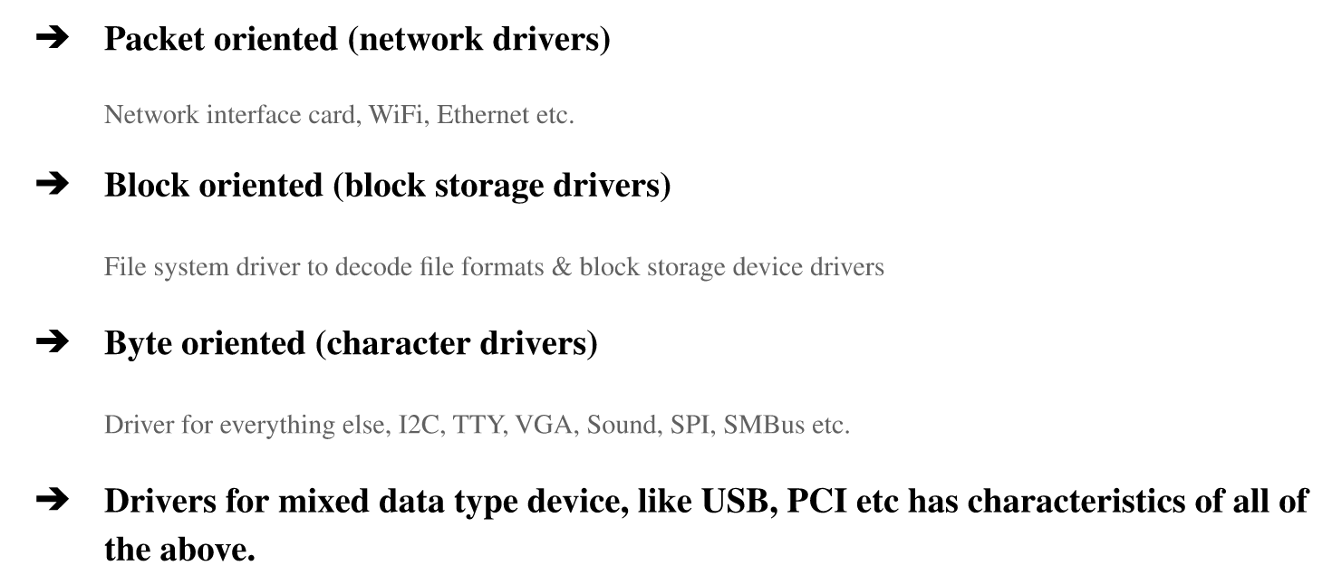
Classification of Drivers
Anandkumar

Slide 9
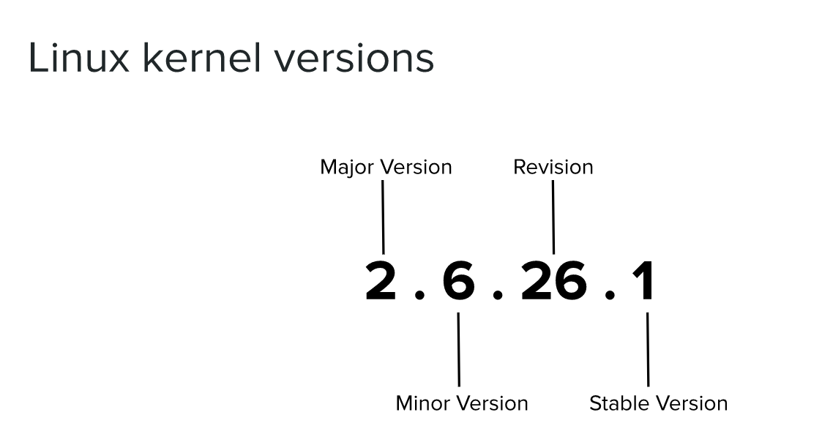
Anandkumar

Slide 10
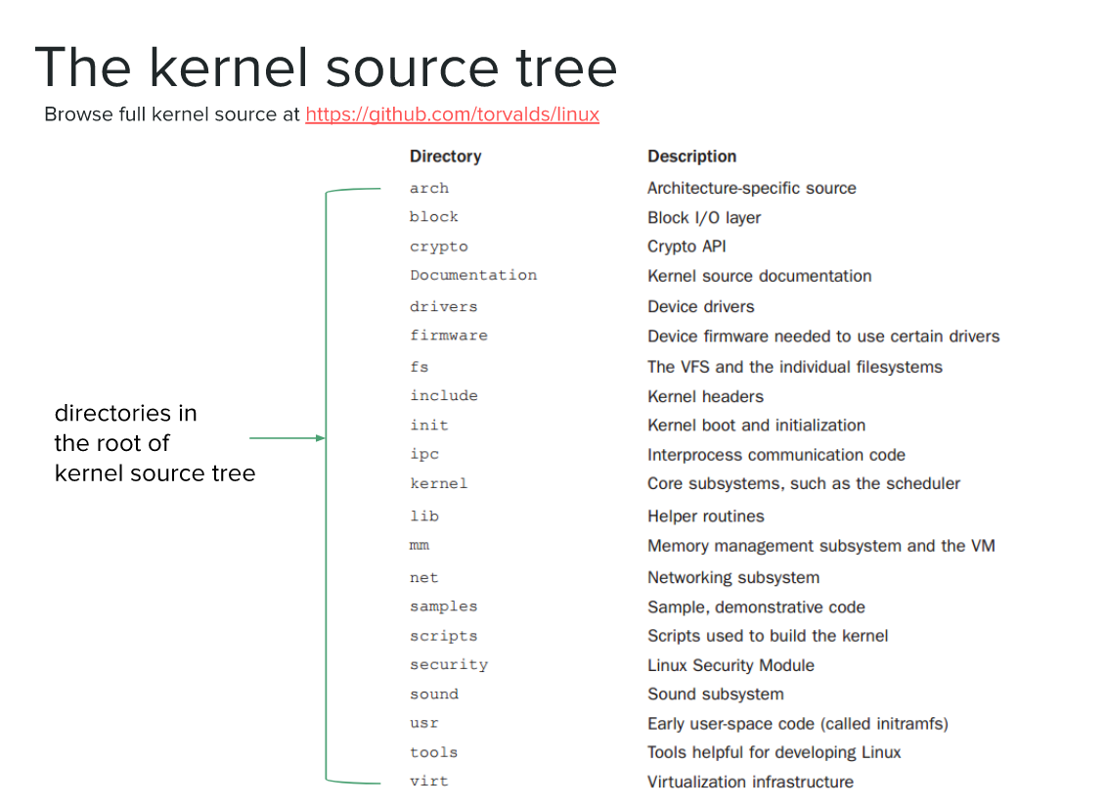
Anandkumar

Slide 11
Standard Functions
printk ()
  8 Priority Levels: KERN_WARNING, KERN_ALERT
  Kernel modules cannot call any functions in the C runtime library (e.g., ‘printf()’)
  But similar kernel versions of important functions are provided (e.g., ‘printk()’)
  Syntax and semantics are slightly different (e.g., priority and message-destination)
  Capabilities may be somewhat restricted (e.g., printk() can’t show floating-point)
Anandkumar

Slide 12
Standard Functions cont…
Init function sets up variables, tells the kernel what the module provides and registers any necessary functions
Cleanup function undoes changes made by init
Anandkumar

Slide 13
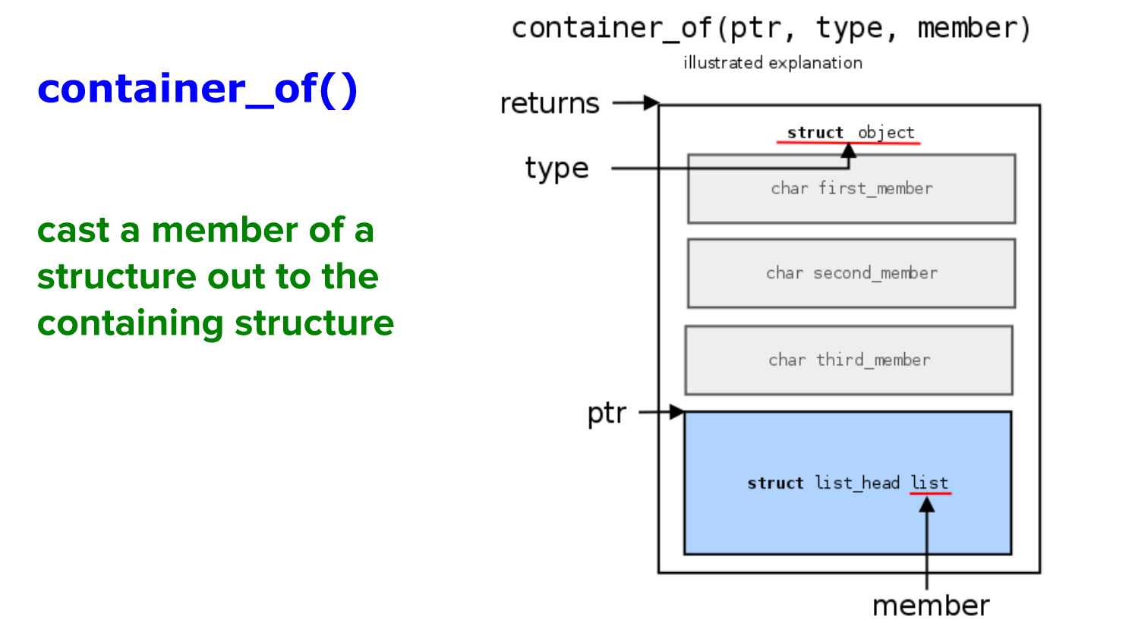
Anandkumar

Slide 14
Standard Functions Cont…
int init_module(void)
  Called when the kernel loads your module.
  Initialize all your stuff here.
  Return 0 if all went well, negative if something blew up.
void cleanup_module(void)
  Called when the kernel unloads your module.
  Free all your resources here.
Anandkumar

Slide 15
A minimal module-template
#include <linux/module.h>
int init_module( void )
{
// code here gets called during module installation
}
void cleanup_module( void )
{
// code here gets called during module removal
}
MODULE_LICENSE(“GPL”);

Slide 16
Setup Environment
Install Kernel Module Tools
# sudo apt-get install kmod
Install development tools and kernel headers
# sudo apt-get install build-essential
# sudo apt-get install linux-headers-$(uname -r)
Anandkumar

Slide 17

User-Mode Linux
What is User-Model Linux?
  Ported to run itself as a set of Linux (non-root user) process on itself.
  Short form as UML
  UML started by Jeff Dike since Feb 1999
  Use simulated hardware i.e., services provided by host kernel.
  Run (nearly) all applications and services available on the host architecture.

Slide 18
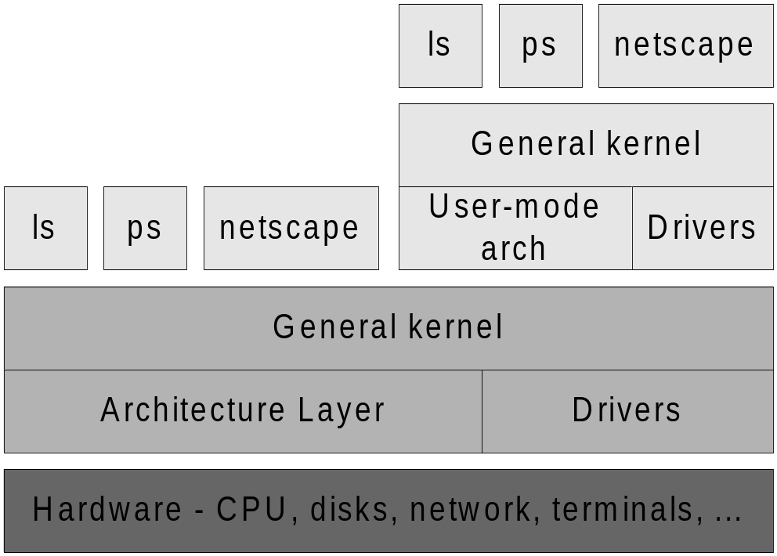
User-Mode Linux
  Provides a self-contained environment:
    Identical as hosting Linux kernel,
    Processes have no access to host resources that were not explicitly provided
  Layer diagram:
Anandkumar

Slide 19
User-Mode Linux
All UML devices are virtual; constructed from the abstractions provided by the host kernel.
The UML devices:
  Consoles and serial lines
    Main console, virtual console and serial lines.
  Block devices
    Access to anything on the host which can be mounted, e.g. CDROM, disk partition
  Network devices
    Network access between UML to host OS/UML and between UML to host in outside network.
Anandkumar

Slide 20
User-Mode Linux
Focus of the presentation:
  Applications
  Design and Implementation
  Some mentioned future works
Anandkumar

Slide 21
User-Mode Linux Applications
Kernel debugging
  on top of software OS, not on separate test machine.
  standard suite of process debugging tools such as gdb, gcov and gprof can be utilized.
Prototyping
  Realizing virtual network with a single physical network.
  Testing software configuration.
Anandkumar

Slide 22
User-Mode Linux
Applications
Isolation
  separating users/applications of virtual machines from each other and from the host.
  purposes:
    Against possibly hostile/untrusted processes,
    performance control - allocation of resources (e.g. CPU, memory, disk space), avoidance of race
Multiple environments
  Especially for Linux applications, some incompatibility problems may exists and need to test.
A Linux environment for other operating systems
  Many Linux applications are free and open-source. With UML, those applications can run upon other hosting OS like MS Windows.
Anandkumar

Slide 23
User-Mode Linux
Setup
Install Dependency
# sudo apt-get install build-essential flex bison
# sudo apt-get install xz-utils wget
# sudo apt-get install ca-certificates bc
# sudo apt-get install libncurses-dev
Downloading the Kernel and extract
  www.kernel.org
  # tar -xvzf linux-5.1.16.tar.gz
Anandkumar

Slide 24
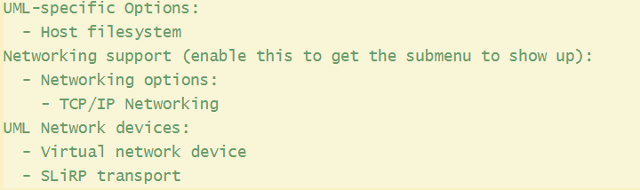
User-Mode Linux
Setup
Configuring the Kernel
# make ARCH=um menuconfig
Anandkumar

Slide 25
User-Mode Linux
Setup
Build Kernel
# make ARCH=um
# mkdir ../bin
# cd ../bin
# cp ../linux-5.1.16/linux .
Setup Guest file system
# tar –xvzf alpine-rootfs.tgz
Boot system
# ./bin/linux rootfstype=hostfs rootflags=/home/test/uml/rootfs/ rw mem=64M init=/bin/sh
Anandkumar

Slide 26
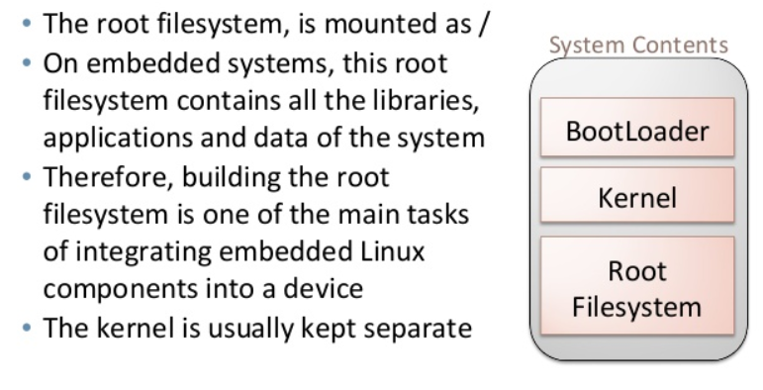
Rootfs
Anandkumar

Slide 27
User-Mode Linux
Setup with custom rootfs
Download busybox and untar
https://busybox.net/downloads/busybox-1.33.1.tar.bz2
# tar –xvjf busybox-1.33.1.tar.bz2
Configure Busybox
# make menuconfig
Enable static build option
Build Busybox
# make
Anandkumar

Slide 28
User-Mode Linux
Setup with custom rootfs
Install Busybox
# make install
Using this rootfs to boot
# ./bin/linux rootfstype=hostfs rootflags=/home/test/uml/rootfs_busybox/ rw mem=64M init=/bin/sh
Anandkumar

Slide 29
Qemu Setup
Install Dependency
# sudo apt-get install qemu-system
Download Cross compiler and install it
# tar -xvf gcc-linaro-10.2.1-2021.02-x86_64_arm-linux-gnueabihf.tar.xz
Downloading the Kernel and extract
  www.kernel.org
  # tar -xvzf linux-5.1.16.tar.gz
Anandkumar

Slide 30
Qemu Setup
Copy the default configuration file
#cp arch/arm/configs/vexpress_defconfig .config
Configuring the Kernel
# make ARCH=arm menuconfig
Cross compile Kernel
# make ARCH=arm CROSS_COMPILE=/home/test/qemu/gcc-linaro-10.2.1-2021.02-x86_64_arm-linux-gnueabihf/bin/arm-linux-gnueabihf-
Anandkumar

Slide 31
Qemu Setup
Boot
# qemu-system-arm -M vexpress-a9 -kernel vmlinuz-3.2.0-4-vexpress -initrd initrd.img-3.2.0-4-vexpress -drive if=sd,file=debian_wheezy_armhf_standard.qcow2 -append "root=/dev/mmcblk0p2"
Anandkumar

Slide 32
Kernel module command
lsmod
List Modules that Loaded Already
insmod
Insert Module into Kernel
modinfo
Display Module Info
rmmod
Remove Module from Kernel
modprobe
Add or Remove modules from the kernel
Anandkumar

Slide 33
Example1
/* example1.c - The simplest kernel module. */
#include <linux/module.h> /* Needed by all modules */
#include <linux/kernel.h> /* Needed for KERN_ALERT */
#include <linux/init.h> /* Needed for macros */
int example1_init(void) {
printk(KERN_ALERT "Initing example1\n"); /* A non 0 return means init_module failed; module can't be loaded. */
return 0;
}
void example1_stop(void) {
printk(KERN_ALERT "Unloading example1\n");
}
module_init (example1_init);
module_exit (example1_stop);
Anandkumar

Slide 34
Example 1 cont…
Accompany your module with a 1-line GNU Makefile:
  obj-m += example1.o
Run the magic make command:
  make -C /lib/modules/$(uname -r)/build M=$(pwd) modulesProduces: example1.ko
To manually load your module:
  insmod example1.ko
Where’s our message?
  dmesg
To unload your module:
  rmmod example1
Anandkumar

Slide 35
Handling Runtime Parameters
module_param() , module_param_array() and module_param_string().
      The macro takes 3 arguments: the name of the variable, its type and permissions for the corresponding file in sysfs.
Anandkumar

Slide 36
More Kernel Macros
MODULE_LICENSE ()
MODULE_AUTHOR ()
MODULE_DESCRIPTION ()
MODULE_SUPPORTED_DEVICE ()
Anandkumar

Slide 37
Example 2
/*
* example2.c - Demonstrates command line argument passing to
* a module.
*/
#include <linux/module.h>
#include <linux/moduleparam.h>
#include <linux/kernel.h>
#include <linux/init.h>
#include <linux/stat.h>
MODULE_LICENSE("GPL");
MODULE_AUTHOR("test");
MODULE_DESCRIPTION ("A module to teach module writing");
MODULE_SUPPORTED_DEVICE ("The mind");
static short int myshort = 1;
static int myint = 420;
Anandkumar

Slide 38
Example 2
static long int mylong = 9999;
static char *mystring = "blah";
static int myintArray[2] = { -1, -1 };
/*
* module_param(foo, int, 0000)
* The first param is the parameters name
* The second param is it's data type
* The final argument is the permissions bits,
* for exposing parameters in sysfs (if non-zero) at a later
* stage.
*/
module_param(myshort, short, S_IRUSR | S_IWUSR | S_IRGRP | S_IWGRP);
MODULE_PARM_DESC(myshort, "A short integer");
module_param(myint, int, S_IRUSR | S_IWUSR | S_IRGRP | S_IROTH);
Anandkumar

Slide 39
Example 2
MODULE_PARM_DESC(myint, "An integer");
module_param(mylong, long, S_IRUSR);
MODULE_PARM_DESC(mylong, "A long integer");
module_param(mystring, charp, 0000);
MODULE_PARM_DESC(mystring, "A character string");
static int arr_argc = 0;
module_param_array(myintArray, int, &arr_argc, 0000);
MODULE_PARM_DESC(myintArray, "An array of integers");
Anandkumar

Slide 40
Example 2
static int __init example2_init(void)
{
int i;
printk(KERN_INFO "Entering Example2\n=============\n");
printk(KERN_INFO "myshort is a short integer: %hd\n", myshort);
printk(KERN_INFO "myint is an integer: %d\n", myint);
printk(KERN_INFO "mylong is a long integer: %ld\n", mylong);
printk(KERN_INFO "mystring is a string: %s\n", mystring);
for (i = 0; i < (sizeof myintArray / sizeof (int)); i++)
{
printk(KERN_INFO "myintArray[%d] = %d\n", i, myintArray[i]);
}
printk(KERN_INFO "got %d arguments for myintArray.\n", arr_argc);
return 0;
}
Anandkumar

Slide 41
Example 2
static void __exit example2_exit(void)
{
printk(KERN_INFO "Exiting Example2\n");
}
module_init(example2_init);
module_exit(example2_exit);
Anandkumar

Slide 42
Module v0.2 cont..
Try to compile on your own and run it??
Anandkumar

Slide 43
Example 2 cont…
Accompany your module with a 1-line GNU Makefile:
  obj-m += example2.o
Run the magic make command:
  make -C /lib/modules/$(uname -r)/build M=$(pwd) modulesProduces: example2.ko
To manually load your module:
  insmod example2.ko
Where’s our message?
  dmesg
To unload your module:
  rmmod example2
Anandkumar

Slide 44
UML Kernel module building
  Enable module support in kernel
  Build kernel module
  # make -C /home/test/uml2/linux-5.1.16/ M=$(pwd) ARCH=um
  Copy to Rootfs
  Boot uml
  # ./linux-5.1.16/linux rootfstype=hostfs rootflags=/home/test/uml2/rootfs_busybox/ rw mem=64M init=/linuxrc
  Insert module
Anandkumar

Slide 45
UML Debugging
  Enable debugging symbols
  Use gdb to debug and start debugging kernel
Anandkumar

Slide 46
jiffies
unsigned long volatile jiffies;
global kernel variable (used by scheduler)
Initialized to zero when system reboots
Gets incremented when timer interrupts
So it counts ‘clock-ticks’ since cpu restart
‘tick-frequency’ is architecture dependent

Slide 47
jiffies
Write kernel module to display jiffies value on installation of kernel module?

Slide 48
jiffies
/*
* example_jiffies.c
*/
#include <linux/module.h> /* Needed by all modules */
#include <linux/kernel.h> /* Needed for KERN_INFO */
#include <linux/jiffies.h>
int init_module(void)
{
printk(KERN_INFO "Entering Jiffies Example\n");
printk(KERN_INFO "The jiffies value=%ld\n",jiffies);
return 0;
}
void cleanup_module(void)
{
printk(KERN_INFO "Exiting Jiffies Example\n");
}

Slide 49
Jiffies cont…
Accompany your module with a 1-line GNU Makefile:
  obj-m += example_jiffies.o
Run the magic make command:
  make -C /lib/modules/$(uname -r)/build M=$(pwd) modulesProduces: example_jiffies.ko
To manually load your module:
  insmod example_jiffies.ko
Where’s our message?
  dmesg
To unload your module:
  rmmod example_jiffies
Anandkumar

Slide 50
Working with multiple files
/* file1.c - The simplest kernel module. */
#include <linux/module.h> /* Needed by all modules */
#include <linux/kernel.h> /* Needed for KERN_ALERT */
#include <linux/init.h> /* Needed for macros */
int example1_init(void) {
printk(KERN_ALERT "Initing example1\n"); /* A non 0 return means init_module failed; module can't be loaded. */
return 0;
}
module_init (example1_init);

Slide 51
Working with multiple files
/* file2.c - The simplest kernel module. */
#include <linux/module.h> /* Needed by all modules */
#include <linux/kernel.h> /* Needed for KERN_ALERT */
#include <linux/init.h> /* Needed for macros */
void example1_stop(void) {
printk(KERN_ALERT "Exiting example1\n");
}
module_exit (example1_stop);

Slide 52
Working with multiple files
Sources exists in two files file1.c and file2.c
obj-m += multiple.o
multiple-objs += file1.o file2.o

Slide 53
Dependency between modules
/* dep1.c - The simplest kernel module. */
#include <linux/module.h> /* Needed by all modules */
#include <linux/kernel.h> /* Needed for KERN_ALERT */
#include <linux/init.h> /* Needed for macros */
void dep1_func(void){
printk(KERN_INFO "I am in dep1 func\n");
}
int dep1_init(void) {
printk(KERN_INFO "Initing dep1\n"); /* A non 0 return means init_module failed; module can't be loaded. */
return 0;
}
void dep1_stop(void) {
printk(KERN_INFO "Exiting dep1\n");
}
module_init (dep1_init);
module_exit (dep1_stop);
EXPORT_SYMBOL(dep1_func);

Slide 54
Dependency between modules
/* dep2.c - The simplest kernel module. */
#include <linux/module.h> /* Needed by all modules */
#include <linux/kernel.h> /* Needed for KERN_ALERT */
#include <linux/init.h> /* Needed for macros */
extern void dep1_func(void);
int dep2_init(void) {
printk(KERN_INFO "Initing dep2\n"); /* A non 0 return means init_module failed; module can't be loaded. */
dep1_func();
return 0;
}
void dep2_stop(void) {
printk(KERN_INFO "Exiting dep2\n");
}
module_init (dep2_init);
module_exit (dep2_stop);

Slide 55
Dependency between modules
Accompany your module with a 2-line GNU Makefile:
  obj-m += dep1.o
  obj-m += dep2.o
Run the magic make command:
  make -C /lib/modules/$(uname -r)/build M=$(pwd) modulesProduces: dep1.ko,dep2.ko
Copy module to /lib/modules/5.8.0-55-generic/ manually:
  cp dep1.ko dep2.ko /lib/modules/5.8.0-55-generic/
Run depmod
  Depmod -a
To insert module:
  Modprobe dep2
To remove module:
  Modprobe –r dep2
Anandkumar

Slide 56
Character Driver
#include <linux/kernel.h>
#include <linux/module.h>
#include <linux/fs.h>
#include <linux/uaccess.h>
#define DEVICE_NAME "testchar"
static int num_major;
static int test_open(struct inode *inode, struct file *file)
{
printk(KERN_INFO "test_open called\n");
return 0;
}
static int test_release(struct inode *inode, struct file *file)
{
printk(KERN_INFO "test_release called\n");
return 0;
}

Slide 57
Character Driver
static ssize_t test_read(struct file *filp,
char *buf,
size_t len,
loff_t * off)
{
printk(KERN_INFO "test_read called\n");
return 0;
}
static ssize_t test_write(struct file *filp,
const char *buf,
size_t len,
loff_t * off)
{
printk(KERN_INFO "test_write called\n");
return 0;
}

Slide 58
Character Driver
static struct file_operations fops= {
.open = test_open,
.release = test_release,
.read = test_read,
.write = test_write,
};
static int __init test_init(void)
{
printk(KERN_INFO "Entering Test Character Driver \n");
num_major=register_chrdev(0, DEVICE_NAME, &fops);
printk(KERN_INFO "Major Number = %d \n",num_major);
printk(KERN_INFO "Name = %s \n",DEVICE_NAME);
printk(KERN_INFO "Generate the device file with\
mknod /dev/%s c %d 0 \n",DEVICE_NAME,num_major);
return 0 ;
}

Slide 59
Character Driver
static void __exit test_cleanup(void)
{
unregister_chrdev(num_major, DEVICE_NAME);
printk(KERN_INFO "Exiting Test Character Driver \n");
}
module_init(test_init);
module_exit(test_cleanup);
MODULE_LICENSE("GPL");
MODULE_AUTHOR("test");
MODULE_DESCRIPTION("Character Device Driver");
MODULE_SUPPORTED_DEVICE("testchar");

Slide 60
Character Driver
Accompany your module with a 1-line GNU Makefile:
  obj-m += example_character.o
Run the magic make command:
  make -C /lib/modules/$(uname -r)/build M=$(pwd) modulesProduces: example_character.ko
To manually load your module:
  insmod example_character.ko
Where’s our message?
  dmesg
To unload your module:
  rmmod example_character
Test Driver functionality using shell command:
Anandkumar

Slide 61
Proc filesysystem
  #include <linux/module.h>
  #include <linux/proc_fs.h>
  #include <linux/seq_file.h>
  #include <linux/jiffies.h>
  static int hello_proc_show(struct seq_file *m, void *v) {
  seq_printf(m, "jiffies = %lu\n", jiffies );
  return 0;
  }
  static int hello_proc_open(struct inode *inode, struct file *file) {
  return single_open(file, hello_proc_show, NULL);
  }
Anandkumar

Slide 62
Proc filesysystem
  static const struct proc_ops hello_proc_fops={
  .proc_open = hello_proc_open,
  .proc_release = single_release,
  .proc_read = seq_read,
  .proc_lseek = seq_lseek
  };
  static int __init hello_proc_init(void) {
  proc_create("jiffies_test", 0, NULL, &hello_proc_fops);
  return 0;
  }
  static void __exit hello_proc_exit(void) {
  remove_proc_entry("jiffies_test", NULL);
  }
Anandkumar

Slide 63
Proc filesysystem
  MODULE_LICENSE("GPL");
  module_init(hello_proc_init);
  module_exit(hello_proc_exit);
Anandkumar

Slide 64
Proc filesysystem
Accompany your module with a 1-line GNU Makefile:
  obj-m += proc_test.o
Run the magic make command:
  make -C /lib/modules/$(uname -r)/build M=$(pwd) modulesProduces: proc_test.ko
To manually load your module:
  insmod proc_test.ko
Where’s our message?
  Cat /proc/jiffies_test
To unload your module:
  rmmod proc_test
Anandkumar

Slide 65
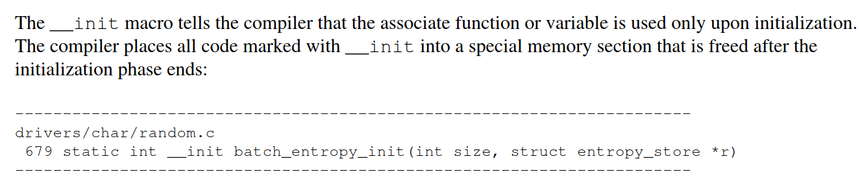
__init
Anandkumar

Slide 66
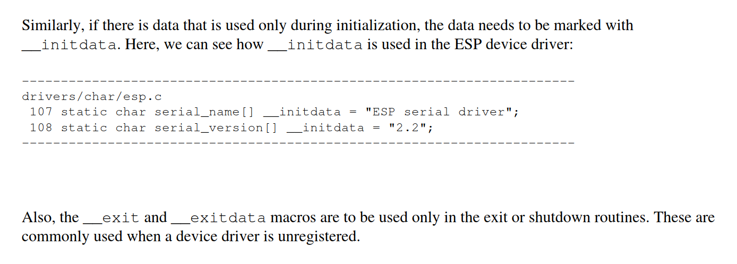
__initdata,__exit,__exitdata
Anandkumar

Slide 67
__initdata,__exit,__exitdata
Anandkumar

Slide 68
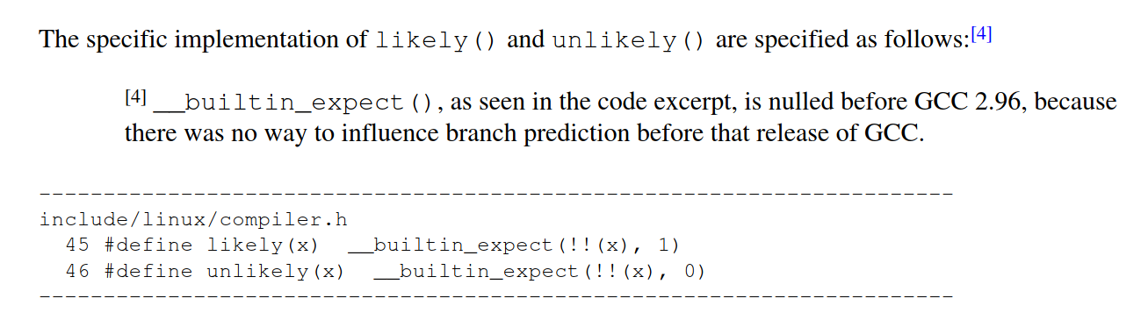
likely(), unlikely()
Anandkumar

Slide 69
likely(), unlikely()
In the following example, we are marking branch as likely true:
    const char *home_dir ;
    home_dir = getenv("HOME");
    if (likely(home_dir))
    printf("home directory: %s\n", home_dir);
    else
    perror("getenv");
For above example, we have marked “if” condition as “likely()” true, so compiler will put true code immediately after branch, and false code within the branch instruction. In this way compiler can achieve optimization. But don’t use “likely()” and “unlikely()” macros blindly.
Anandkumar

Slide 70
likely(), unlikely()
If prediction is correct, it means there is zero cycle of jump instruction, but if prediction is wrong, then it will take several cycles, because processor needs to flush it’s pipeline which is worst than no prediction.
Anandkumar

Slide 71
Process Management
  Finding process information
    ps
    top
    For each process, there is a corresponding directory /proc/ to store this process information in the /proc pseudo file system
Anandkumar

Slide 72
Process Management
  Header files
    include/linux/sched.h – declarations for most process data structures
    include/linux/wait.h – declarations for wait queues
    include/asm-i386/system.h – architecture-dependent declarations
Anandkumar

Slide 73
Process Management
  Source files
    kernel/sched.c – process scheduling routines
    kernel/signal.c – signal handling routines
    kernel/fork.c – process/thread creation routines
    kernel/exit.c – process exit routines
    fs/exec.c – executing program
    arch/i386/kernel/entry.S – kernel entry points
    arch/i386/kernel/process.c – architecture-dependent process routines
Anandkumar

Slide 74
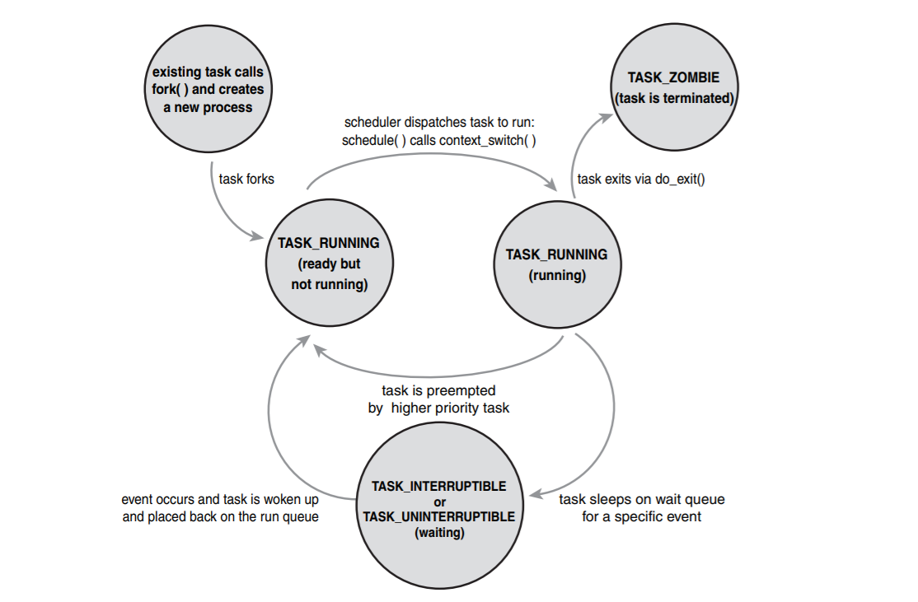
Process Management
Anandkumar

Slide 75
Process Management
  Kernel needs work space as well
    Store kernel code, data, heap, and stack
  •E.g., process control blocks
    Must be protected from user processes
  Can give kernel its own address space
  Problem: switching address space is costly
  Solution: map kernel address space into process address space
Anandkumar

Slide 76
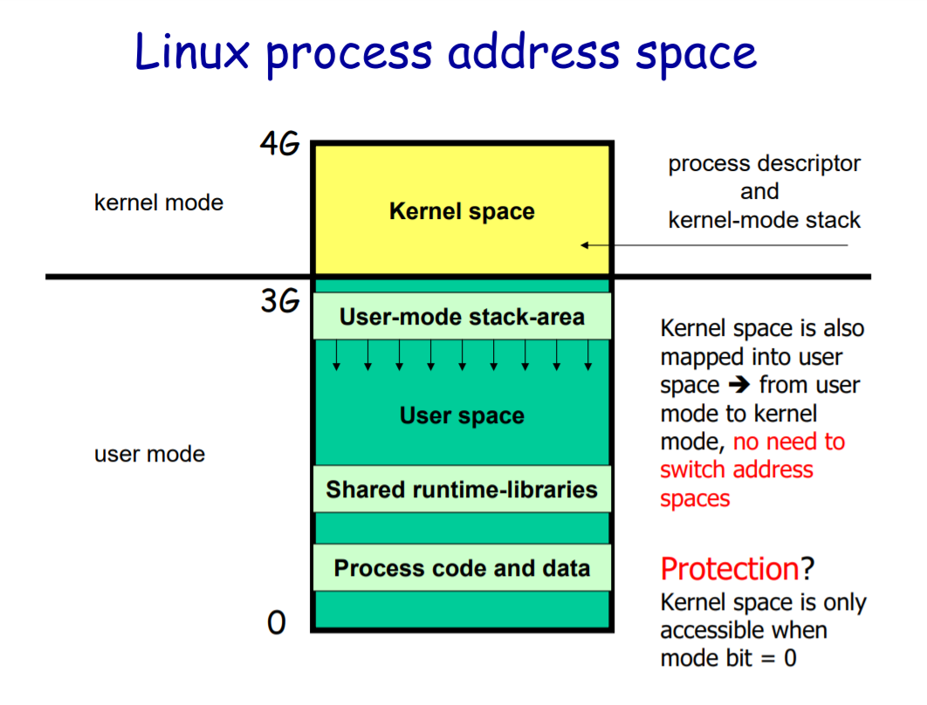
Process Management
Anandkumar

Slide 77
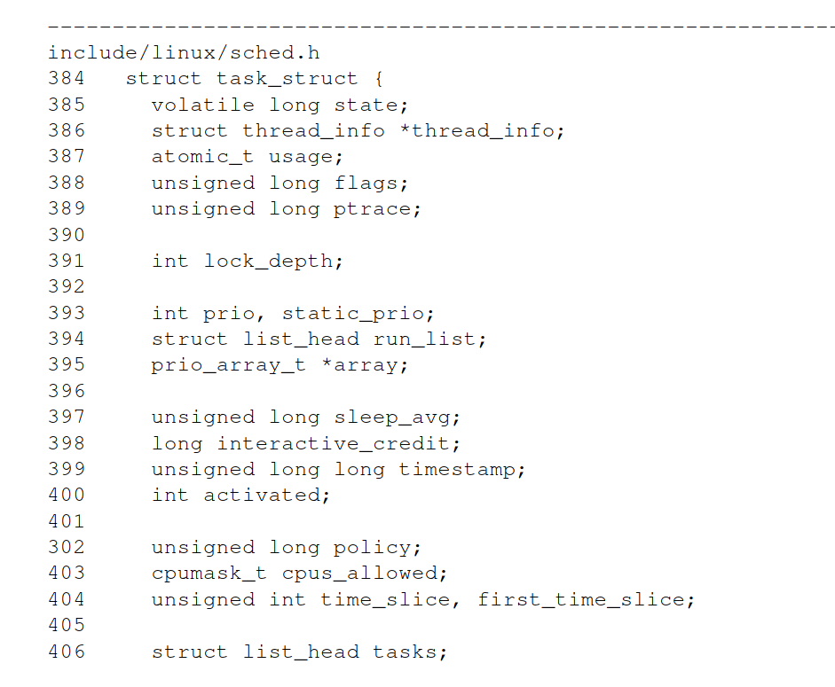
Process Management
Anandkumar

Slide 78
Process Management
  State
    TASK_RUNNING: The process is runnable; it is either currently running or on a runqueue waiting to run .This is the only possible state for a process executing in user-space; it can also apply to a process in kernel-space that is actively running.
    TASK_INTERRUPTIBLE: The process is sleeping (that is, it is blocked), waiting for some condition to exist.When this condition exists, the kernel sets the process’s state to TASK_RUNNING.The process also awakes prematurely and becomes runnable if it receives a signal.
Anandkumar

Slide 79
Process Management
    TASK_UNINTERRUPTIBLE: This state is identical to TASK_INTERRUPTIBLE except that it does not wake up and become runnable if it receives a signal. This is used in situations where the process must wait without interruption or when the event is expected to occur quite quickly. Because the task does not respond to signals in this state, TASK_UNINTERRUPTIBLE is less often used than TASK_INTERRUPTIBLE.
    TASK_ZOMBIE: The task has terminated, but its parent has not yet issued a wait4() system call.The task’s process descriptor must remain in case the parent wants to access it. If the parent calls wait4(), the process descriptor is deallocated.
Anandkumar

Slide 80
Process Management
    TASK_STOPPED: Process execution has stopped; the task is not running nor is it eligible to run.This occurs if the task receives the SIGSTOP, SIGTSTP, SIGTTIN, orSIGTTOU signal or if it receives any signal while it is being debugged.
Anandkumar

Slide 81
Process Management
    Manipulating the Current Process State
      Kernel code often needs to change a process’s state. The preferred mechanism is using set_task_state(task, state); /* set task 'task' to state 'state' */
Anandkumar

Slide 82
Process Management
  Exit_state
    how a process exited
    EXIT_ZOMBIE: the process is exiting but has not yet been waited for by its parent
    EXIT_DEAD: the process has exited and has been waited for
Anandkumar

Slide 83
Process Management
  Pid
    pid of first thread in process getpid() returns this ID, so all threads in a process share the same process ID
    Linux kernel uses pidhash to efficiently find processes by pids see include/linux/pid.h, kernel/pid.c
Anandkumar

Slide 84
Process Management
  Processes are related: children, sibling Parent/child
  Process groups: signal_struct->pgrp
    Possible to send signals to all members
  Sessions: signal_struct->session
    Processes related to login
Anandkumar

Slide 85
Process Management
  Processes are related: children, sibling Parent/child
  Process groups: signal_struct->pgrp
    Possible to send signals to all members
  Sessions: signal_struct->session
    Processes related to login
Anandkumar

Slide 86
Process Management
  Linux uses multiple queues to manage processes
  Queue for all tasks
  Queue for “running” tasks
  Queues for tasks that temporarily are “blocked ” while waiting for a particular event to occur
  These queues are implemented using doublylinked list (struct list_head in include/linux/list.h )
Anandkumar

Slide 87
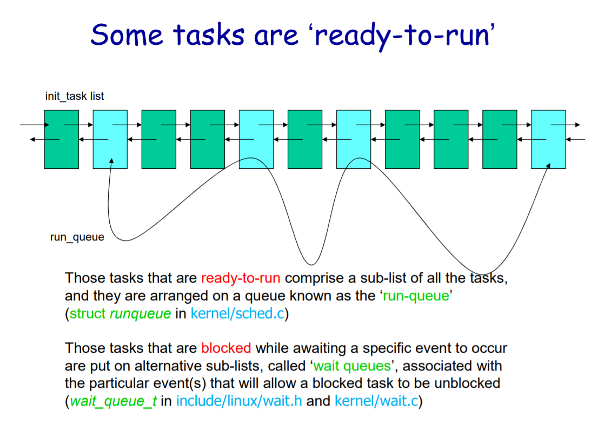
Process Management
Anandkumar

Slide 88
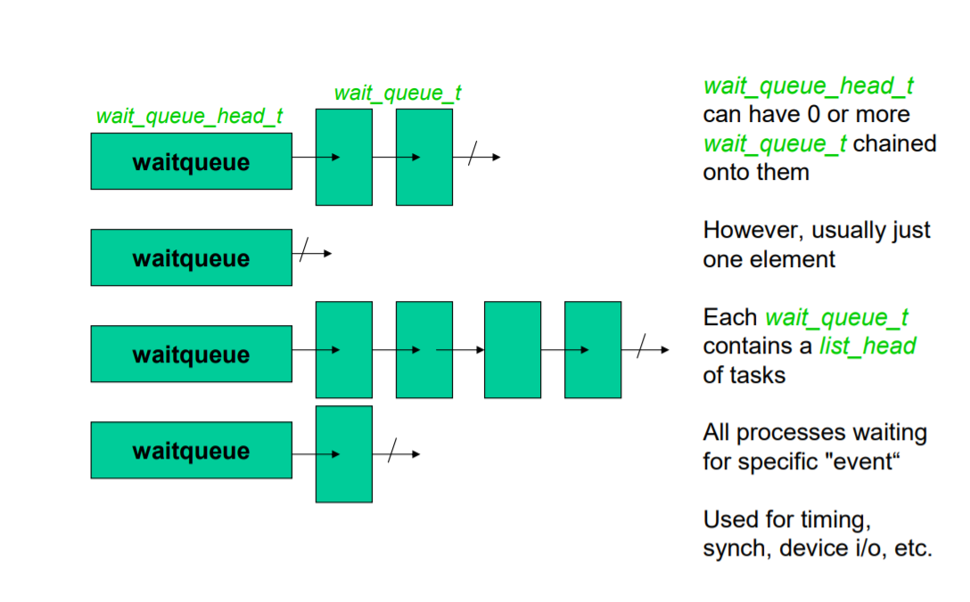
Process Management
Anandkumar

Slide 89
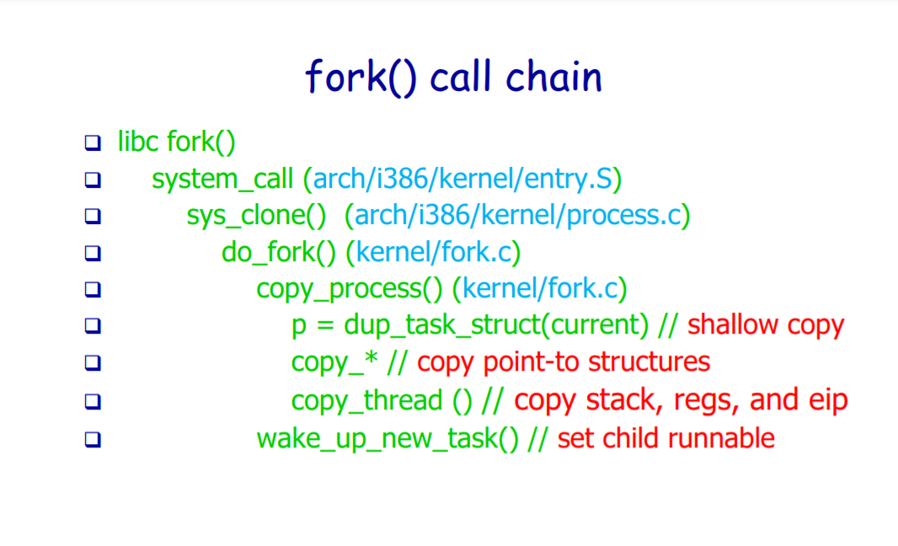
Process Management
Anandkumar

Slide 90
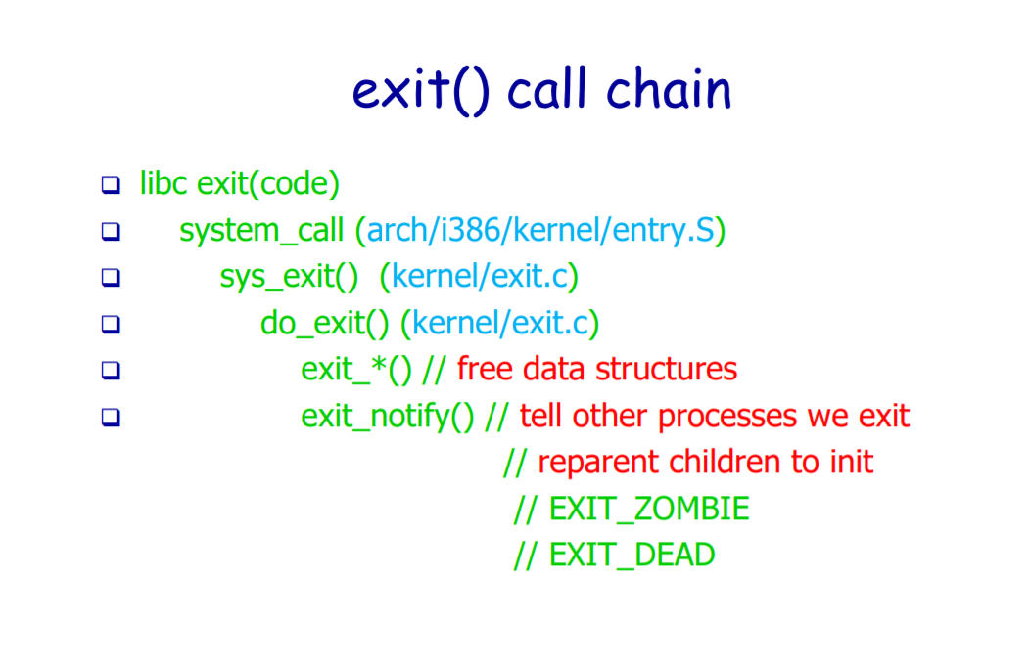
Process Management
Anandkumar

Slide 91
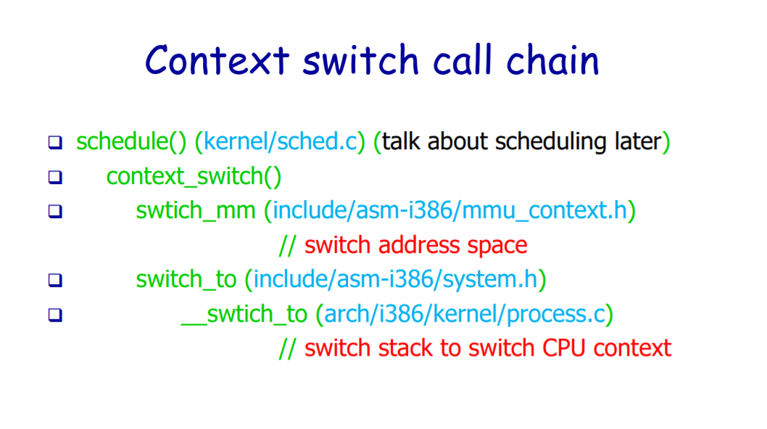
Process Management
Anandkumar

