Slide 1

Python Loops
By
Mohit

Slide 2
Range()
Allows user to generate a series of numbers within a given range
Syntax
Range(start=0, stop, step=1)

Slide 3
Range()
start: integer starting from which the sequence of integers is to be returned
stop: integer before which the sequence of integers is to be returned. The range of integers end at stop – 1.
step: integer value which determines the increment between each integer in the sequence

Slide 4
For loop
The for loop in Python is used to iterate over a sequence (list, tuple, string) or other Iterable objects.
Syntax
For <variable> in iterator:
statement1
statement2

Slide 5
While loop
The while loop in Python is used to iterate over a block of code as long as the test expression (condition) is true.
Syntax
While condition:
statement1
statement2

Slide 6
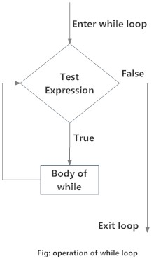
Flow chart of while

Slide 7
break
The break statement terminates the loop containing it. Control of the program flows to the statement immediately after the body of the loop.
If the break statement is inside a nested loop (loop inside another loop), the break statement will terminate the innermost loop.

Slide 8
Continue
The continue statement is used to skip the rest of the code inside a loop for the current iteration only. Loop does not terminate but continues on with the next iteration.

Slide 9
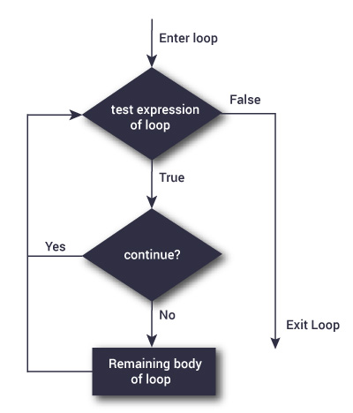

Slide 10
pass
Nothing happens when the pass is executed. It results in no operation (NOP).

Slide 11
Thanking You!

