Slide 1


Python Dictionary
By
Mohit

Slide 2
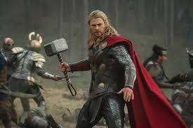
Dictionary
In a list, values are indexed by the range of numbers, but in a dictionary, values are indexed by keys
A dictionary is a sequence of key-value, or item, pairs separated by commas.
Syntax
Dictionary_name = {key: value}

Slide 3
Key features of the dictionary are
The key of the dictionary can not be changed
A string, int, or float can be used as a key
A tuple that does not contain any list can be used as a key
Keys are unique
Values can be anything, for example, list, string, int, and so on
Values can be repeated
Values can be changed
A dictionary is an unordered collection, which means that the order in which you have entered the items in a dictionary may not be retained and you may get the items in a different order

Slide 4
Operations on the dictionary
Accessing the values of dictionary
Deleting an item from the dictionary
Updating the values of the dictionary
Adding an item to the dictionary

Slide 5
Dictionary method
copy
Get
Keys
Values
Items
update

Slide 6
Dictionary with for loop

Slide 7
Thanking You!

