Slide 1


Python Operators
By
Mohit

Slide 2

Types of Operators
Arithmetic operators
Comparison operators
Assignment operators
Bitwise operators
Logical operators
Membership operators
Identity operators

Slide 3
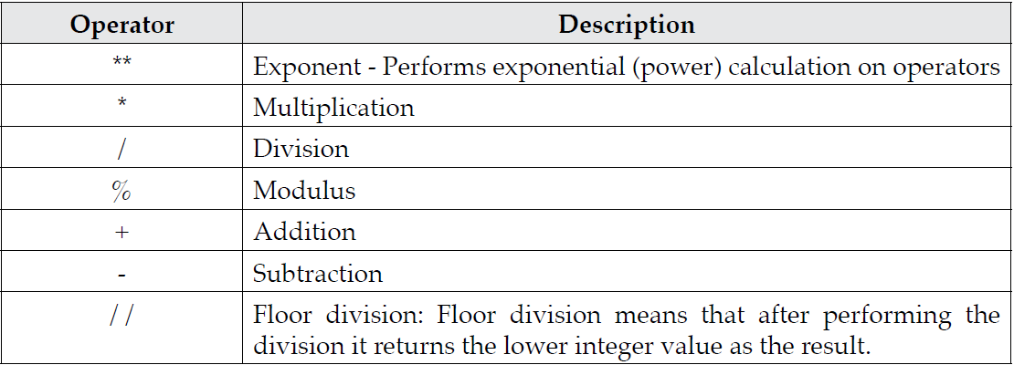
Arithmetic operators

Slide 4
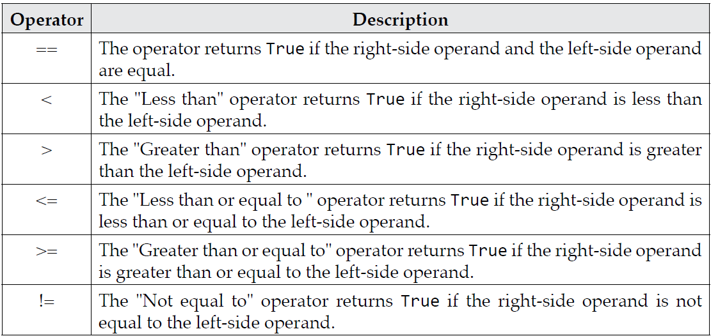
Comparison operators

Slide 5
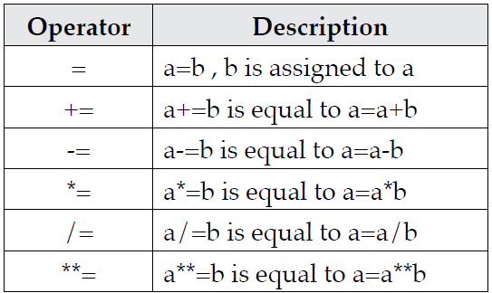
Assignment operators

Slide 6
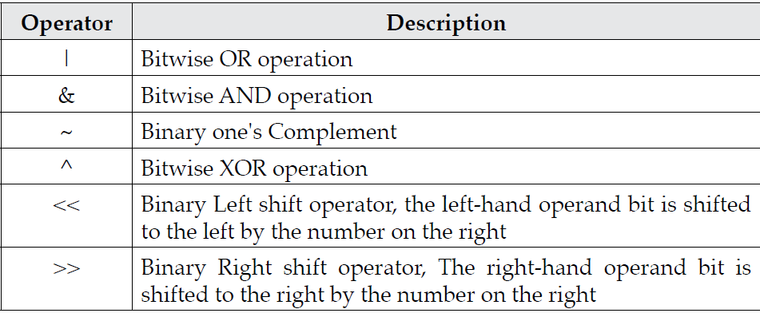
Bitwise operators

Slide 7
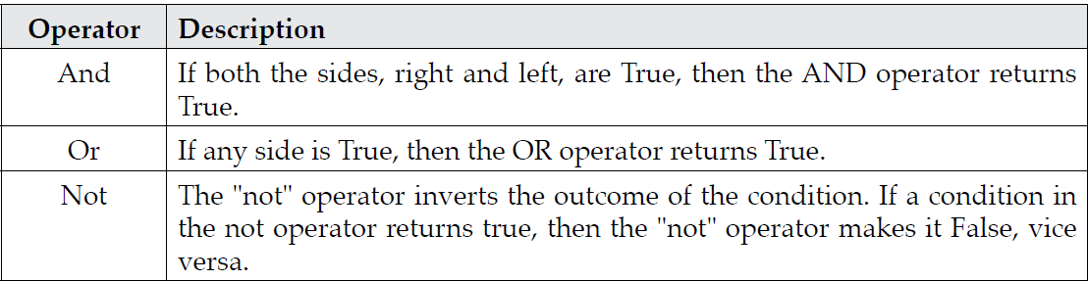
Logical operators

Slide 8
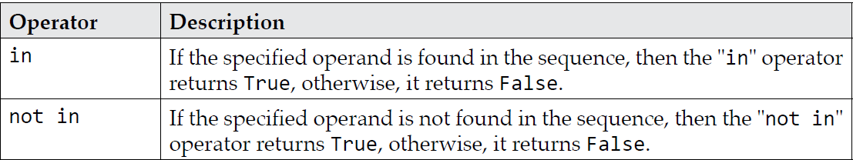
Membership operators

Slide 9
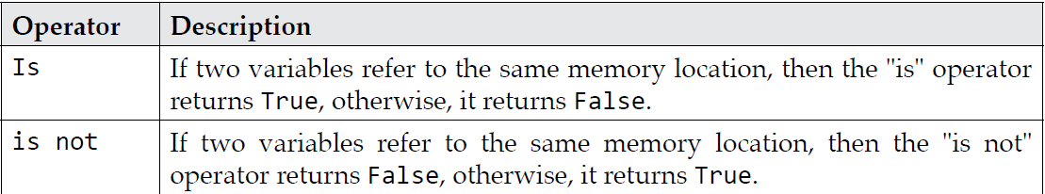
Identity Operators

Slide 10
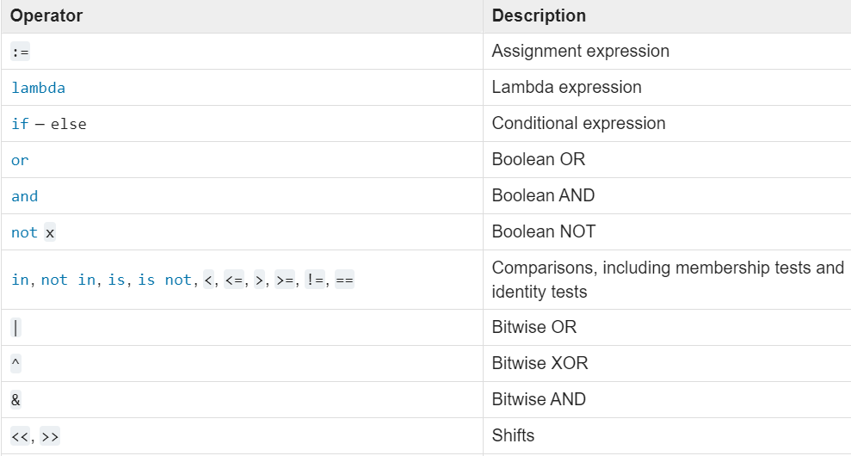
Operator Precedence from lowest precedence (least binding) to highest precedence (most binding)

Slide 11
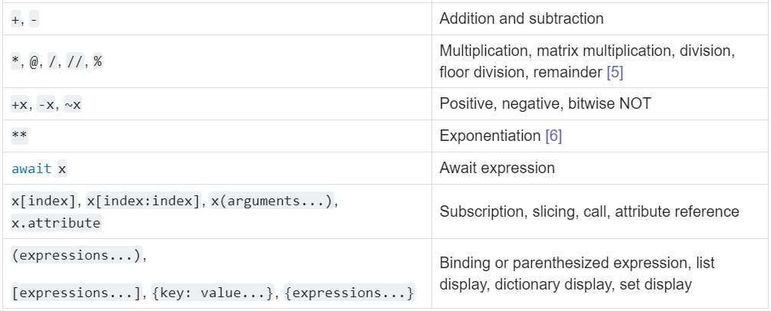
Operator Precedence Conti….

Slide 12
Important Points
Operators in the same box have the same precedence.
Operators in the same box group left to right
Exponentiation, which groups from right to left

Slide 13
Thanking You!

