Slide 1


Python Tuples
By
Mohit

Slide 2

Tuple
Python tuple is a sequence, which can store heterogeneous data types such as integers, floats, strings, lists, and dictionaries.
Like strings, tuple is immutable.

Slide 3
Creating tuple with elements
A= (1,)
A = (1,2,3,4, “a”)
A = 1,2,3,4

Slide 4
Slicing of tuple

Slide 5
Unpacking
>>> tup1 = (1,2,3)
>>> a,b,c = tup1
>>> a
1
>>> b
2
>>> c
3

Slide 6
Tuple method
'count’
'index'

Slide 7
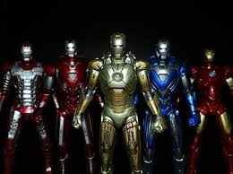

List
Like tuple, a list is also a built-in data structure available in Python.
It can contain heterogeneous values such as integers, floats, strings, tuples, lists, and dictionaries.
However, Python lists are mutable

Slide 8
Creating a list
List1 = [ ]
List2 = [‘a’, ‘b’, 1, 2]

Slide 9
List operations
In order to access list values, use list names with positional index in square brackets.
Accessing list values
Slicing the list
Updating the list
Deleting values from a list
Addition
Multiplication

Slide 10
List methods
append ()
Extend()
Count()
Index()

Slide 11
List method
Insert
Remove
Pop
Reverse
sort

Slide 12
Thanking You!

