Slide 2
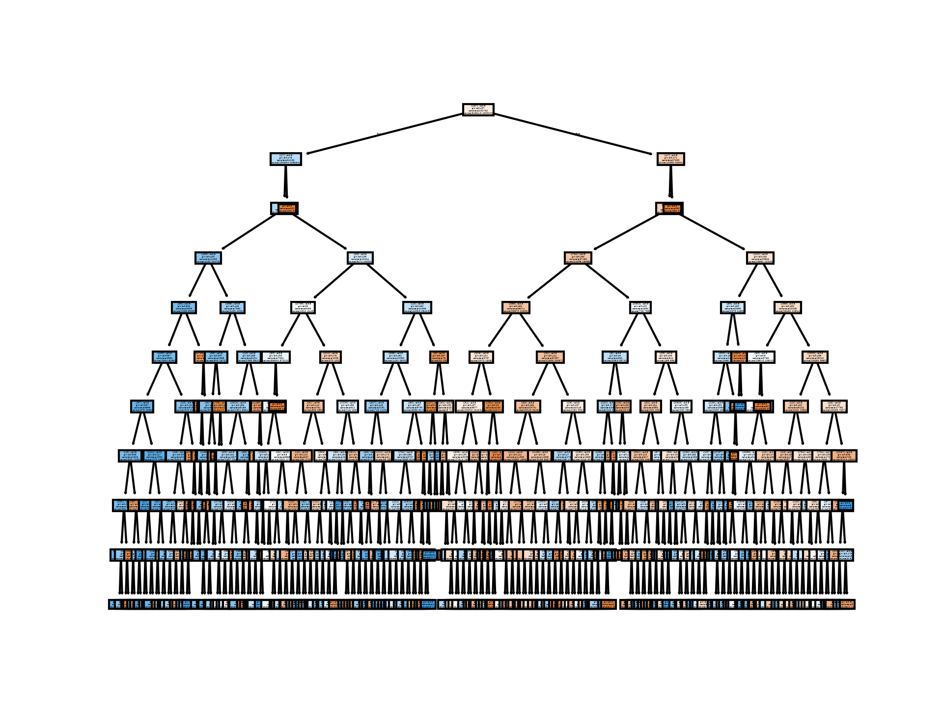

Slide 3
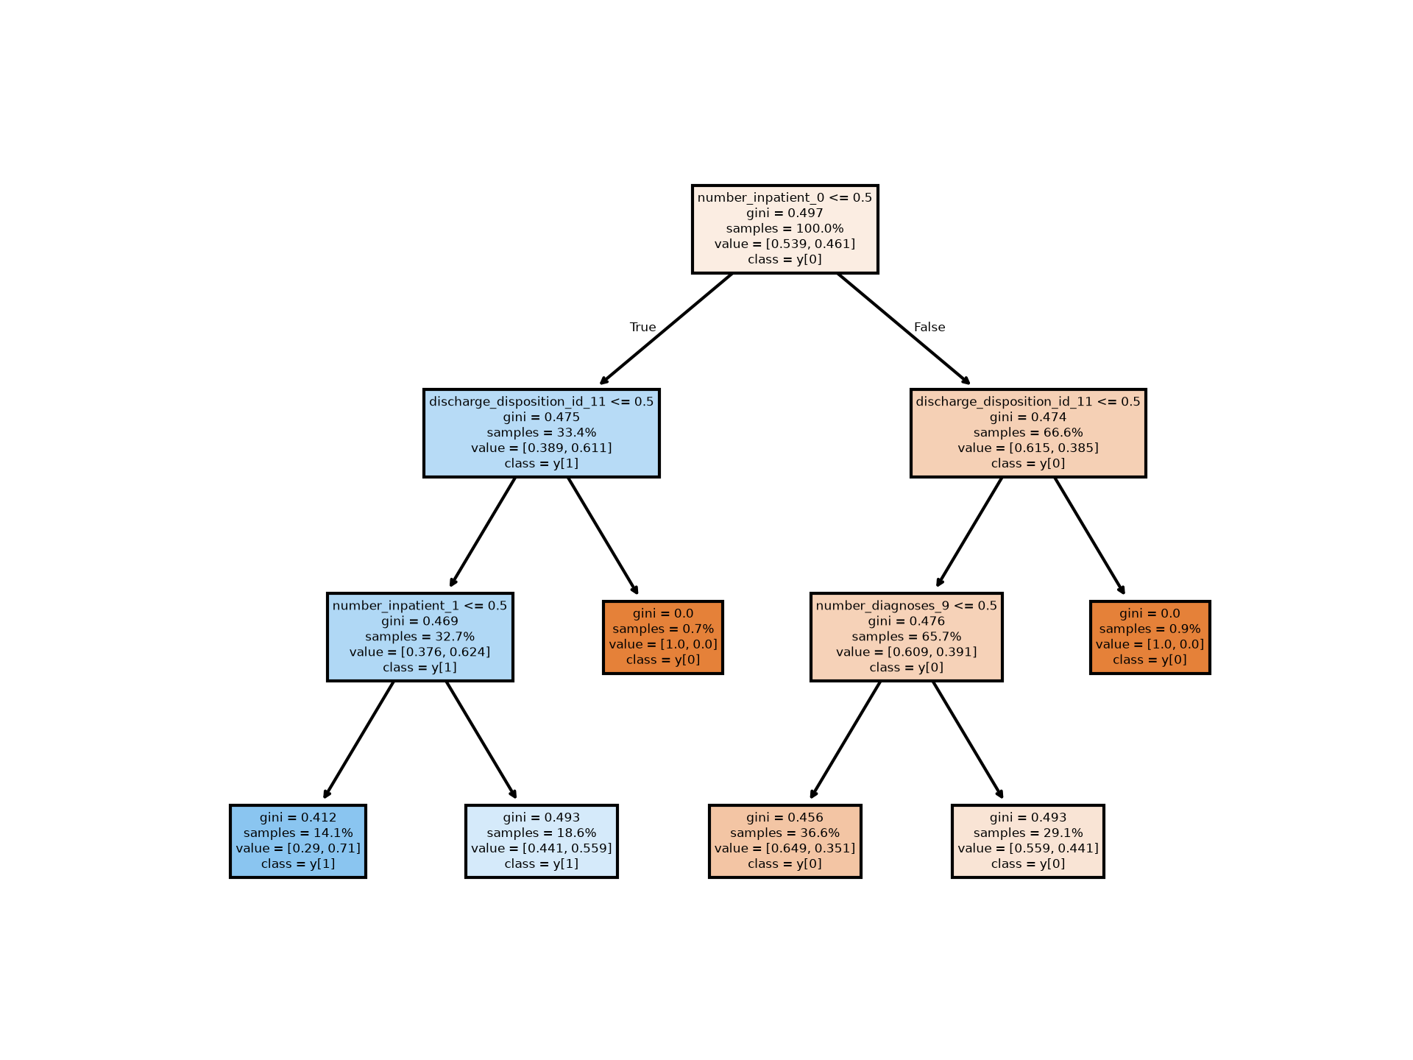
Number_inpatient_0 < = 0.5
Gini = 0.497 (measure the quality of a split; gini impurity (shanon information gain – probability that a randomly chosen element would be mislabeled if it were labelled randomly and independently – reaches its minimum – 0 – when all cases in the node fall into a single target category)
-> So if a new X was to be provided as input to the tree gini gives us the probability that if X was to reach that node, what is the chance it would be mislabeled (appears to be intuitive to me) (https://victorzhou.com/blog/gini-impurity/ and https://victorzhou.com/blog/information-gain/ )
Samples = 100% = percentage of training samples in this node
Value = [0.539, 0.461] => Percentage of samples in class/label 0 and class 1, respectively

Slide 4
Information gain is used to decide which feature to split on at each step in building the tree. Simplicity is best, so we want to keep our tree small. To do so, at each step we should choose the split that results in the most consistent child nodes. A commonly used measure of consistency is called information which is measured in bits. For each node of the tree, the information value "represents the expected amount of information that would be needed to specify whether a new instance should be classified yes or no, given that the example reached that node".^{[27]}

Slide 5
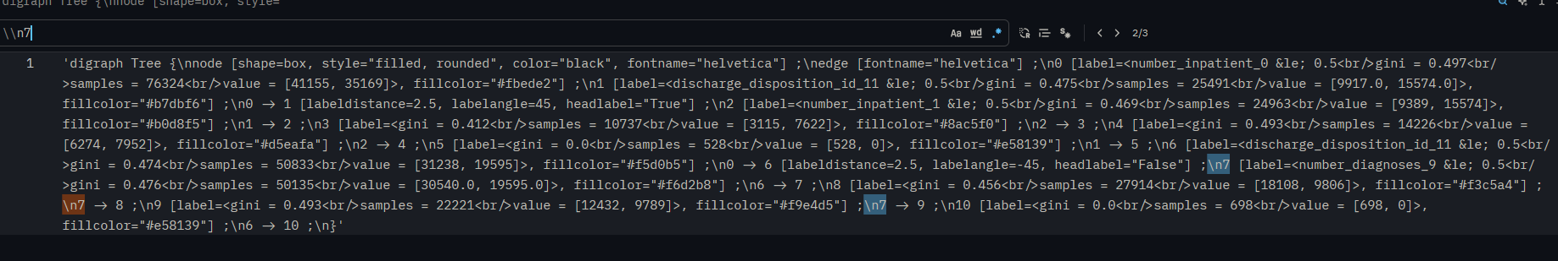

Slide 6


