Slide 1
static website + go:embed => ./website
Amit Saha
https://echorand.me
Notes:
Hello Gophercon! I am super excited to be presenting my lightning talk today - a first for me at Gophercon ever.
Welcome to my talk, today i will be sharing my experiment with deploying a static website as a binary using go:embed magic. embed

Slide 2
Problem Statement
There was no problem to solve
I wanted to host my new static website in the cloud on a virtual machine

Slide 3
Thinking about the solution
Initial plan - just copy the HTML and CSS files to the server
Put in nginx and be done
Then… I thought of writing my server in Go and serving the files from the filesystem
And then… I thought of the embed package

Slide 4

Solution to the problem
markdown -> hugo -> html + css ->
Go server with everything embedded
-> deploy
Notes:
the embed package was added in Go 1.16

Slide 5

First pass

Slide 6

Create binary
Create new hugo site
Put some content
Render the HTML
Then ..

Slide 7
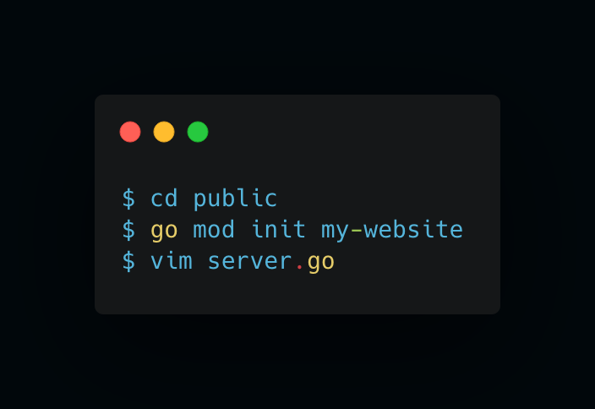
Create a new module

Slide 8
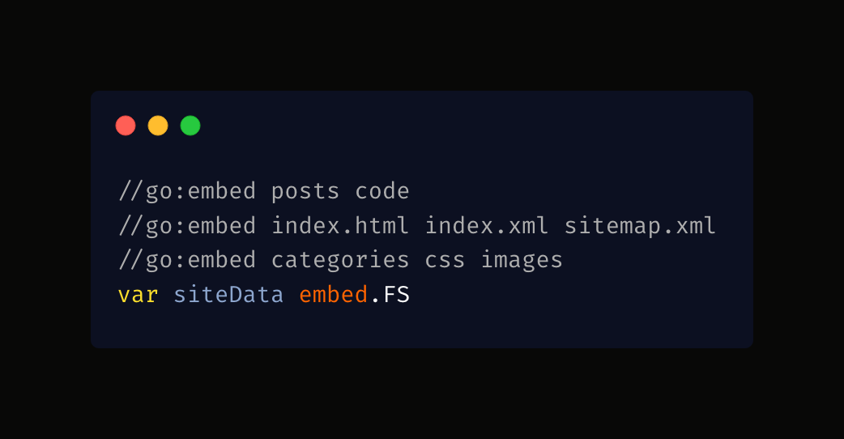
Write go:embed directives

Slide 9
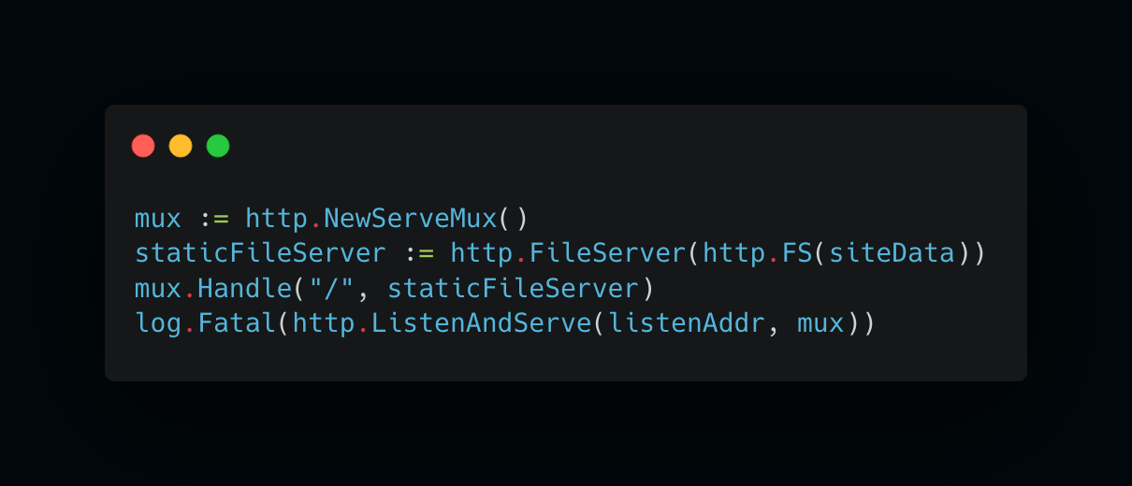
Write the server

Slide 10
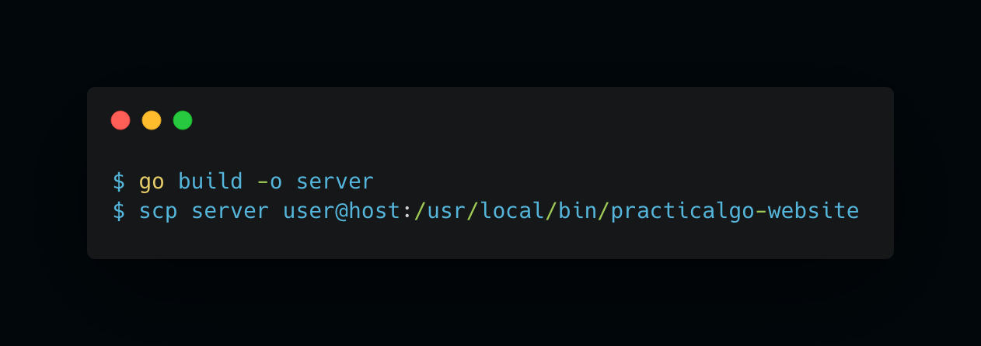
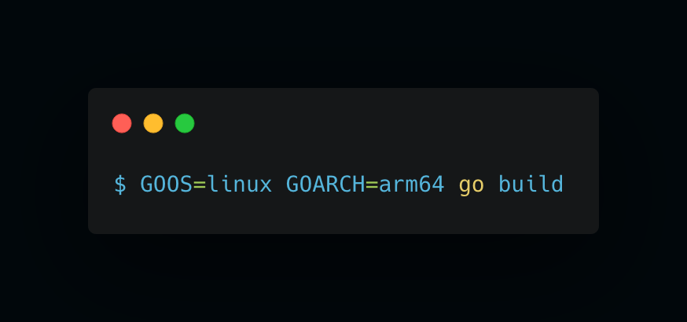
Build and deploy

Slide 11
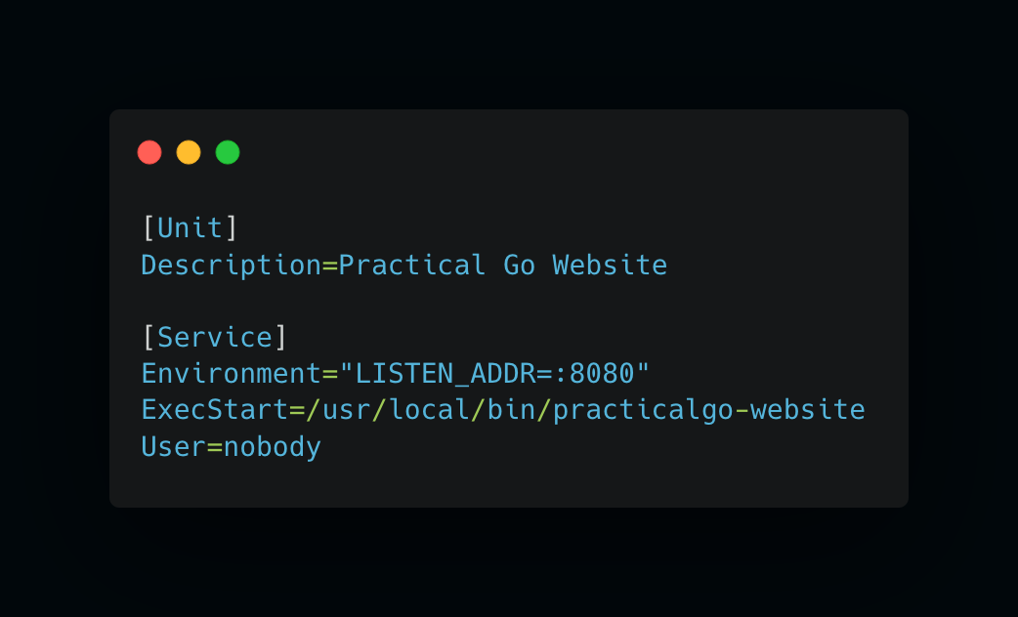
Systemd service

Slide 12
DNS and IP address
Created a DNS record and pointed it to the public IP of my virtual machine

Slide 13
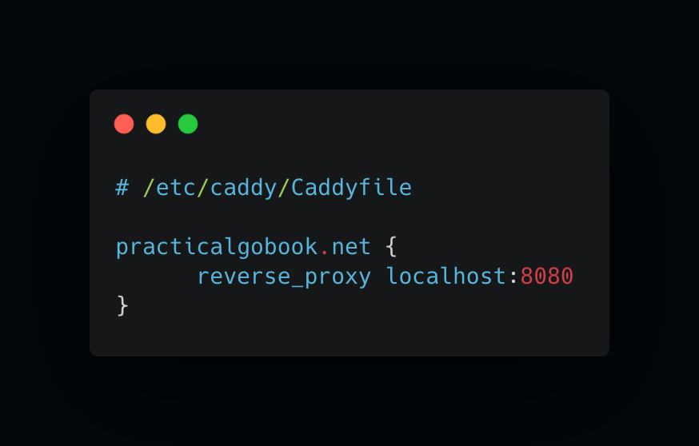
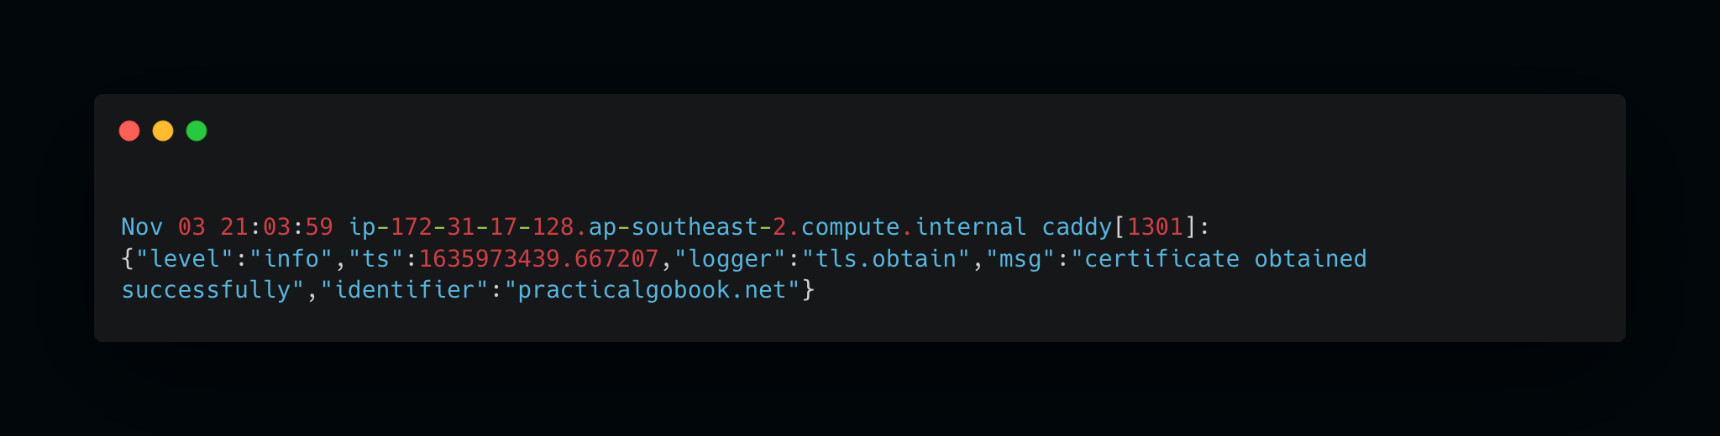
HTTPS and Reverse Proxy with Caddy
Installed Caddy via the repository -> automatically systemd service
https://caddyserver.com/

Slide 14
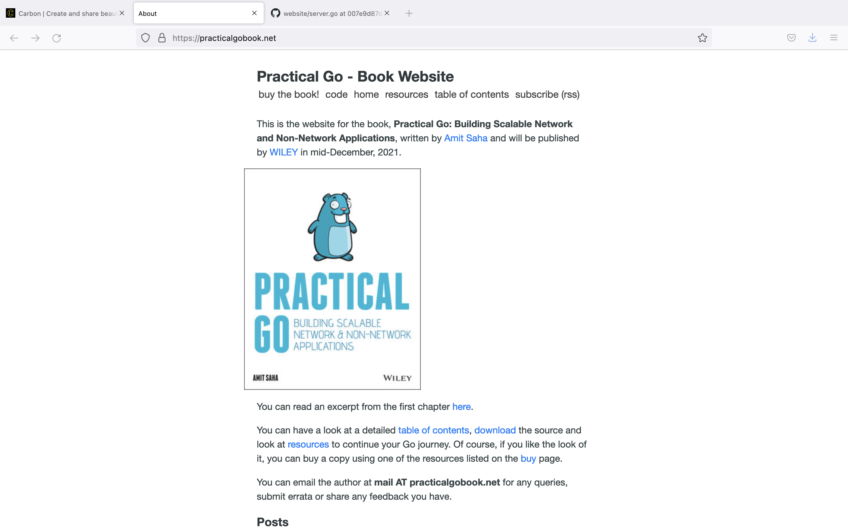
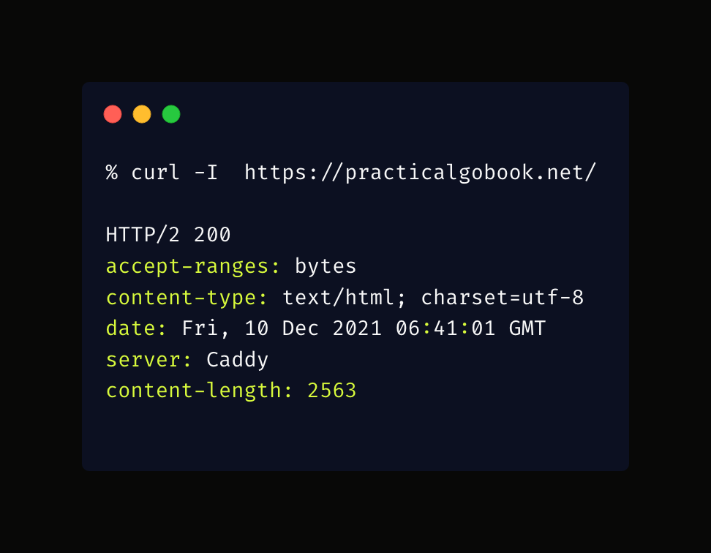
Result - my new book’s website!
https://practicalgobook.net

Slide 15

Second pass

Slide 16
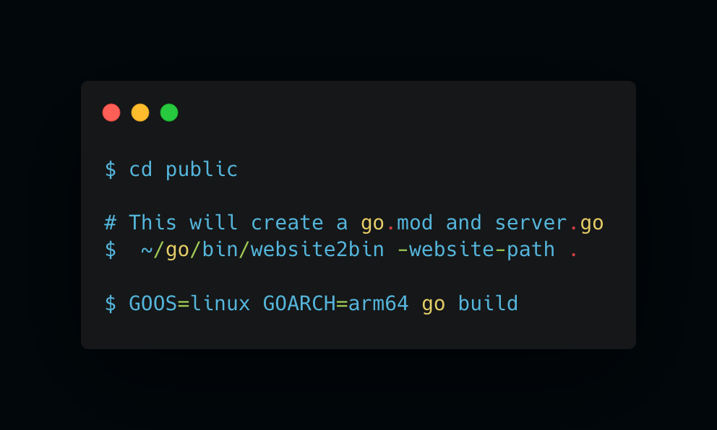
Automate the server creation
https://github.com/amitsaha/website2bin

Slide 17
More “problems” to solve
The update/deployment story isn’t great

Slide 18
Thank you!
https://echorand.me
https://github.com/amitsaha

