Slide 1

static website + go:embed => ./website
Amit Saha
https://echorand.me

Slide 2
Problem Statement
There was no problem to solve
I wanted to host my new static website in the cloud on a virtual machine

Slide 3
Initial plan - just copy the HTML and CSS files to the server
Put in nginx and be done
Then… I thought of writing my server in Go and serving the files from the filesystem
And then… I thought of the embed package

Slide 4

Solution to the problem
markdown -> hugo -> html + css ->
Go server with everything embedded
-> deploy

Slide 5

First pass

Slide 6

Create binary
Create new hugo site
Put some content
Render the HTML
Then ..

Slide 7
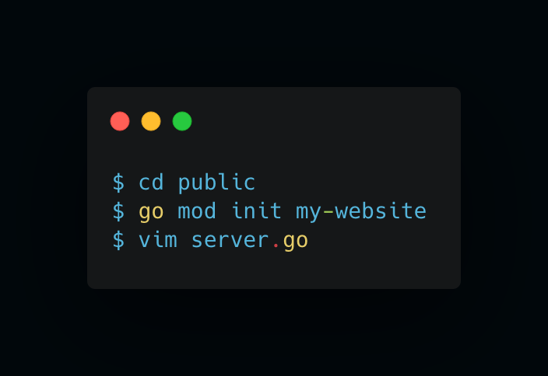
Create a new module

Slide 8
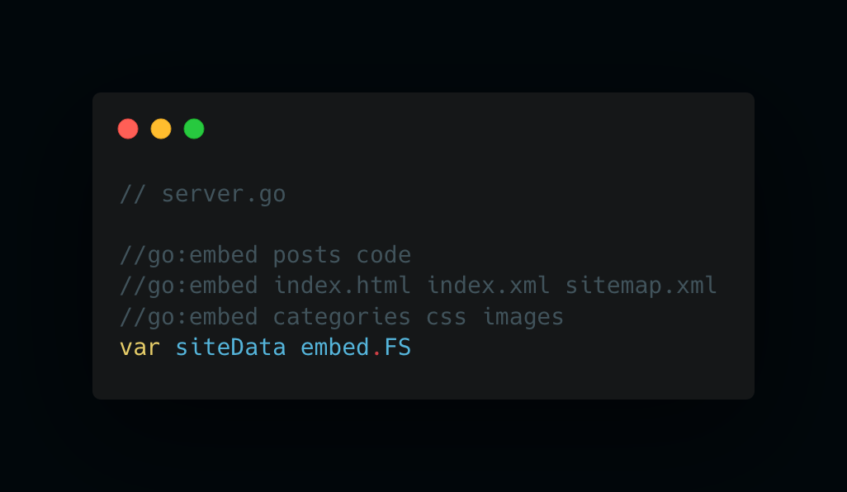
Write go:embed directives

Slide 9
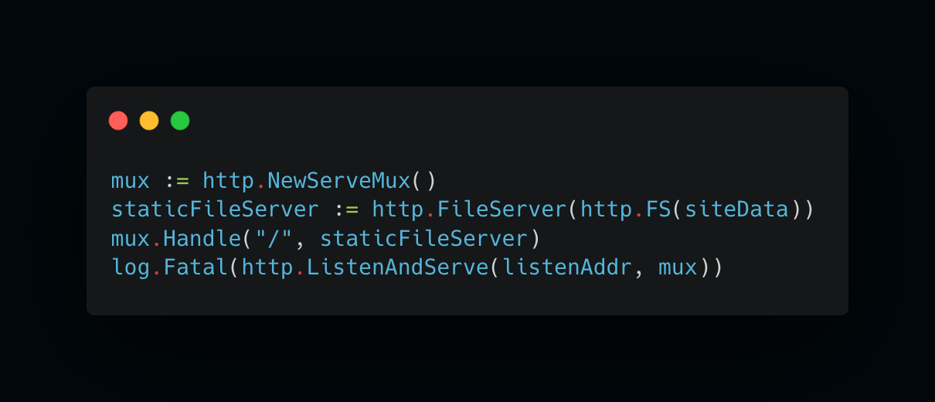
Write the server

Slide 10
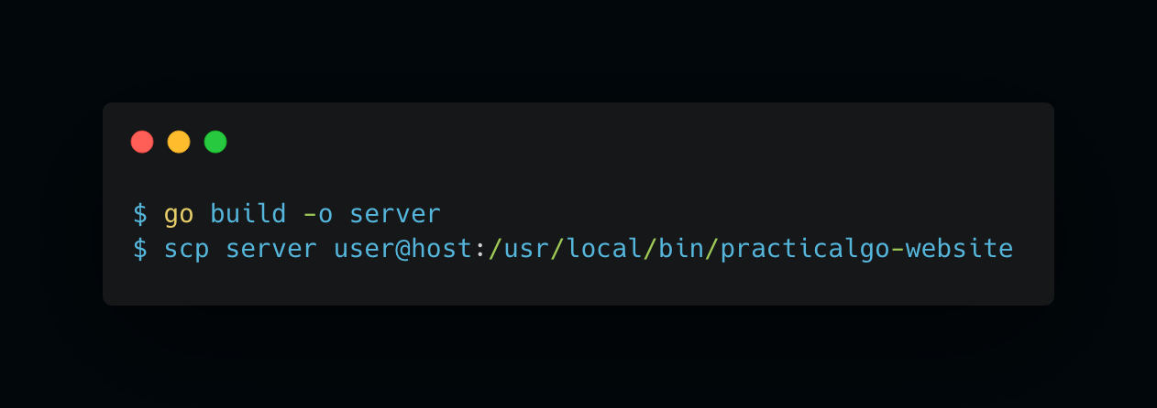
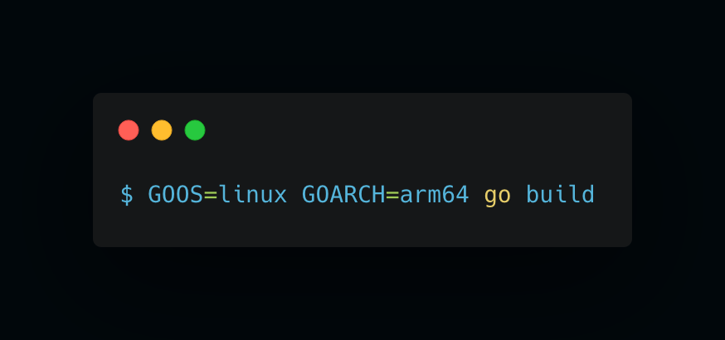
Build and deploy

Slide 11
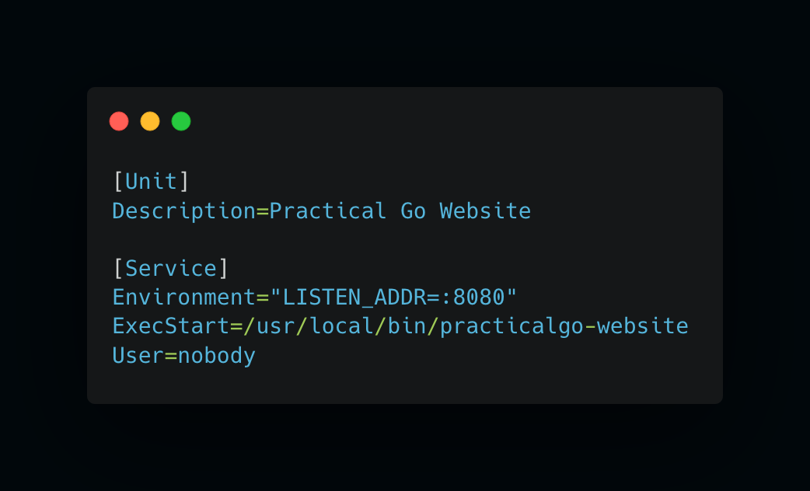
Systemd service

Slide 12
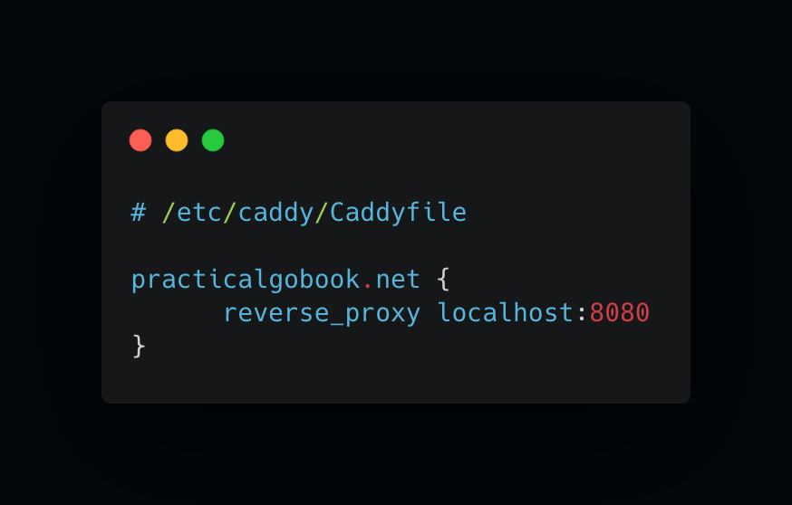
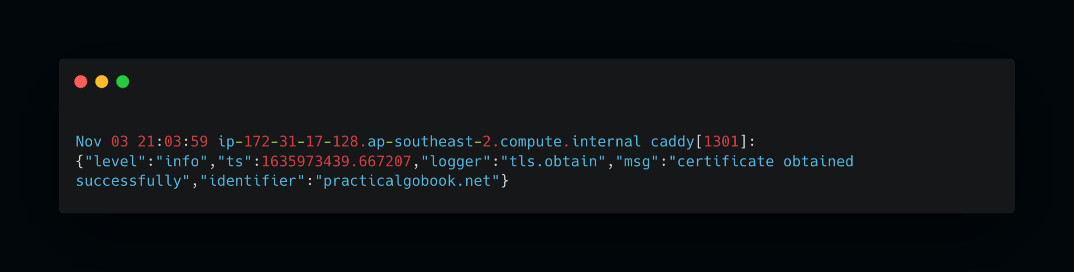
HTTPS and Reverse Proxy with Caddy
Installed Caddy via the repository -> automatically systemd service
https://caddyserver.com/

Slide 13

Second pass
https://github.com/amitsaha/website2bin

Slide 14
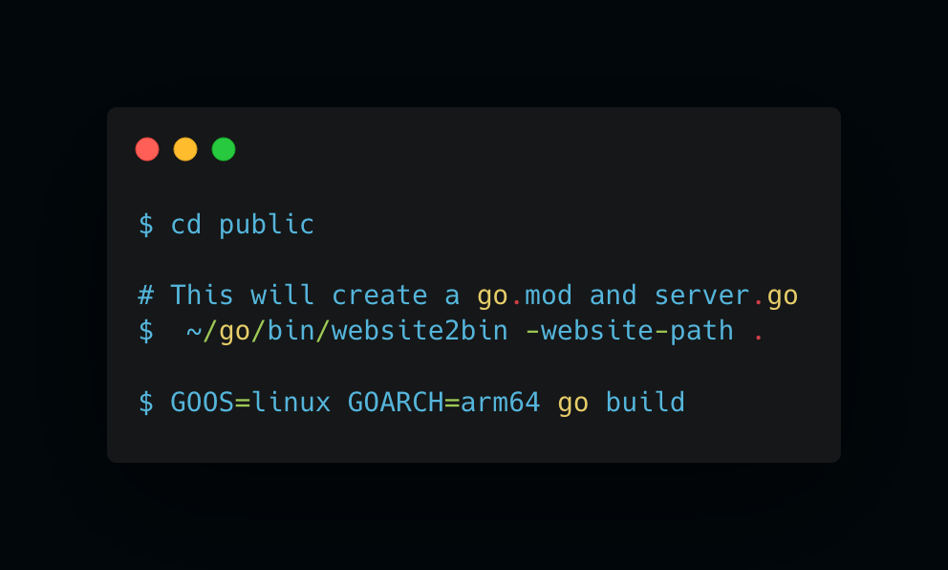
Automate the server creation

Slide 15
Result

Slide 16

My new book’s website!
https://practicalgobook.net

Slide 17
Thank you!
https://echorand.me
https://github.com/amitsaha

