Slide 1

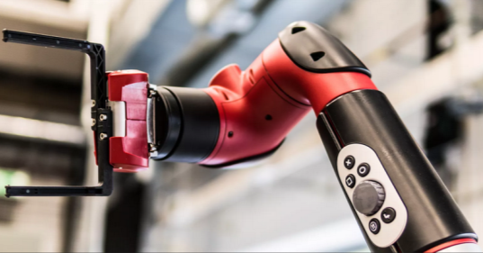
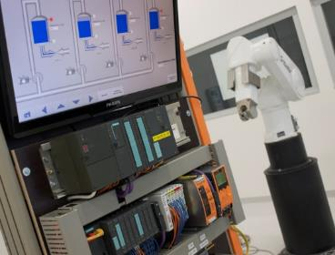
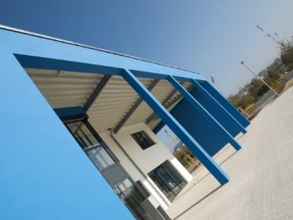
Intelligent Robotics Lab
Development of a SLAM and Autonomous Navigation System for a Self-Driving Car
Deadline: September 14, 2026
Student: Amit Sajeev
Supervisor: Prof. Dr. Dmitrii Dobriborsci
Notes:
1

Slide 2
Problem definition
Develop a SLAM and Autonomous Navigation System for a Self-Driving Car
ROS2-based autonomous navigation system for the Quanser QCar by integrating sensor fusion
Problem statement
Building a complete stack for a self driving car
To fuse different sensor data into the environment to localize and navigate the car in real time.
Design architecture for ROS2 and implement SLAM
Scope
Deliverables: ROS2 Humble simulation environment, QCar URDF model, ros2_control joint controllers, RViz visualization, documented repository
2
Notes:
2

Slide 3
Thesis goal
Main objective
Design and implement a ROS2-based perception and navigation system for the Quanser QCar, enabling real-time SLAM, localization and autonomous indoor driving.
Sub-objectives
Sensor characterization and time-synchronized data acquisition (LiDAR, IMU, encoders, camera)
Multi-sensor fusion for state estimation using EKF/UKF (robot_localization package)
Evaluate and configure ROS2-compatible SLAM algorithms (Cartographer, KISS-ICP, gmapping)
Integrate Nav2 for autonomous path planning and obstacle avoidance on the QCar
3
Notes:
3

Slide 4
Plan
Plan for the last 2 weeks
Expected tasks
Task1: Restore gazebo_ros2_control + drive_controller/steering_controller stack
Task2: Implement cmd_vel_to_drive.py converter for Nav2 integration
Task3: Add ground truth odometry using libgazebo_ros_p3d.so
Task4: Fix odom→base TF chain for Nav2 local costmap
Connection to the milestones:
M5: Complete SLAM pipeline with odometry fusion ready for Nav2
4
Notes:
4

Slide 5
Progress
Work completed
Completed tasks
T1: Keyboard teleop implemented - both Float64MultiArray and Twist modes
T2: LiDAR plugin added - publishing /scan at 10Hz
T3: Cartographer SLAM configured - full map built and saved
T4: Nav2 stack launched - path planning and goal navigation working
T5: cmd_vel converter implemented - Nav2 controls QCar drive controller
T6: libgazebo_ros_p3d.so ground truth odometry added - /odom topic publishing odom→base TF
T7: odom_to_tf.py node broadcasting real odometry TF from p3d plugin
T8: Full Nav2 stack active — map_server, amcl, controller_server, bt_navigator all lifecycle-managed
T9: Autonomous goal navigation confirmed working — Goal succeeded logged
Progress:Robot navigates autonomously to a set 2D goal pose in RViz. AMCL localizes against saved map using LiDAR. Goal reaching confirmed. Minor goal accuracy imprecision remains due to Ackermann-style steering approximation in the converter.
Work NOT completed
Precise goal accuracy (arrives near goal but with heading/position offset)
Real wheel encoder odometry (using ground truth p3d as substitute)
Reasons:
drive_controller (velocity) publishes no real odometry - p3d plugin used as ground truth substitute
Ackermann steering geometry not fully modeled in cmd_vel_to_drive.py converter
5
Notes:
5

Slide 6
Plan for the next 2 weeks
Upcoming tasks:
T1: Optimize simulation stack performance and clean up codebase
T2: Connect to physical QCar and establish ROS2 Humble communication
T3: Deploy simulation stack to QCar onboard computer
T4: Calibrate LiDAR sensor on real hardware - verify /scan topic publishing
T5: Test keyboard teleop on real QCar - validate drive and steering response
T6: Run Cartographer SLAM on real hardware - build map of physical environment
Expected outcomes:
ROS2 stack running on physical Qcar
Real LiDAR data publishing and teleop confirmed working
First real-world SLAM map built
Milestone:
M6: Simulation-to-hardware transition initiated, real robot teleoperated and sensor-verified
6
Notes:
6

Slide 7
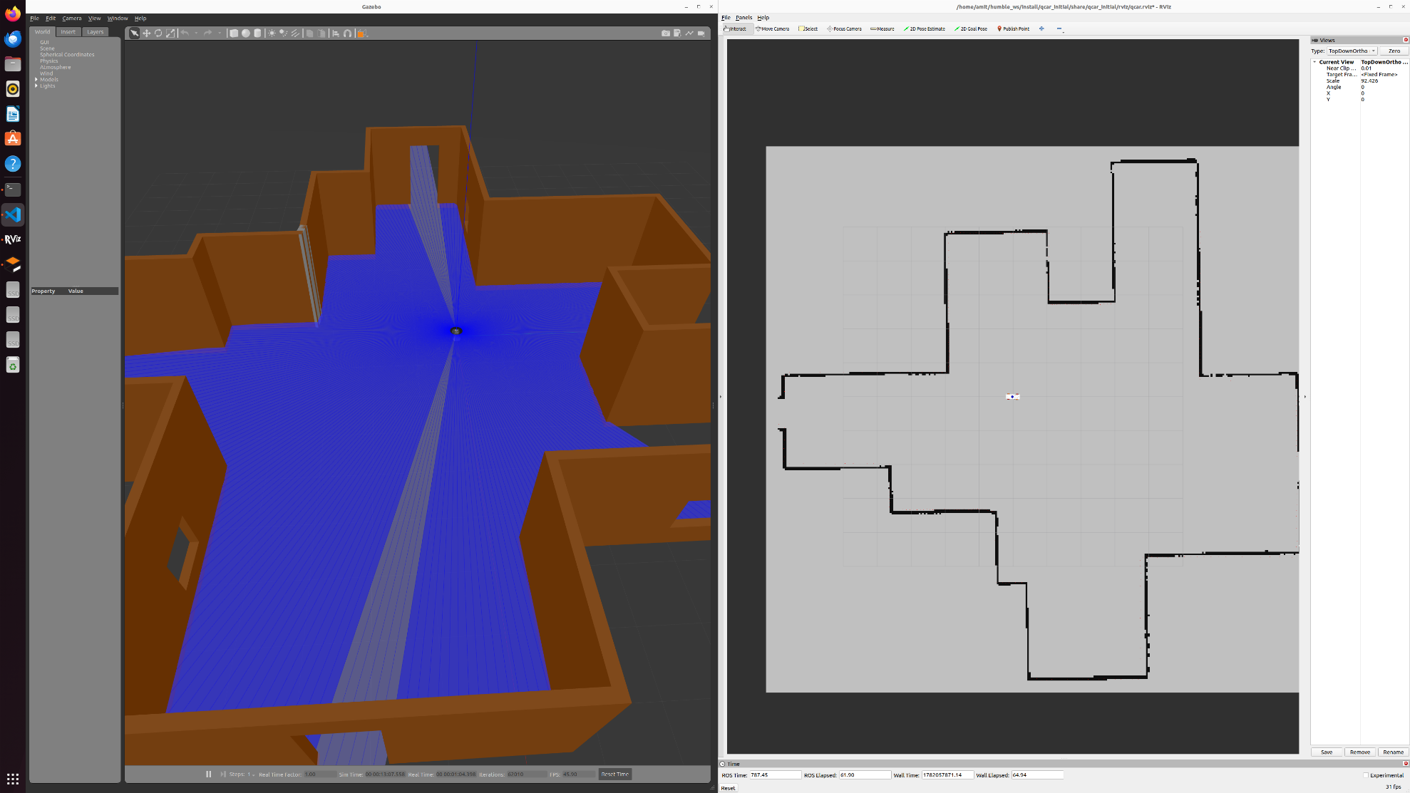
Results: SLAM Mapping, Localization and Autonomous Navigation
Autonomous goal navigation confirmed - "Goal succeeded" logged in Nav2 terminal

Slide 8
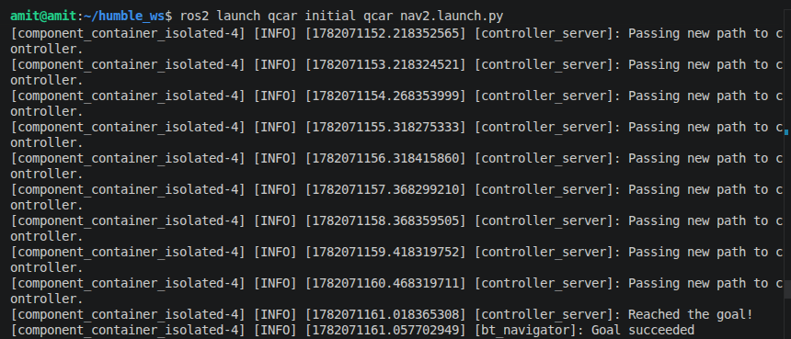
Results: SLAM Mapping, Localization and Autonomous Navigation
Autonomous goal navigation confirmed - "Goal succeeded" logged in Nav2 terminal

Slide 9
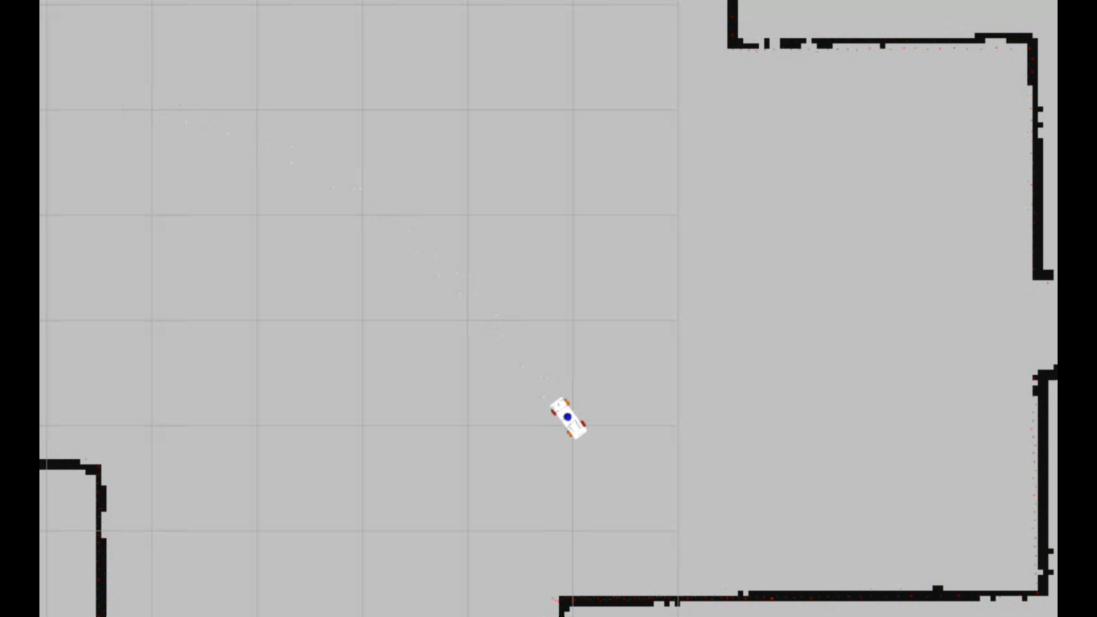
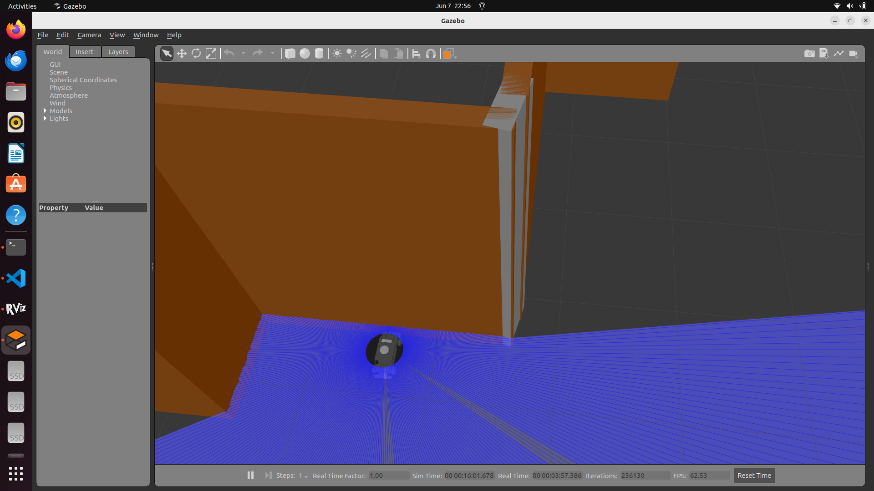
Issues faced
Robot deviates from Nav2 planned path.
Goal reaching imprecise - Ackermann steering geometry
approximated in cmd_vel converter

Slide 10
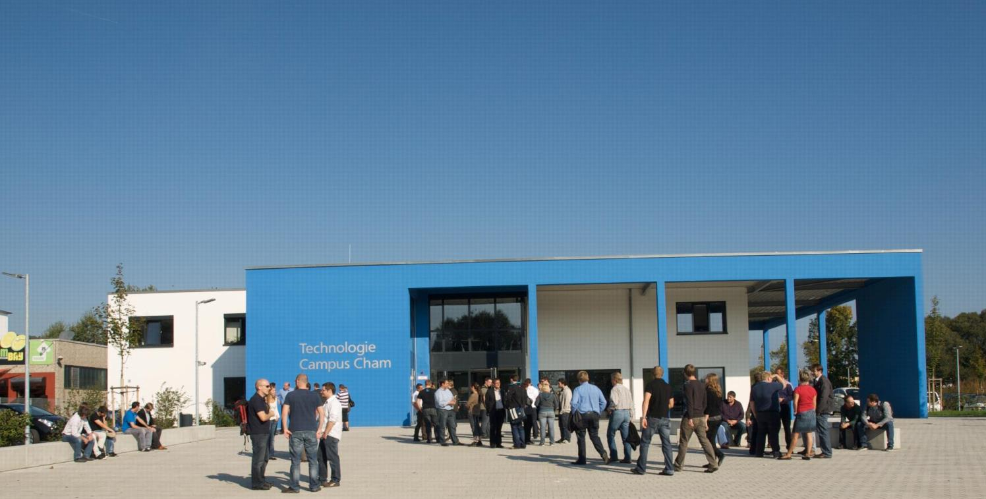
KONTAKT
Herzlichen Dank für Ihr Interesse!
Technologie
Campus Cham
Badstraße 21
93413 Cham
www.tc-cham.de
Prof. Dr. Dmitrii Dobriborsci
Dmitrii.dobriborsci@th-deg.de
10

