Slide 1
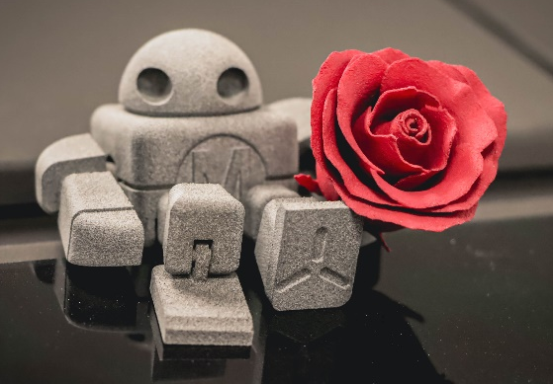
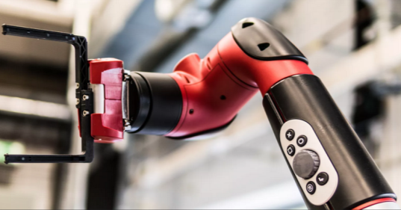
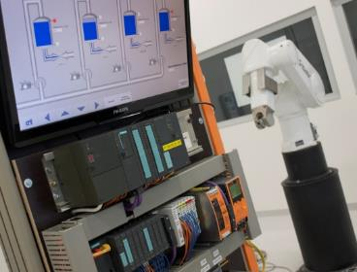
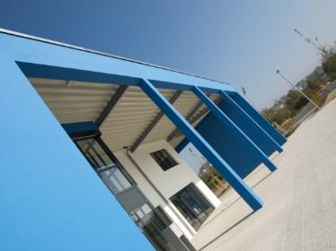
Intelligent Robotics Lab
Development of a SLAM and Autonomous Navigation System for a Self-Driving Car
Deadline: September 14, 2026
Student: Amit Sajeev
Supervisor: Prof. Dr. Dmitrii Dobriborsci
Notes:
1

Slide 2
Problem definition
Develop a SLAM and Autonomous Navigation System for a Self-Driving Car
ROS2-based autonomous navigation system for the Quanser QCar by integrating sensor fusion
Problem statement
Building a complete stack for a self driving car
To fuse different sensor data into the environment to localize and navigate the car in real time.
Design architecture for ROS2 and implement SLAM
Scope
Deliverables: ROS2 Humble simulation environment, QCar URDF model, ros2_control joint controllers, RViz visualization, documented repository
2
Notes:
2

Slide 3
Thesis goal
Main objective
Design and implement a ROS2-based perception and navigation system for the Quanser QCar, enabling real-time SLAM, localization and autonomous indoor driving.
Sub-objectives
Sensor characterization and time-synchronized data acquisition (LiDAR, IMU, encoders, camera)
Multi-sensor fusion for state estimation using EKF/UKF (robot_localization package)
Evaluate and configure ROS2-compatible SLAM algorithms (Cartographer, KISS-ICP, gmapping)
Integrate Nav2 for autonomous path planning and obstacle avoidance on the QCar
3
Notes:
3

Slide 4
Plan
Plan for the last 2 weeks
Expected tasks
T1: Resolve corner-cutting/curve-radius complaint
T2: Connect to physical QCar, establish ROS2 communication
T3: Deploy simulation stack to QCar onboard computer
T4: Check LiDAR sensor on real hardware
T5: Test keyboard teleop on real QCar
Connection to the milestones:
M7: Simulation stack complete; hardware integration initiated
4
Notes:
4

Slide 5
Progress
Work completed
Completed tasks
T1: Improved goal accuracy - increased minimum turning radius and loosened yaw tolerance; robot now reaches goals almost accurately
T2: Investigated remaining path deviation on tight-turn goals - tested 5 parameters, no single fix found; confirmed it's a geometry limitation of the goal itself, not a software bug
T3: Created qcar_hardware package - reference docs, hardware test scripts and integration guide for the physical Qcar
T4: Solved ROS2 version conflict - QCar runs Dashing, dev PC runs Humble; set up a separate native Dashing workspace on the QCar to avoid compatibility issues
T5: First successful hardware run - physical QCar connected and driven via keyboard teleop
Progress: Nav2 setup with Smac global planner + MPPI sampling-based local controller. Issues resolved. Harware integration completed and successfully teleoperated the robot.
Work NOT completed
Real LiDAR, encoder odometry and stack integration on hardware
SLAM on real hardware - not yet run
Humble-tuned Nav2/MPPI stack can't run natively on QCar's Dashing workspace
Planned resolution: Docker to run Humble-based navigation stack in a container on the QCar, alongside native Dashing workspace handling direct hardware I/O
5
Notes:
5

Slide 6
Plan for the next 2 weeks
Upcoming tasks:
T1: Set up Docker to run Humble-based Nav2/MPPI stack on/against the QCar
T2: Expand on-device Dashing workspace - real LiDAR node, encoder odometry
T3: Validate teleop more thoroughly - drive/steering response under real load and friction
T4: Run Cartographer/SLAM on real hardware for physical-environment map
T5: Begin end-to-end testing of Nav2 autonomy stack on hardware via Docker
Expected outcomes:
Successfully able to navigate in physical-environment with QCar
Milestone:
M7: Humble navigation stack running on the physical QCar via Docker; real sensor integration underway
6
Notes:
6

Slide 7
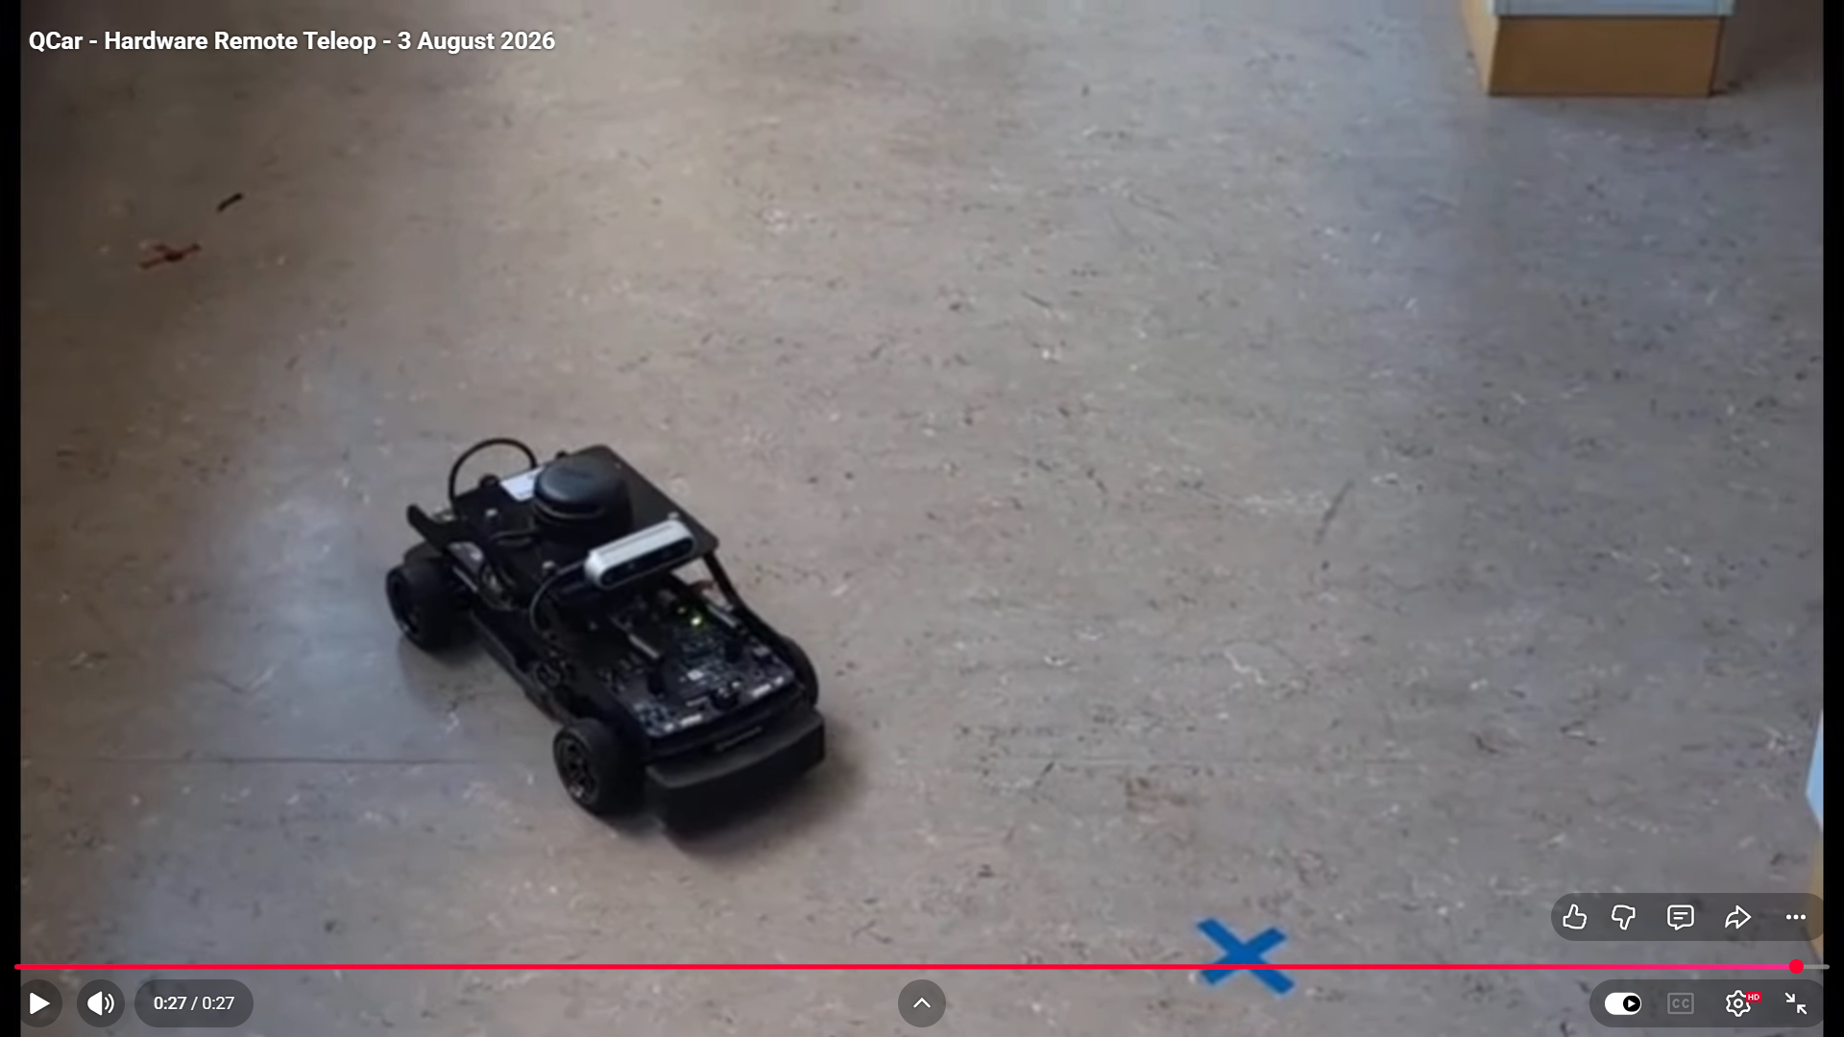
Results: QCar Hardware Teleoperation
https://www.youtube.com/watch?v=KhUEylLyjYM

Slide 8
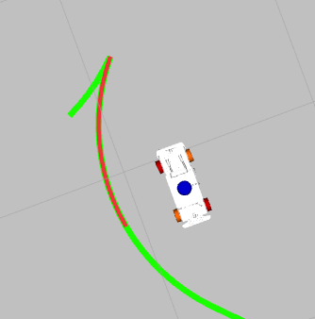
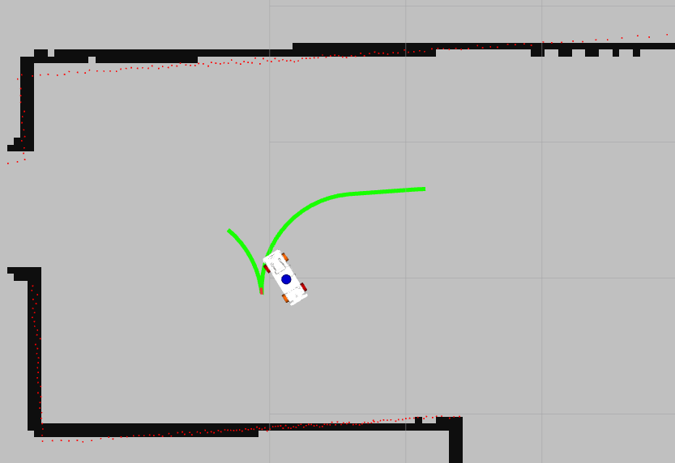
Issues faced
Robot deviates from Nav2 planned curved path.
At times take multiple iterations to reroute

Slide 9
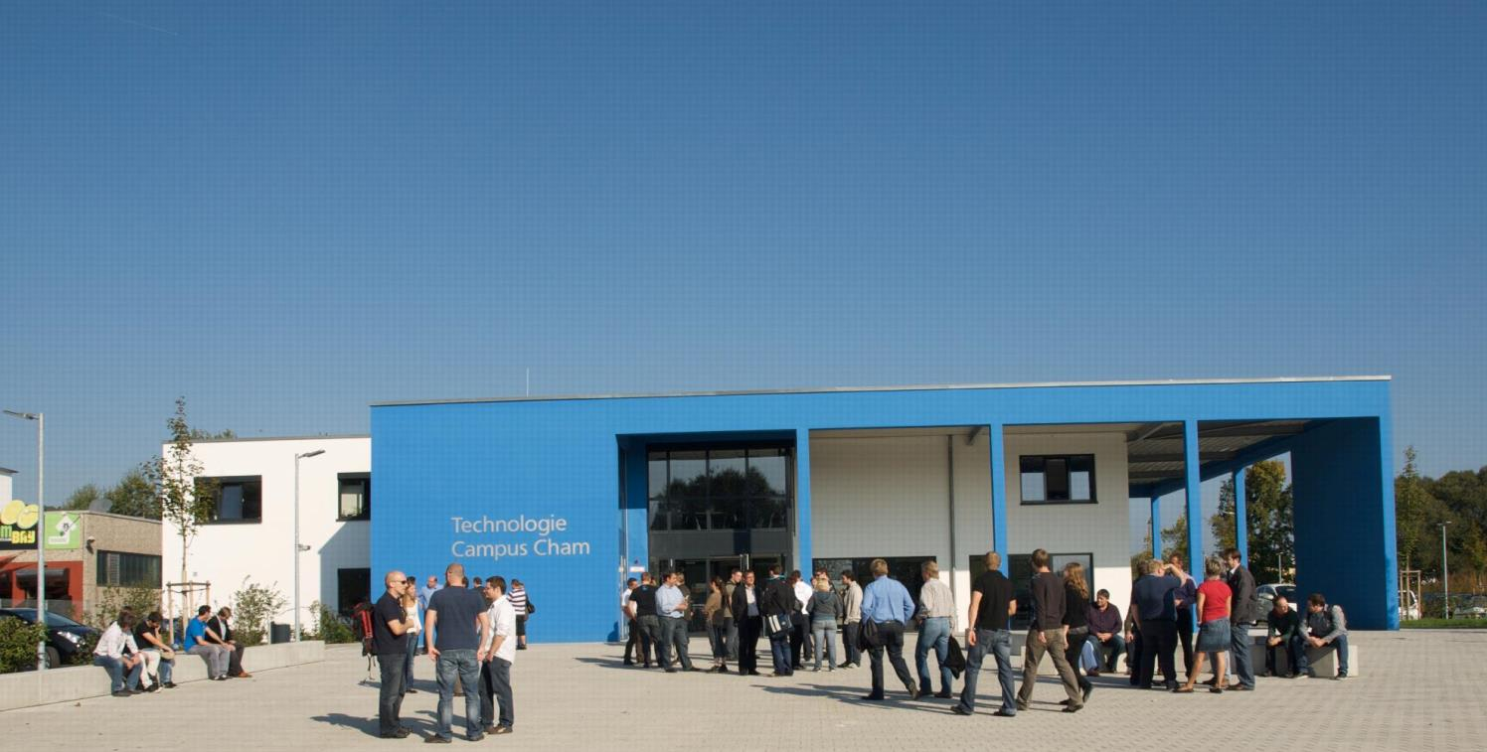
KONTAKT
Herzlichen Dank für Ihr Interesse!
Technologie
Campus Cham
Badstraße 21
93413 Cham
www.tc-cham.de
Prof. Dr. Dmitrii Dobriborsci
Dmitrii.dobriborsci@th-deg.de
9

