Slide 1

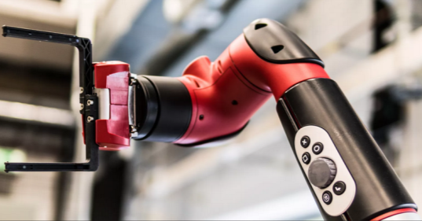
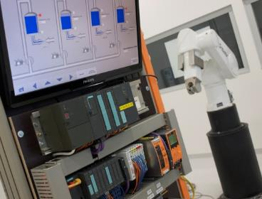
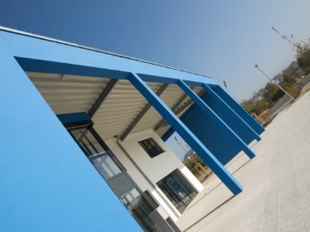
Intelligent Robotics Lab
Development of a SLAM and Autonomous Navigation System for a Self-Driving Car
Deadline: September 14, 2026
Student: Amit Sajeev
Supervisor: Prof. Dr. Dmitrii Dobriborsci
Notes:
1

Slide 2
Problem definition
Develop a SLAM and Autonomous Navigation System for a Self-Driving Car
ROS2-based autonomous navigation system for the Quanser QCar by integrating sensor fusion
Problem statement
Building a complete stack for a self driving car
To fuse different sensor data into the environment to localize and navigate the car in real time.
Design architecture for ROS2 and implement SLAM
Scope
Deliverables: ROS2 Humble simulation environment, QCar URDF model, ros2_control joint controllers, RViz visualization, documented repository
2
Notes:
2

Slide 3
Thesis goal
Main objective
Design and implement a ROS2-based perception and navigation system for the Quanser QCar, enabling real-time SLAM, localization and autonomous indoor driving.
Sub-objectives
Sensor characterization and time-synchronized data acquisition (LiDAR, IMU, encoders, camera)
Multi-sensor fusion for state estimation using EKF/UKF (robot_localization package)
Evaluate and configure ROS2-compatible SLAM algorithms (Cartographer, KISS-ICP, gmapping)
Integrate Nav2 for autonomous path planning and obstacle avoidance on the QCar
3
Notes:
3

Slide 4
Plan
Plan for the last 2 weeks
Expected tasks
T1: Fix navigation inaccuracy
T2: Replace hand-rolled converter with ackermann_steering_controller (ros2_control)
T3: Switch to gazebo_ros_ackermann_drive plugin for native Ackermann kinematics + odometry
T4: Fix wheel collision geometry and friction for correct physics
T5: Tune Nav2 planner and controller for Ackermann vehicle
T6: Begin hardware integration
Connection to the milestones:
M6: Kinematically correct Ackermann simulation stack
4
Notes:
4

Slide 5
Progress
Work completed
Completed tasks
T1: Replaced cmd_vel_to_drive.py + dual joint controllers with ackermann_steering_controller
T2: Replaced ackermann_steering_controller with gazebo_ros_ackermann_drive plugin - simpler architecture, native /odom and TF publishing, no relay nodes
T3: Fixed three physics bugs exposed by plugin: wheel collision meshes (plugin couldn't read radius → robot couldn't move), zero wheel friction, steering PID gains too weak
T4: Restructured the behavior tree
T5: Switched global planner from NavFn (Dijkstra) to Smac - heading-aware planning with K-turn/reversal support; resolved root cause of goal-approach oscillation
T6: Replaced local controller from Regulated Pure Pursuit to MPPI
T7: Fixed MPPI collision checking - was checking robot center only, not actual rectangular car frame
T8: Fixed enforce_path_inversion flag - MPPI was not handling planned reversal segments correctly
T9: Tuned AMCL for localization jitter - ruled out vehicle physics as cause of remaining failures
T10: Removed PreferForwardCritic as it was directly fighting the planner's own decisions
T11: Fixed turns early into curve - two separate critics targeting look-ahead points past the curve start
5
Notes:
5

Slide 6
Progress
Work completed
Completed tasks
T12: Robot wasn’t moving on reorientation-only goal - fixed - three path-adherence critics measured distance to goal, switching off for entire maneuver
T13: Robot doesn't move when path starts with a turn - fixed - planner bug inserting a pointless reversal-then-forward wiggle at path
T14: Fixed /joint_states reporting fake frozen state - wheels appeared static in RViz while robot was moving correctly
T15: Built custom EarlyCommitCritic MPPI critic from scratch - no existing critic provided heading guidance for immediate-curve cases; fixed mismatch between custom code and Nav2's precompiled MPPI library
T16: Fixed 4 stacked bugs behind persistent failure: runaway 33Hz replanning (behavior tree bug), zero safety margin between planner and controller turning radius limits, and MPPI warm-start self-reinforcing stall
Progress: Stack moved from approximated Ackermann conversion + basic Nav2 to kinematically to Smac global planner + MPPI sampling-based local controller. End-to-end navigation verified. Corner-cutting/curve-radius tuning still inconclusive.
Work NOT completed
Corner-cutting on curves - not proven fixable with single critic weight adjustment; under investigation
Hardware integration - deprioritized in favor of achieving correct simulation kinematics first
6
Notes:
6

Slide 7
Plan for the next 2 weeks
Upcoming tasks:
T1: Resolve corner-cutting/curve-radius complaint
T2: Connect to physical QCar and establish ROS2 Humble communication
T3: Deploy simulation stack to QCar onboard computer
T4: Calibrate LiDAR sensor on real hardware - verify /scan topic publishing
T5: Test keyboard teleop on real QCar - validate drive and steering response
Expected outcomes:
Navigation stack fully tuned and verified in simulation
Hardware integration initiated - QCar teleoperated and sensor-verified
Milestone:
M6: Simulation stack complete with verified Ackermann kinematics; hardware integration initiated
7
Notes:
7

Slide 8
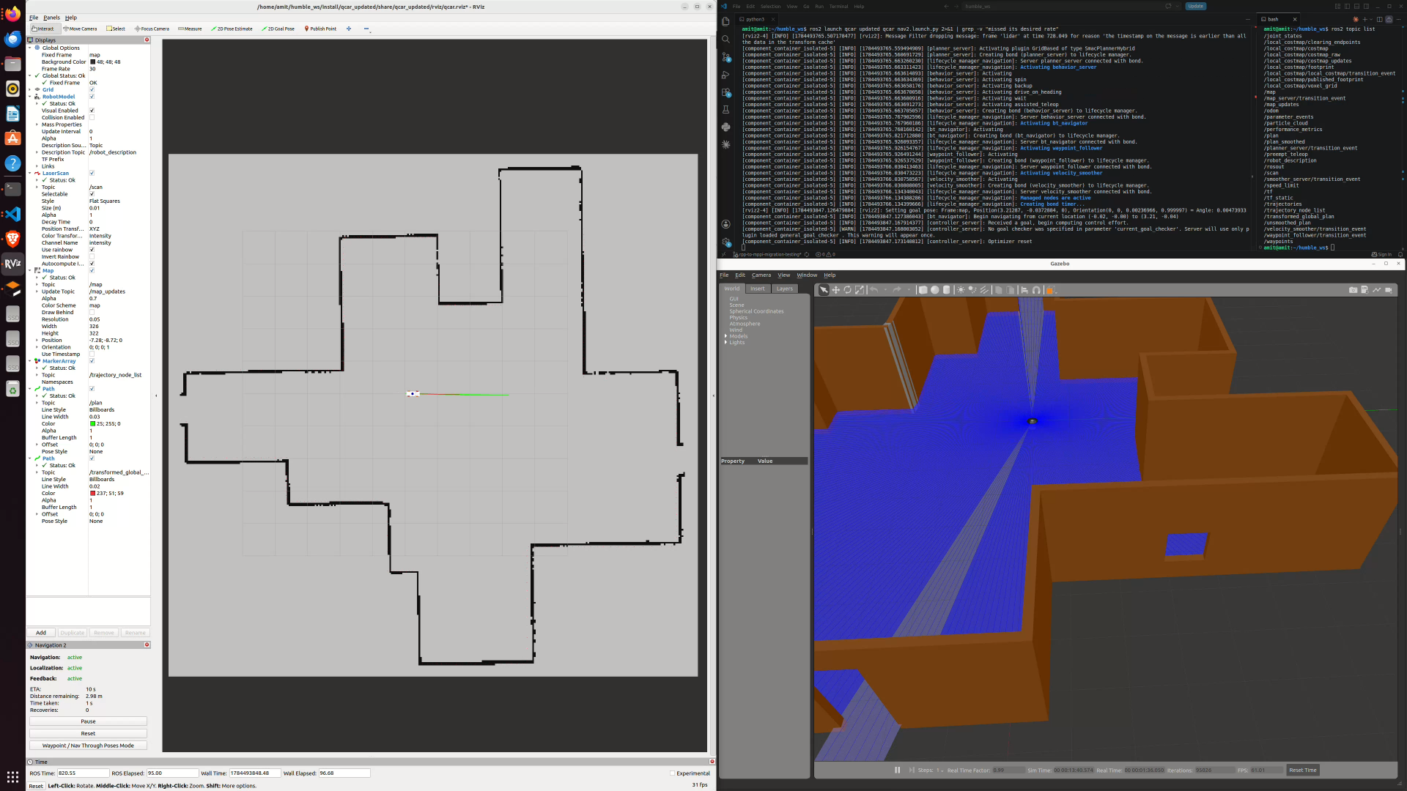
Results: SLAM Mapping, Localization and Autonomous Navigation
https://www.youtube.com/watch?v=nIZiZn91m-E

Slide 9
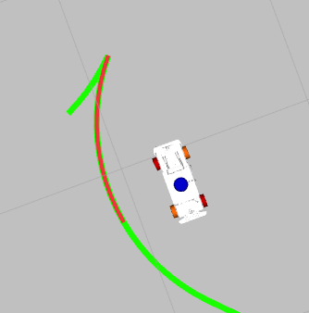
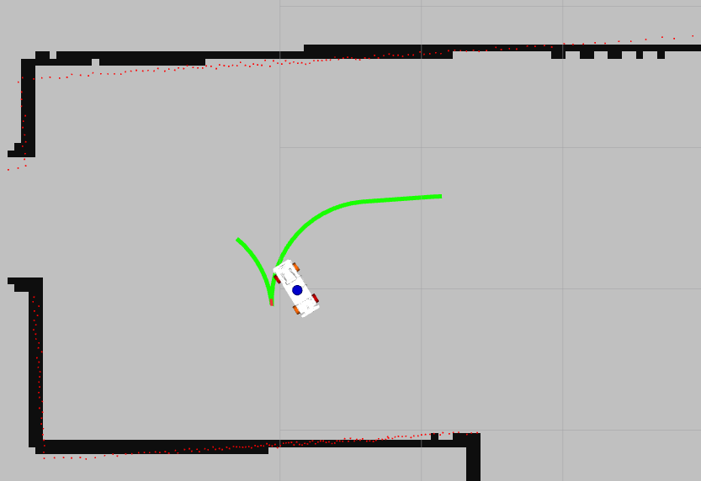
Issues faced
Robot deviates from Nav2 planned curved path.
At times take multiple iterations to reroute

Slide 10
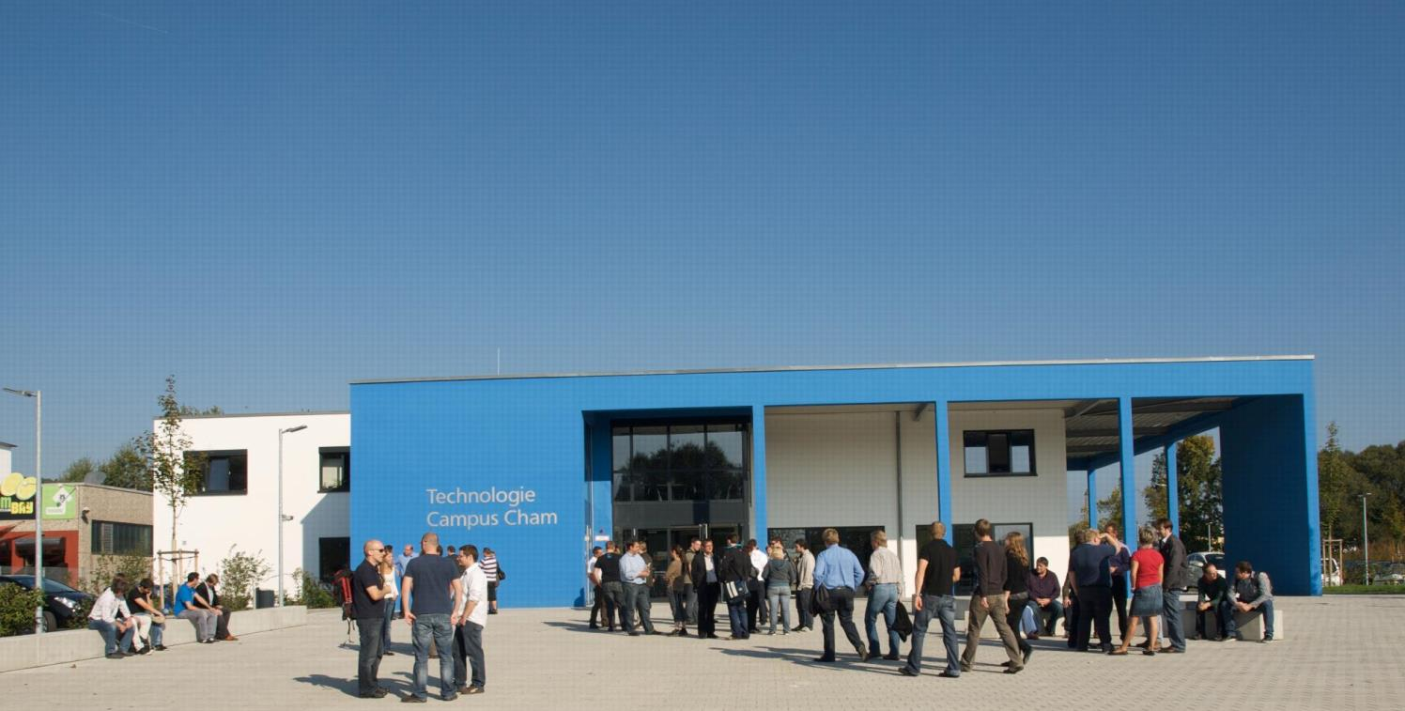
KONTAKT
Herzlichen Dank für Ihr Interesse!
Technologie
Campus Cham
Badstraße 21
93413 Cham
www.tc-cham.de
Prof. Dr. Dmitrii Dobriborsci
Dmitrii.dobriborsci@th-deg.de
10

