Slide 1
The Golden Rules
Name: Amit Singh Baghel Email:amitsb3747@gmail.com

Slide 2
What is User Interface Design?

Slide 3

The design of user interfaces for machines and software with the focus on maximizing usability and the user experience. The goal of user interface design is to make the user's interaction as simple and efficient as possible, in terms of accomplishing user goals.

Slide 4
A user interface is like a joke. If you have to explain it, it’s not that good.

Slide 5
What happens if we have to explain it ?
Or The result of a poor UI ?

Slide 6
Google Wave that failed due to its poor UI design.

Slide 7
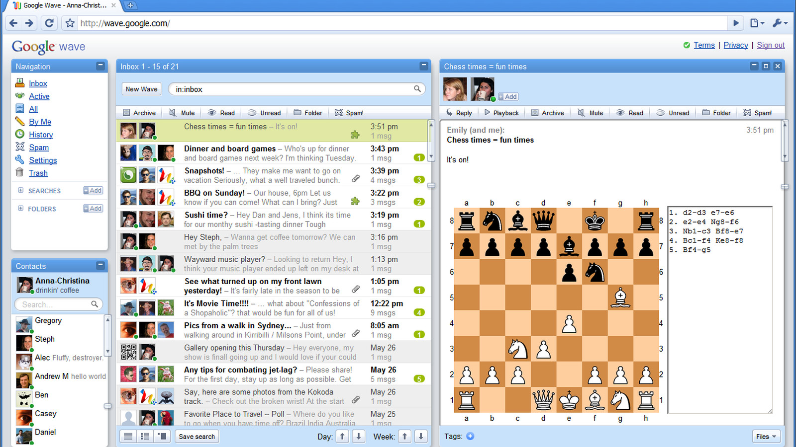

Slide 8

What should we do to make a good UI?
We should follow the Three Golden Rules coined by Mr. Theo Mandel, Ph.D.
The basis for a set of UI design principles that guide this important aspect of software design.

Slide 9
The Golden Rules
Place the user in control
Reduce the user’s memory load
Make the interface consistent

Slide 10
1. Place the user in control
"What I really would like,” said the user solemnly, “is a system that reads my mind. It knows what I want to do before I need to do it and makes it very easy for me to get it done. That’s all, just that.”
-During a requirements-gathering session, a key user was asked about the attributes of the window-oriented graphical interface.

Slide 11
1. Place the user in control
Users want to control the computer but does not want to be controlled by the computer. So, user interface constraints specified by the designer must simplify the mode of user's interaction with the computer. User interface must not frustrate the user.

Slide 12
1. Place the user in control
Define interaction modes in a way that does not force a user into unnecessary
or undesired actions.
1.

Slide 13
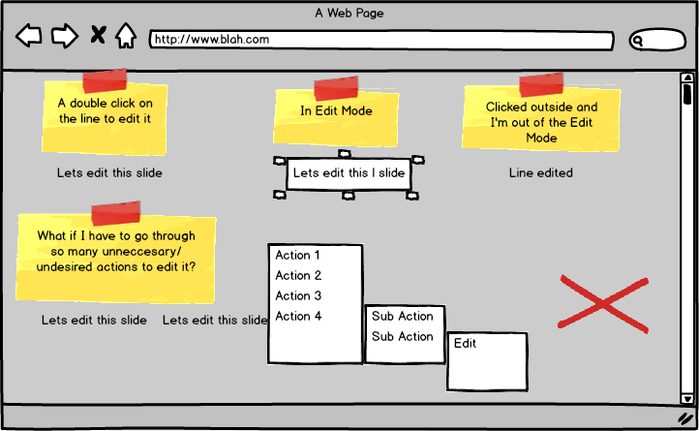
The user should always be able to enter and exit the mode with little or no effort.

Slide 14
1. Place the user in control
Provide for flexible interaction
2.

Slide 15
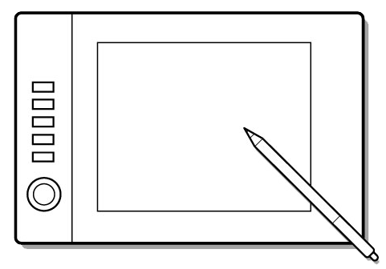

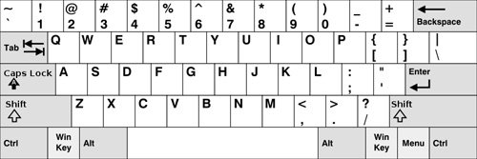
Different users have different interaction preferences, choices should be provided.
Drawing complex shapes via
keyboard commands frustrates users but doing the same via mouse is simple.

Slide 16
1. Place the user in control
Allow user interaction to be interruptible and undoable.
3.

Slide 17
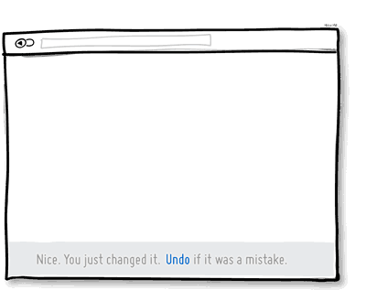
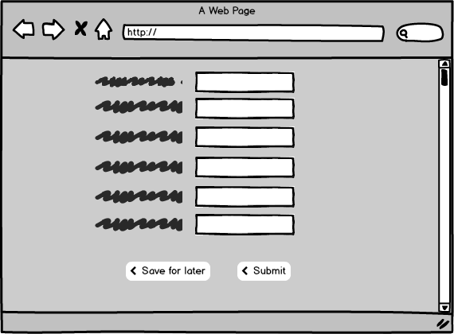
User should be able to interrupt even when in a sequence of actions but without losing any progress. Also, any user action must be undoable.

Slide 18
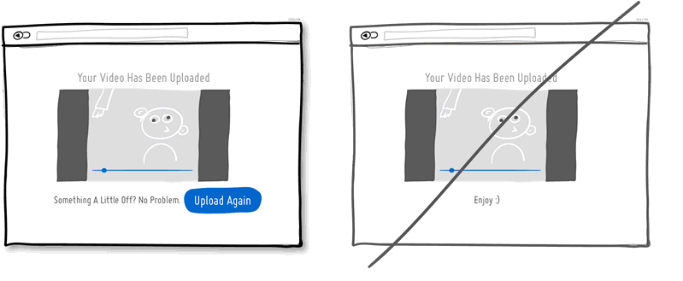
User should be able to interrupt even when in a sequence of actions but without losing any progress. Also, any user action must be undoable.

Slide 19
1. Place the user in control
Streamline interaction as skill levels advance and allow the interaction to
be customized.
4.

Slide 20
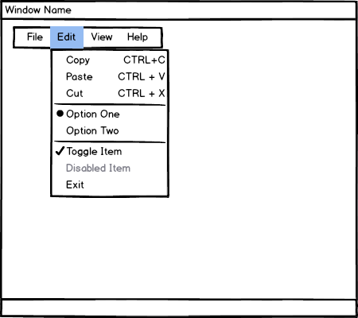
Users may be normal people or computer experts.
Users of different skill levels should be able to interact with a program at different levels.

Slide 21
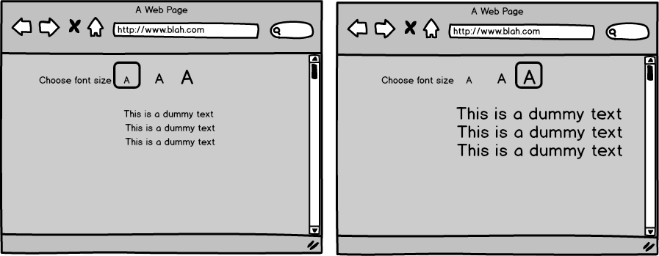
Users may be normal people or computer experts.
Users of different skill levels should be able to interact with a program at different levels.

Slide 22
1. Place the user in control
Hide technical internals from the casual user.
5.

Slide 23
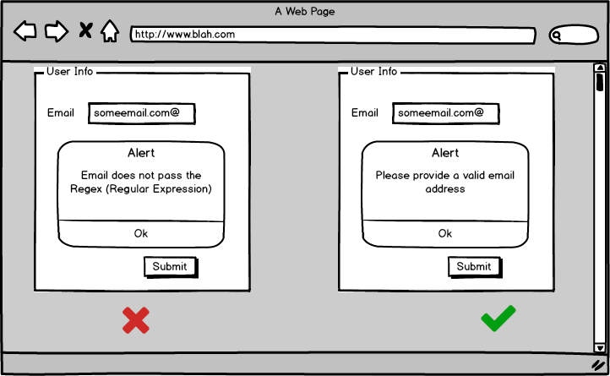
The user should not be aware of the operating system, file management functions, or other arcane computing technology.

Slide 24
1. Place the user in control
Design for direct interaction with objects that appear on the screen.
6.

Slide 25

The user feels a sense of control when able to manipulate the objects that are necessary to perform a task in a manner similar to what would occur if the
object were a physical thing

Slide 26
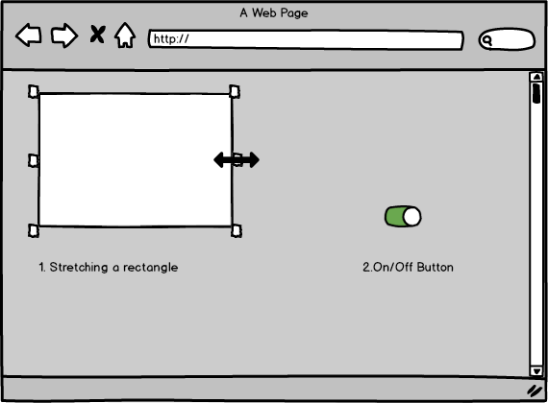
The user feels a sense of control when able to manipulate the objects that are necessary to perform a task in a manner similar to what would occur if the object were a physical thing.

Slide 27
2.Reduce the User’s Memory Load
A software must not force a user to memorize anything. On the other hand, it should provide recall feature to provide data when it is needed by storing it in its memory.

Slide 28
2.Reduce the User’s Memory Load
Reduce demand on short-term memory.
1.

Slide 29
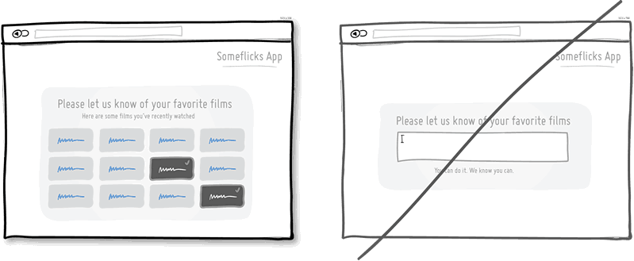
User Interface must be designed such that visual cues are provided to the user which helps him/her in reusing previous results etc.

Slide 30
2.Reduce the User’s Memory Load
Establish meaningful defaults.
2.

Slide 31
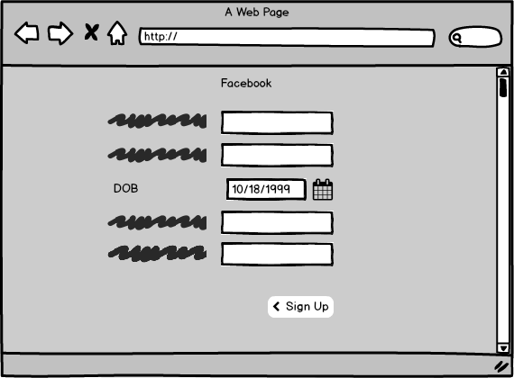
The default values of such properties must be meaningful i.e. generally used.
The user must be able to change the properties if he/she wants to. Also, user must be able to reset the properties to their default values.

Slide 32
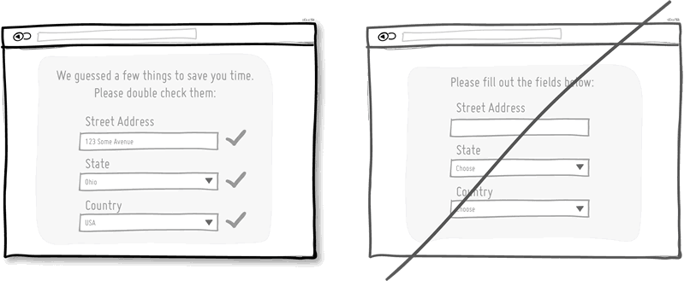
The default values of such properties must be meaningful i.e. generally used.
The user must be able to change the properties if he/she wants to. Also, user must be able to reset the properties to their default values.

Slide 33
2.Reduce the User’s Memory Load
Define shortcuts that are intuitive.
3.

Slide 34
The shortcuts must be designed such that they are easy to remember i.e. Ctrl + C to copy is easy to remember as
C is for Copy etc.

Slide 35

Photos
Add User
Cloud
Battery
Let’s match the column.

Slide 36
2.Reduce the User’s Memory Load
The visual layout of the interface should be based on a real-world metaphor.
4.

Slide 37
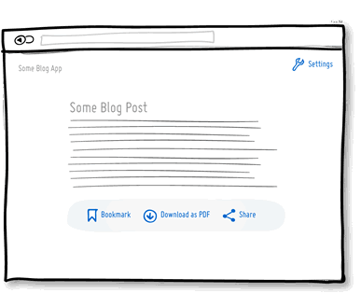
Real-world metaphor enables the user to rely on well-understood visual cues, rather than
memorizing an arcane interaction sequence.

Slide 38
2.Reduce the User’s Memory Load
Disclose information in a progressive fashion.
4.

Slide 39
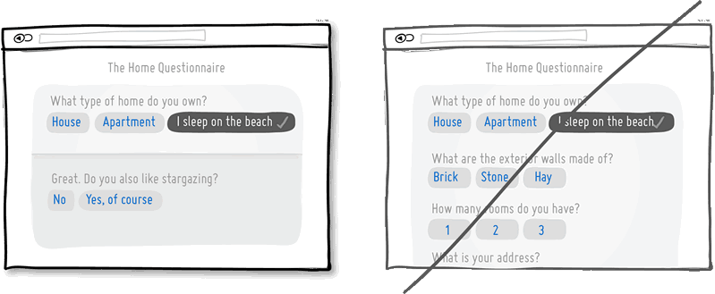
According to this principle, user interface must be such that general underline must be shown at low levels of abstractions and users can go to higher levels of abstraction by a mouse click etc,.

Slide 40
3.Make the Interface Consistent
This includes organization of visual information according to design rules common to all types of screens, defining and implementing mechanisms for navigation from task to task consistently etc,.

Slide 41
3.Make the Interface Consistent
Allow the user to put the current task into a meaningful context.
1.

Slide 42
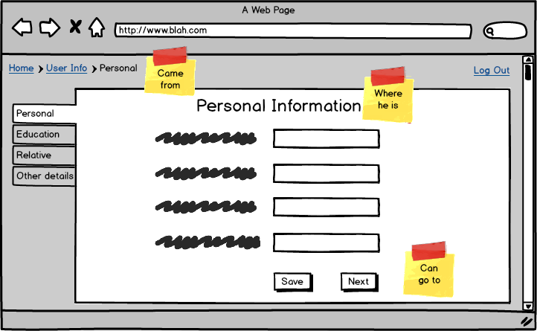
The interface must be in a way that enables the users to know the context of the current task. So, there should be some indicators which say from which task did the user come here and to which task he/she can go from here

Slide 43
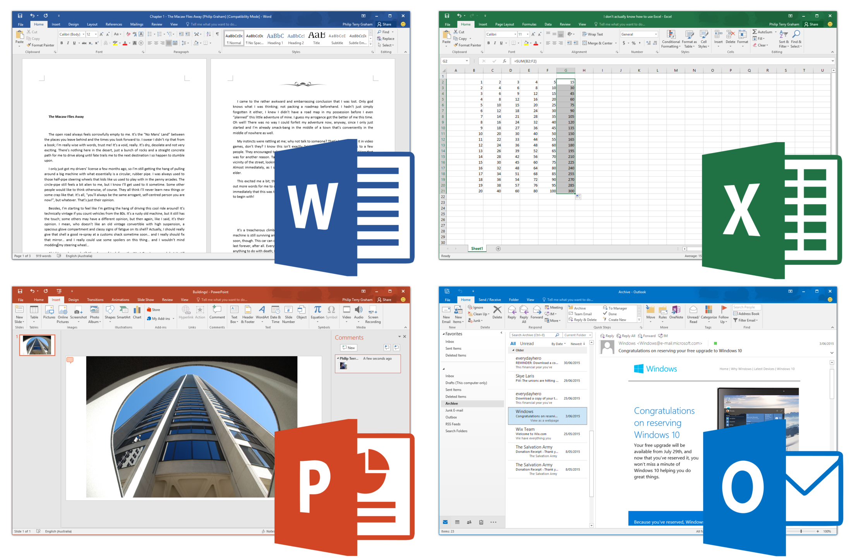

Slide 44
3.Make the Interface Consistent
Maintain consistency across a complete product line.
2.

Slide 45
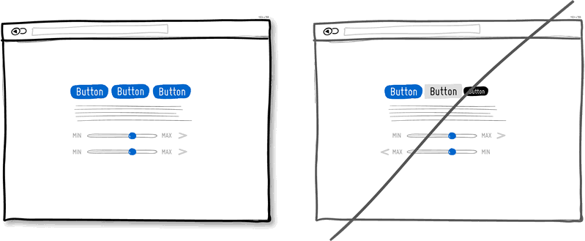
This rule suggests that a set of software applications should implement same design rules if possible so that interaction gets easier with time
Product 1 :
Product 2 :

Slide 46
3.Make the Interface Consistent
If past interactive models have created user expectations, do not make changes unless there is a compelling reason to do so.
3.

Slide 47
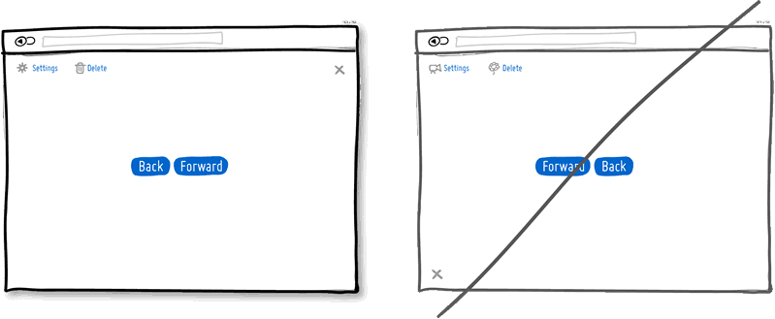
Suppose a special feature or an UI is provided in a previous version of the software application and its popular among its users, do not try to remove it or change it.

Slide 48
References
http://www.indiastudychannel.com/resources/169860-User-Interface-Design-Golden-Rules.aspx
https://en.wikipedia.org/wiki/User_interface_design

Slide 49
Credits
Tool used to make images Balsamiq.
Some images taken from GoodUI.
Trinculo presentation template by SlidesCarnival.

Slide 50
Summary
Keep calm and follow the Golden Rules:
Place the user in control
Reduce the user’s memory load
Make the interface consistent

Slide 51






Thanks!
Any Questions?
Further you can find me with this name @CodingKeeda on these platforms.

