Slide 1

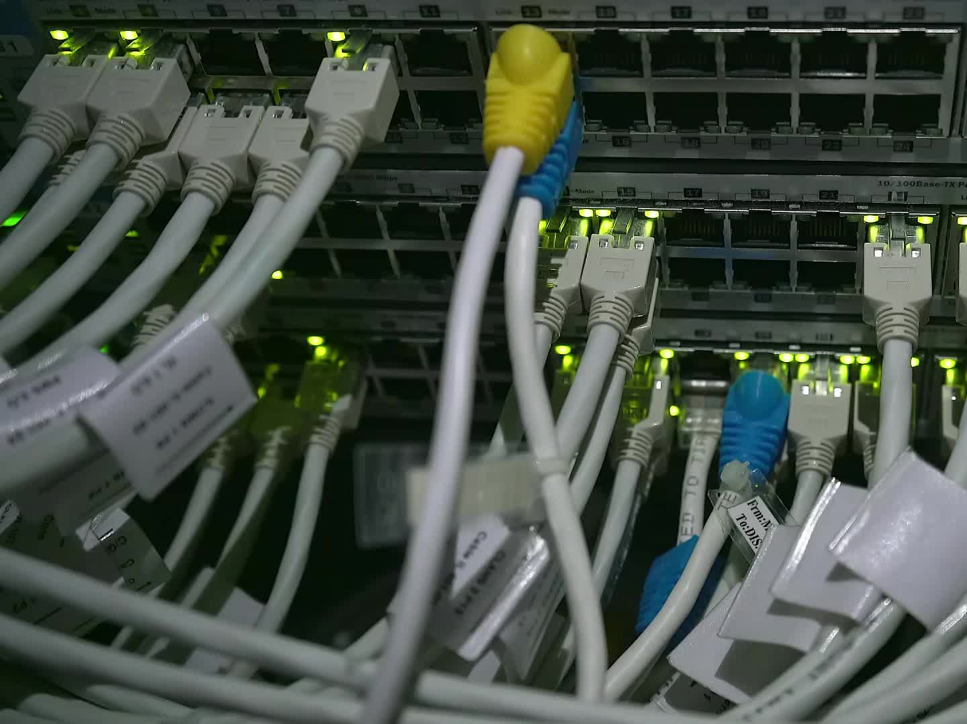
MCP Server Implementation
Presented by: Amit Sharma
Date: 17/03/2025

Slide 2
Introduction
This project implements an MCP (Message Communication Protocol) Server.
The server is responsible for handling client requests, processing data, and returning responses.
The project follows a client-server architecture for communication.

Slide 3
Technology Stack
Programming Language: Python
Libraries Used: Flask, Requests, dotenv
Development Tools: VS Code, GitHub, Postman (for API testing)

Slide 4
Project Architecture
The architecture follows a client-server model.
The server processes incoming requests and sends appropriate responses.
The client communicates with the server via API calls.
Environment variables (.env file) store sensitive credentials.

Slide 5
Key Features
Server Implementation: Handles client requests and sends responses.
Secure Communication: Uses environment variables for security.
Client Testing: A test client script to verify functionality.
Logging & Error Handling: Implements robust error handling mechanisms.

Slide 6
Code Structure
/project_root
│── server.py # Main server implementation
│── test_client.py # Client script to send test requests
│── .env # Environment variables (ignored in Git)
│── readme-file.md # Project documentation
│── requirements.txt # Dependencies
│── venv/ # Virtual environment (ignored in Git)

Slide 7
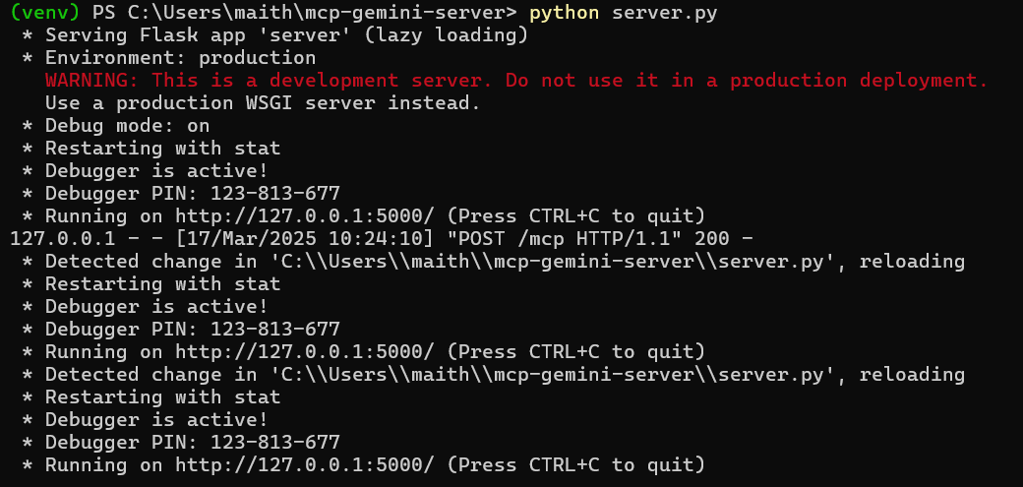
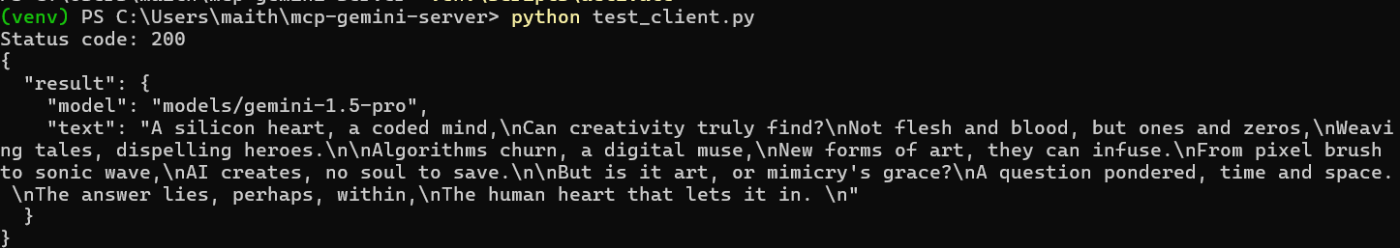
Working Demo (Screenshots)
1. Start the server using `python server.py`.
2. Run the test client using `python test_client.py`.
3. Observe the request-response cycle.

Slide 8
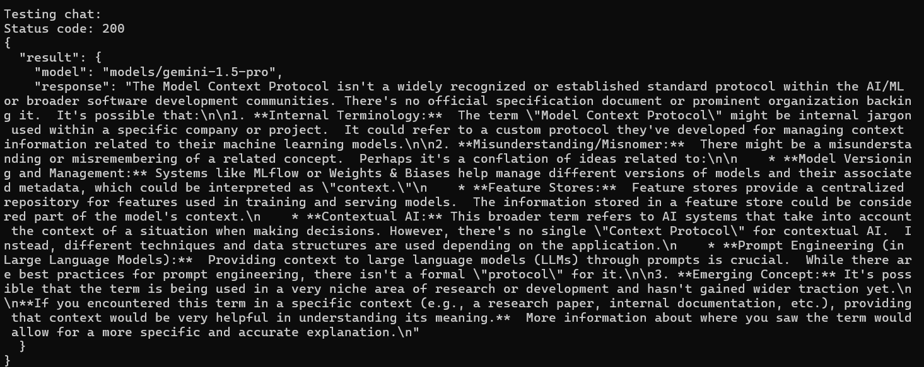
Testing & Output
The test client sends sample requests to the server.
The server processes the request and returns appropriate responses.

Slide 9
Challenges & Improvements
Challenges Faced:
Handling concurrent client requests.
Ensuring proper security with environment variables.
Future Improvements:
Implementing authentication for secure communication.
Expanding the project to support more request types.

Slide 10
Conclusion & Thank You
This project successfully implements a basic MCP Server and client interaction.
Future work includes adding authentication, database integration, and scalability.
Thank You! 🎉

