Slide 1

MARKET RISK · CVA · BA-CVA (FULL VERSION)
BA-CVA Capital for the
Derivatives Counterparty Book
From given netting-set EAD and computed effective maturity to a single, auditable CVA risk charge — the full BA-CVA with hedge recognition (MAR50.1, 50.13–50.26).
$313.7m
8
11
3+2
RWA (full BA-CVA)
counterparties (IG + HY)
netting sets
single-name + index hedges
Basel BA-CVA engine · illustrative reference book · all figures computed by the live Python engine

Slide 2
WHY THESE TRANSACTIONS · CRE51
CCR — and hence CVA — arises wherever both parties can lose from the other's default
A loan is unilateral — only the lender is at risk (CRE51.2). A derivative or SFT carries a bilateral risk of loss (CRE51.3): its value swings either way, so each side faces the other's default whenever the contract is in-the-money to them.
THE TRANSACTIONS THAT GIVE RISE TO CCR (CRE51.4)
OTC derivatives
Exchange-traded
Long-settlement
SFTs (fair-valued)
DEFAULT SLICE → CCR
The risk the counterparty defaults while the trade is in-the-money to the bank. Capitalised as EAD via SA-CCR (CRE52) — the GIVEN input to this engine.
SPREAD-DETERIORATION SLICE → CVA
The mark-to-market loss as the counterparty's creditworthiness deteriorates — before any default. Footnote 2 to CRE51.3 names this the CVA risk of MAR50 — what BA-CVA capitalises.
THE TAKEAWAY Same trades, two slices of risk: CCR (SA-CCR) capitalises the counterparty actually defaulting; CVA — this deck — capitalises the MtM hit as its spread widens. Trades cleared with a QCCP are excluded from both.
Source: CRE51.2–51.4 (bilateral risk, categories); CRE51.3 fn2 (CVA link to MAR50)
2

Slide 3
FRAMEWORK LANDSCAPE · 1 OF 2
BA-CVA is one of several orthogonal charges on the same book — each capturing a different risk
One trading-book derivative can attract several capital charges at once. They are not nested — each captures a different risk on the same trade.
MARKET RISK MAR20–30
CCR DEFAULT CRE52
the underlying price moves (rates / FX) — SBM / IMA
the counterparty defaults — EAD × risk weight
Book scope: Trading book (+ FX/comm in BB)
Book scope: Both books
CVA MAR50
DRC MAR22
the counterparty's spread widens (MtM loss) — this deck
a referenced issuer defaults (credit / equity underlyings)
Book scope: Both books
Book scope: Trading book
THE TAKEAWAY Same trade, several charges, each a different risk. Crucially the book scope differs: market risk and DRC are trading-book, but CCR and CVA follow the counterparty across BOTH books — default and spread risk attach to the counterparty, not the position.
Source: MAR20–30 (market risk), CRE52 (CCR), MAR50 (CVA), MAR22 (DRC)
3

Slide 4
FRAMEWORK LANDSCAPE · 2 OF 2
Each risk is charged once — explicit carve-outs keep the frameworks disjoint
A CVA hedge is market-risk sensitive, so it looks like it should sit in both market risk and CVA. The rulebook deliberately routes each risk to exactly one charge.
ELIGIBLE CVA HEDGES → CVA ONLY
QCCP-CLEARED TRADES → NOT CVA
INELIGIBLE HEDGES → MARKET RISK
MAR50.11(2)
MAR50.5 / CRE54
MAR50.11(3)
An eligible external hedge is EXCLUDED from market-risk capital (MAR10–40) and lives only in the CVA portfolio — its spread risk is charged once, in CVA.
A derivative cleared with a qualified CCP is not a covered transaction — no CVA charge; it sits in the CCP framework (CRE54). We model this with the Cleared_QCCP flag (our CDX hedges).
A credit position that isn't an eligible CVA hedge stays in the trading book under MAR10–40 — it lands in exactly one perimeter.
THE TAKEAWAY The circles overlap, but no instrument pays twice for the same thing. Our engine models the CVA slice; market risk (MAR20–30) is a separate framework, out of this project's scope.
IN THIS MODEL This is why our eligible CDS/CDX hedges never appear in a market-risk charge here — they are, by MAR50.11(2), CVA-portfolio instruments.
Source: MAR50.11(2)/(3) (hedges), MAR50.5 / CRE54 (QCCP clearing)
4

Slide 5
OBJECTIVE & SCOPE
Quantify CVA risk on the derivatives book as one auditable capital number — the full BA-CVA
CVA risk is the mark-to-market loss when a counterparty's credit spread widens — not its default. BA-CVA is the simpler of the two CVA approaches, used by banks without SA-CVA approval (MAR50.7).
$313.7m
RWA — full BA-CVA
= 12.5 × DS × K_full
Approach. Full BA-CVA — reduced charge plus recognition of single-name and index credit hedges (MAR50.13–50.26). SA-CVA is out of scope.
$25.1m
$541.0m
Exposure. Non-IMM. EAD per netting set is GIVEN (the SA-CCR output); M_NS and the discount factor are COMPUTED. BA-CVA consumes SA-CCR EAD — it does not replace it.
Capital
Total EAD (given)
= DS × K_full
across netting sets
Output. One stand-alone CVA charge aggregated across counterparties with a single correlation, then scaled to RWA (× 12.5).
THE TAKEAWAY On $541.0m of given EAD across 8 counterparties, the full BA-CVA draws $25.1m of capital ($313.7m RWA) — and the engine computes every step, including the effective maturity and the hedge benefit.
Source: MAR50.1, 50.7, 50.13–50.26
Engine: phase5_k_full.py · Artefact: phase5_k_full.xlsx
5

Slide 6
WHO BA-CVA IS FOR
BA-CVA is the default CVA charge — for banks without the SA-CVA machinery, not the marquee dealers
MAR50.7: banks must use BA-CVA unless they receive approval for SA-CVA. SA-CVA needs a CVA-sensitivities engine and a dedicated CVA desk — so the largest dealers tend to run SA-CVA, and BA-CVA is the approach for everyone else.
MID-SIZE & REGIONAL BANKS
MATERIALITY OPT-OUTS
SA-CVA CARVE-OUTS
Run material derivatives books but lack the CVA-sensitivities infrastructure and CVA desk that SA-CVA approval requires.
Banks with ≤ €100bn non-centrally-cleared notional may even set CVA capital = 100% of CCR capital (MAR50.9) — BA-CVA is the next step up.
SA-CVA banks must use BA-CVA for any netting set carved out of SA-CVA approval (MAR50.8) — so even large dealers run BA-CVA on the side.
THE TAKEAWAY The intuition is backwards from instinct: the biggest sell-side dealers mostly run SA-CVA (they have CVA desks). BA-CVA is the proportionate default — for smaller/regional banks, materiality opt-outs, and carved-out netting sets at larger firms.
NOTE Specific institutions' approach choices are supervisory and not publicly disclosed — this slide describes the regulatory profile of a typical BA-CVA user.
Source: MAR50.7 (approval), MAR50.8 (carve-out), MAR50.9 (materiality)
6

Slide 7
THE INPUTS
Four input tables drive the engine — netting sets, trades, single-name hedges and index hedges
Netting_Sets 11 netting sets
Covered_Transactions 34 trades
Counterparty, Sector, Credit Quality, Region, and the GIVEN EAD per netting set.
Trade-level product, notional and dates — consumed only to COMPUTE M_NS (CRE32.49).
SingleName_Hedges 3 hedges
Index_Hedges 2 indices (225 names)
Reference name, the counterparty hedged, and the relationship that sets r_hc (direct / legal / sector-region).
CDX.NA.IG + CDX.NA.HY, each with a look-through constituents table → name-weighted risk weight × 0.7.
THE TAKEAWAY Clean separation: regulatory constants live in a config workbook; market/portfolio data lives in the input book. EAD is given; everything else — M_NS, DF, SCVA, the hedge terms, the index RW — is computed.
DESIGN RULE Every constant (α, ρ, β, DS, the risk-weight and correlation tables) is read from BA_CVA_Config.xlsx at runtime — no regulatory number is hardcoded in the Python.
Source: Input/CVA_CCR book.xlsx + Input/BA_CVA_Config.xlsx
Engine: phase1_inputs.py
7

Slide 8
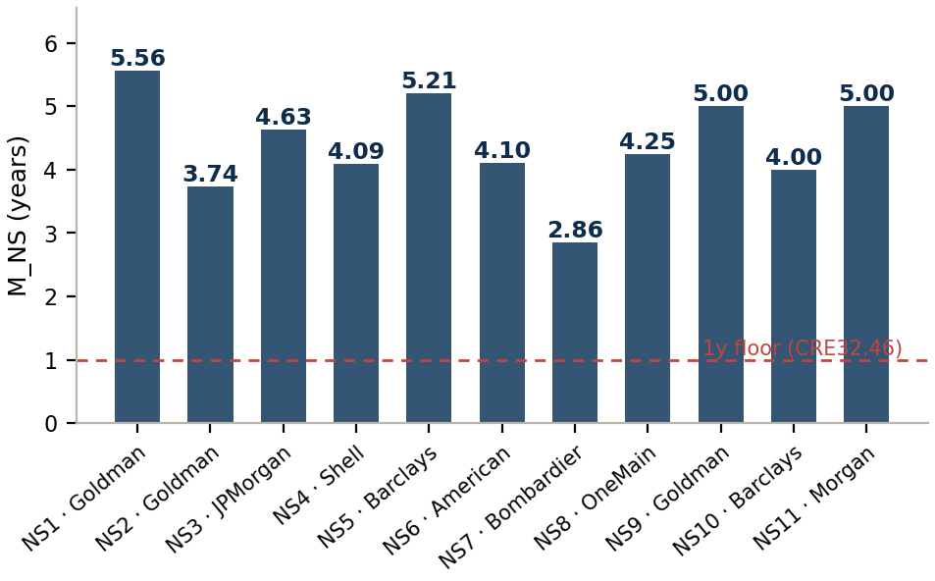
EFFECTIVE MATURITY · HIGHLIGHTED FEATURE
M_NS is computed — notional-weighted trade maturity (CRE32.49), no 5-year cap, long/short irrelevant
M_NS = Σ |Notional_i| · M_i ÷ Σ |Notional_i|
CRE32.49 — derivatives under a master netting agreement
EXHIBIT 1 Computed M_NS per netting set
No 5-year cap. MAR50.15(2) removes CRE32's 5y cap for CVA — a 7y SFT keeps M=7.
Absolute notional. CRE32.49 weights by gross notional; signed weighting can go negative or blow up, so long/short is irrelevant for M_NS.
Swaption = settlement. M_i runs to the underlying swap's final settlement (exercise + tenor), not the option expiry.
THE TAKEAWAY M_NS is the headline computed input: it turns a static given EAD into an exposure-over-time measure — the longer the netting set lives, the more CVA it carries.
Source: CRE32.49; MAR50.15(2) (no 5y cap)
Engine: maturity.py · Artefact: phase1_inputs.xlsx
8

Slide 9
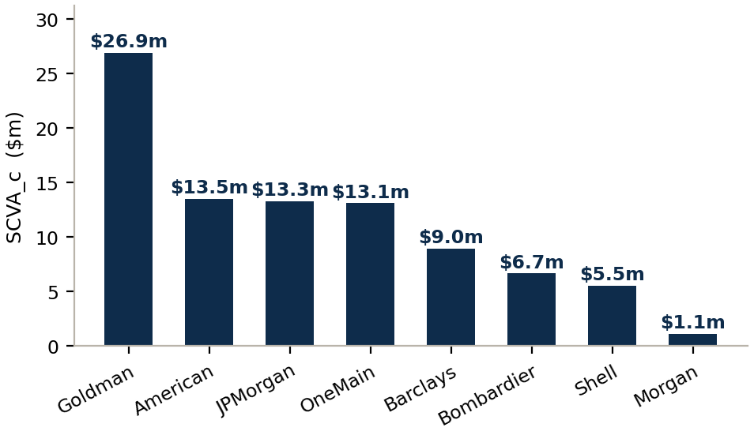
DF & SCVA
SCVA turns given EAD into a stand-alone CVA charge per counterparty
SCVA_c = (1/α) · RW_c · Σ_NS ( M_NS · EAD_NS · DF_NS )
DF — the missing discount. DF = (1−e^(−0.05·M))/(0.05·M). Non-IMM M is undiscounted, so DF supplies the present-value weighting (=1 for IMM).
EXHIBIT 2 SCVA per counterparty
M·EAD·DF — area proxy. The inner term is a proxy for the discounted exposure profile; EAD enters as given, untouched.
1/α — strip the buffer. Given EAD carries α=1.4's 40% conservatism; SCVA divides it back out to recover EEPE.
RW_c — sector × quality. From MAR50.16 Table 1 — e.g. IG financial = 5%.
THE TAKEAWAY SCVA is each counterparty's stand-alone CVA capital — the building block. Three of the four moving parts (M_NS, DF, RW) are computed; only EAD is given.
Source: MAR50.15–16; 50.15 fn3 (DF)
Engine: phase2_scva.py · Artefact: phase2_scva.xlsx
9

Slide 10
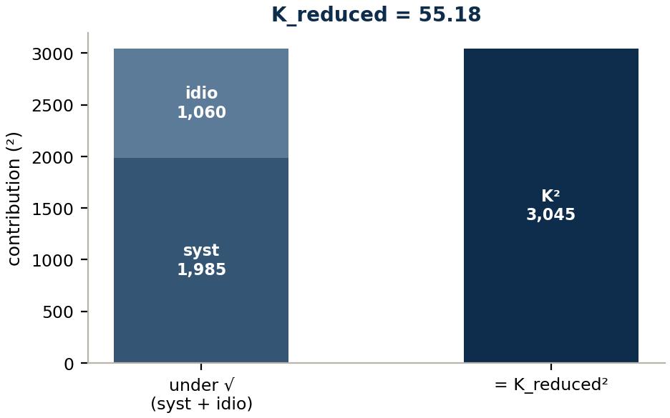
K_REDUCED
K_reduced aggregates SCVA with diversification — a systematic and an idiosyncratic term
K_reduced = √[ (ρ·Σ SCVA_c)² + (1−ρ²)·Σ SCVA_c² ]
MAR50.14 — ρ = 0.5
First term = systematic. Sum-then-square keeps the cross-terms → counterparties moving together (a market-wide credit shock).
EXHIBIT 3 Systematic + idiosyncratic → K²
Second term = idiosyncratic. Square-then-sum drops cross-terms → name-specific, diversifying risk.
Diversification. Σ SCVA = $89.1m, but K_reduced = $55.2m — less than the naive sum because spreads aren't perfectly correlated.
THE TAKEAWAY K_reduced is the no-hedge charge (and the floor for the full version). The √-of-two-terms is the single-factor model: shared systematic risk plus diversifying idiosyncratic risk.
Source: MAR50.14
Engine: phase3_k_reduced.py · Artefact: phase3_k_reduced.xlsx
10

Slide 11
OPERATING MODEL · THE CVA DESK
Trading desks outsource their CVA charge to a central CVA desk — which then hedges it externally
CVA risk is born on every client trade but managed centrally: each desk pays an internal CVA transfer charge to the CVA / xVA desk, which owns and hedges the counterparty-spread risk of the whole book.
TRADING DESKS
CENTRAL CVA DESK
MARKET HEDGES
Rates · FX · Commodities · Credit. Originate client derivatives — each generating counterparty CVA risk.
→
Charges each desk an internal CVA transfer price; aggregates all counterparty-spread risk into one managed book.
→
Buys single-name CDS (bilateral) and index CDX (cleared) to reduce the BA-CVA charge.
THE TAKEAWAY Capital perimeter: an eligible EXTERNAL hedge is excluded from market-risk capital (MAR50.11(2)) — it lives only in the CVA portfolio. An INTERNAL hedge's trading-desk leg sits in the trading book (50.11(4)(b)), but 50.11(5) forces an exact external offset, so it nets ~flat.
KEY POINT So centralisation and the market-risk exclusion are not in conflict: the central desk can hedge externally and keep CVA hedges out of the MAR20–30 perimeter entirely.
Source: MAR50.11 (hedge booking & capital perimeter)
11

Slide 12
CAPITAL PERIMETER · WHO HOLDS WHAT
Each charge sits at exactly one desk — and only the externally-placed notional earns hedge credit
EXHIBIT 4 which charge sits at which desk
EXHIBIT 5 recognised hedge = external notional only (illustrative)
Desk | Market risk | CVA capital
Trading desk | ✓ its own trades | ✗ paid away (transfer price)
CVA desk | ✗ hedges excluded · 50.11(2) | ✓ whole book — floored β·K_red
Credit desk | ~0 · internal+external cancel | ✗ pass-through
$100m counterparty CVA exposure the CVA desk now manages
$80m hedged externally
$20m
$80m placed with the market (CDS + CDX) → this is B in SNH / IH
Trading desks keep market risk; the CVA desk owns the whole book's CVA — smaller after hedging, but never below β·K_reduced. The conduit nets flat. No charge is paid twice, none falls through a gap.
$20m internal-only — no external offset (50.11(5))
not an eligible hedge → no SNH/IH credit; stays in SCVA as residual CVA.
THE TAKEAWAY Capital follows the risk to one desk each — and the hedge benefit follows the notional actually placed with the market. The $100m transferred internally is not the hedge; the $80m externalised is. The $20m gap simply stays unhedged in SCVA.
Source: MAR50.11(2)/(4)/(5) (perimeter); 50.20 (β floor); 50.23–24 (hedge notional)
Engine: phase4_hedges.py / phase5_k_full.py · Artefact: phase4/phase5 .xlsx
12

Slide 13
SINGLE-NAME HEDGES
Single-name recognition scales with how closely the hedge references the counterparty — three r_hc tiers
100% direct
80% legal
50% sector_region
Reference name = the counterparty
Reference name legally related (parent/subsidiary)
Same sector & region as the counterparty
SNH_c = Σ_h r_hc · M_h · B_h · DF_h · RW_h HMA_c = Σ_h (1 − r_hc²) · (RW_h·M_h·B_h·DF_h)²
EXHIBIT 6 Single-name hedges in the reference book
Hedge | Counterparty | Tier | r_hc | M_h | B_h $m | RW_h | SNH $m | HMA $m
H1 | American Airlines | direct | 100% | 5.00 | 50 | 8.5% | 18.80 | 0.00
H2 | Bombardier | legal | 80% | 4.00 | 40 | 7.0% | 8.12 | 37.10
H3 | OneMain Financial | sector_region | 50% | 5.00 | 35 | 12.0% | 9.29 | 258.87
THE TAKEAWAY A direct hedge (r=1) earns full SNH and zero HMA. As the link weakens (80%→50%), SNH shrinks and the misalignment add-back HMA grows — a proxy hedge can never zero the charge.
Source: MAR50.23 (SNH), 50.25 (HMA), 50.26 (r_hc)
Engine: phase4_hedges.py · Artefact: phase4_hedges.xlsx
13

Slide 14
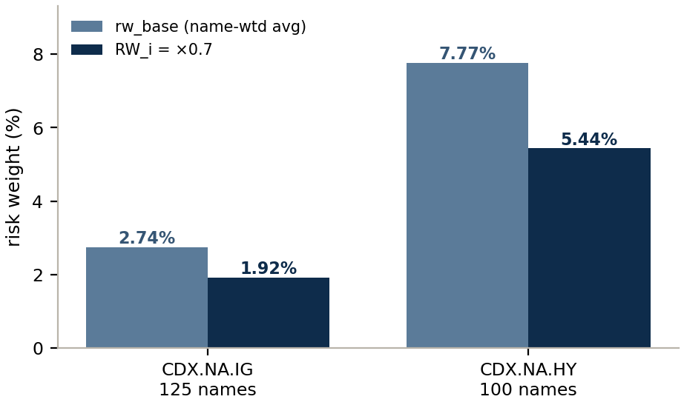
INDEX HEDGES · LOOK-THROUGH
Two index hedges, each built bottom-up from its constituents — CDX.NA.IG (125) and CDX.NA.HY (100)
MAR50.24(4)(b): a multi-sector index uses the name-weighted average of constituents' Table-1 risk weights, then × 0.7 for within-index diversification.
EXHIBIT 7 rw_base and RW_i per index
Index | names | rw_base | RW_i ×0.7 | IH $m | cleared?
CDX.NA.IG | 125 | 2.736% | 1.915% | $8.47m | ✓ QCCP
CDX.NA.HY | 100 | 7.765% | 5.436% | $15.76m | ✓ QCCP
OPTION-B & THE HONEST APPROXIMATION
IG: healthcare/utility names reclassified into the 1.5% bucket per-name. HY: the annex's combined sectors ('Energy & Utilities', 'Non-Cyclical & Healthcare') can't be cleanly split, so they map to the dominant sector — a documented, slightly conservative approximation.
THE TAKEAWAY HY's blended RW (7.8%) dwarfs IG's (2.74%) — an index hedge of HY exposure carries far more weight. Both are QCCP-cleared, so neither adds any seller CVA.
Source: MAR50.24(4)(b); CDX.NA.IG annex + CDX.NA.HY CSV
Engine: phase4_hedges.py · Artefact: phase4_hedges.xlsx → 50/51/52
14

Slide 15
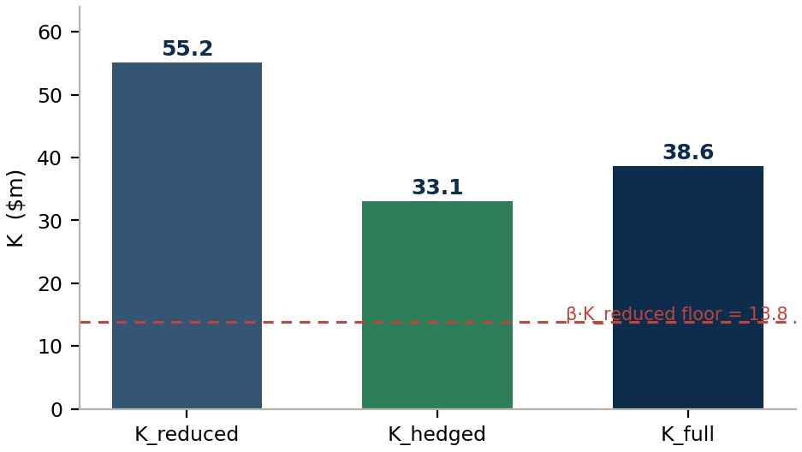
Β & K_HEDGED
K_full blends the hedged and reduced charges — β floors the hedge benefit at 75% recognition
EXHIBIT 8 K_reduced → K_hedged → K_full
K_hedged = √[ (ρ·Σ(SCVA−SNH) − IH)² systematic
+ (1−ρ²)·Σ(SCVA−SNH)² idiosyncratic
+ Σ HMA_c ] misalignment add-back
K_full = β·K_reduced + (1−β)·K_hedged
SNH
systematic & idiosyncratic — lowers both terms — direct credit offset
IH
systematic only — one scalar; index hedges the common factor
HMA
idiosyncratic floor — adds back proxy-hedge basis risk
THE TAKEAWAY Hedges cut the charge from K_reduced $55.2m to K_hedged $33.1m, but β=0.25 holds K_full at $38.6m — hedging can remove at most 75% of the charge.
Source: MAR50.20–22
Engine: phase5_k_full.py · Artefact: phase5_k_full.xlsx
15

Slide 16
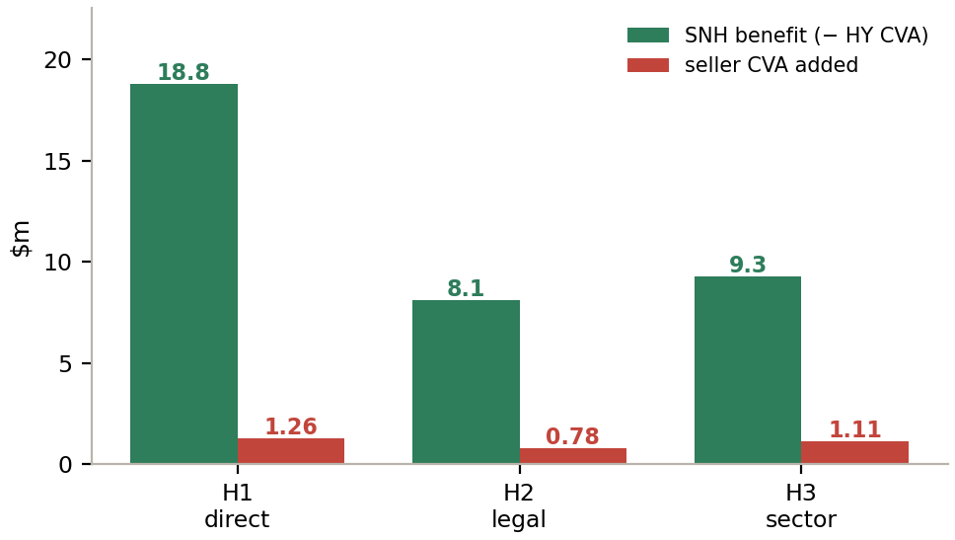
HEDGE-SELLER CVA & CLEARING
Buying a hedge creates a new CVA on the seller — small, and zero when the trade is cleared
MAR50.11(1): a bilateral CDS is a covered transaction of the seller, so the IG dealer gets its own CVA — but tiny next to the HY CVA removed. A QCCP-cleared hedge isn't a covered transaction at all (MAR50.5), so it adds nothing.
EXHIBIT 9 SNH benefit vs seller CVA added (bilateral single-name)
BILATERAL single-name CDS
Faces an IG dealer → seller CVA applies. Total added across the 3 hedges: $3.15m — vs $36.2m of SNH benefit (~9% give-back).
QCCP-CLEARED index CDX
Faces the QCCP → not a covered transaction (MAR50.5) → zero seller CVA. Both CDX.NA.IG and CDX.NA.HY are cleared here.
NOT 'dealer hedges via CCP'
If you trade bilaterally and the DEALER lays off to a CCP, you still face the dealer → you still have its CVA. Zero only when YOUR trade faces the QCCP.
THE TAKEAWAY The asymmetry is the point: a hedge bought from a strong, collateralised IG dealer removes a large HY CVA and adds only $3.15m of seller CVA — and clearing removes even that.
Source: MAR50.11(1) (seller CVA); MAR50.5 (QCCP exclusion)
Engine: phase2_scva.py (dealer netting sets)
16

Slide 17
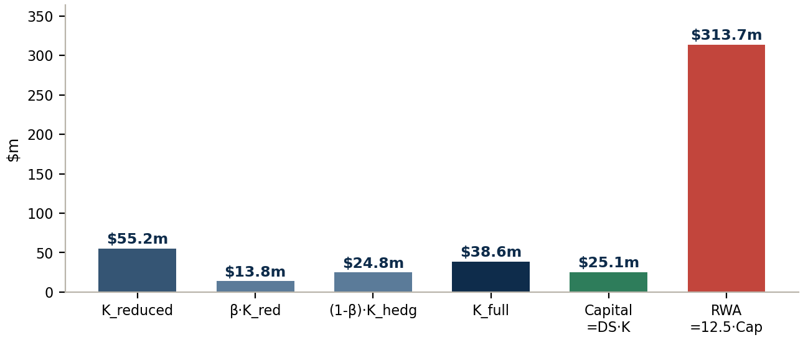
RESULT · ALL NUMBERS
Full BA-CVA: $313.7m RWA from $541.0m of EAD
EXHIBIT 10 From K_reduced/K_hedged to capital and RWA ($m)
$313.7m
RWA (full BA-CVA)
= 12.5 × Capital
$38.6m
$25.1m
K_full
Capital
β·K_red+(1−β)·K_hedg
DS × K_full
Quantity | $m
Σ SCVA | $89.11m
K_reduced | $55.18m
IH (index) | $24.24m
K_hedged | $33.09m
K_full | $38.61m
DS = 0.65 — a deliberate 35% recalibration (Capital = DS·K_full)
The 2020 targeted revisions judged the standardised BA-CVA over-conservative and recalibrated it to align with the (reduced) FRTB framework — a flat supervisory dial, which is why it lives in config as one constant.
THE TAKEAWAY Every figure here is produced by the live engine and snapshot to an auditable Excel per phase — any reviewer can re-run any step from the prior phase's output.
Source: MAR50.1, 50.20–22; 2020 targeted revisions (DS)
Engine: run_all.py · Artefact: phase1…phase5 .xlsx
17

Slide 18
ENGINEERING · MODULE ARCHITECTURE
A modular, config-driven engine — one phase per transform, every number golden-tested
run_all.py — orchestrates phases 1→5 in strict dependency order, then the QA suite
PHASE 1
PHASE 2
PHASE 3
PHASE 4
PHASE 5
phase1_inputs.py
▸
phase2_scva.py
▸
phase3_k_reduced.py
▸
phase4_hedges.py
▸
phase5_k_full.py
M_NS (CRE32.49) + DF
SCVA per counterparty
K_reduced
SNH / IH / HMA (+ IG & HY look-through)
K_hedged · K_full · RWA
phase1_inputs.xlsx
phase2_scva.xlsx
phase3_k_reduced.xlsx
phase4_hedges.xlsx
phase5_k_full.xlsx
phase_snapshot.py
config_loader.py
maturity.py
qa_suite.py + _qa_*
shared 5-sheet writer (+ optional 50+ appendix sheets)
all constants & tables from BA_CVA_Config.xlsx — nothing hardcoded
M_NS per CRE32.49, per-product trade maturity
goldens (RWA 55.23), no-hedge collapse, baseline bit-lock
THE TAKEAWAY One concern per phase, strict dependency order, every constant in config, and every number locked by a golden + a bit-identical baseline — a Basel update is a data edit, not a code change.
Source: Model/ — phases 1–5 + maturity, config, phase_snapshot, qa_suite
Engine: run_all.py · Artefact: 5 phase snapshots
18

