Slide 1

MARKET RISK · FRTB INTERNAL MODELS APPROACH · MAR32
Actual P&L and
Hypothetical P&L
One book, one day, two measures — what goes into each, why the difference is narrower than it looks, and what a breach costs.
2
4
12 / 30
max
measures backtested
questions place any VA
desk exception limits
of the two counts governs
Market Risk — FRTB Programme

Slide 2
SESSION 1
The Two Measures
In this session: What each one is, and where the boundary falls.

Slide 3
SESSION 1 · THE TWO MEASURES
NOTE → §1
executive summary
Two comparisons are required, not one
MAR32.4: the one-day VaR measure is compared against each of the actual P&L and the hypothetical P&L, over the prior 12 months.
APL
HPL
both
actual P&L
hypothetical P&L
backtested daily
the desk's real trading day
the market on a frozen book
neither is optional
Same book, same day. the two measures are built from one desk's positions; they differ only in what they are permitted to contain.
Different questions. HPL asks whether the model captures the market; APL asks whether the model's static-book assumption survived a real day.
THE TAKEAWAY Neither measure is “the real one”. They are two deliberately narrow views of the same day.
Source: BCBS MAR32 / MAR33 / CAP30; companion note APL_vs_HPL_Backtesting_Note_v14.docx
Note: §1
3

Slide 4
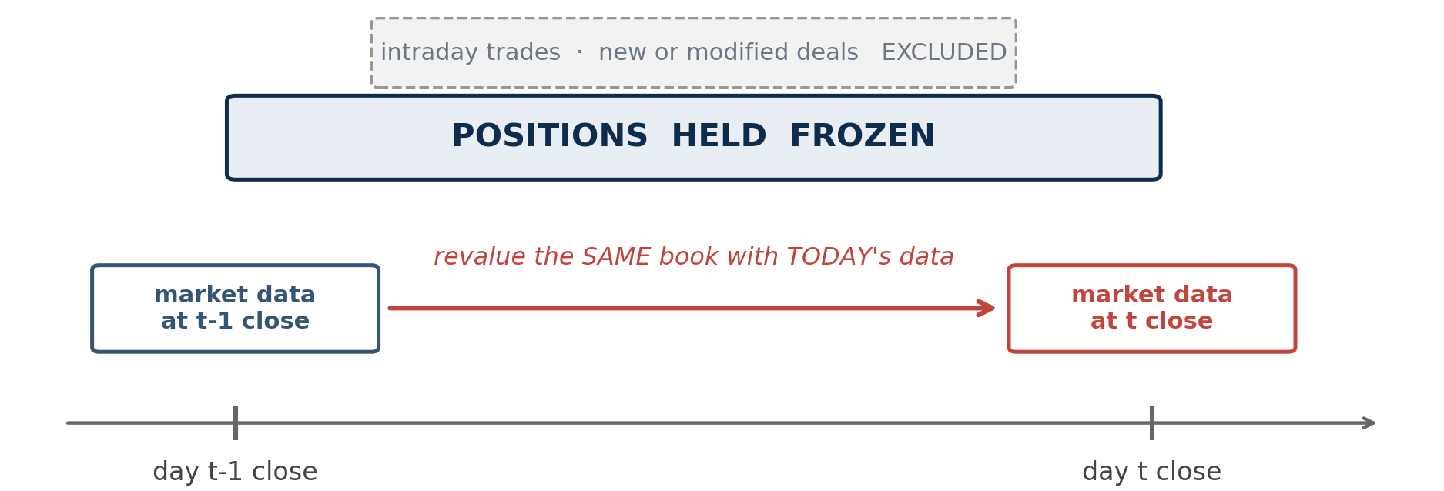
SESSION 1 · THE TWO MEASURES
NOTE → §2.1
hypothetical P&L
HPL takes yesterday's positions and today's prices
THE TAKEAWAY Positions from t‑1, market data from t (MAR32.25).
Source: BCBS MAR32 / MAR33 / CAP30; companion note APL_vs_HPL_Backtesting_Note_v14.docx
Note: §2.1
4

Slide 5
SESSION 1 · THE TWO MEASURES
NOTE → §2.1
MAR32.25
Freezing the book is what makes HPL a clean test
EXCLUDED BY CONSTRUCTION
INCLUDED, OFTEN MISSED
WHY IT MATTERS
Intraday trading, and any new or modified deals. HPL measures the change in value that would occur if end-of-day positions never moved.
EXAMPLE a round-trip opened and closed inside day t
Foreign denominated positions, and commodities held in the banking book. Both sit in APL and HPL alike.
EXAMPLE a P&L feed built from the trading book alone is short
With trading activity removed, whatever P&L remains is attributable to market movement acting on the very positions the model saw.
EXAMPLE so an HPL exception points at the model, not the desk
The same HPL serves twice. MAR32.24 requires the HPL used for the PLA test to be identical to the HPL used for backtesting — so an error in this definition lands in both regimes at once.
THE TAKEAWAY A desk can trade all day, end flat, and post zero HPL. That is the measure working as designed.
Source: BCBS MAR32 / MAR33 / CAP30; companion note APL_vs_HPL_Backtesting_Note_v14.docx
Note: §2.1
5

Slide 6
SESSION 1 · THE TWO MEASURES
NOTE → §2.2
actual P&L
APL is anchored to the P&L the bank actually reports
Starts from the reported figure. APL begins with the P&L the bank genuinely books and reports, then adjusts it.
Same pricing stack. both measures must use the same pricing functions, pricing configurations, model parametrisation, market data and systems as the reported daily P&L (MAR32.29).
Then the exclusions apply. fees, commissions and the valuation adjustments capitalised elsewhere come out (MAR32.26–32.28).
What remains is APL. market movement, intraday trading, new and modified deals, and market-risk valuation adjustments.
Why the anchor matters: a backtest run against a P&L the bank does not actually report would discipline nothing. This is also why APL is a books-and-records measure rather than a desk's own view of its day.
THE TAKEAWAY MAR32 never defines APL constructively. It anchors it to the reported P&L and then tells you what to take out.
Source: BCBS MAR32 / MAR33 / CAP30; companion note APL_vs_HPL_Backtesting_Note_v14.docx
Note: §2.2
6

Slide 7
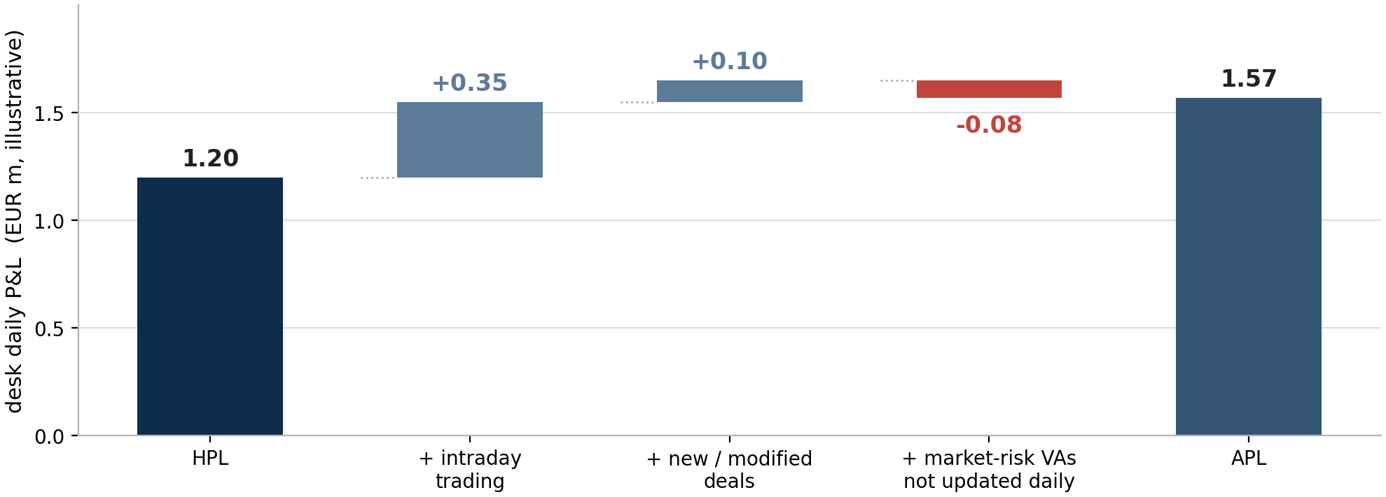
SESSION 1 · THE TWO MEASURES
NOTE → §5
the boundary
Intraday trading is the headline difference
THE TAKEAWAY Fees and commissions never appear on this bridge — they are excluded from both measures before the comparison starts.
Source: BCBS MAR32 / MAR33 / CAP30; companion note APL_vs_HPL_Backtesting_Note_v14.docx
Note: §5
7

Slide 8
SESSION 1 · THE TWO MEASURES
NOTE → §5
exhibit 2
The gap is narrower than most summaries suggest
Component | In APL? | In HPL? | Provision
Market moves on end-of-previous-day positions | Yes | Yes | MAR32.25
Intraday trading | Yes | No | MAR32.25
New or modified deals | Yes | No | MAR32.25
Fees and commissions | No | No | MAR32.26
CVA and its associated eligible hedges | No | No | MAR32.26
VAs deducted from CET1 (eg DVA) | No | No | MAR32.26
Other market-risk VAs, updated daily | Yes | Yes | MAR32.27
Other market-risk VAs, not updated daily | Yes | No | MAR32.27
P&L from the passage of time | Yes | consistent with APL and RTPL | MAR32.27
FX positions and banking-book commodities | Yes | Yes | MAR32.25
VAs not computable at desk level | bank-wide only | bank-wide only | MAR32.28
THE TAKEAWAY Only two things separate the measures: intraday activity, and valuation adjustments that are not updated daily.
Source: BCBS MAR32 / MAR33 / CAP30; companion note APL_vs_HPL_Backtesting_Note_v14.docx
Note: §5
8

Slide 9
SESSION 1 · THE TWO MEASURES
NOTE → §5.1
fees and commissions
Fees and commissions are in neither measure
Excluded from both APL and HPL, along with valuation adjustments capitalised elsewhere in the framework and those deducted from CET1 (MAR32.26).
THE QUESTION DESKS ASK
THE ANSWER
THE CONSEQUENCE
How does a VaR model account for fees and commissions?
It does not have to. They are removed from both measures before the comparison is ever made.
Any explanation that has fees flowing into APL and then reaches for a reserve or operational-risk mechanism is solving a problem the standard already deleted.
THE TAKEAWAY Bid-offer is a different case entirely — it is market-risk related, so it stays. Fees leave; bid-offer does not.
Source: BCBS MAR32 / MAR33 / CAP30; companion note APL_vs_HPL_Backtesting_Note_v14.docx
Note: §5.1
9

Slide 10
SESSION 2
What Is Being Tested
In this session: Why two comparisons, and what the model has to hold.

Slide 11
SESSION 2 · WHAT IS BEING TESTED
NOTE → §3.1
the timing
VaR forecasts one book. HPL scores that book.
When | What happens | Which book
End of day t-1 | The risk system takes a position snapshot. | book B
End of day t-1 | VaR is computed from that snapshot — the 1-day 99% loss for this book. | book B
Day t | The market moves. The desk may also trade. | —
End of day t | HPL revalues the snapshot at today's prices. | book B
End of day t | APL reflects the day the desk actually had. | book B + what was traded
The VaR number was a statement about book B, and HPL measures what happened to book B. APL deliberately does not — it scores that forecast against the book the desk actually ran, which is how it catches a snapshot that stopped being representative.
THE TAKEAWAY That like-for-like property is the whole reason HPL exists as a separate measure.
Source: BCBS MAR32 / MAR33 / CAP30; companion note APL_vs_HPL_Backtesting_Note_v14.docx
Note: §3.1
11

Slide 12
SESSION 2 · WHAT IS BEING TESTED
NOTE → §3.1
what HPL tests
HPL tests the model
The book is held still. so whatever P&L emerges is attributable to market movement acting on positions the model actually saw when it produced the VaR number.
the model
That makes it the clean test. if the forecast distribution is too narrow, or the pricing of the frozen book is wrong, HPL exceptions expose it without any confounding from trading activity.
what an HPL breach implicates
pricing, or the forecast distribution
No hiding place. a desk cannot explain an HPL exception by pointing at what it traded, because by construction it traded nothing.
THE TAKEAWAY HPL answers: does the risk model capture the market it claims to capture?
Source: BCBS MAR32 / MAR33 / CAP30; companion note APL_vs_HPL_Backtesting_Note_v14.docx
Note: §3.1
12

Slide 13
SESSION 2 · WHAT IS BEING TESTED
NOTE → §3.1
two failure modes
An HPL exception has only two possible causes
Trading is excluded by construction, so both of them are the model's.
1 · THE FORECAST DISTRIBUTION IS TOO NARROW
2 · THE PRICING OF THE FROZEN BOOK IS WRONG
The model assumes market moves are less extreme than they are — understated volatility, correlation, or tail weight. The 99% line is drawn too close in, so it is crossed more often than one day in a hundred.
EXAMPLE exceptions spread across many desks and many days
The model gets the market move right but the portfolio's response to it wrong — a missed convexity, a delta approximation where gamma matters, a mispriced exotic.
EXAMPLE exceptions concentrated in particular products
Neither has anything to do with how the desk traded. That is what makes the diagnosis actionable — you know which team owns the fix before you start.
THE TAKEAWAY The two failure modes have different signatures: one spreads, the other concentrates.
Source: BCBS MAR32 / MAR33 / CAP30; companion note APL_vs_HPL_Backtesting_Note_v14.docx
Note: §3.1
13

Slide 14
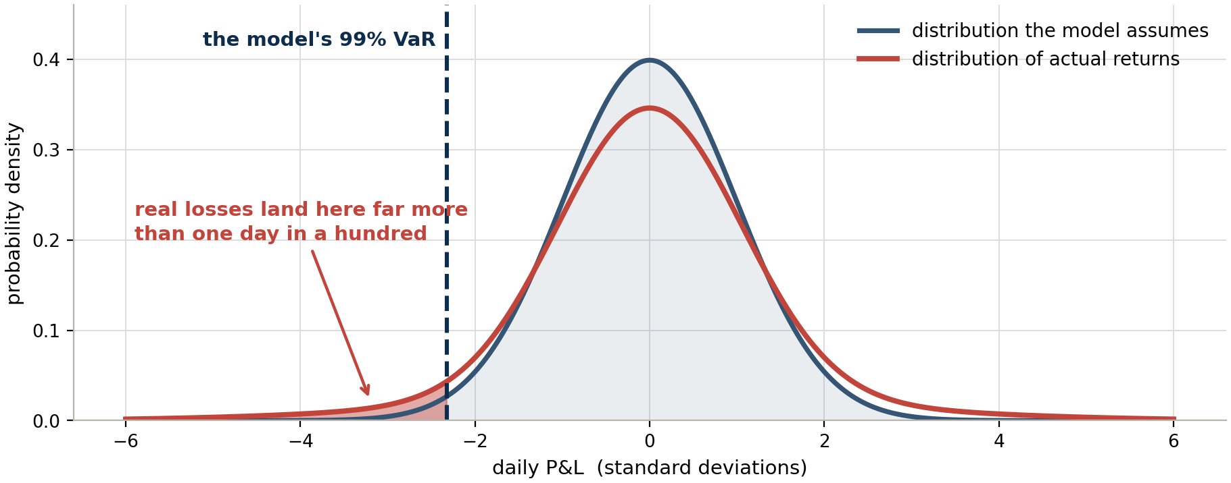
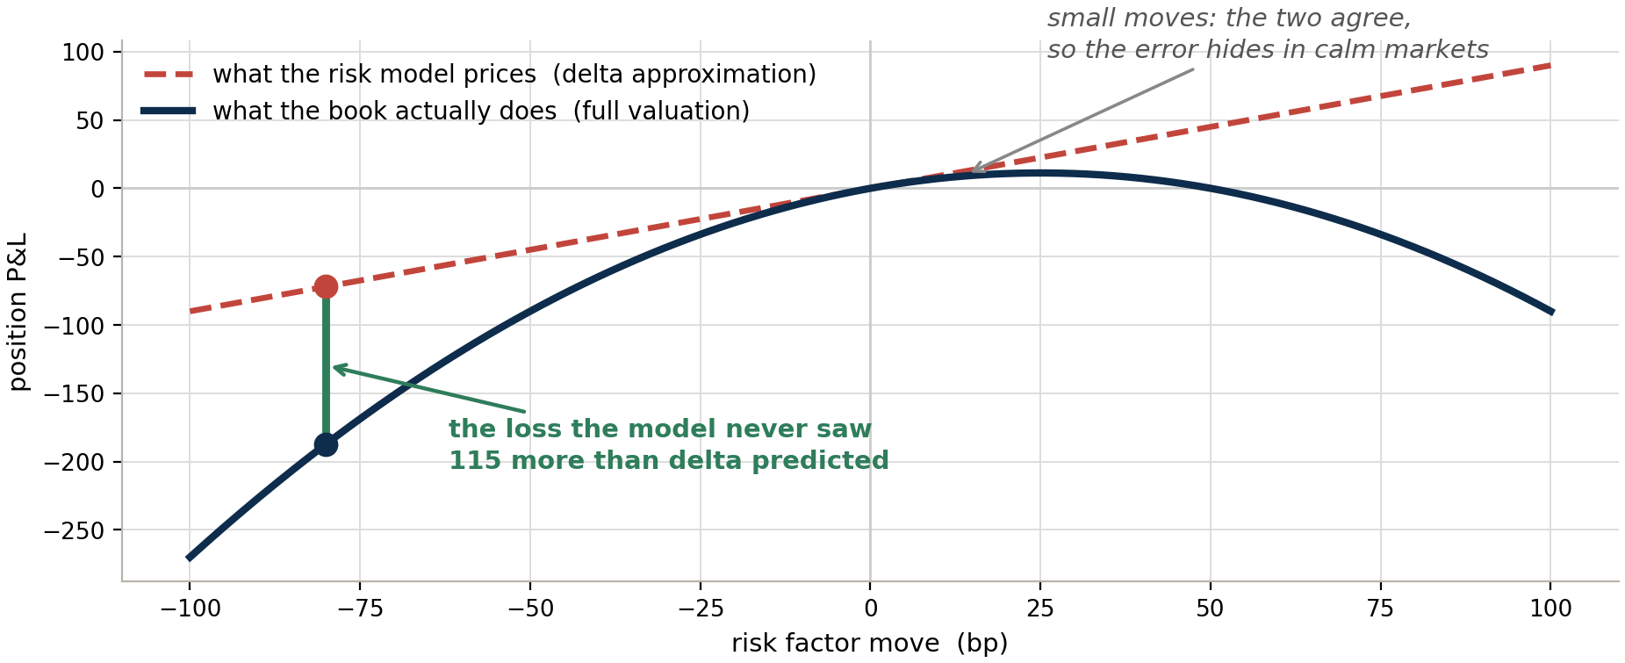
SESSION 2 · WHAT IS BEING TESTED
NOTE → §3.1
two failure modes
What each failure mode looks like
1 · the distribution is too narrow
2 · the pricing of the frozen book is wrong
Left: the model's 99% line is drawn too close in, so real losses cross it far more often than one day in a hundred. Right: the model gets the market move right and the book's response to it wrong — the gap only opens on large moves, so it hides in calm markets.
THE TAKEAWAY Different signatures: a narrow distribution spreads exceptions across desks and days; bad pricing concentrates them in particular products.
Source: BCBS MAR32 / MAR33 / CAP30; companion note APL_vs_HPL_Backtesting_Note_v14.docx
Note: §3.1
14

Slide 15
SESSION 2 · WHAT IS BEING TESTED
NOTE → §3.2
what APL tests
APL tests the assumption behind the model
VaR rests on a snapshot. the number was produced from one position snapshot, and assumes that snapshot represents the day.
the assumption
APL is what tests that. a desk can start inside its limits, build and unwind a far larger position during the session, and end flat.
what an APL breach implicates
that a daily snapshot describes exposure
HPL would show nothing. the frozen book never moved. The risk was real, the P&L was real, and only APL carries it.
THE TAKEAWAY Drop either comparison and one of the two questions goes unasked.
Source: BCBS MAR32 / MAR33 / CAP30; companion note APL_vs_HPL_Backtesting_Note_v14.docx
Note: §3.2
15

Slide 16
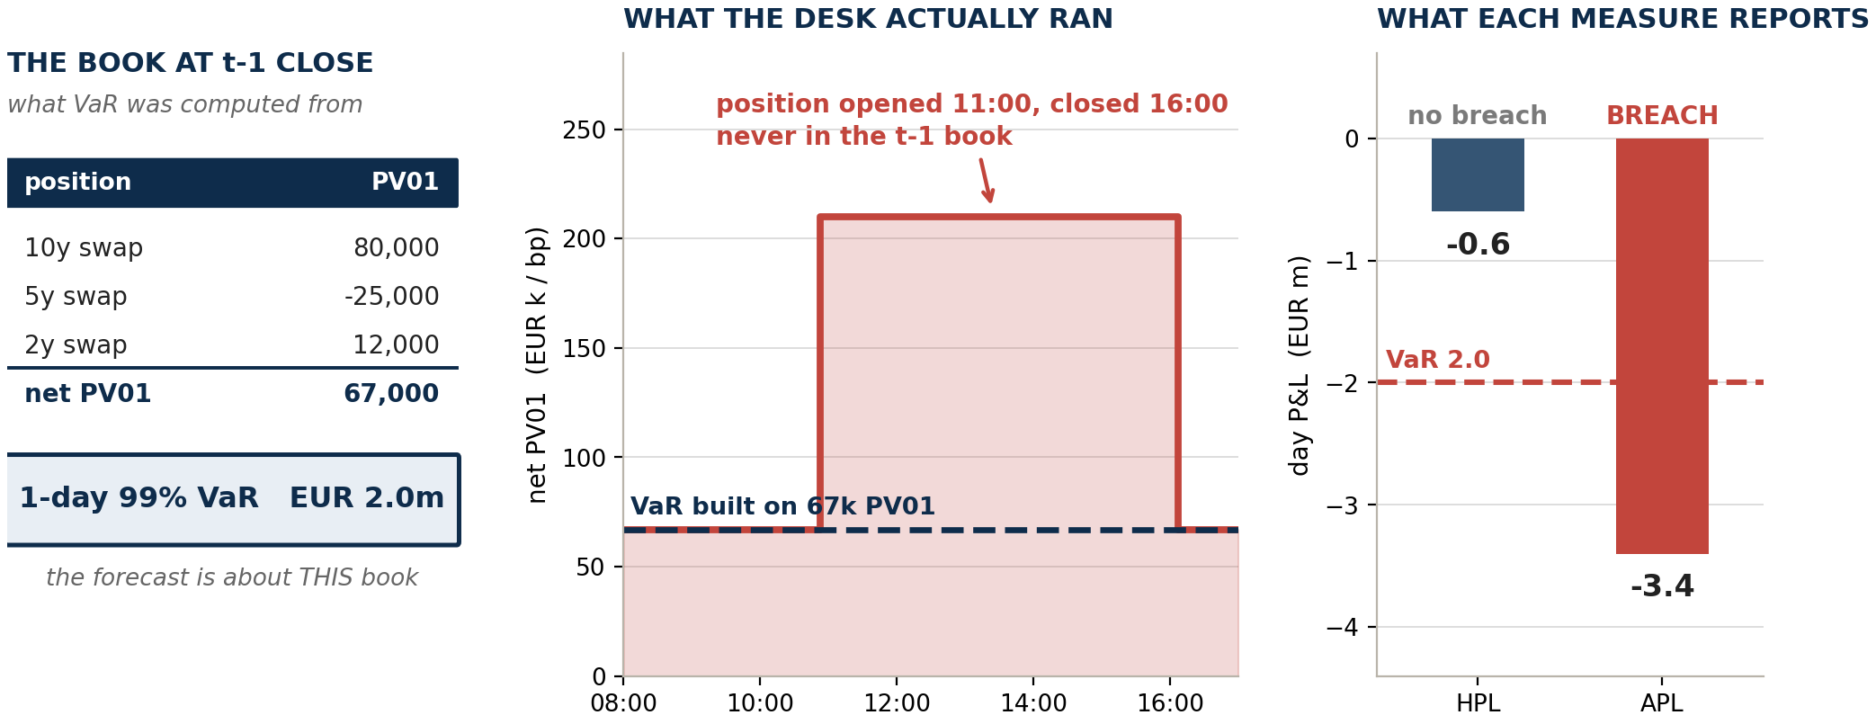
SESSION 2 · WHAT IS BEING TESTED
NOTE → §3.2
the position VaR never saw
The position VaR never saw
THE TAKEAWAY The book was flat at both closes, so HPL barely moved. The desk still lost 3.4 against a VaR of 2.0 — and only APL carries it.
Source: BCBS MAR32 / MAR33 / CAP30; companion note APL_vs_HPL_Backtesting_Note_v14.docx
Note: §3.2
16

Slide 17
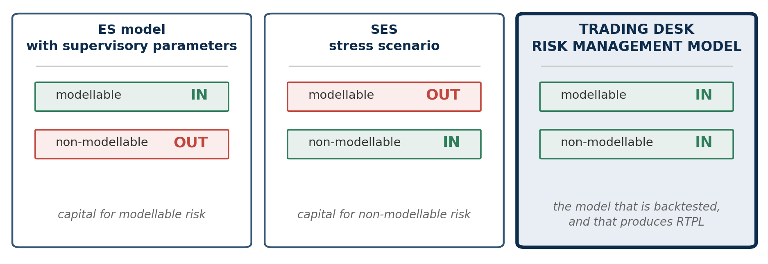
SESSION 2 · WHAT IS BEING TESTED
NOTE → §4.1
model scope
NMRFs belong in the model that is backtested
The trap: building the backtesting VaR off the capital ES factor set. That set omits non-modellable risk factors by design, because MAR33.16 capitalises them separately — inherit it and the model breaches MAR32.22(1), and PLA breaks with it.
THE TAKEAWAY MAR32.16 backtests the desk's risk management model, and MAR32.22(1) requires that model to hold the ES factors and the non-modellable ones.
Source: BCBS MAR32 / MAR33 / CAP30; companion note APL_vs_HPL_Backtesting_Note_v14.docx
Note: §4.1
17

Slide 18
SESSION 2 · WHAT IS BEING TESTED
NOTE → §4.2
MAR32.23
Representation and calibration are different jobs
Failing the eligibility test means you lack real prices. It does not bar you from forecasting the factor. MAR32.23 draws exactly that line.
The requirement | What it means in practice
The risk factor must be represented in the model | It sits in the factor set, drives revaluation, and its actual return flows into RTPL and into HPL.
Its forecasting component may use other data | Proxy series, related-factor mapping, alternative or augmented data — whatever supports a defensible distribution where real prices are sparse.
Capitalised by neither ES nor SES | Excluded from the risk-theoretical P&L altogether (MAR33.16 FAQ1). The factor set is the union of what ES covers and what SES covers.
THE TAKEAWAY The eligibility test governs how a factor is capitalised — not whether the risk model may contain it.
Source: BCBS MAR32 / MAR33 / CAP30; companion note APL_vs_HPL_Backtesting_Note_v14.docx
Note: §4.2
18

Slide 19
SESSION 3
Valuation Adjustments
In this session: The branching half of the boundary.

Slide 20
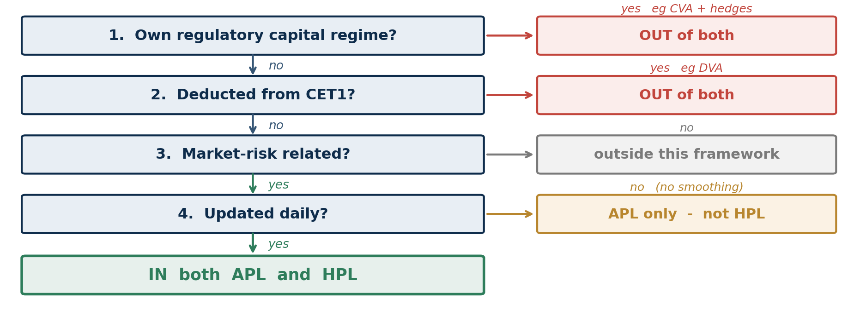
SESSION 3 · VALUATION ADJUSTMENTS
NOTE → §6.1
four questions
The standard gives a test, not a list of adjustments
THE TAKEAWAY Four questions settle any adjustment, and the order matters — the first “yes” stops the process.
Source: BCBS MAR32 / MAR33 / CAP30; companion note APL_vs_HPL_Backtesting_Note_v14.docx
Note: §6.1
20

Slide 21
SESSION 3 · VALUATION ADJUSTMENTS
NOTE → §6.1
questions 1 and 2
Q1 and Q2 ask how capital treats it elsewhere
QUESTION 1 · DOUBLE-COUNTING
QUESTION 2 · ALREADY REMOVED
If an adjustment is already capitalised under its own regime, letting it into a market-risk backtest would charge for the same risk twice.
EXAMPLE CVA and its associated eligible hedges
An adjustment deducted from CET1 has been taken out of capital directly, so it does not belong in the P&L being tested.
EXAMPLE DVA — the own-credit gain
Both tests are about the treatment the adjustment receives elsewhere in the capital stack — not what it is called.
That is why prudent-valuation AVAs leave both measures too: they are CET1 deductions, so question 2 catches them even though MAR32.26 names only DVA.
THE TAKEAWAY CVA and DVA are economic mirror images, and both leave these measures — by different gates.
Source: BCBS MAR32 / MAR33 / CAP30; companion note APL_vs_HPL_Backtesting_Note_v14.docx
Note: §6.1
21

Slide 22
SESSION 3 · VALUATION ADJUSTMENTS
NOTE → §6.1
the DVA callout
“Deducted from CET1” is a reversal, not a penalty
 | What happens | Effect on capital
Accounting | Own credit deteriorates → liabilities are worth less → the bank books a gain | equity rises
Basel III | That own-credit gain is deducted from CET1 | removed
Net position | The bank is put back to neutral, not penalised | zero benefit
CAP30.15 says derecognise, not deduct. all unrealised gains and losses due to own credit risk, plus all valuation adjustments on derivative liabilities.
So it is symmetric. an own-credit improvement is filtered out on the same basis — not a one-way ratchet.
CVA and DVA may not be netted. CAP30.15 prohibits offsetting own-credit against counterparty-credit adjustments.
THE TAKEAWAY Derecognition is the mechanism that stops a bank booking capital benefit as its own credit quality worsens.
Source: BCBS MAR32 / MAR33 / CAP30; companion note APL_vs_HPL_Backtesting_Note_v14.docx
Note: §6.1
22

Slide 23
SESSION 3 · VALUATION ADJUSTMENTS
NOTE → §6.1
question 4
Question 4 is what splits the two measures
And it is a fact about the bank's process, not about the adjustment itself.
RECALCULATED DAILY
RECALCULATED MONTHLY
The same reserve sits in both APL and HPL.
EXAMPLE bid-offer on a liquid rates or FX book
The reserve sits in APL alone, and may not be smoothed.
EXAMPLE model-uncertainty or concentration reserves
What actually blocks a daily calculation. rarely the arithmetic. Bid-offer spreads on liquid instruments arrive from data providers and market makers every day, and most banks do post that reserve daily.
It is the input that binds. exotic and illiquid positions have no observable two-way market, so spreads come from monthly consensus services or periodic broker surveys.
THE TAKEAWAY Two banks holding the identical reserve can place it differently, purely because one recalculates it daily and the other does not.
Source: BCBS MAR32 / MAR33 / CAP30; companion note APL_vs_HPL_Backtesting_Note_v14.docx
Note: §6.1
23

Slide 24
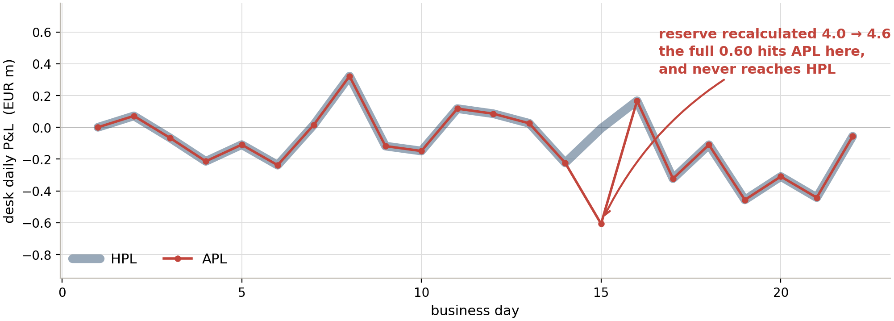
SESSION 3 · VALUATION ADJUSTMENTS
NOTE → §6.2
the no-smoothing rule
A monthly reserve lands whole, in APL alone
THE TAKEAWAY A reserve revision can push APL through VaR on a day when HPL is unremarkable — an exception caused by a valuation calendar, not by the market. It still counts.
Source: BCBS MAR32 / MAR33 / CAP30; companion note APL_vs_HPL_Backtesting_Note_v14.docx
Note: §6.2
24

Slide 25
SESSION 3 · VALUATION ADJUSTMENTS
NOTE → §6.3
bid-offer
Only one of bid-offer's two drivers is the market
Books are marked at mid. but a position is exited at the bid or the offer. A bid-offer reserve bridges that gap.
Sized the usual way. net risk in each bucket × half the quoted spread. The standard does not prescribe the methodology — it only decides where the resulting P&L goes.
Driver one: the spread. widens and narrows with the market. Both measures see this.
Driver two: the position. changes when the desk trades. Only APL sees this, because HPL is still holding yesterday's book.
 | At t-1 close | At t close
Net PV01, 10y bucket | EUR 80,000 / bp | EUR 140,000 / bp (desk added risk)
Half bid-offer spread | 0.20 bp | 0.30 bp (spreads widened)
THE TAKEAWAY Same formula, same widened spread. The two measures differ only in which book they apply it to.
Source: BCBS MAR32 / MAR33 / CAP30; companion note APL_vs_HPL_Backtesting_Note_v14.docx
Note: §6.3
25

Slide 26
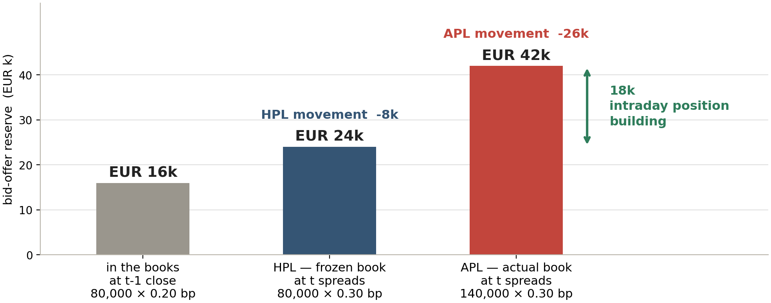
SESSION 3 · VALUATION ADJUSTMENTS
NOTE → §6.3
the split
The 18k gap is intraday position building, priced
THE TAKEAWAY Not a market move and not a model failure. The desk carried more risk through the widening than the frozen book did.
Source: BCBS MAR32 / MAR33 / CAP30; companion note APL_vs_HPL_Backtesting_Note_v14.docx
Note: §6.3
26

Slide 27
SESSION 3 · VALUATION ADJUSTMENTS
NOTE → §6.3
two traps
Two traps sit next to this example
TRAP 1 · “VaR IS MID-TO-MID, SO BID-OFFER IS OUT”
TRAP 2 · THE RESERVE IS NOT THE AVA
What VaR measures has no bearing on what APL and HPL contain. A bid-offer reserve recalculated daily is market-risk related, so it is in both. What leaves both is fees and commissions — a different thing entirely.
The accounting bid-offer reserve hits fair value and P&L, so it is in APL and in HPL if daily. The close-out cost AVA under prudent valuation is a CET1 deduction, so it leaves both at question 2.
Same underlying spread, opposite destinations. Running the two together is a genuine reconciliation break, not a naming quibble.
THE TAKEAWAY Both traps come from reasoning about what a number is called rather than how capital already treats it.
Source: BCBS MAR32 / MAR33 / CAP30; companion note APL_vs_HPL_Backtesting_Note_v14.docx
Note: §6.3
27

Slide 28
SESSION 3 · VALUATION ADJUSTMENTS
NOTE → §6.4
time effects
On time effects, consistency is the obligation
P&L arising from the passage of time belongs in APL, and must be treated consistently across APL, HPL and RTPL (MAR32.27).
THETA
CARRY
FUNDING COSTS
The sensitivity of price to the passage of time — the first-order derivative of price with respect to time.
The cost or benefit of holding the position across the day.
The cost of funding the position, named explicitly in the MAR32.27 footnote.
Note what the rule is not. The standard does not prescribe a particular treatment. Inconsistent handling of theta and carry between the front-office and risk engines is a routine source of attribution noise, and it is avoidable.
THE TAKEAWAY Pick a treatment, then apply the same one in all three measures. The rule polices agreement, not method.
Source: BCBS MAR32 / MAR33 / CAP30; companion note APL_vs_HPL_Backtesting_Note_v14.docx
Note: §6.4
28

Slide 29
SESSION 4
When A Breach Happens
In this session: How the threshold is built, how breaches are counted, what they cost.

Slide 30
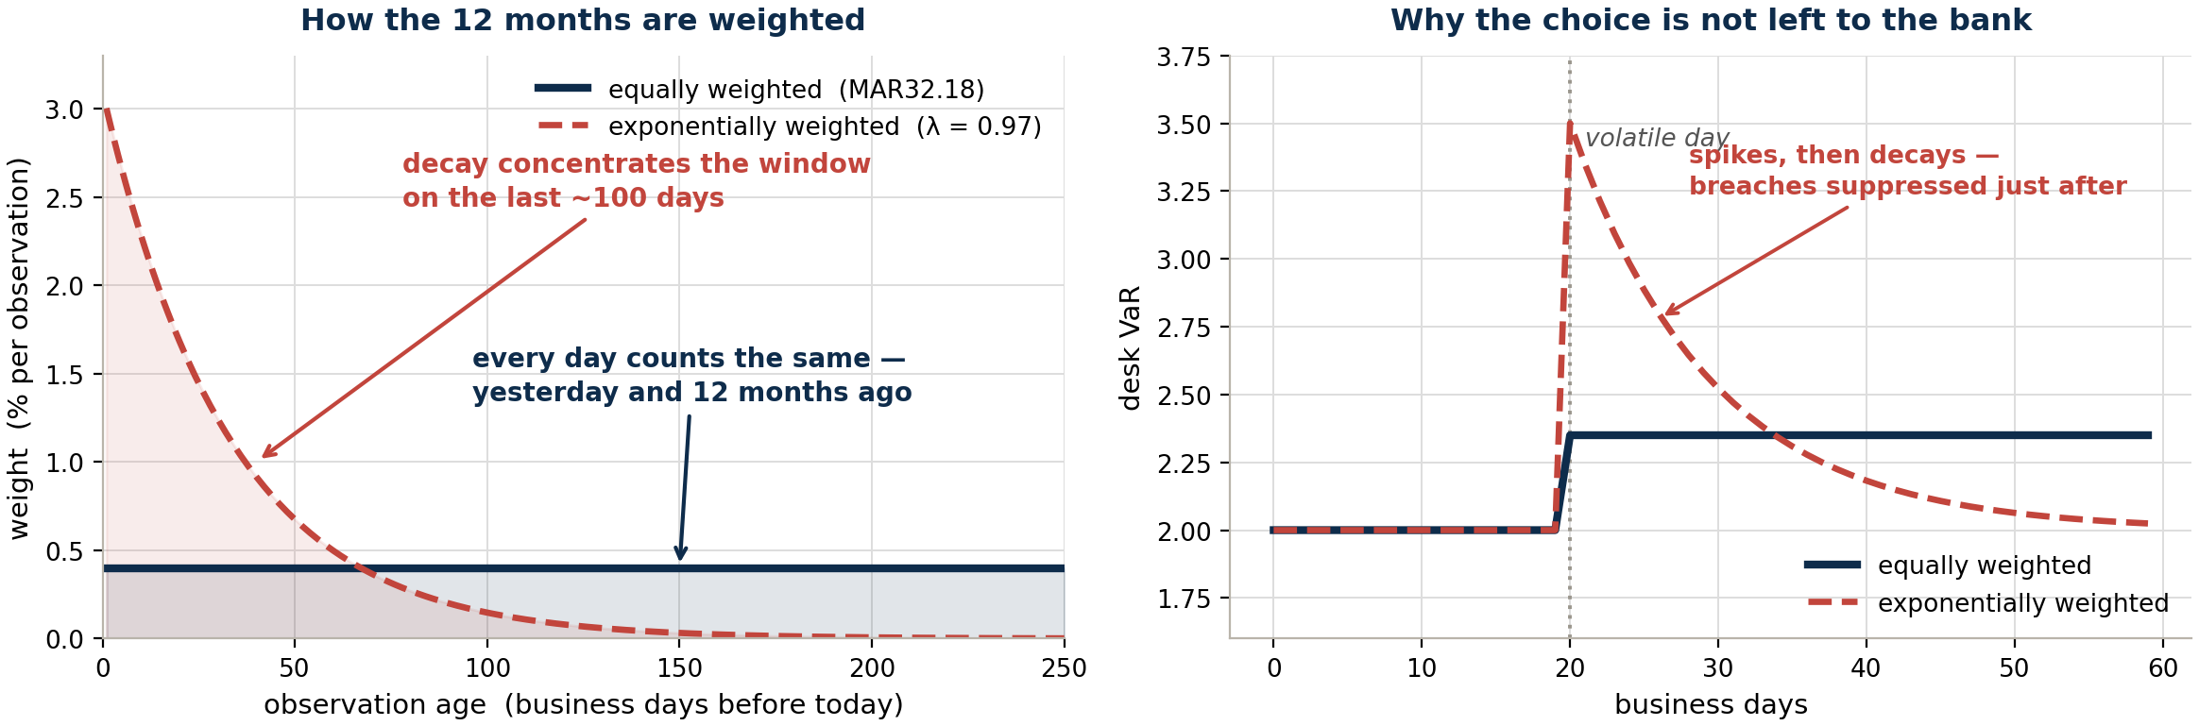
SESSION 4 · WHEN A BREACH HAPPENS
NOTE → §7.1
MAR32.18
The backtesting VaR carries no time or vol weighting
MAR32.18 fixes the calibration: “the most recent 12 months' data, equally weighted”. Every observation carries 1/250 — yesterday and a year ago count the same. No EWMA, no decay factor, no volatility scaling.
THE TAKEAWAY The decay factor would otherwise be a free parameter a bank could tune to suppress its own exception count. Fixing it is what makes the count comparable.
Source: BCBS MAR32 / MAR33 / CAP30; companion note APL_vs_HPL_Backtesting_Note_v14.docx
Note: §7.1
30

Slide 31
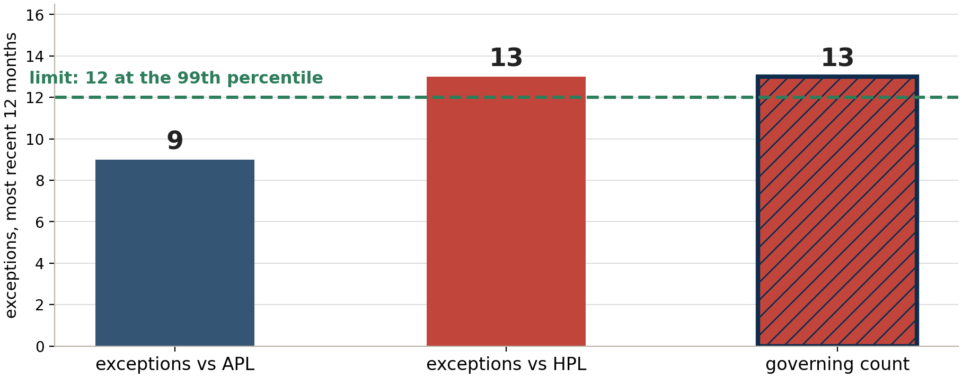
SESSION 4 · WHEN A BREACH HAPPENS
NOTE → §7
the counting rule
The greater of the two counts governs
THE TAKEAWAY Exceptions are tallied separately for APL and HPL, and the larger tally is the one that counts — MAR32.5(1) bank-wide, MAR32.18(1) at desk level.
Source: BCBS MAR32 / MAR33 / CAP30; companion note APL_vs_HPL_Backtesting_Note_v14.docx
Note: §7
31

Slide 32
SESSION 4 · WHEN A BREACH HAPPENS
NOTE → §7
diagnosis vs consequence
Diagnosis differs. The consequence does not.
DIAGNOSIS — USEFUL
CONSEQUENCE — INDIFFERENT
An APL-only breach points at the trading day: intraday positioning, execution, transaction costs. An HPL-only breach points at the model: volatility, correlations, pricing. This reasoning belongs in the explanation MAR32.12 requires for every exception.
The capital outcome follows the greater of the two counts, whichever measure produced it. MAR33.42(4) sets the backtesting add-on on that same maximum. A desk comfortably inside the limit on APL and outside it on HPL has failed.
The common error: reading “APL breached, HPL did not” as though it changed the penalty. It does not. Which measure breached tells you where to investigate — never what you will pay.
THE TAKEAWAY Use which-measure-breached to investigate. Never to predict the capital outcome.
Source: BCBS MAR32 / MAR33 / CAP30; companion note APL_vs_HPL_Backtesting_Note_v14.docx
Note: §7
32

Slide 33
SESSION 4 · WHEN A BREACH HAPPENS
NOTE → §7
desk thresholds
12 at the 99th, 30 at the 97.5th — then standardised
Level | VaR percentile | Governing count | Consequence
Bank-wide | 99th | greater of APL / HPL | backtesting zones set the multiplier — green 1.50, amber 1.70 to 1.92, red 2.00
Trading desk | 97.5th and 99th | greater of APL / HPL | more than 12 at the 99th, or 30 at the 97.5th, in the most recent 12 months: every position in the desk is capitalised under the standardised approach
Desk backtesting runs at two percentiles. not one — MAR32.18. A programme built only around the 99th is incomplete.
Missing data counts against you. where either the P&L or the risk measure is unavailable or impossible to compute, that day counts as an outlier.
THE TAKEAWAY Desk-level failure is not a multiplier adjustment. It removes the desk from the internal models approach altogether.
Source: BCBS MAR32 / MAR33 / CAP30; companion note APL_vs_HPL_Backtesting_Note_v14.docx
Note: §7
33

Slide 34
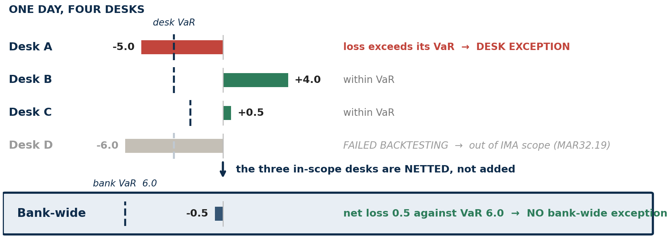
SESSION 4 · WHEN A BREACH HAPPENS
NOTE → §7.2
bank vs desk
Desk exceptions do not add up to bank exceptions
THE TAKEAWAY A separate test on a separate aggregate: total trading-book P&L against total trading-book VaR (MAR32.5(1)). Desk results are never summed, and scope is re-cut quarterly (MAR32.7).
Source: BCBS MAR32 / MAR33 / CAP30; companion note APL_vs_HPL_Backtesting_Note_v14.docx
Note: §7.2
34

Slide 35
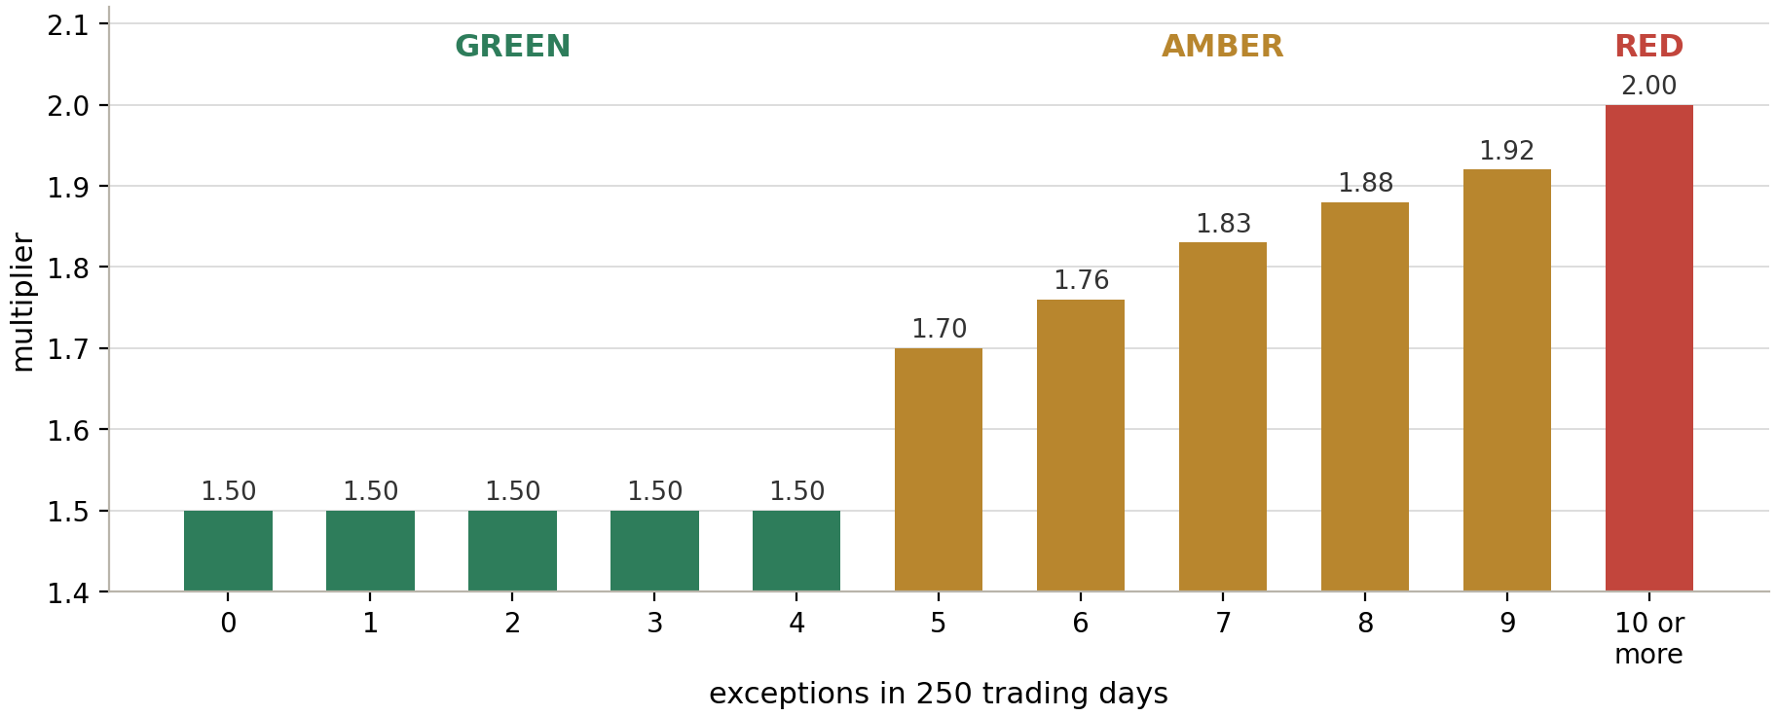
SESSION 4 · WHEN A BREACH HAPPENS
NOTE → §7
bank-wide zones
Bank-wide, the exception count sets the multiplier
THE TAKEAWAY MAR32.8–32.9 Table 1, on a sample of 250 observations. The amber zone is graduated; the red zone is not.
Source: BCBS MAR32 / MAR33 / CAP30; companion note APL_vs_HPL_Backtesting_Note_v14.docx
Note: §7
35

Slide 36
SESSION 4 · WHEN A BREACH HAPPENS
NOTE → §7.2
why relief exists
Inclusion is not calibration
THE APPARENT CONTRADICTION
THE RESOLUTION
If non-modellable risk factors sit inside the backtested model, why does MAR32.6 offer relief for exceptions they drive? Surely the model should have seen the move coming.
A factor is non-modellable precisely because real price observations are sparse. The twelve months of equally weighted data MAR32.18 requires is thin, proxied or stale for it. The factor is in the model; its forecast is weak.
So a genuine large move can breach VaR anyway — while the stress scenario is already capitalising that same factor far above the level VaR implies. MAR32.6 is relief from paying twice, not a patch for absent risk factors.
THE TAKEAWAY Capital is already held for the factor through SES. Where that capital exceeds the loss, the exception need not also count against the desk.
Source: BCBS MAR32 / MAR33 / CAP30; companion note APL_vs_HPL_Backtesting_Note_v14.docx
Note: §7.2
36

Slide 37
SESSION 4 · WHEN A BREACH HAPPENS
NOTE → MAR32.6
companion note
The SES must beat the full loss, never the excess
1.50
1.00
0.80
stands
loss for the day
VaR
desk-level SES
the exception
the benchmark
excess over it is 0.50
clears 0.50, not 1.50
SES must beat the loss itself
The comparison is against the loss itself. MAR32.6 FAQ1 requires an SES in excess of the maximum of the APL loss or the HPL loss for that day — not the amount by which the loss exceeded VaR.
Judged standalone. the SES is assessed without adding VaR to it.
Desk-attributable. for desk-level backtesting the bank must be able to calculate the NMRF capital requirement for the specific desk, and not only for the risk factor across all desks.
Causation must be evidenced. with the NMRF's value history documented and the supervisor notified and not objecting.
THE TAKEAWAY EUR 0.80m clears the 0.50m excess and fails the 1.50m loss. Testing against the excess is the error the FAQ was written to close.
Source: BCBS MAR32 / MAR33 / CAP30; companion note APL_vs_HPL_Backtesting_Note_v14.docx
Note: MAR32.6
37

Slide 38
SESSION 5
Getting It Right
In this session: What to do about it, and the beliefs that cost money.

Slide 39
SESSION 5 · GETTING IT RIGHT
NOTE → §7.4
APL-only breaches
An APL-only breach is not a model problem
The standard prescribes the consequence, not the cure — the exception counts either way. Everything below is practice, not text.
The reflex to resist: recalibrating the model. HPL — the measure that isolates it — did not breach. Inflating VaR to cover intraday activity raises capital for risk the snapshot never held, and breaks PLA.
Cause | The tell | Where the remedy sits
Intraday position building | peak intraday risk far above the snapshot | intraday VaR / PV01 limits and monitoring — desk, not modelling
Execution loss on round-trips | high turnover; P&L lost on fills, not direction | execution quality review, transaction cost analysis
A new or modified deal | one large trade booked during the day | day-one P&L review, new-product approval, pricing validation
A non-daily valuation adjustment | the breach falls on the reserve calendar date | nothing to remediate — a valuation-process artefact
Booking or feed error | attributable to none of the above | reconcile — MAR32.29 ties both to the reported pricing stack
THE TAKEAWAY Recurring APL-only breaches still send the desk to the standardised approach — with a sound model. The remedy is intraday limits, not model tuning.
Source: BCBS MAR32 / MAR33 / CAP30; companion note APL_vs_HPL_Backtesting_Note_v14.docx
Note: §7.4
39

Slide 40
SESSION 5 · GETTING IT RIGHT
NOTE → §8
common beliefs
Four beliefs that change an implementation decision
Common belief | The position | Reference
HPL reprices today's book using yesterday's market data | Inverted. Positions from the end of the previous day, market data of the present day. | MAR32.25
APL includes execution fees and commissions | Excluded from both APL and HPL. | MAR32.26
APL is the accounting P&L — what hits the ledger | Anchored to the reported daily P&L, but with fees, commissions, CVA and CET1-deducted VAs removed. | MAR32.26, 32.29
The supervisory response depends on which measure breached | Counted separately; the greater governs, and the add-on follows that maximum. | MAR32.5(1), 32.18(1), MAR33.42(4)
THE TAKEAWAY The first two survive into production documentation more often than any others. Both are checkable against your own P&L feed this afternoon.
Source: BCBS MAR32 / MAR33 / CAP30; companion note APL_vs_HPL_Backtesting_Note_v14.docx
Note: §8
40

Slide 41
SESSION 5 · GETTING IT RIGHT
NOTE → §8
common beliefs
Three more, all of them cheap to check
Common belief | The position | Reference
Bid-ask is excluded from APL along with fees | Market-risk-related VAs, which include close-out and bid-offer, remain in APL regardless of update frequency. | MAR32.27
Desk backtesting is run at the 99th percentile | Run at both the 97.5th and the 99th. | MAR32.18
VaR / ES models the intraday P&L component | Nothing asks the model to. Intraday activity is excluded from HPL by construction; APL is the control that detects it. | MAR32.25, 32.4
The pattern behind all seven. each comes from reasoning about what a number is called, or what VaR does, instead of reading what the standard says belongs in each measure.
THE TAKEAWAY None of these is subtle once stated. All of them are expensive if they reach a model-validation review before you do.
Source: BCBS MAR32 / MAR33 / CAP30; companion note APL_vs_HPL_Backtesting_Note_v14.docx
Note: §8
41

Slide 42
SESSION 5 · GETTING IT RIGHT
NOTE → Appendix
scope note
What this deck deliberately leaves out
RISK-THEORETICAL P&L
THE PLA TEST ITSELF
PLA DATA ALIGNMENT
Its definition and required risk-factor coverage, including the requirement that RTPL carry non-modellable risk factors even though they sit outside the expected shortfall model.
EXAMPLE MAR32.22
Spearman correlation and the Kolmogorov-Smirnov metric, the 250-day window, the green, amber and red thresholds, and the capital consequences.
EXAMPLE MAR32.34–32.44
Including the asymmetry that RTPL may be aligned to HPL inputs but not the reverse, and the prohibition on adjusting for residual operational noise.
EXAMPLE MAR32.30–32.33
One cross-reference worth carrying: HPL is the single measure appearing in both regimes — the HPL used for the PLA test must be identical to the HPL used for backtesting (MAR32.24).
THE TAKEAWAY Get the HPL definition wrong and the error lands in the backtest and the attribution test at the same time.
Source: BCBS MAR32 / MAR33 / CAP30; companion note APL_vs_HPL_Backtesting_Note_v14.docx
Note: Appendix
42

Slide 43
SESSION 5 · GETTING IT RIGHT
NOTE → §9
bottom line
Two measures. One rule.
HPL. yesterday's positions, revalued on today's market data
MAR32.25
APL. the reported daily P&L of a real trading day, adjusted
MAR32.26, 32.29
Both exclude. fees, commissions, CVA and its hedges, CET1-deducted VAs
Bid-offer stays. in APL always; in HPL when recalculated daily
MAR32.27
Time effects. belong in APL, treated consistently across all three
MAR32.27
Both are backtested. against the one-day VaR over the prior 12 months
MAR32.4
The greater count governs. at bank-wide and desk level alike
MAR32.5(1), 32.18(1)
THE TAKEAWAY The capital consequence always follows the worse of the two. That is the whole framework in one sentence.
Source: BCBS MAR32 / MAR33 / CAP30; companion note APL_vs_HPL_Backtesting_Note_v14.docx
Note: §9
43

