Slide 1
NOIDA Tech Connect

Slide 2
Flexbox For Responsive Design By Amit Kumar 28-July-2016

Slide 3
What is the Flexbox?
Advantages of flexbox
When to Use Flexbox for Your Layout
Exploring Flexbox Properties
Responsive Menu using flexbox

Slide 4
What is the Flexbox?
The main idea behind the flex layout is to give the container the ability to alter its items' width/height (and order) to best fill the available space (mostly to accommodate to all kind of display devices and screen sizes). A flex container expands items to fill available free space, or shrinks them to prevent overflow.
Flexbox is a layout model that allows elements to align and distribute space within a container. Using flexible widths and heights, elements can be aligned to fill a space or distribute space between elements, which makes it a great tool to use for responsive design systems.
new layout mechanism.

Slide 5
Advantages of flexbox
Flexbox Has Many Exciting Features, As It
can be laid out in any flow direction (leftwards, rightwards, downwards, or even upwards!)
can have display order reversed or rearranged at the style layer.
can be laid out linearly along a single (main) axis or wrapped into multiple lines along a secondary (cross) axis
can “flex” their sizes to respond to the available space
can be aligned with respect to their container or each other

Slide 6
When to Use Flexbox
Personally, I like to use flexbox for a few main things: scaling, vertically and horizontally aligning, and re-ordering elements within a container.
There are plenty of other uses for flexbox, like changing the direction of a column or row.
Don’t use flexbox if you have a lot of traffic from IE8 and IE9.

Slide 7
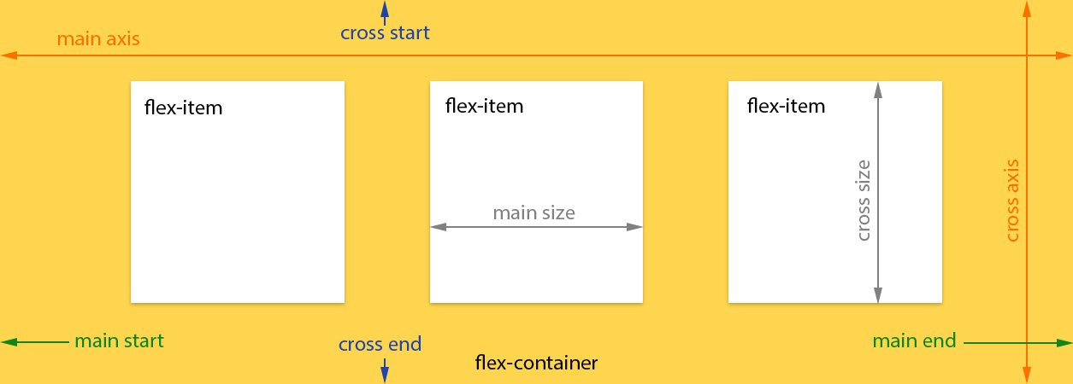
Exploring Flexbox Properties
Before we start with describing the flexbox properties let’s give a little introduction of the flexbox model. The flex layout is constituted of parent container referred as flex container and its immediate children which are called flex items.

Slide 8
Flexbox Properties :
Display
Flex-direction
Justify-content
Align-content
Align-items
Flex-wrap
Flex-flow
Order
Flex

Slide 9
Flex Container : display
This defines a flex container; inline or block depending on the given value. It enables a flex context for all its direct children.
.container { display: flex; /* or inline-flex */ }

Slide 10
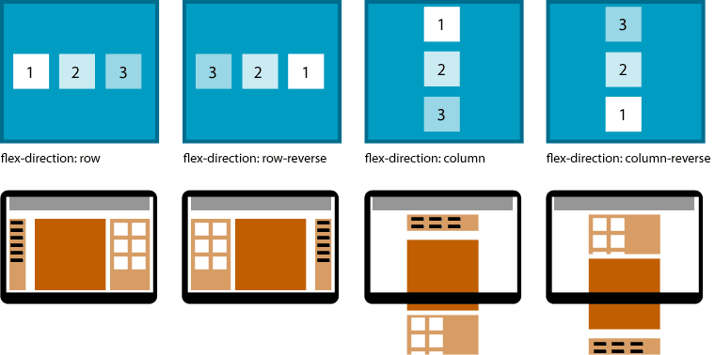
Flex Direction
Specifies the direction of the flexible items inside a flex container
.container { flex-direction: row | row-reverse | column | column-reverse; }

Slide 11
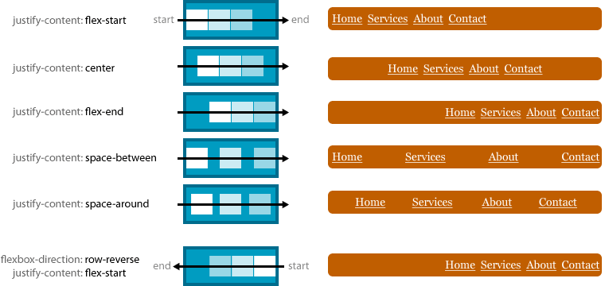
justify-content
Horizontally aligns the flex items when the items do not use all available space on the main-axis
.container { justify-content: flex-start | flex-end | center | space-between | space-around; }

Slide 12
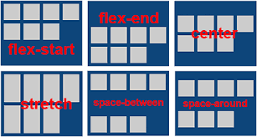
align-content
This aligns a flex container's lines within when there is extra space in the cross-axis, similar to how justify-content aligns individual items within the main-axis.
.container { align-content: flex-start | flex-end | center | space-between | space-around | stretch; }

Slide 13
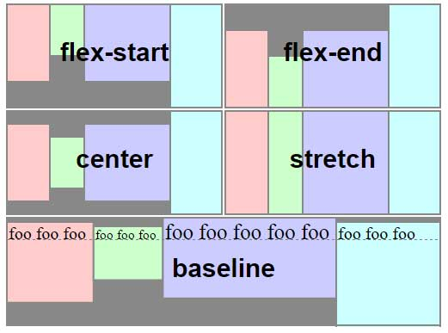
align-items
Vertically aligns the flex items when the items do not use all available space on the cross-axis
. .container {align-items: flex-start | flex-end | center | baseline | stretch;}

Slide 14
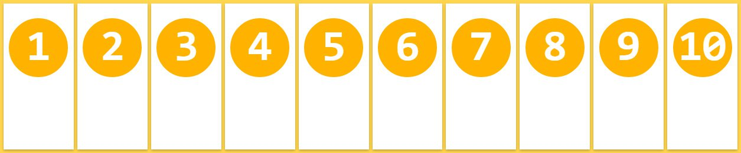
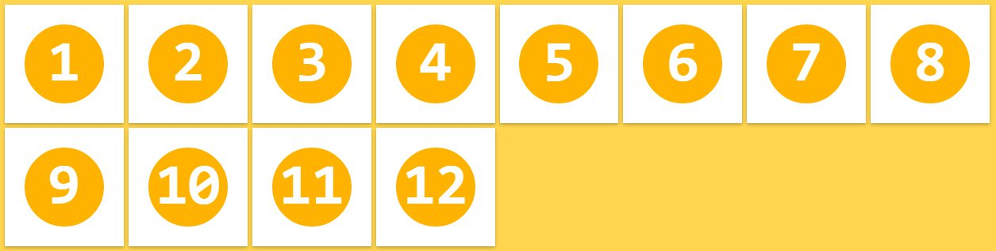
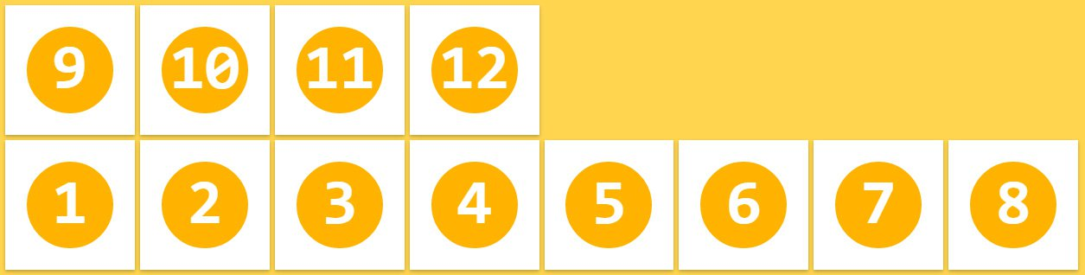
flex-wrap
Specifies whether the flex items should wrap or not, if there is not enough room for them on one flex line
.container{ flex-wrap: nowrap | wrap | wrap-reverse; }
Nowrap:
Wrap:
wrap-reverse

Slide 15
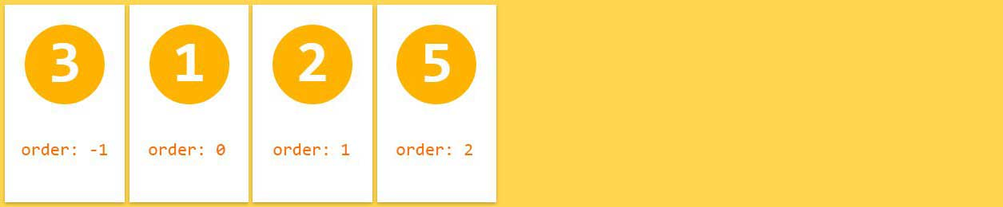
order
By default, flex items are laid out in the source order. However, the order property controls the order in which they appear in the flex container.
.item { order: <integer>; }

Slide 16
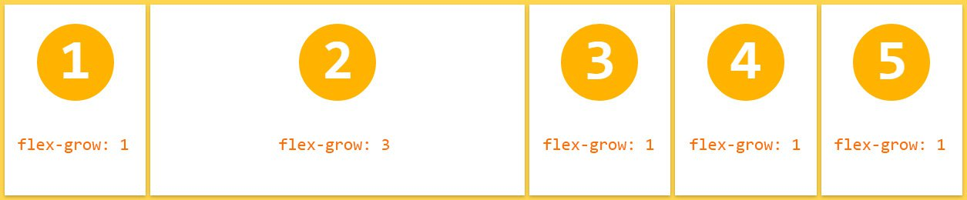
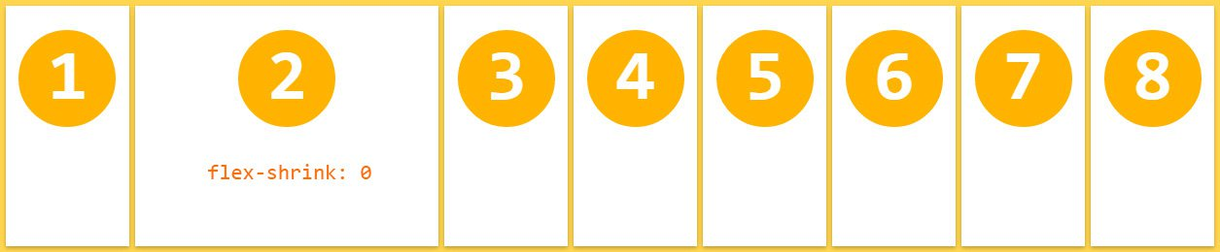
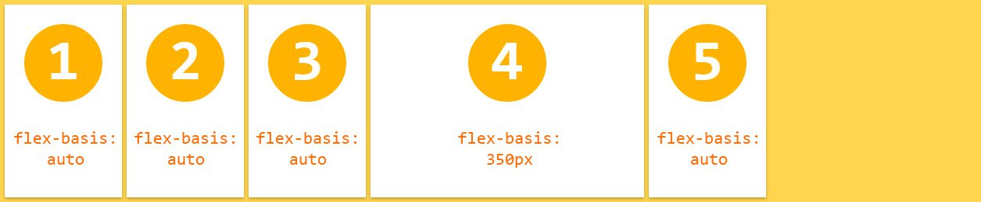
Flex
The flex CSS property is a shorthand property specifying the ability of a flex item to alter its dimensions to fill available space. Flex items can be stretched to use available space proportional to their flex grow factor or their flex shrink factor to prevent overflow.
.flex{flex-grow ,flex-shrink, flex-basis}
flex-grow :
flex-grow :
flex-basis :

Slide 17
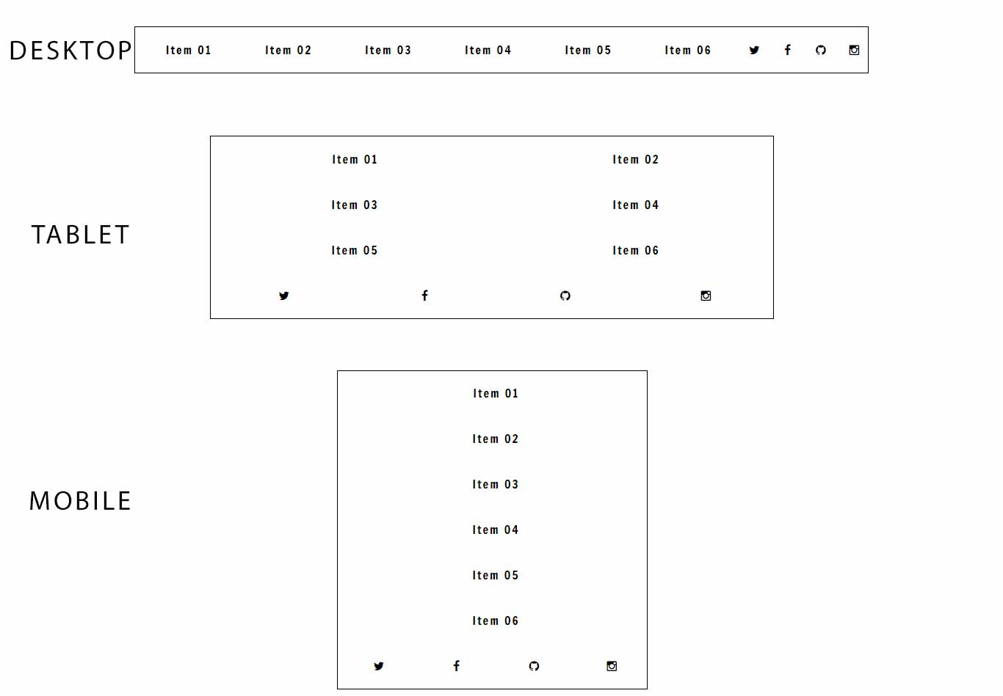
Flexbox, Responsive Menu Example

