Slide 1


Online Shoe Store
MASTER OF COMPUTER APPLICATIONS
Of
Gujarat Technological University (GTU)
Tanvi T. Ajani (1311169007)
Namita M. Rangpadiya (1311169040)
Archana O. Singh (1311169025)
Project Guide
Prof. S. Sathya Franklin
Marwadi Education Foundation’s
Group of Institutions
(MEFGI)
Rajkot, Gujarat.
2014 – 2015

Slide 2
SYNOPSIS
The Project entitled “Online Shoe Store” is a web-based application Software developed in PHP LANGUAGE using Dreamweaver and Browser as front end on Pentium machine.
The main aim of "Online Shoe Store" is to improve the services of Customers and vendors. It maintains the details of customer product receipts, addition of new customers, products and also updating, deletion for the same.

Slide 3
SYNOPSIS
The primary features of the project entitled "Online Shoe Store" are high accuracy, design flexibility and easy availability.

Slide 4
PREAMBLE
Project Description
Use PHP as front end and My SQL as back end. An E- Commerce system integrating latest technologies to read – world development scenarios is made by setting up a full-fledged online shoe store front.
Features :-
User registration
Browsable product
Order management
Easy to use
Easy to use layout

Slide 5
PREAMBLE
Modules included in the project
Front End :-
Home
Categories
Men’s shoes
Women’s shoes
Kid’s shoes

Slide 6
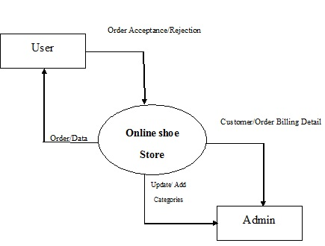
System Design & Development
Context Level Diagram

Slide 7
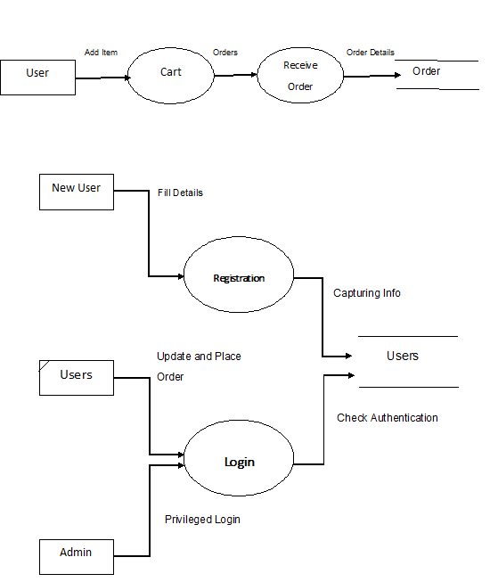
DFD Level-1 Diagram

Slide 8
DFD Level-2 Diagram
Registration
Cart
Management
Login

Slide 9
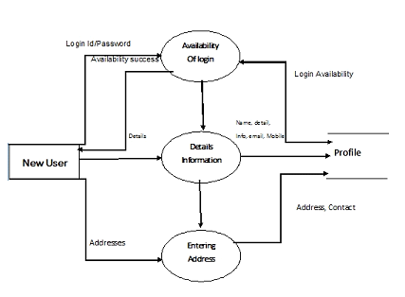
Registration

Slide 10
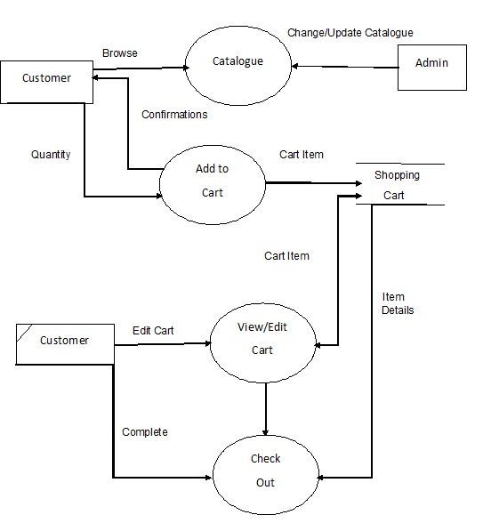
Cart

Slide 11
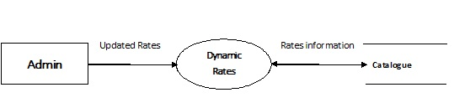
Management

Slide 12
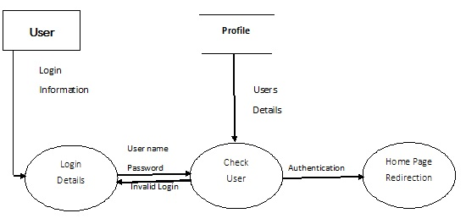
Login

Slide 13
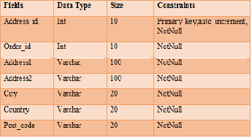
Table Structure
wg_address table :- It Stores Customers Address Id, Order Id, Address, City, Country, Pin Code all Details of customer.

Slide 14
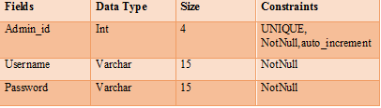
Table Structure
wg_admin table :-It Stores Admin Username and Password for the admin login purpose. Admin give the same username and password he/she can store than and then they can login.

Slide 15
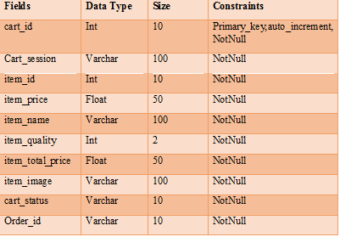
Table Structure
wg_cart table :- It Stores Details of these products that can selected by user. It store cart id, cart session, item id, item price, item name, item quality, item total price, item image, cart status, and order id .

Slide 16
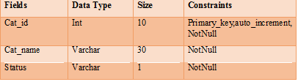
Table Structure
wg_categories table :- It Stores Categories Id, Name, Status for user interaction. And user only See these categories.

Slide 17

Table Structure
wg_cities table :- It Stores Cities name in database that can be entered by user.

Slide 18
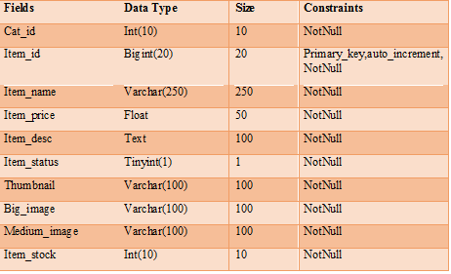
Table Structure
wg_items table :- It Stores items id, name, price, description, status, thumbnail, big image, medium image, Item stock. For user interaction purpose.

Slide 19
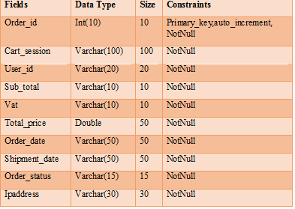
Table Structure
wg_orders table :- It Stores Orders that given by user. It stores Order id, cart session, user id, subtotal, vat, total price, order date, shipment date, order status, IPaddress.

Slide 20
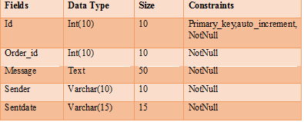
Table Structure
wg_order_messages table :- It Stores Ordered Message that can send by user. It stores order id, message, sender ip, sent date all data are stored in database.

Slide 21
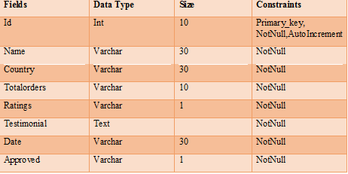
Table Structure
wg_testimonials table :- It Stores testimonials or feedback for our web site that can give by user. All details of user id, name, country, total orders, Rating, testimonial, date, approved are stored.

Slide 22
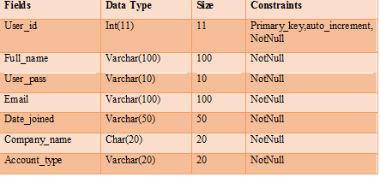
Table Structure
wg_users table :- It Stores users is, full name, User password, Email, Date for joined these account, Company name, Account Type.

Slide 23
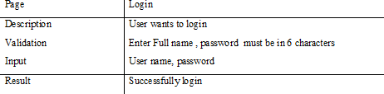
SYSTEM TESTING
Test Case - 1

Slide 24
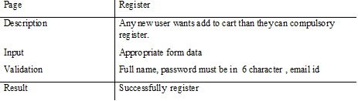
SYSTEM TESTING
Test Case – 2

Slide 25
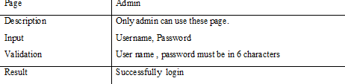
SYSTEM TESTING
Test Case – 3

Slide 26
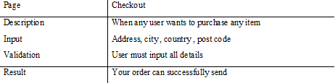
SYSTEM TESTING
Test Case – 4

Slide 27
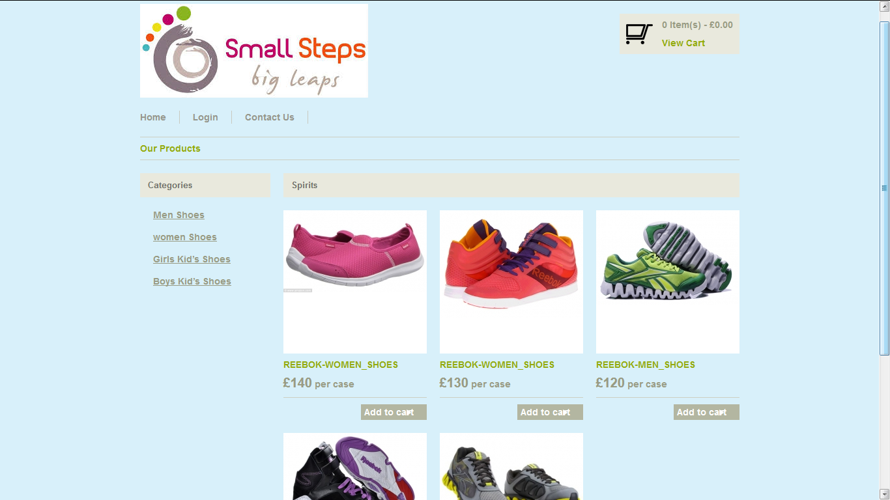
SCREENSHOTS
Home Page:- This page is Home Page. And it display different links of the Shoes details and also give information about project user can easily interact with our web site.

Slide 28
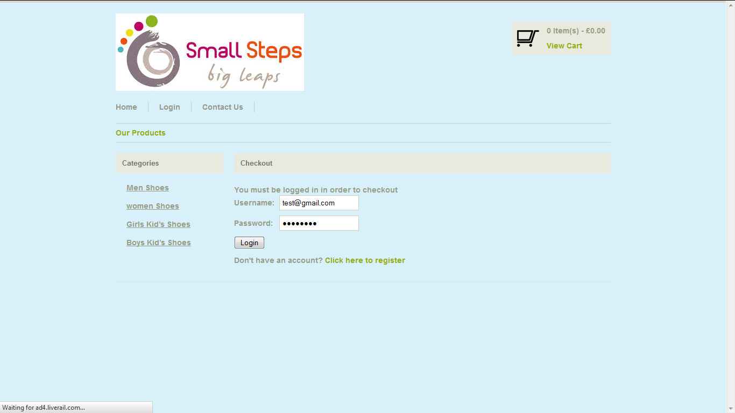
Login Page:- In this page user can login, when user wants to purchase any product then user must login first.

Slide 29
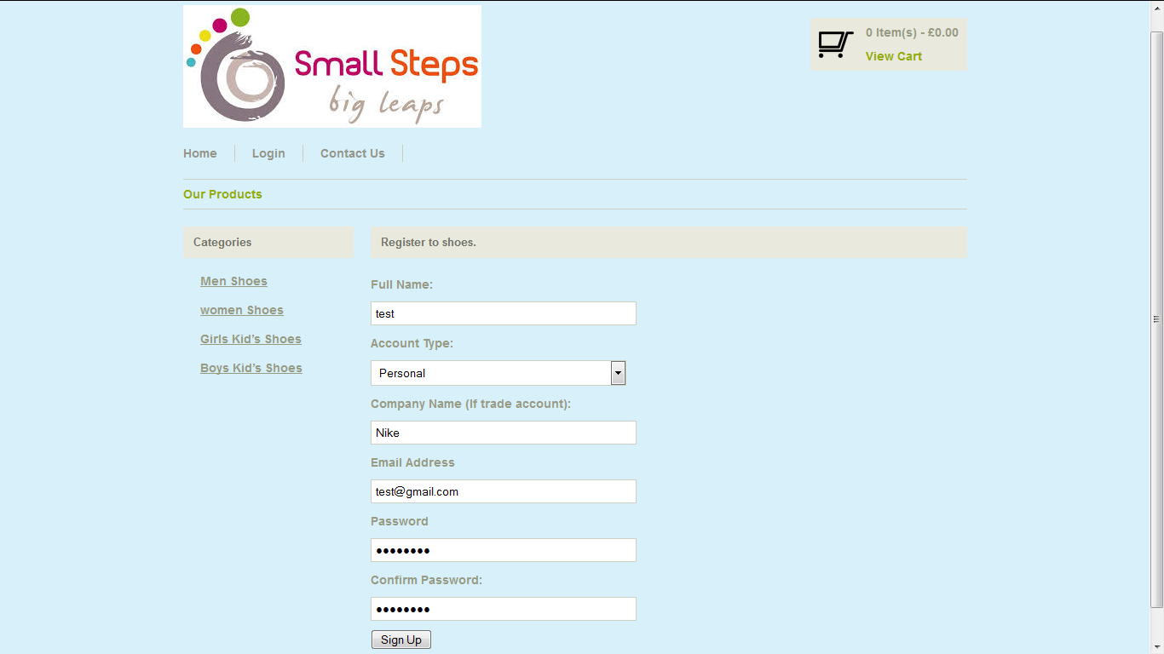
Registration Page:- When user wants to purchase and add to cart the product then they can register.

Slide 30
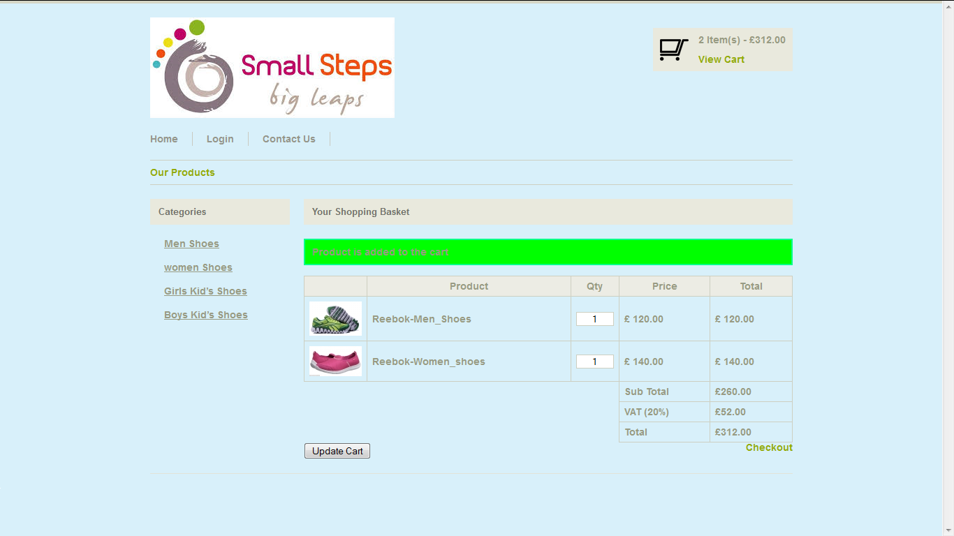
Add to Cart :- User wants to purchase any product then user can add those products to cart.

Slide 31
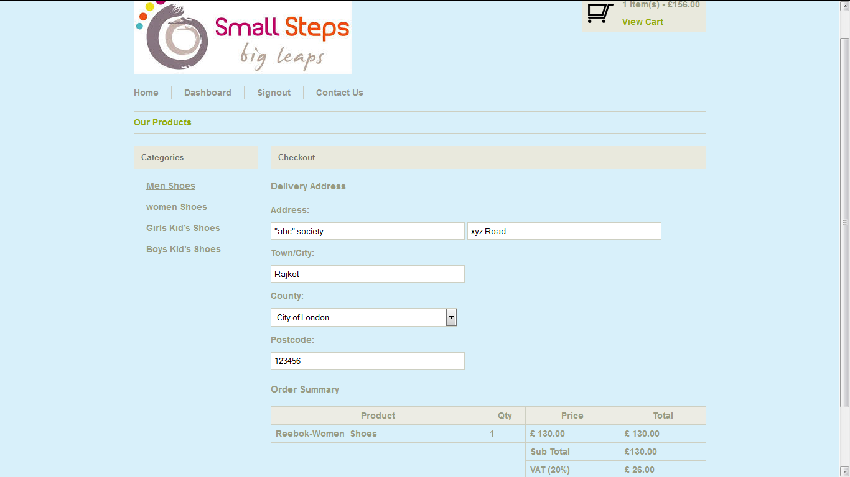
Checkout Page:- When user wants to purchase and add to cart the product then they can checkout and must login and enter Delivery Address.

Slide 32
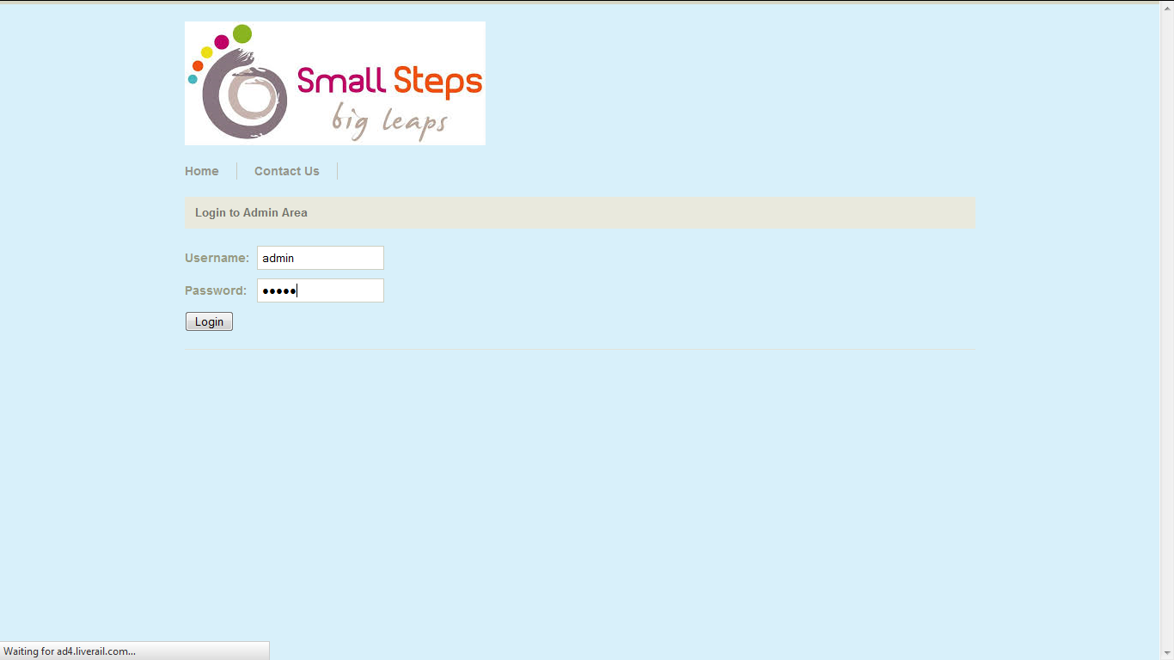
Admin Login Page :- Admin can login using this page.

Slide 33
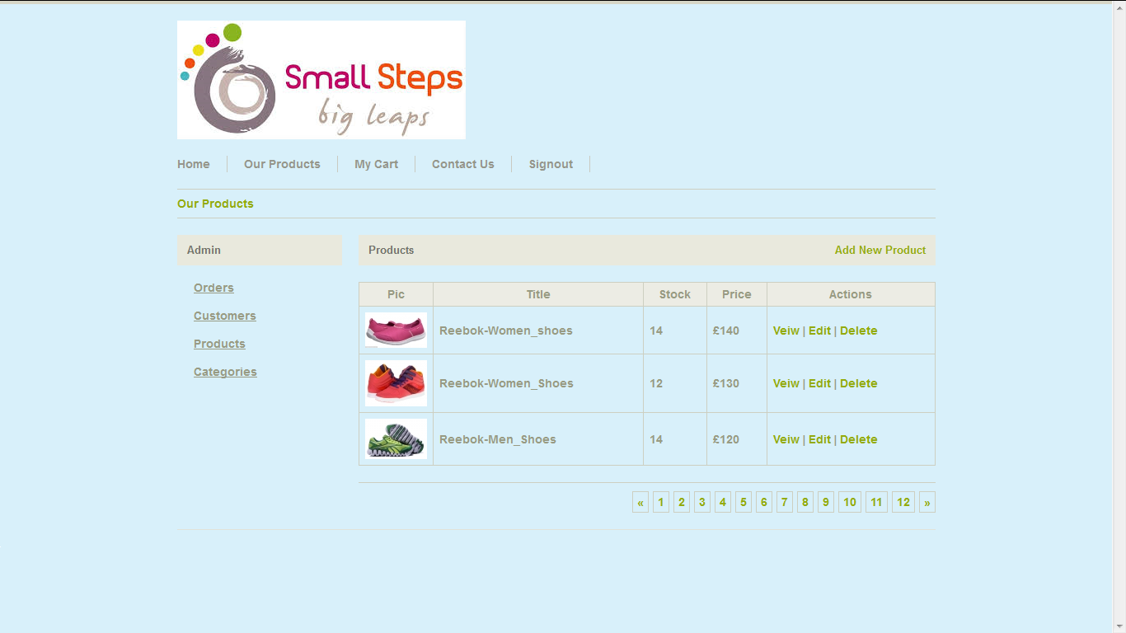
Product (Edit, Delete, View) :- Admin can Edit, Delete, View the all products in this page.

Slide 34
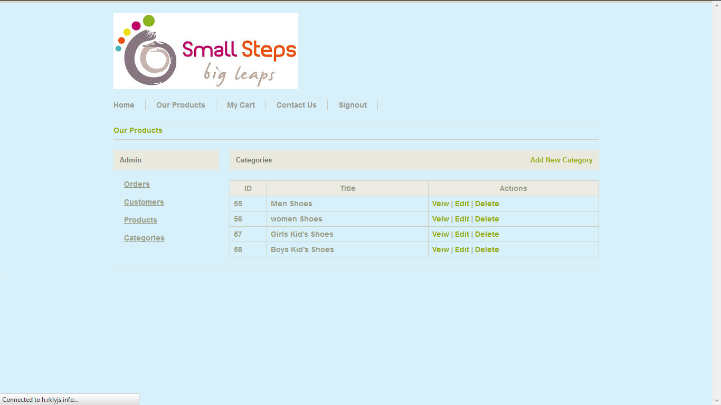
Categories (View, Edit, Delete):- Admin can Edit, Delete, View the all categories in these page.

Slide 35
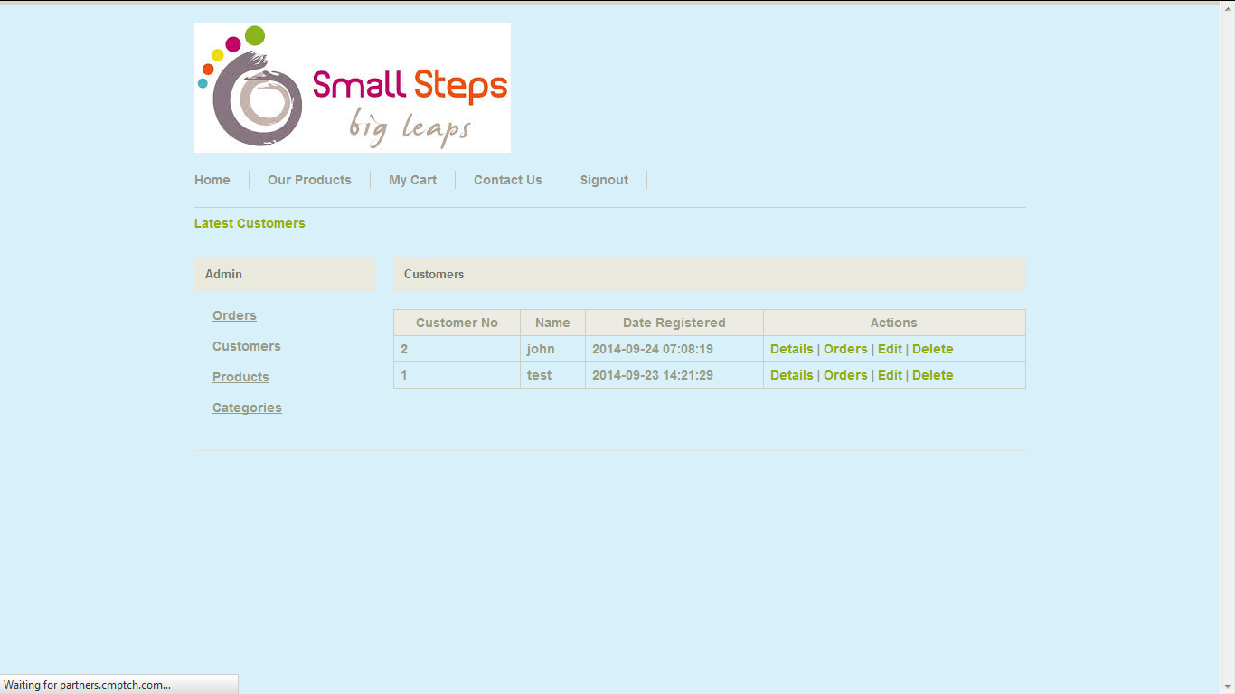
Customers (Details, Orders, Edit, Delete):- Admin can view orders ,details, edit ,delete customer.

Slide 36
Conclusion
The system is very easy to understand. Anyone can work with it. There is no for a person to have much more knowledge of computer.
System has not been using any kind of bound controls, so no change is required to work from one system to another system.
Web Sites : www.OnlineShoeStore.com

Slide 37
Thank You

